Slide 1
SILICO TOXICOSIS
PROFESSOR DR.J.SANGUMANI M.D.,D.Diab
ASST. PROFESSORS
DR.R.SUNDARAM M.D.,
DR.K.S.RAGHAVAN M.D.,

Slide 2
40 yrs old male came with complaints of
Breathlessness x 1 yr aggravated
1 week
Sudden onset
MRC grade – I
Relieved by rest
No postural/diurnal variation

Slide 3
H/o diffuse left sided chest pain increased on coughing
H/o dry cough x 1 week
H/o weight loss
No H/o fever
No H/o loss of appetite
No H/o orthopnea/PND
No H/o reduced urine output/abd distension

Slide 4
No H/o trauma
No H/o blood on coughing
No H/o palpitations
No H/o diaphoresis/giddiness/vomiting
No H/o hoarseness of voice

Slide 5
PAST HISTORY
Not a known case of
Diabetes
Hypertension/CAD/COPD
Asthma
Tuberculosis
Thyroid disorder
Heart disease
Epilepsy

Slide 6
PERSONAL HISTORY
Not a smoker/alcoholic
Takes veg & non veg diet
No bowel bladder disturbance
No H/o similar illness in family members
Married has a son
FAMILY HISTORY

Slide 7
OCCUPATIONAL HISTORY
WORKED AS A STONE QUARRY WORKER FOR 6 YRS

Slide 8
GENERAL EXAMINATION
Conscious
Oriented
No pallor
No cyanosis
No clubbing
No icterus
No generalized lymphadenopathy
No pedal edema

Slide 9
No external markers of tuberculosis
PROPTOSIS
STARING LOOK
LID LAG SIGN
FINE TREMORS +

Slide 10
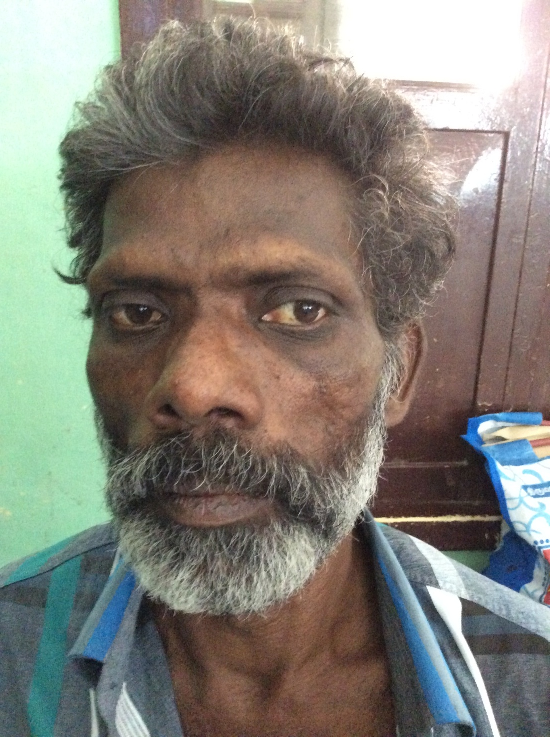

Slide 11
VITALS
Pulse
116/min
Regular
Normal volume
Felt equally in all accesible peripheral vessels
No radioradial /radio femoral delay
Conditionn of vessel wall normal
BP – 140/90mmhg
SpO2-97% in room air
Resp.rate – 22/min
Sleeping pulse rate – 106/min

Slide 12
RESPIRATORY SYSTEM
INSPECTION
Trachea seems to be slightly shifted to right side
Chest wall symmetrical /no spine deformities
Apical impulse normal in position
No scar/sinus
No visible pulsations

Slide 13
RESPIRATORY SYSTEM
PALPATION
INSPECTORY FIDINGS CONFIRMED
Chest wall measurements equal on both sides and normal chest expansion
No tactile fremitus

Slide 14
RESPIRATORY SYSTEM
PERUSSION - Resonant in all areas
sternal percussion resonant
AUSCULTATION
Bilateral crackles

Slide 15
Other system examination
CVS – s1 s2 present
no murmur
jvp not elevated
Abdomen – Soft no organomegaly
bowel sounds present
CNS - conscious oriented
B/L pupil 3 mm Reacting to light
no focal neurological deficit

Slide 16
Local examination of neck
Diffuse swelling of thyroid gland present
No warmth
No tenderness
No bruit
No significant cervical nodes palpable

Slide 17
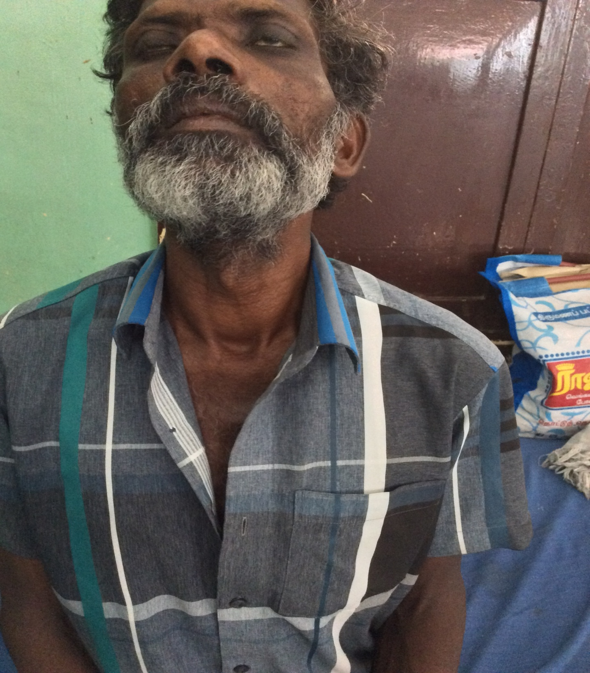

Slide 18
PROVISIONAL DIAGNOSIS
? Pulmonary tuberculosis
Hyperthyroidism/? Grave’s disease

Slide 19
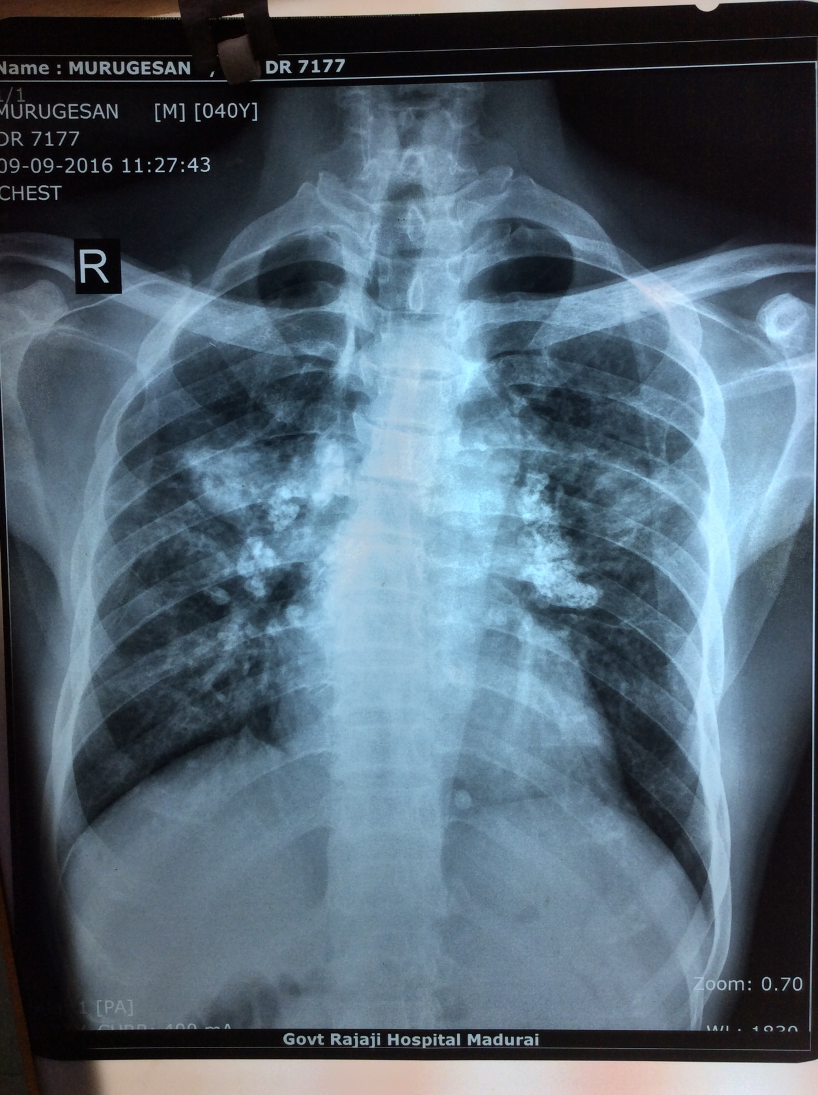
Chest x ray

Slide 20
BILATERAL HILAR CALCIFICATION
TUBERCULOSIS
SILICOSIS
SARCOIDOSIS

Slide 21
Blood investigations
Hb – 11.7 gms
TC – 10,600 cell/mm3
Differential – P41 L46 M13
Platelets – 2.68 lakhs/mm3
ESR – 23mm/ hr
PCV – 34%

Slide 22
Rbs – 87 mg/dl
Urea – 31mg/dl
Creatinine – 0.9mg/dl
LFT – wnl
Sr.proteins total – 5.3g/dl albumin – 2.3g/dl
CRP – negative
Echo - normal study
SERUM CALCIUM - 7.8 mg /dl
CORRECTED SR. CALCIUM – 9.16 mg/dl

Slide 23
THORACIC PHYSICIAN OPINION
? EGG SHELL CALCIFICATION
?TUBERCULOSIS
?SILICOSIS
Adviced CT CHEST
Sputum AFB – NEGATIVE
BAL – GENE EXPERT NEGATIVE FOR MTB
GRAM STAINING – negative
NO ACID FAST BACILLI

Slide 24
CT CHEST

Slide 28
CT CHEST

Slide 29
CT CHEST
Bilateral hilar node calcification
Plaque like fibrotic strands in bilateral upper lobe
Ground glass opacity in bilateral upper and middle lobe
Silicosis to be considered

Slide 30
THYROID PROFILE
Total T4 - 23.98 mg/dl
TSH - 0.001 IU/ml
ANTI TPO ANTIBODY – POSITIVE IN 1:640 TITRE
USG NECK - THYROIDITIS

Slide 31
ENDOCRINOLOGIST OPINION
HYPERTHYROIDISM
Adv to start-
T .carbimazole 5 mg 1-1-1
T.propranolol 40mg 1-0-1

Slide 32
Quarry worker
x 6 yrs
Bilateral hilar calcification
Ground glass opacity in upper lobes
Autoimmune thyroiditis
Silico toxicosis

