Slide 1
JOURNAL CLUB 3rd MEDICAL UNIT
CHIEF: PROF.DR.K.SENTHIL MD.,
ASSISTANT PROFESSORS:
DR.MANIKANDAN MD.,
DR.SARAVANA MADHAV MD.,
DR.ILAMARAN MD.,DM.,
PRESENTOR:
DR.RANJITH M (1ST YEAR PG)

Slide 2
EARLY NEUROLOGICAL DETORIATION(END)
Early neurological deterioration (END) refers to the decline in neurological function that occurs within a few hours or days of the onset of acute ischemic stroke.
It is defined as an increase of >/= 2 points in total National Institutes of Health Stroke Scale (NIHSS) score or >/= 1 point in the motor items of the NIHSS within 7 days after admission.
It may be attributed to thrombus extension,hemodynamic compromise and incomplete response to the antiplatelet therapy.

Slide 3
END was observed in approximately one in seven patients hospitalized with AIS.
The highest incidence of END occurred within 24 h of admission and decreased steeply as time progressed.
Older age, BMI, WHR, SBP, baseline NIHSS, neutrophil, uric acid, and TG levels, lower lymphocyte count, history of diabetes mellitus and atrial fibrillation, and infarct location in the lenticulostriate artery area and cerebral watershed were predictive of END
END was associated with a risk of poor outcome at 3 months in patients with AIS.

Slide 4
One in seven patients with END who received standard antiplatelet therapy died within 3 months of treatment.
There have been no large sample studies demonstating effective treatment for patient with END

Slide 5
Efficacy of Argatroban in acute ischemic Stroke with Early neurological detoriation (EASE) :A prospective,randomised,open-lable,blinded-end point,multi-centre trial

Slide 6
HYPOTHESIS:
Hypothesis tested is Argatroban plus the standard therapy will be superior to standard therapy alone in improving the functional outcomes in AIS patients with END.

Slide 7
OBJECTIVES OF THE TRIAL:
Primary objective: To test the hypothesis that the argatroban plus standard therapy will be superior to standard therapy alone in improving good functional outcomes in AIS patients with END.
Secondary outcome:1.To determine the proportion of favourable functional outcome at 90 days by treatment group.
2. Recovery assessed by categorical shift in mRS at 90 days
3. National Institutes of Health stroke scale (NIHSS) score at 7 days and 90±3 days after randomization
4. The rate of composite cardiovascular events at 90±3 days, including cerebrovascular events, myocardial infarction, angina pectoris and systemic embolism.
5. Barthel scale score at 90±3 days.

Slide 8
TRIAL DESIGN
Prospective
Randomized
Open-label,
Blinded-endpoint
Multicentre trial
TRIAL POPULATION
Adults older than18yearswith AIS within 48 hours and experienced END with an increase of 2 or more points on the total National Institutes of Health Stroke Scale
TRIAL PERIOD
The trial was conducted from April 4, 2020,through July31,2022.The date of final follow-up was October31, 2022.

Slide 9
Age >18 years
Patients presented with clinical signs of acute ischemic stroke with 48 hours of stroke onset (for stroke with unknown time of onset, the midpoint of the time last known to be well and symptom recognition time
Early neurological deterioration with National Institutes of Health Stroke Scale score ≥2 increase within 48 hours after stroke onset
Informed consent from patient/ family member
INCLUSION CRITERIA

Slide 10
Cardiogenic cerebral embolism, patients with any definite source of cardiac embolism,chronic or paroxysmal atrial fibrillation, sick sinus syndrome, mitral stenosis, mechanical valve, endocarditis, intracardiac clot or vegetation, myocardial infarction within three months, dilated cardiomyopathy, left atrial spontaneous echo contrast, ejection fraction less than 30%.
Intracranial hemorrhage or lesions larger than two thirds of the territory of the middle cerebral artery shown on CT
Pre-stroke mRS score of > 1
Contraindication for argatraban
EXCLUSION CRITERIA

Slide 11
Current treatment with tirofiban
Severe heart, liver or kidney dysfunction, defined as left ventricular ejection fraction <40%; glutamic-pyruvic transaminase or glutamic oxalacetic transaminase increased to three times 164 of the upper limit of normal; creatinine clearance < 30ml/min
Severe disease with a life expectancy of less than 3 months
Any condition that could impose hazards to the patient if study therapy is initiated
EXCLUSION CRITERIA

Slide 12
SAMPLE SIZE:
The sample size was estimated according to the results of the previous observational cohort at the study center, with 33 patients in the experimental group and 66 patients in the control group.
There were no significant differences in age and NIHSS score (baseline and progressive time), and the proportion of patients with an mRS score of 0 to 3 at day 90 in the experimental group and the control group was 80%and69.6%,respectively.
Based on 0.8 power to detect a significant difference (2-sided P = .05)and to compensate for non evaluable patients of 15%,a total sample size of upto 630 patients would be required.

Slide 13
RANDOMIZATION:
Patients were randomly assigned to either treatment or control arms using a secure, web-based randomization system.
The randomization algorithm uses biased-coin minimization and the variance method with stratification weights.
The strategy was to balance treatment assignment along the marginal distribution of each stratification factor. The stratification factors used and their hierarchy were as follows: (1) age, (2) sex, and (3) NIHSS score at randomization.
Patients and treating physicians were not blinded to treatment assignment, but study outcomes assessors were blinded to treatment assignment.

Slide 14
INTERVENTIONS:
Patients were randomly assigned to the argatroban group and control group within 48 hours of symptom onset.
Both groups received standard therapy based on guidelines, including oral mono or dual antiplatelet therapy
ARGATROBAN GROUP
314 patients were randomized
Intravenous argatroban for 7days-continuous infusion at a dose of 60mg per day for 2 days,followed by 20mg per day for 5 days
+
standard therapy
CCONTROL GROUP
314 patients were randomized
Received standard therapy

Slide 15
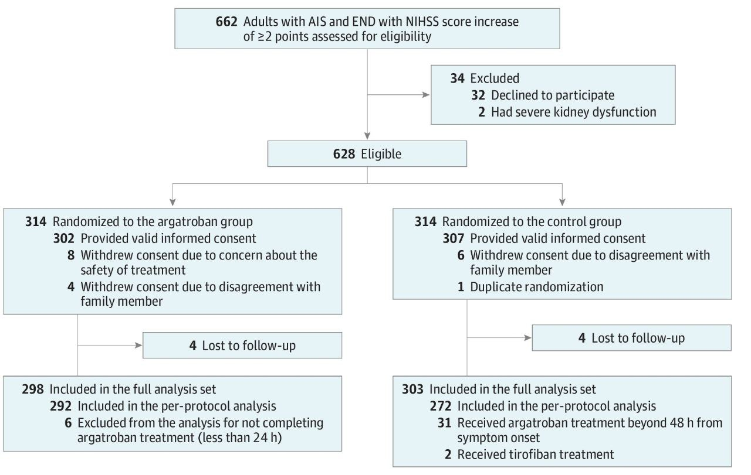

Slide 16
OUTCOMES:
Primary outcome:The primary end point was good functional outcome at 90 days, defined as a score of 0 to 3 on the modified Rankin Scale (mRS) for the evaluation of neurological disability, through a structured interview for telephone assessment by personnel certified in the scoring of the mRS 90 days after randomization

Slide 17
SECONDARY OUTCOMES
Favorable functional outcome(mRS score of 0-2) at 90 days
Recovery assessed by categorical shift in mRS at 90 days
NIHSS score at 7 days and 90 ±3days after randomization
Barthel scale score at 90 ± 3 days
The rate of composite cardiovascular events at 90 ± 3 days, including cerebrovascular events, myocardial infarction, angina pectoris, and systemic embolism.

Slide 18
STATISTICAL ANALYSIS:
The modified intention-to-treat analyses were performed on the full analysis set,which included all patients who received atleast 1 study protocol treatment and atleast 1 efficacy evaluation after baseline.
Generalized linear models(GLMs) were performed for the analyses of the primary and secondary outcomes of good functional outcome at 90 days,favorable functional outcome at 90 days,NIHSS score at 90 days,Barthel scale score at 90 days, and stroke or other vascular events within 90 days.
The treatment effects for these outcomes are presented as risk ratios (RRs) and risk differences (RDs) with their 95% CIs.

Slide 19
RESULTS

Slide 21
The percentage of patients with mRS scores of 0 to 3 at 90 days was 80.5% (240 of 298) in the argatroban group and 73.3% (222 of 303) in the control group.
In the full analysis set population,the risk of having a good outcome showed a significant difference between the argatroban and control groups

Slide 22
Significant differences were observed in the secondary outcomes of the mRS score distribution at 90days in both the unadjusted and adjusted analysis.
No significant differences were observed in the other secondary outcomes,including the rate of having an mRS score of 0 to 2,NIHSS score at 90days,Barthel scale score at 90 days,and stroke or other vascular events within 90days.

Slide 23
A prespecified subgroup analysis demonstrated a potentially stronger effect of argatroban among female patients (argatroban vs control:female, 81.7%[89of109] vs65.5%[72 of 110]; male, 79.9% [151 of 189] vs 77.7% [150 of 193]; interaction P=0.046
Other subgroup analysis showed characteristics, such as age, NIHSS score at randomization reperfusion therapy,and time from the onset of symptom to randomization, did not have a significant impactvon the effectiveness of the intervention of argatroban in reducing the risks of the primary outcome.

Slide 24
ADVERSE EFFECTS

Slide 25
This randomized clinical trial shows that the combination of argatroban and antiplatelet therapy resulted in a significantly greater likelihood of good functional outcome at 90 days in patients with END after AIS, with no additional risk of major intracranial or extracranial hemorrhage.

Slide 26
Argatroban is a direct thrombin inhibitor,which is rapid acting, short acting, and has low bleeding rates, which is useful in preventing thrombus propagation and providing additional benefit after stroke/TIA.
Thrombin inhibition by argatroban also prevents injury to the vascular endothelium,thus facilitating endogenous plasminogen activator production,Preventing clot formation.

Slide 27
CRITICAL APPRAISAL:
Does this study address a relevant, focused research question?
Yes,this study shows that combination of argatroban and antiplatelet therapy resulted in a significantly greater likelihood of good functional outcome at 90 days in patients with END after AIS,
Was assignment of participants to intervention randomised?
Eligible patients were assigned in a 1:1 ratio by centralized computer randomization Did each study group received same level of care were treated equally? Baseline characteristics were similar in both groups were treated equally

Slide 28
Does the novelity of the study pertain to current crisis in need?
Yes
Is the study generalisable?
Further reseasrch needed.

Slide 29
LIMITATIONS
There were more crossover patients in the control group than in the argatroban group, primarily due to the open-label design, which may have biased the study; although, the per-protocol analysis yielded similar results to the full analysis.
The current investigation did not conceal the allocated treatment from the participants and physicians because of the openlabel design. Nevertheless, blinded–end point assessments were used to mitigate measurement bias and guarantee objective measurement of the primary end point.
Further confirmation of these conclusions in non-Chinese populations would be welcome, considering the variations in comorbidities and etiology among patients with AIS.

Slide 30
THANK YOU

