Slide 1
Physcon
By first medical unit
Chief : prof dr.m.Natarajan md
Asst prof:Dr.palani kumaran md d.diab
Dr.vasanthakalyani md dcp
Dr.sureshkumar md
Dr Vignesh md

Slide 2
Hypochromic hypertension

Slide 3
history
20 yr old male who is k/c/o thalassemia major who is on regular blood transfusion came with c/o
Breathlessness of nyha class 2 dyspnea for 3 days
Dry cough for 2 days which get aggravated on lying down
c/o b/l swelling of lower limb +
H/O ORTHOPNEA +, NO PND
No h/o chest pain ,palpitation and syncope
No h/o hemoptysis
h/o loss of appetite + ,early satiety +
h/o abdominal distension +

Slide 4
Past h/o
Not a k/c/o diabetes /SHTN / BRONCHIAL ASTHMA /EPILEPSY /CAD /CVA
PREVIOUS BLOOD TRANSFUSION WAS DONE 10 DAYS BEFORE ADMISSION
PT WAS ON IRON CHELATORS THERAPY ( tab desferroxime 400 mg bd )
Personal h/o
Not a smoker /alcoholic
Normal bowel and bladder habits
Pt born out of second degree consanguineous marriage

Slide 5
general examination
Concious ,oriented ,.afebrile
Pallor + ,icterus + ,cyanosis ,clubbing ,pedal edema + ( b/l pitting )
Generalised hyperpigmentation + /frontal bossing ? Chipmunk facies +
Atropic glossitis / dry skin + /no secondary sexual character development
No bony tenderness / no generalized lymphadenopathy

Slide 6
Systemic examination
Cvs : s1s2 + ,esm + over pulmonary area with loud p2 +
Rs : b/l ae + ,no added sounds
p/a : soft ,bs +
massive splenomegaly + crossing the umbilicus
hepatomegaly 6 cm below rcm /no free fluid clinically
Cns : nfnd

Slide 7
Investigation
Initially before transfusion
Wbc : 3100 cells /mm3
Rbc : 2,26 million
Hb : 5.5 gm%
Plt : 35000 /mm3
Mcv : 73 fl
Mch : 24 .3 pg
Mchc : 33.3 g/dl
Dc : 73 /23 / 4
Rdw –sd : `49.1 fl
Rdw – cv : 18.2 %
After 1 packed cell transfusion
Wbc : 1600 cells /mm3
Hb : 7.0 gram %
Dc : 39/50 /11
Plateletcount : 44000
Urine routine
Alb : nil
Sugar : trace
Deposit : 2-8 pus cell ,no rbc seen
Bile salt and pigment : positive

Slide 8
Rbs : 186 mg /dl
Urea / creatinine : 51/0.8
Bilirubin (T) : 2.1 mg/dl
Direct bil : 1.1 mg/dl
Indirecr bil : 1.0 mg/dl
Sgot : 148 u/l
Sgpt : 76 u/l
Alp : 191 u/l
Na : 132 meq/l
K : 3.9 meq /l
Serum TSH level : 3.45 HIU /ML
EUTHYROID STATE
VCTC –NON REACTIVER
HBS AG : NEGATIVE
ANTI HVC : REACTIVE
SERUM .FERITTIN : 535 NG /ML ( 2O -250 NG/ML

Slide 9
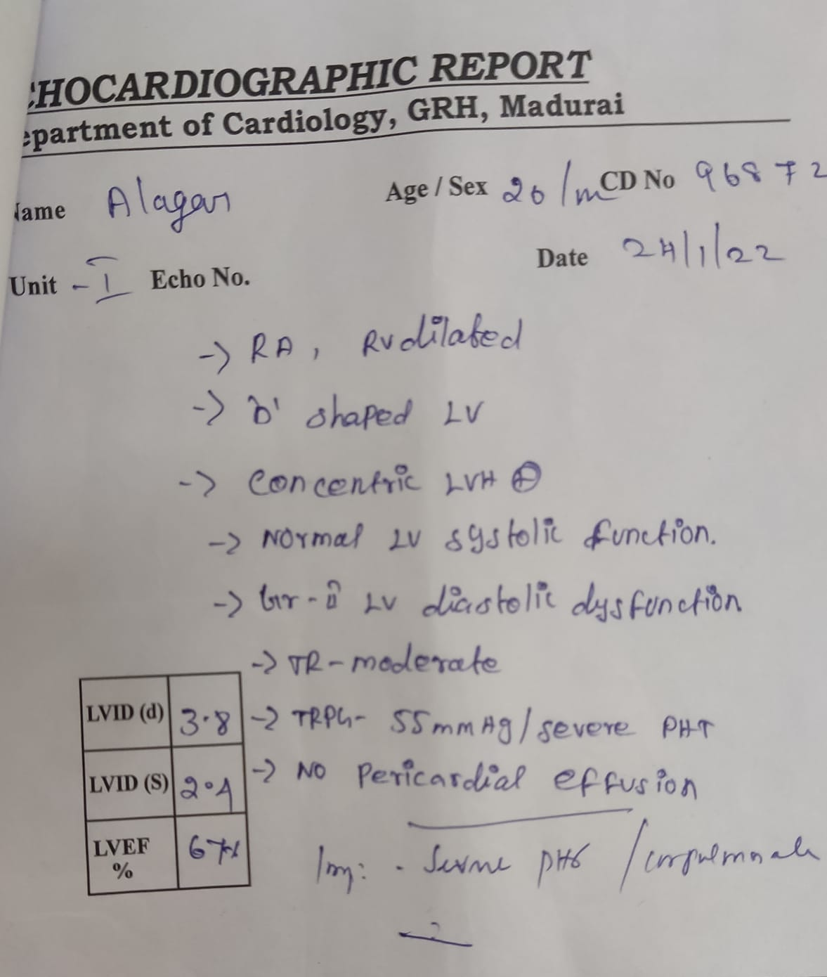
ECHO

Slide 10
TREATMENT GIVEN
1 UNIT OF PACKED CELL RBC
INJ LASIX 20 MG BD IV
TAB .SPIRONOLACTONE 25 MD 1 OD
TAB . DESFEROXAMINE 400 MG BD
TAB FOLIC ACID 5 MG OD

Slide 11
THEN THE TRAGIC PHASE
PT SUDDENLY DEVELOPED NASAL BLEED AND EAR BLEED SPONTANEOUSLY AND THEN PATIENT WAS TREATED WITH INJ TRAnexamic acid infusion and 2 unit of platelet and ffp each
And pt went into hypotension and pt was started on inotropic support and transfused with blood and pt could not be saved

Slide 12
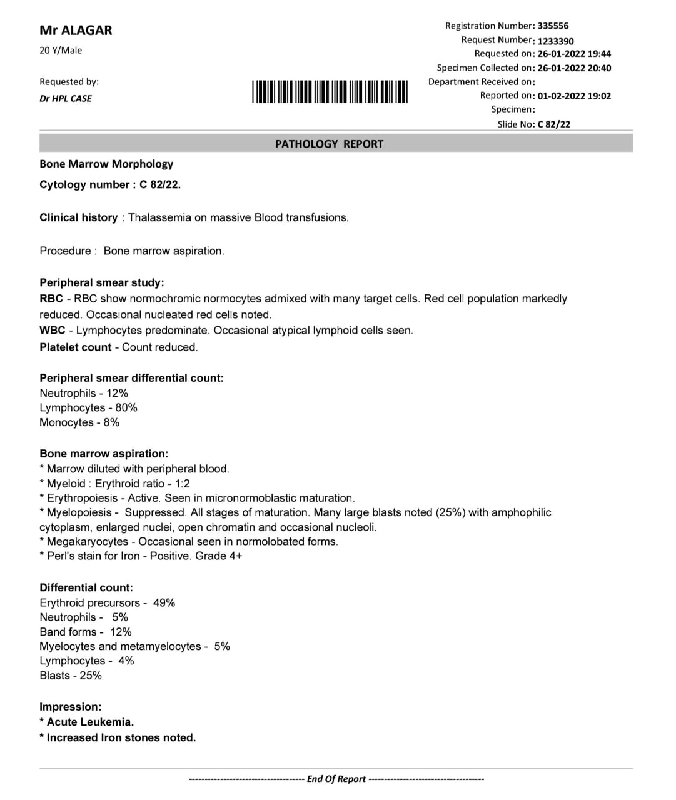
SURPRISED

