Slide 1
TREATMENT OF RHEUMATOID ARTHRITIS
Chief: Prof. Dr. R.Sundaram, M.D.,
Asst. Professors: Dr.S.Sugadev, M.D.,
Dr.P.Krishnarajan, M.D.,
Presenter - Dr.G.Preethi
(3rd year Post graduate)

Slide 2
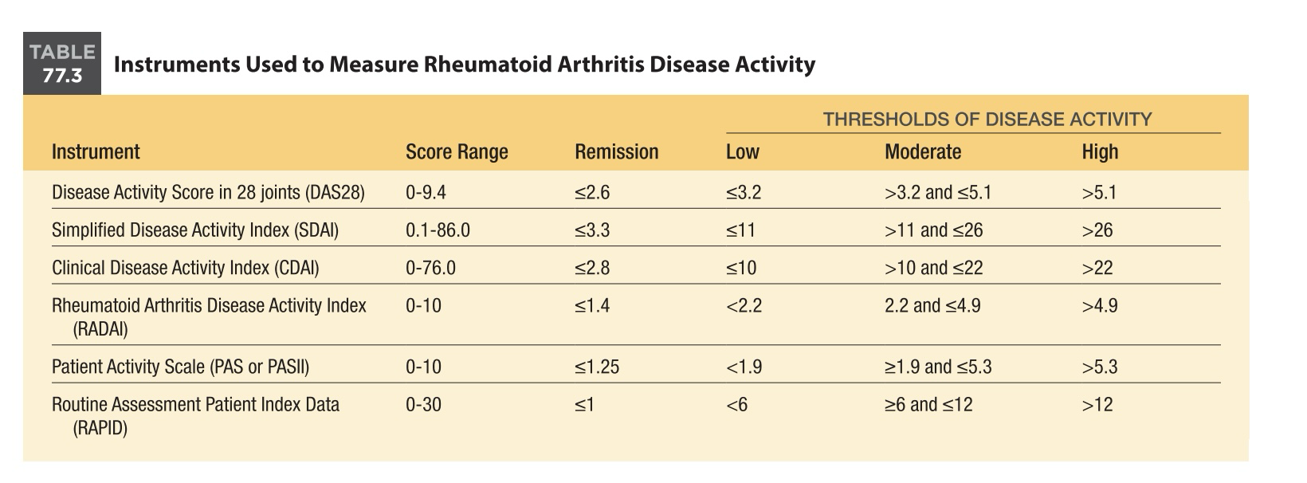
TREATMENT
Treat to target
*start early DMARDS
*to achieve low disease activity or remission

Slide 3
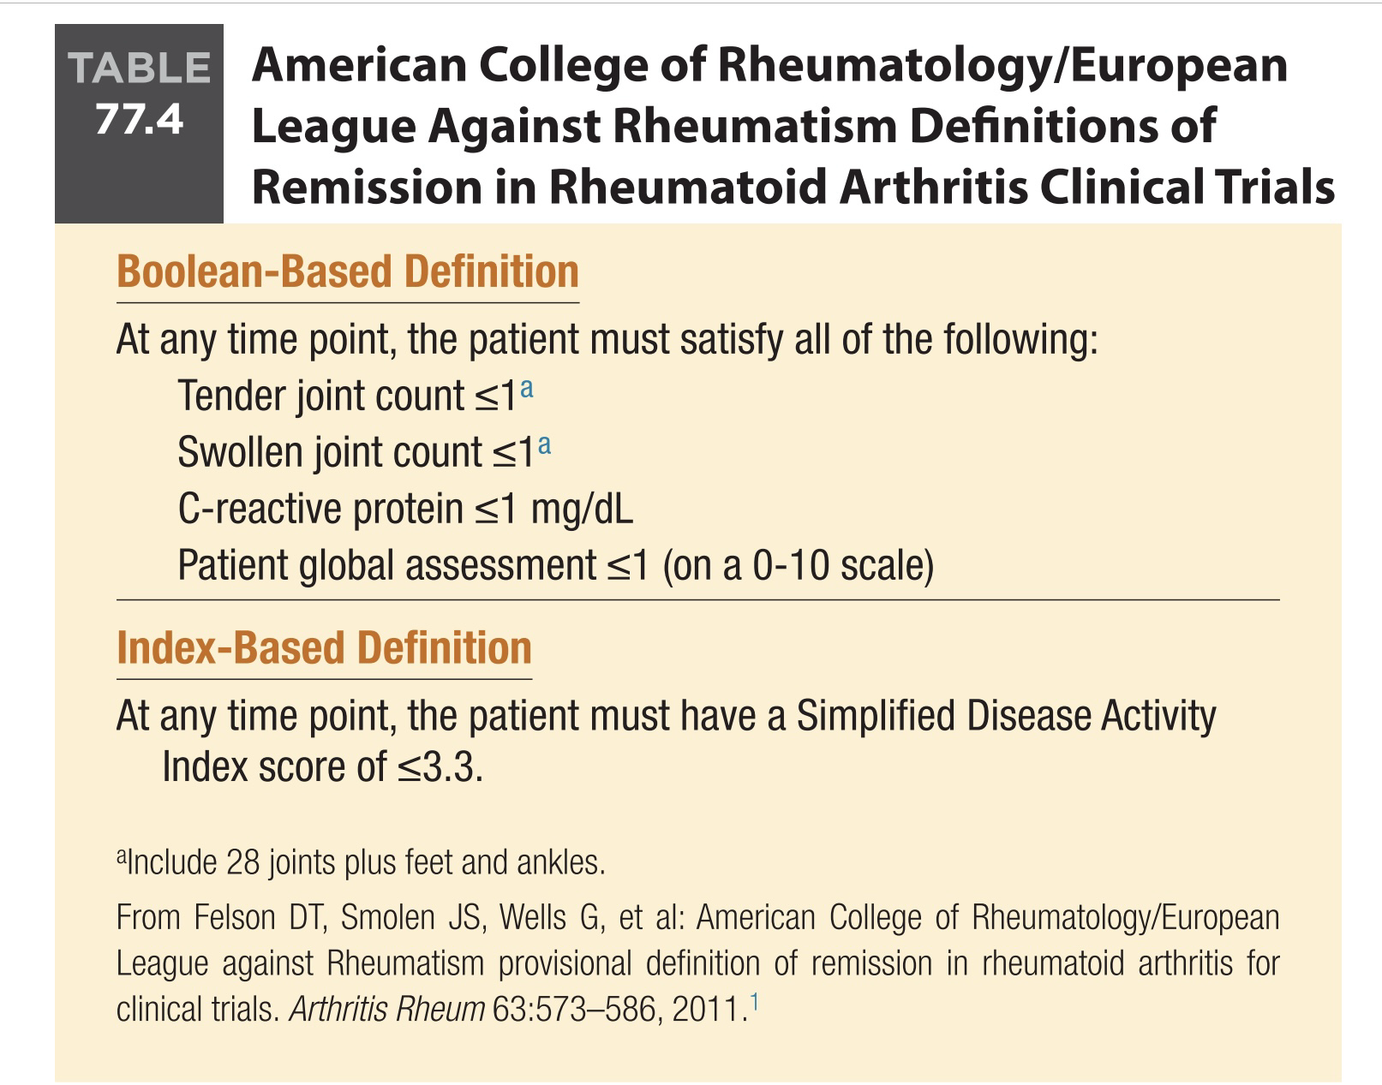
DRUGS:
STEROID REVOLUTION(1950)
DMARDS – conventional
Biologicals

Slide 4
Glucocorticoids
Used in severe flares, extra articular manifestations, bridging therapy for DMARDS.
*Classification of Glucocorticoid Dosages
Low dose ≤7.5 mg prednisone equivalents per day
Medium dose >7.5 mg and ≤30 mg prednisone equivalents per day
High dose >30 mg and ≤100 mg prednisone equivalents per day
Very high dose >100 mg prednisone equivalents per day
Pulse therapy: ≥250 mg prednisone equivalents per day for 1 day or a few days

Slide 5
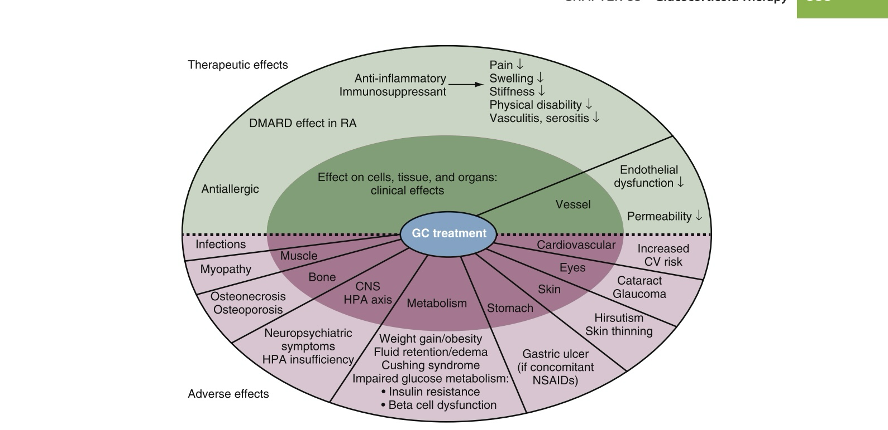

Slide 6
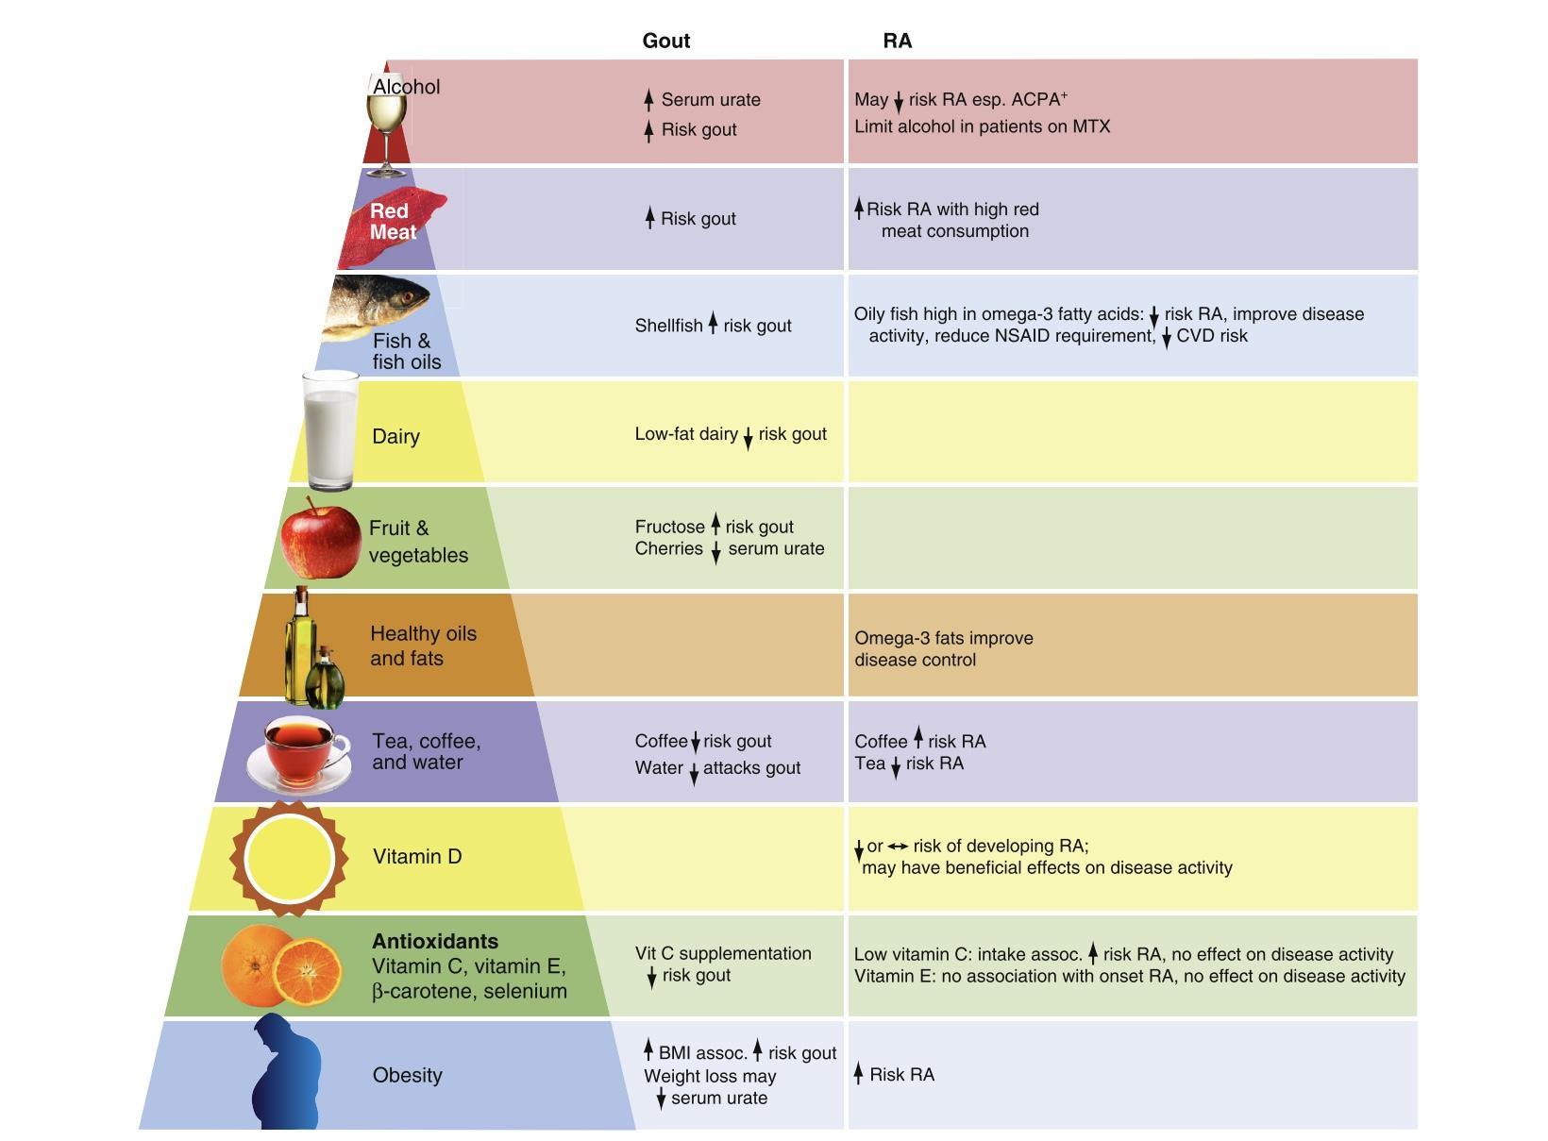

Slide 7
Disease Modifying Anti-Rheumatic Drugs-DMARDS
Slows down structural progression of rheumatoid arthritis
CONVENTIONAL DMARDS BIOLOGICALS
Hydroxycholoroquine 1)TNF alpha inhibitors
Methotrexate 2)Abatacept
Sulfasalazine 3)Anakinra
Leflunomide 4)Rituximab
5)IL 6 inhibitors
6)JAK inhibitors

Slide 8
Hydroxychoroquine:
Mechanism of action - ↑ pH of subcellular vesicles→Interference with Ag processing and cell-mediated cytotoxicity. Blocks TLR binding to nucleic acid to down regulate pro-inflammatory cytokine production.
Dose-200 to 400 mg/day orally. Safe dose <5 mg/kg
Side effects- Retinopathy(Bull's eye maculopathy
* Safe in pregnancy and lactation
Monitoring by optic coherence test

Slide 9
Mechanism of action-Inhibition of ATIC→↑ Adenosine Inhibition of TYMS→↓ Pyrimidine synthesis Inhibition of
DHFR→↓ Transmethylation reaction.
patients with normal renal function, the starting dose is usually 15 mg given as a single weekly dose, with a range of 5 to 25 mg weekly, and initiation with parenteral route for improved efficacy.
If the oral dose of MTX exceeds 15 mg, split the dose, with each half given 6 to 12 hours apart, for improved absorption and bioavailability.
Parental MTX is given approximately 20 mg weekly.
In elder people, initial doses should be approximately 5 to 7.5 mg/ week and should not exceed 20 mg/wk.
METHOTREXATE:

Slide 10
Side effects-Hepatotoxicity, myelosuppression, infections, oral ulcers, alopecia.
Contraindications-Active infection, symptomatic pulmonary disease, WBC
<3000/mm3, Plt <50,000/mL3, CrCl <30 mL/min, history of myelodysplasia or
recent lymphoproliferative disorder, LFT >2 × ULN, acute or chronic HBV or
HCV,pregnancy, lactation

Slide 11
Leflunomide
Mechanism of Action:
Leflunomide is immunomodulatory, with the net effect being a reduction in activated T lymphocytes.
Its two in vitro mechanisms of action vary depending on concentration:
(1) At the concentration of the active metabolite cause reversible inhibition of the enzyme dihydroorotate dehydrogenase (DHODH), which results in inhibition of pyrimidine synthesis.
(2) At higher concentrations inhibits tyrosine kinases, interfering with cell signal transduction.

Slide 12
Dose:
Leflunomide is available in oral tablets at doses of 10, 20, and 100mg.
Oral leflunomide is rapidly metabolized to teriflunomide, which has a very long half-life;
start therapy with a loading dose of 100 mg daily for 3 days, then give maintenance dose of 10 to 20 mg daily.
Side effects:
Hepatoxicity, myelosuppresion, infections, hypertension.
Contraindications :
Active infection WBC <3000/mm3, Plt <50,000/mL3, history of myelodysplasia or recent lymphoproliferative disorder, LFT >2 × ULN, acute or chronic HBV or HCV, pregnancy, lactation.

Slide 13
Sulfasalazine:
Mechanism of action:
Inhibits pro inflammatory cytokines and NF – kB
Dose-
Initial: 500 mg orally twice daily
Maintenance: 1000–1500 mg twice daily
Side effects:
Granulocytopenia and Hemolytic anemia (with G6PD deficiency)
* Relatively safe in pregnancy

Slide 14
TNF alpha inhibitors:
Infliximab: 3 mg/kg IV at weeks 0, 2, 6, then every 8 weeks. May increase dose up to 10 mg/kg every 4 weeks
Etanercept: 50 mg SQ weekly, or 25 mg SQ weekly
Adalimumab: 40 mg SQ every other week
Golimumab: 50 mg SQ monthy
Certolizumab: 400 mg SQ weeks 0, 2, 4, then 200 mg every other week

Slide 15
Toxicity of TNF alpha inhibitors :
↑ Risk bacterial, viral infections, Reactivation of latent TB
* Category B in pregnancy.
Abatacept:
* CTLA 4 fusion protein acts as T CELL costimulation modulator
* Dose :
Weight based: <60 kg: 500 mg
60–100 kg: 750 mg
>100 kg: 1000 mgIV dose at weeks 0, 2, and 4, and then every 4 weeks or 125 mg sc weekly.

Slide 16
Anakinra:
IL 1 receptor antagonist, given as sc injection of dose 100 mg daily.
*Toxicity
Risk bacterial, viral infections, reactivation of latent tuberculosis , neutropenia.
Rituximab:
Chimeric monoclonal antibody directed against CD20, expressed by most mature B lymphocytes.
*Dose
1000 mg IV × 2, days 0 and 14, may repeat course every 24 weeks or more
Premedicate with methylprednisolone 100 mg to decrease infusion reaction.
*Side effects
Risk bacterial, viral infectionsInfusion reaction, cytopenia, Hepatiti B reactivation

Slide 17
IL 6 INHIBITORS:
Tocilizumab:
4–8 mg/kg IV monthly
or
162 mg SQ every other week (<100 kg weight); weight >100 mg 162 mg SQ every week .
Sarilumab:
200 mg SQ every other week
*side effects
Risk of infection, infusion reaction, LFT elevation, dyslipidemia, cytopenia.
Associated with an increased rate of gastrointestinal perforation and should be
avoided in patients with a history of diverticulitis and a recent gastric or duodenal ulcer.

Slide 18
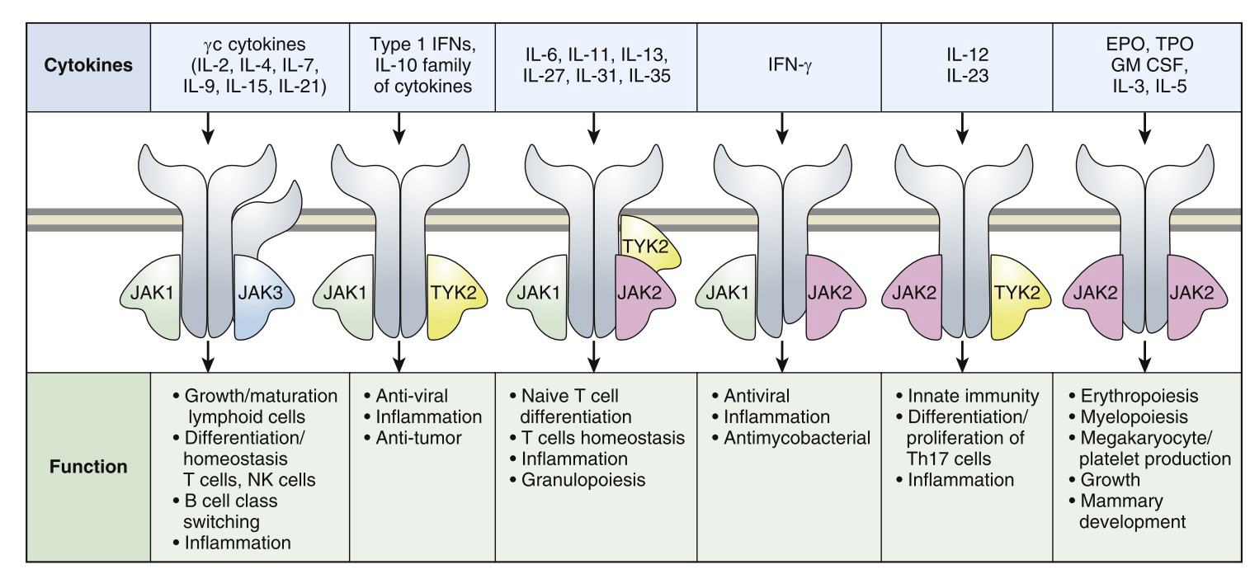
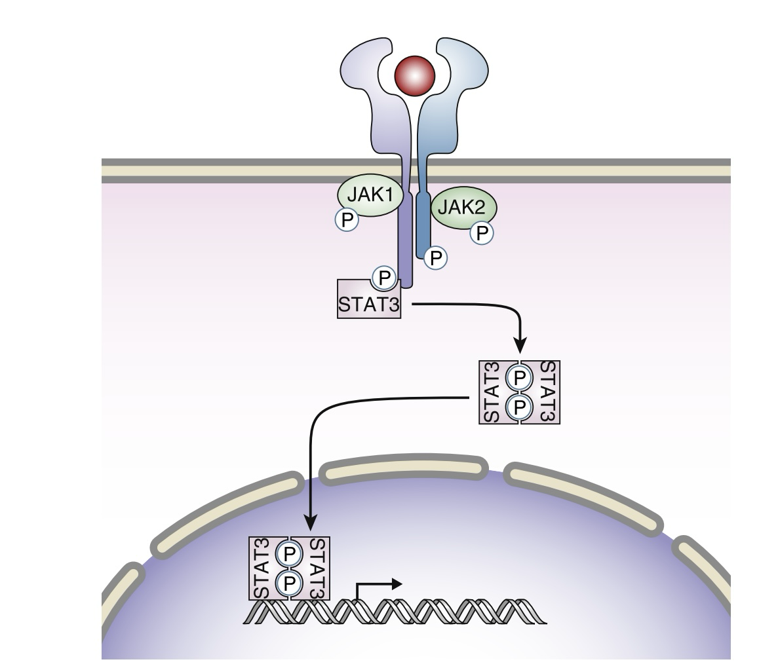
Target specific synthetic DMARDS
JAK INHIBITORS:

Slide 19
1)Tofacitinib : JAK 1& 3 inhibitors, dose -5 mg orally twice daily or 11 mg orally daily
2)Baricitinib : JAK 1& 2 inhibitor, dose – 2 mg OD orally daily
3) Upadacitinib: Selective JAK 1 inhibitor, dose-15 mg orally daily
4) Filgotinib : Selective JAK 1 inhibitor , dose – 200 mg OD orally daily
5)Peficitinib: pan JAK inhibitor, dose- 100 mg OD orally daily
*side effects:
Increased risk of infections, including bacterial infections and herpes zoster, elevated liver transaminases, neutropenia, increased cholesterol levels, hypertension, and elevations in serum creatinine.
Recent studies have also found an increased risk of thrombosis, major adverse cardiovascular events, and malignancies in patients taking tofacitinib compared with TNF inhibitors, with the highest of these risks in the elderly.

Slide 20
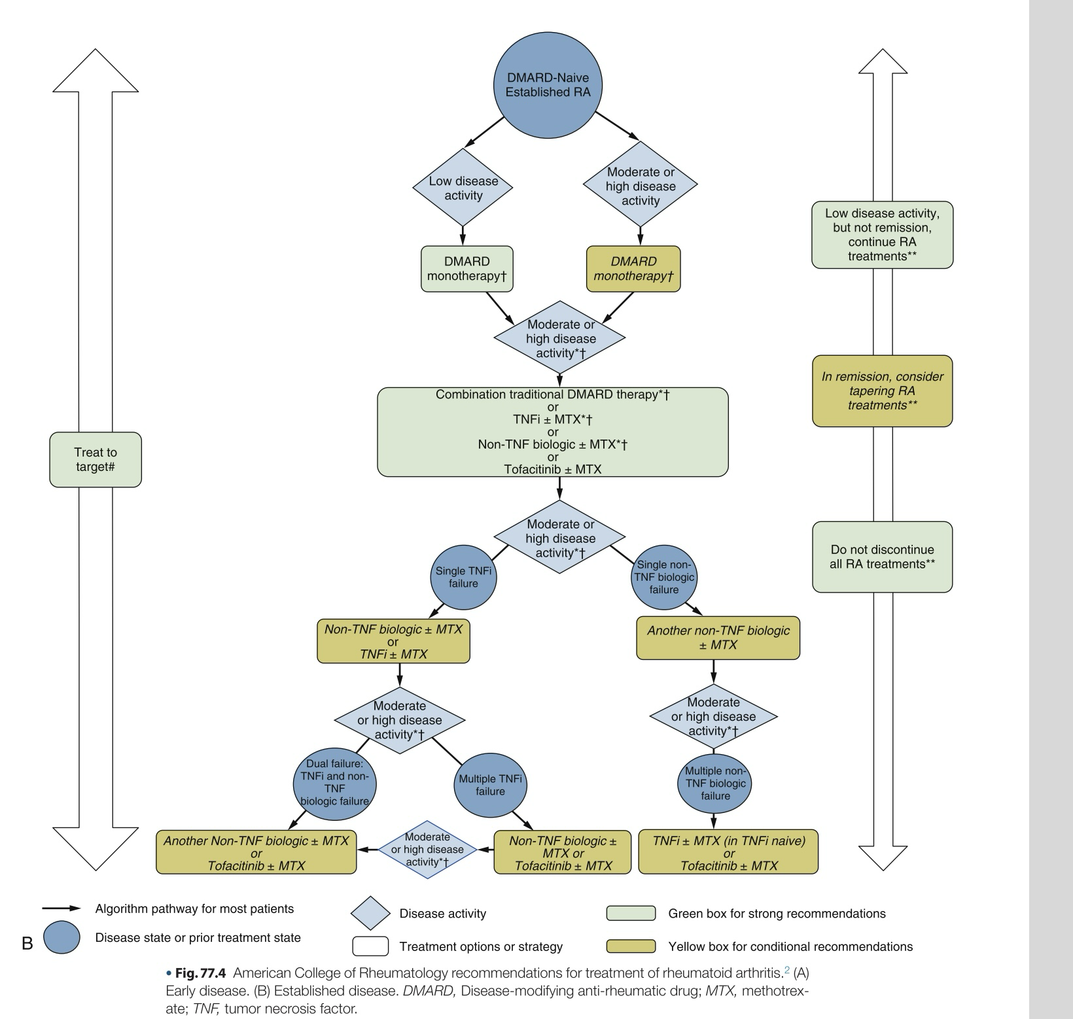

Slide 21
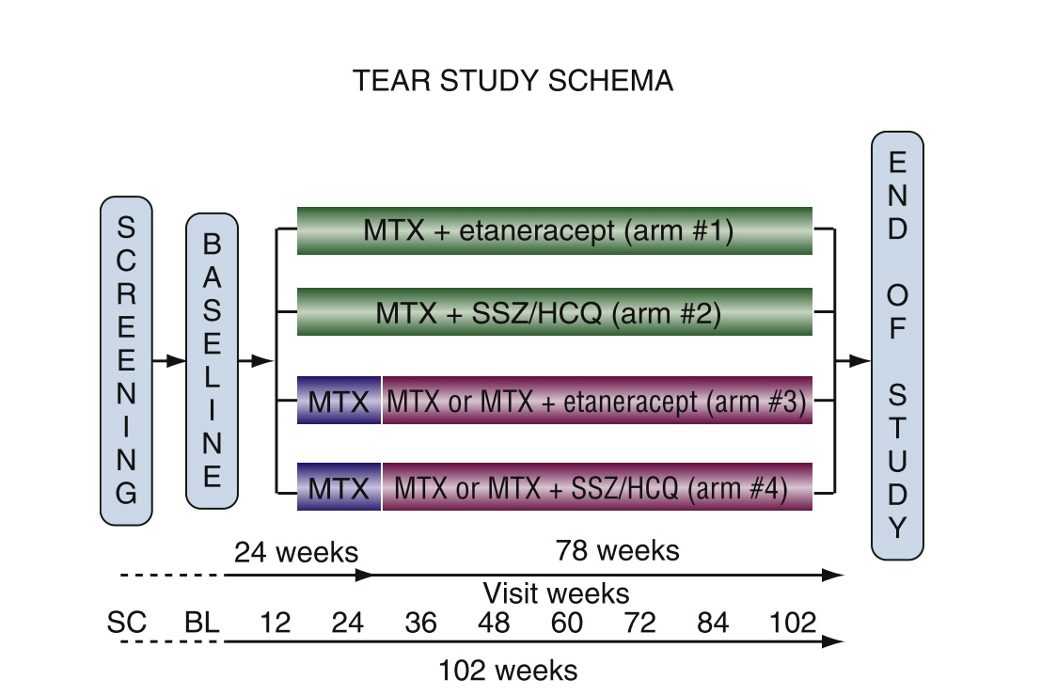
Best study
TEAR study

