Slide 1
PLEURAL EFFUSION- A RARE CAUSE
VII MU

Slide 2
VII MEDICAL UNIT
CHIEF: PROF.DR.K.SENTHIL.MD
ASSOCIATE PROF: DR.K.MURALIDHARAN MD
ASST PROF: DR V.MANIKANDAN MD
DR C. RAMANAN MD
DR.SARAVANA MADAV MD

Slide 3
51 Yr old male admitted with
c/o breathlessness - 2 months
Right sided chest pain
Loss of weight

Slide 4
HOPI
H/O Breathlessness – 2 months duration
Gradual onset , not progressive
MMRC –Grade 3
Not a/w orthopnea/PND
h/o Right sided chest pain – intermittent; more on deep inspiration;
h/o loss of weight +
h/o low back ache – on &off past 2 months
No h/o cough/ hemoptysis
No h/o fever
No h/o oliguria/ swelling of legs

Slide 5
No h/o vomiting
No h/o loose stools
No h/o jaundice
No h/o fever
No h/o abdominal distension
H/o abdominal pain
PAST H/O – not a k/c/o T2DM/HTN/ TB / BA/THYROID disorders
PERSONAL H/O – Chronic alcoholic/smoker

Slide 6
O/E Pt conscious
Oriented
Afebrile
Tachypneic +
No pallor
No icterus
b/l Pandigital clubbing + Gr II
No pedal edema
VITALS :
BP-110/80
PR - 130/min
Spo2 – 98% RA
RR -24/min

Slide 7
CVS – S1,S2+, No murmurs, JVP Not elevated
RS – Chest movements decreased in RT side
Absent breath sound – RT side
Right 2nd Intercostal space – dull on percussion
P/A – soft
Tenderness + in left hypochondrium
No organomegaly
CNS – Pt conscious ,oriented
b/l pupils 3mm RTL
NFND

Slide 8
CXR ON ADMISSION

Slide 9
Right sided ICD Insertion was done – 1200 ml hemorrhagic fluid drained & graded drainage of pleural fluid was done every 6 hrs
Pleural fluid analysis- Heamorrhagic effusion
Protein –1.6G/dl
Sugar –15.2
Total count – 200
Differential count –
N-5%
L-95%

Slide 10
PLEURAL FLUID ADA – 19.20U/L
PLEURAL FLUID CYTOLOGY – No granuloma/atypical cells/ Malignant cells seen – NEGATIVE
PLEURAL FLUID C/S – No growth
PLEURAL FLUID LDH – 380 U/L
SPUTUM AFB – NEGATIVE

Slide 11
INVESTIGATIONS
 | 26/7 | 10/7
TC | 18400 | 15000 | UREA | 46 | T.BIL | 0.7
DC | 74/18/8 | 82/13/5 | CREAT | 1.0 | D.BIL | 0.1
HB | 8.8 | 8.1 |  |  | I.BIL | 0.6
PCV | 28% | 26.7 |  |  | SGOT | 25
PLT | 3.25LK | 5.1lk |  |  | SGPT | 38
ESR | 42 |  |  |  | ALP | 107
P.SMEAR | Microcytic hypochromic anemia with neutrophilic leukocytosis

Slide 12
T.PROTEIN | 5.2 | FBS | 102
S.ALBUMIN | 2.5 | FLP
S.GLOBULIN | 2.7 | TC | 117
Sr Calcium | 9.1 | TG | 122

Slide 13
USG ABDOMEN
LIVER – Normal size &echoes
PANCREAS – Obscured
Spleen – normal
KIDNEYS – Normal size, normal echoes, CMD Maintained
Minimal ascites
B/l pleural effusion (R>L)

Slide 14
CECT CHEST
Moderate pleural effusion with passive collapse of right lower lobe
Contrast – homogenous enhancement
RT ICD Tube tip noted in anterior mediastinal junctional line
Visualised upper abdomen – Pancreatic distal body and tail region show well defined fluid collection
Fluid collection noted in perisplenic region
? Pseudocyst ? Necrotising pancreatitis

Slide 15
SERUM AMYLASE – 331 U/L
SERUM LIPASE - 1276 U/L
PLEURAL FLUID AMYLASE – VERY HIGH

Slide 16
CECT ABDOMEN
PANCREAS : HEAD m/s 2.3 cm
BODY - 1.1cm
TAIL – 2.7 cm
Parenchyma reduced in thickness
Main pancreatic duct – 14mm
THICK WALLED COLLECTION WITH SURROUNDING FAT STRANDING NOTED IN THE REGION OF DISTAL BODY AND TAIL OF PANCREAS m/s 4.7*2.4*2.3 cm
Imp- CHRONIC PANCREATITIS WITH WALLED OFF COLLECTION

Slide 17
MRCP

Slide 18
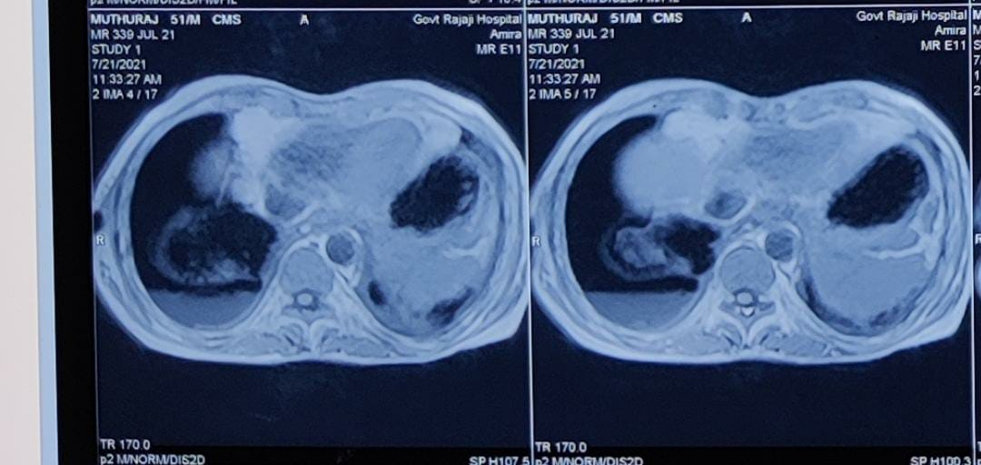

Slide 19
MRCP
PANCREAS reduced in size with inhomogenous signal intenity
Disruption of pancreatic duct noted at distal body with adjacent collection measuring 4.5*2.2 cm
Tract seen to extend from Walled off necrosis of distal body of pancreas in oblique transverse plane though esophageal hiatus to posterior mediastinum
Communication noted with right pleural space
DISRUPTED PANCREATIC DUCT WITH WALLED OFF NECROSIS AND PANCREATICO PLEURAL FISTULA .

Slide 20
ERCP
Precut Needle knife sphincterotomy of pancreatic duct done

Slide 21
REPEAT CT CHEST – Taken after 3 weeks

Slide 22
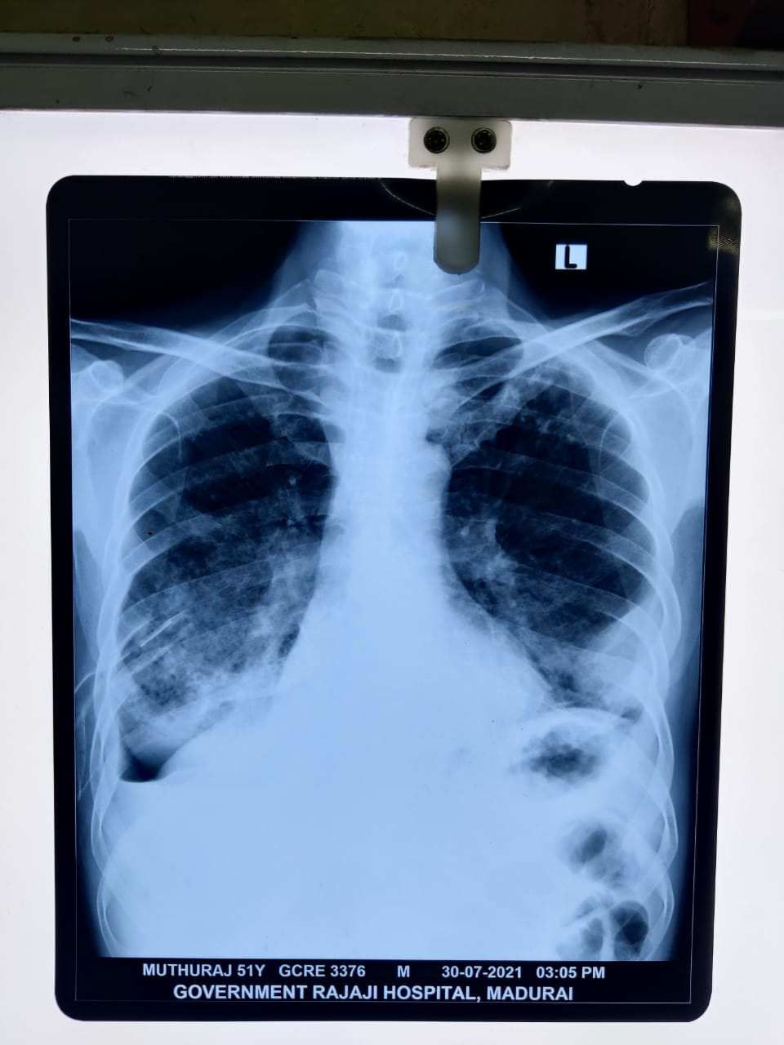
ICD collection gradually reduced
ICD removal done on 5th day Post ERCP
On Follow up – there was no further collection
Patient was discharged 5 days later

Slide 23
DIAGNOSIS RIGHT MASSIVE PLEURAL EFFUSION CHRONIC PANCREATITIS WITH WALLED OFF NECROSIS PANCREATICO PLEURAL FISTULA

Slide 24
THANK YOU

