Slide 1
HYPERTENSION
  MEDICINE 5TH UNIT
  Chief
  Dr Syed Bahavudeen Hussaini M.D
  Assistant professors
  Dr Vinoth Kannan M.D
  Dr Priya M.D
  Post graduate
  Dr Sathiyaseelan

Slide 2
DEFINITION
Hypertension is defined as an average of three SBP or DBP readings
at or above the 95th percentile or an SBP or DBP ≥130 or 80 mmHg,
Respectively.
Types of Hypertension
1) Primary Hypertension.
2) Secondary Hypertension
-Obstructive sleep apnea(OSA)
- Renal parenchymal disease
- Primary aldosteronism
-Renovascular disease
Hypertensive disorders of pregnancy

Slide 3
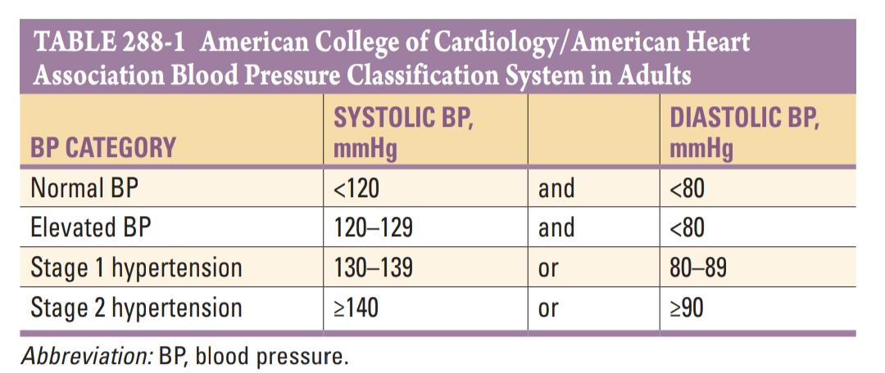

Slide 4
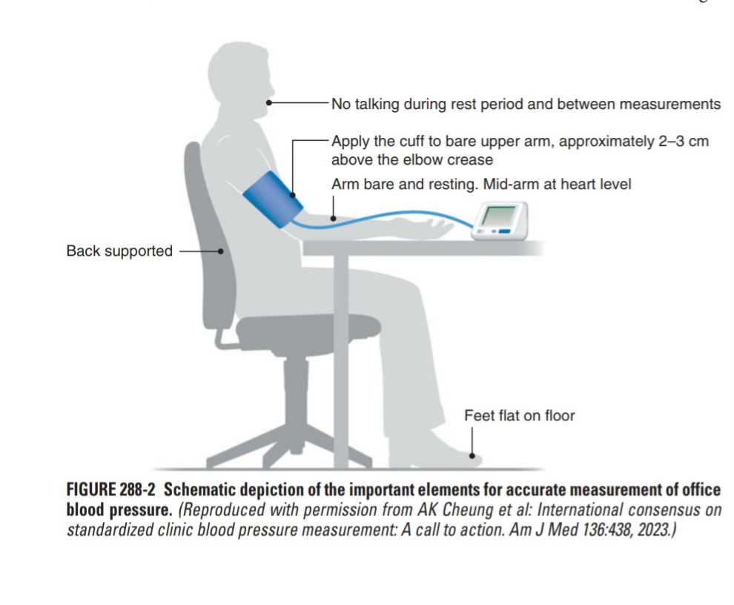

Slide 5
NONPHARMACOLOGICAL INTERVENTIONS TO PREVENT AND TREAT HYPERTENSION
DASH DIET
The DASH (Dietary Approaches to Stop Hypertension) diet is a heart-healthy diet that was specifically formulated to lower BP. The DASH diet is high in vegetables, fruits, whole grains, and low-fat dairy products and low in fats, saturated fats, and cholesterol.
Weight Loss
Weight loss not only lowers BP but can also improve lipid levels and is effective for prevention and management of diabetes mellitus. It can be achieved through a combination of calorie reduction and increased physical activity

Slide 6
Potassium Supplementation
A higher intake of potassium is associated with a lower BP and a reduced risk of CVD, especially stroke. U.S. Dietary Reference Intake committees have not made a dietary allowance intake recommendation due to insufficient evidence but have identified 2600 and 3400 mg/d in women and men, respectively, as adequate intake levels.
Physical Activity
Observational studies identify a strong inverse association between physical activity (leisure time or total) and BP as well as CVD. In like manner, high-quality RCTs have demonstrated that increased physical activity lowers BP in adults with and without hypertension

Slide 7
Alcohol Consumption
Alcohol has long been known to be a pressor. Observational dose-response meta-analyses demonstrate a roughly linear association between alcohol consumption and both BP and hypertension, with no threshold for the association. For each 14-mg increased intake of alcohol (amount in a U.S. standard alcoholic drink), SBP is ~1.5 mmHg higher.
Dietary Sodium Reduction
Many RCTs have demonstrated reductions in BP following decreases in dietary sodium intake. In a large dose-response meta-analysis of RCTs, there was a striking almost linear relationship between reduction in dietary sodium intake and the corresponding decreases in BP.

Slide 8
First-line Antihypertensive Drugs
1) Diuretics (Thiazide and Thiazide-like diuretics)
2) ACE Inhibitors (ACEIs)
3) Angiotensin II Receptor Blockers (ARB)
4( Calcium channel blockers
Second-line / Add-on Drugs
1)Beta Blockers
2) Mineralocorticoid receptor antagonists
3) K+-sparing diuretics
4) Loop Diuretics
5) Alpha Blockers
6) Direct vasodilator
7) Central α2-agonist and other centrally acting drugs

Slide 9
First line drugs
Diuretics (thiazide and thiazide-like).
Mode of action
Block sodium reabsorption in distal convoluted tubule
Chlorthalidone 12.5–25mg OD
Hydrochlorothiazide 12.5–50mg OD
Indapamide 1.25–2.5 mg OD
Side effects
Hyponatremia,Hypokalemia,Hypercalcemia, Hyperuricemia
Hyperglycemia, Dyslipidemia
Remarks
Chlorthalidone preferred due to long half-life

Slide 10
ACE inhibitors
Mechanisms of Action
Inhibit ACE activity and Ang II production
Enalapril 5–40 mg OD or BD
Lisinopril 10–40 mg OD
Benazepril 10–40 mg OD or BD
Ramipril 2.5–20 mg OD
Trandolapril 1–4 mg OD

Slide 11
Side effects
Cough
Hyperkalemia in CAD
AKF in severe bilateral RAS
Hypotension
Angioedema
Remarks
Do not use in combination with ARB; contraindicated in pregnancy

Slide 12
ANGIOTENSIN RECEPTOR BLOCKER
Mechanisms of action
Block Ang II binding to Ang receptors
Losartan 50–100 mg OD OR BD
Valsartan 80–320 mg OD
Azilsartan 40–80 mg OD
Candesartan 8–32 mg OD
Olmesartan 20–40 mg. OD

Slide 13
Side effects
Hyperkalemia in CKD
Reduced GFR
AKF in severe bilateral RAS
Hypotension
Do not use in combination with ACE inhibitor;
contraindicated in pregnancy

Slide 14
CALCIUM CHANNEL BLOCKER(DHP)
Mechanisms of Action
Blocks calcium from entering cells, primarily inhibiting vasoconstriction
Amlodipine 2.5–10 OD
Felodipine2.5–10 OD
Nifedipine LA30–90 OD
Side effects
Peripheral edema (dose-dependent)Gingival hyperplasia
Amlodipine may be preferred CCB if tolerated
Not recommended in HFrEF

Slide 15
CCB (non-DHP)
Mechanisms of Action
Blocks calcium from entering cells, reducing heart rate and vasoconstriction
Diltiazem ER 120–360mg OD
Verapamil ER 100–300mg OD
Side effects
Bradycardia
Nausea
Constipation.
Do not use in combination with β-blockers
Do not use in HFrEF or in high-grade AV or SA block

Slide 16
Β-Blocker
Mechanisms of Action
Block β-adrenergic receptors
Metoprolol 50–200mg. OD
Carvedilol 20–80mg. OD
Nebivolol 5–40mg. OD
Side effect
Asthma
Bradycardia
Fatigue
Exercise intolerance
Impaired concentration
First-step drugs when clinically indicated, e.g., in IHD and HF
Contraindicated in high-grade heart block

Slide 17
Mineralocorticoids Receptor Antagonist
Mechaniam of Action
Block distal tubule mineralocorticoid receptor activity
Spironolactone. 25–100mg
Eplerenone. 50–100mg
Finerenone. 10–20mg
Side effects
Hyperkalemia, especially in CKD and with potassium-sparing agents
Spironolactone may cause tender breasts, gynecomastia, and erectile dysfunction in men
Especially useful in resistant hypertension and low-renin states

Slide 18
K+sparing diuretics
Mechanisms of action
Block distal tubule sodium reabsorption
Amiloride 5–10 OD or BD
Triamterene 50–100 OD or BD
Side effects
Hyperkalemia, especially in CKD or with other agents that favor potassium retention
Minimal effect on BP
Used to counteract hypokalemic effect of diuretics

Slide 19
Loop diuretics
Mechanisms of action
Inhibits reabsorption of sodium in loop of Henle
Furosemide 20–80 mg BD
Torsemide 5–10 mg OD
Side effects
Hypokalemia
Volume depletion
Hyperuricemia
Infrequent Preferred in CKD with GFR <30, in symptomatic HF, and
when using potent direct vasodilator Minoxidil

Slide 20
α1-Receptor blockers
Mechanisms of action
Inhibit α1-adrenergic receptors
Doxazosin 1-16 mg OD
Side effects
Orthostatic hypotension, especially in older adults
Less cardioprotective than diuretics
Mostly used in men with prostrate hypertrophy

Slide 21
Direct vasodilator
Mechanisms of action
Dilate peripheral arterioles
Hydralazine 100–200 mg. BD or TDS
Minoxidil 5–100 mg. OD to TDS
Side effects:
NA Reflex tachycardia
Fluid retention
Hydralazine-induced lupus syndrome (rare)
Minoxidil-induced hirsutism in women

Slide 22
Potent antihypertensive agents
Usually reserved for fourth- or fifth step treatment in resistant hypertension
Usually combined with diuretic
(loop agents for minoxidil) and β-blocker to minimize side effects

Slide 23
Central α2-agonist and other centrally acting drugs
Mechanisms of action
Stimulate central nervous system α2- adrenergic receptors
Clonidine (oral) 0.1–0.8. BD
Clonidine patch. 0.1–0.3 mg. Once weekly
Methyldopa. 250-1000mg. BD
Side effects
Sedation
Dry mouth
Bradycardia
Fatigue
Constipation
Orthostatic hypotension.

Slide 24
Infrequently used due to side effects and potential for hypertensive crisis following abrupt withdrawal
Methyldopa has a good safety record in pregnancy
Resistant Hypertension
Failure to control SBP/DBP to <130/80 mmHg with three antihypertensive medications, preferably including a diuretic, or taking four or more antihypertensive medications to achieve an SBP/DBP <130/80 mmHg is designated as apparent resistant hypertension

Slide 25
Diabetes / CKD. -ACEIs or ARBs
Heart failure. -ACEIs, beta-blockers, spironolactone
Ischemic heart disease. - Beta-blockers, ACEIs
Pregnancy. - Methyldopa, labetalol
Elderly. - CCBs, diuretics

Slide 26
ACEIs and ARBs should not be used in combination because this unnecessarily increases the risk of hyperkalemia.
Neither an ACEI nor an ARB should be used in pregnancy or planned pregnancy due to the risk of teratogenic side effects in the fetus.
The earliest beta blocker drugs were relatively nonselective blockers of β-adrenergic receptors, including the heart (β1 receptors) and lungs (β2 receptors). They are rarely prescribed for hypertension due to the potential for bronchospasm.
Nondihydropyridine CCBs should rarely be employed to treat hypertension unless there is another compelling indication for their use. Particular caution is necessary in patients at risk for bradycardia, heart block, or HF.

Slide 27
LIPID DISORDERS

Slide 28
SEVERE HYPERTRIGLYCERIDEMIA
Fasting TG levels >500 mg/dL and is usually accompanied by moderately elevated total cholesterol levels and reduced levels of HDL-C, usually without important elevation in LDL-C or apoB.
Risk
Pancreatitis
ASCVD risk
Patients who are at high risk for ASCVD due to other risk factors should be treated with statin therapy.
In patients who are otherwise not at high risk for ASCVD, lipid-lowering drug therapy can frequently be avoided with appropriate dietary and lifestyle changes.
Patients with plasma TG levels >500 mg/dL after a trial of diet and exercise should be considered for drug therapy with a fibrate or fish oil to reduce TGs in order to prevent pancreatitis.

Slide 29
HYPERCHOLESTEROLEMIA (ELEVATED LDL-C)
Elevated LDL-C is common and is medically important because it is associated with risk of premature ASCVD. Elevated LDL-C is often caused by impaired uptake of LDL by the liver
The diagnosis of familial hypercholesterolemia involving several genes that influence LDL clearance should be considered in patients with LDL-C levels >190 mg/dL
MIXED HYPERLIPIDEMIA (ELEVATED TG AND LDL-C)
Mixed hyperlipidemia can be defined as fasting TGs >150 mg/dL and evidence of elevated cholesterol containing lipoproteins (such as LDL-C >130 mg/dL or non-HDL-C >160 mg/dL). It is one of the most common types of lipid disorders seen in clinical practice, due both to genetic predisposition and influence of medical conditions and environmental factors

Slide 30
Drugs Used to Treat Dyslipidemia
LDL-Lowering Drugs
1)HMG-CoA reductase inhibitors (statins)
Indication -Elevated LDL-C; increased CV risk
Mechanisms of action
↓ Inhibition of cholesterol synthesis →↑Hepatic LDL receptors
Side effects
Myalgias and myopathy, ↑gʻtransaminases, ↑ diabetes risk
Lovastatin 20–40 mg daily - Max 80 mg daily. Atorvastatin 20–40 mg daily Max 80 mg daily
Simvastatin 20–40 mg daily –Max 80 mg daily. Pitavastatin 1–2 mg daily Max 4 mg daily
Pravatatin 40–80 mg daily -Max 80 mg daily. Rosuvastatin 5–20 mg daily Max 40 mg daily.
Fluvastatin 20–40 mg daily - Max 80 mg daily

Slide 31
Cholesterol absorption inhibitor
Ezetimibe 10 mg daily - Max 10 mg daily
Indication - Elevated LDL-C
Mechanisms of action
↓ Cholesterol absorption→ ↑LDL receptors
Adverse effects -Elevated transaminases
Bile acid sequestrants
Cholestyramine 4 g daily - Max32 g daily
Colestipol 5 g daily -Max 40 g daily
Indication- Elevated LDL-C ↑
Mechanisms of action - Bile acid excretion → ↑ LDL receptors
Adverse effects -Bloating, constipation, elevatedtriglycerides

Slide 32
PCSK9 inhibitors
Indication- Elevated LDL-C
Evolocumab (Ab) 140 mg SC every 2 weeks
Alirocumab (Ab) 75 mg SC every 2 weeks
Mechanisms of action
↓ PCSK9 activity due to Ab inhibition → ↑LDL receptors
Adverse effects
Injection site reactions
Inclisiran (siRNA) 300 mg SC every 6 months
↓ PCSK9 synthesis due to siRNA silencing→ ↑ LDL receptors
Adverse reactions -Injection site reactions

Slide 33
ATP citrate lyase inhibitor
Bempedoic acid 180 mg daily
Indication- Elevated LDL-C
Mechanisms of Action
↓ Inhibition of cholesterol synthesis → ↑ LDL receptors
Adverse effects - ↑ uric acid and gout ↑ cholelithiasis
MTP inhibitor
Indication- Homozygous Familial hypercholesterolemia
Lomitapide 5 mg daily 60 mg daily
Mechanisms of action
MTP inhibition → ↓ VLDL assembly and secretion
Adverse effects - Nausea, diarrhea, increased hepatic fat

Slide 34
ApoB inhibitor (ASO)
Homozygous Familial Hypercholesterolemia
Mipomersen 200 mg SC weekly
Mechanisms of action
↓ ApoB synthesis due to ASO silencing → ↓ ApoB/VLDL secretion
Adverse effects
Injection site reactions, flu-like symptoms, increased hepatic fat

Slide 35
TG-Lowering Drugs
Fibric acid derivatives (fibrates)
Gemfibrozil – 600 mg bid
Fenofibrate – 40–160 mg daily
Indication – Elevated TG
Mechanisms-↑ LPL, ↓ VLDL synthesis
Adverse effects-Dyspepsia, myalgia, cholelithiasis, elevated transaminases

Slide 36
Omega-3 fatty acids
Indication- Elevated TG
Acid ethyl esters 4 g daily
Icosapent ethyl 4 g daily
Mechanisms of action - ↑ TG catabolism
Adverse effects –Dyspepsia

Slide 37
THANK YOU

