Slide 1
The “mas’’ presentation
HOD :PROF. DR.NATARAJAN,M.D
CHIEF: PROF. DR.ALAGAVENKATESAN ,M.D
ASSISTANT PROFESSOR: DR.SUGADEV,M.D
PRESENTOR: DR.M.KAVITHA
COURTESY :IVTH MEDICAL UNIT

Slide 2
Chief complaints
A 30years old female patient brought by her husband with chief complaints of
loose stools X 2 months
Black tarry ,sticky stools x 2days
Seizure x 1episode

Slide 3
History of presenting illness
H/O Loose stools x 1month,small in amount ,3-6 times /day,with mucus
H/O MALENA X 2 days
H/O seizure X 1 episode, GTCS
H/O Yellowish discoloration of eyes and urine X 5 days
H/O Pruritis X 3 days
H/O Facial puffiness X 3 days
H/O Decreased urine output x 3 days

Slide 4
HISTORY OF PRESENTING ILLNESS
NO H/O Abdominal pain
NO H/O Hemetemesis /vomiting
NO H/O Hematochezia
NO H/O Abdominal distension
NO H/O constipation
No H/O jointpain
No H/O rashes
No H/O Bloating

Slide 5
History of presentating illness
No H/O FEVER
No H/O Altered sensorium
No H/O headache

Slide 6
Past history
H/O Gestational hypertension in 8th month of 3rd pregnancy, after that she is on ANTIHYPERTENSIVE medication for past one and half years
ON OCTOBER 2022 - She had 3-4 episodes /day of LOOSE STOOLS, For which she was treated in nearby GH
ON 16th November 2022 – she had similar complaints for which she was evaluated and
CECT Abdomen taken,which suggests the possibility of MENETRIERS DISEASE/LYMPHOMA STOMACH , B /L SACROILEITIS
BIPOSY from stomach --INTESTINAL METAPLASIA

Slide 7
PAST HISTORY
ON 16/12/2022, She had an episode of SEIZURE ,GTCS,for which she was evaluated .
CT BRAIN –P/O DANDYWALKER CYST
MRI BRAIN – MEGA CISTERNA MAGNA
Treated with antiepileptics and discharged.

Slide 8
Personal history
Takes mixed diet
Sleep pattern normal
Bladder and bowel habitus normal
No h/o substance abuse
No h/o blood transfusion
No h/o tattooing.

Slide 9
Menstrual ,Marital and obstetric history
Attained menarche at 15 years of age.
Menstrual cycle- regular,5/28,
Lmp not known
Married since 2010
LCB –one and half years back
P3L3,LN,not sterilised
Obstetric history UNEVENTFUL except gestational hypertension in 3rd pregnancy

Slide 10
On examination
CVS : S1,S2 heard ,
no murmur
RS :Bilateral airentry +
no added sounds heard
P/A : Distended
soft ,not warmth
tenderness + in right hypochondrium
No palpable organs
CNS –Conscious
oriented
moves all 4 limbs
b/l pupil 3mmERTL
No focal neurological deficit.
Consious
Oriented
Pallor +
Icterus +
No clubbing
No cyanosis
No generalised LNAP
NO pedal edema

Slide 11
INVESTIGATION
 | 29/12/22 | 31/12/22 | 1/1/23 | 3/1/23 | 5/1/23 | 7/1/23 | 9/1/23 | 11/1/23 | 12/1/23 | 15/1/23
TC | 2900 | 2400 | 4400 | 9400 | 20100 | 19100 | 12000 | 13600 | 13000
DC
HB | 6.9 | 5.9 | 6.8 | 6.6 | 7.2 | 5.9 | 7.2 | 9.6 | 9.3
PCV | 21 | 15 | 21 | 20 | 22 | 15 | 23 | 26 | 25
PLT | 52000 | 41000 | 40000 | 40000 | 1.45 | 1.56 | 72000 | 89000 | 1.4
RBS | 250 | 119 |  | 133 |  | 102
UREA | 105 | 87 | 67 | 144 | 162 | 139 |  |  |  | 42
Cr | 2.3 | 1.5 | 0.8 | 2.4 | 2.4 | 1.7 |  |  |  | 0.3
Na | 127 |  |  |  |  | 129 |  |  |  | 130
K | 3.5 |  |  |  |  | 2.8 |  |  |  | 3.5

Slide 12
 | 29/12/22 | 31/12/22 | 3/1/23 | 6/1/23 | 8/1/23 | 10/1/23 | 15/1/23
ESR/qCRP |  | 116 |  |  |  | 53/113 | 44/45
TB | 13.9 | 15.5 | 21 | 24.3 | 29.2 | 31.5 | 23.3
DB | 9.9 | 12.9 | 12.1 | 15 | 14.7 | 19.6 | 16.2
IB | 4 | 2.6 | 8.9 | 9.3 | 14.5 | 11.79 | 7.1
SGOT | 187 | 240 | 148 | 159 | 114 | 122 | 120
SGPT |  |  |  | 26 | 121 |  | 35
ALP |  |  |  | 1183 | 1067 | 967 | 1025
PT/aPTT | 34.6/ 46.9 | 21/37 | 14
INR | 2.9 | 1.6 | 1.07

Slide 13
investigation
URINE ANALYSIS :
albumin –loaded
Urine sugar _ nil
Bilesalt ,bilepigment – positive.
SPOT PCR>3
SERUM LDH – 614 [on 30/12/2022]
- 1148[ on 6/1/2022]
UPT – Negative
DCT – NEGATIVE
ANA [by ELISA – negative]
TOTAL CHOLESTEROL -328
TRIGLYCERIDE – HIGH
SERUM FERRITIN –More than 1500

Slide 14
INVESTIGATIONS
VCTC- NR
VIRAL MARKERS- NEGATIVE
CPK 30
TOTAL PROTEINS 4.8
S.ALBUMIN 1.8
S. GLOBULIN 3.0
S. LIPASE 465 77
IGM DENGUE- NEGATIVE
IGM SCRUB- NEGATIVE
IGM LEPTO- NEGATIVE
Malaria, Typhoid- negative

Slide 16
INVESTIGATIONS
Blood c/s- Klebsiella pneumonia
Stool c/s- no growth
Urine c/s- Candida krusei
PERIPHERAL SMEAR:
30/12/22- Pancytopenia with relative neutrophilia, few target cells, microspherocytes, elongated cells
8/1/23- Dimorphic anemia with neutrophilic leucocytosis andthrombocytopenia, neutrophils show toxic granules in cytoplasm

Slide 18
INVESTIGATION
TFT- Normal
ECG- Sinus tachycardia
ECHO: Normal study, EF 60%
Ascitic fluid analysis:
Sugar- 117mgs/dl
Protein-706mgs/dl
LDH – 705 U/L
Cell count- 40cells/cumm
Predominantly polymorphonuclear cells.

Slide 21
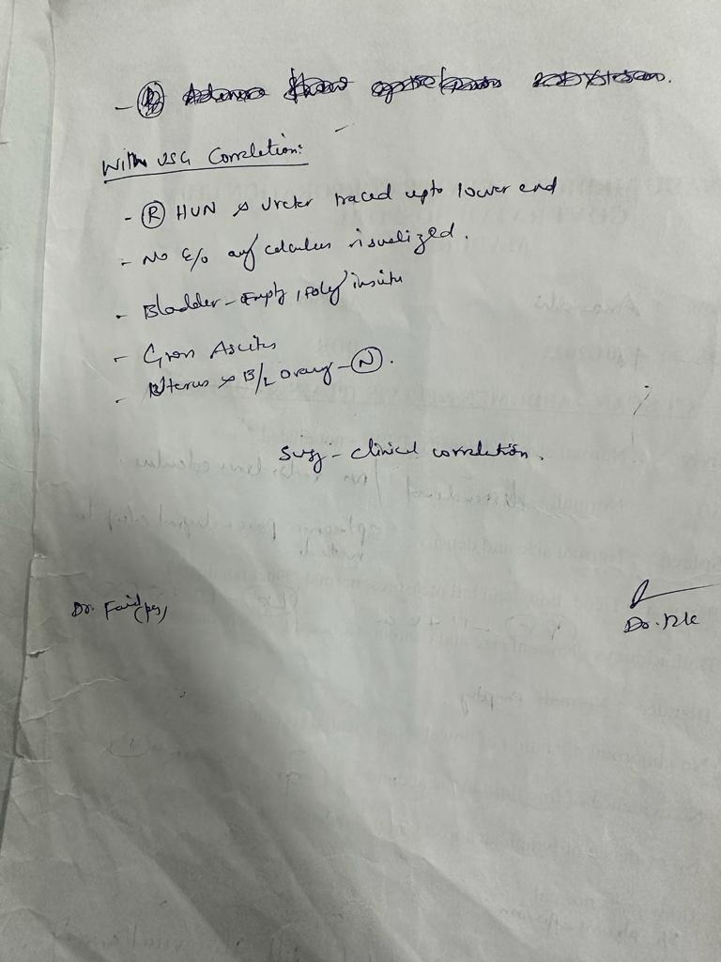

Slide 22
MGE OPINION
MGE OPINION:
IMPRESSION – Suspected CA Stomach with liver metastasis
-- TO R/O Hematological malignancy
--TO R/O autoimmune causes
--infilterative liver disease /?lymphoma
SUGGESTED- serial LFT,PT-INR monitoring,Portal vein doppler,viral marker,vctc,stool routine examination,ascitic fluid analysis,peripheral smear. OGD SCOPY.

Slide 23
NEPHROLOGIST OPINION
NEPHRO OPINION:
IMP: Renal failure
?Bile salt nephropathy
?Tropical AKI
SUGGESTED: C3 C4, serial RFT, HD

Slide 24
ENA PROFILE – REPORTS AWAITED

Slide 26
final diagnosis
MACROPHAGE ACTIVATION SYNDROME WITH UNDERLYING RHEUMATOLOGICAL CONDITION

Slide 27
THANK YOU

