Slide 1
A CASE OF AMLODIPINE POISONING
IV MEDICAL UNIT
CHIEF : DR. DAVID PRADEEP KUMAR, M.D., ASST : DR. N. RAGAVAN , M.D.,
DR. M. RAM KUMAR , M.D.,
DR. R. PONRAJ , M.D.,

Slide 2
A 27 yrs old female came with alleged h/o consumption of amlodipine tablets on 24.1.2022 as per AR
HOPI:
Alleged h/o consumption of 50 tablets of 5 mg Amlodipine on 24.1.2022 in empty stomach along with water, not associated with vomiting
Pt developed symptoms of giddiness the next day, treated in Private hospital with iv fluids for next 3 days ( records NA )

Slide 3
After 3 days, Pt persistently had h/o giddiness , went to nearby GH - referred to GRH
H/o vomiting + - around 2 to 3 epsiodes/day, not ass. with blood in vomitus
H/o breathlessness on exertion + , MMRC grade 3 , sudden onset, not ass. with chest pain, palpitations

Slide 4
H/o fever for 2 days- intermittent, low grade not ass with chills, rigors - 1 week back for which pt was took treatment in local clinic
No h/o yellowish discolouration of eyes, skin
No h/o syncope/seizures
No h/o decreased urine output
No h/o cough with expectoration
No h/o weakness of limbs
No h/o poluria/polydipsia

Slide 5
PAST HISTORY:
not a known Diabetic/SHTN/TB/Epilepsy/CAD/
COPD/CKD/Thyroid disorder
PERSONAL H/O:
Mixed diet consumer
Bowel and bladder habits normal
MENSTRUAL HISTORY:
LMP –15.1.2022
Regular cycle : 2-3 days ; 3 pads/day

Slide 6
CONDITION ON ADMISSION:
Pt Conscious
oriented
no pallor
not icteric
no cyanosis
no clubbing
no pedal edema
no lymphadenopathy
tachypneic +

Slide 7
Vitals
Blood pressure – 80/60 mm Hg
Pulse rate – 106/min,regular , low volume, no abnormal character, no radio-radial or radio-femoral delay
Temp – Afebrile
Saturation – 78 % on room air
RR – 24/min

Slide 8
Systemic examination:
CVS – S1,S2 present, no murmur
RS – Bilateral air entry +, air entry decreased on both lower lung fields ( R more than L )
PA - Soft, non tender, not distended
no organomegaly

Slide 9
CNS – Conscious
Oriented
Bil pupil 3.5mm ERTL
No focal neurological deficit

Slide 10
INVESTIGATIONS
CBC | 27/1 | 28/1 | 1/ 2
TC | 18,300 | 16,500 | 11000
HB | 9.2 | 9.0 | 11.5
HCT | 26.7 | 28 | 34
PLT | 3.34 L | 3.01 L | 2.82 L

Slide 11
RFT | 27/1 | 28/1 | 30/1
UREA | 128 | 104 | 19
CREATININE | 2 | 1.3 | 0.9
SODIUM | 114 | 124 | 131
POTTASIUM | 3.9 | 4.2 | 3.8
LFT | 27/1 | 30/1
T.BIL | 1.9 | 0.9
I.BIL | 0.8 | 0.5
D.BIL | 1.1 | 0.4
SGOT | 76 | 46
SGPT | 123 | 65
ALP | 135 | 117

Slide 12
RBS | 28/1 | 29/1 | 1/ 2
 | 170 | 114 | 120
SR PROTEINS
T.PR | 6.3
ALB | 3.6
GLB | 2.7
URINE RE
SUG | NIL
ALB | NIL
DEP | 2-3 PUS CELLS

Slide 13
ECG – WITHIN NORMAL LIMITS
ABG ANALYSIS – pH – 7.44
pCO2 – 31
pO2 – 74
lactate – 1.0
HCO3 - 22

Slide 14
USG ABD AND PELVIS
LIVER : NORMAL
GB : DISTENDED
PANCREAS : NORMAL
SPLEEN : NORMAL
KIDNEYS : RK - 9.6 cross 3.6
LK – 9.9 cross 4.1
Echoes – N, CMD maintained
BLADDER : EMPTY, FOLEY’s INSITU
IVC, HEPATIC VEINS APPEAR PROMINENT
UTERUS/OVARIES : NORMAL
MINIMAL FREE FLUID +
BIL PLEURAL EFFUSION

Slide 15
ECHO

Slide 16
CT CHEST

Slide 19
RADIOLOGIST OPINION
BIL PLEURAL EFFUSION ( R MORE THAN L ) WITH R FISSURAL EFFUSION

Slide 20
PLEURAL FLUID ANALYSIS
PROTEIN – 1.8
TOTAL COUNT – 22 CELLS
SUGAR – 132 mg/dL
SR. PROTEIN – 6.3
LIGHT’S CRITERIA – TRANSUDATIVE

Slide 21
NEPHROLOGIST OPINION:
Diagnosis-?AKI/?RPGN
Advice – To Take USG KUB,Urine routine ,urine spot PCR,C3,C4.
-SRD, FRD
-30ml NAHCO3 in 5%D @75 ml /hr.

Slide 22
THORACIC MEDICINE OPINION:
Diagnosis- ? Volume overload state/ AKI(recovering)
Advice- chest physiotheraphy
incentive spirometry
pleural fluid analysis

Slide 23
TREATMENT GIVEN
Backrest/nasal O2 at 6lts/min
SRD / FRD less than 1 Lt/day
Inj noradrenaline 8mg in 5% dextrose at 10 drops/min
Inj Calcium gluconate 10% in 10 ml NS iv tds
BP/TPR/Input Output chart
Vitals monitoring

Slide 24
With treatment and observation, RFT, LFT and total count returned to baseline
Pleural effusion resolved completely

Slide 25
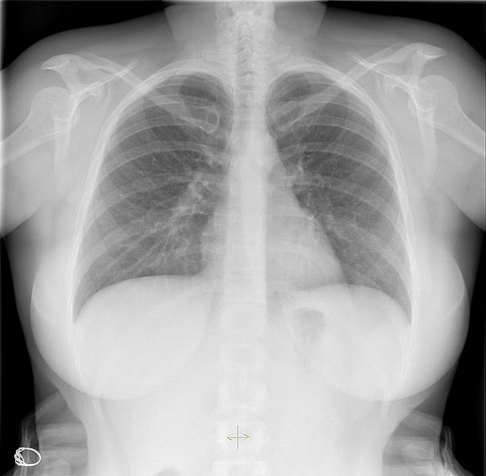

Slide 28
AIM OF THE PRESENTATION
TO DISCUSS WHETHER THE PLEURAL EFFUSION - A COINCIDENCE OR IS IT A CONSEQUENCE OF AMLODIPINE POISOING
TO DISCUSS THE PATHOPHYSIOLOGY OF MODS IN AMLODIPINE POISONING
TO HIGLIGHT THE ATYPICAL PRESENTATION OF AMLODIPINE POISOINING

