Slide 1
A CASE OF CARDIO-CUTANEOUS SYNDROME
1ST MEDICAL UNIT
CHIEF: Dr.M.NATARAJAN M.D
Asst.Prof: Dr.P.S.VALLIDEVI M.D
Dr.P.SHRIDHARAN M.D
DR. VASANTHAKALYANI M.D, DCP
PRESENTED BY: DR.SAI RAMAN.h 2ND YR PG

Slide 2
MYSTERIOUS HISTORY
A 43 years aged female was brought in an unconscious state with history of difficulty in walking and speaking for past 2 days
Patient was apparently normal 2 days back
She went to temple , around 10 am while walking in road patient had difficulty in using her right upper and lower limbs , along with difficulty in speaking

Slide 3
Which was insidious onset during exersion , progressive distal more than proximal with equal upper and lower limb involvement, no regain of power and sensorium worsened along with facial lag and aphasia.
No H/O seizures
No H/O bowel and bladder incontinence
No H/O head injury

Slide 4
No H/O dysphagia , diplopia
No H/O similar complaints in past
Patient not a k/c/o DM, BA, IHD, PTB
K/C/O SHTN DIAGNOSED RECENTLY ON T.AMLODIPINE 2 OD
No h/o steroid / NSAIDS abuse

Slide 5
Examining--- the mining Art for diagnosis
Pt was drowsy
Response to pain +
Paucity of movement in upper and lower limbs of right side
Facial lag + umn
Congested conjunctiva
Not icteric/ cyanosed
No pallor
Clubbing + b/L pan digital grade 2

Slide 6
No GLAP
NO PEDAL EDEMA
No markers of RHD , INFECTIVE ENDOCARDITIS
NO markers of acceletated atherosclerosis
No markers of congenital heart disease

Slide 7
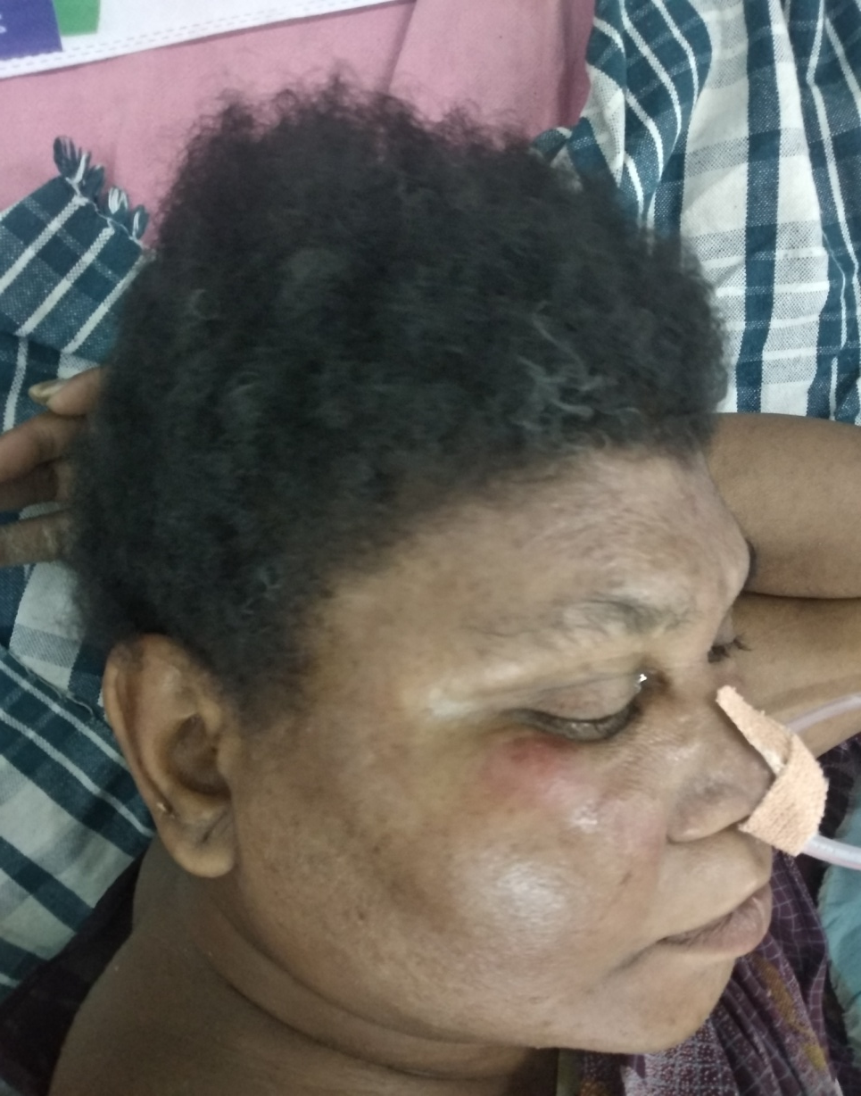
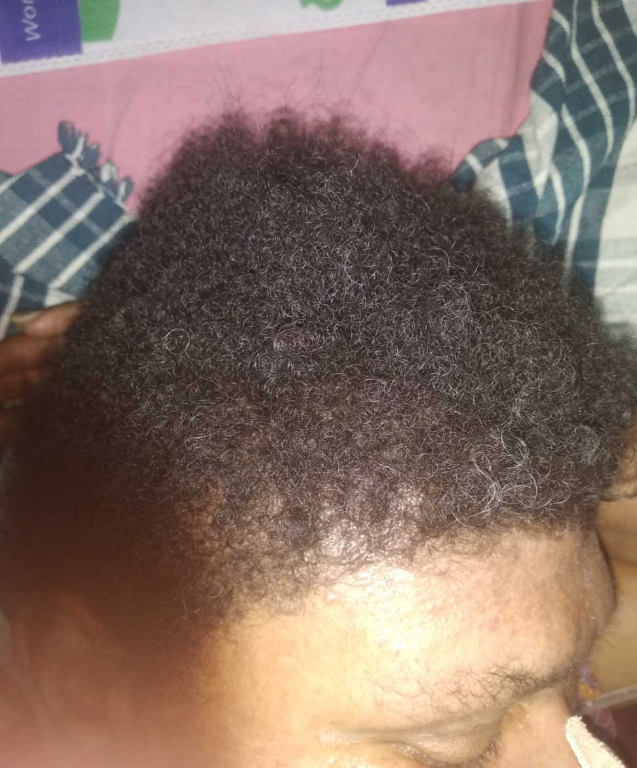

Slide 8
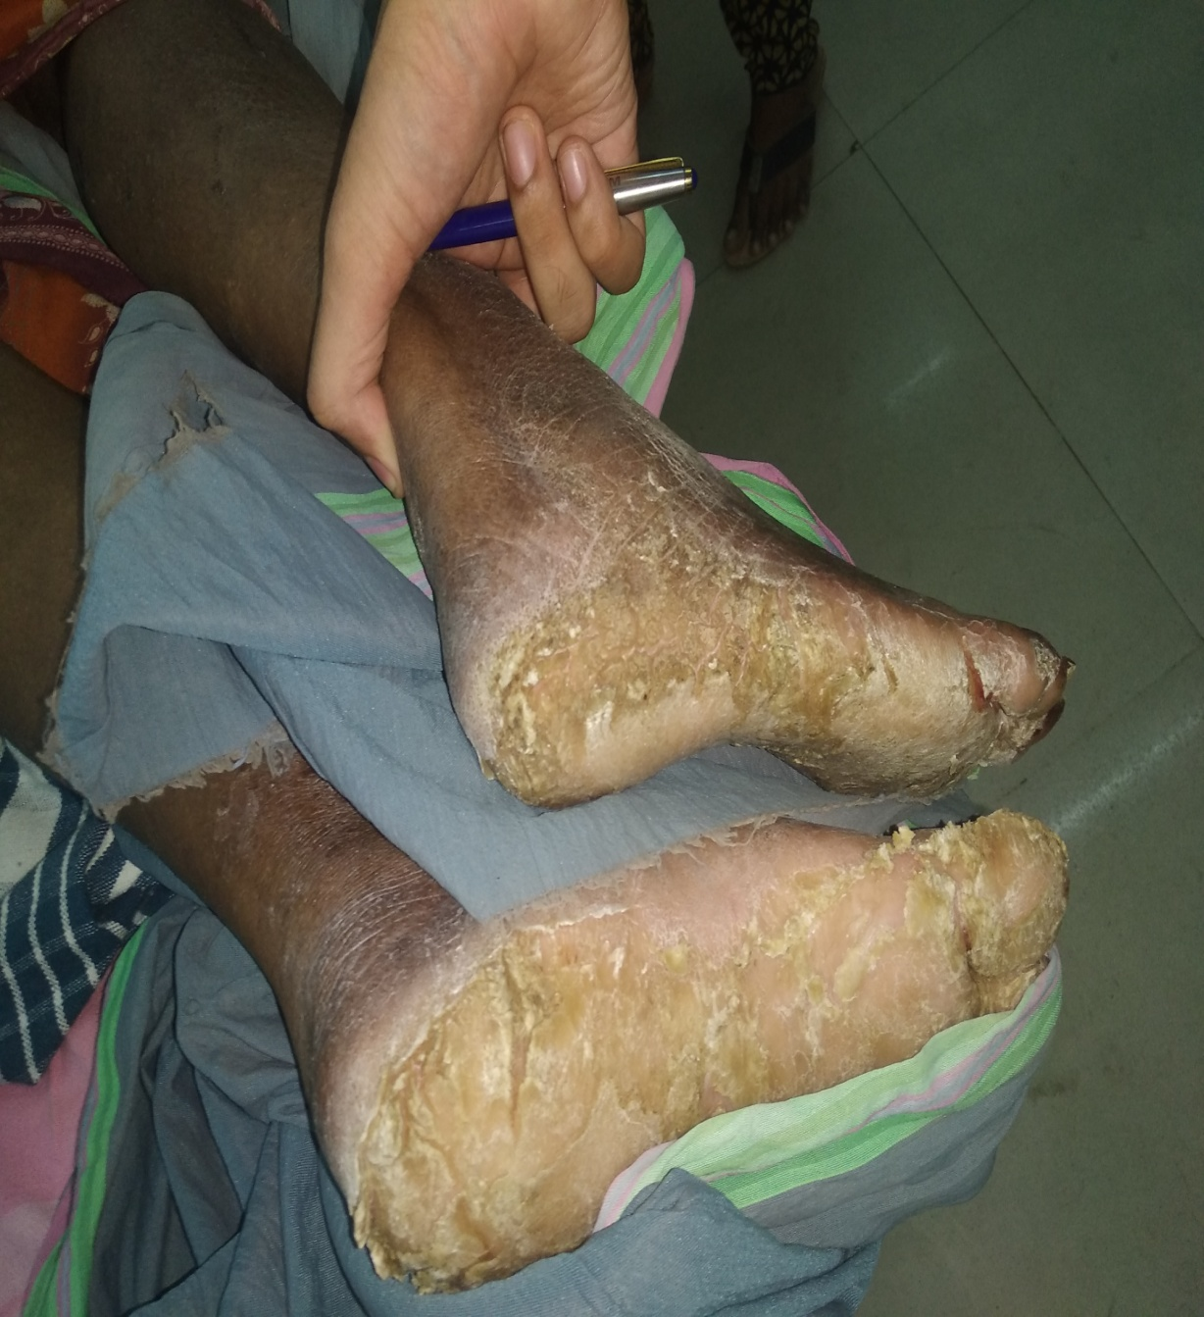
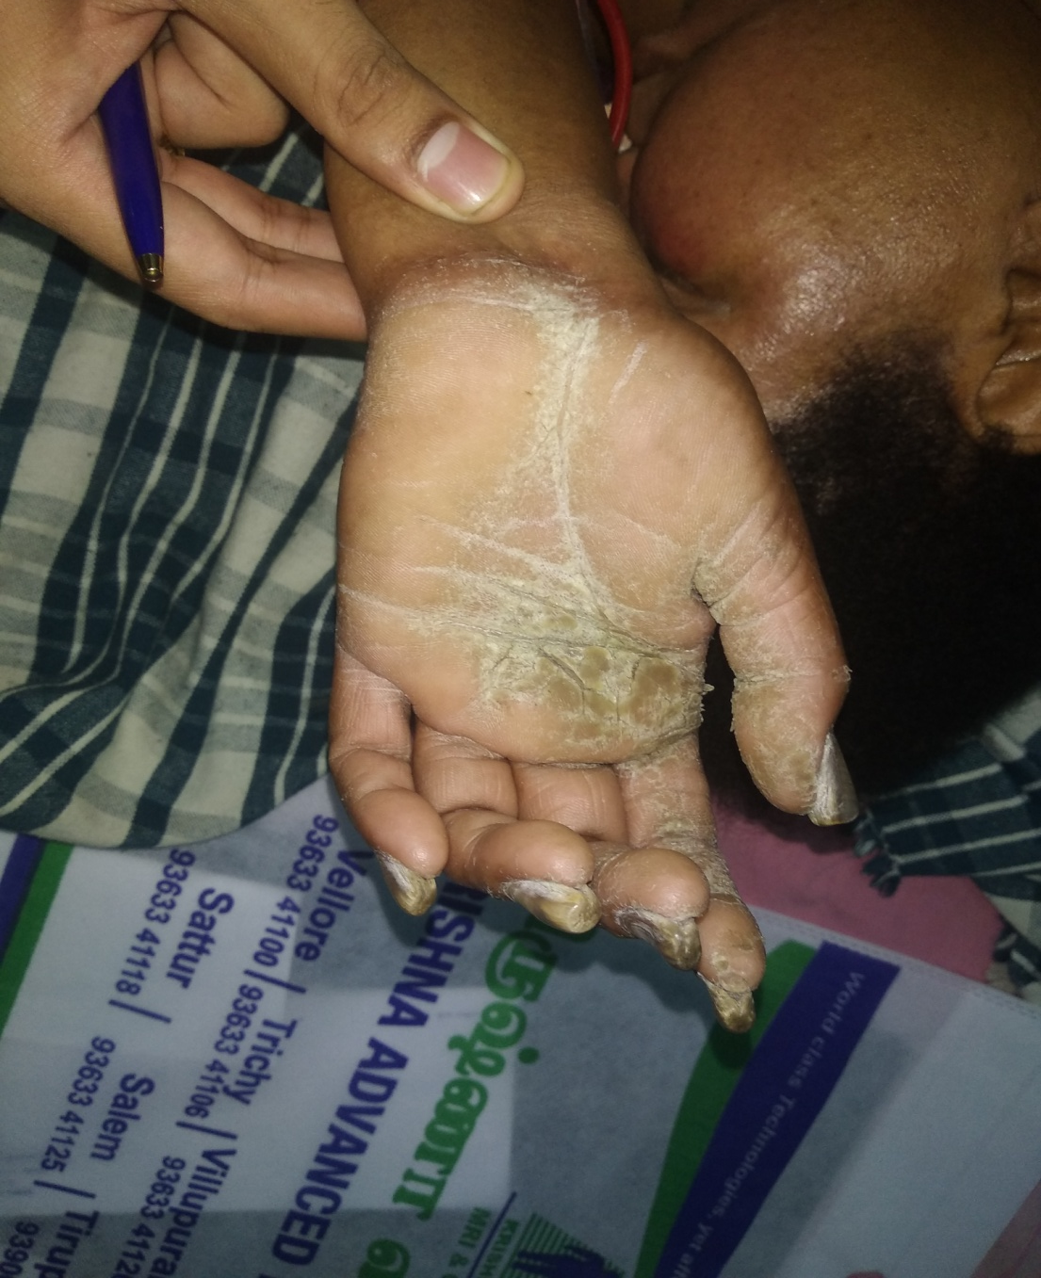

Slide 9
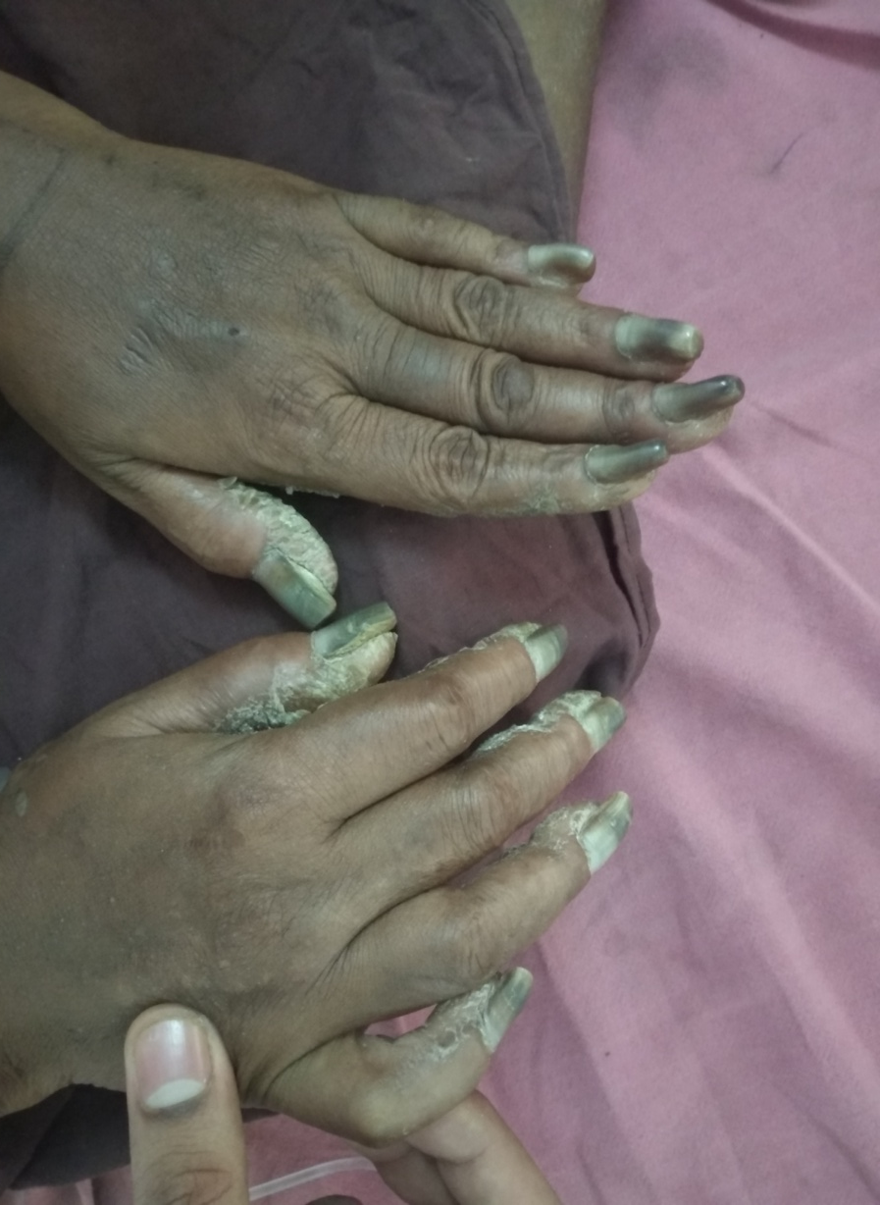
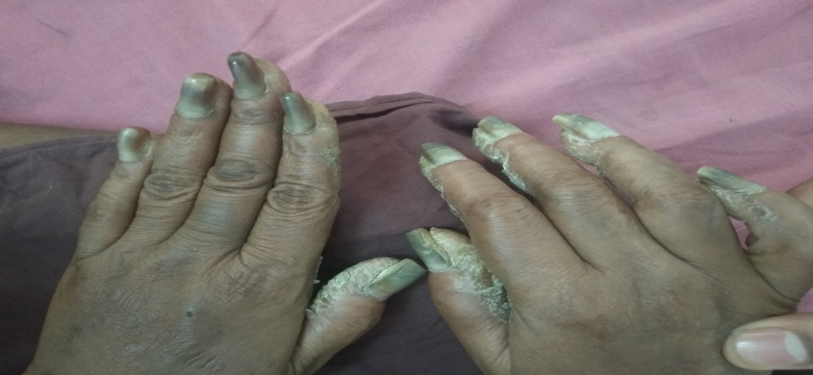
SUB UNGUAL HYPERKERATOSIS AND BEAU LINES

Slide 10
Hair – wooly
Palmar keratosis +
Plantar keratosis +
No similar lesions in trunk or limbs –
Auspitz sign negative
No kobners phenomenon
Milia +
Acneform lesions in skin +

Slide 11
BP- 210 /120 MMHG in R upper limb
PR- 132 / MIN large volume Regular ,
Spo2 96% in right upperr limb
No desaturation in extremities
Afebrile
RR- 14 / MIN no specific pattern

Slide 12
CVS- S1S2+
ESM IN AA +
A2 LOUD
RS- b/l AE+
PA – SOFT BS +
NO RENAL BRUIE

Slide 13
CNS
Pt drowsy
Response to pain +
Paucity of movements in right upper and lower limb + to pain
Facial lag elicited in response to pain
Right upper and lower limb was hypotonic areflexic with left extensor plantar

Slide 14
B/l pupil equal and reacting to light -3mm
No anisocoria
Carotids
– right carotid was feeble and bruie +

Slide 15
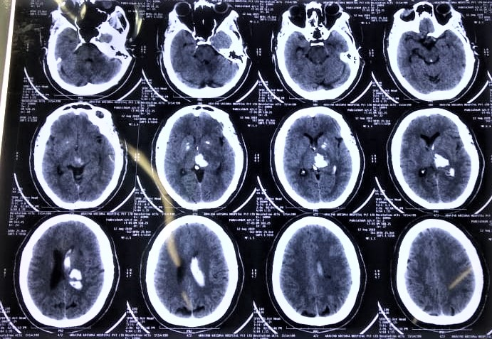
CT BRAIN – BRAIN ....DRAIN

Slide 16
HISTORY – TURNING OUT AS MYSTERY---- ADDING FUEL TO OUR HIII -STORY
FAMLY HISTORY OF SUDDEN CARDIAC DEATH +
FATHER –DIED OF SCD DURING WORK
BROTHER – HAD PANCREATIC DIVISUM AND DIED OF SCD
SIMILAR SKIN LESIONS RUNNING IN FAMILY

Slide 17
PEDIGREE CHART

Slide 18
PIN POINT QUESTIONS TO PIN THE POINT IN DIAGNOSIS
H/O PALPITATIONS ON AND OFF + SUDDEN ONSET AND SUDDEN OFFSET +
NO H/O CHEST PAIN
H/O GIDDINESS +
NO H/O LOC / SEIZURE LIKE EPISODES

Slide 19
SKIN--- THE ART OF WIN
history of wooly hair anomaly right from birth
When patient started crawling patient had lesions in palms and soles and initially it was a bullous lesion then scaly , non itchy
SAME SKIN and hair lesions in her younger sister +
SAME SKIN and hair lesions in younger brother who died due to scd . He had pancreatic divisum

Slide 20
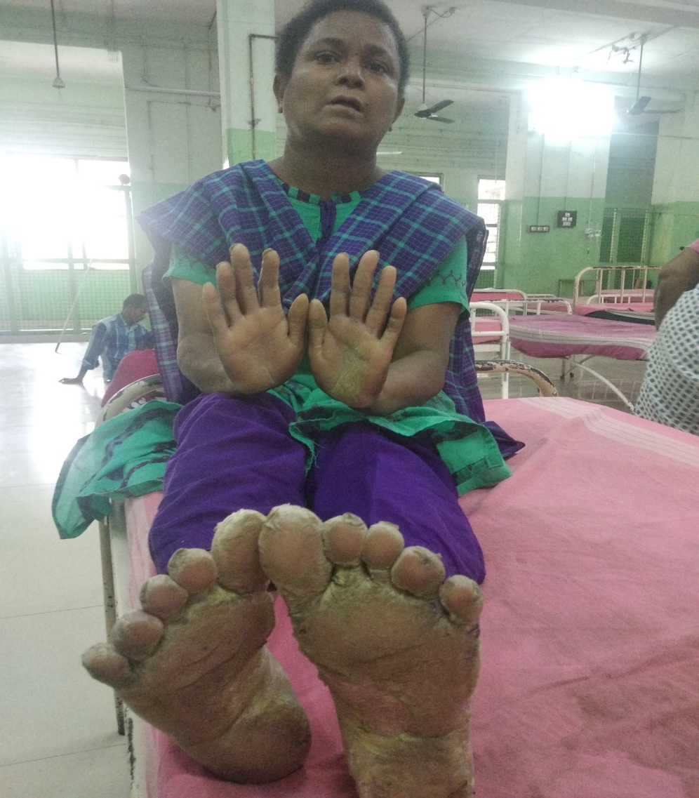
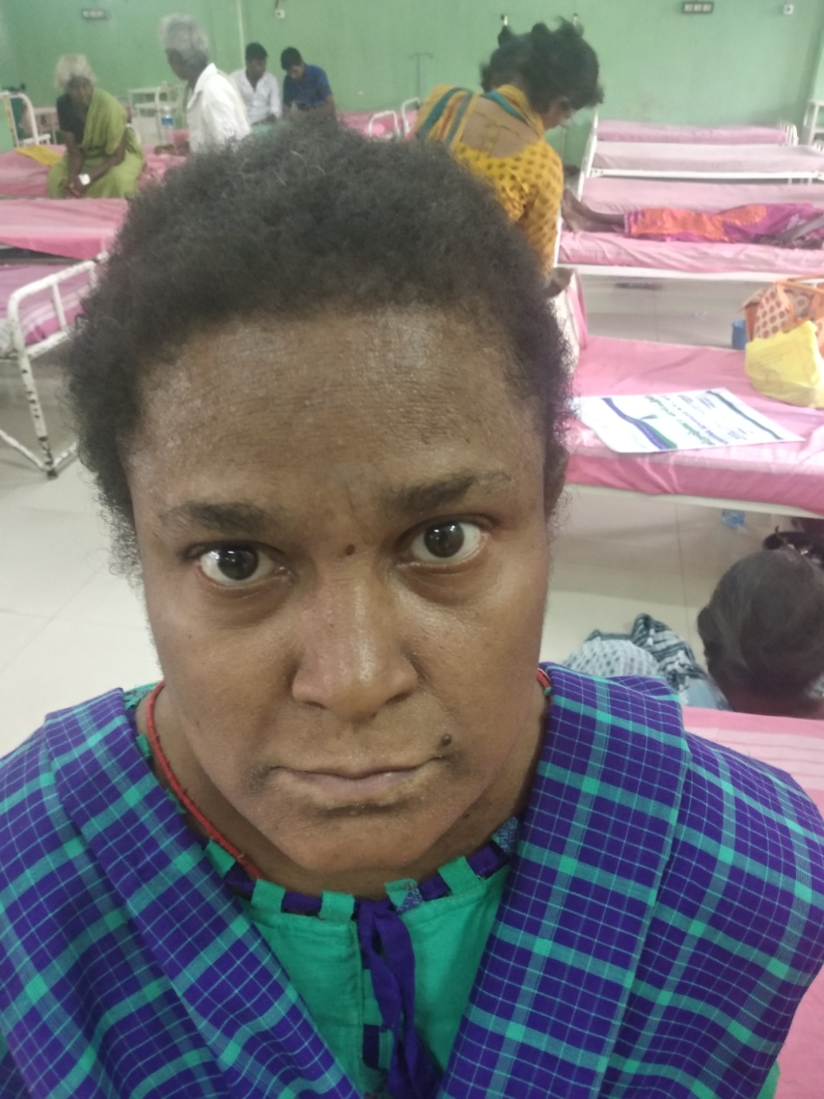

Slide 21
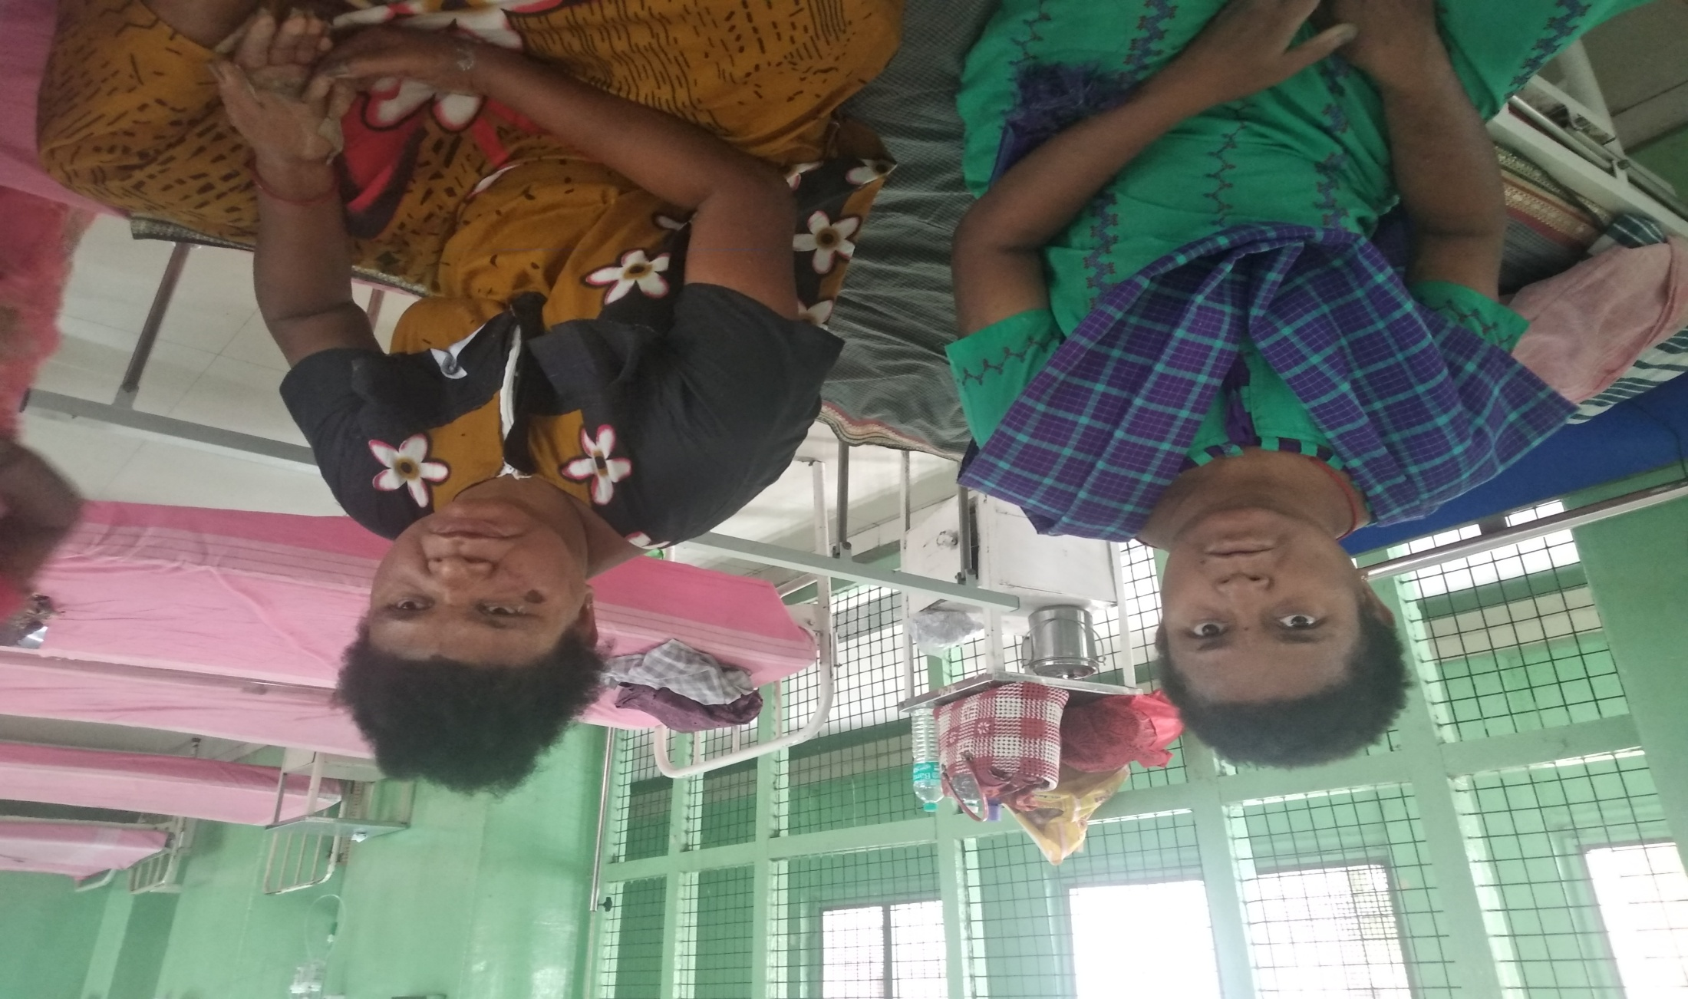

Slide 22
ON ADMISSION – INVESTIGATION OF NO OMISSION
K+ = 3.8
Na+ = 137
Hb- 12.8
Tc- 7800
ESR- 12
PLT – 2.63 L
UREA- 32
CREAT- 1.1
FLP- NORMAL
RBS- 70
COAGUALTION PROFILE NORMAL

Slide 23
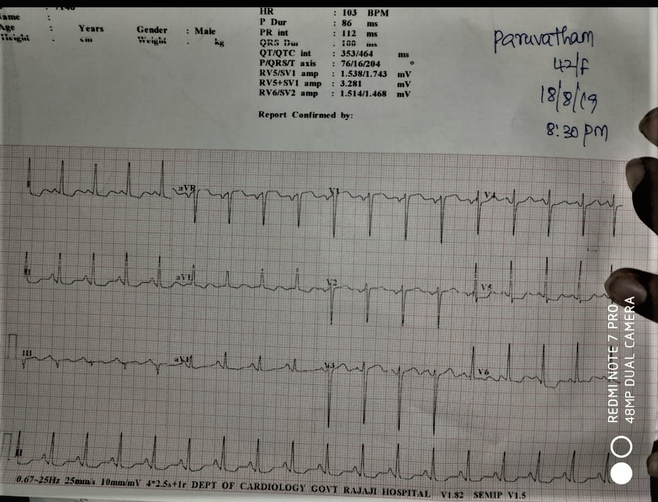
ECG- CAN IT FIND WHAT IS IN THE MIND ?

Slide 24
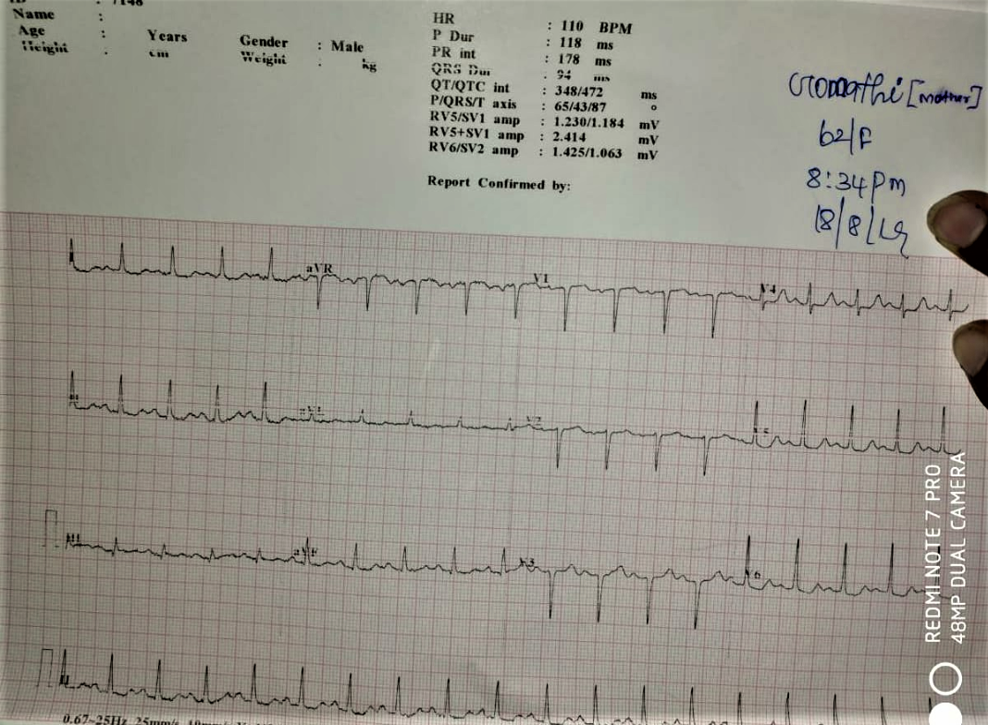
ECG OF FAMILY MEMBERS
FAMILY MEMBERS NOT ONLY SHARE SAME FOOD AND SHELTER BUT ALSO SAME DISEASE TOO...............

Slide 25
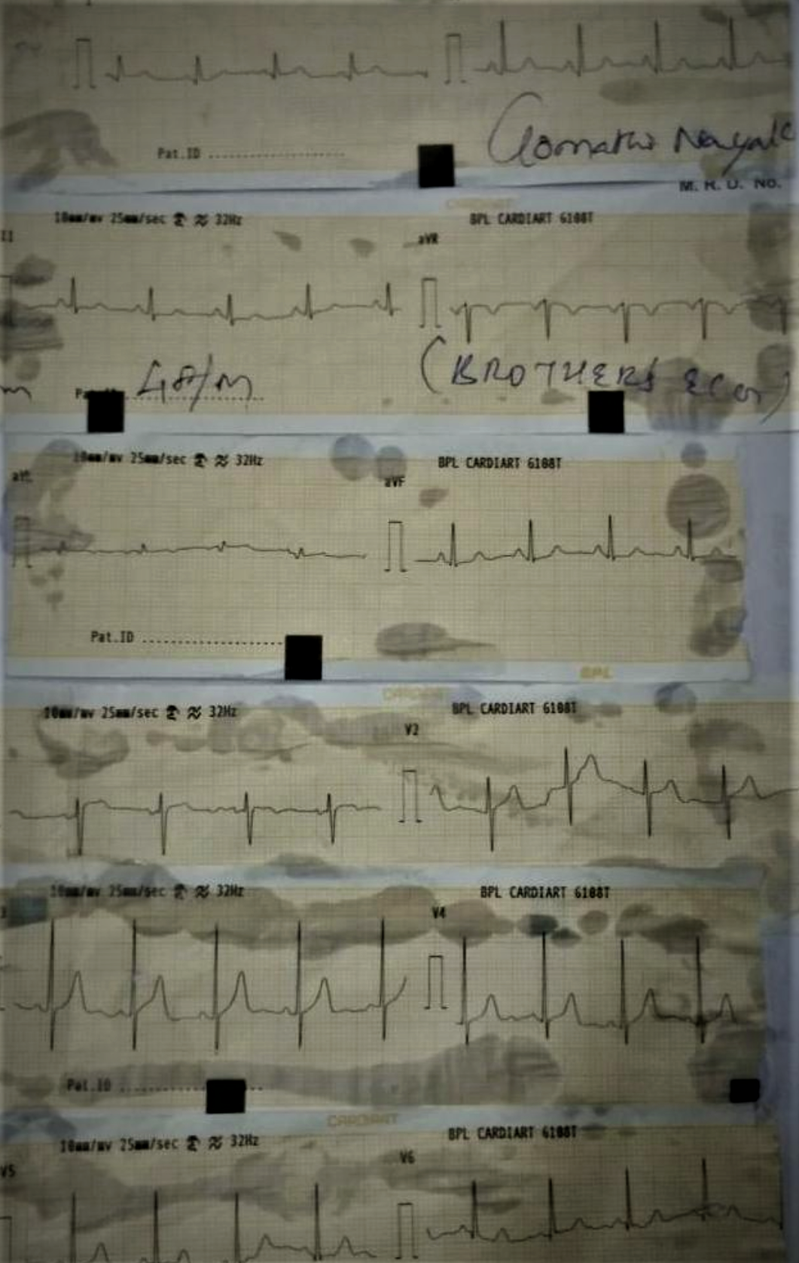

Slide 26
ECHO-- CAN IT PICK UP OUR MINDS ECHO?
EF -60 %
LVH+
NO RWMA
USG ABDOMEN
NORMAL STUDY
RENAL SIZE AND ECHO NORMAL
UTERUS AND OVARIES NORMAL
RENAL ARTERY DOPPLER- NORMAL FLOW

Slide 27
DISEASES DONT PRESENT WITH READING TEXTBOOKS -
A CASE OF ICH --NOT ALL THAT BLEEDS ARE PRIMARILY HEMORRHAGIC
ECHO NOTHING PICKED UP – AT TIMES MISSES AND MESSES
ECG – NO CLASSICAL FINDINGS--- CLASSY IS NOT CLASSY ALWAYS
SONOLOGICALLY NORMAL
CAROTID DOPPLER- RIGHT CAROTID – FLOW LIMITED THROMBOSED

Slide 28
WHAT NEXT ?

Slide 29
CARDIAC MRI WITH CONTAST- A BLACK & WHITE INVESTIGATION THAT THROWED A COLORFUL DIAGNOSIS

Slide 30
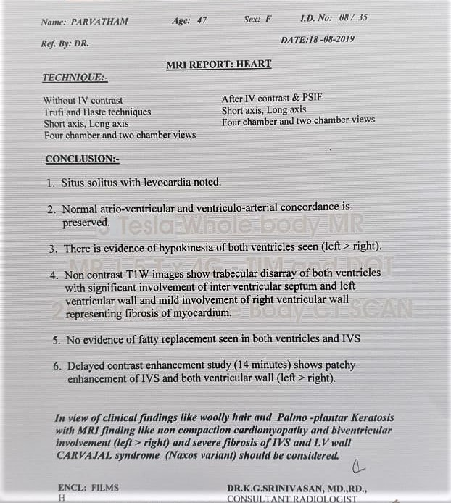

Slide 31
WHAT IS SO SPEACIAL ABOUT THIS CASE ?
RARITY OF THE DISEASE
WHEN PICKED UP EARLIER – SCD CAN BE PREVENTED
IT IS THE RAREST OF RARE CASE WITH RAREST PRESENTATION
FAMILIAL SCREENING
IT IS ONE AMONG THE SINGLE DIGIT CASES FROM INDIA IF REPORTED AND IS THE RAREST OF ITS KIND

Slide 32
SOME CARDIO-CUTANEOUS MARKERS ENCOUNTERED

Slide 33
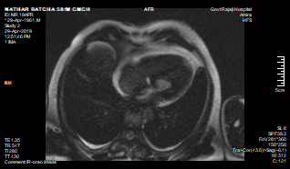

Slide 34
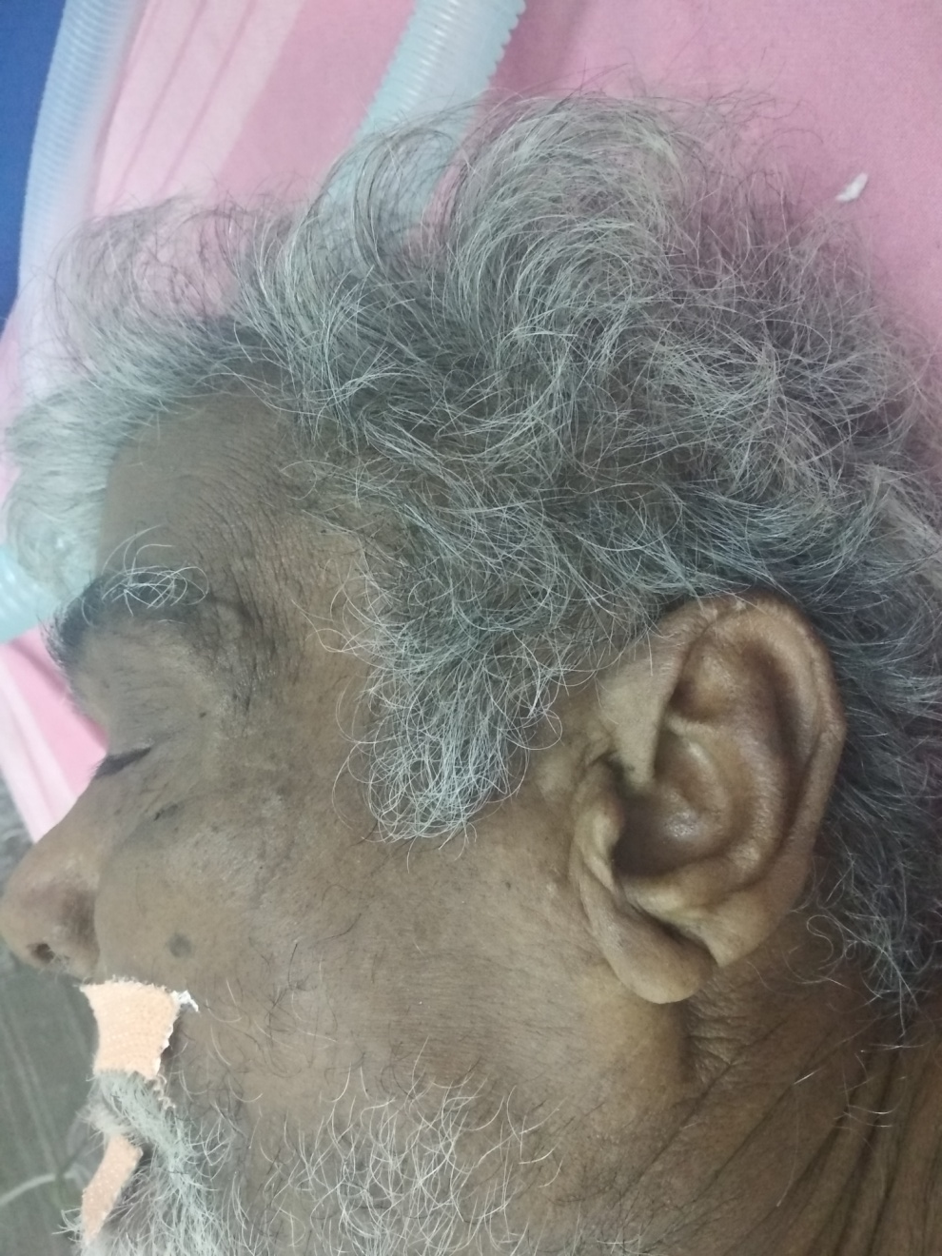

Slide 35
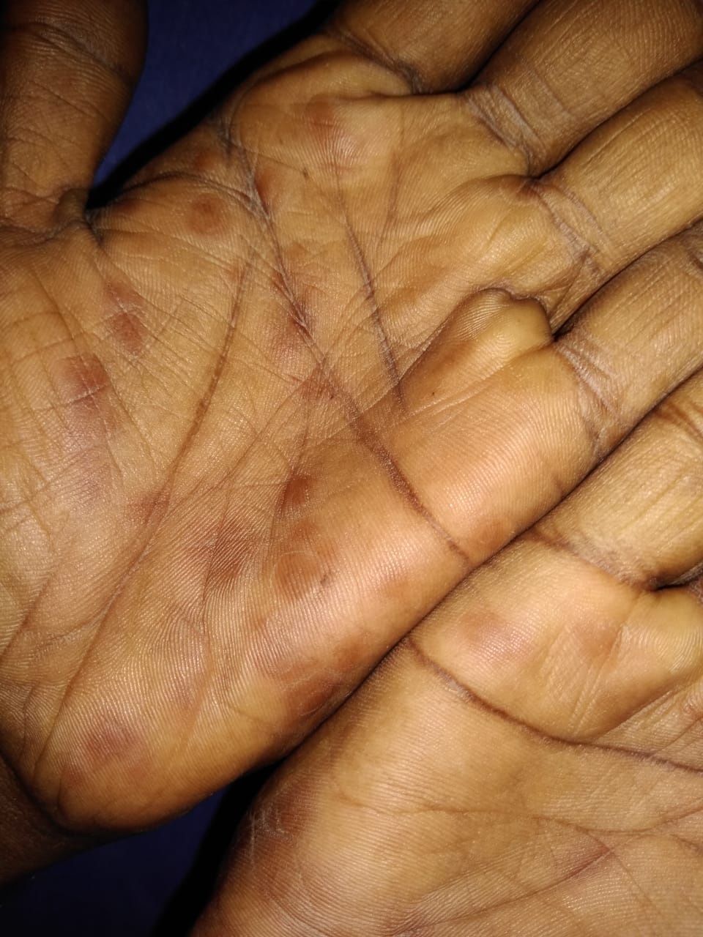
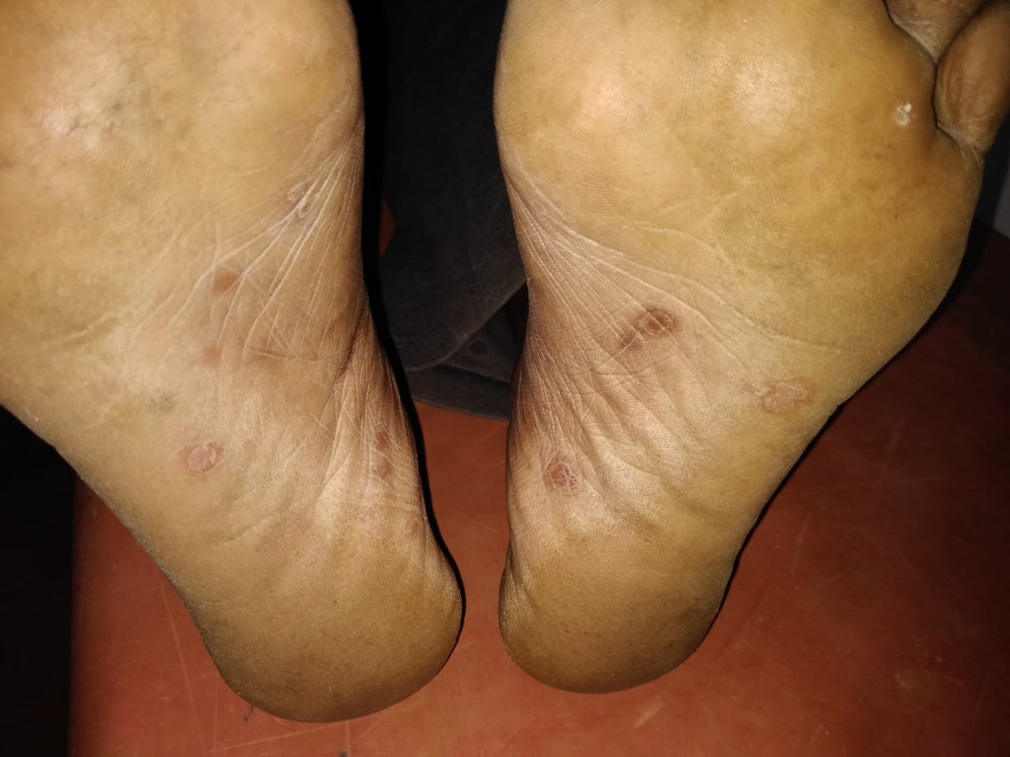

Slide 37
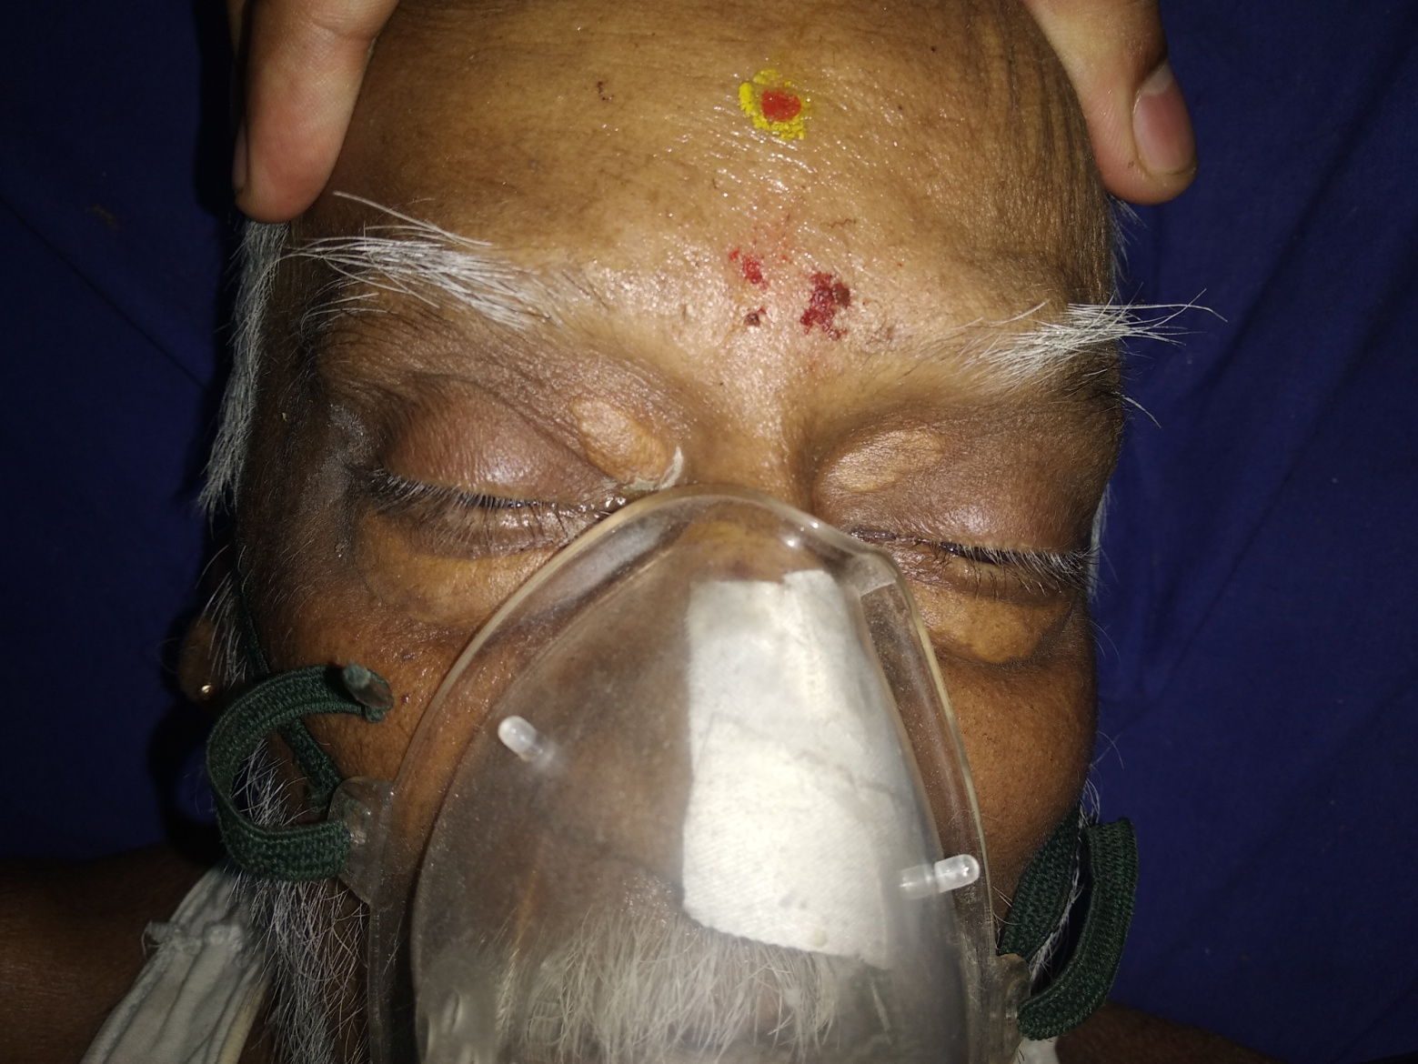

Slide 38
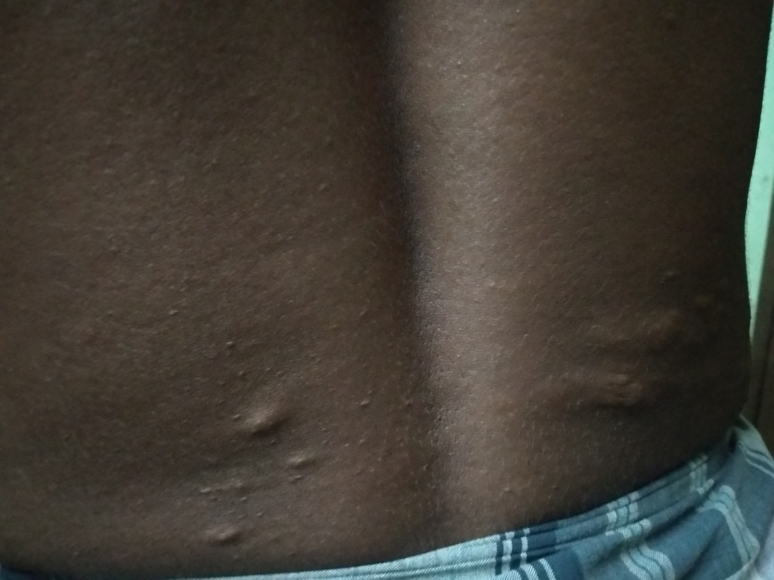
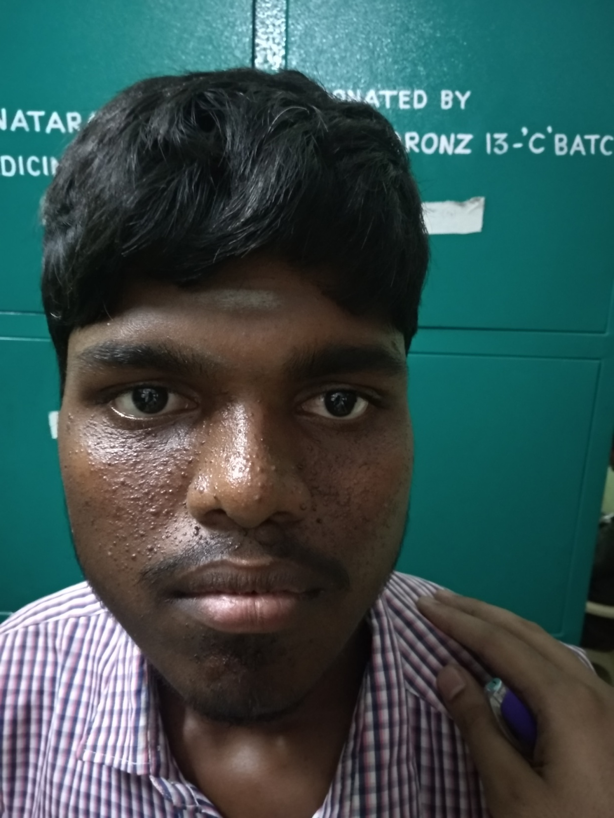
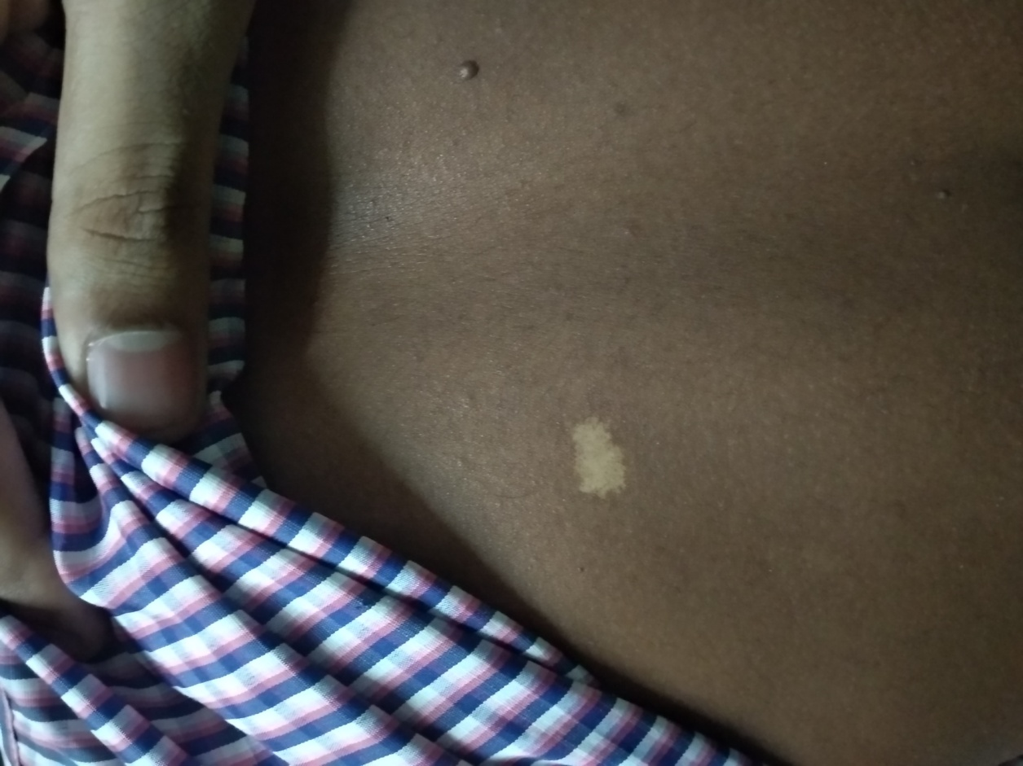

Slide 39
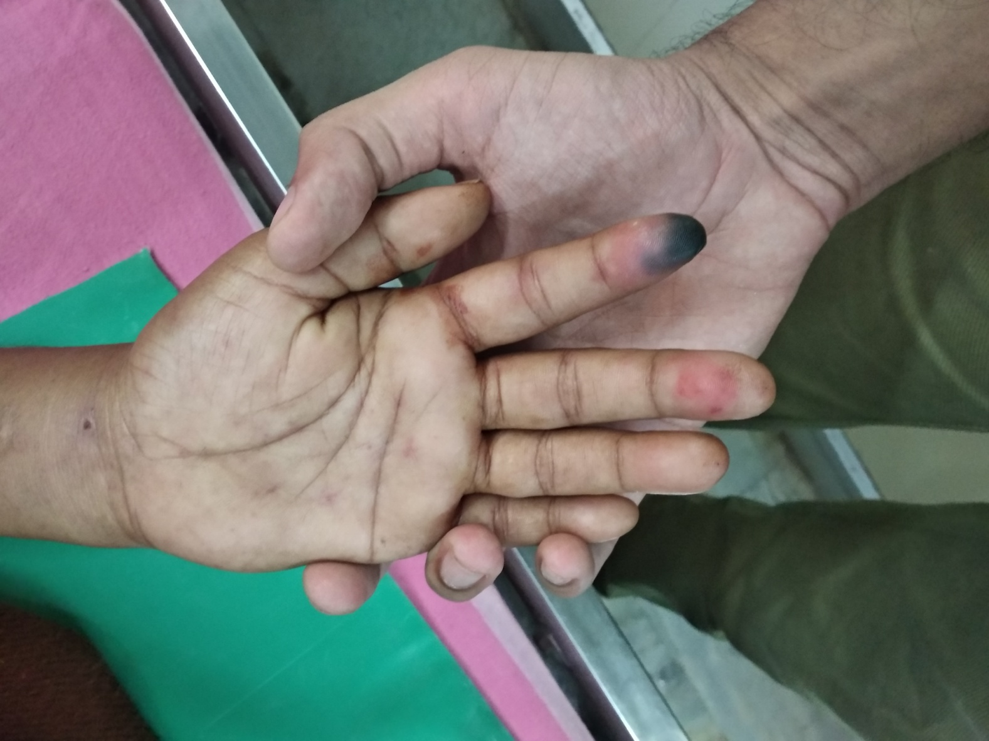
Pt ad fever- thrombocytopenia- on multiple drugs – treated oral iv....developed rash – murmur and tender spleen

Slide 40
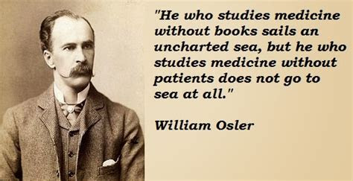
Thank you

