Slide 1
COMPLICATIONS OF MALARIA
UNIT IV
CHIEF : Dr.R.SUNDARAM MD.,
ASSISTANT PROFESSORS : Dr.S.SUGADEV MD.,
Dr.P.KRISHNARAJAN MD.,
PRESENTOR : SHREENIDHI.N

Slide 2
Severe Malaria
Malaria with evidence of any organ dysfunctions as per WHO defined severity criteria is severe malaria.
Individuals with severe malaria may present with altered sensorium, convulsions, oliguria, jaundice, shock, disseminated intravascular coagulation, bleeding manifestations or breathlessness.
Mortality with severe falciparum malaria approaches 100% if untreated and 10–20% with treatment.
Mortality increases with the increasing number of organ dysfunctions.

Slide 3
WHO CRITERIA FOR SEVERE MALARIA
IMPAIRED CONSCIOUSNESS | A Glasgow Coma Scale (GCS) <11 in adults
PROSTRATIONS | Generalized weakness so that the person is unable to sit, stand or walk without assistance
MULTIPLE CONVULSIONS | More than two episodes within 24 h
HYPOGLYCEMIA | Blood or plasma glucose <40mg/dL
METABOLIC ACIDOSIS | A base deficit of >8 mEq/L or a plasma bicarbonate level of <15mmol/L or venous plasma lactate >4
SEVERE ANEMIA | Hemoglobin concentration ≤7 g/dL or a hematocrit of ≤20% in adults with parasite count >10,000/µL

Slide 4
RENAL IMPAIRMENT | Plasma or serum creatinine > 3 mg/Dl or blood urea >20 mmol/L
JAUNDICE | Plasma or serum bilirubin >3 mg/dL with a parasite count >100,000/µL
PULMONARY EDEMA | Radiologically confirmed or oxygen saturation <92% on room air with respiratory rate >30/min, often with chest indrawing and crepitations on auscultation
SIGNIFICANT BLEEDING | Including recurrent or prolonged bleeding from the nose, gums or venipuncture sites; hematemesis or melena
SHOCK | Compensated shock is defined as capillary refill ≥3 s or temperature gradient on leg, but no hypotension. Decompensated shock is defined as systolic blood pressure <80mmHg with evidence of impaired perfusion
HYPERPARASITEMIA | P. falciparum parasitemia >10%

Slide 5
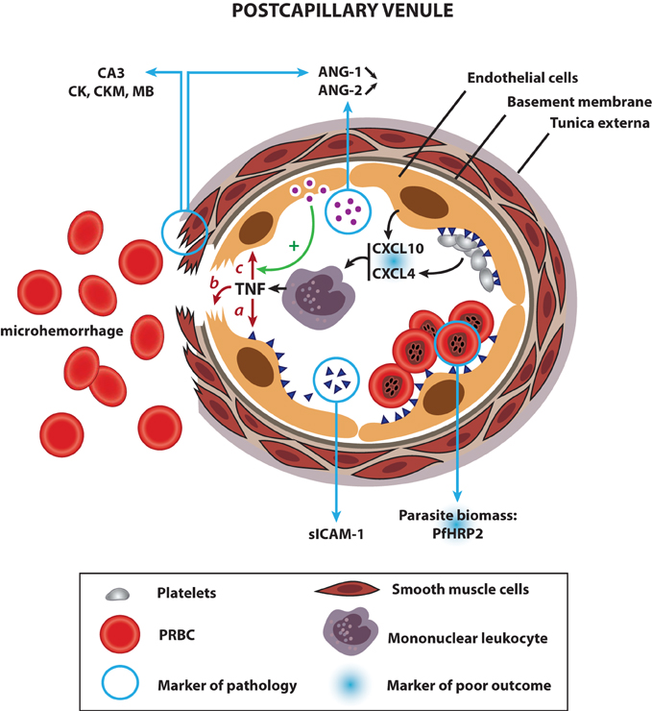
Cerebral Malaria
Impaired consciousness with or without convulsions in the absence of hypoglycemia.
Usually focal neurological deficits and neck stiffness are absent.
Common in children and is due to cytoadherence and sequestration of parasitized RBCs in cerebral vasculature.

Slide 6
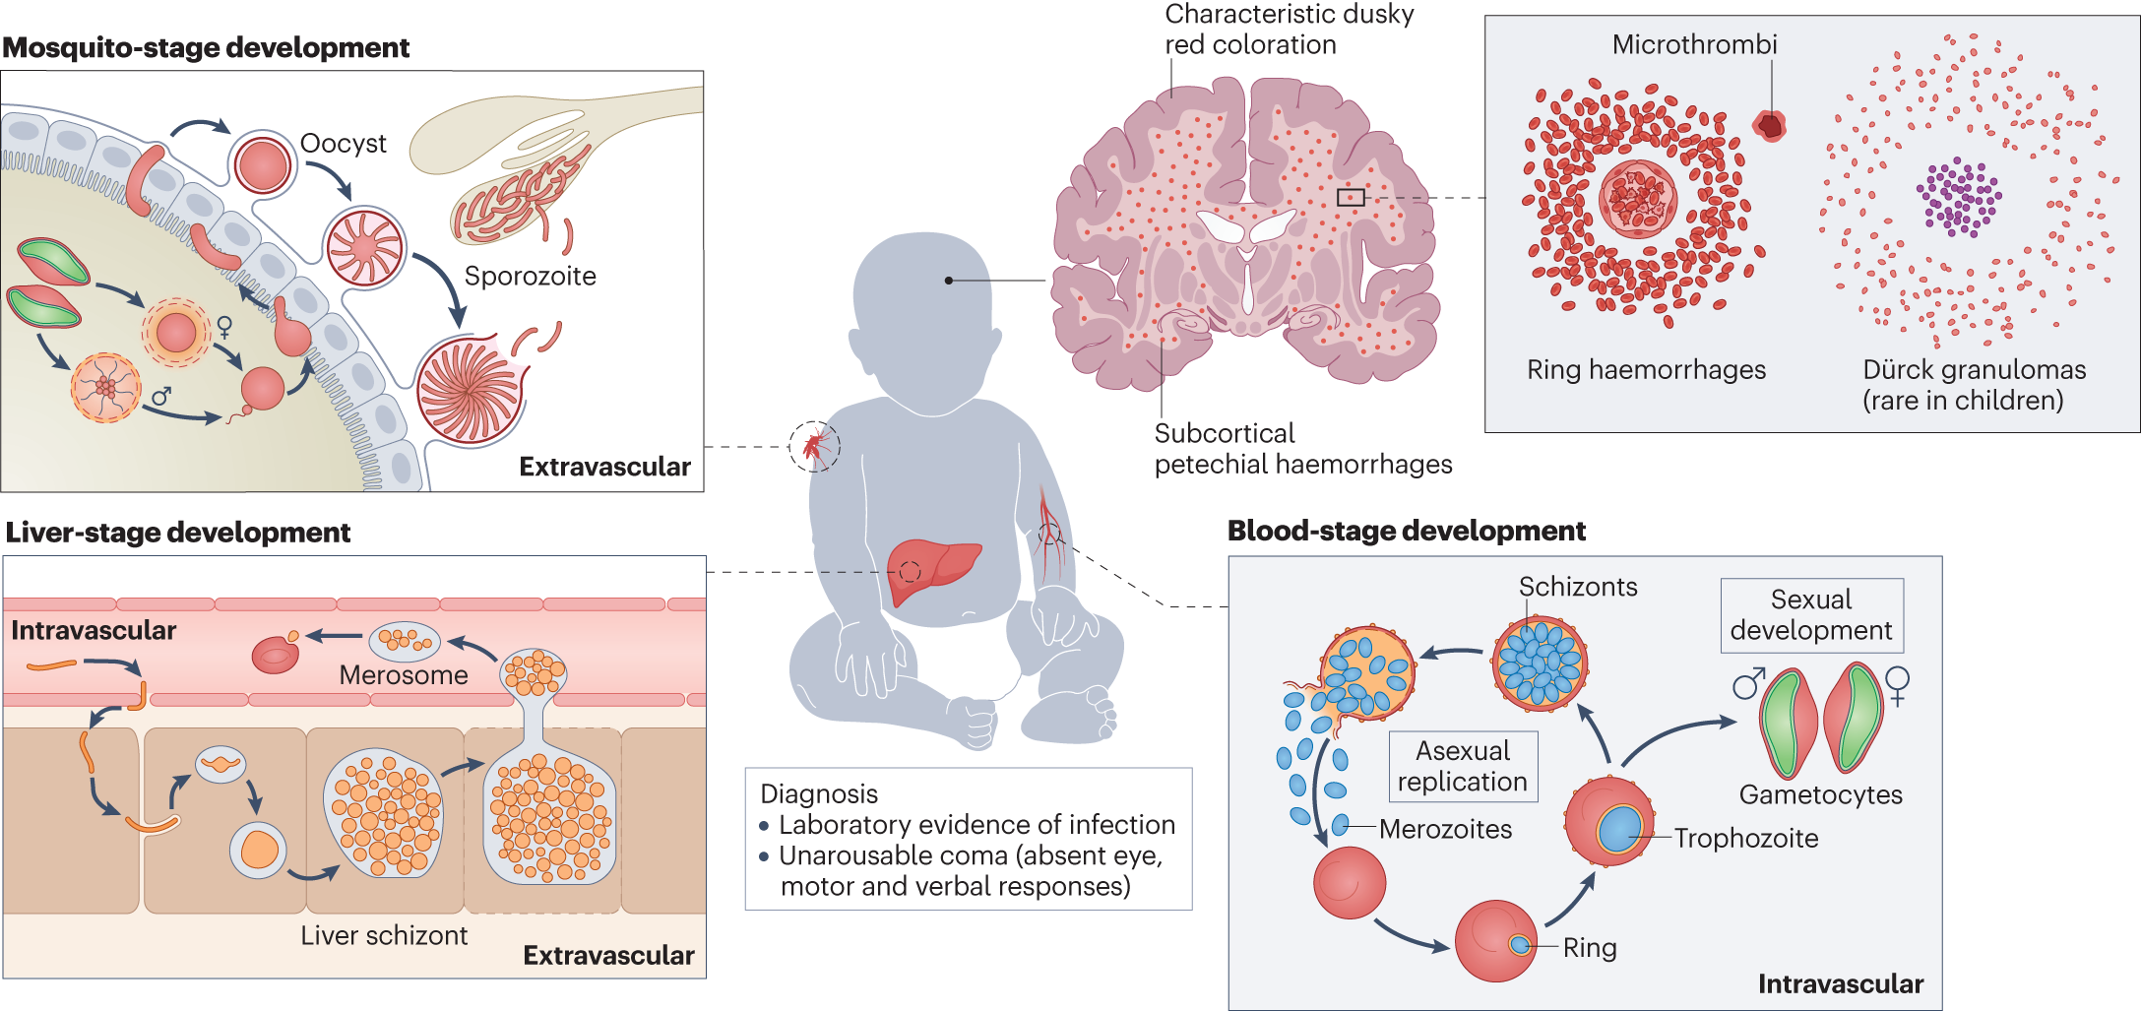

Slide 7
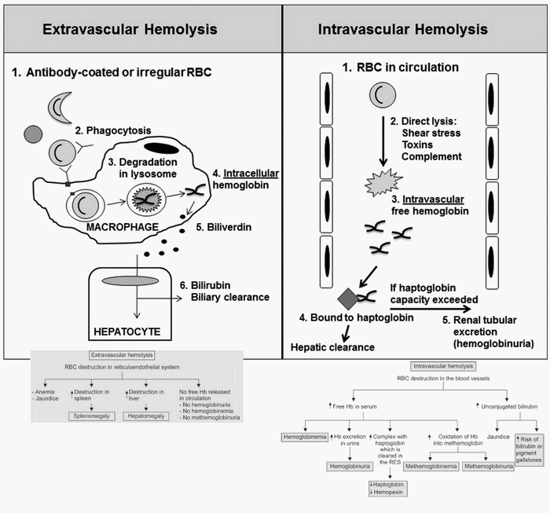
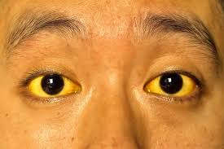
Severe Anemia
Occurs more commonly in children than adults and is due to intravascular hemolysis.
Jaundice
Most common complication seen among patients with severe malaria.
Occurs because of hemolysis.
Both conjugated and unconjugated hyperbilirubinemia and transaminitis is seen due to liver dysfunction.
Attributed to cytoadherence and sequestration in vital organs in addition to the inflammatory mediators.

Slide 8
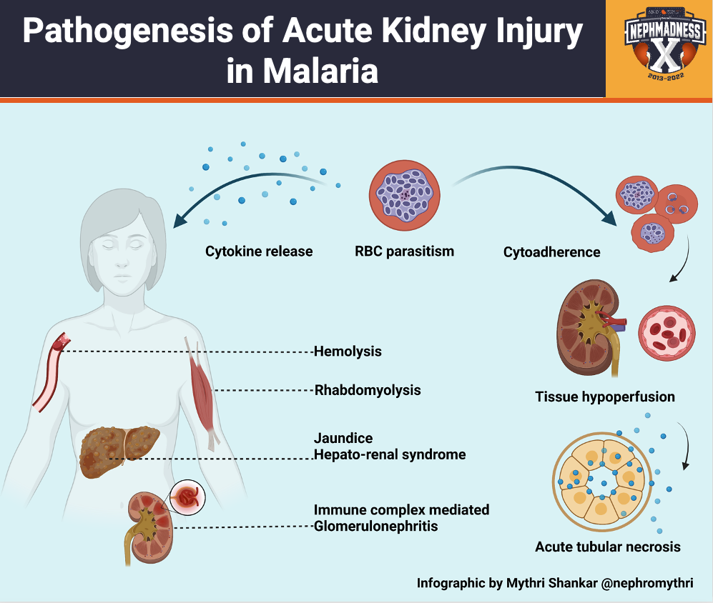
Acute Kidney Injury
Occurs due to hypovolemia due to
vomiting and dehydration,
sequestration of parasites, sepsis,
hypotension or
hemoglobinuria resulting from intravascular hemolysis.

Slide 9
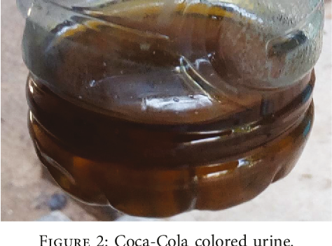
Patients develop metabolic acidosis due to AKI as well as hyperlactatemia resulting from anaerobic respiration.
Black water fever is the term used for severe intravascular hemolysis resulting in dark color urine due to hemoglobinuria, and is precipitated by quinine.

Slide 10
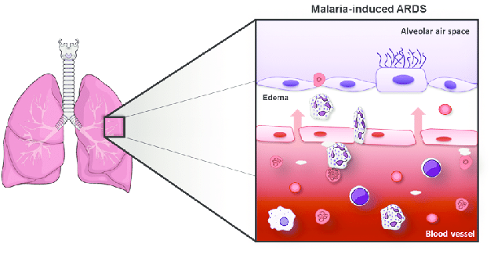
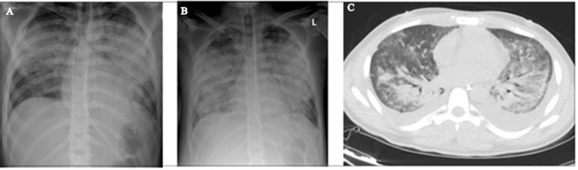
Acute Respiratory Distress Syndrome
Noncardiogenic pulmonary edema may develop due to leaky capillaries. It is more common with P.vivax.
ARDS may develop as a late manifestation even after parasite clearance.

Slide 11
Malaria due to P.ovale, P.malariae and P. knowlesi
P. malariae produces mild acute attacks, however, parasitemia may persist for years with the occasional recrudescence of fever.
P. malariae causes glomerulonephritis and nephrotic syndrome in children.
P. ovale causes mild malaria, with potential to cause relapses.
P. knowlesi malaria can result in full spectrum of illness including severe malaria (with the exception of cerebral malaria) and mortality

Slide 12
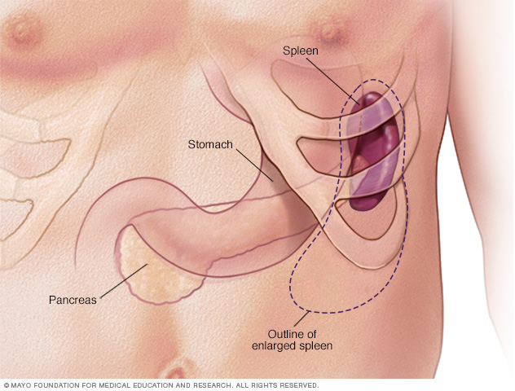
CHRONIC COMPLICATIONS OF MALARIA
Tropical Splenomegaly (Hyperreactive Malarial Splenomegaly)
On exposure to recurrent malarial infections, some residents of endemic area exhibit abnormal immunological response characterized by massive splenomegaly, and hepatomegaly.
Due to a defective CD8 lymphocyte function, there is marked stimulation of B lymphocytes resulting in marked elevation in IgM and malarial antibodies.

Slide 13
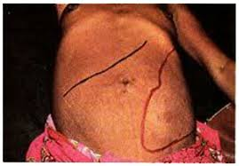
IgM aggregates stimulate reticuloendothelial hyperplasia and clearance activities and eventually produce splenomegaly.
Responds to long term antimalarial chemoprophylaxis such as proguanil.

Slide 14
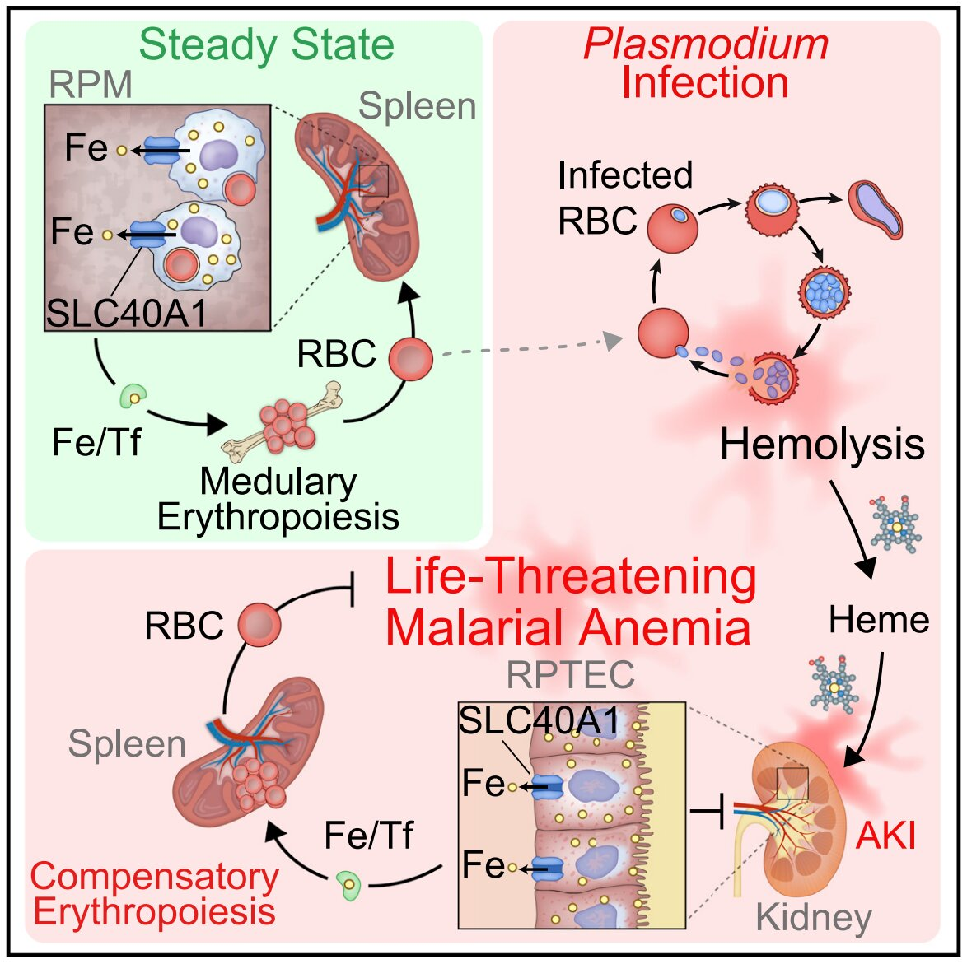
Quartan Malarial Nephropathy
Chronic or repeated infections with P. malariae can cause immune complex mediated glomerulonephritis resulting in nephrotic syndrome.
Usually responds poorly to either antimalarial agents or glucocorticoids and cytotoxic drugs.

Slide 15
Recurrent Malaria
Recurrent malaria is the reappearance of parasitemia after a clearance following acute malaria. They can occur in the following settings.
Recrudescence: Appearance of parasitemia from the blood stage parasite
Relapse: Appearance of parasitemia from the activation of dormant hypnozoites from the liver. Hypnozoites, the dormant liver forms in P. vivax and P. ovale get activated and produce relapses of malaria up to a period of 2 years.
Reinfection: Appearance of parasitemia because of new infection following a mosquito bite

Slide 16
INVESTIGATIONS

Slide 17
Peripheral Smear Examination
The gold standard for diagnosis of malaria is demonstration of asexual forms of the malarial parasite in stained peripheral blood smears.
Romanowsky stains such as Giemsa, or Leishman’s stain can be used.In India we use JSB (Jaswant singh battacharya) stain
Thick and thin blood smears should be examined.
Thick blood smear concentrates the parasite by 40–100-folds and increases the diagnostic sensitivity.
Before a thick smear is judged negative, a minimum of 200 fields should be examined under oil immersion.

Slide 18
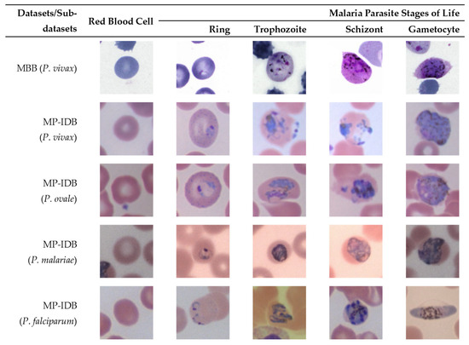

Slide 19
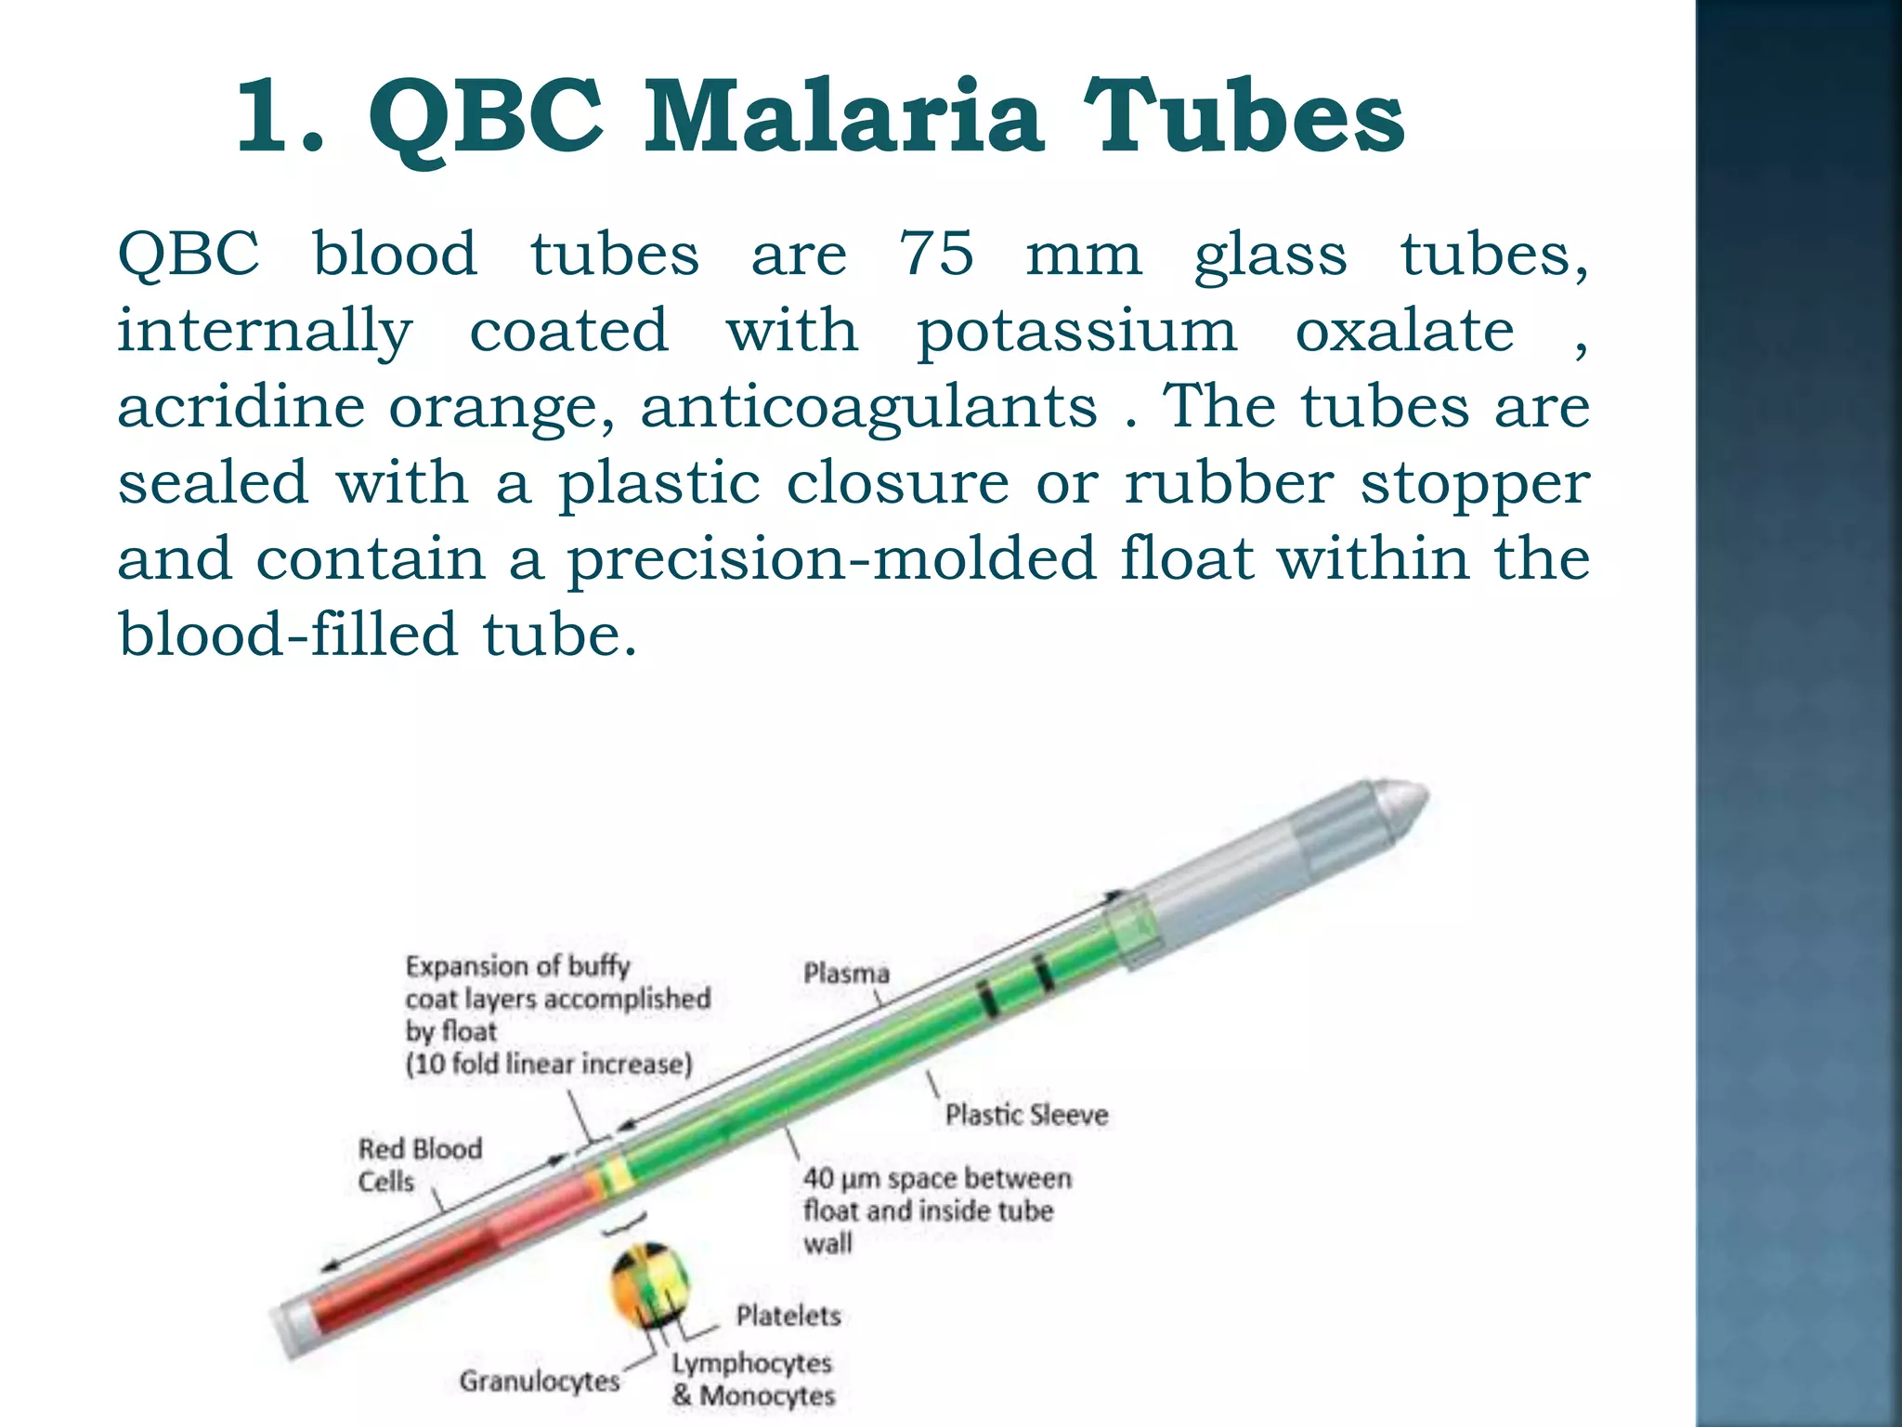
Quantitative Buffy Coat Examination
It is based on acridine orange staining of centrifuged peripheral blood samples in a micro-hematocrit tube and examination under Fluorescence microscopy.
Centrifugation concentrates the RBCs in the QBC tube, making detection easy and fast.
RBCs containing plasmodia are less dense than normal ones and concentrate just below the leukocytes, at the top of the erythrocyte column.
Since the parasites contain DNA which takes up the acridine orange stain, they appear as bright specks of light among the non fluorescing RBCs.

Slide 20
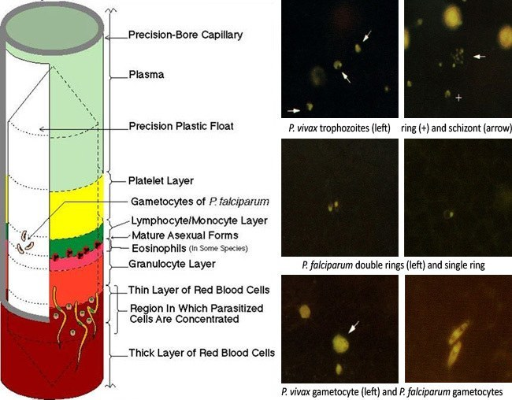

Slide 21
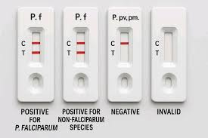
Antigen Detection
Immunochromatographic Test Rapid diagnostic tests based on detection of plasmodium antigens offers rapid, easy way to diagnose malaria in remote areas where microscopy is not available.
The parasite lactate dehydrogenase (LDH) is a plasmodium antigen present in P. falciparum, P. vivax, P. ovale and P. malariae whereas P. falciparum histidine rich protein 2 (PfHRP2) antigen is specific for P. falciparum.

Slide 22
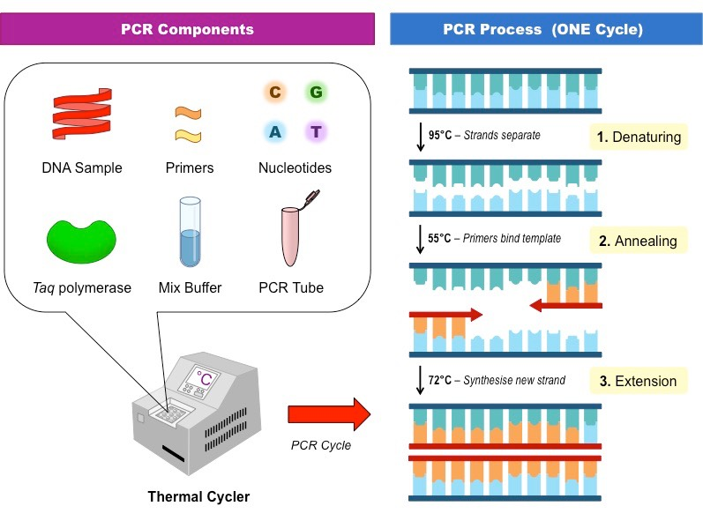
Molecular Diagnostics
Polymerase chain reaction (PCR) are more
sensitive and specific for different species
of plasmodia.
PCR will be required for diagnosis of infection by P.knowlesi.
PCR tests will be useful in epidemiological surveys.

Slide 23
Other Laboratory Tests
Normocytic normochromic anemia, especially in P. falciparum malaria.
Thrombocytopenia in P. falciparum, P. vivax and P. knowlesi infections in about 70 to 80% cases.
WBC count is mostly unaltered except in a few patients with severe malaria which may show leukocytosis.
THANK YOU

