Slide 1
A case of quadriparesis
By 4TH MEDICAL UNIT
CHIEF PROF.DR.S.PEER MOHAMED M.D,
ASST PROF. DR.M.SATHEESH KUMAR M.D,
DR.C.VIGNESH M.D,
DR.V.P.PRIYA M.D.

Slide 2
CHIEF COMPLAINTS :-
A 26 year old female Mrs.Muneeshwari, from virudhunagar admitted with the chief complaints of,
Numbness Of Both Upper And Lower Limb For 3 Months.
Weakness Of Both Upper And Lower Limb For 3 Months

Slide 3
History of presenting illness
The Patient Was Apparently Normal Before 3 Months. After Which She Developed,
H/O numbness Of Both upper & Lower Limbs for 3 months, insidious in Onset,symmetrical,starting in the lower limbs ascends upwards involving upto mid thigh and numbness of upper limbs starting distally and ascends proximally involving upto shoulder in the next 2 months
partly able to feel cloth sensation
able to feel hot and cold water sensation
No h/o band like sensation
No h/o root pain,funicular pain

Slide 4
History of presenting illness
H/O weakness of both upper and lower limbs since 3 months,insidious in onset,symmetrical ,involving distal muscles of upper and lower limbs ,progressive to involve the proximal muscles in the next 2 months and static for past 1 month
h/o difficulty in mixing food
h/o aware slippage of slippers
h/o difficulty in standing from squatting position
h/o difficulty in raising the legs above the ground
h/o difficulty in raising the arms above the ground
No h/o difficulty In rolling over the bed
No h/o difficulty in lifting the head of the pillow
No h/o diurnal variation in the weakness

Slide 5
History of presenting illness :-
No H/O difficulty in appreciating smell
No h/o blurring of vision,double vision,loss of colour vision
No H/O difficulty in eye movements,drooping of eyelids
No H/O difficulty in appreciating sensation over face
No H/O difficulty in chewing food
No H/o deviation of angle of mouth,drooling of saliva,loss of taste
No h/o tinnitus, vertigo,hearing loss
No H/O difficulty in swallowing,nasal regurgitation of food,hoarseness of voice
No H/O difficulty in turning head from side to side
NO H/O difficulty in protruding tongue,making food boluses

Slide 6
History of presenting illness :-
No h/o Giddiness,palpitations,syncope
No h/o headache/LOC/speech/memory disturbances
No history suggestive of bowel and bladder incontinence
Able to perceive bladder fulness
Able to initiate micturition/defaecation
Able to hold urine midstream

Slide 7
History of presenting illness :-
No h/o skin rashes,joint pains,hair loss,early morning stiffness
No h/o altered taste,dental caries,oral thrush,swelling in the cheek
No h/o skin thickening,skin tightening,ulcers,discolouration of digits
No h/o fever
No h/o yellowish discolouration of eyes,skin or urine
No loose stools,blood in stools,abdominal pain ,constipation
No h/o loss of weight /loss of appetite
No h/o swelling in the neck/axilla/groin/night sweats/fever
No h/o bone pains,

Slide 8
PAST HISTORY :-
Not a K/C/O SHTN ,T2dm, Epilepsy, Bronchial Asthma,CAD,CVA,Thyroid disorders
No h/o similar complaints in the past
No h/o drug intake/toxin exposure
No h/o recent vaccination/dog bite/poisoning
H/O BLOOD TRANSFUSION for ANEMIA 3 months back

Slide 9
PERSONAL HISTORY
Mixed Diet
Normal Bowel & Bladder Habits
Not a known smoker/alcoholic
FAMILY HISTORY:
No h/o similar illness in the family
OCCUPATIONAL HISTORY:
She is a home maker

Slide 10
MENSTRUAL AND MARITAL HISTORY
Age at menarche-13 years
Had regular cycles,5/28 days cycle
P2l2a0
Spontaneous conception
no h/o treatment for infertility
No h/o previous abortions

Slide 11
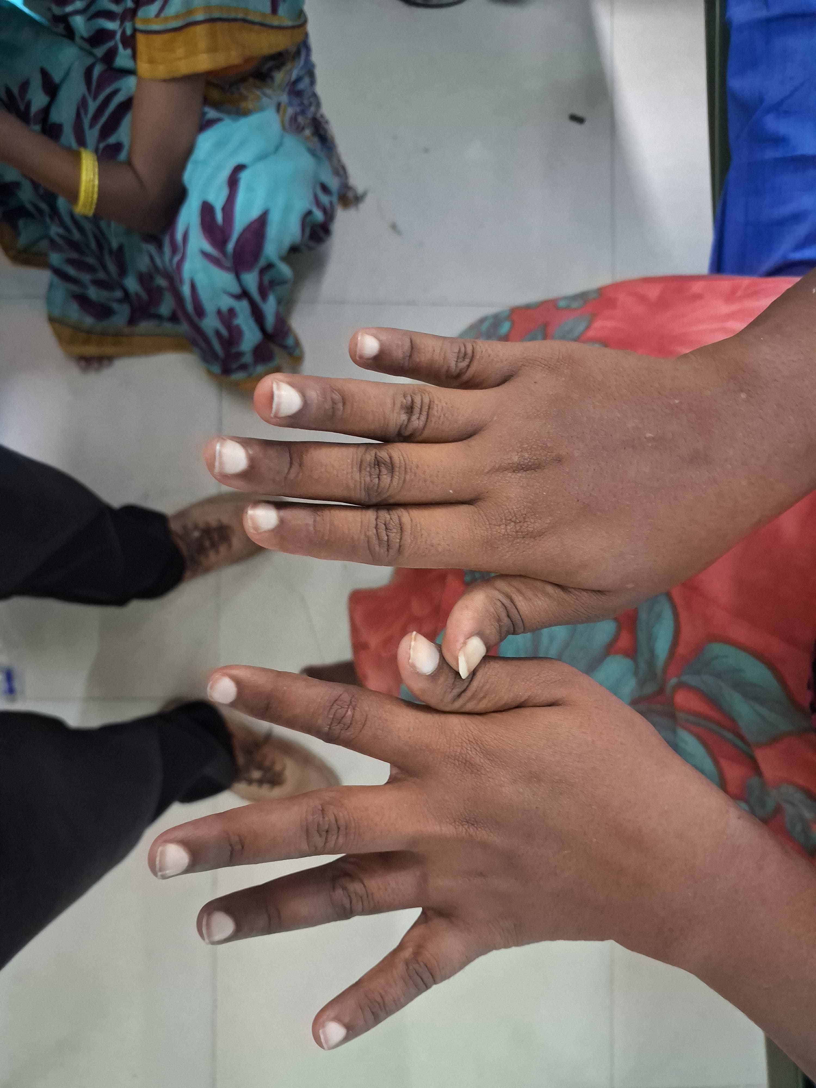
ON EXAMINATION :-
Pt conscious,oriented
Moderately built and moderately nourished
Pallor +
No icterus
No cyanosis
No clubbing
No pedal edema
No generalized lymphadenopathy
Leukonychia +

Slide 12
SYSTEMIC EXAMINATION :-
VITALS :-
BP – 110/70 mmhg
PR – 82 bpm
RR-14 cpm
SpO2 – 98 % @ room air
CVS – S1,S2 +,
NO MURMURS
RS – BAE+,NVBS+
P/A – SOFT, BS+

Slide 13
CNS EXAMINATION Higher mental functions
Conscious
Oriented to time , place and person
Right handed person
Memory- immediate, recent and remote memory – normal
Intelligence – normal
Speech- fluency, comprehension and repetition – normal

Slide 14
Cranial nerve examination
I – Able to perceive olfactory stimulus in both sides equally
II -
 | Right Eye | Left Eye
Visual acuity | 6/6 | 6/6
Field of vision | Normal | Normal
Colour vision | Normal | Normal

Slide 15
III,IV,VI – Extra ocular movements –full in both eyes
No squint or ptosis
Direct and indirect light reflex – normal on both eyes
Accomodation reflex normal on both eyes
V – Touch, pain, temperature sensation equal on both sides of the face
Able to clench the teeth equally on both sides
Corneal and conjunctival reflex normal on both sides
Jaw jerk - absent

Slide 16
VII – Wrinkling of forehead + on both sides Able to close both eyes tightly against resistance Nasolabial fold not obliterated NO Deviation of angle of mouth
Taste sensation in anterior 2/3 of tongue – normal
lacrimation +
VIII- Rinnes test -ac > bc in both sides
Webers test- no lateralisation
ABC – normal

Slide 17
IX, X – Uvula in midline , no deviation
Gag and palatal reflex normal
XI – Able to turn head side to side against resistance
Able to flex the head forward against resistance
Shrugging of shoulder normal on both sides
XII – Tongue – normal in size , no wasting/ fasciculation
No deviation of tongue
Power – normal

Slide 18
Motor system
BULK:
EQUAL ON BOTH UPPER AND LOWER LIMBS.
Tone | Right | Left
Upper limb | Normal | Normal
Lower limb | Normal | Normal

Slide 19
Power |  |  | Right | Left
Upper limb | Shoulder | Flexion | 4/5 | 4/5
 |  | Extension | 4/5 | 4/5
 |  | Abduction | 4/5 | 4/5
 |  | Adduction | 4/5 | 4/5
 |  | Internal rotation | 4/5 | 4/5
 |  | External rotation | 4/5 | 4/5
 | Elbow | Flexion | 4/5 | 4/5
 |  | Extension | 4/5 | 4/5
 | Wrist | Flexion | 3/5 | 3/5
 |  | Extension | 3/5 | 3/5
 | Handgrip |  | 50% | 50%

Slide 20
Power |  |  | Right | Left
Lower limb | Hip | Flexion | 4/5 | 4/5
 |  | Extension | 4/5 | 4/5
 |  | Abduction | 4/5 | 4/5
 |  | Adduction | 4/5 | 4/5
 | Knee | Flexion | 3/5 | 3/5
 |  | Extension | 3/5 | 3/5
 | Ankle | Dorsiflexion | 3/5 | 3/5
 |  | Plantar flexion | 3/5 | 3/5

Slide 21
Reflexes
SUPERFICIAL REFLEXES | RIGHT | LEFT
Conjunctival reflex | + | +
Corneal reflex | + | +
Abdominal relex | - | -
Plantar reflex | No response | No response
DEEP TENDON REFLEX | RIGHT | LEFT
Biceps | absent | absent
Triceps | absent | absent
Supinator | absent | absent
Knee | absent | absent
Ankle | absent | absent

Slide 22
SENSORY SYSTEM | RIGHT | LEFT
Fine Touch | Decreased in both distal UL &LL | Decreased in both distal UL &LL
Pain | Normal | Normal
Temperature | Normal | Normal
Vibration | Decreased in both distal UL &LL | Decreased in both distal UL &LL
Proprioception | Decreased in both distal UL &LL | Decreased in both distal UL &LL
COORDINATION | RIGHT | LEFT
Finger- nose-finger test | Normal | Normal
Finger-finger test | Normal | Normal
Heel – knee test | Normal | Normal
No dysdiadochokinesia

Slide 23
CNS EXAMINATION
No neck stiffness
Kernig’s and Brudzinski sign – negative
Autonomic system examination -Normal

Slide 24
INVESTIGATIONs
 | 17/10/24
T.BIL | 0.2
D.BIL/I.BIL | 0.1/0.1
OT/PT | 16/12
ALP | 93
T.PROT | 5.6
S.ALB/S.GLOB | 2.8/2.7
S.LDH | 780
ESR | 95
S.TSH | 4
S.CALCIUM | 9.1
Q-CRP | 13
 | 17/10/24 | 20/10/24
HB | 8.5 | 7.6
WBC | 10400 | 6200
PLT | 1.86 L | 1.7L
UREA | 48 | 50
CREATININE | 0.9 | 0.8
NA+ | 135 | 133
K+ | 4.6 | 4.0
RBS | 93
S.CPK | 163 | 105
S.CK-MB | 94 | 55

Slide 25
INVESTIGATIONs
URINE | 17/10/24
U.SUGAR | NIL
U.PROTEIN | +++
U.DEPOSITS | NIL
SPOT PCR | 270/09
24HR URINE PROTEIN | 3630 mg
FBS-88 mg/dl PPBS-126 mg/dl HBA1C- 5.2

Slide 26
INVESTIGATIONs
CHG WITH PS –
HYPOCHROMIC MICROCYTIC ANEMIA. RETIC COUNT – 0.9%
USG ABDOMEN AND PELVIS –
NIL SIGNIFICANT ABNORMALITY NOTED.

Slide 27
INVESTIGATIONS
MRI BRAIN WITH SPINE SCREENING :-
NO SIGNIFICANT ABNORMALITY NOTED
OPHTHALMOLOGICAL EVALUATION:
NORMAL FUNDUS

Slide 28
DISCUSSION…..

