Slide 1
IRRITABLE BOWEL SYNDROME
From Medical unit 6
Chief Prof Dr M Rajkumar M.D.,
Assistant professors:
Dr T Balaselvi M D.,D.G.O.,
Dr N P Madhan vignesh M.D.,
Presenter - Harinikha E 2nd year postgraduate

Slide 2
OVERVIEW
DEFINITION
CRITERIA
CLASSIFICATION
EPIDEMIOLOGY
RISK FACTORS
PATHOPHYSIOLOGY
CLINICAL FEATURES
INVESTIGATIONS
TREATMENT
CONCULSION

Slide 3
IBS - Definition
Chronic functional gastrointestinal disorder
Characterized by abdominal pain
Associated with altered bowel habits
No structural abnormality

Slide 4
Rome IV Diagnostic Criteria
Recurrent abdominal pain, on average, at least 1 day per week in the last 3 months,
associated with ≥ 2 of the following criteria:
1.Related to defecation
2. Associated with a change in frequency of stool
3. Associated with a change in form (appearance) of stool.
Criteria fulfilled for the last 3 months with symptom onset at least 6 months prior to diagnosis.

Slide 5
Classification
IBS-C (Constipation predominant)
IBS-D (Diarrhea predominant)
IBS-M (Mixed type)
IBS-U (Unclassified)
Hard/narrow stools, <3 movements per week, straining, and feeling of blockage
Loose stools (<200 mL), urgency, and mucus. Often triggered by stress or food

Slide 6
Epidemiology
Prevalence: 10–15%
More common in females.
Common in young adults (age < 45 yrs).
Chronic relapsing course.

Slide 7
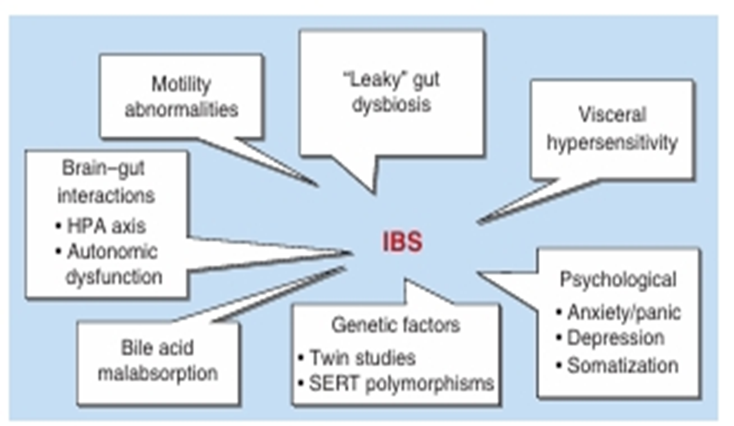
Risk Factors
Family history
Emotional stress, anxiety
Young age
Food intolerance
GI infections
Antibiotic use
Sleep disorders

Slide 8
PATHOPHYSIOLOGY
GI Motor Abnormalities
Postprandial hypermotility: IBS patients show ↑ rectosigmoid motor activity for up to 3 hours after meals.
Increased HAPCs (IBS-D): Higher motility index & amplitude → rapid transit + abdominal pain.

Slide 9
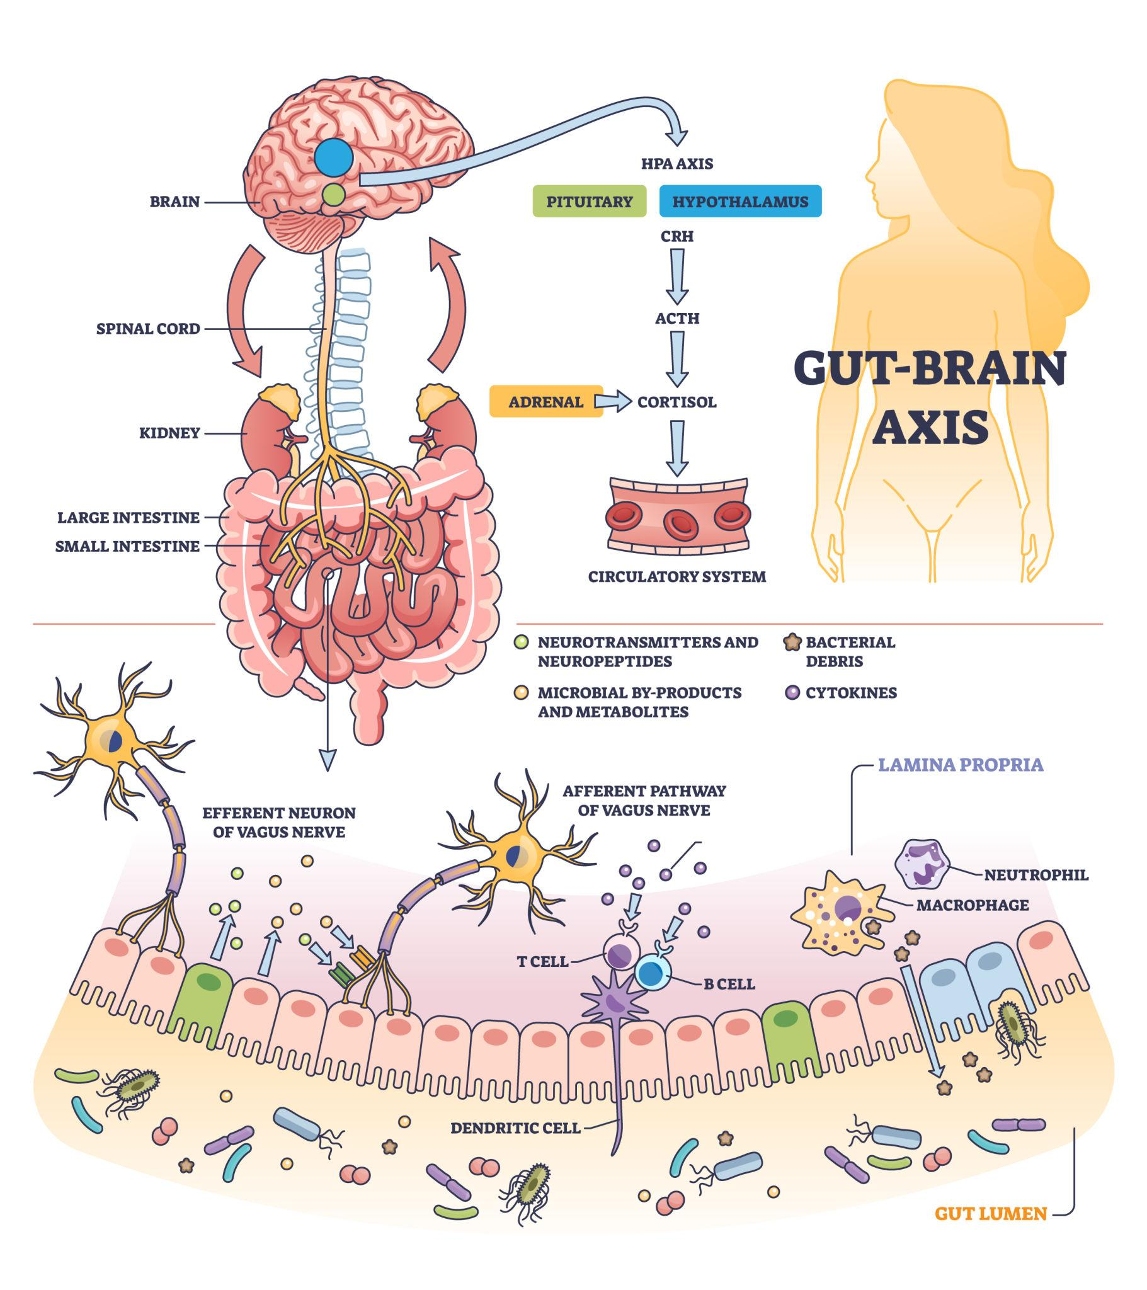
Gut-brain axis dysfunction
Brain–gut axis dysfunction: Stress & emotional disorders worsen IBS.
Altered brain activation: ↑ mid-cingulate cortex activity → affects attention & perceived unpleasantness of pain.
Hypervigilance: ↑ prefrontal cortex activation → heightened alertness → contributes to cerebral dysregulation.

Slide 10
Visceral Hypersensitivity
Visceral hypersensitivity: IBS patients perceive pain/discomfort at lower rectal distension volumes → selective visceral afferent dysfunction.
Food-related sensitivity: ↑ perception of food intolerance; lipids further lower pain thresholds → explains postprandial symptoms (gastrocolic response).

Slide 11
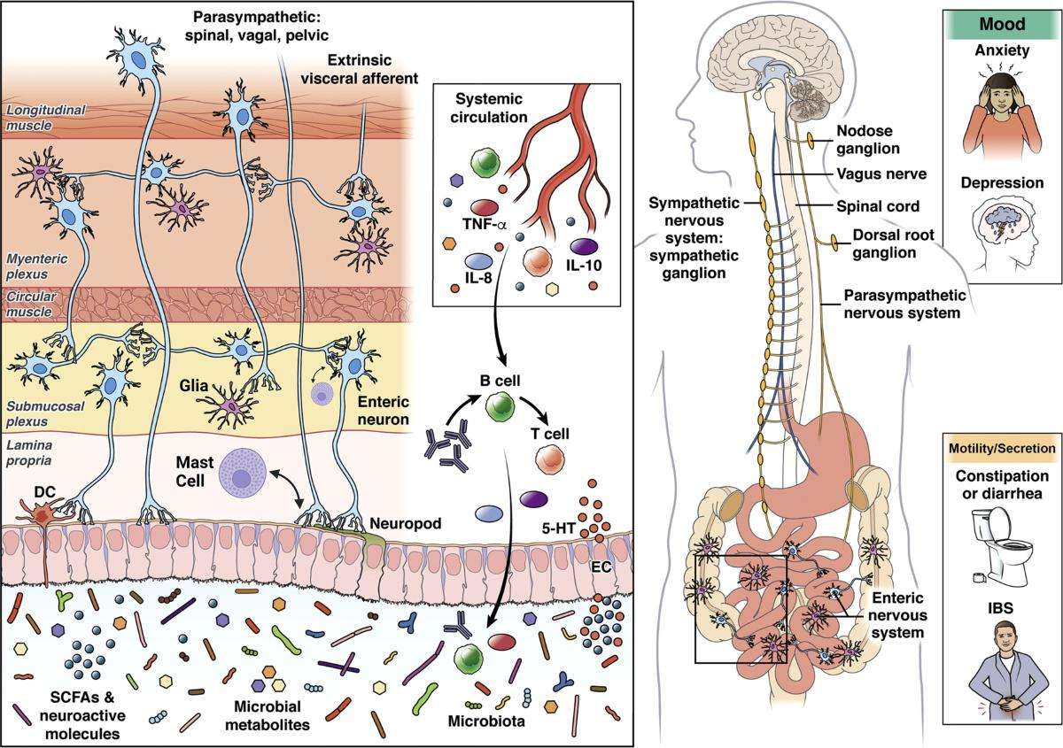
abnormal Psychological Features
psychological association: Up to 80% have psychiatric features; stress alters pain thresholds and symptom severity.
Early life factors: Genetic/epigenetic influences + history of abuse → affect brain networks (emotional, autonomic, sensory integration).
Altered pain processing: Enhanced visceral sensitivity persists; ↑ cingulate cortex activation → ↑ pain perception & distress.

Slide 12
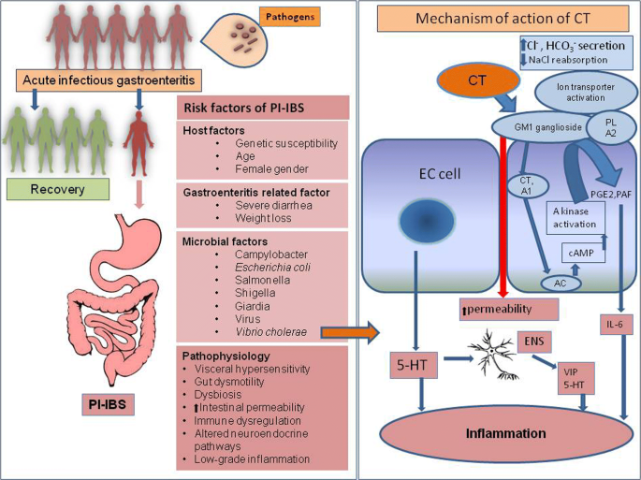
Postinfectious IBS
Post-infectious IBS (PI-IBS): ~10% develop IBS after acute enteritis; ~4× risk. Common organisms → Campylobacter jejuni, Salmonella, Shigella, pathogenic E. coli; parasites like Giardia lamblia
Mechanism: Persistent low-grade inflammation (↑ enteroendocrine cells, T-cells), post-infectious dysbiosis (e.g., altered Bacteroides, Firmicutes, ↓ Lactobacillus/Bifidobacterium) → ↑ gut permeability & visceral hypersensitivity.

Slide 13
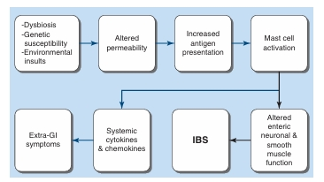
Immune Activation and Mucosal Inflammation
Low-grade inflammation: ↑ lymphocytes, mast cells, and proinflammatory cytokines (IL-6, IL-1β, TNF) → ↑ permeability & abnormal secretion.
Mast cell–nerve interaction: Activated mast cells release histamine, proteases, PGE₂ near nerve fibers → correlates with abdominal pain & visceral hypersensitivity.
TRPV1 sensitization: ↑ TRPV1 channel expression in gut sensory neurons → amplifies pain signaling and maintains hypersensitivity.

Slide 14
Altered Intestinal Permeability
Barrier dysfunction: Impaired intestinal permeability (especially IBS-D & post-infectious IBS) → correlates with symptom severity.
Structural & functional changes: ↓ tight junction proteins → ↑ passage of macromolecules/bacteria across epithelium.
Contributing factors: Stress, diet, dysbiosis, and mast cell activation → key drivers of barrier disruption.

Slide 15
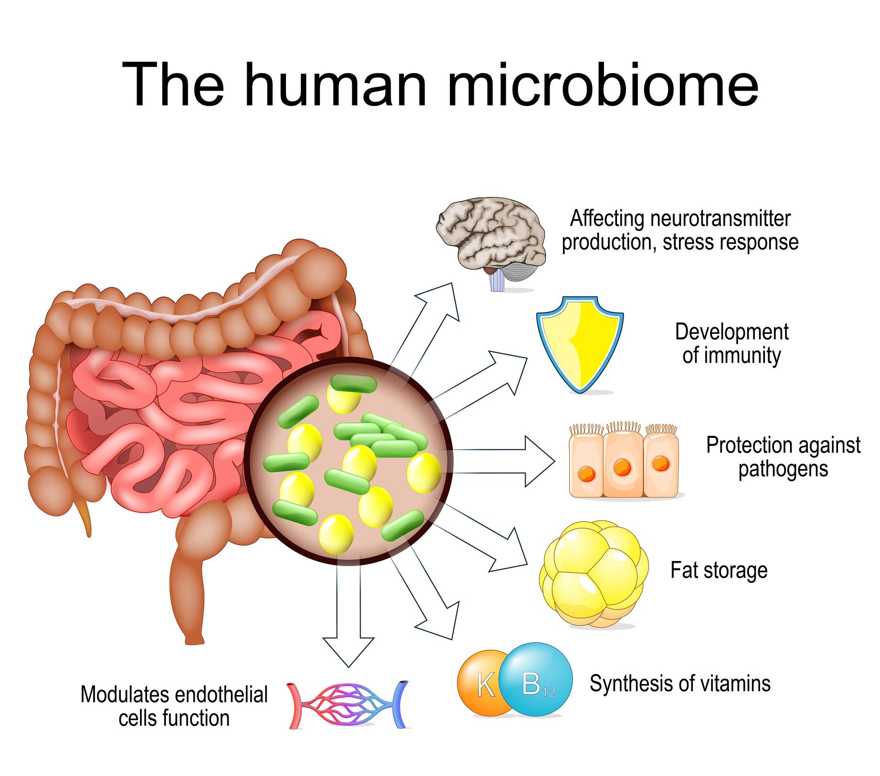
Altered Gut Flora
Gut dysbiosis pattern: ↓ Bifidobacterium, Faecalibacterium; ↑ Enterobacteriaceae, Lactobacillaceae, Bacteroides → ↓ microbial diversity in IBS.
Pathophysiology: Dysbiosis → ↑ permeability & antigen exposure → mast cell activation, cytokine release → visceral hypersensitivity, altered motility, and even extra-GI symptoms (fatigue, anxiety).

Slide 16
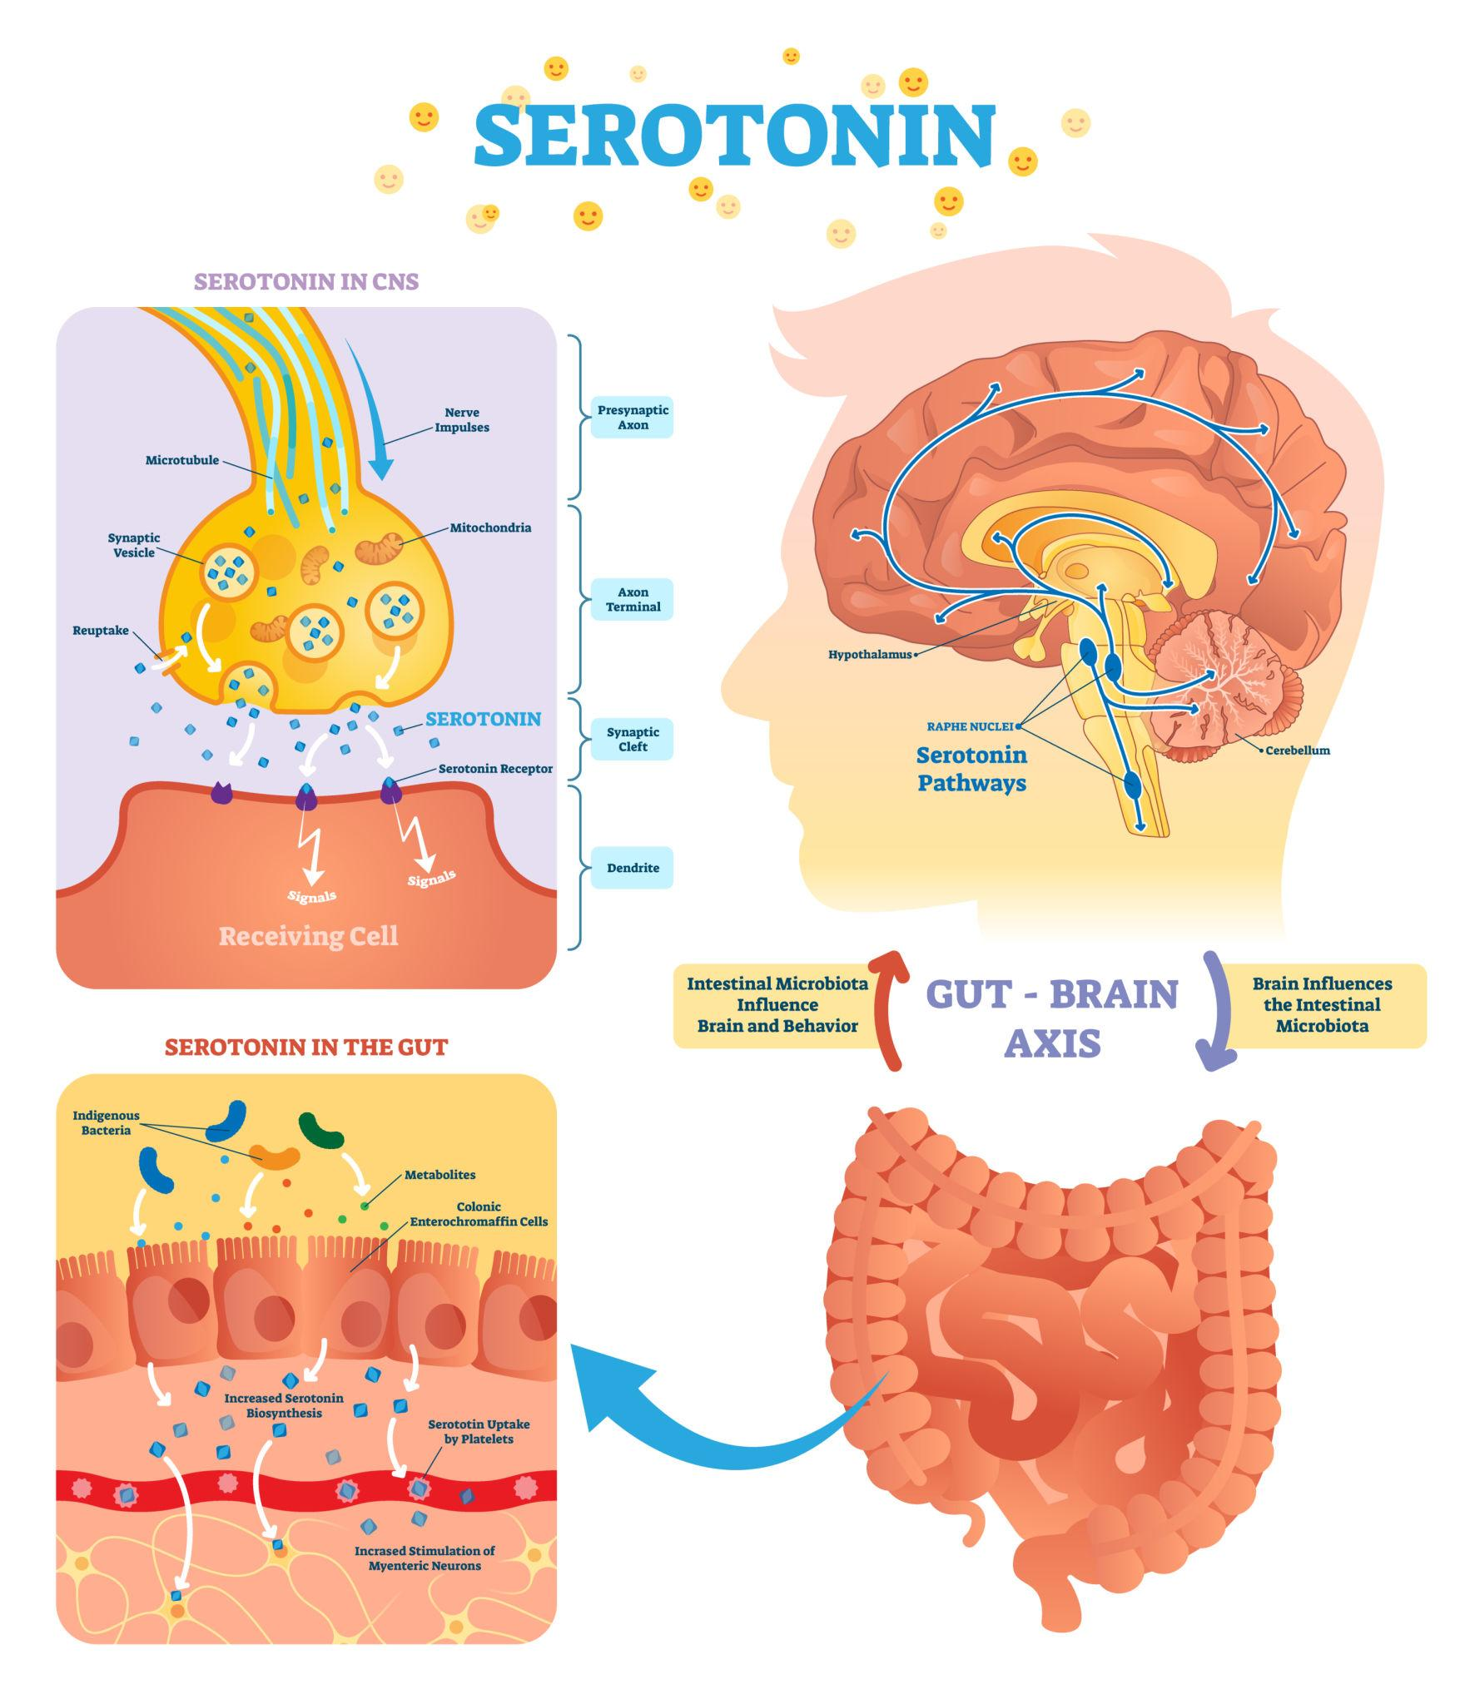
Abnormal Serotonin Pathways
↑ Serotonin in IBS-D: ↑ enterochromaffin cells → ↑ postprandial serotonin levels.
Regulatory mechanisms: TPH1 polymorphism ↑ serotonin synthesis; ↓ SERT (due to gram-negative dysbiosis) → impaired reuptake → excess serotonin.
Clinical effect: Excess serotonin → ↑ gut motility + visceral sensitivity → postprandial symptoms.

Slide 17
Bile Acids
Bile acid diarrhea in IBS-D: ~25% have excess colonic bile acids.
Mechanism: ↓ FGF-19 (ileal) or genetic defects → ↑ hepatic bile acid synthesis → ↑ colonic bile acids.
Effects: Accelerated colonic transit + ↑ permeability + visceral hypersensitivity → diarrhea symptoms.

Slide 18
Clinical Features
Abdominal pain
Bloating
Constipation
Diarrhea
Dyspepsia
Nocturnal symptoms rare.
Weight loss
Rectal bleeding
Anemia
Nocturnal symptoms
Family history of cancer

Slide 19
Investigations
Lab Findings Against IBS
Anemia, ↑ ESR/CRP
Blood/leukocytes in stool
Stool volume >200–300 mL/day
CBC, CRP
Stool examination, Fecal calprotectin
Colonoscopy if indicated
Alarm features / age >40 → Colonoscopy ± biopsy (microscopic colitis)
Suspected:
  Lactose intolerance → H₂ breath test
  SIBO → glucose breath test
  RUQ pain → USG abdomen
  Dyspepsia → UGI endoscopy
Key Differentials
Upper pain: PUD, biliary disease, pancreatic CA
Lower pain: IBD, diverticulitis, colon cancer
Diarrhea: Celiac, lactose intolerance, hyperthyroidism, infection
Constipation: Drugs, hypothyroidism, lead poisoning

Slide 20
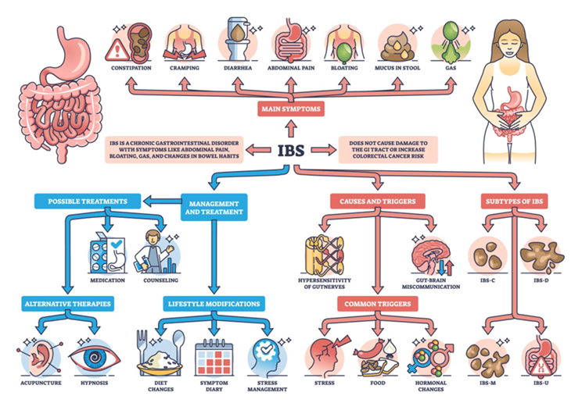
Non-Pharmacological Treatment
Reassurance: Functional disorder, no structural disease
Identify triggers: stress, food, lifestyle
Psychological Therapy (Stress management CBT, Hypnotherapy, relaxation)
Exercise: overall benefit, low risk
Dietary Modifications
Avoid gas-producing foods, carbonated drinks
Lactose restriction if suspected intolerance

Slide 21
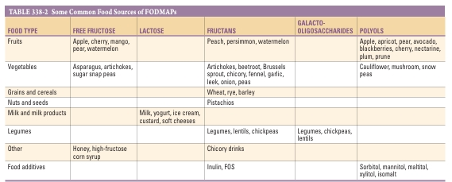
Low FODMAP Diet
Poorly absorbed carbs → fermentation → gas & osmotic effect
Reduces bloating, pain
3 phases:
  Restriction (2–6 weeks)
  Reintroduction
  Personalization

Slide 22
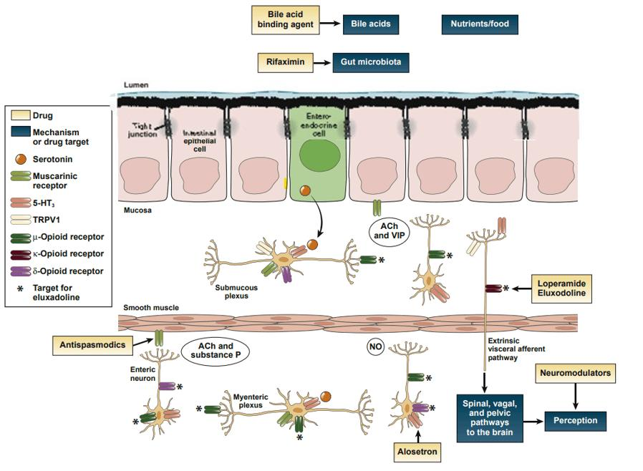
Antispasmodics
Dicyclomine, hyoscine
Mechanism: ↓ gut spasm, inhibit gastrocolic reflex
Best taken before meals
Peppermint oil: effective for pain
Side effects: anticholinergic (dry mouth, blurred vision)

Slide 23
Stool-Bulking Agents (Fiber)
Soluble fiber (psyllium) preferred
Dose: gradually ↑ to 20–30 g/day
Benefits: ↑ stool bulk, ↓ constipation, ↓ rectal sensitivity
Side effects: bloating, flatulence
Avoid insoluble fiber (wheat bran)

Slide 24
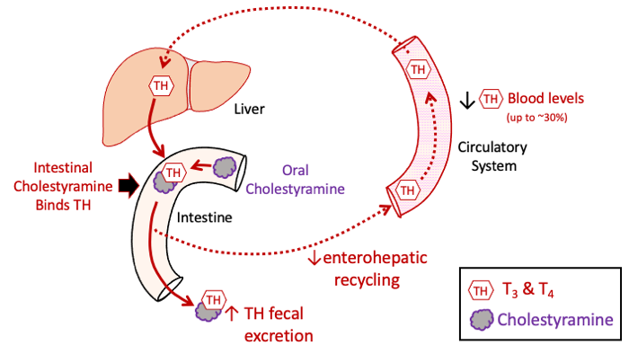
Antidiarrheal Agents (IBS-D)
Loperamide: 2–4 mg (max 12 mg/day)
Effects: ↓ transit, ↑ anal tone
Eluxadoline: opioid receptor modulator
Bile acid binders: cholestyramine (for bile acid diarrhea)

Slide 25
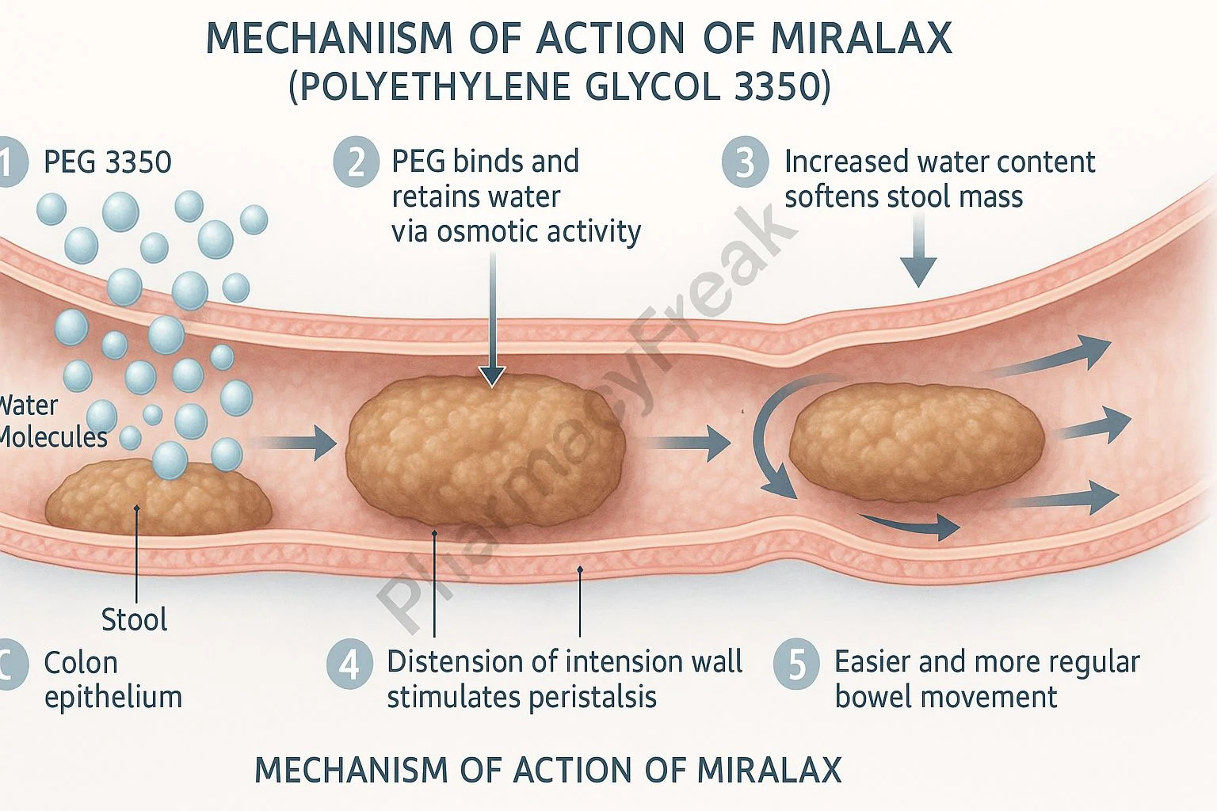
Laxatives (IBS-C)
PEG (preferred) > lactulose
Osmotic agents: draw water → soften stool
Caution:
  Mg → hypermagnesemia (renal failure)
  Phosphate → electrolyte imbalance

Slide 26
Antidepressants
TCAs (e.g., imipramine):
  ↓ motility (good for IBS-D)
  ↓ visceral pain
Act independent of mood effects
SSRIs: variable benefit

Slide 27
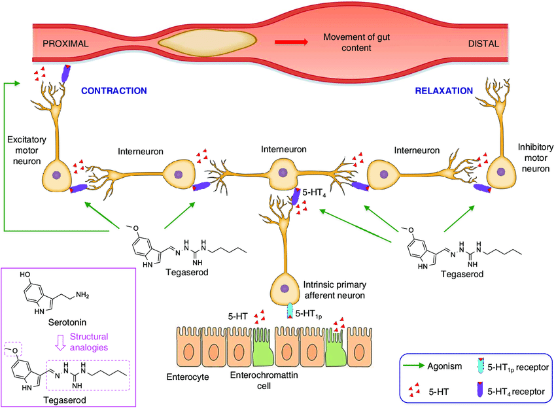
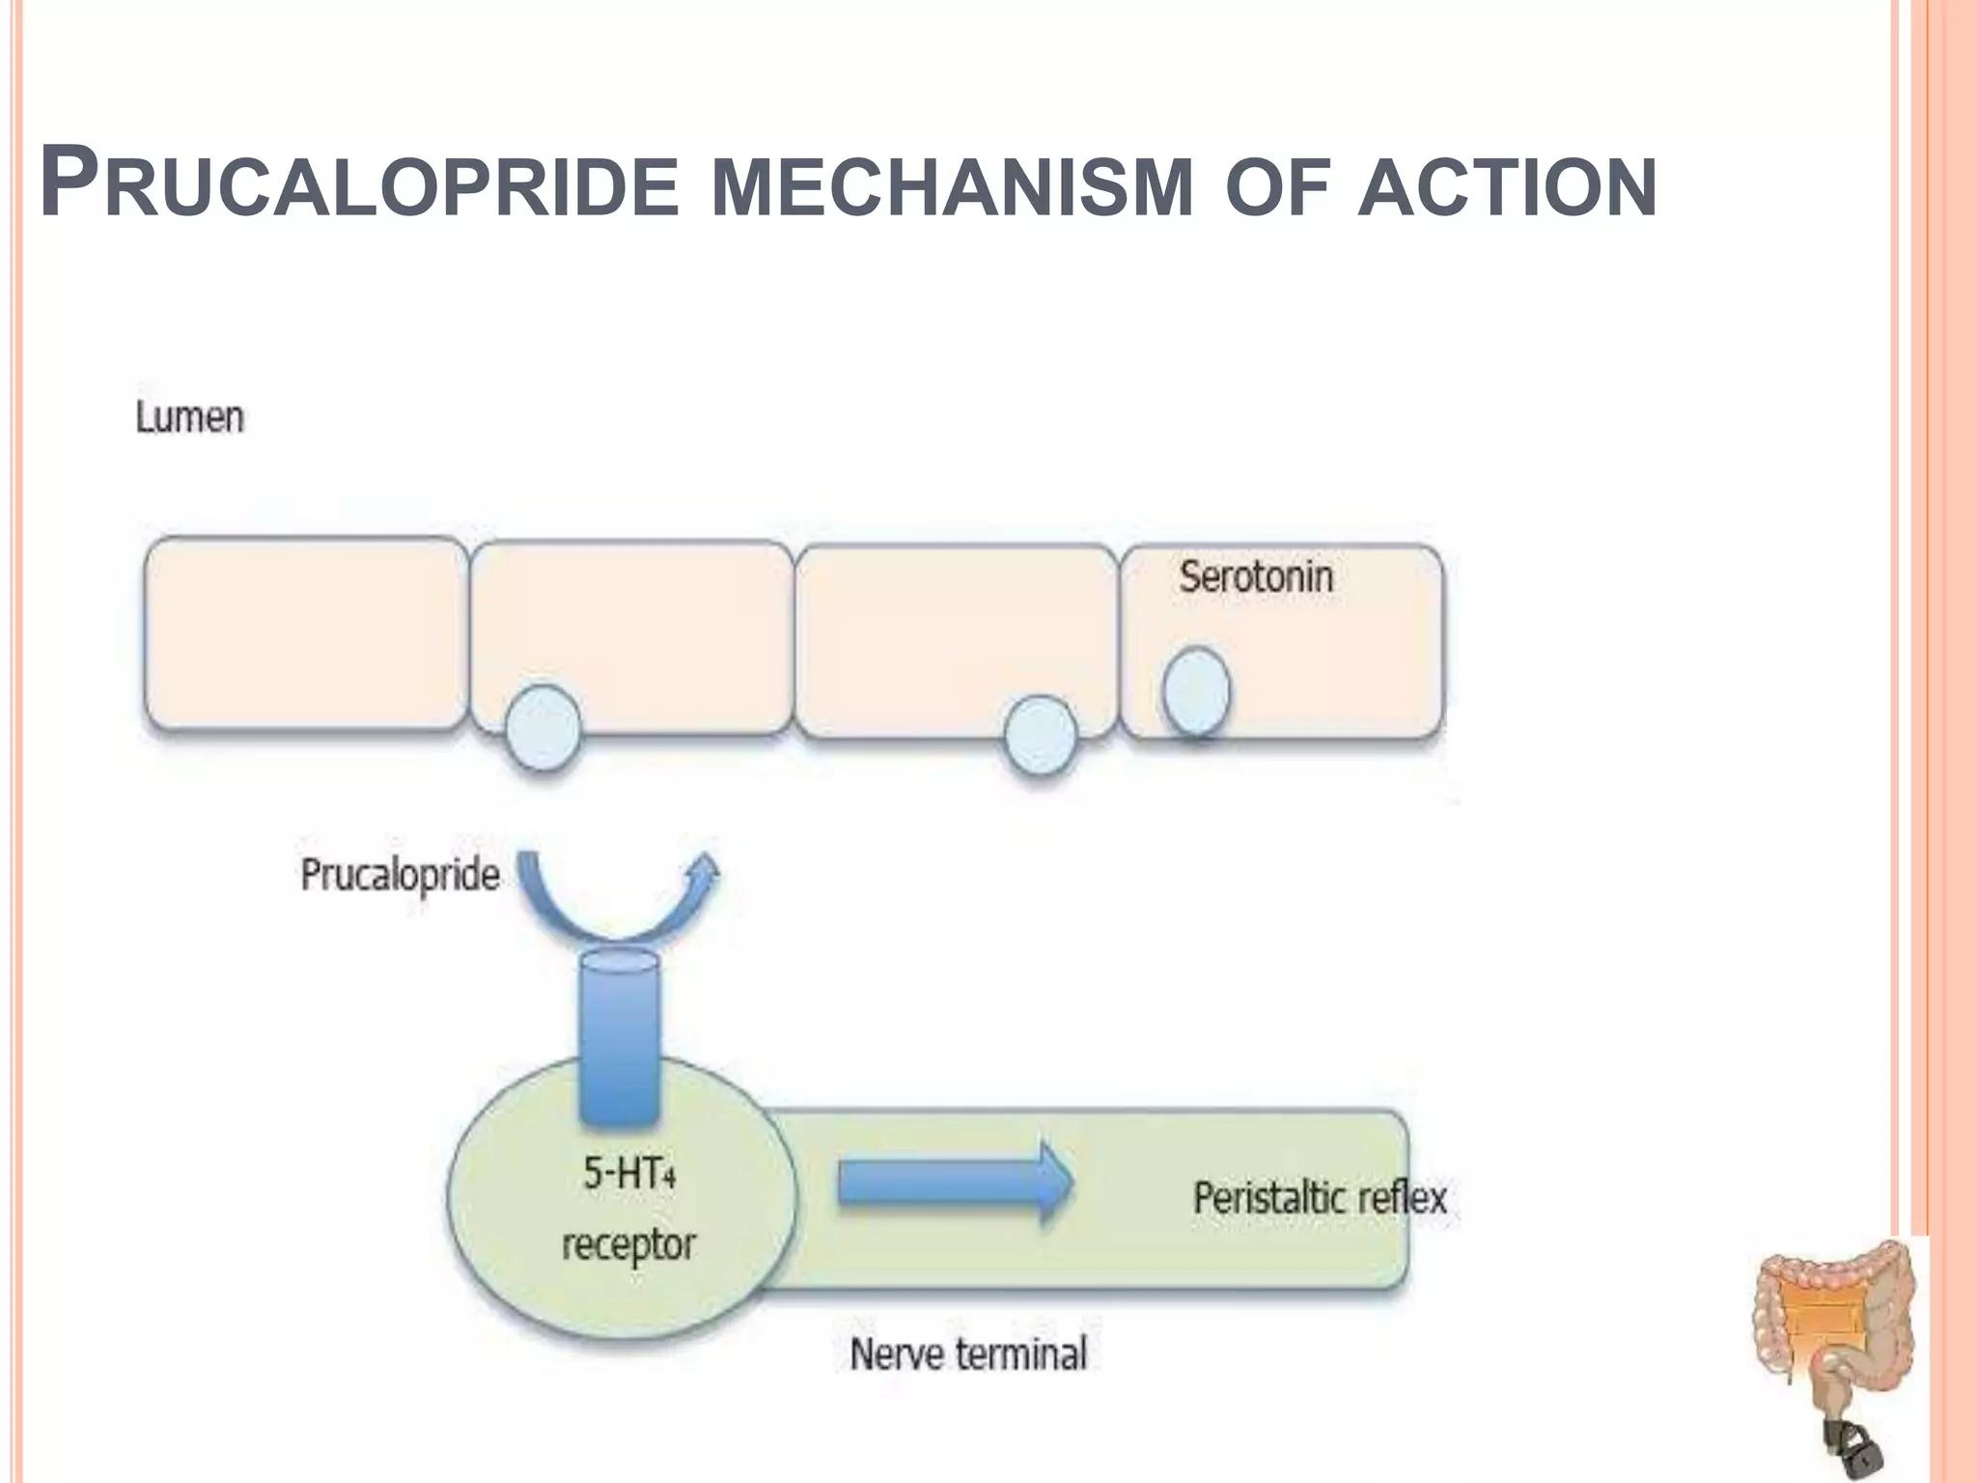
Serotonin Modulators
5-HT4 agonist
(Tegaserod):
  ↑ motility (IBS-C)
  Restricted use (CV risk; <65 yrs, low risk)
  Prucalopride is a selective 5-HT₄ receptor agonist that stimulates colonic motility and promotes bowel movements.
  It is used in chronic constipation, especially in patients not responding to conventional laxatives.

Slide 28
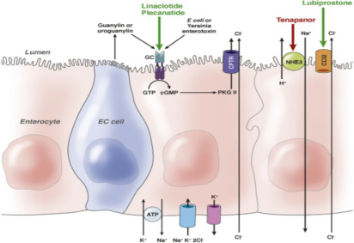
Secretagogues (IBS-C)
Lubiprostone: Cl⁻ channel activator
Linaclotide / Plecanatide: GC-C agonists → ↑ fluid secretion
Tenapanor: ↓ Na absorption → ↑ water in lumen
Effects: ↑ transit, ↓ pain
Side effect: diarrhea

Slide 29
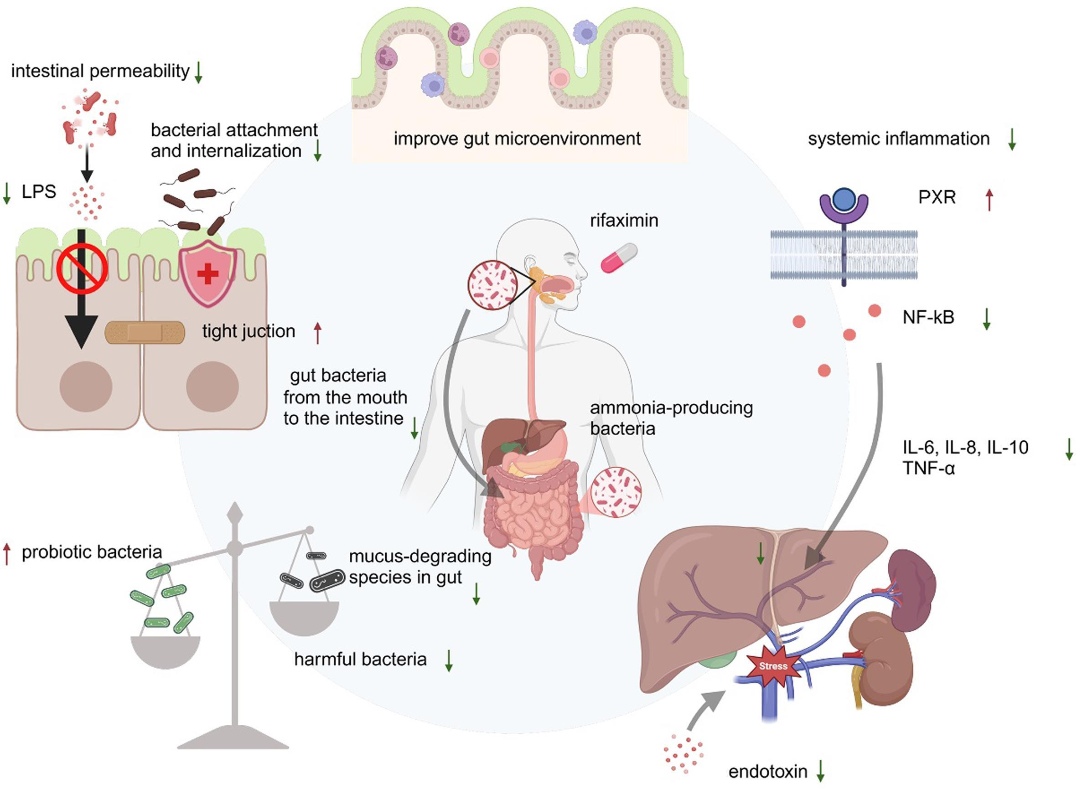
Modulation of Gut Flora
Antibiotics:
Rifaximin (550 mg TID × 2 weeks) → IBS-D
Neomycin (less commonly used)

Slide 30
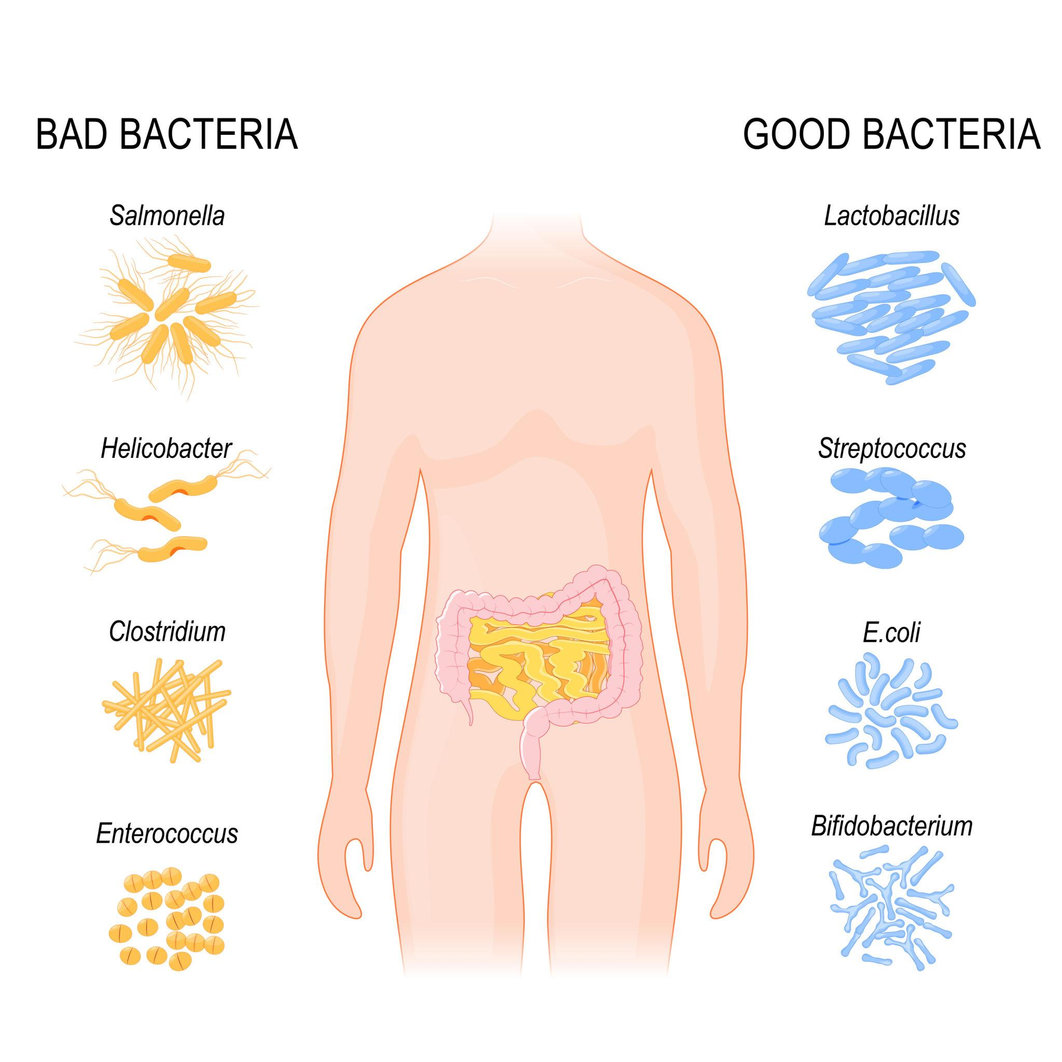
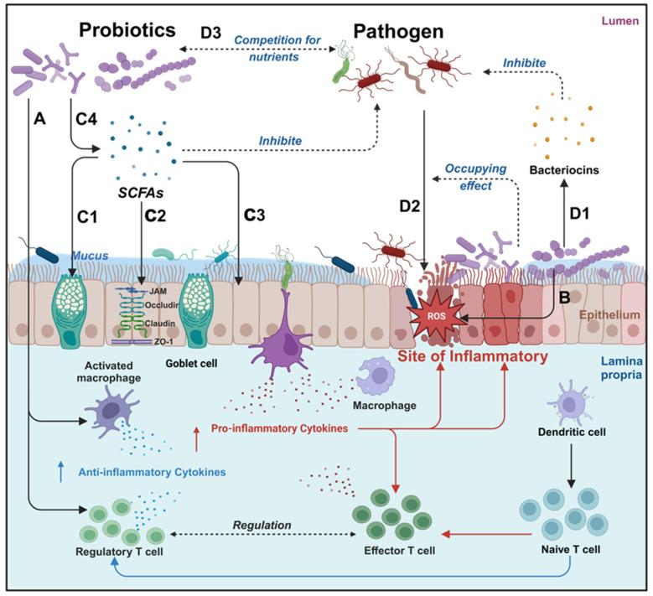
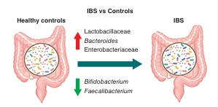
Probiotics
Lactobacillus
Bifidobacterium
Restore gut flora
Reduce inflammation

Slide 31
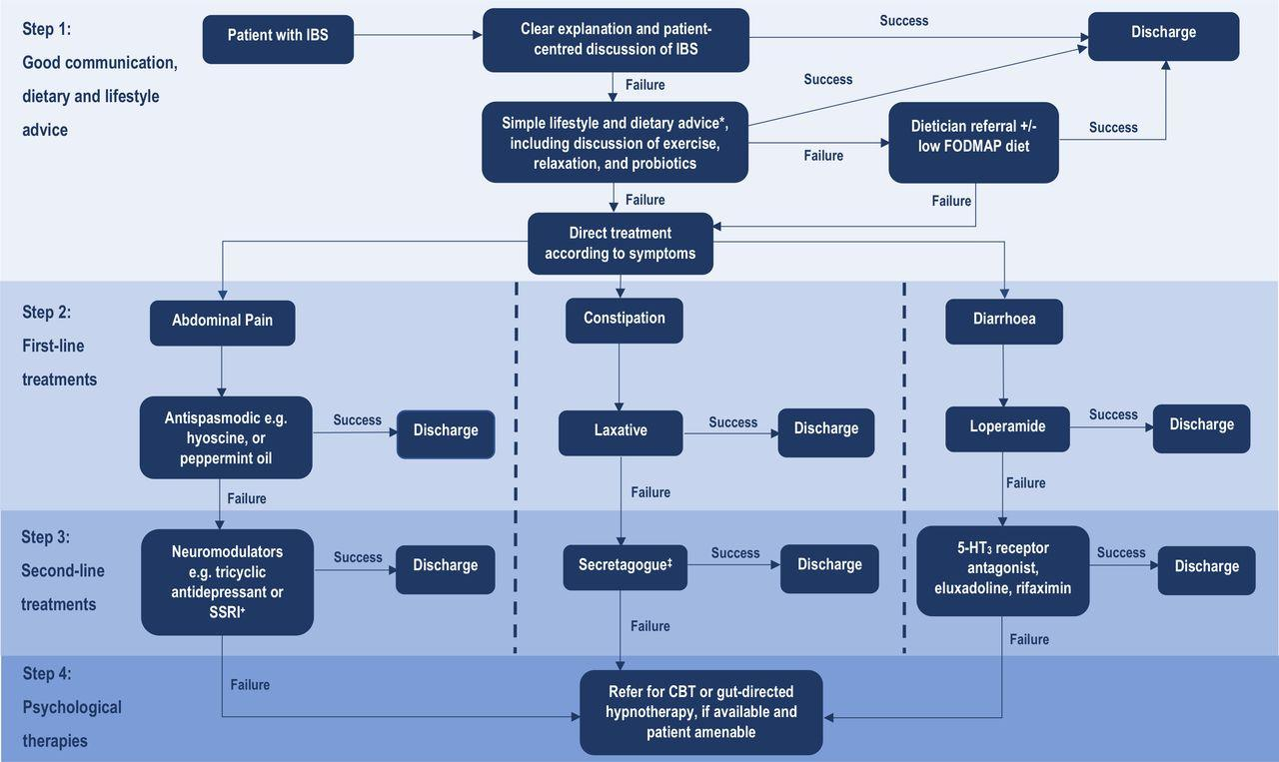

Slide 32
Newer Agents
Domperidone: Dopamine antagonist (prokinetic) → ↑ gastric motility; limited role in IBS (more for dyspepsia/gastroparesis)
TRP blockers: Capsazepine, Resiniferatoxin (experimental; no routine clinical drugs yet)
CRF antagonists: Antalarmin, Pexacerfont (mainly experimental, not in routine use)

Slide 33
Recent Advances
Microbiome therapy: Modulates gut flora (probiotics, rifaximin) to reduce dysbiosis and symptoms.
FMT Fecal Microbiota Transplant : Transfers healthy microbiota; mixed evidence, not routine in IBS.
Digital therapy: App-based CBT/hypnotherapy to improve brain–gut axis and symptoms.
AI approaches: Enable personalized IBS management by predicting triggers and treatment response.

Slide 34
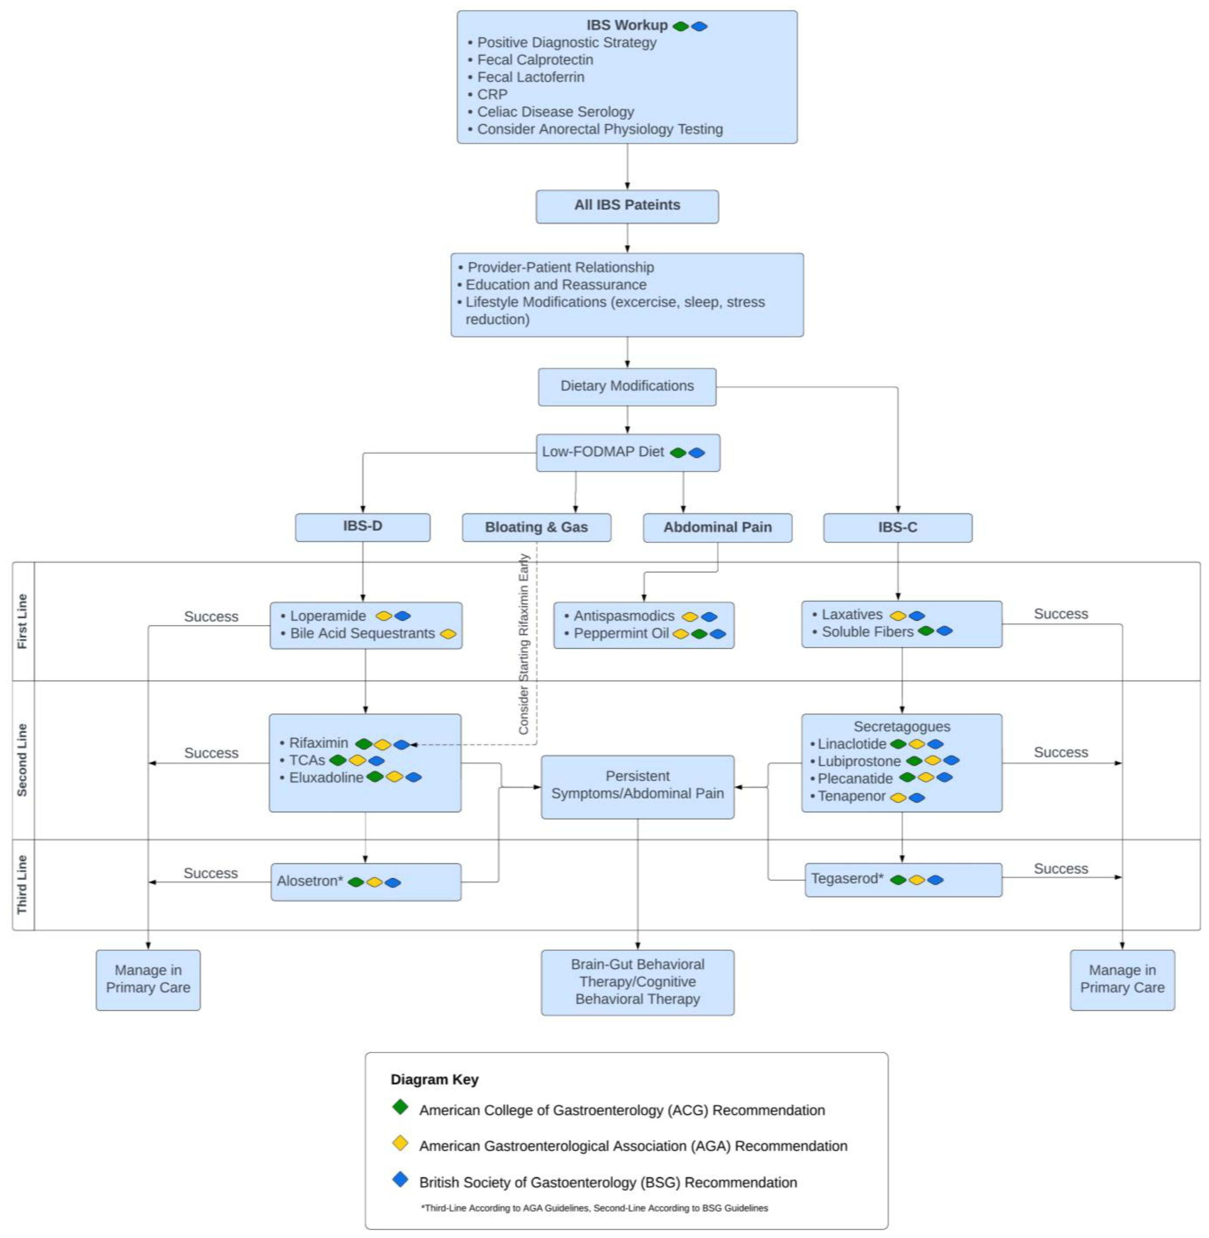

Slide 35
Conclusion
IBS is a chronic functional GI disorder with no structural cause.
Involves gut–brain axis dysfunction, motility issues, and visceral hypersensitivity.
Symptoms include abdominal pain with altered bowel habits. Diagnosis is clinical.
Significant impact on quality of life but not life-threatening.
Management is individualized: diet (low FODMAP), drugs, and psychological therapy.

