Slide 1
ECG DISCUSSION
4th MEDICINE UNIT
CHIEF : Dr.DAVID PRADEEP KUMAR
ASST.PROF :
Dr.NASEEMA BANU
Dr.RAMKUMAR
Dr.NABIL FAYAZ

Slide 2
CHIEF COMPLAINTS
A 49 year old male k/c/o T2DM/Old AWMI brought by his attender with chief C/O breathing difficulty × 3 days
History of breathlessness ×3 days
Insidious onset
Progressive in nature
NYHA 3 to 4
NO other specific complaints

Slide 3
DIAGNOSIS: T2DM/CAD/OLD AWMI/HF EF-35%/ACUTE PULMONARY EDEMA
TREATMENT:
Back rest
NIV
INJ.LASIX 40MG-40MG-0 IV
T.ASPRIN 150MG 0-1-0
T.CLOPIDOGREL 75MG 0-1-0
T.ENALAPRIL 2.5MG1-0-1
T.SPIRONOLACTONE 25MG 1-0-0
INJ.HA ACC TO CBG

Slide 4
Patient underwent sudden cardiorespiratory arrest on day 2
CPR and resuscitation
Patient revived

Slide 5
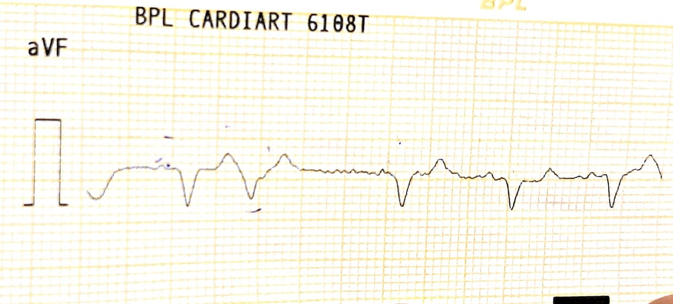
POST CPR ECG
"C:\Users\drsne\

Slide 6
POST CPR ECG

Slide 7
Discussion

Slide 9
Thank you

