Slide 1
JOURNAL CLUB
BY 1ST MEDICAL UNIT
CHIEF : | Prof.Dr.M.NATARAJAN MD
ASST PROF : | Dr.PALANI KUMARAN MD D.Diab Dr.VASANTHA KALYANI MD DCP Dr.SURESH KUMAR MD
PRESENTOR : | Dr.M.KRUTHIKA

Slide 2
SURVODUTIDE IN MASH AND FIBROSIS
Phase 2 Randomized Trial

Slide 3
AIM OF THE STUDY
Whether Survodutide improves the condition in MASH patients with no worsening of fibrosis.

Slide 4
BACKGROUND
A once-weekly subcutaneous injections of Survodutide administered to patients with biopsy-confirmed MASH and fibrosis shows histologic improvement (reduction) in MASH with no worsening of fibrosis.

Slide 5
METHOD OF STUDY
Investigator-initiated
Multicentered
Double-blind
Randomized
Controlled trial

Slide 6
INCLUSION CRITERIA
Adult patients - 18 years of age or older
Patients who had biopsy-confirmed MASH and a fibrosis stage of F1 through F3.

Slide 7
EXCLUSION CRITERIA
No previous clinically significant alcohol consumption (>210 g per week in men and >140 g per week in women for >3 months).
No H/O use of medications associated with liver injury, hepatic steatosis, or steatohepatitis within 12 weeks before screening.
No history of other forms of chronic liver disease.

Slide 8
PARTICIPANTS
Date Range: From April 27, 2021, to December 21, 2023.
Total of 1153 patients were assessed for eligibility, and 295 patients were enrolled,
73 in 2.4 mg group.
73 in 4.8 mg group.
75 in 6.0 mg group.
74 in Placebo group.
As per Baseline biopsies 70% of the participants had an NAFLD activity score of 5 or more,
16% had F1B fibrosis,
41% had F2 fibrosis,
35% had F3 fibrosis.

Slide 9
PARTICIPANTS
The mean age of the patients was
49.6 ± 13.7 years in the 2.4 mg group
50.2 ± 12.9 years in the 4.8 mg group
50.4 ± 13.1 years in the 6.0 mg group
53±11.5 years in the placebo group
49%, 47% and 55% were women in the 2.4, 4.8 and 6.0 mg group respectively and 59% in the placebo group.

Slide 10
TRIAL PROCEDURE
Eligible participants were randomly assigned in a 1:1:1:1 ratio to receive once-weekly subcutaneous injections of survodutide at a dose of 2.4, 4.8, or 6.0 mg or placebo.
Participants, investigators, central reviewers, and personnel involved in trial conduct or analysis were unaware of the trial-group assignments.
Randomization lists were generated with the use of a pseudorandom number generator; participants were stratified according to status with respect to type 2 diabetes (with vs. without).

Slide 11
TRIAL PROCEDURE
The trial had two phases:
A 24-week rapid-dose-escalation phase (with escalations every 2 weeks until the target dose was reached),
A 24-week maintenance phase.
Dose adjustment was allowed twice.
A screening or historical biopsy performed within 6 months before randomization was used as a baseline for histologic variables.
The MRI-PDFF was assessed at screening, week 28, and the end of treatment.

Slide 12
END POINT
PRIMARY OUTCOME
The primary end point was improvement in histologic findings on liver biopsy after 48 weeks of treatment, defined as a composite of improvement in MASH (≥2-point decrease in the NAFLD activity score with ≥1-point decrease in either lobular inflammation or hepatocellular ballooning) with no worsening of fibrosis (absence of any increase in fibrosis stage).

Slide 13
END POINT
SECONDARY OUTCOME
A decrease in liver fat content (as measured by the MRI-PDFF) by at least 30%, absolute change (not reported here) and percentage change in liver fat content (as measured by the MRI-PDFF).
Biopsy-assessed improvement in fibrosis (≥1-stage decrease) and absolute change in the NAFLD activity score, all from baseline after 48 weeks of treatment.
Improvement in fibrosis (≥1-stage decrease) with no worsening of MASH (no increase in any of the NAFLD activity subscores), and resolution of MASH (absence of ballooning [score of 0], no or mild inflammation [score of 0 or 1], and possible steatosis [score of 0 to 3]) with no worsening of fibrosis, both from baseline after 48 weeks of treatment as assessed by liver biopsy.

Slide 14
RESULTS
Improvement in MASH with no worsening of fibrosis occurred in
47% in the Survodutide 2.4-mg group,
62% in the Survodutide 4.8-mg group,
43% in the Survodutide 6.0-mg group,
14% in the placebo group.
(P<0.001 for the quadratic dose–response curve as best fitting model).
A decrease in liver fat content by at least 30% occurred in
63% in the Survodutide 2.4-mg group,
67% in the Survodutide 4.8-mg group,
57% in the Survodutide 6.0-mg group,
14% of those in the placebo group.

Slide 15
RESULTS
Improvement in fibrosis by at least one stage occurred in
34% in the Survodutide 2.4-mg group,
36% in the Survodutide 4.8-mg group,
34% in the Survodutide 6.0-mg group,
22% in the placebo group.
Adverse events that were more frequent with Survodutide than with placebo included
Nausea (66% vs. 23%),
Diarrhea (49% vs. 23%),
Vomiting (41% vs. 4%).
Serious adverse events occurred in 8% with Survodutide and 7% with placebo.

Slide 16
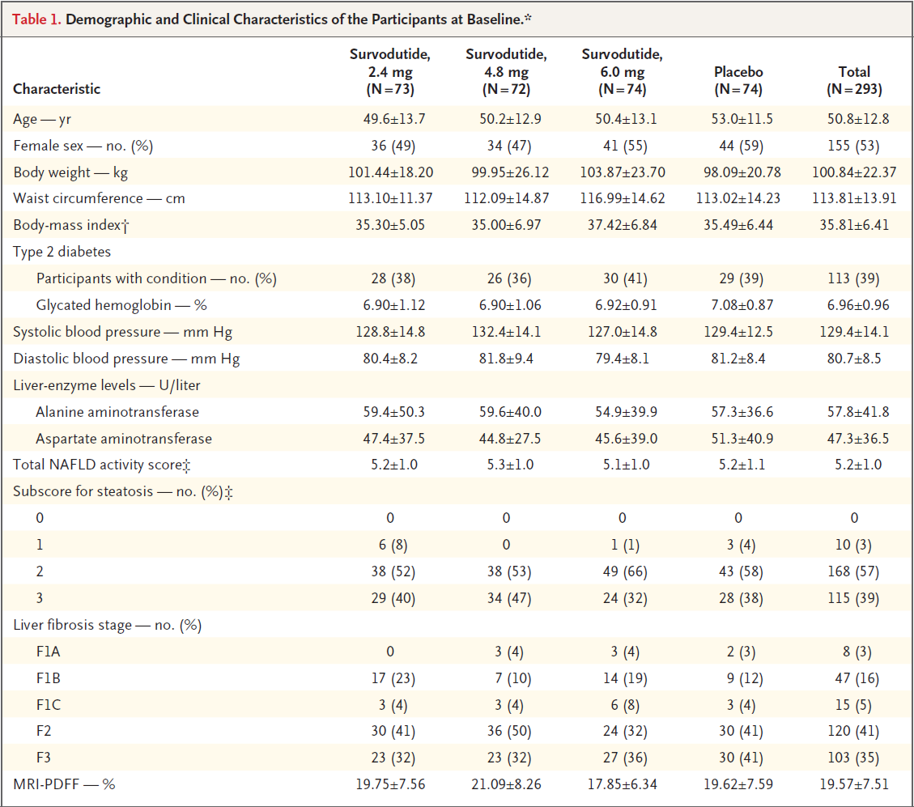
* Plus–minus values are means ±SD.
Subcutaneous doses were administered once weekly.
Percentages may not total 100 because of rounding.
MRI-PDFF denotes magnetic resonance imaging proton density fat fraction.

Slide 17
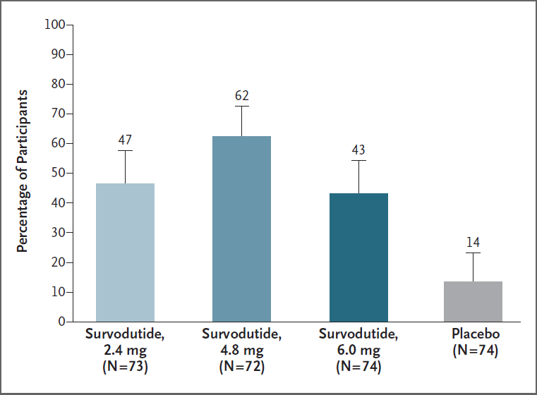
Subcutaneous doses were administered once weekly. The primary end point was histologic improvement (reduction) in metabolic dysfunction– associated steatohepatitis (MASH) with no worsening of fibrosis at week 48. Improvement in MASH was defined as a decrease in the nonalcoholic fatty liver disease activity score (range, 0 to 8, with higher scores indicating more severe disease) of at least 2 points with a decrease in either the lobular inflammation subscore (range, 0 to 3) or hepatocellular ballooning subscore (range, 0 to 2) of at least 1 point. No worsening of fibrosis was defined as the absence of any increase in the fibrosis stage. Participants who did not undergo end-of-treatment biopsy were considered to have a nonresponse. Error bars represent 95% confidence intervals and have not been adjusted for multiplicity, so they should not be used for hypothesis testing.

Slide 18
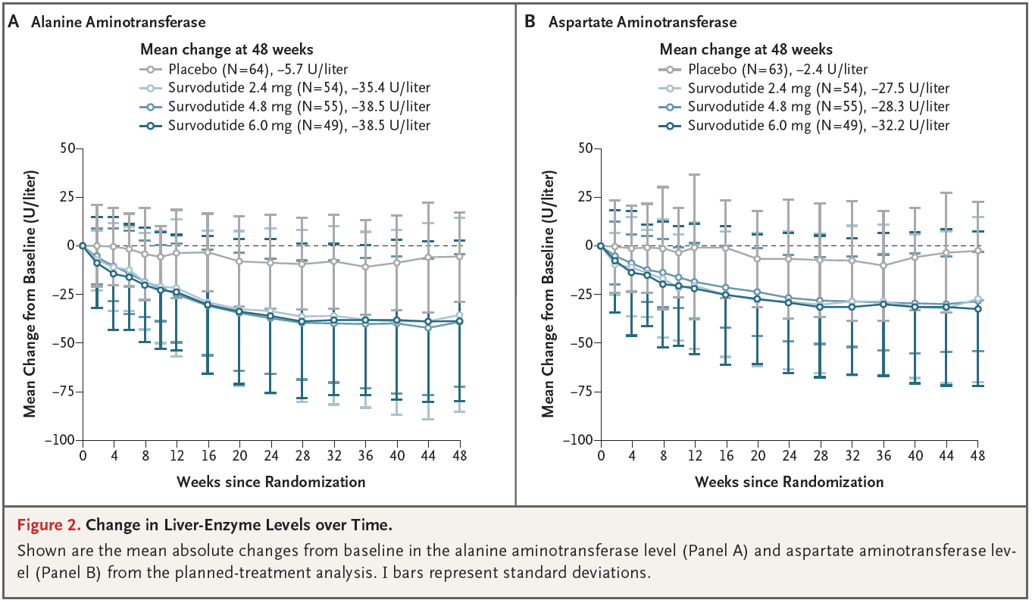

Slide 19
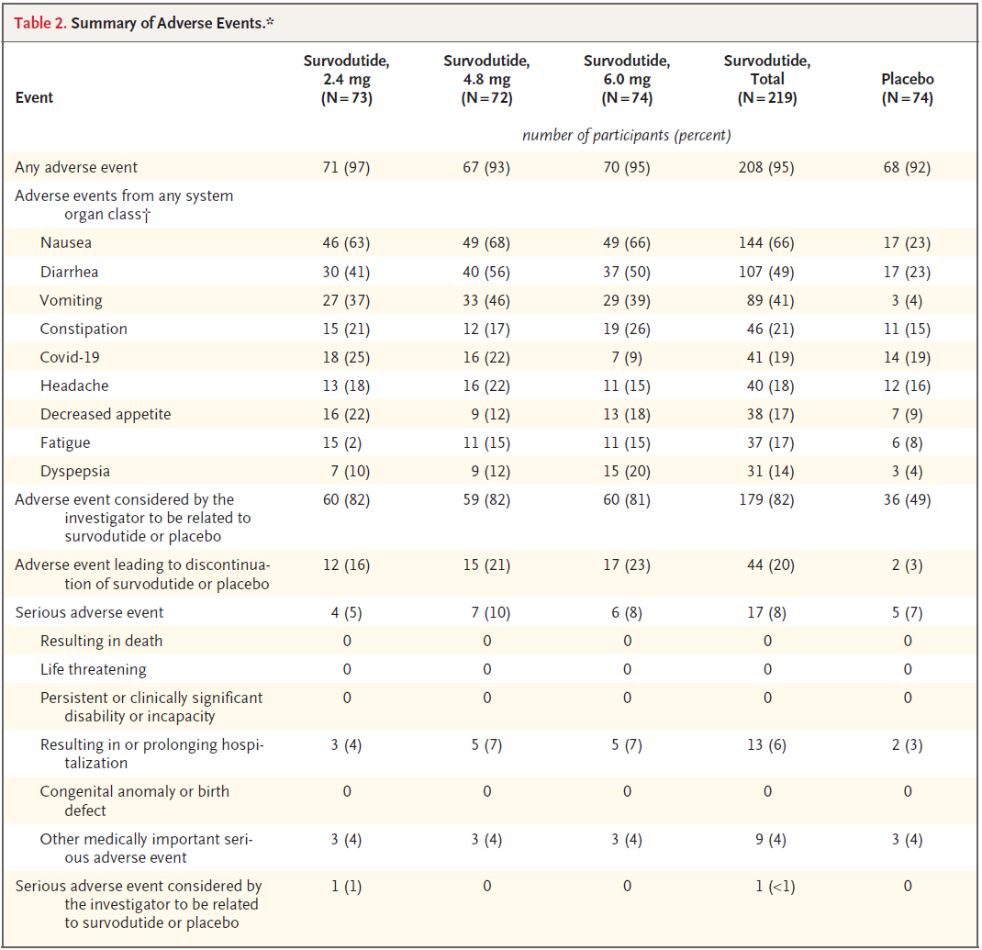

Slide 20
CONCLUSION
In the phase 2 trial, Survodutide was associated with significant improvement in MASH with no worsening of fibrosis (P<0.001).
Results also suggest a possibility of clinical benefit with respect to improvement in fibrosis (34% of the participants in the survodutide 6.0-mg group vs. 22% of those in the placebo group).
Hence, warranting further investigation in phase 3 trials.

Slide 21
THANK YOU

