Slide 1
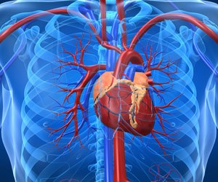
Congenital heart disease for discussion
CHIEF : DR.DAVID PRADEEP KUMAR MD
ASSISTANTS : DR.RAGHAVAN MD
DR.RAMKUMAR MD
DR. PONRAJ MD
PRESENTOR : DR.A.VIGNESH MD 1st yr

Slide 2
CLINICAL HISTORY
A 30 Y/M PAINTER BY OCCUPATION ADMITTED FOLLOWING C/O SEIZURE
HOPI :
H/O SEIZURE – ONE EPISODE,FOCAL TYPE INVOLVING LEFT UPPERLIMB AND LOWERLIMB , WITH FROTHING AND TONGUE BITE F/B LOC FOR 5 MINS .
H/O DYSPNEA *6 months ,class III NYHA
H/O PALPITATION *6 months
H/O CHEST PAIN – NON ANGINAL TYPE

Slide 3
NO H/O CYANOTIC SPELLS
NO H/O ORTHOPNEA , PND
NO H/O SWELLING OF LEGS
NO H/O SYNCOPE
PAST H/O: NO medical problems of note
PARENTS NOTICED SKELETAL DEFORMITY AT
1 and 1/2 YEARS - NO TREATMENT TAKEN

Slide 4
PERSONAL HISTORY : NOT an alcoholic and smoker
TREATMENT HISTORY : H/O TREATMENT TAKEN FOR RECURRENT LOWER RESPIRATORY TRACT INFECTIONS from 10 yrs of age.
FAMILY HISTORY: NO h/o similar illness in the family members

Slide 5
CLINICAL EXAMINATION
ON EXAMINATION :
SHORT STATURE
SHORT WEBBED NECK
WEBBING OF DIGITS
NO PALLOR
NOT ICTERIC
CENTRAL CYANOSIS
PANDIGITAL CLUBBING-GRADE 3
NO PEDAL EDEMA
SCOLIOSIS with convexity towards left
(CERVICOTHORACIC)

Slide 6
EXTERNAL MARKERS OF CONGENITAL HEART DISEASE
1. SHORT STATURE(137cms)
2. WIDELY SPACED NIPPLES
3. HIGH ARCHED PALATE
4. RIGHT PRE-AURICULAR EAR TAGS
5.B/L CUBITUS VALGUS 20 Degrees
JVP EXAMINATION :
– ELEVATED 14 CMS FROM RA
‘A’ AND ‘V’ WAVES PROMINENT

Slide 7
ANTHROPOMETRY :
HEIGHT – 137 CMS
UPPER SEGMENT – 57 CMS
LOWER SEGMENT – 80 CMS
US : LS RATIO – 0.71
ARM SPAN – 157 CMS
WEIGHT – 45 KGS
HEIGHT – NECK RATIO : >13
HEAD CIRCUMFERENCE – 35 CMS
CHEST EXPANSION – 6 CMS

Slide 8
VITALS : BP – 100/60 mmHg
PR – 90/min , REGULAR IN RHYTHM , NO SPECIFIC CHARACTER
SPo2 : 86 % ON RA,76% ON RT LATERAL,82%ON LT LATERAL POSITION
RR – 22/min
CVS : INSPECTION : CHEST WALL ASYMMETRICAL , PROMINENT LEFT SCAPULA ,
AI LEFT 6 ^{TH} ICS LATERAL TO MIDCLAVICULAR LINE
PALPATION : GRADE III PARASTERNAL HEAVE

Slide 9
AUSCULTATION :
MITRAL AREA - S1 – LOUD ;
P2 – LOUD A2 – NORMAL ;
GRADE 3/6 – PANSYSTOLIC MURMUR +
TRICUSPID AREA - S1 S2 +,WIDE FIXED SPLIT S2 + ; GRADE – 3/6 PANSYSTOLIC MURMUR WHICH INCREASES WITH INSPIRAION +
AORTIC AREA – S1 S2 + , MIDSYSTOLIC MURMUR
PULMONARY AREA - S1 S2 + , LOUD P2 +, S2 SPLIT+ , WIDE FIXED SPLIT + ,GRADE - 3/6 , MIDSYSTOLIC MURMUR +.
EXAMINATION OF OTHER SYSTEM CLINICALLY NORMAL

Slide 10
BASIC INVESTIGATIONS
CBC :
TC – 6500 ; DC -51/32/17
HB – 16.8 g%
PCV – 57
PLT – 1.46 L
RFT : URINE ROUTINE :
UREA – 22 ; CREAT – 0.9 ALB - NIL
SUGAR - NIL
LFT : DEPOSITS – 0-2 PUS CELLS
T.B – 0.8 ; D.B – 0.2 ; I.B – 0.6 ;
OT/PT – 31/-
ALP – 60
RBS : 94

Slide 11
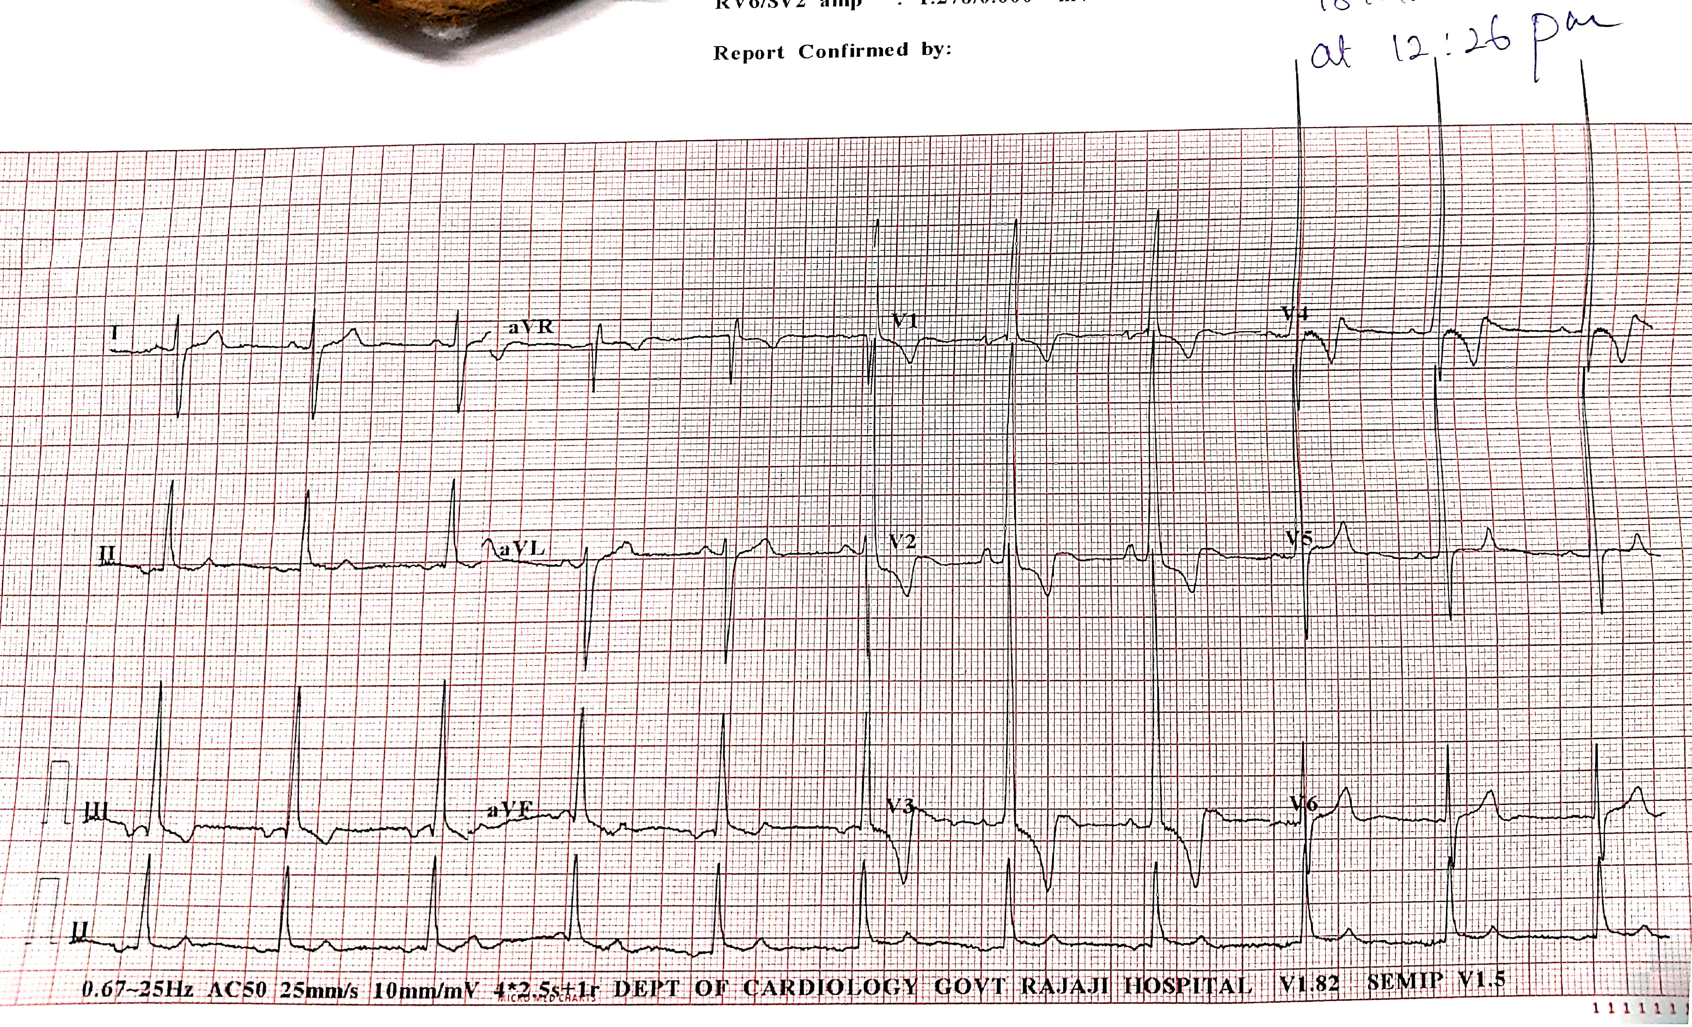
ECG

Slide 12
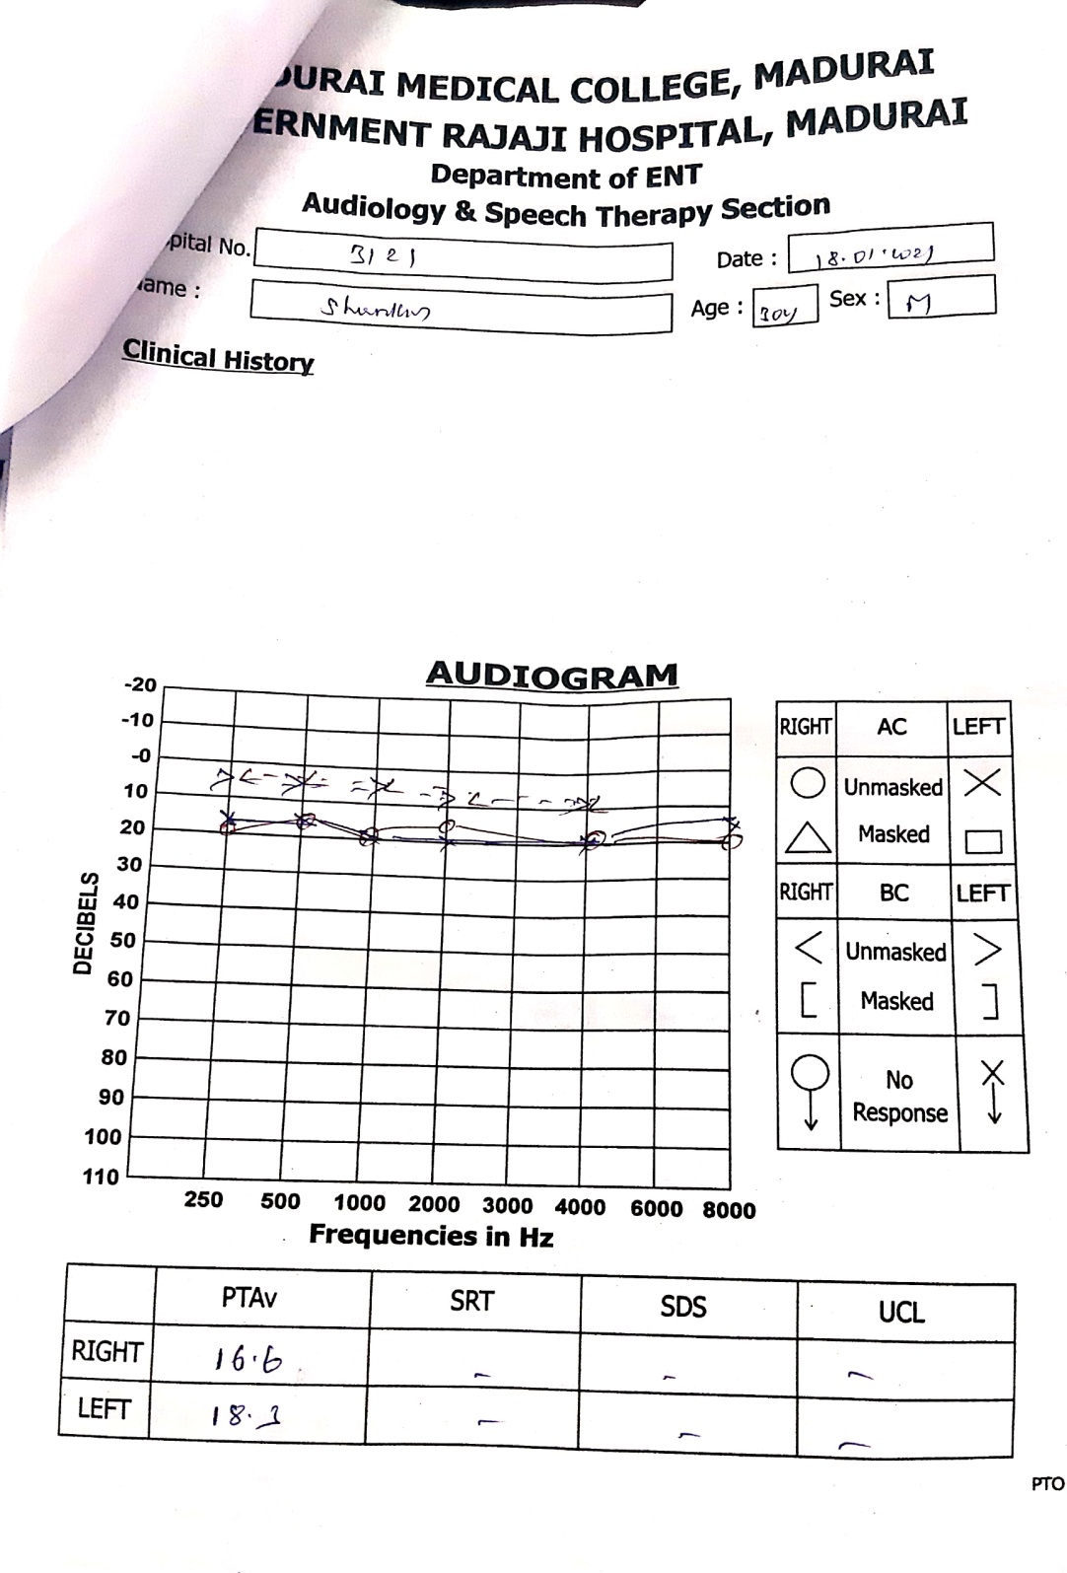
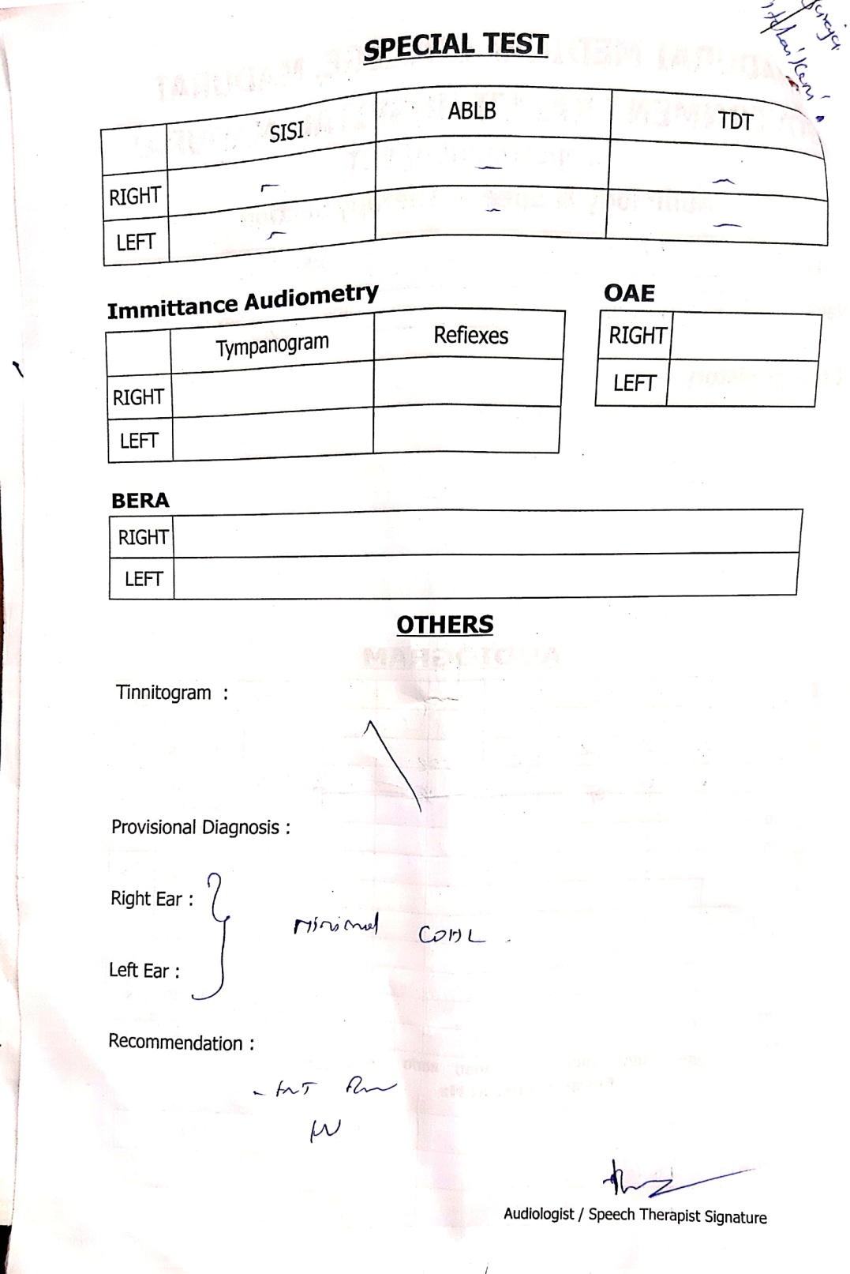
AUDIOGRAM

Slide 13
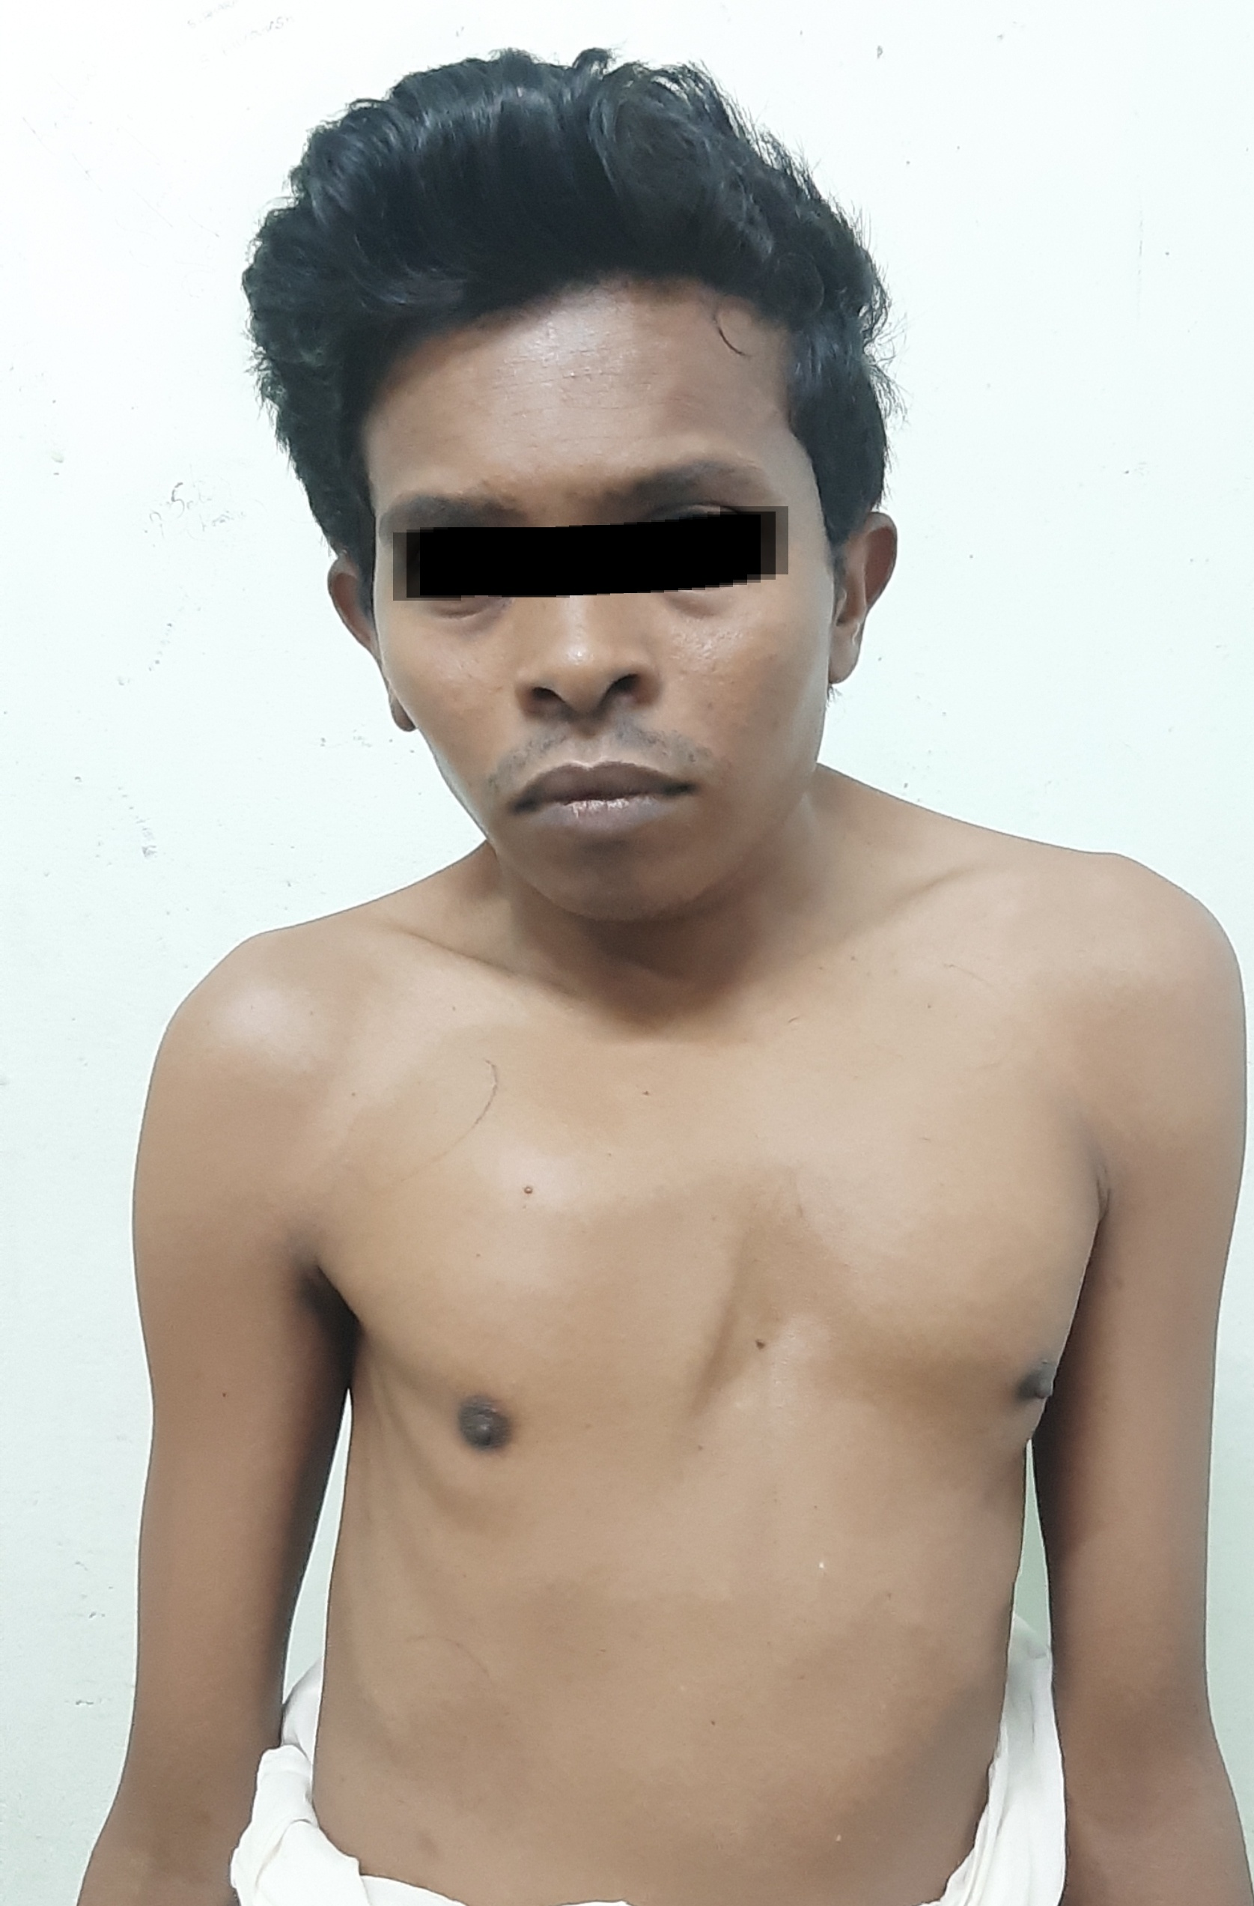

Slide 14
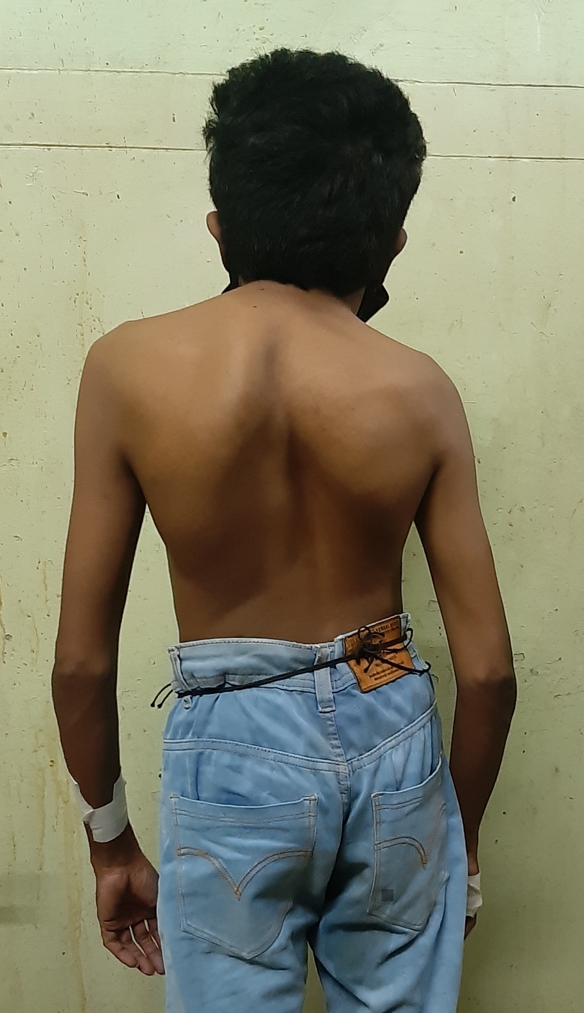

Slide 15
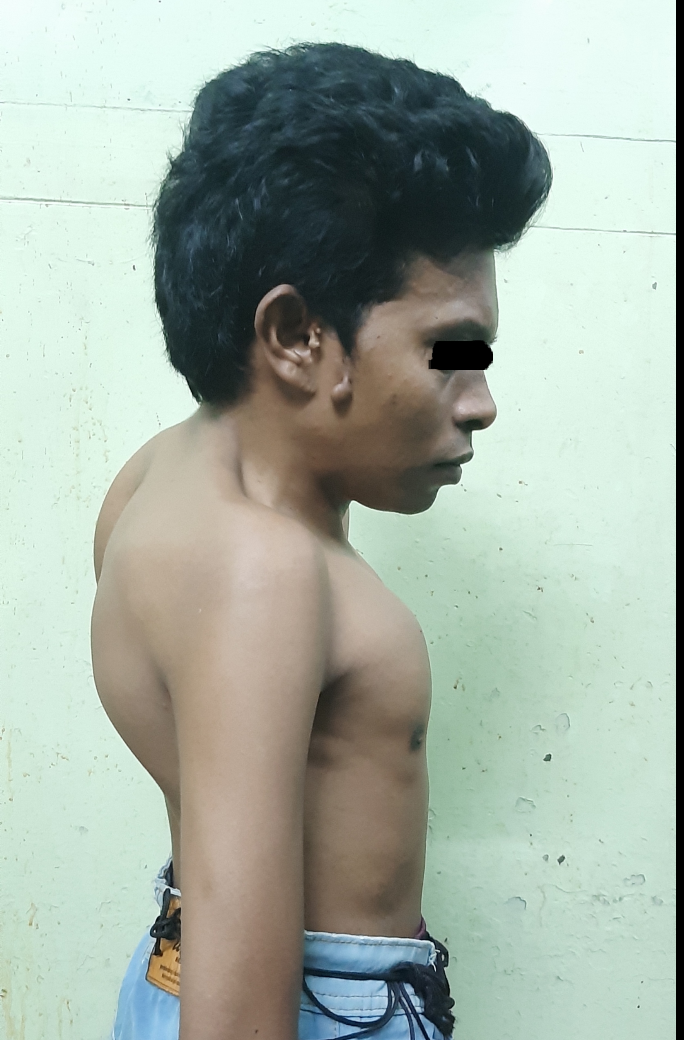

Slide 16
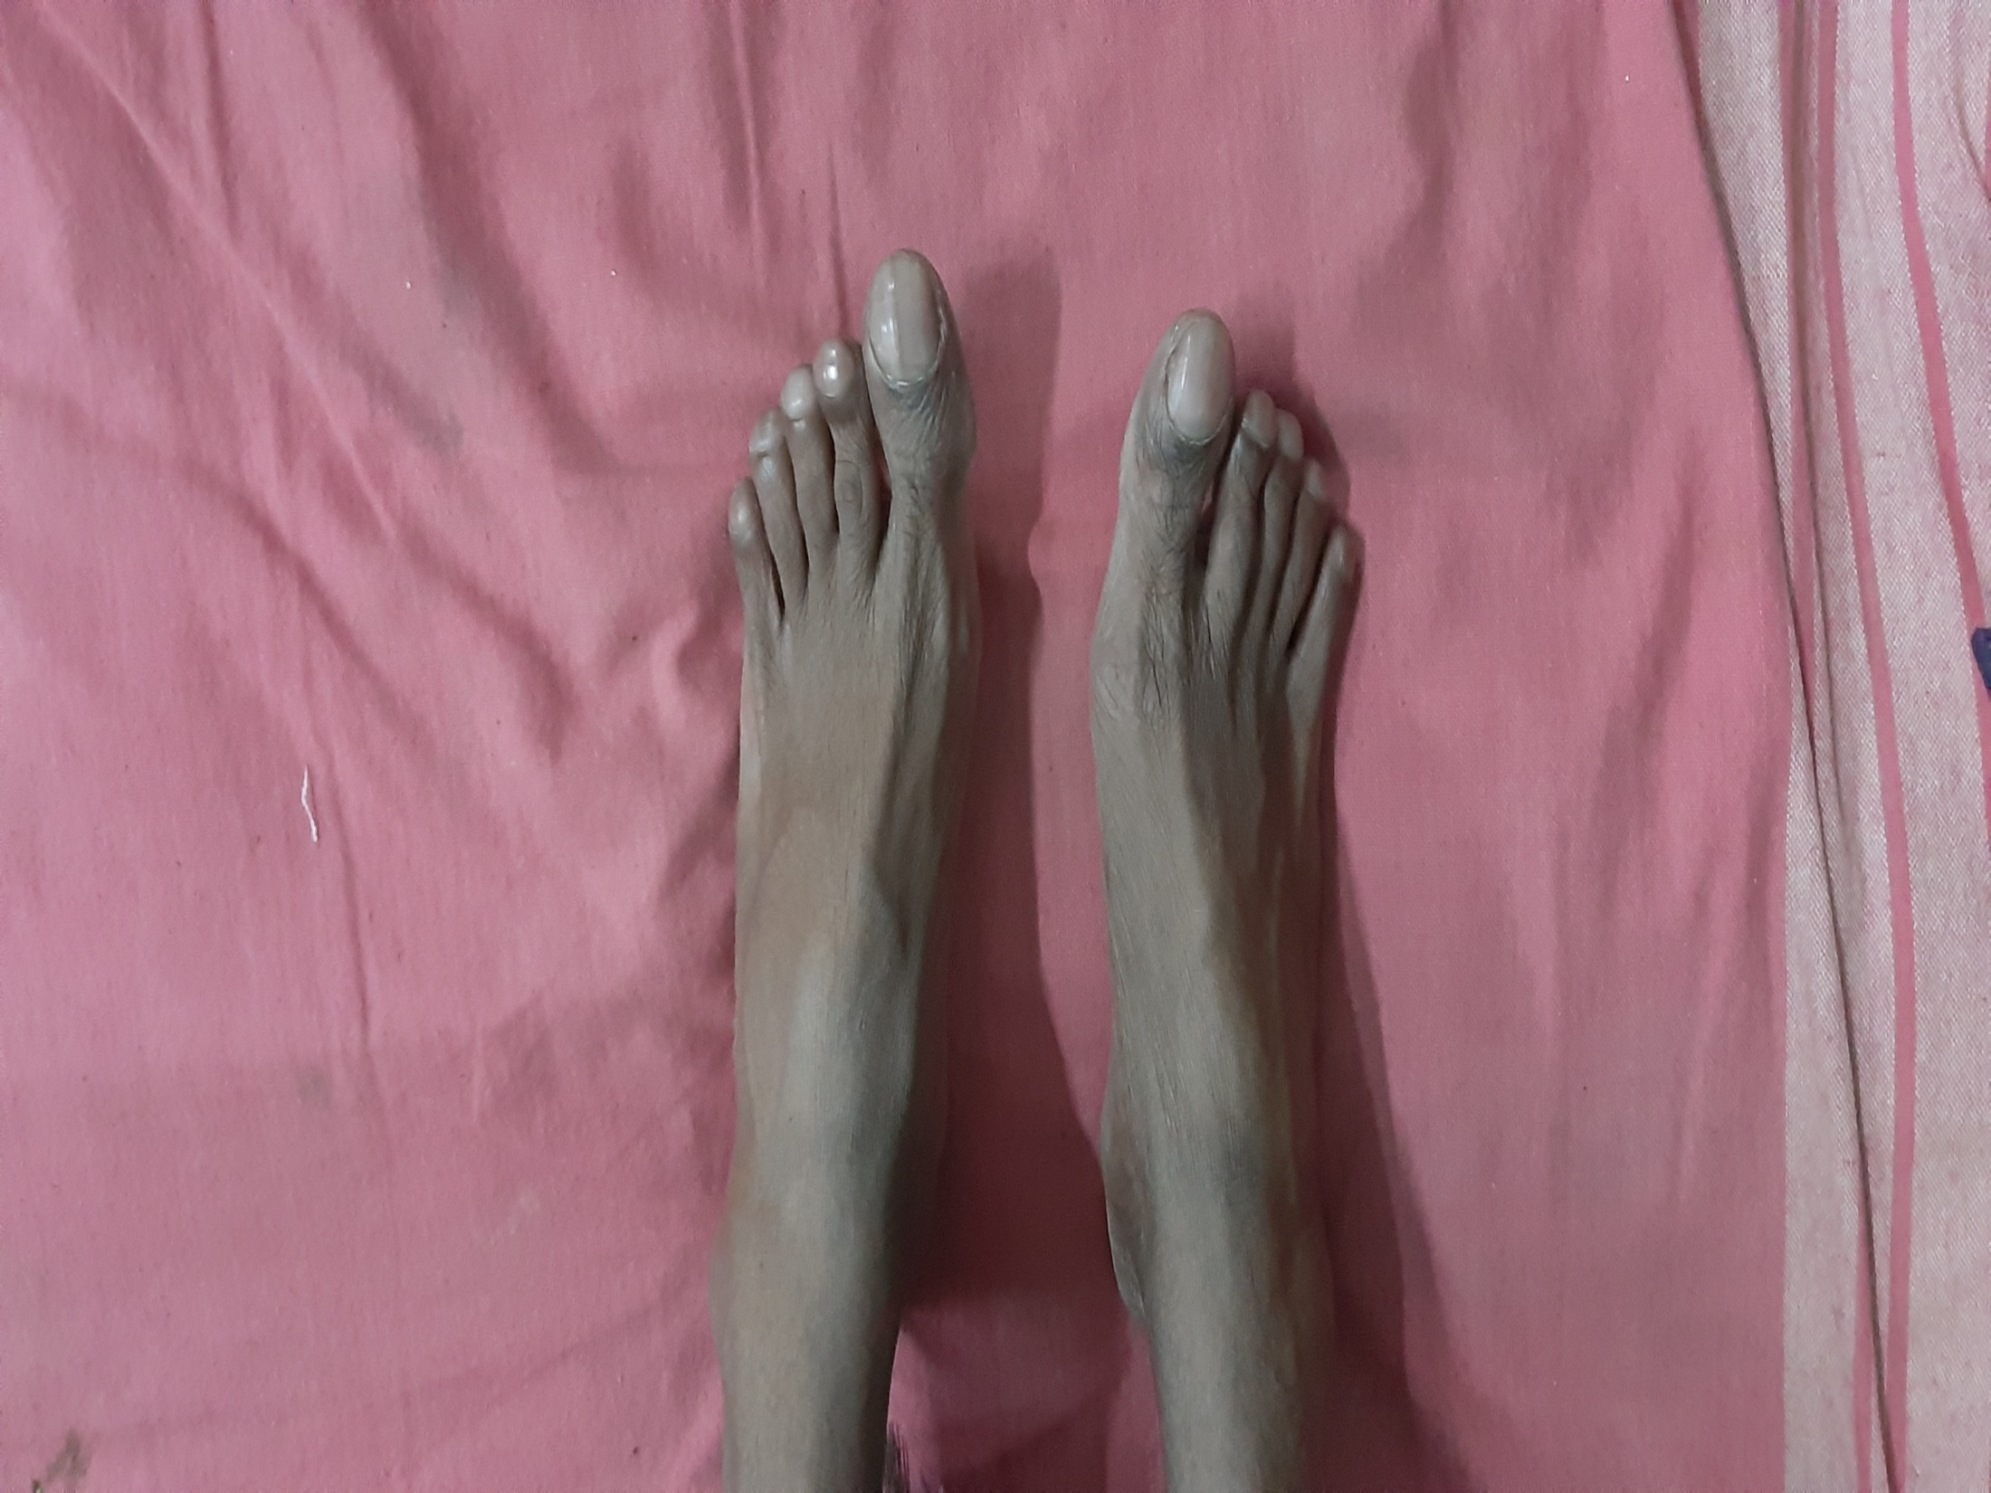

Slide 17
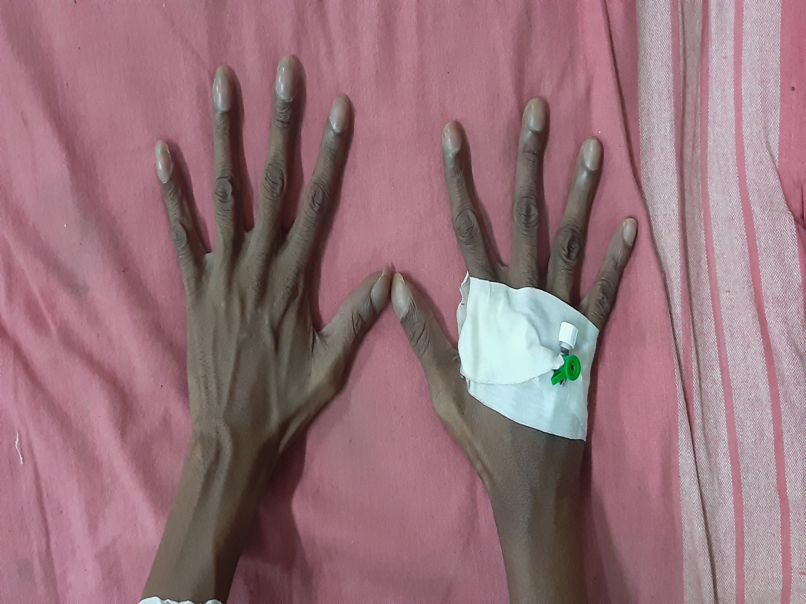

Slide 20
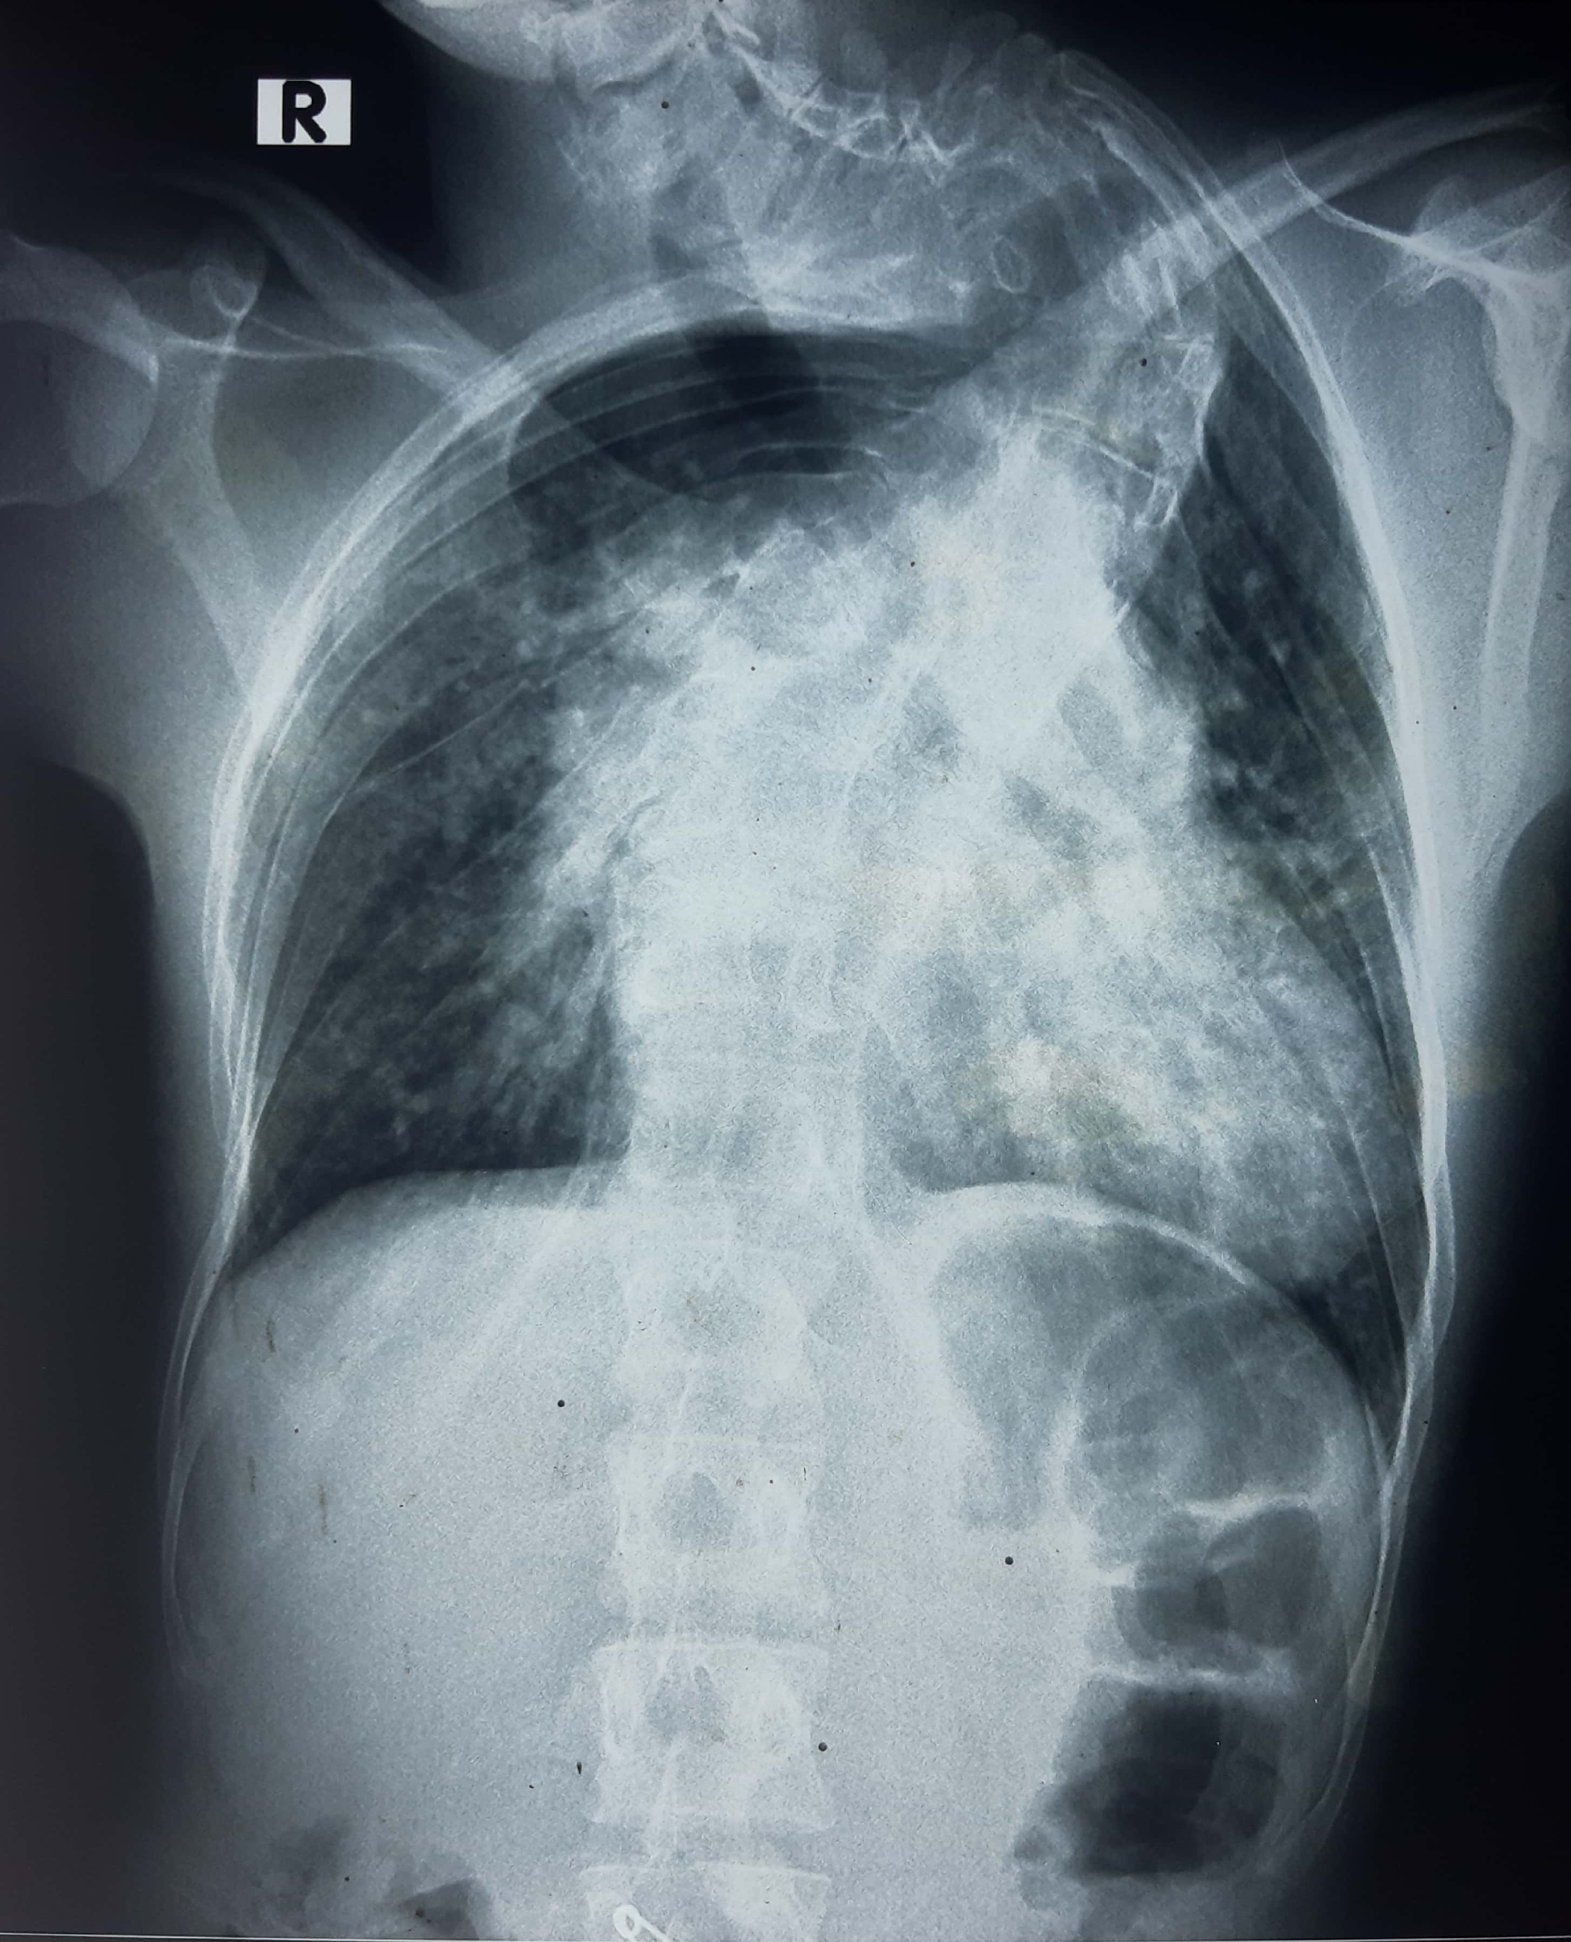
CHEST XRAY PA VIEW

Slide 21
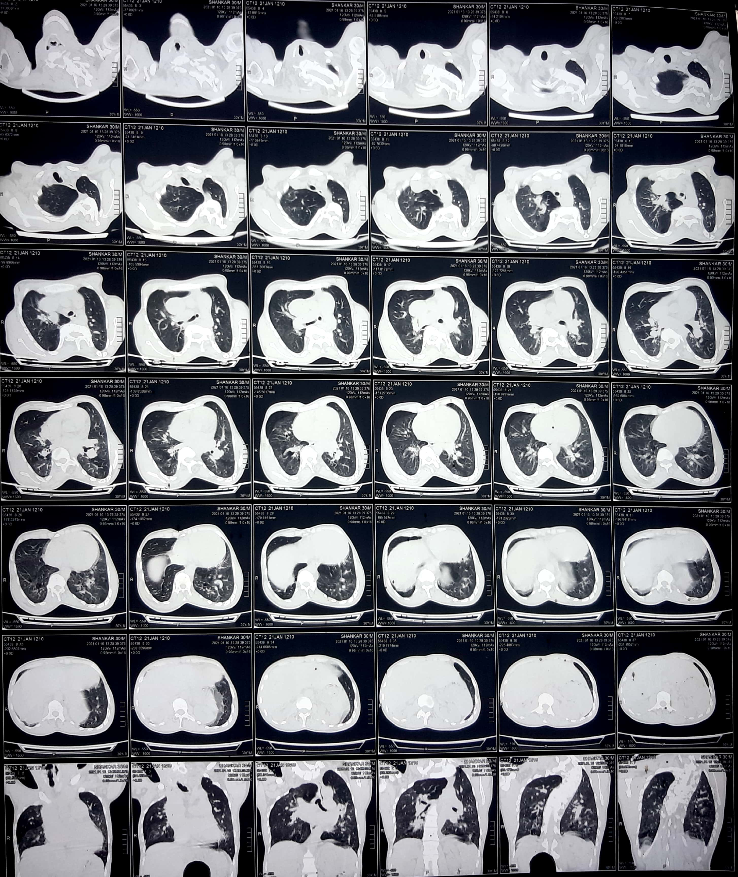

Slide 22
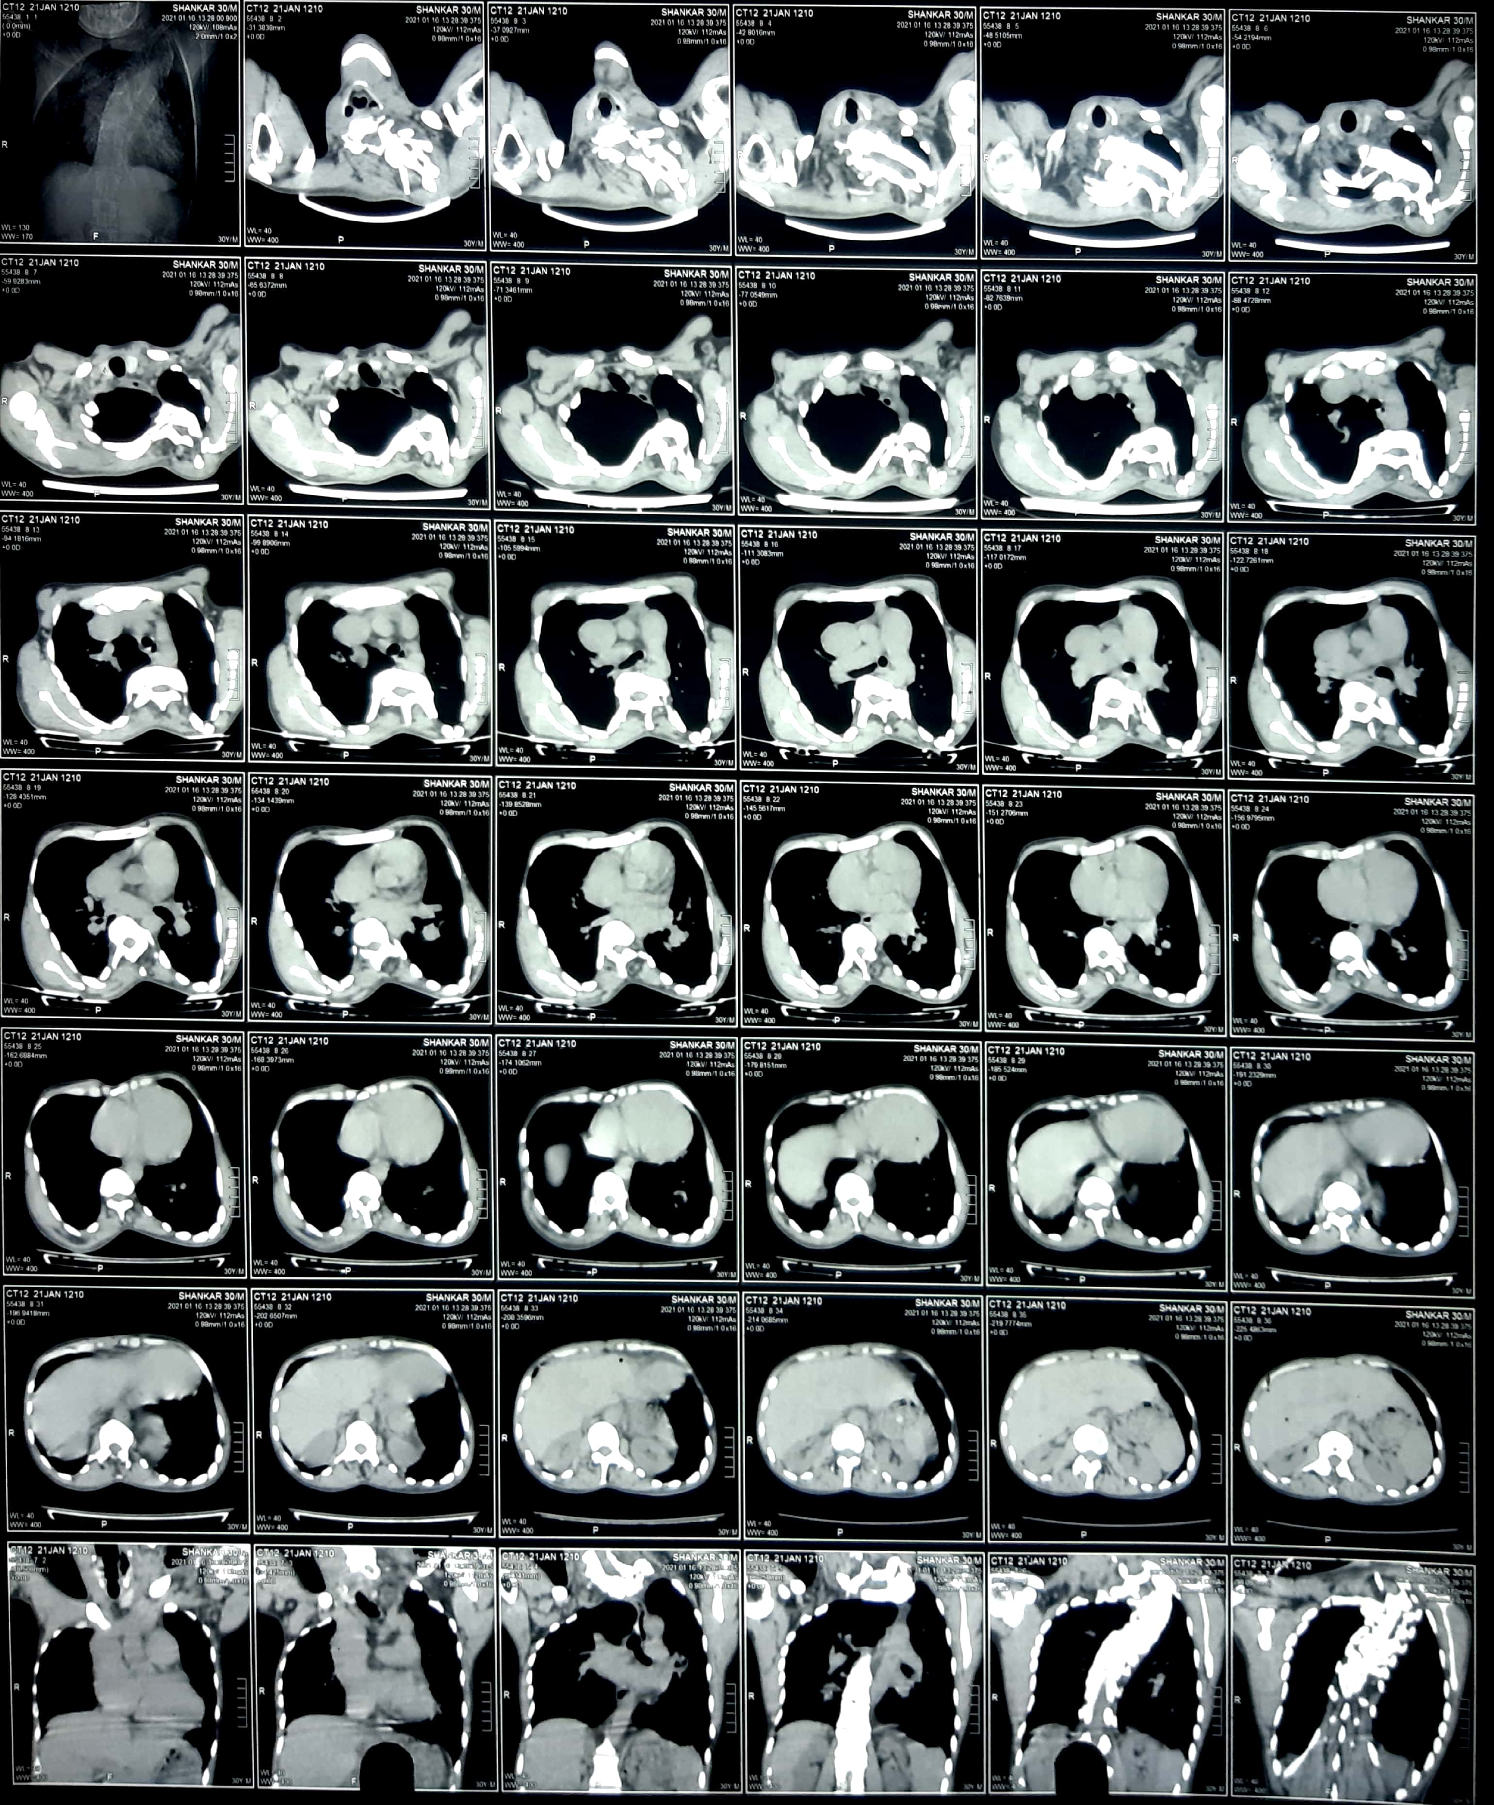

Slide 23
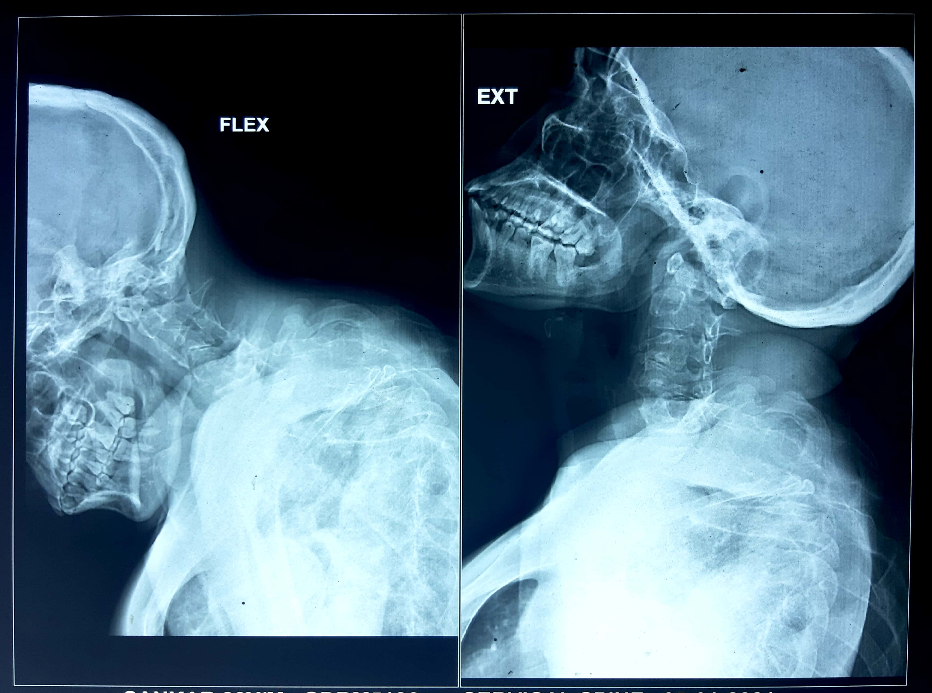

Slide 24
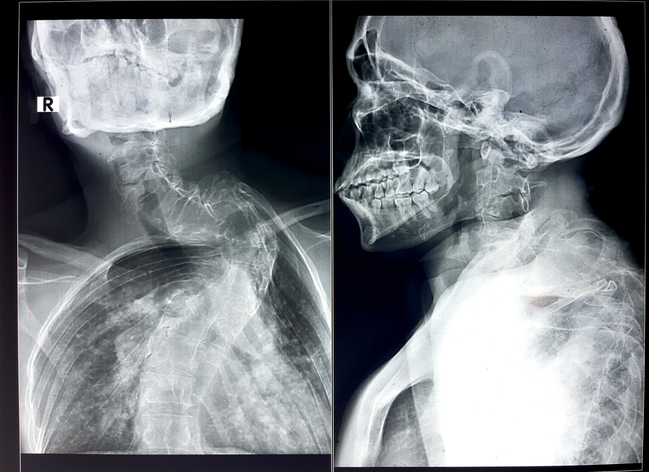

Slide 25
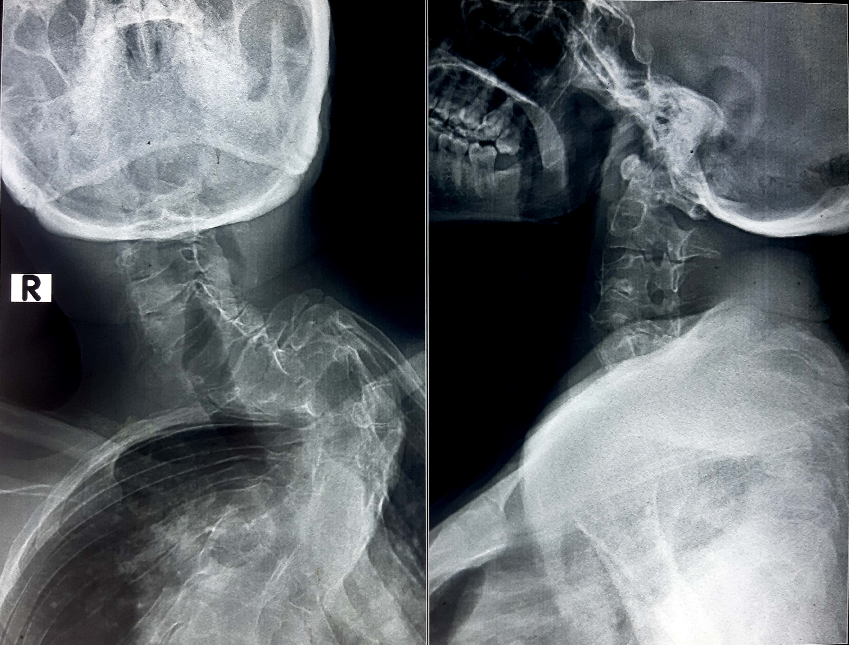

Slide 26
CHEST XRAY PA VIEW
B/L INCREASED PULMONARY PLETHORA NOTED
SEVERE DEGREE OF CERVICOTHORACIC SCOLIOSIS NOTED WITH CONVEXITY TOWARDS LEFT SIDE
C6-C7 COMPLETE BLOCK VERTEBRAE PRESENT WITH PARTIAL BLOCK VERTEBRAE OF C7-T1 AND T1-T2
SCREENING OF B/L UL BONES: NO OBVIOUS BONY ABNORMALITY DETECTED.
ULTRASOUND ABD AND PELVIS: IMP : CONGESTIVE LIVER
AUDIOGRAM: B/L MINIMAL CONDUCTIVE HEARING LOSS

Slide 27
ECHOCARDIOGRAPHY
RA , RV DILATED
TR – SEVERE
TRPG – SEVERE
TRPG – 100 mmHg / severe PHTN
ALL 4 PULMONARY VEINS DRAIN INTO A COMMON CHAMBER POSTERIOR TO LA
VERTICAL VEIN ARISES FROM COMMON CHAMBER AND DRAINS INTO SVC
OBLIGATORY RIGHT TO LEFT SHUNT ACROSS IAS
NORMAL BIVENTRICULAR FUNCTION
LVID (d) – 4.5 ; LVID (s) – 3.0 ; LVEF – 60 %
IMPRESSION : SUPRACARDIAC TAPVC WITH ASD WITH SEVERE PULMONARY HTN

Slide 28
CARDIAC CATHETERISATION REPORT
IMPRESSION :
TAPVC / SUPRACARDIAC TYPE WITH OS-ASD
SMALL PDA
SEVERE PULMONARY HYPERTENSION

Slide 29
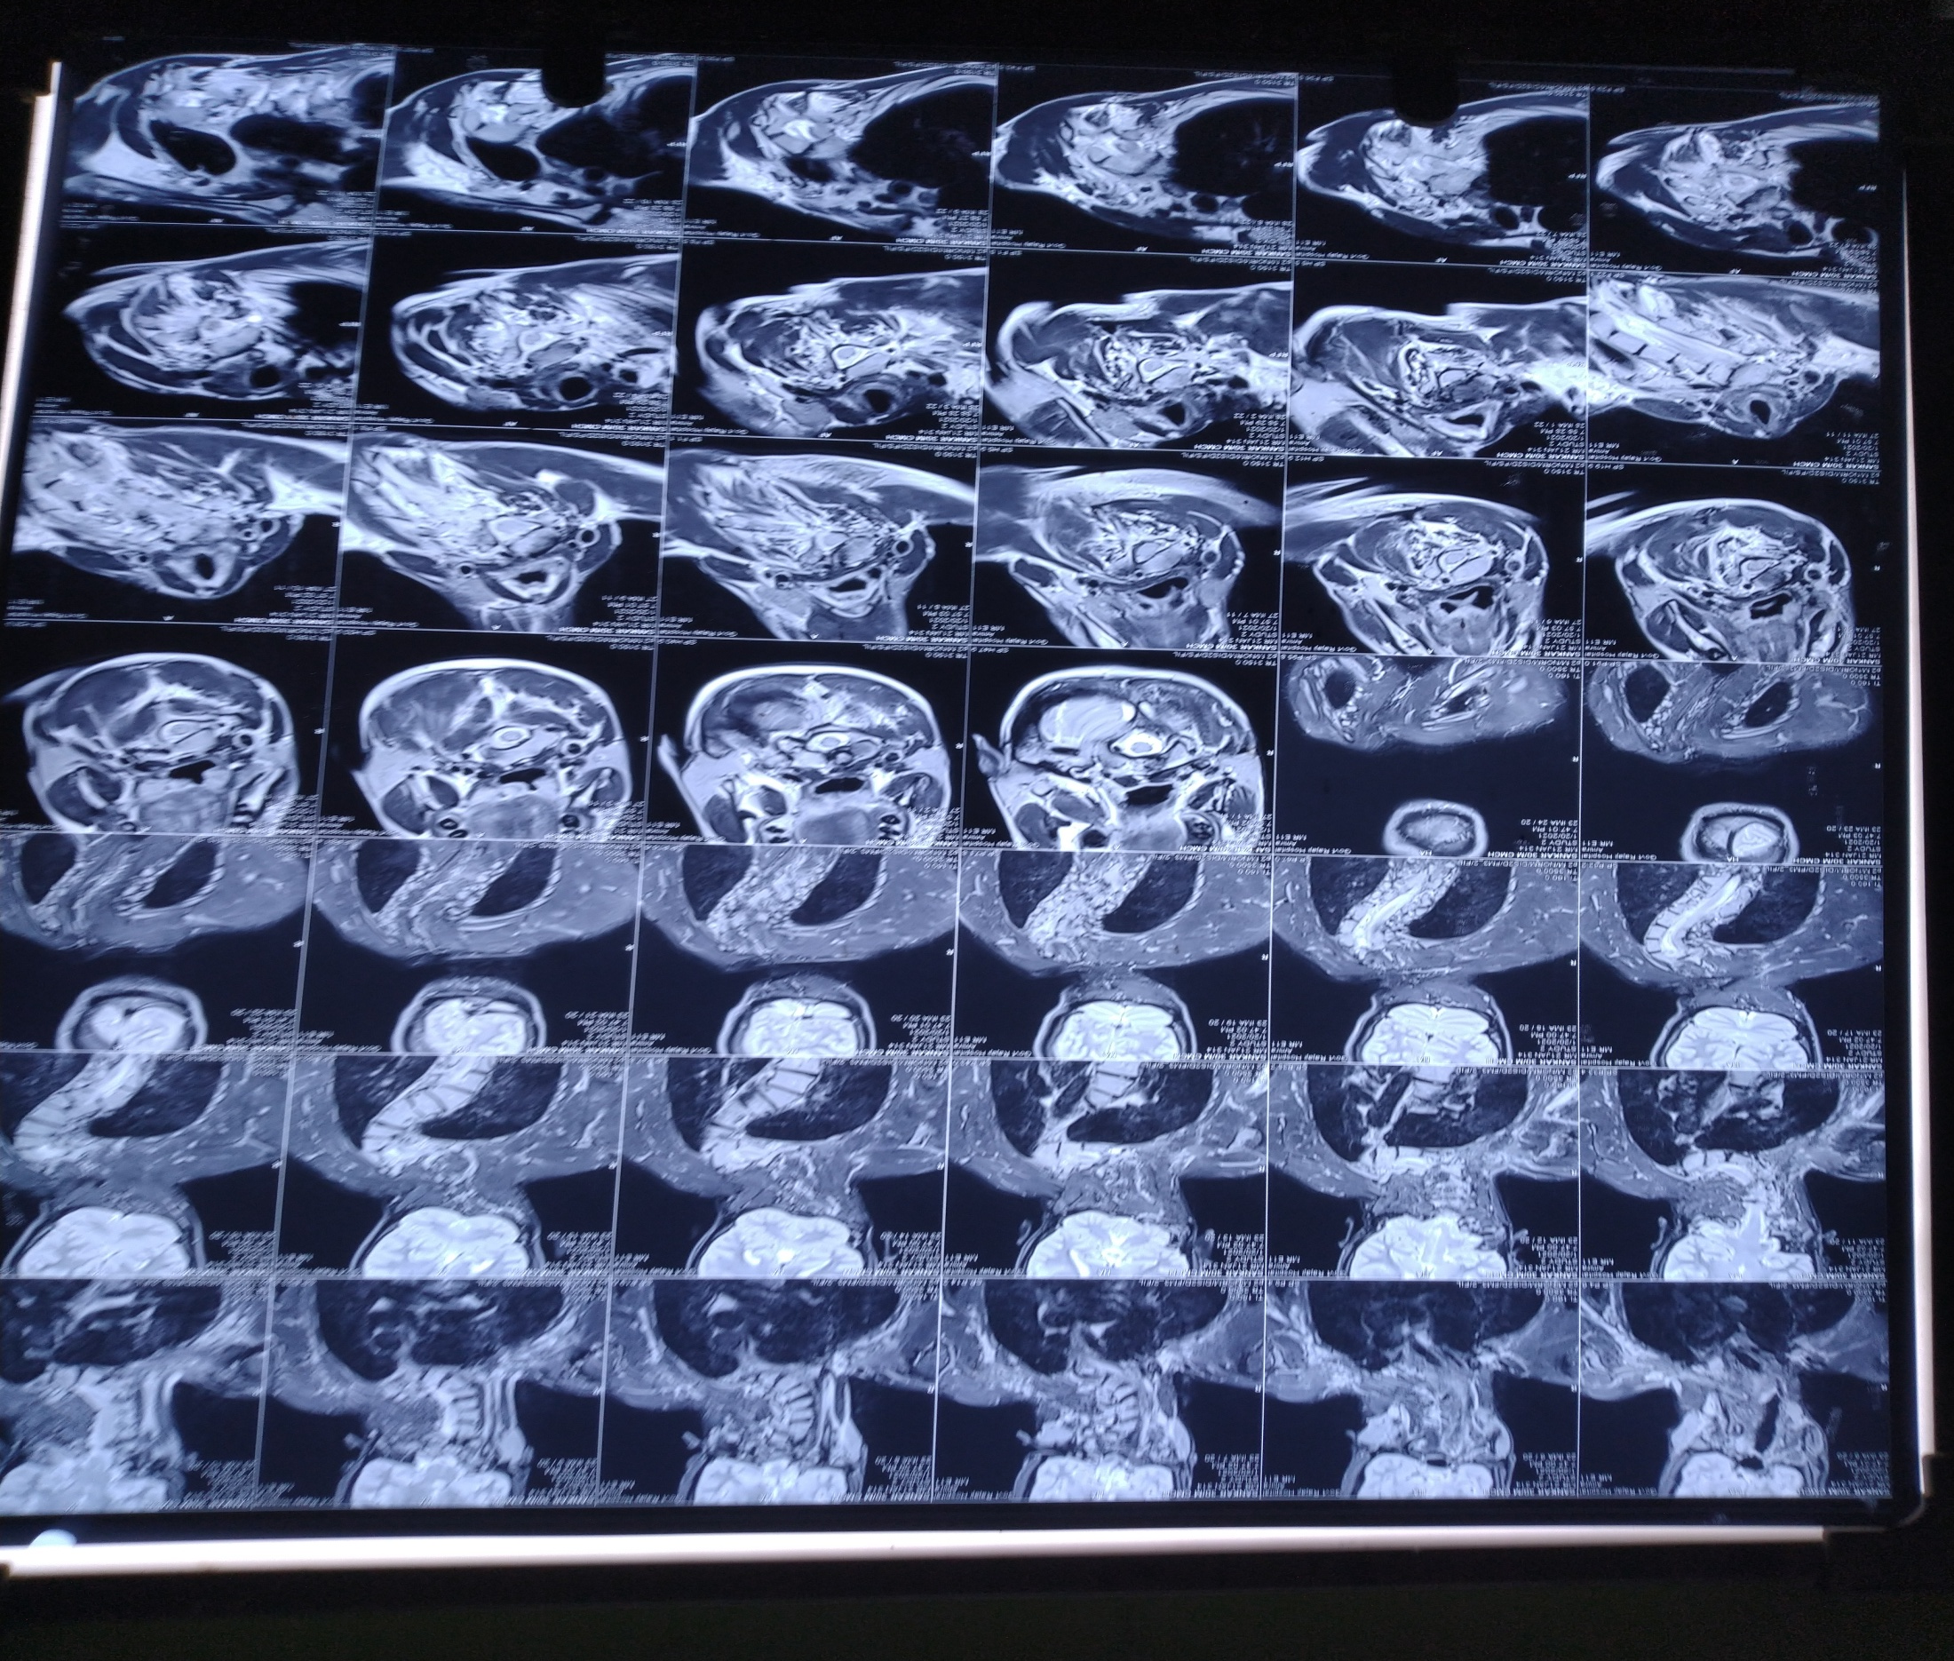

Slide 30
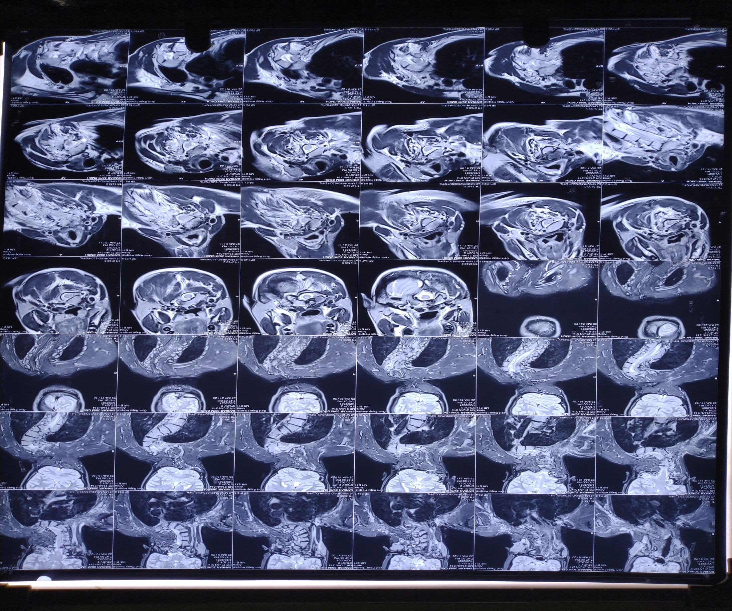

Slide 31
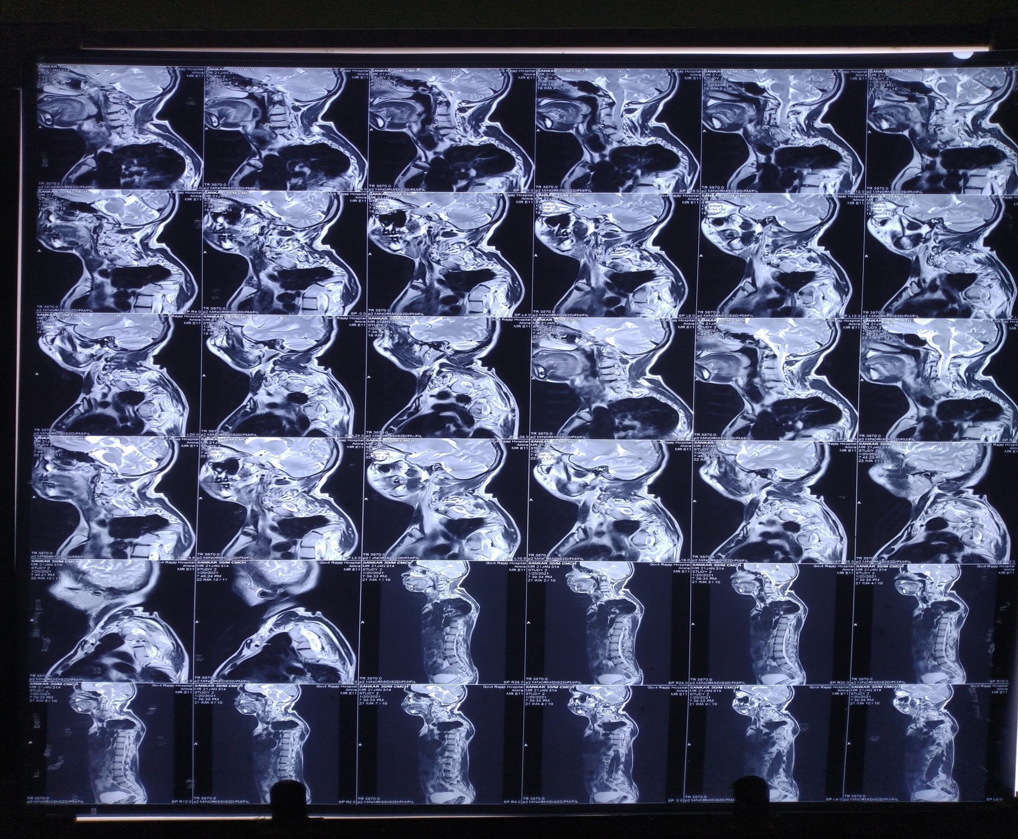

Slide 32
MRI DORSO –LUMBAR SPINE
SEVERE LEVOSCOLIOSIS INVOLVING LOWER CERVICAL,UPPER AND MID DORSAL VERTEBRA CENTERING ON D3 VERTEBRA.
COBBS ANGLE MEASURES : 48 DEGREES
MULTIPLE SEGMENTATION ANOMALIES IN THE FORM OF MULTIPLE HEMIVERTEBRA INVOLVING UPPER DORSAL VERTEBRA
D7-D8 FACET JOINT SHOWS ABNORMAL ANTEROMEDIAL TILT
C6-C7 COMPLETE BLOCK VERTEBRAE PRESENT WITH PARTIAL BLOCK VERTEBRAE OF C7-T1 AND T1-T2
C3-C4 COMPLETE BLOCK VERTEBRA

Slide 33
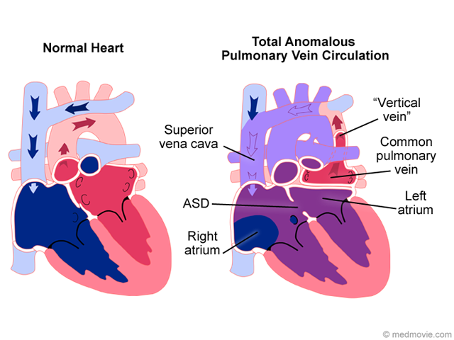

Slide 34
DIAGNOSIS
KLIPPEL FEIL- SYNDROME WITH SUPRACARDIAC TAPVC

Slide 35
FEATURES FAVORING DIAGNOSIS
Klippel feil triad
Cervico thoracic scoliosis
Multiple cervical vertebral fusion
Hearing loss
Webbing of digits

Slide 36
FEATURES NOT PRESENT
No genito urinary abnormalities
No neurological deficits
Omovertebral bone

Slide 37
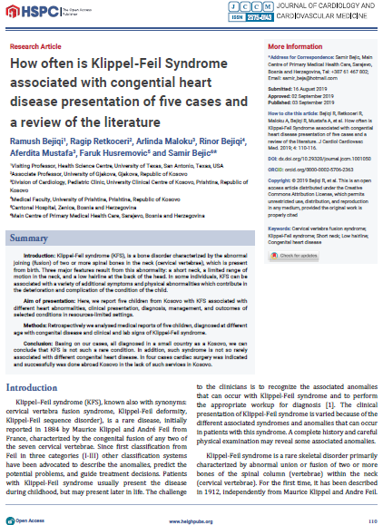

Slide 38
THANK YOU
OUR SINCERE THANKS TO
CARDIOLOGY DEPT
RADIODIAGNOSIS DEPT
MMC,MADURAI.

