Slide 1
A RARE TUMOUR
BY 2nd Medical unit
Chief: Dr.G.Bagialakshmi MD.,
Asst prof :Dr.P.Saravanan MD.,
Asst prof :Dr.M.Satheeshkumar MD.,

Slide 2
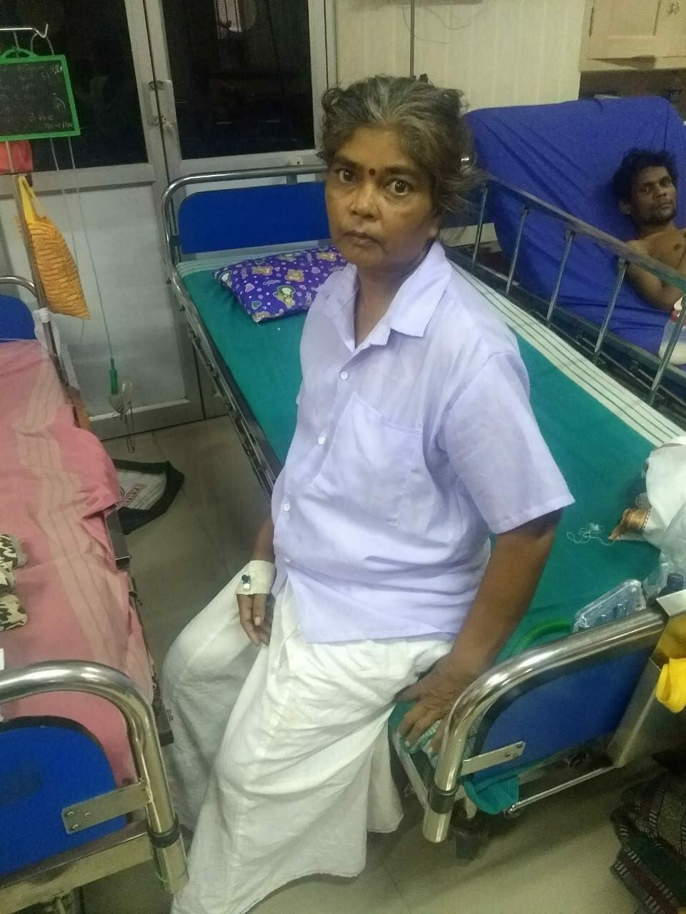
45 year old female admitted with
c/o chestpain for 1 year
H/o presenting illness:
pt was apparently normal before one year
presented with chestpain for 1 year
increased pain during last 10 d
Right sided ,dull aching
continuous in nature,
No aggravating factors
no reliving factors
H/o abdominal pain,
H/o Loss of weight,
H/o Loss of appetite,
No H/o cough

Slide 3
No H/o hemoptysis
No H/o vomiting
No H/o loose stools
No H/o abdominal distension
No H/o decreased urine output
No H/o malena,hemetemesis
No H/o headache ,seizures
No H/o pedal edema,
No H/o rt hypochondrial pain
No H/o facial puffiness
No H/o breathlessness

Slide 4
Past History:
Not a known DM,HT,PTB,CAD,CKD
Personal History:
mixed diet
no specific addiction habit
Drug History:
Nil significant

Slide 5
On examination:
conscious
oriented
afebrile
pallor
not icteric
no clubbing,no cyanosis,
no pedal edema,
no generalised lymphadenopathy
cvs-s1s2 heard ,no murmur
RS-Decreased air entry in Rt in
mammary,infra axillary,infra
scapular region
P/A- soft,no organomegaly
CNS-conscious,
B/Lpupil 3mm RTL
B/L Plantar flexor

Slide 6
INESTIGATION
AUTOMATED HEMOGRAM
RFT
Hb | 12.8 gm/dl
TC | 7400 cells/cumm
DC | P64/L30/E06 %
PCV | 37%
PLT | 2.97 Laksh/cumm
ESR | 13mm/hr
UREA | 20 | 16 | 23
S.Cr | 0.9 | 0.7 | 0.9
Urine routine Alb | nil
Sugar | ++
Deposit | 2-4pus cells
Acetone | Negative

Slide 7
ECHO: NORMAL STUDY EF 60%
USG :ABDOMEN PELVIS
NIL ABNORMALITY DETECTED
COAGULATION PROFILE :WITHIN NORMAL LIMIT
BLOODSUGAR LEVEL
FBS | 132mg/dl | 98mg/dl
PPBS | 234 mg/dl | 168mg/dl

Slide 8
INVESTIGATION
Na | 128
K | 4.1
T.BILIRUBIN | 0.4
DIRECT.B | 0.2
INDIRECT | 0.2
SGOT | 14
SGPT | 09
ALP | 70
HIV 1&2 | NON REACTIVE
HBsAg | NEGATIVE
Anti-HCV | NEGATIVE

Slide 9
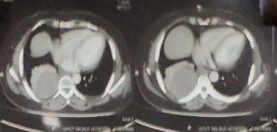

Slide 10
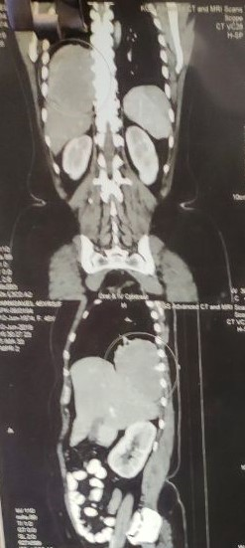

Slide 11
PROVISIONAL DIAGNOSIS
45 Yr old female
H/o Rt sided chest pain one yr
H/o Loss of weight
H/o Loss of appetite
X Ray Rt lower lobe homogenous opacity
CT CHEST showed Rtlung mass
T2DM / RIGHTSIDEDLUNG MASS
PLAN :CT GUIDED BIOPSY

Slide 12
Ct guided biopsy shows

Slide 13
DIAGNOSIS
SPINDLE CELL TUMOUR PROBABLY NERVE SHEATH TUMOUR

Slide 14
treatment
T.MORPHINE SULPHATE 1-1-1
T.PARACETAMOL 500MG 1-1-1
T.DICLOFENAC SODIUM 10 MG 1-01
T.RANITIDINE 150 MG 1-0-1
T.DOMPERIDONE 10MG 1-0-1
T.BISACODYL 5MG 0-0-2
T.METFORMIN 500MG1-1-1
T.GLIBENCLAMIDE 5MG 1-0-1

Slide 15
NEXT
Pt shifted to medical oncology for furthur management
on supportive care
PLAN: EXCISION OF TUMOUR
Shifted to cardio thoracic surgery
excision of mass done

Slide 17
Biopsy shows
SPINDLE CELL

Slide 18
Neurofibroma Right thoraCic cavity

Slide 21
THANK YOU

