Slide 1
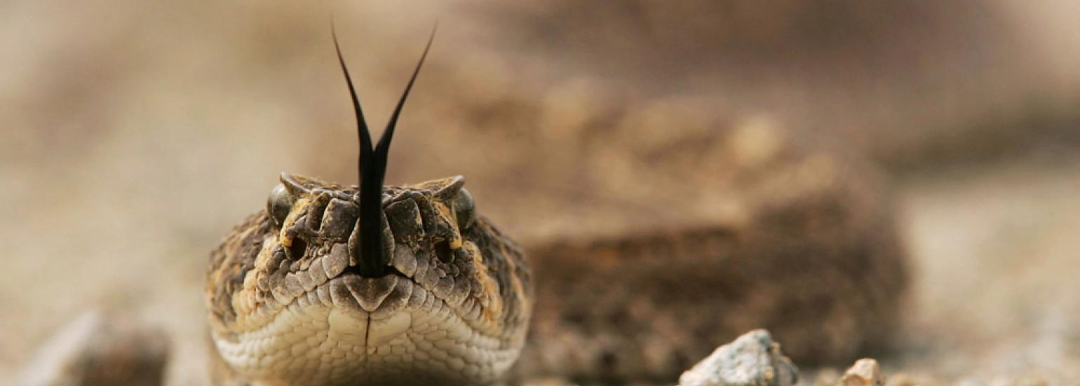
III MEDICAL UNIT
Dean Prof.Dr. J.Sangumani M.D.,D.Diab
Toxicology Prof. Dr.Alagavenkatesan M.D., Asst prof Dr.Palanikumaran M.D. D.Diab.,
Asst prof Dr.Sudha M.D.,
Asst prof Dr.Sureshkumar M.D.,
HEMOTOXIC SNAKE BITE WITH RARE OCULAR MANIFESTATION

Slide 2

CHIEF COMPLAINTS
18 YEAR OLD MALE ADMITTED WITH ALLEGED H/O UNKNOWN BITE OVER LEFT FOOT ON 21/11/2019 AT AROUND 12 MIDNIGHT AT HIS FARM FIELD

Slide 3
HISTORY OF PRESENTING ILLNESS
12.30am
1.00am
3.00am
Patient admitted at GRH with c/o swelling & pain in left foot
2.00am
Alleged h/o unknown bite over left foot at his farm field
h/o pain at bite site & bleeding from bite site immediately
Patient was taken to nearby GH
On the way , patient developed giddiness, become unconscious
Recovered immediately
Pt went & admitted in Chozhavanthan GH & Referred to GRH
H/o abdominal pain
H/o blurring of vision + ,No h/o drooping of eyelids
Pt went for native treatment ,consumed some decoction (kashayam), then

Slide 4
No other significant positive history
Past history
Not a k/c/o DM/HT/TB/BA/thyroid disorders/Heart diseases/Epilepsy
Personal history
Takes mixed diet ,Normal bowel & bladder habits
Not a smoker/alcoholic

Slide 5
GENERAL EXAMINATION
BP – 120/80
PR- 86/min
Felt in all accessible pulses
SPO2 – 97%
RR- 14/MIN
Pt. Conscious
Oriented
Afebrile
No Pallor
No Pedal edema
No Clubbing
No Cyanosis
No Generalised lymphadenopathy
Not Icteric

Slide 6
SYSTEMIC EXAMINATION
CVS – S1, S2 HEARD , NO MURMUR
RS – B/L AIR ENTRY +, NVBS, NO ADDED SOUNDS
P/A – SOFT, NOT DISTENDED, NOT TENDER, BOWEL SOUNDS+

Slide 7
CNS EXAMINATION
PATIENT CONSCIOUS
ORIENTED
MOVES ALL FOUR LIMBS
NO NECK MUSCLE WEAKNESS
NO PTOSIS
EOM – FULL
 | PUPIL | VISION
RIGHT EYE | 3MM RTL | NORMAL
LEFT EYE | 5MM SRTL | ONLY PERRCEPTION OF LIGHT +

Slide 8
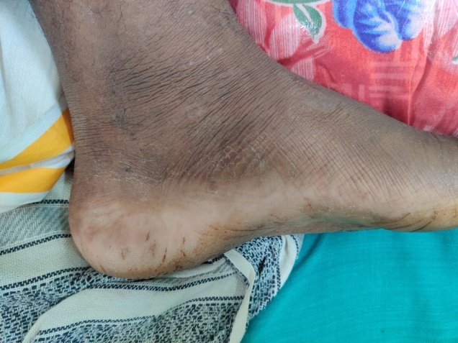
LOCAL EXAMINATION
BITE MARK SEEN IN MEDIAL ASPECT OF LEFT FOOT
SWELLING AROUND BITE SITE+
REGIONAL LYMPHADENITIS+
NO DISTAL NEURO VASCULAR DEFICIT

Slide 9
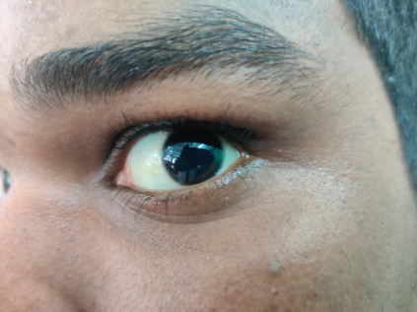
OCULAR EXAMINATION
VISION
 | RIGHT EYE | LEFT EYE
VISION | NORMAL | PERCEPTION OF LIGHT +
PUPIL | RTL 2MM | STRL 5MM
Fundus | Normal | Blurred disc margin Cherry red spot +

Slide 10
FIRST INVESTIGATION & DX
WBCT > 20 MINS
DX – UNKNOWN BITE LEFT FOOT/LEFT FOOT CELLULITIS/?HEMOTOXIC SNAKE BITE/
SUDDEN PAINLESS LOSS OF VISION LEFT EYE F/E

Slide 11
INVESTIGATIONS
CBC
 | 21/11 | 22/11 | 25/11 | 30/11
TC | 23100 | 21000 | 13600 | 15100
DC | 80/11/9 | 83/10/7 | 61/30/09 | 67/21/12
HB | 16.4 | 16.1 | 15.4 | 14.8
PCV | 43 | 44 | 38 | 40
PLATELET | 2.05 | 1.52 | 2.10 | 3.88
SERUM ELECTROLYTES
NA – 135
K – 3.8
URINE ROUTINE
ALBUMIN-NIL
SUGAR-NIL
DEPOSITS – 0-2
RBS- 84

Slide 12
LFT
LFT | 21/11 | 22/11 | 23/11 | 24/11 | 29/11 | 30/11
BILLIRUBIN (T) | 5.0 | 3.9 | 1.2 | 0.9 | 1.3 | 1.0
DIRECT | 1.0 | 1.0 | 0.6 | 0.3 | 0.4 | 0.8
INDIRECT | 4.0 | 2.9 | 0.6 | 0.6 | 0.9 | 0.2
SGOT | 46 | 43 | 26 | 20 | 14 | 20
SGPT | 17 | 25 | 20 | 16 | 15 | 22
ALP | 127 | 49 | 82 | 75 | 67 | 63
TOTAL PROTEIN- 6.9
S. ALBUMIN -3.6
S. GLOBULIN – 3.3
URINE
BILE SALTS &
BILE PIGMENTS –
Negative
LDH – 650 U/L

Slide 13
RFT
RFT | 21/11 | 22/11 | 23/11 | 24/11 | 25/11 | 26/11 | 29/11 | 30/11
UREA | 27 | 34 | 36 | 31 | 36 | 39 | 26 | 22
CREATININE | 0.9 | 1.0 | 1.2 | 1.0 | 1.1 | 0.7 | 1.4 | 1.0
INPUT (ML) |  | 4050 | 3900 | 2900 | 4250 | 3900 | 3050 | 3050
OUTPUT |  | 4700 | 2550 | 3300 | 2850 | 3700 | 2850 | 2900

Slide 14
PT/APTT
 | 21/11 | 23/11 | 24/11 | 26/11
PT | 32.6 | 24.8 | 19.0 | 16.4
INR | 2.71 | 1.8 | 1.43 | 1.2
APTT | 13.9 | 24.1
ECG
NSR
NORMAL AXIS
NO ST/T
CHANGES
ECHOCARDIOGRAM
ALL CHAMPERS NORMAL IN SIZE
NO MR/TR
NO RWMA
GOOD LV FUNCTION
NO E/O PERICARDIAL EFFUSION
NO E/O CLOT
USG
NO
SIGNIFICANT
ABNORMALLY
DETECTED

Slide 15
CAROTID ARTERY DOPPLER-
B/L CCA/ICA SHOW NORMAL FLOW
B/L IJV SHOW NORMAL FLOW
NO E/O ANY THROMBUS NOTED
ESR – 30MM 1 HR
CRP - NEGATIVE
FDP NOT DONE

Slide 16
TREATMENT
21/11/19
AT 3.10 AM
WBCT >20MIN
10 VIALS OF ASV GIVEN
21/11/19
AT 9.30 AM
RPT WBCT
> 20 MIN
10 VIALS OF ASV GIVEN
21/11/19
AT 8PM
RPT WBCT
>20 MIN
2 FFP GIVEN

Slide 17
ÒTHER TREATMENT
IV ANTIBIOTICS
IV FLUIDS
T.SERRATIOPEPTIDASE 1 TDS
2 FFP ON 21/11/19 & 2 FFP ON 23/11/19
T. RANITIDINE 150MG 1 BD
LEFT LOWER LIMB ELEVATION
VITALS MONITORING

Slide 18
SURGEON OPINION
LEFT FOOT ELEVATION
T.SERRATIO PEPTIDASE
10MG 1 TDS
CARDIOLOGIST OPINION
ECHOCARDIOGRAM NORMAL
NIL CARDIAC INTERVENTION NEEDED AT PRESENT

Slide 19
OPHTHALMOLOGY OPINION
 | RIGHT | LEFT
VISION | >3/60 | PL
TENSION | DIGITALLY NORMAL | DIGITALLY NORMAL
 | RIGHT | LEFT
LIDS | NORMAL | NORMAL
CONJUCTIVA | NORMAL | NORMAL
CORNEA | CLEAR | CLEAR
AD | ND | ND
IRIS | CPN | CPN
PUPIL | RTL | RAPD
LENS | CLEAR | CLEAR
EOM | FULL | FULL

Slide 20
FUNDUS
 | RIGHT EYE | LEFT EYE
MEDIA | CLEAR | CLEAR
DISC | NORMAL | SWELLING + BLURRING OF MARGIN +
C:D | 0.3:1 | 0.2:1
A:V | 2:3 | RETINAL EDEMA +, PALE RETINA
MACULA | NORMAL | CHERRY RED SPOT+
DIAGNOSED AS ACUTE LEFT EYE CRAO
STARTED ON
T.ACETAZOLAMIDE 250MG 1-0-1

Slide 21
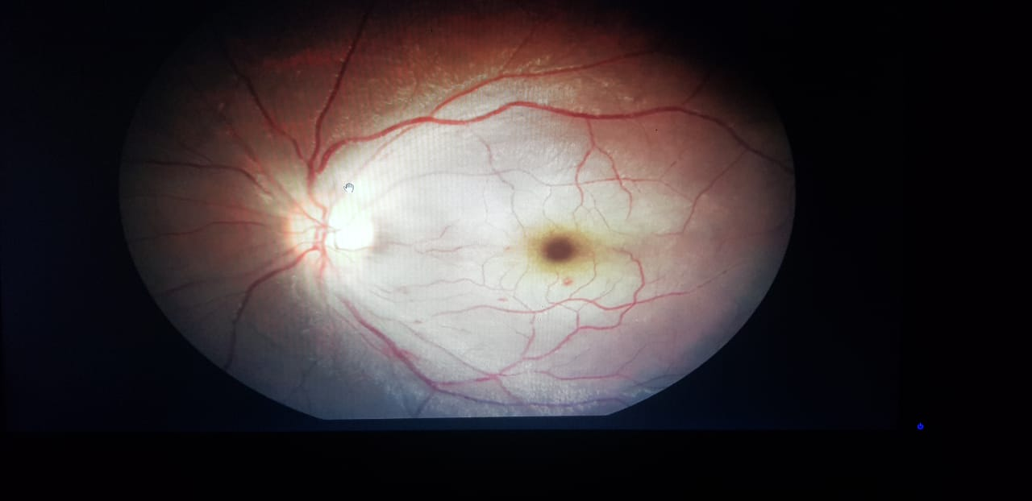

Slide 22
FINAL DIAGNOSIS
UNKNOWN BITE LEFT FOOT/LEFT FOOT CELLULITS/?HEMOTOXIC SNAKE BITE/ACUTE CENTRAL RETINAL ARTERY OCCLUSION LEFT EYE

Slide 23
 | 22/11 | 24/11 | 25/11 | 27/11 | 30/11 | 2/12
VISION | CFCF | CFCF | CFCF | HM+ | CFCF | CFCF
TENSION |  |  |  | 17.3 | 17.3 | 17.3
PUPIL | RAPD | RAPD | RAPD | RAPD | RTL | RTL
MEDIA | CLEAR | CLEAR | CLEAR | CLEAR | CLEAR | CLEAR
DISC | BLURRING OF SUP/INF NASAL MARGINS RETINAL EDEMA + | BLURRING OF SUP/INF NASAL MARGINS | BLURRING OF SUP/INF NASAL MARGINS | BLURRING OF SUP/INF NASAL MARGINS | BLURRING OF SUP/INF NASAL MARGINS | BLURRING OF SUP/INF NASAL MARGINS
C:D | 0.3:1 | 0.3:1 | 0.3:1 | 0.3:1 | 0.3:1 | 0.3:1
VESSELS | THROMBI NOTED AT SUPERONASAL / INFERO TEMPORAL AREAS | THROMBI NOTED AT SUPERONASAL / INFERO TEMPORAL AREAS | THROMBI NOTED AT SUPERONASAL / INFERO TEMPORAL AREAS | THROMBI NOTED AT SUPERONASAL / INFERO TEMPORAL AREAS | HEMMORRHAGE NOTED IN SUPERONSAL/INFEROTEMPORAL AREAS | RESOLVING EDEMA RESOLVING HEMORRHAGES
A:V | 2:3 | 2:3 | 2:3 | 2:3 | 2:3 | 1:3
MACULA | BGR PALE | BGR PALE | BGR PALE | BGR PALE | BGR PALE | BGR PALE
FR | CHERRY RED SPOT + | CHERRY RED SPOT + | CHERRY RED SPOT + WITH ONE NEW BLOTCH HEMMORHAGE IN MACULAR AREA | CHERRY RED SPOT + | CHERRY RED SPOT + WITH 2 NEW BLOTCH HEMMORHAGE IN MACULAR AREA | CHERRY RED SPOT +

Slide 24
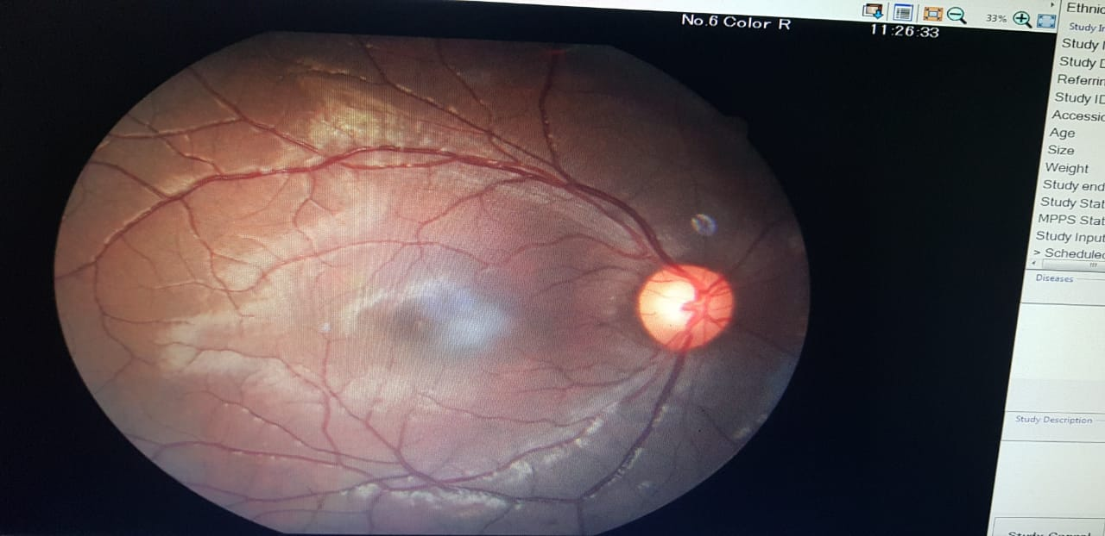

Slide 25
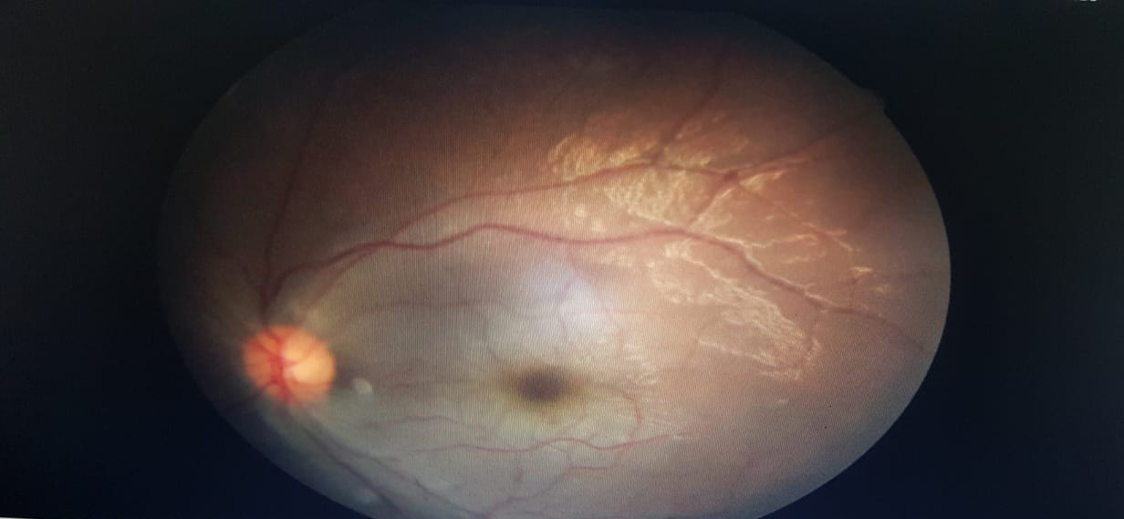

Slide 26
OCT
LE : Intra Retinal fluid +
Inner retinal thickening
Hypo reflectivity of inner retinal layers
AFTER 4DAYS T.ACETAZOLAMIDE STOPPED
TIMOLOL E/D
Dorzolamide E/D
NAPAFENAC E/D given

Slide 27
CLOTTING BECAME NORMAL ON 2ND DAY
NO FURTHER BLEEDING MANIFESTATIONS
CELLULITIS REGRESSED
RENAL PARAMETERS NORMAL
NO AKI
VISION IN LEFT EYE
IMPROVED FROM PL TO CFCF
NO COMPLETE RECOVERY TILL NOW

Slide 28
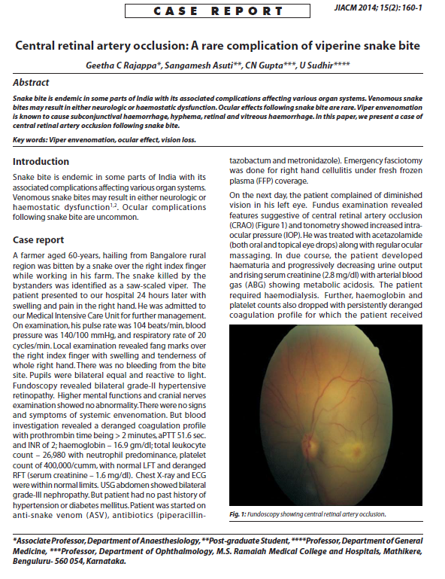
SNAKE BITE & CRAO

Slide 29
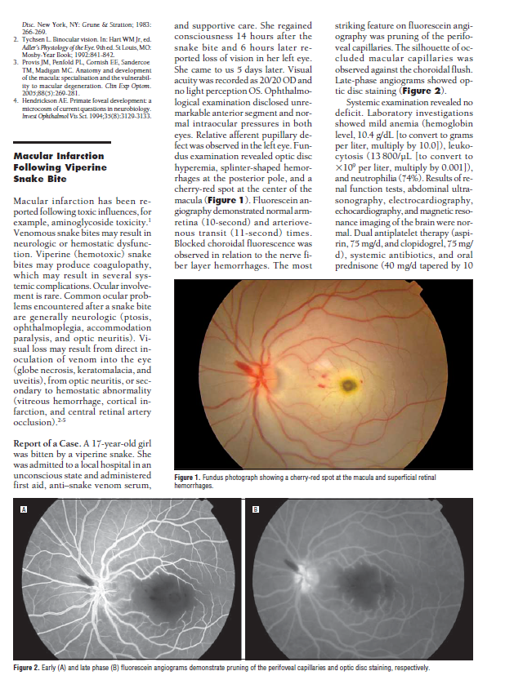

Slide 30
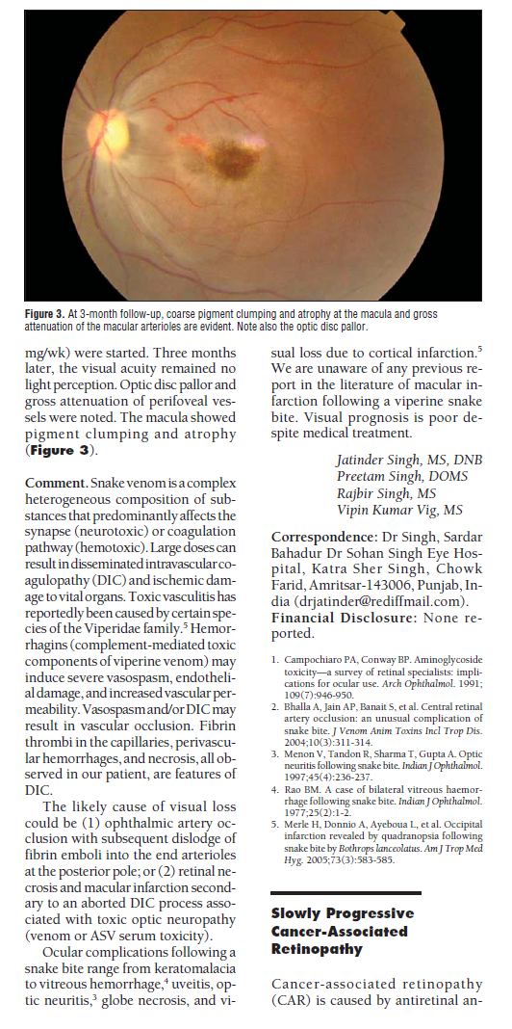

Slide 31
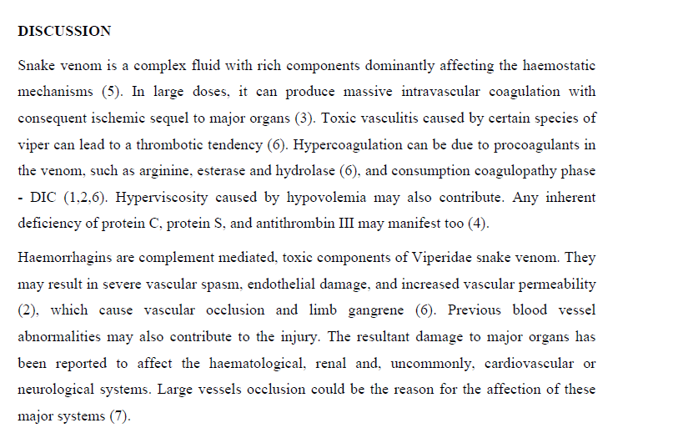

Slide 32
THANK YOU

