Slide 1
PHYSCON
BY FIRST MEDICAL UNIT
CHIEF: PROF DR.M.NATARAJAN MD
ASST PROF:DR.PALANIKUMARAN MD D.Diab
Dr.vasantha Kalyani md dcp
dr .suresh kumar md
Dr.Vignesh md

Slide 2
Born with anaemia

Slide 3
history
13 yr old female came with c/o cough with expectoration for 2 days
Sputum is white mucoid in nature ,not a/w hemoptysis
h/o easy fatigability +
h/o breathlessness + of nyha class 2 dyspnea
h/o not gaining height compared to her sibling
h/o poor scholastic
No h/o orthopnea &pnd
No h/o abdominal distension /pedal edema
No h/o reduced urine output
No h/o chest pain /palpitation /syncope
no h/o malena /hematemesis
No h/o gum bleeding
No h/o fever/loose stool and myalgia

Slide 4
No h/o jaundice
No h/o yellowish discolouration of urine
No h/o hematuria /dark coloured urine /abdominal pain
No h/o loss of weight and appetite

Slide 5
PAST HISTORY
NOT A K/C/O DIABETES ,HYPERTENSION, CAD/CVA/BRONCHIAL ASTHMA /EPILEPSY
PREVIOUS H/O BLOOD TRANSFUSION DONE 1 UNIT OF PC AND 2 UNIT OF PLATELET BEFORE 4 MONTHS
NO H/O CHEMOTHERAPY OR RADIOTHERAPY
NO OCCUPATION EXPOSURE TO RADIATION AND CHEMICAL INDUSTRY
NATAL H/O
BORN OUT OF FULL TERM NORMAL VAGINAL DELIVERY

Slide 6
Personal h/o
Mixed diet
Normal bowel and bladder habits
Not attained menarche
Family h/o
Nil significant family history

Slide 7
examination
Pt was concious ,oriented ,afebrile
Pallor+ ,no icterus ,no cyanosis ,no clubbing ,no pedal edema ,no generalized lymphadenopathy
Elevated jvp +,short stature +
Rt hand polydactyly + , café au lait spot +
Multiple oral ulceration + ,hypomelanotic macules all over the trunk +
Scoliosis +

Slide 8
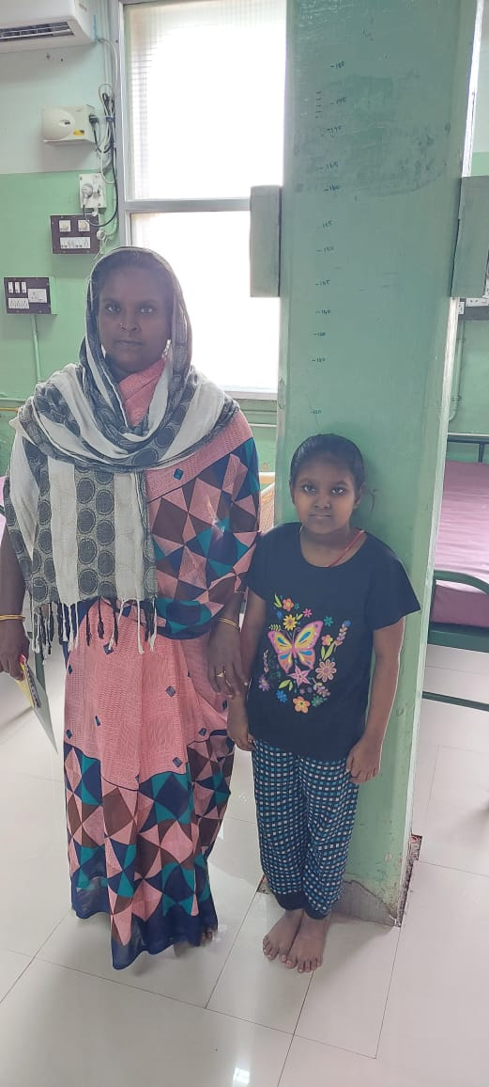
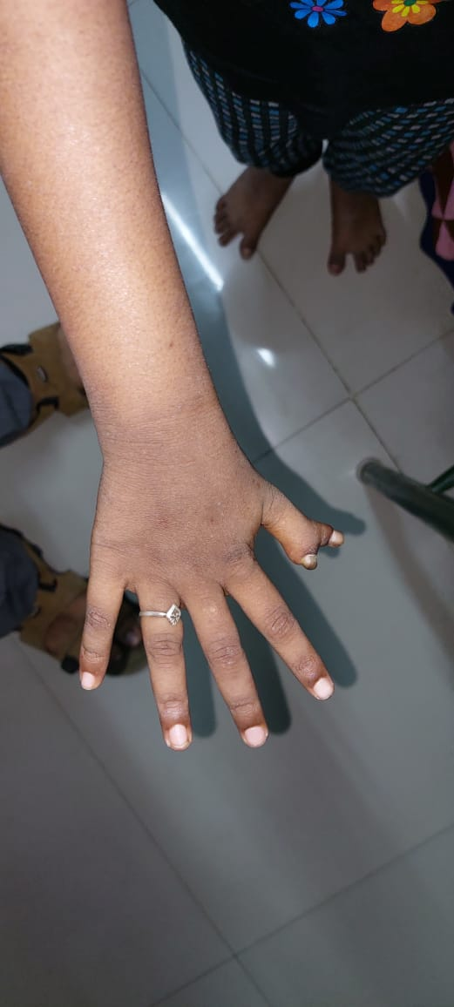
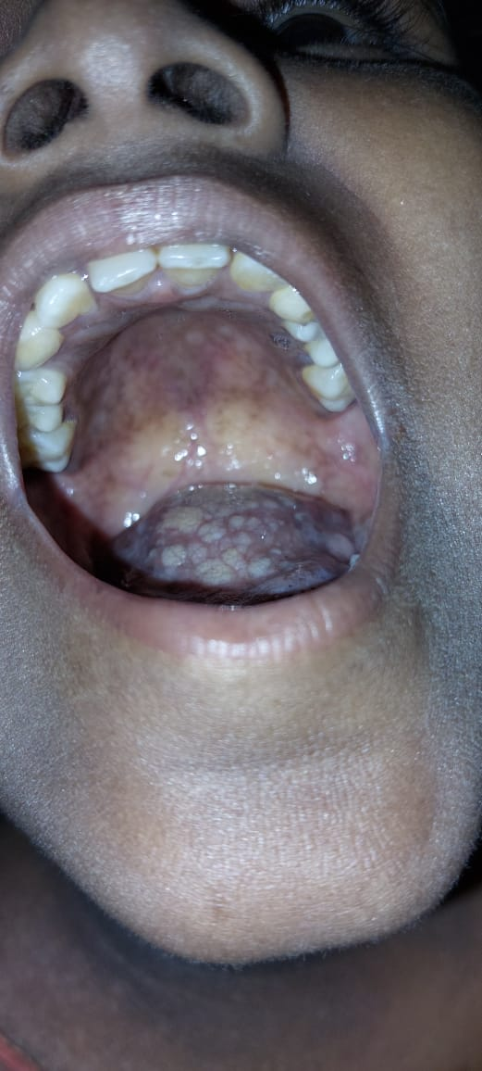

Slide 9
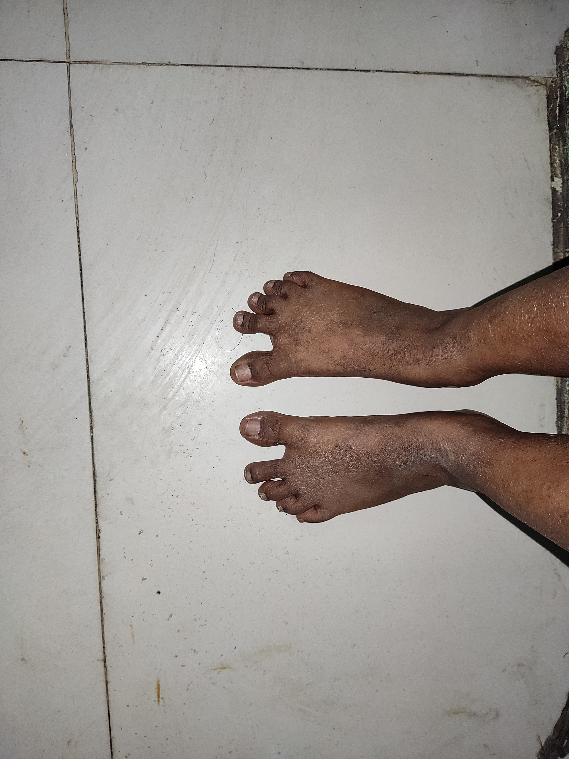
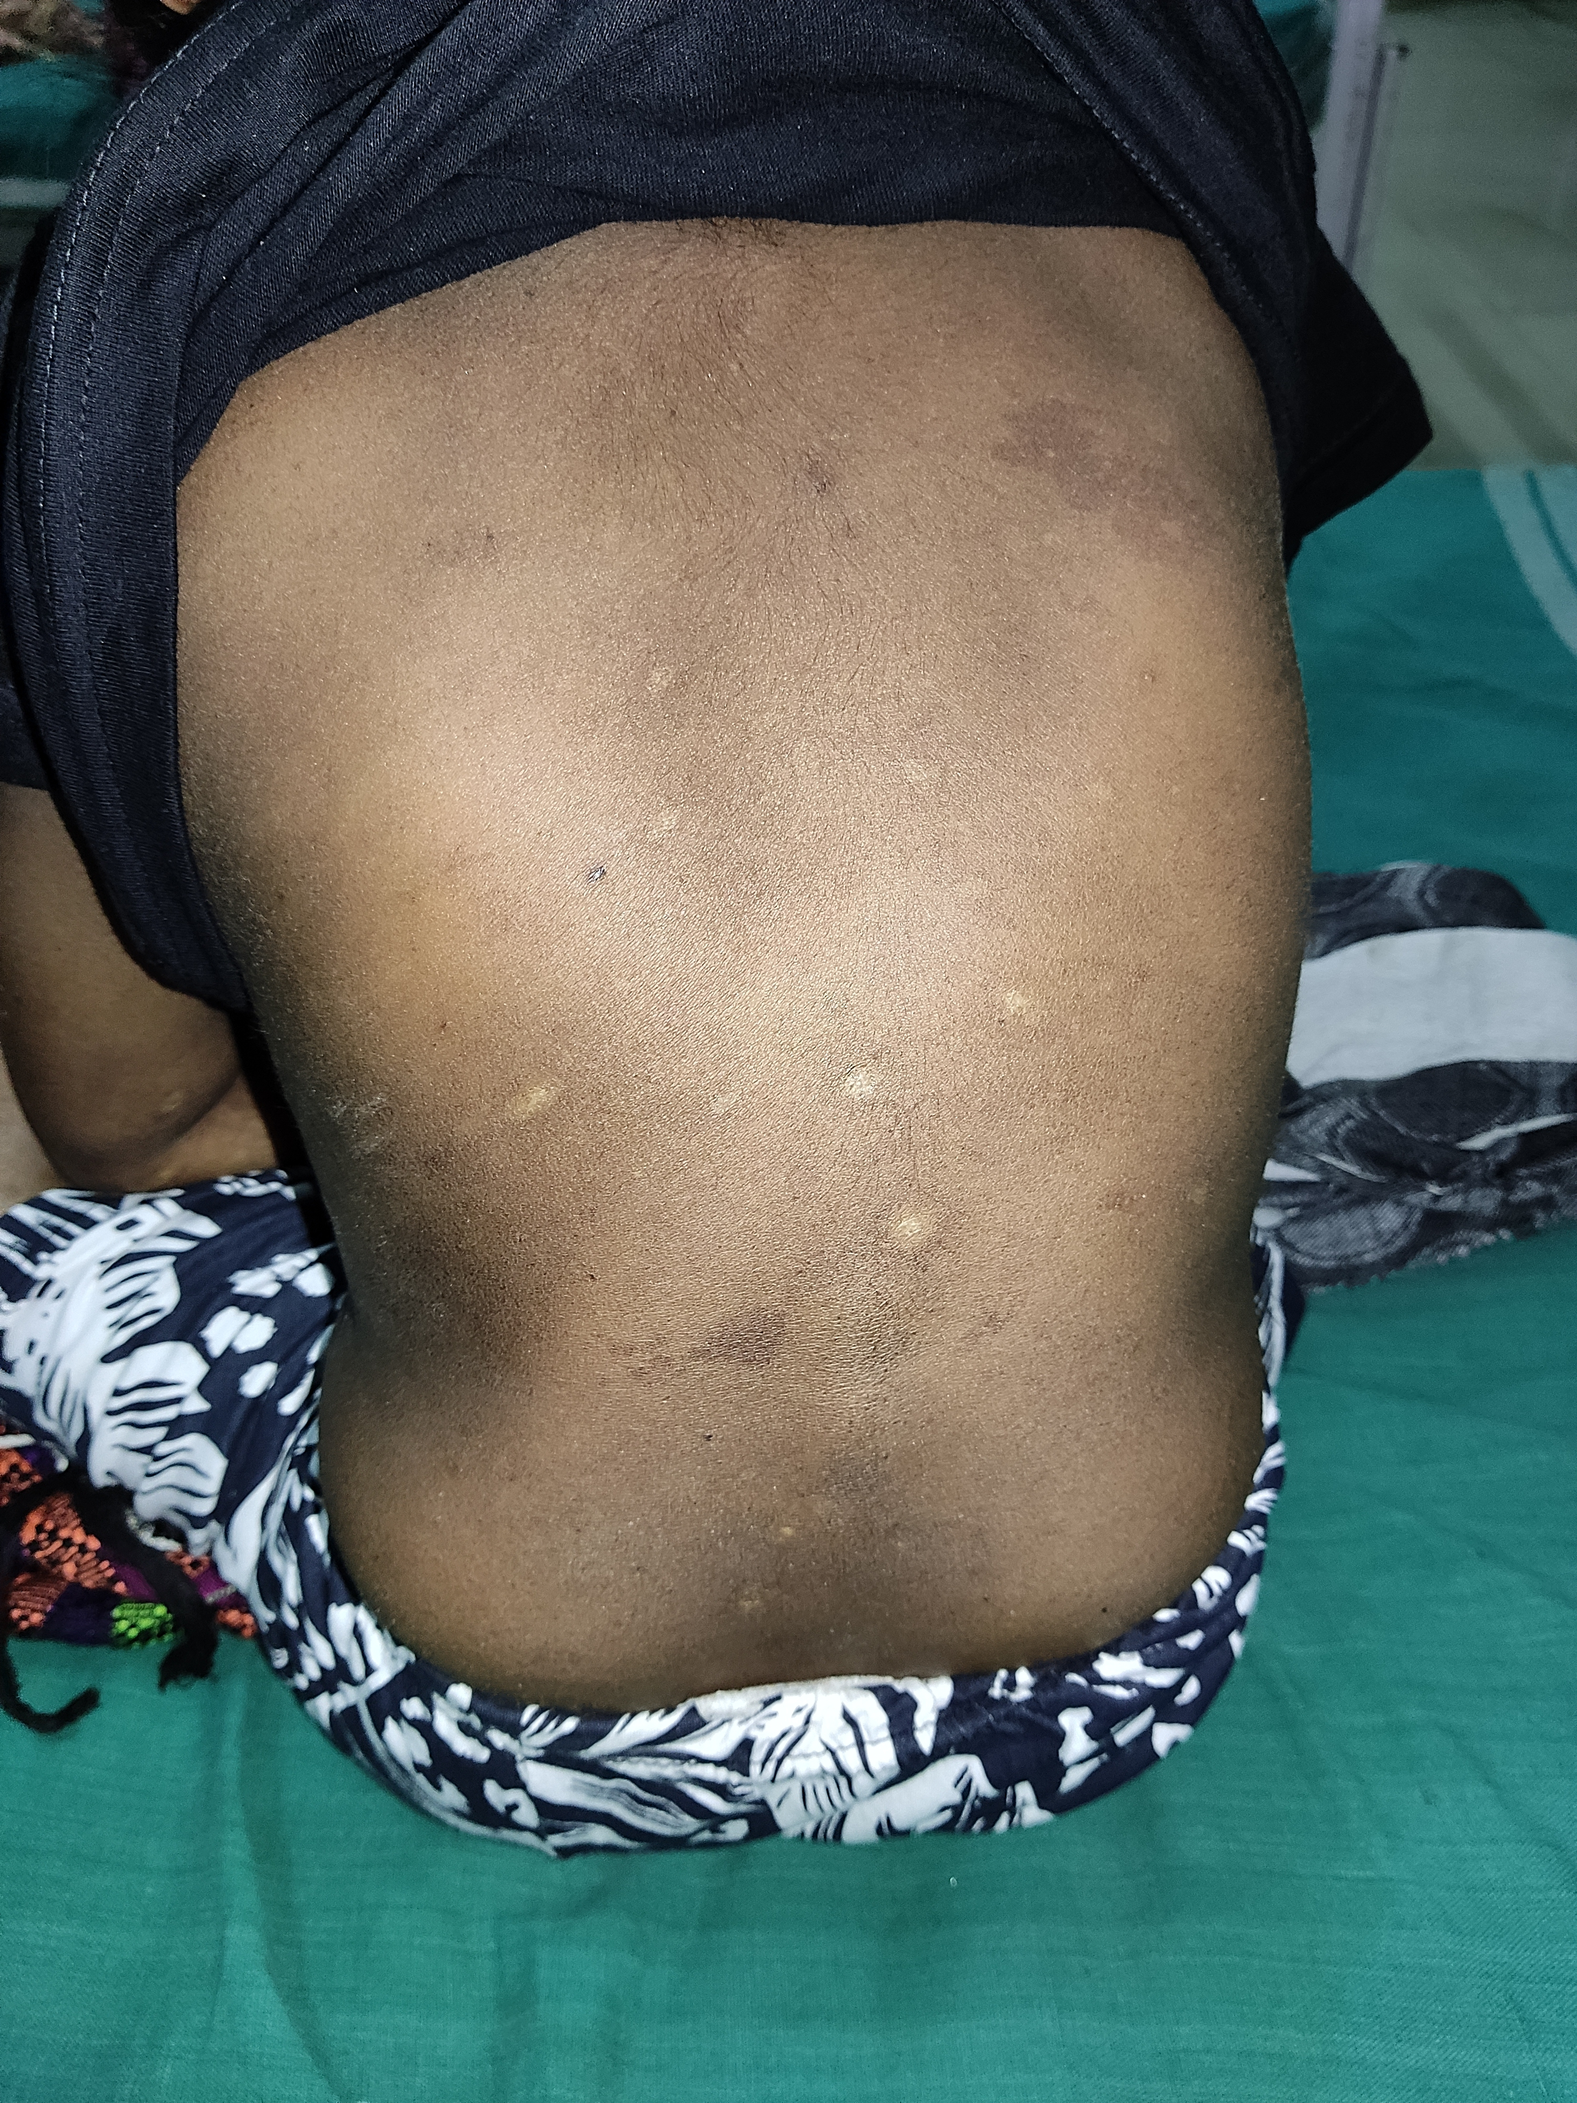

Slide 10
VITALS
WT : 20 KG
HEIGHT : 115 CM , BMI – 15.15 KG/M2
PR – 108/MIN
BP – 100/60 MMHG
SPO2 – 96% @ ROOM AIR

Slide 11
Systemic examination
Cvs : s1s2 + ,no murmur ,loud p2 +
Rs : b/l ae +, b/l expiratory wheeze
p/a : soft ,bowel sound + ,no organomegaly
Cns : nfnd

Slide 12
Investigation
Cbc
Tc :2100 /mm3
Dc : 47/46/7
Hb : 1.2 gm%
Platelet : 7000 /mm3
Rft
Urea : 25 mg/dl
Creatinine : 1.0 mg /dl
Lft
Bil ( total) : 0.3
Bil ( direct) : 0.1
Bil (indirect) : 0.2
Sgot /sgpt : 45/33
Alp : 148
Vctc –non reactive
Hbsag – negative
Anti hcv – negative
Tsh level – 1.77 HIU (EUTHYROID )

Slide 13
Complete hemogram
Mcv : 108 fl
Mch : 32.4pg /dl
Mchc: 30.0 g/dl
Lymp: 46.7%
Eosinophil: 5.8 %
Neut : 47.5
Rdw -sd - 71.3fl
Rdw- cv - 19.3%
Pdw - 9.3 fl
Mpv: 7.1 fl
P- lcr 9.6 %

Slide 14
Peripheral smear
Rbc shows hypochromic microcytic along with normochromic normocytes & few elongated cells ,no hemoparasites
Wbc – no atypical cells ,reduced in numbers
Platelet count is diminished
Impression : pancytopenia
Retic count : 0.7%

Slide 15
Imaging
Ct chest
b/l perihilar opacity with peribronchial cuffing
mild cardiomegaly f/s/o pulmonary edema
no e/o active ptb /old ptb sequele
Usg abdomen & pelvis
Liver – normal size and echoes
Pancreas: obscured
Spleen : normal size and echoes
Kidney : rk – 9.2* 4.2 cm ,normal echoes
lk – 6.4 * 3.6 cm smaller in size Malrotated seen in lif ( ectopic kidney)
Uterus – infantile
Bladder – wall appears thickened s/o cystitis

Slide 16
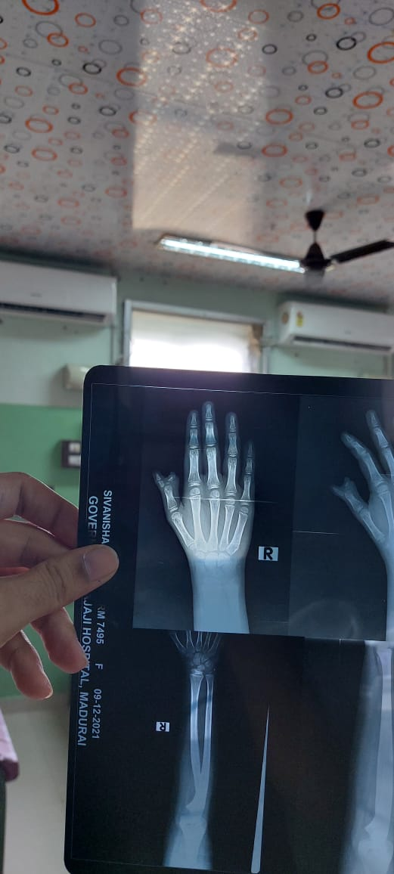
XRAY

Slide 17
ECHO
SITUS SOLITUS
LEVOCARDIA
NO CARDIAC ANOMALY
MILD MR +
BRADYCARDIA DURING STUDY
NO PULMONARY HYPERTENSION

Slide 18
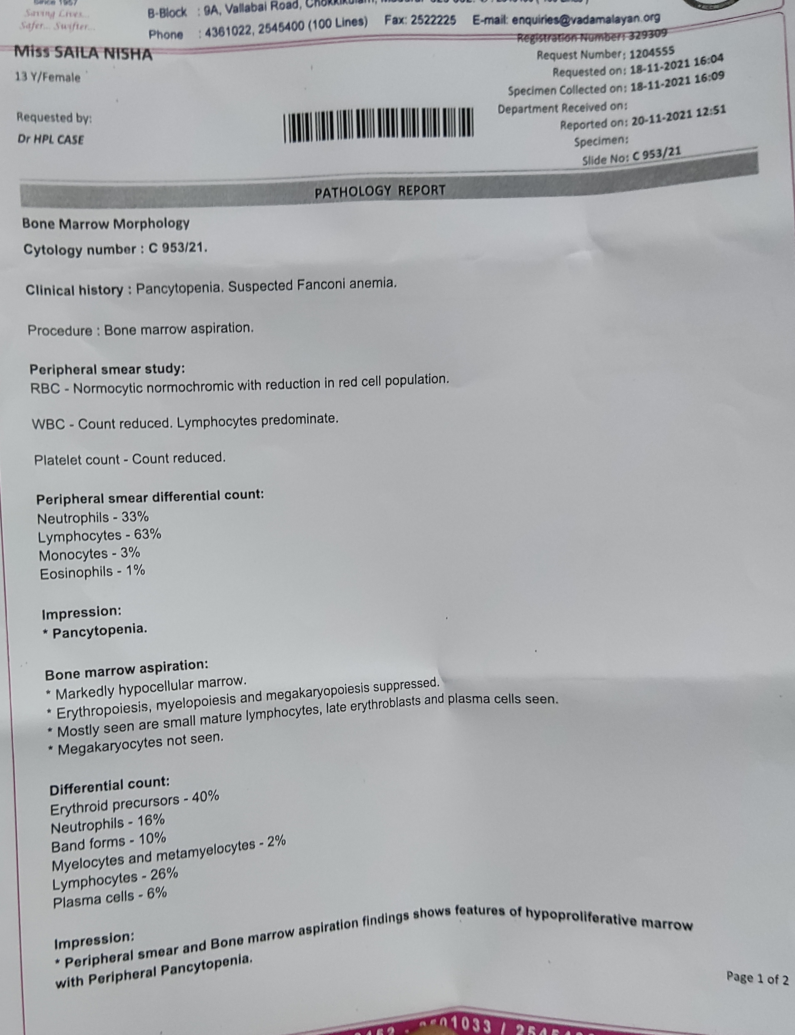
BONE MARROW REPORT

Slide 19
TREATMENT
2 UNIT OF PACKED CELL AND 2 UNIT OF PLATELET
T.FST /BCT 1 OD
INJ CEFTRIAXONE 1G IV BD
NEB SALBUTAMOL AND BUDECORT 12 TH HOURLY
T.FLUCONAZOLE 150 MG 0D FOR 7 DAYS
AND OTHER SUPPORTIVE MEASURES

Slide 20
DIAGNOSIS AND WHAT NEXT ????

Slide 21
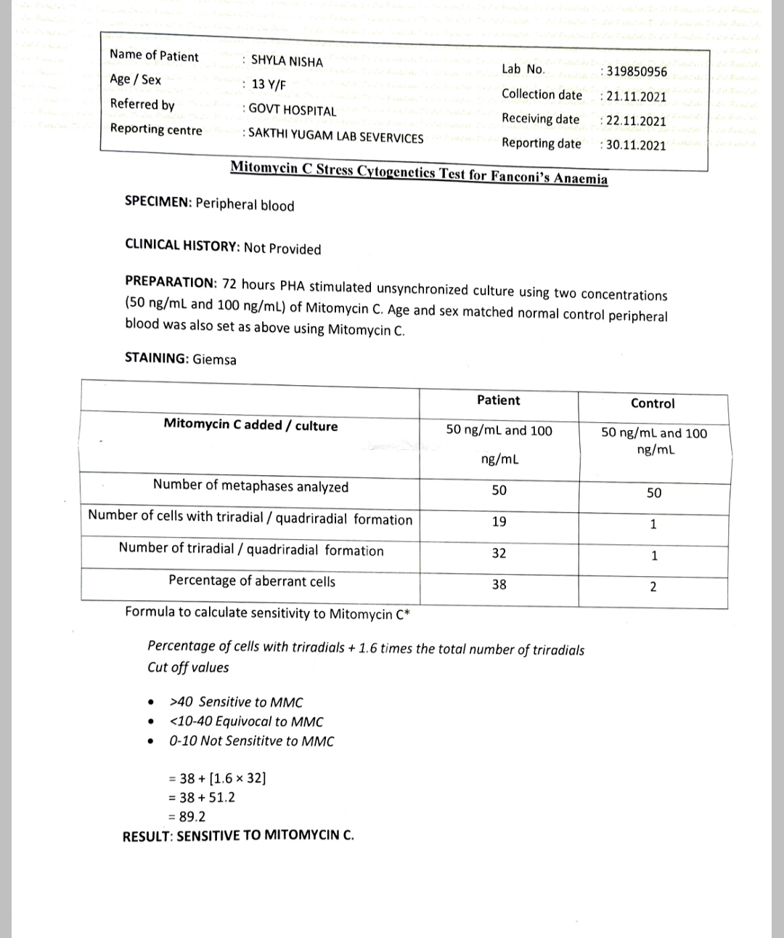

Slide 22
Final diagnosis
FANCONI’S ANAEMIA

