Slide 1
OXYMORON IN MEDICINE THROMBOCYTOPENIA WITH THROMBOSIS by imcu and MU-1
HOD : PROF. Dr. Natarajan M.D
CHIEF PROF. Dr. Alagu Venkatesan M.D
ASST.PROF. Dr. Suresh Kumar M.D
Presentor : Dr. Panneer Selvam PG

Slide 2
CHIEF COMPLAINTS
A 29 Years old female patient who is a housewife, referred to our hospital from Dindigul GH came with chief c/o
Headache for past 5 days
Seizures for past 3 days
Difficulty in using Left upper limb and lower limb for 1 day
HISTORY OF PRESENTING ILLNESS
Patient was k/c/o ITP diagnosed 1 month back,
H/O headache for past 5 days
H/O seizures for past 3 days – GTCS , multiple episodes , each lasting for 5 min; followed by loss of consciousness, regained conscious within 5 mins
H/O Difficulty in using left upper limb and lower limb for past 1 day
H/O fever for past 1 day
H/O altered sensorium for past 1 day
H/O difficulty in raising from bed
H/O difficulty in moving from side to side

Slide 3
No h/o projectile vomiting
No h/o neck pain
No h/o alteration in smell
No h/o visual disturbances
No h/o inability to chew food
No h/o deviation of angle of mouth
No h/o hard of hearing
No h/o vertigo/tinnitus
No h/o difficulty in swallowing
No h/o hoarseness of voice/ speech disturbance
No h/o deviation of tongue

Slide 4
No h/o tremors
Able to feel clothing sensation/pain/temperature
Able to feel bladder and bowel sensation
No h/o giddiness/Excessive sweating
No h/o chest pain/palpitation/Breathlessness
No h/o altered bowel habits
No h/o bleeding manifestations at present
No h/o Trauma
No h/o recent vaccination
No h/o loose stools
No h/o ear discharge

Slide 5
PAST HISTORY
She is a K/C/O ITP diagnosed and managed in GRH one month ago
Not a K/C/O – DM/ HTN/ TB/ CAD/ CVA/ Thyroid or Epilepsy disease

Slide 6
Treatment History
Previously she was admitted with bleeding gums and severe thrombocytopenia of 3000 cells
Admitted in IMCU and Dexamethasone pulse therapy given, for which no adequate response obtained with PLT <10,000 cells
IVIG 2g/kg was administered ( PLT <20,000 )
Then with Iv methyl prednisone for three days , she was transferred to ward with PLT of 52,000 cells and rising
Discharged with Oral steroids and a steroid sparing agent Azathioprine.

Slide 7
Two weeks after discharge, she developed Headache and seizures
Admitted in Dindigul GH, where Brain imaging done
Which showed F/S/O CVT and venous hemorrhagic infarct
Then With Mannitol, Iv Dexamethasone, Heparin, Azathioprine, they referred to GRH Madurai for further management on 5/11/2023

Slide 8
PERSONAL HISTORY
Mixed diet
Bladder and bowel habits normal
Normal sleep and appetite
Not an Alcoholic
Not a smoker
No h/o any other substance abuse
MENSTRUAL HISTORY
LMP – 28/10/2023, Regular cycle(4/28), normal flow, 4 days, 2 pads per day, no excessive clot;

Slide 9
OBSTETRIC HISTORY
Married at 18 years of age; consanguineous marriage
1st preg– IUD at 8 months of gestation
2nd preg – NVD, 11yrs male
3rd preg – C- section, 8yrs male
FAMILY HISTORY
H/O IUD of 1st child of her mother at 8 months of gestation

Slide 10
GENERAL EXAMINATION
Patient was conscious
Oriented
Afebrile
Moderately built & nourished
Pallor +
No icterus
No cyanosis
No clubbing
No pedal edema
No generalised lymphadenopathy
No external Markers of HIV/TUBERCULOSIS
No external neurocutaneous markers
VITALS
BP:120/70 mmhg
PR:90/min
SPO2:98% RA

Slide 11
EXAMINATION OF CENTRAL NERVOUS SYSTEM
EXAMINATION OF HIGHER MENTAL FUNCTIONS
conscious
Oriented to Time/Place/Person
Right handed individual
Intelligence &behaviour normal
Memory intact
Able to read simple words,
Not able to do simple calculations
Left side Hemineglect +
EXAMINATION OF CRANIAL NERVES – Normal
SENSORY SYSTEM EXAMINATION- Normal

Slide 12
EXAMINATION OF MOTOR SYSTEM
 |  | RIGHT |  | LEFT
BULK | MID ARM | 28 CM |  | 28 CM
 | MID FOREARM | 20 CM |  | 20 CM
 | MID THIGH | 56 CM |  | 57 CM
 | MID CALF | 30 CM |  | 32 CM
TONE | UPPER LIMB | NORMAL |  | DECREASED
 | LOWER LIMB | NORMAL |  | DECREASED
POWER | UPPER LIMB | 5/5 |  | 0/5
 | LOWER LIMB | 5/5 |  | 0/5
DEEP TENDON REFLEX | UPPER LIMB | ++ |  | -
 | LOWERLIMB
 |  |  |  | -
 |  | ++
PLANTAR |  | FLEXOR |  | MUTE

Slide 13
Cerebellum | Right | Left
Nystagmus | No Nystagmus | No Nystagmus
Tremor | No tremor | No tremor
Finger Nose test | No past pointing | Not able to perform
Finger Finger Nose test | No past pointing | Not able to perform
Heel knee test | able to perform | Not able to perform
Dysdiadochokinesia | Not able to perform | Not able to perform
Rebound phenomenon | Not able to perform | Not able to perform

Slide 14
EXAMINATION OF SPINE AND CRANIUM
No swelling
No tenderness
No deformity
No Meningeal signs of irritation
No Neck Rigidity
Kernig’s sign - Negative
Brudzinski’s sign – Negative

Slide 15
OTHER SYSTEM EXAMINATION
CVS: S1S2 Heard
No murmur
RS :Bilateral air entry +
No added sounds
P/A : Soft
Bowel sounds +
No organomegaly

Slide 16
INVESTIGATIONS
 | 4/11/23 | 5/11/23 | 7/11/23 | 8/11/23 | 9/11/23 | 10/11/23 | 11/11/23
CBC TC | 7300 | 12000 | 10500 | 9700 | 7100 | 5100 | 4900
DC | 81/14/5 | 68/24/08 | 76/21/03 | 76/18/7 | 77/16/5 | 65/24/3 | 66/22/3
HB | 12.6 | 10.6 | 10.1 | 10.7 | 9.1 | 10.7 | 11.0
PCV | 39.8 | 33.8 | 32.1 | 34.3 | 30.6 | 33.6 | 34.5
PLT | 79000 | 65000 | 47000 | 63000 | 65000 | 90000 | 96000
RBS | 143
UREA | 12
CREATININE | 0.6
Na+ | 131
K+ | 2.9

Slide 17
 | 4/11/23 | 7/11/23 | 8/11/23 | 11/11/23
TOT.BILIRUBIN | 1.2
DIR.BILIRUBIN | 0.4
IND.BILIRUBIN | 0.8
SGOT | 42
SGPT | 109
ALP | 55
PT | 15.7 | 15.3 | 14.8 | 13.2
INR | 1.1 | 1.1 | 1.0 | 0.94
APTT | 19.8 | 21.9 | 24.8 | 23.2
URINE ROUTINE
ALBUMIN | NIL
SUGAR | NIL
DEPOSITS | 0_2 PUS CELLS

Slide 18
Viral markers – negative
VCTC - non reactive
ANA – negative
Peripheral smear – mild hypochromic microcytic anemia, mild neutrophilia, thrombocytopenia
Blood group – A+
Stool for H.pylori Negative
USG abdomen & pelvis – mild splenomegaly(10.5 cm) with rounded borders
TSH – Euthyroid state
Echo – Normal study
DCT - Negative

Slide 19
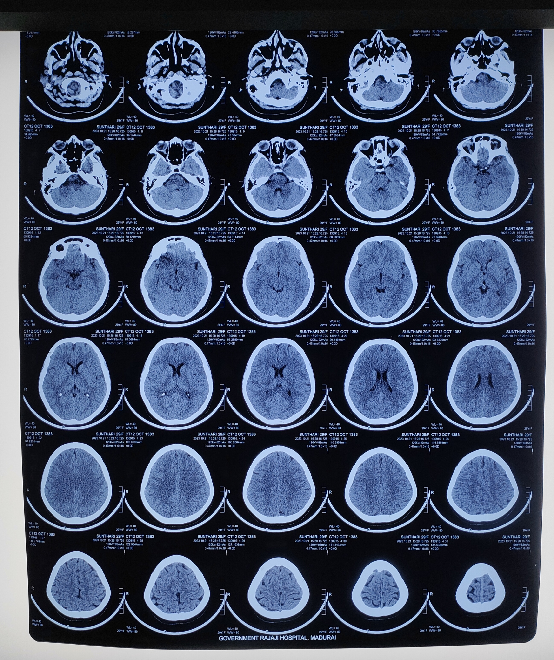
CT BRAIN
Dated on 21/10/2023 (previous admission)
Nil significant abnormality detected

Slide 20
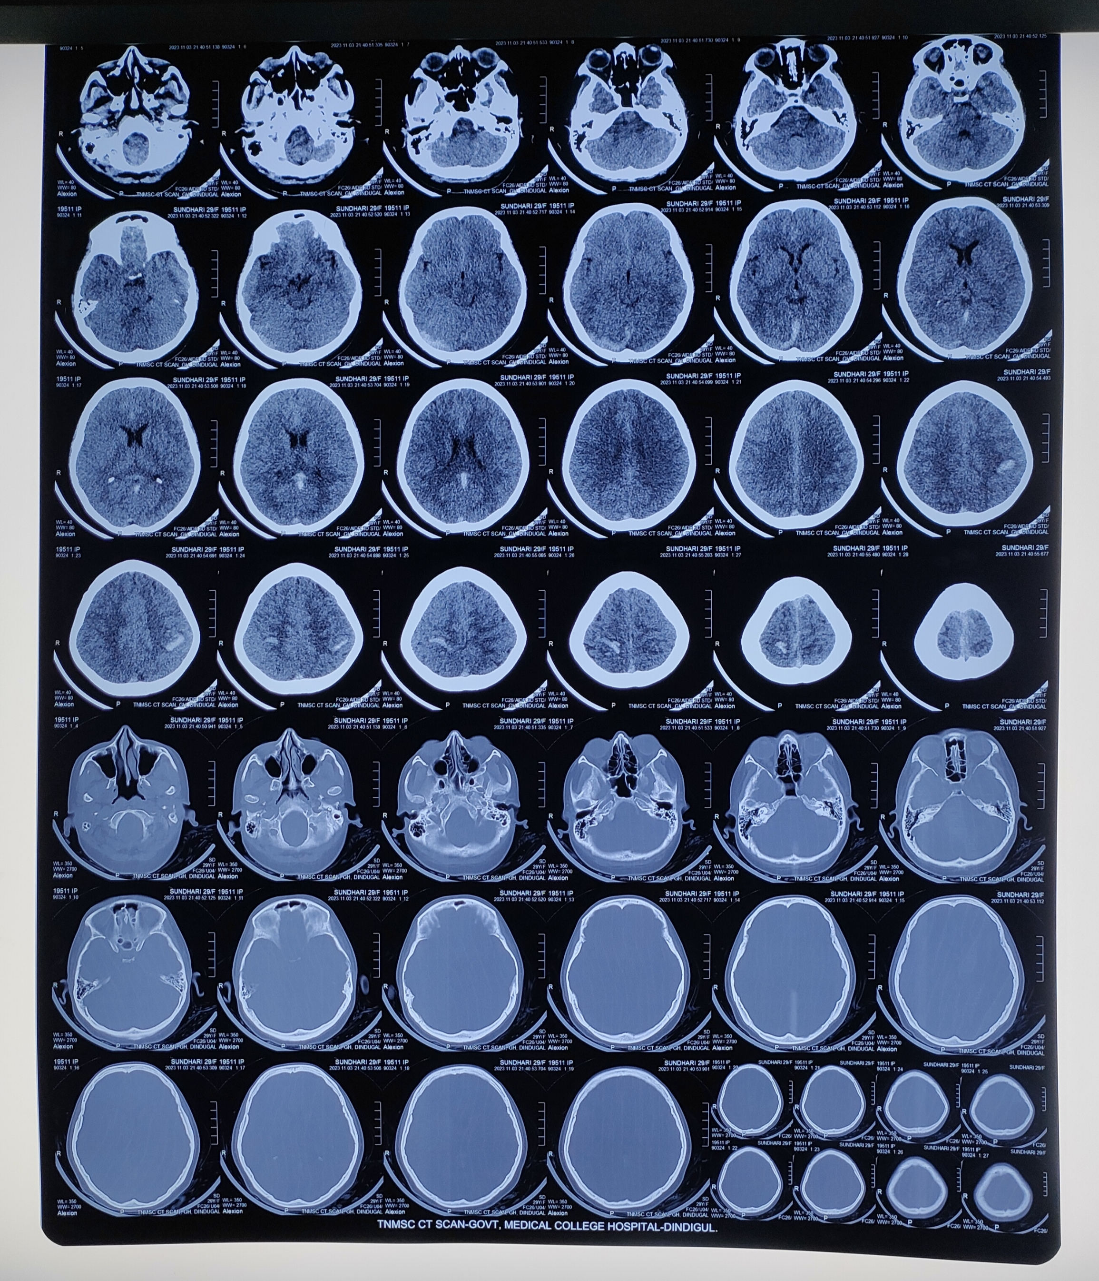
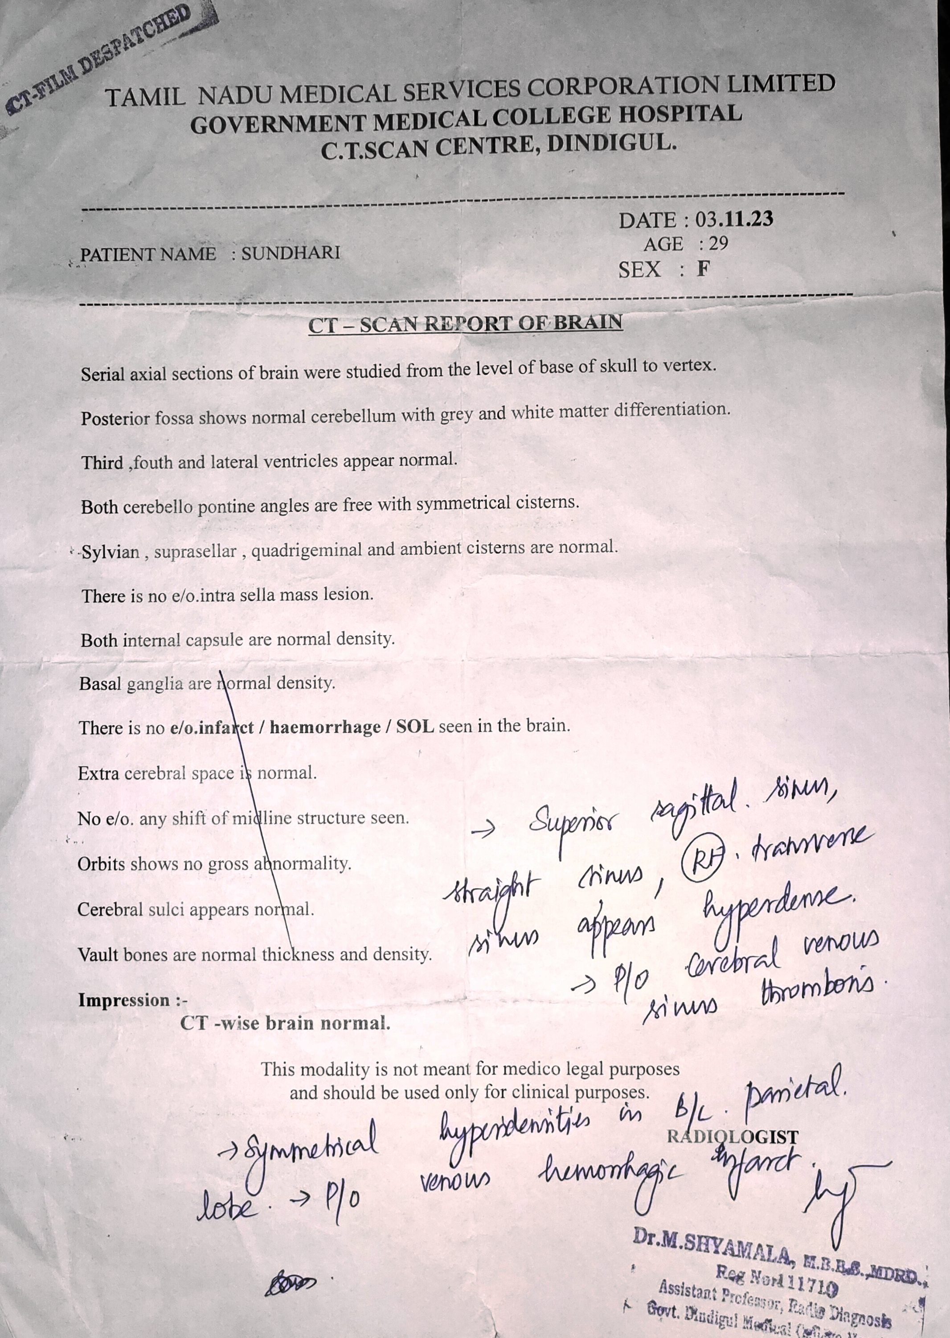

Slide 21
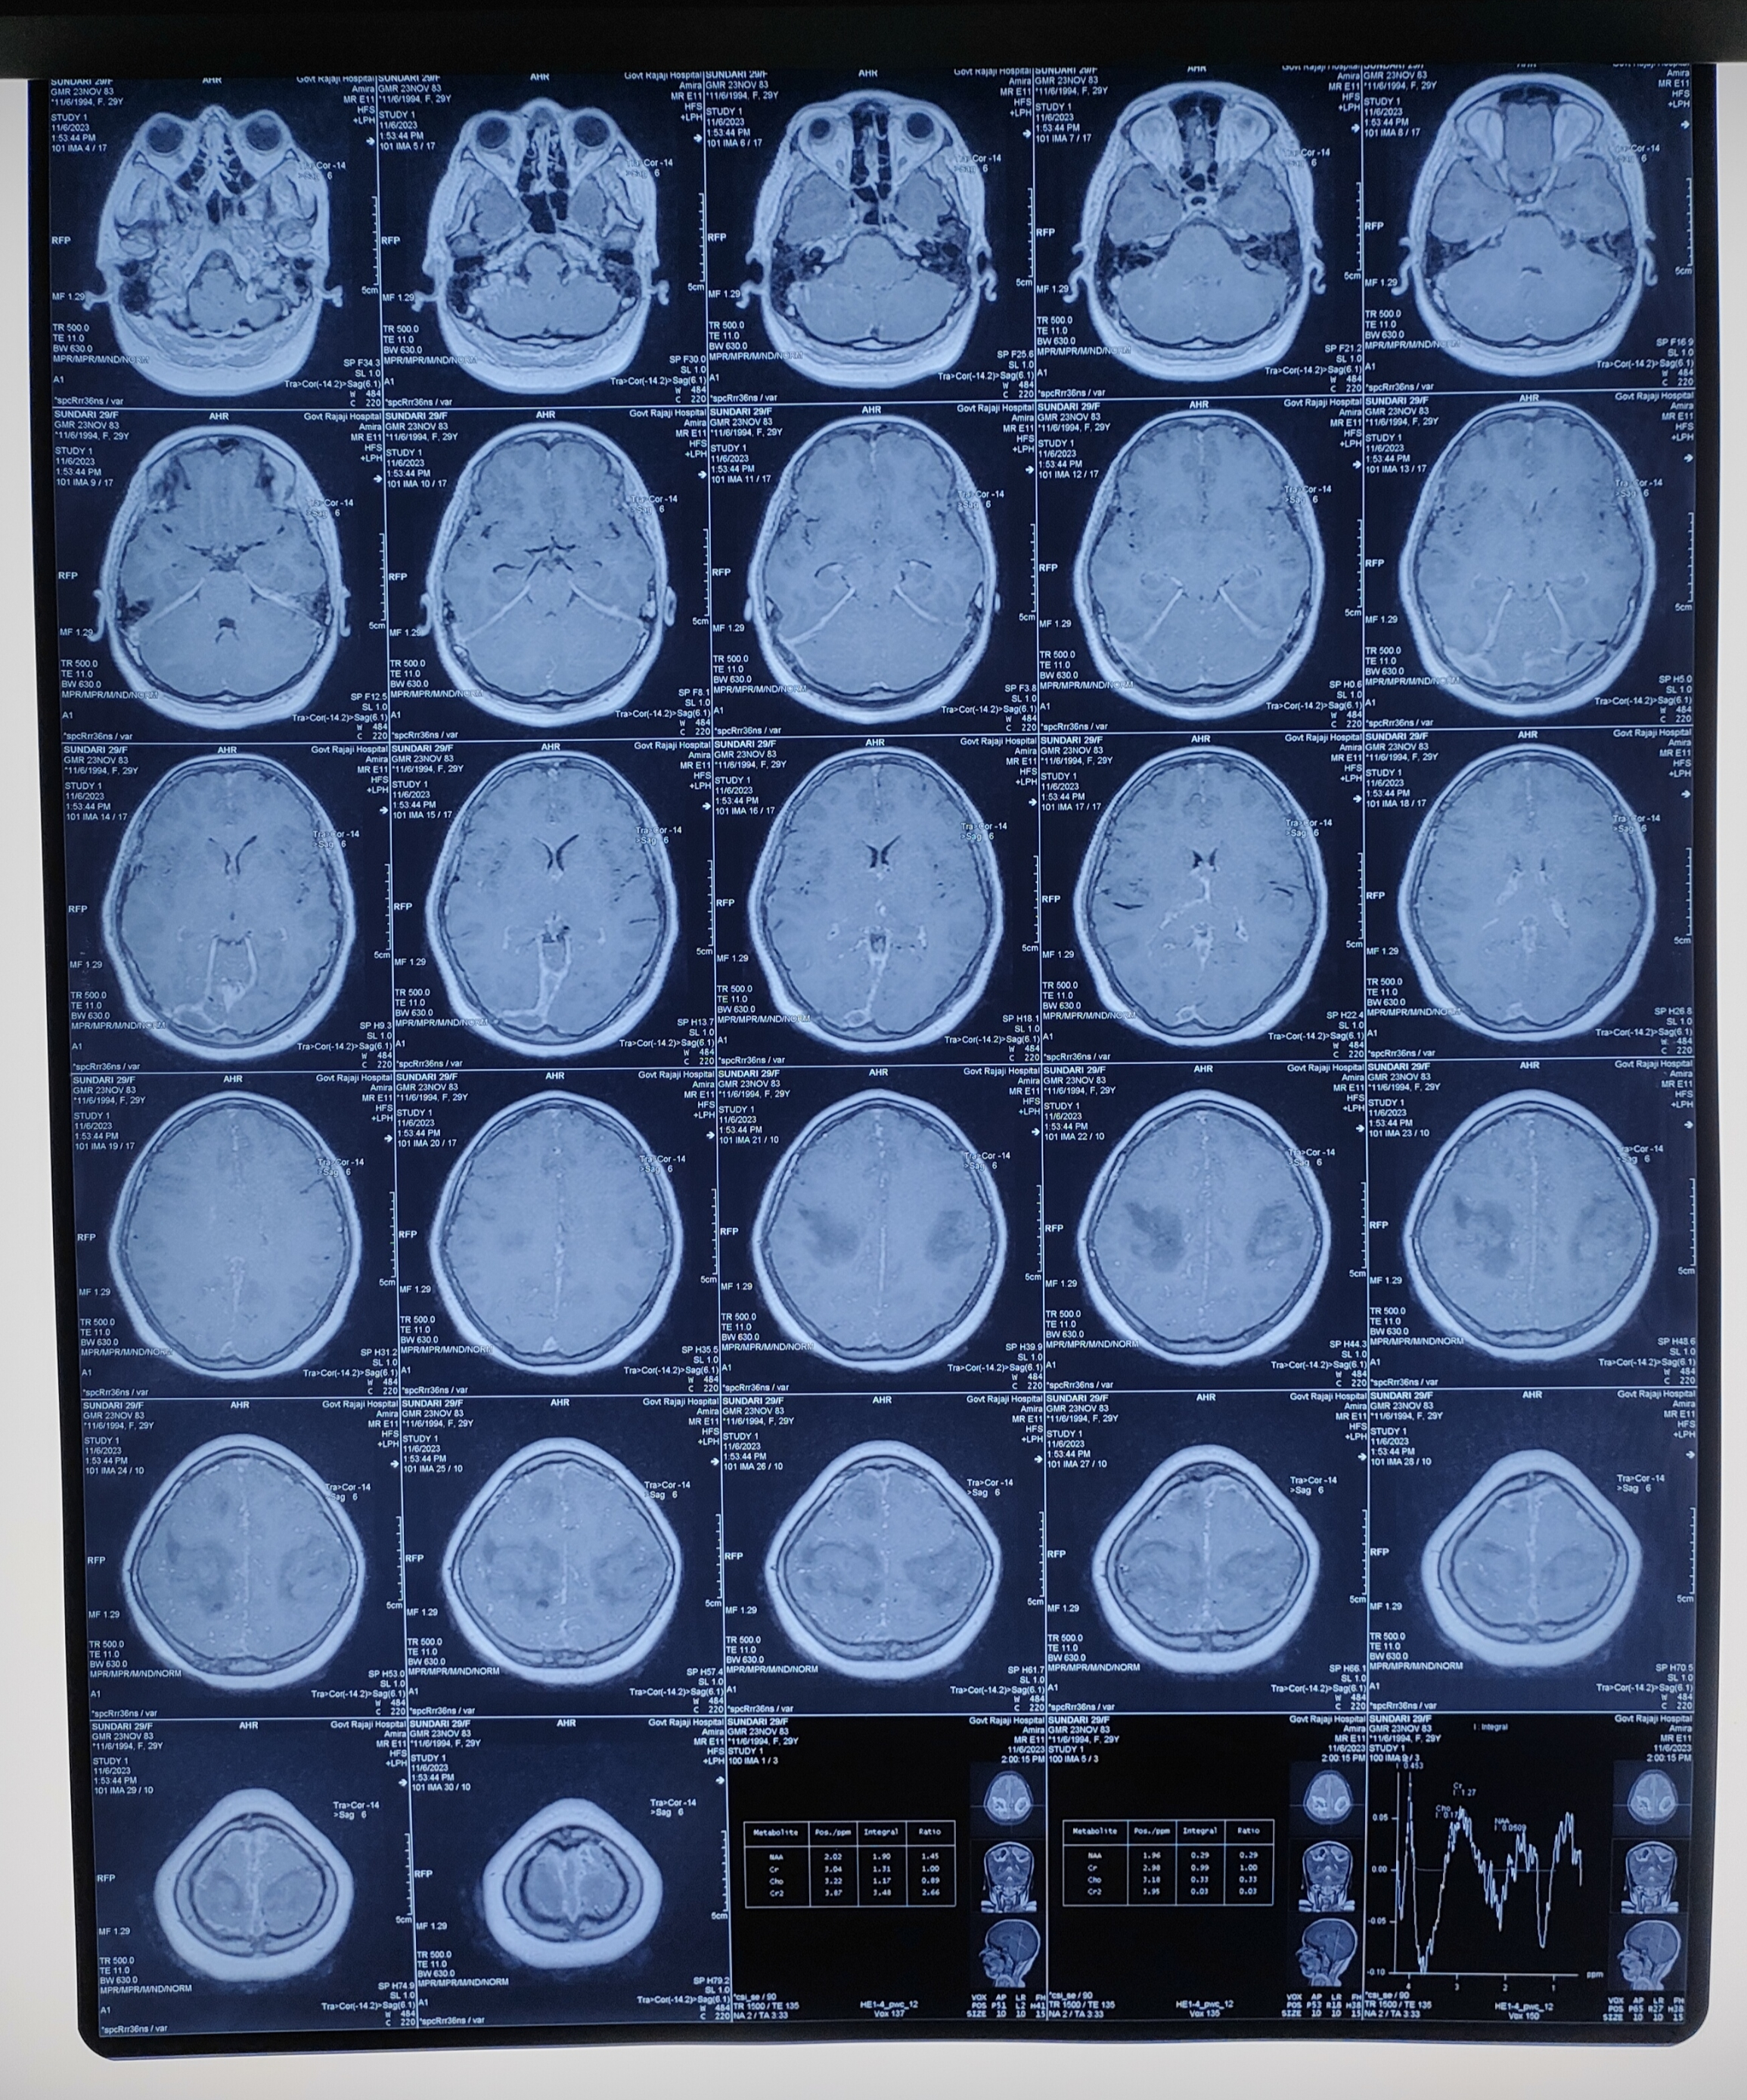
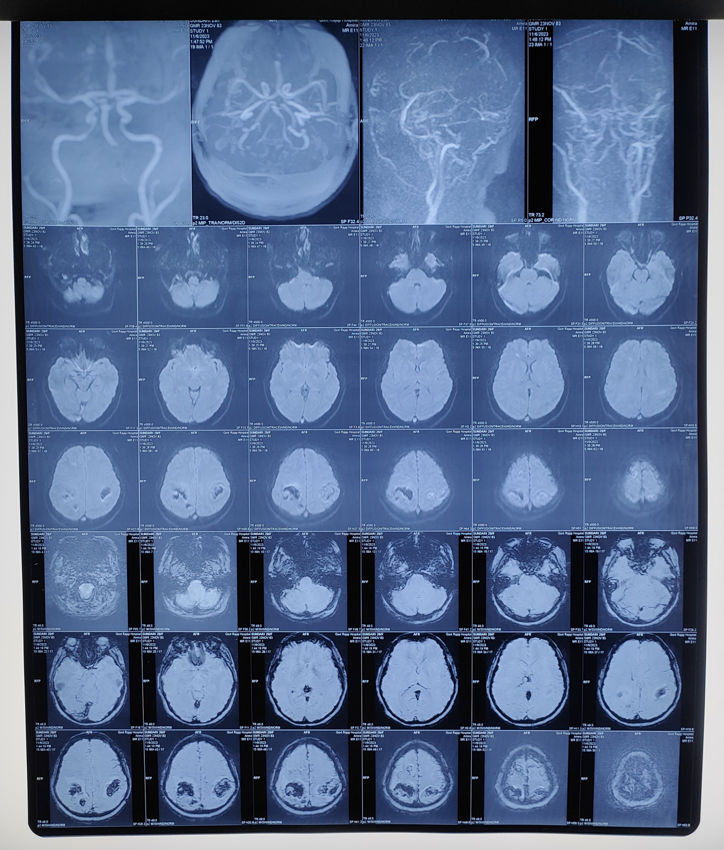
MRI BRAIN

Slide 22
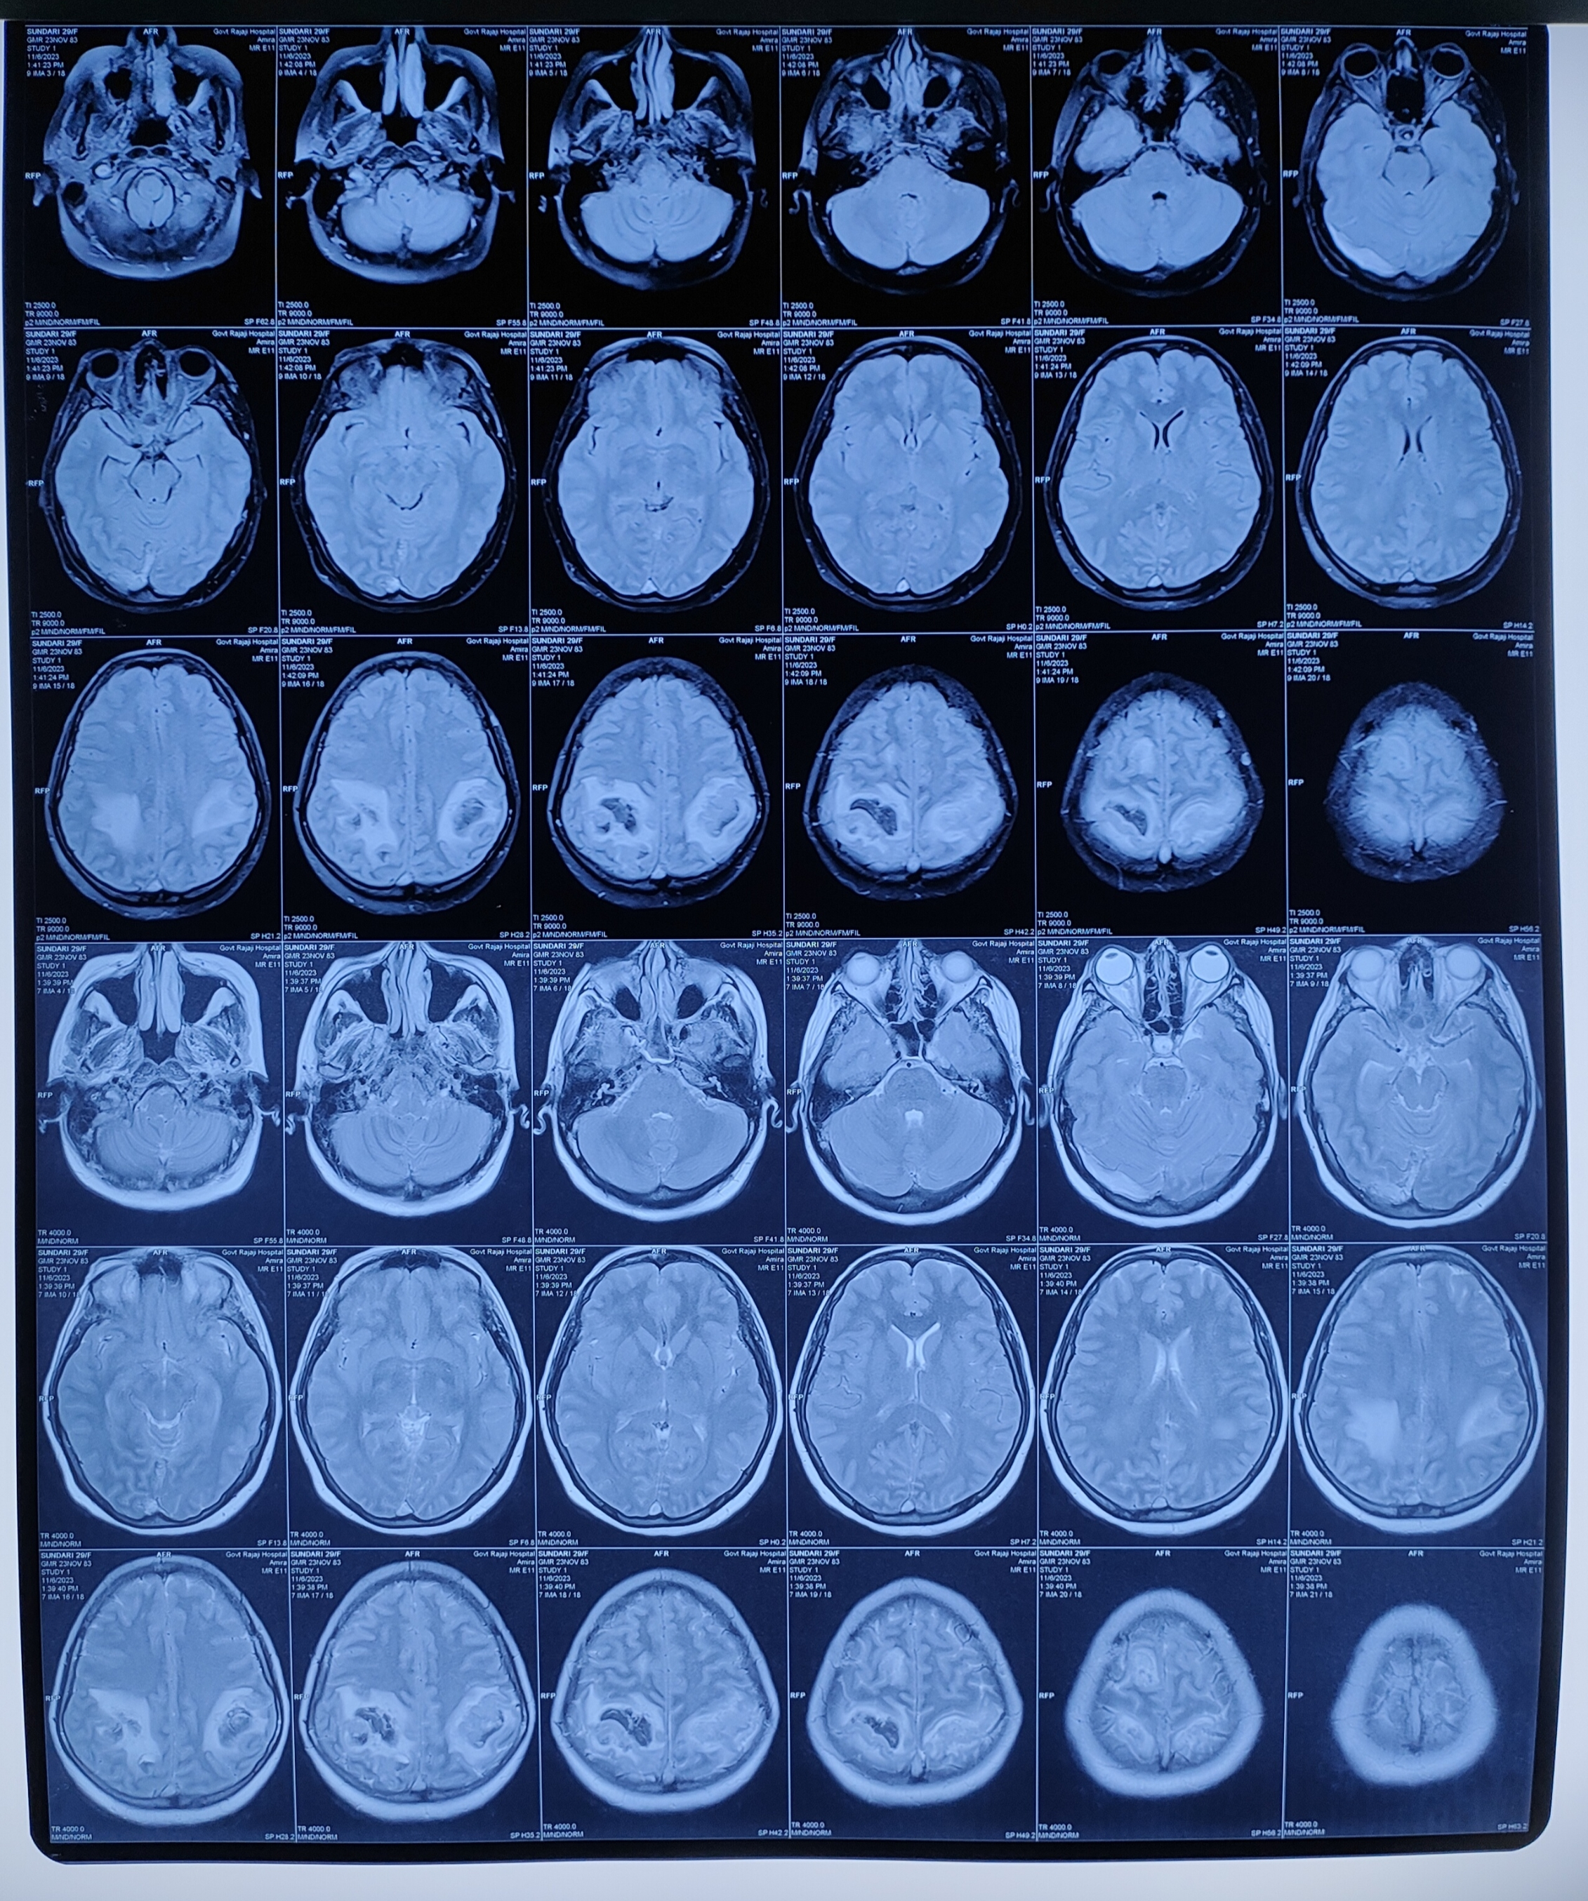
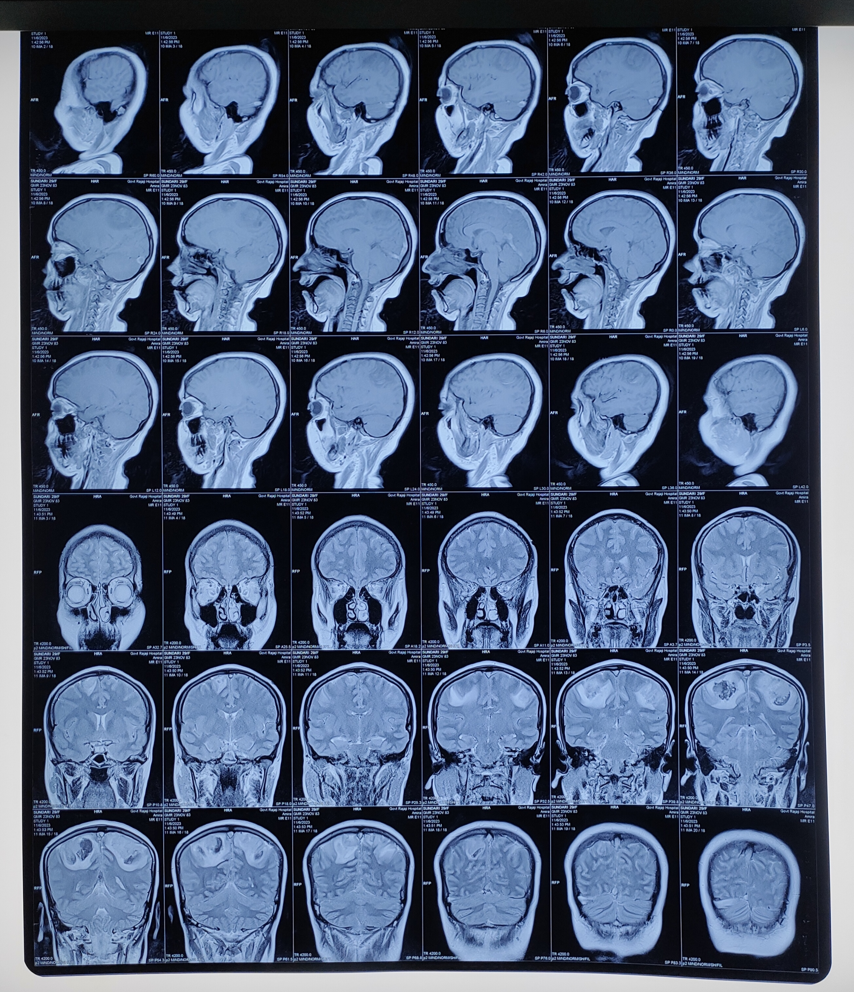

Slide 23
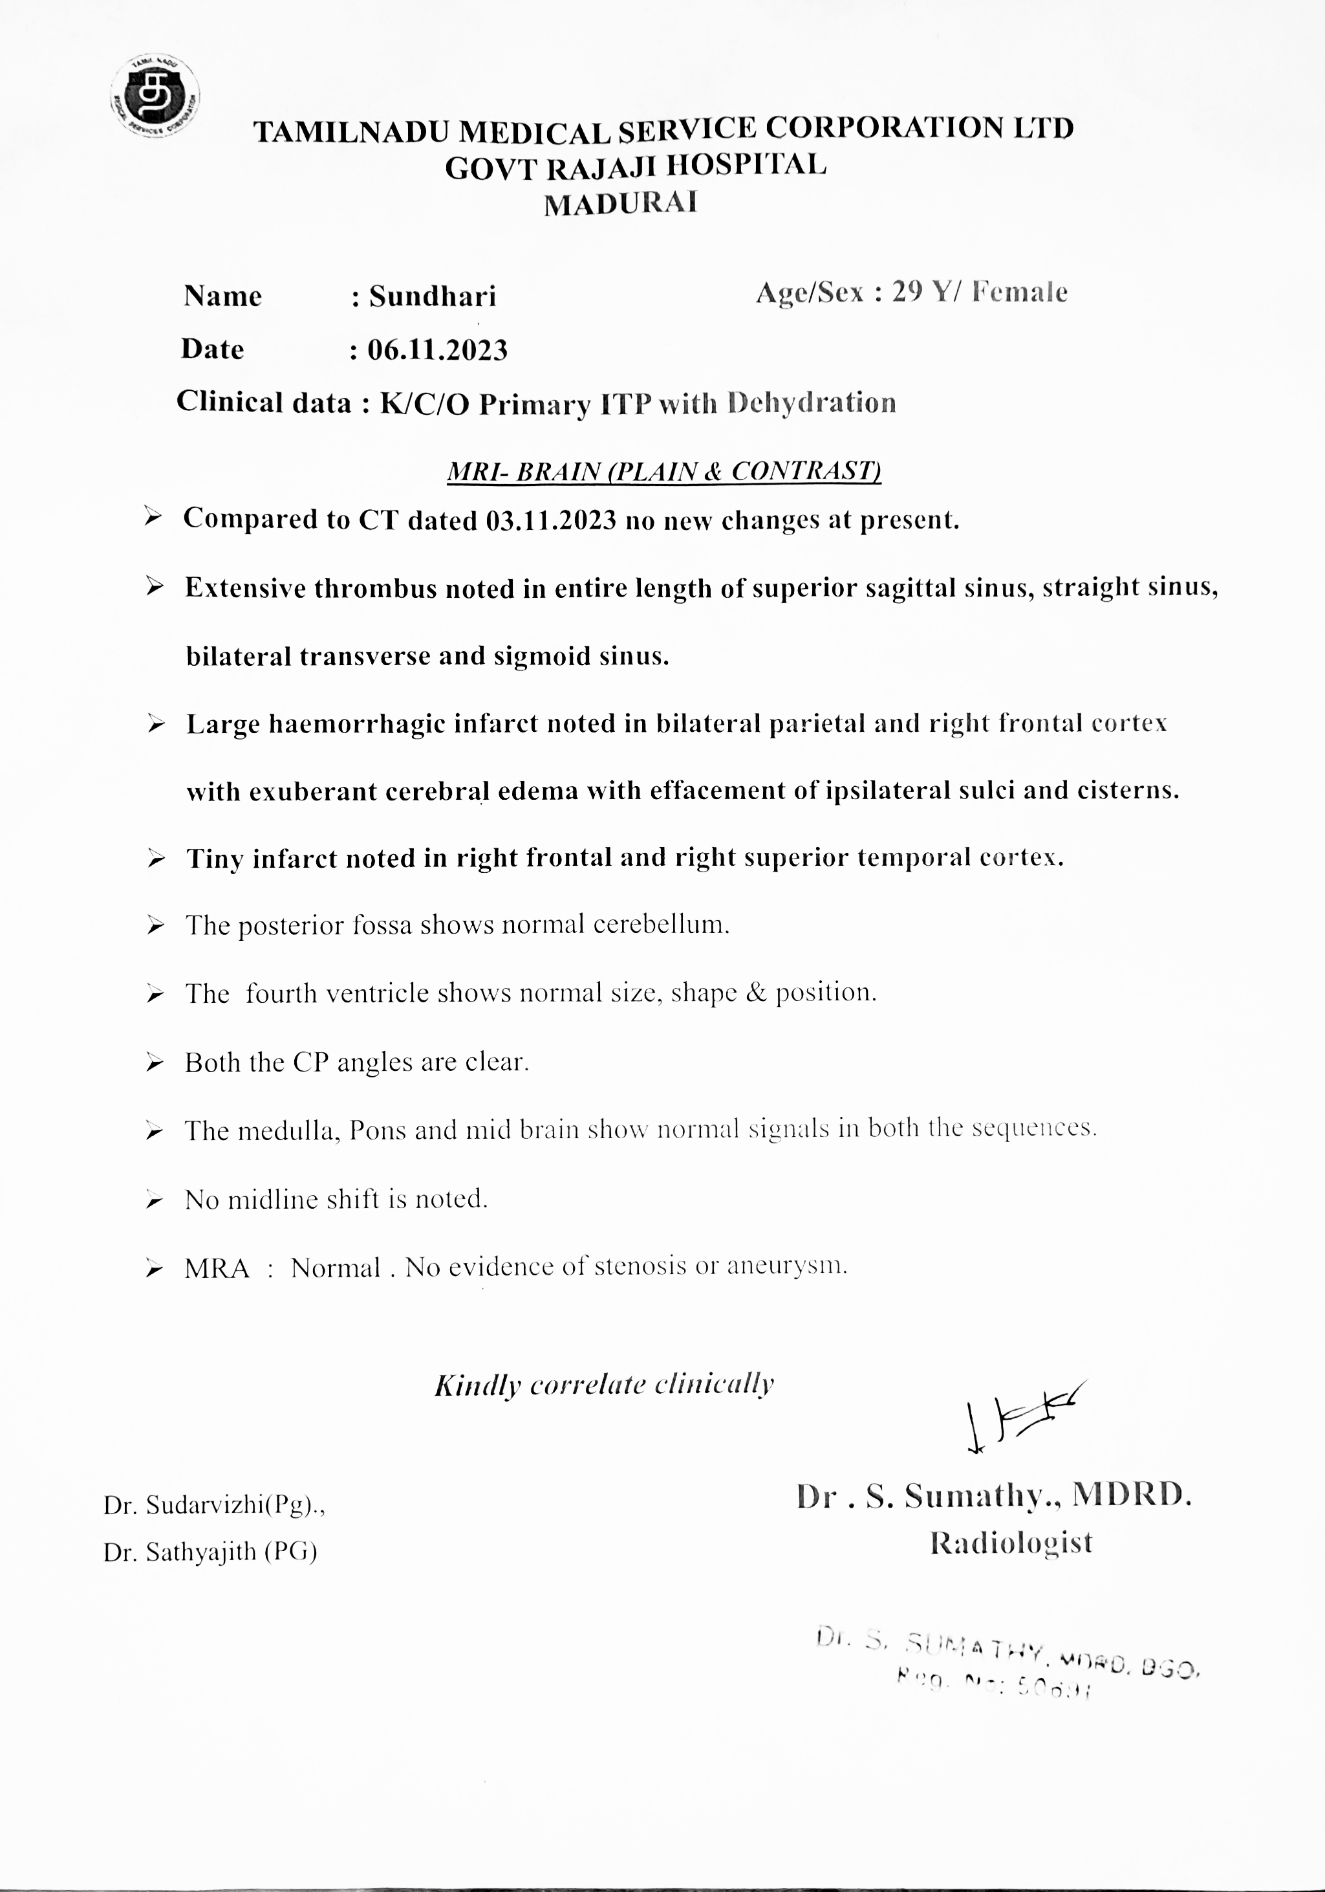

Slide 24
NEURO MED OPINION
Imp : CVT/ Acute symptomatic seizures/ ITP/ APLAS
Sugg: MRI Brain with MRA/MRV, Inj. Mannitol, Inj. Dexamethasone, Inj. Phenytoin.
NEURO SURGERY OPINION
Sugg: MRI Brain with MRA/ MRV, continue other line of management
OPTHALMOLOGIST OPINION
Both eye fundus - Normal

Slide 25
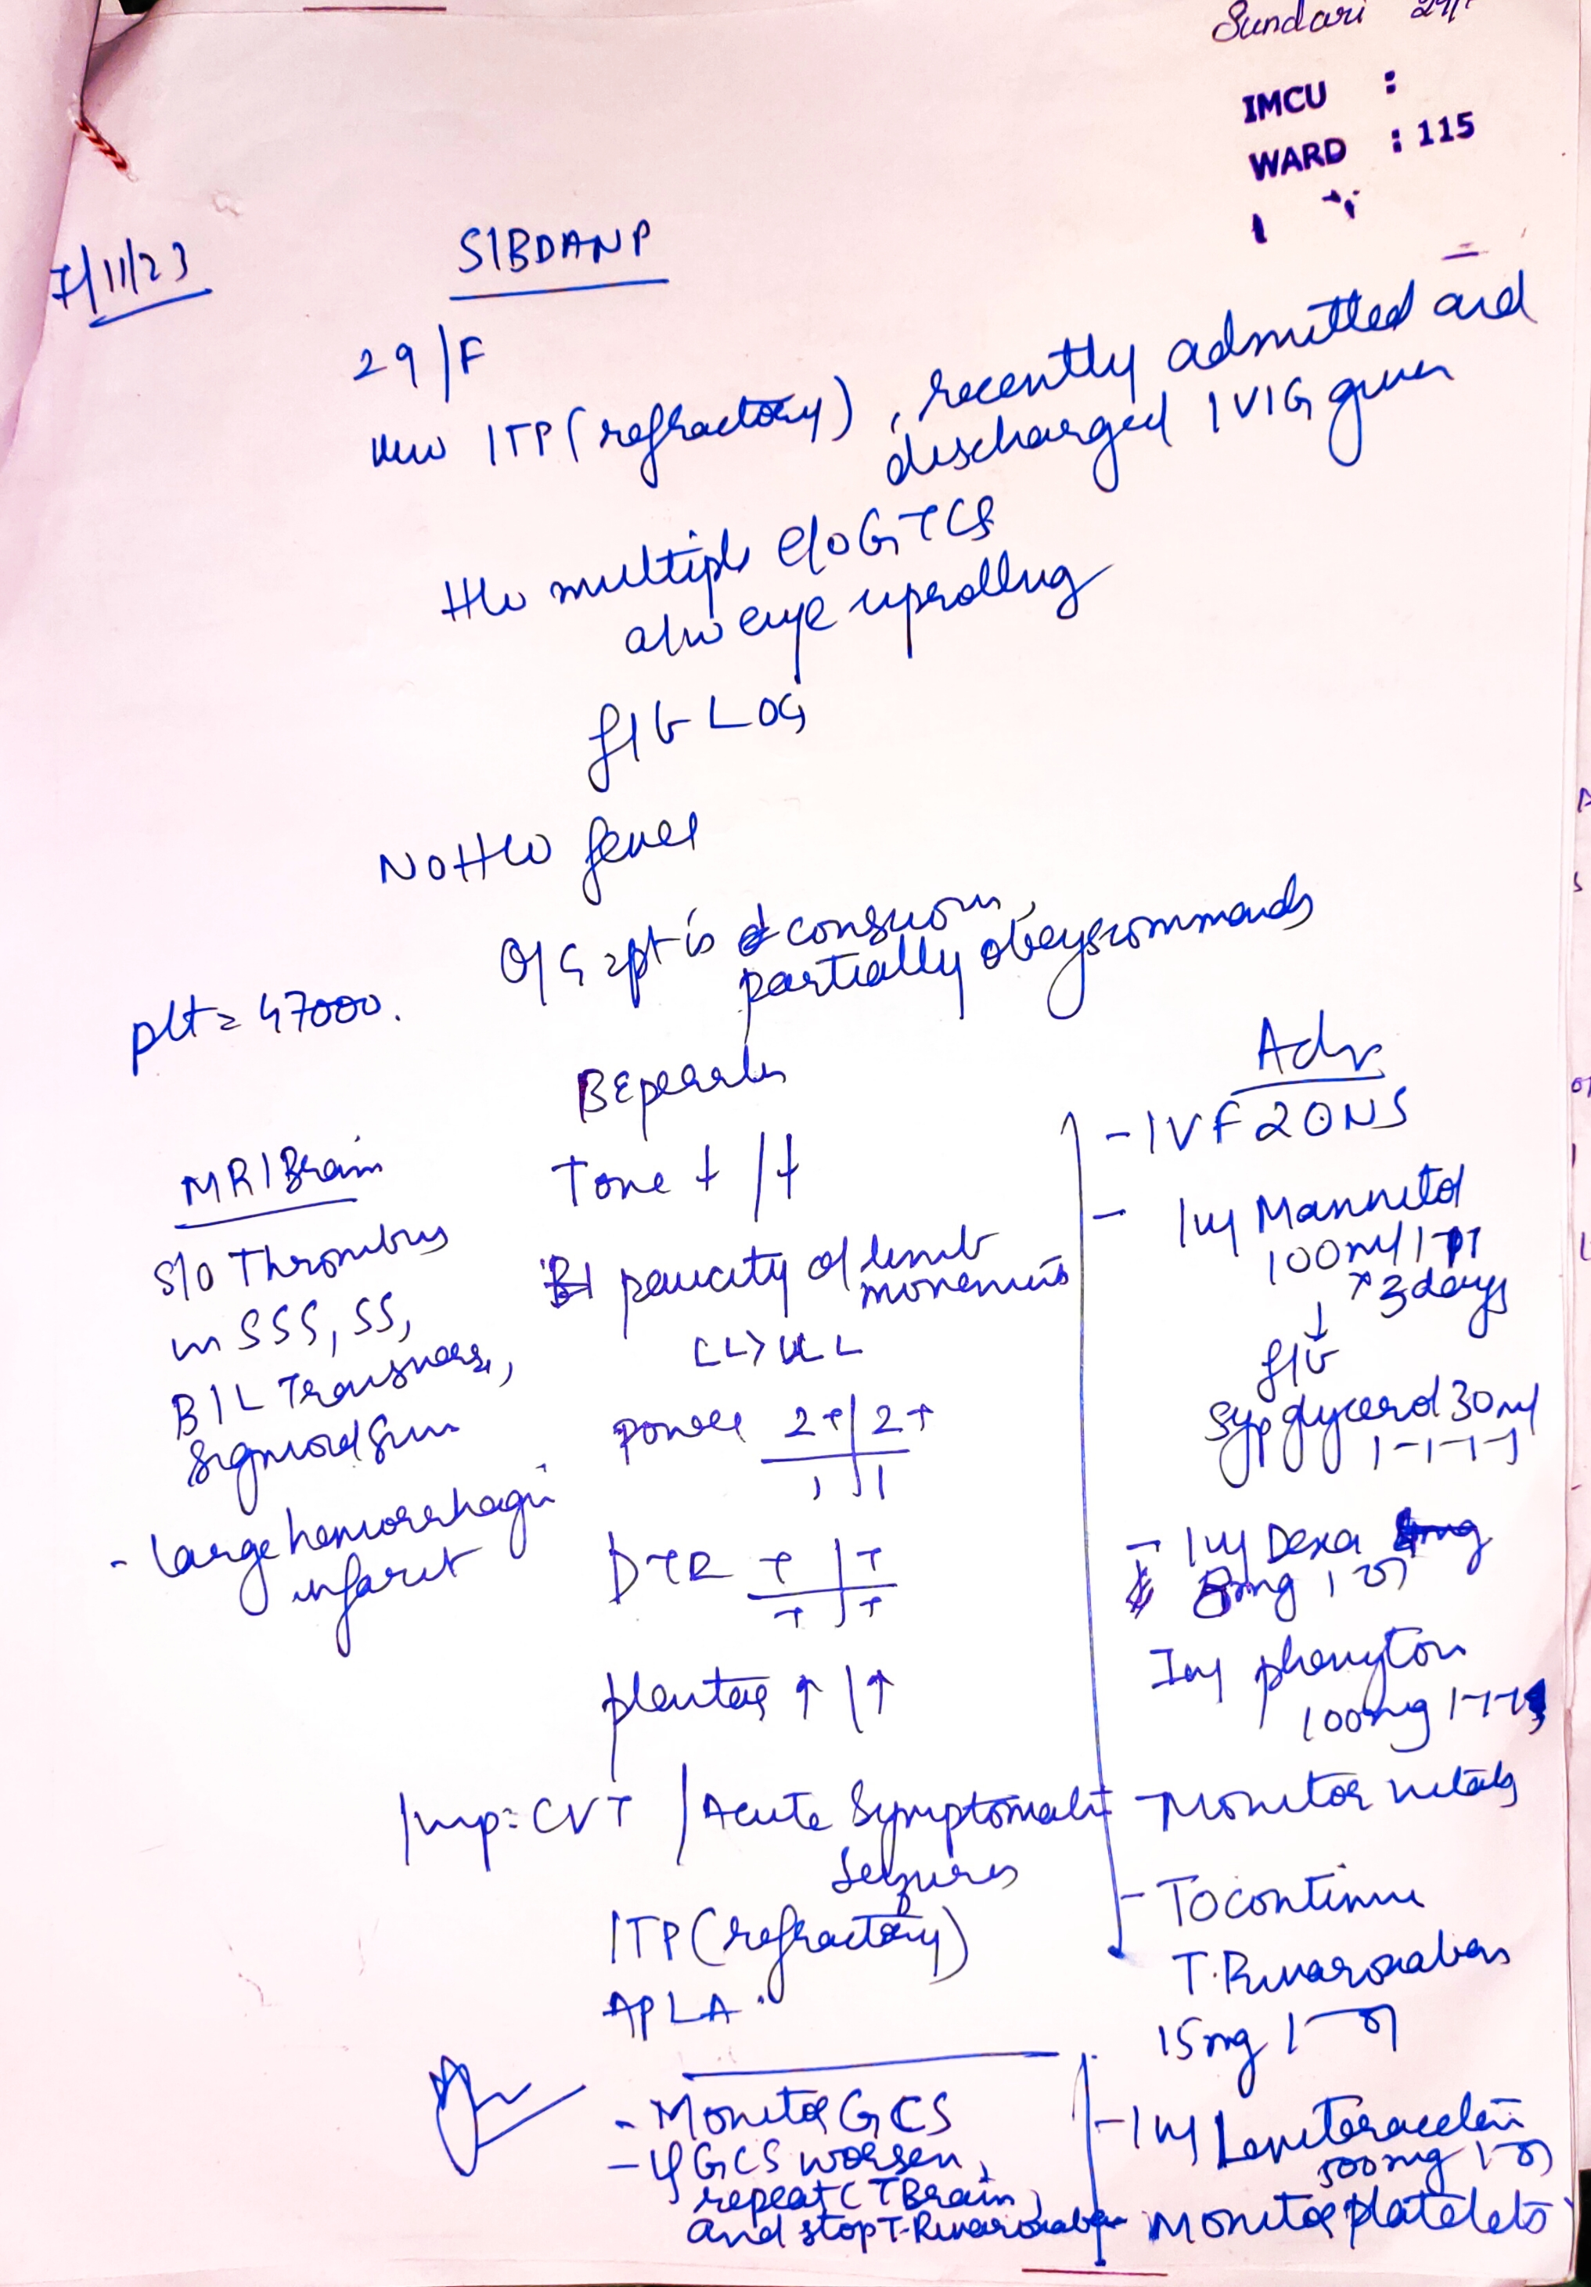
NEURO MEDICINE REVIEW

Slide 26
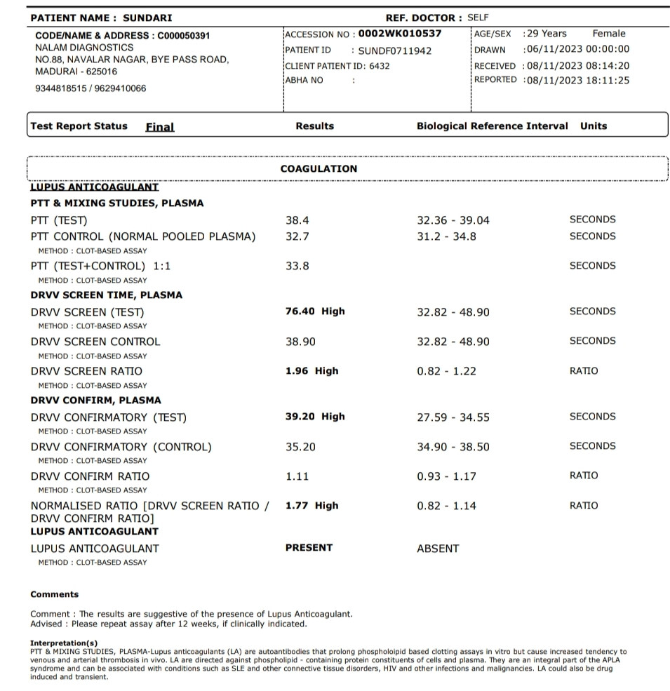
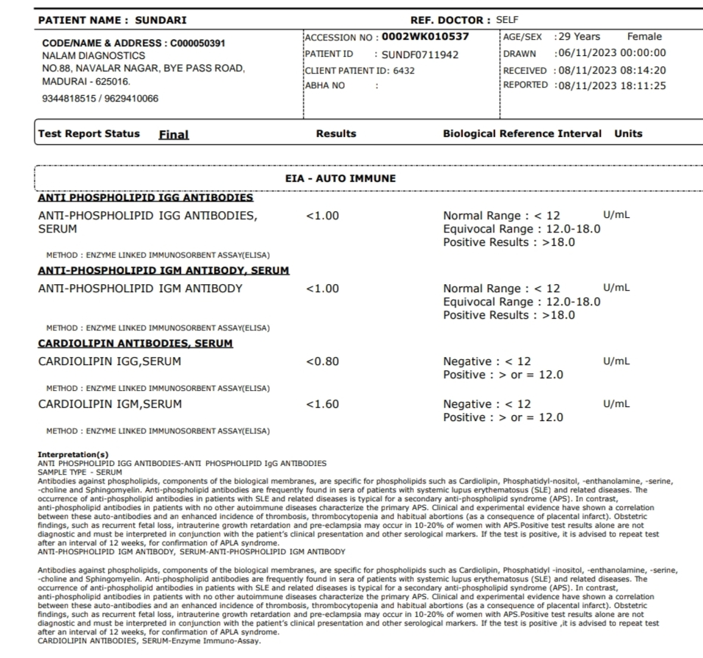
ANA –NEGATIVE
APLA PROFILE

