Slide 1
A CASE OF CHOLEMIC NEPHROPATHY

Slide 2
A 13 year old female patient who is a known case of T1DM and hypothyroid came with
-c/o abdominal pain
-c/o Fever × 2 days

Slide 3
HISTORY OF PRESENTING ILLNESS
-H/o Abdominal pain ×2 days
dull aching type,
Diffuse ,not radiating .
No aggravating or relieving
factors.
H/o Fever ×2 days
High grade,intermittent
Not associated with chills
and rigor.
H/o Nausea +
No h/o loose stools/burning micturition
No h/o cough/breathlessness
No h/o seizures/altered sensorium.

Slide 4
PAST HISTORY
Known case of T1DM since 5 years of
age on inj RI 12 -0-10
Nph 12 -0-10
Known case of Hypothyroid diagnosed 3 years back on T.Thyroxine 50 ug 1 OD .
No other co -morbidities.

Slide 5
PERSONAL HISTORY
Mixed diet
Normal bowel and bladder habits.
Attained Menarche 2 months back .

Slide 6
FAMILY HISTORY
No significant family history.

Slide 7
General examination
Patient
Concious
Oriented
Afebrile
Icterus +
No pallor/clubbing
No pedal edema
No cyanosis
Facial puffiness +
Hydration fair

Slide 8
Vitals
Bp - 120 /80 mmhg
PR - 98/ min.
Spot-98 % in R.A
S/E
CVS -S1 ,S2 + ,No murmur.
RS -B/l AE +,No added sounds.
CNS -NFND
P/A - soft ,diffuse tenderness (more on right hypochondriac and right lumbar region )
No guarding/rigidity.

Slide 9
Blood sugar-589 mg/dl
Urine acetone-Negative.
Pt got treated with insulin infusion and blood sugar was corrected.
ABG : PH 7.39 lact 2.0
PCO2 22 Hco3 13.3
Na 116
K 2.4
Gluc 327

Slide 10
 | 3/7 | 6/7 | 8/7 | 10/7 | 11/7 | 14/7 | 15/7
TC | 4300 |  | 6800 |  | 14100
HB | 11.5 |  | 10.0 |  | 10.3
PLT | 1.96 |  | 1.74 |  | 4.59
T.B | 1.3 | 3.4 | 6.2 | 9.4 | 11.7 | 14.8 | 15.9
D.B/I.B | 0.9/ 0.4 | 2.1/ 1.3 | 3.2/ 1.1 | 7.2/ 2.2 | 9.0/ 2.7 | 10.0/ 4.8 | 11.7/ 4.2
OT/PT | 9140/ 5200 | 817/ 967 | 1410/2342 | 738/ 1227 | 742/ 946 | 153/ 420 | 117/ 313
ALP | 552 | 369 | 344 | 479 | 128 | 225 | 229
Pt | 21.5 | 14.7 |  | 14.1 |  |  | 16.9
Inr | 1.7 | 1.1 |  | 1.0 |  |  | 1.30
Aptt |  | 33.9 |  | 33.4 |  |  | 38.2

Slide 11
 | 3/7 | 6/7 | 7/7 | 8/7 | 10/7 | 11/7 | 12/7 | 14/7
Urea | 30 | 118 | 109 | 101 | 133 | 111 | 112 | 120
Creat | 1.0 | 4.3 | 4.9 | 6.0 | 6.3 | 6.0 | 6.7 | 8.8
Na | 132 | 130 | 132 |  | 127 |  |  | 125
K | 4.7 | 4.7 | 5.0 |  | 5.5 |  |  | 4.5
FBS | 161
I/o | 1100/ 1250 |  | 870/ 1100

Slide 12
Peripheral smear
Rbc - normochromic normocytes with few hypochromic microcytes.
Wbc - wbc count normal
Reactive lymphocytes seen
Platelet- Normal in number and morphology.
IMPRESSION
HYPOCHROMIC MICROCYTIC ANEMIA
NO PARASITES.

Slide 13
OTHER INVESTIGATIONS
Sr.proteins -- 5.3
Albumin - 2.9
Globulin - 2.4
Sr. Calcium 10.3
Corrected calcium 11.2
AEC - 192 cells /cubic mm
Vctc =non reactive
Viral markers = negative.
URINE ROUTINE
ALB - 1+
SUG -3+
DEP - 0 to 4 pus cells
ACETONE - Negative.
URINE spot pcr
Pro 161 mg%
Creat 37 mg%
24 hr urinary protein
178 mg/day.

Slide 15
Usg abdomen on 4.7.23
IMP :
GB WALL EDEMA
Altered liver echoes.
Cystitis
Minimal ascites.

Slide 16
Usg abdomen on 8.7.23
IMP
1. F/s acute hepatitis.
2.b/l kidneys appears bulky with increased echoes.

Slide 17
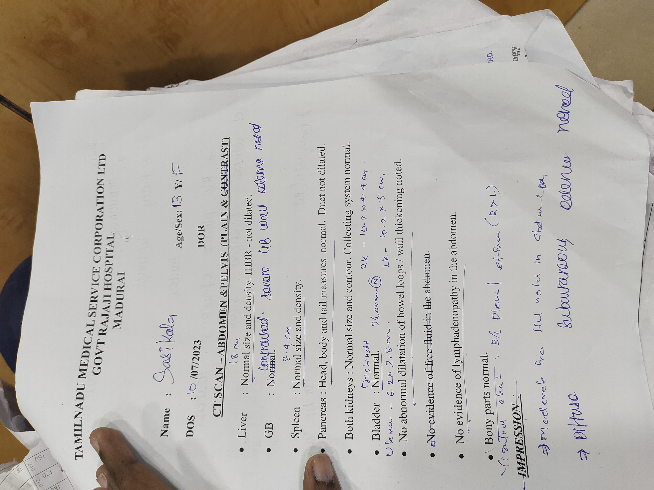
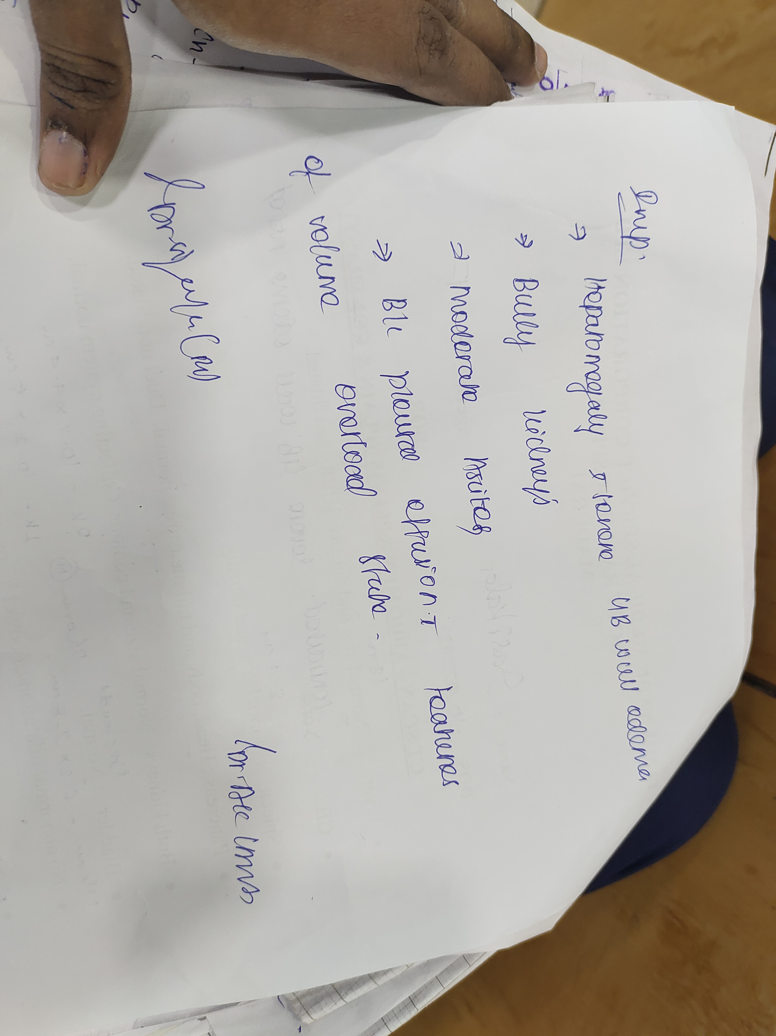
CT ABDOMEN

Slide 18
Fundus examination
B/l fundus Normal.

Slide 20
MGE OPINION
Review (6/7/23)
Advice :
I.v antibiotics
Viral markers
IgM anti HAV
Urine c/s
Lft monitoring
Avoid hepatotoxic drugs.
I/o monitoring.
IMP: acute hepatitis
? viral/ischemic/toxic.
Cholestatic features +
Advice : glycemic control.
T.Udca 300mg bd
Syp .lactose 15ml tds
Serial lft anand Pt inr monitoring.

Slide 21
CARDIOLOGY OPINION
Normal sized chambers ,
LviDd 4.2
LviDs 2.6
EF 63%
NORMAL LV SYSTOLIC FUNCTION
NO PERICARDIAL EFFUSION.

Slide 22
NEPHROLOGY OPINION
8.7.23
SRD,
fluid restriction
I =O +300ml /day
To do
Sr.cpk ,srLDH.
11.7.23
IMP = T1DM/Hepatitis A/non oliguric renal failure f/e
Advice:
Fluids 1.5l /d
T.NaHco3 Tds
T.Caco3 bd
RFT,Sr. Electrolytes.

Slide 23
T1DM / HYPOTHYROID/ACUTE VIRAL HEPATITIS / NON OLIGURIC AKI
What are all the possible reasons for acute kidney injury in this patient?

