Slide 1
AN INTERESTING CASE OF “TYPE 2 DIABETES – TEEN”
PROF – DR.M.NATARAJAN M.D
ASST PROF – DR. SYED BAHAVUDEEN HUSSAINI M.D
DR VALLI DEVI M.D

Slide 2
Chief complaints
15 year old male, studying 11th standard
Presented with
c/o Loss of weight for the past 1 month
c/o increased frequency of micturition for the past 2 years.

Slide 3
History of presenting illness
c/o loss of weight for the past 1 month:
One month back , patient weighed 55 kg
Started noticing sudden loss of weight ,
Lost nearly 10 kgs in the past 1month.
At present the patient weighs 45 kg.
No h/o loss of appetite
No h/o vomiting
No h/o altered bowel habits

Slide 4
h/o increased frequency of micturition for the past 2 years
4 to 5 times in the night time.
h/o polyuria +
No h/o burning micturition
h/o polydipsia + : drinks 3 to 4 litres of water/day.

Slide 5
No h/o abdominal pain/abdominal distension
No h/o steatorrhea
No h/o cough with expectoration
No h/o fever
No h/o chest pain
No h/o palpitations
No h/o breathlessness
No h/o syncope

Slide 6
No h/o weakness of limbs
No h/o seizures
No h/o headache
No h/o easy fatiguability
No h/o altered sensorium
No h/o blurring of vision.

Slide 7
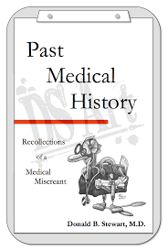
Past history
Not a known case of
Diabetes mellitus
TB
Bronchial asthma
Seizures
Rheumatic heart disease

Slide 8
Personal history
Not a smoker
Not an alcoholic
Developmental history:
BIRTH WEIGHT : 2.8 kg
Cried immediately after birth
Normal developmental milestones attained
No congenital anomalies

Slide 9
Family history
family history of Diabetes mellitus present
Born of 2nd degree consanginous marriage.
Father diagnosed to have Type 2 DM.., 2 years back on OHA ‘S
No history of GDM in his mother
Grand father and Grand mother have T2DM on treatment.

Slide 10
GENERAL EXAMINATION
Conscious
Oriented
Afebrile
Comfortable at rest
No pallor
No icterus/ cyanosis/ clubbing/ pedal edema
No generalised lymphadenopathy

Slide 11
Acanthosis nigricans present in the neck and axilla
External genitalia normal

Slide 12
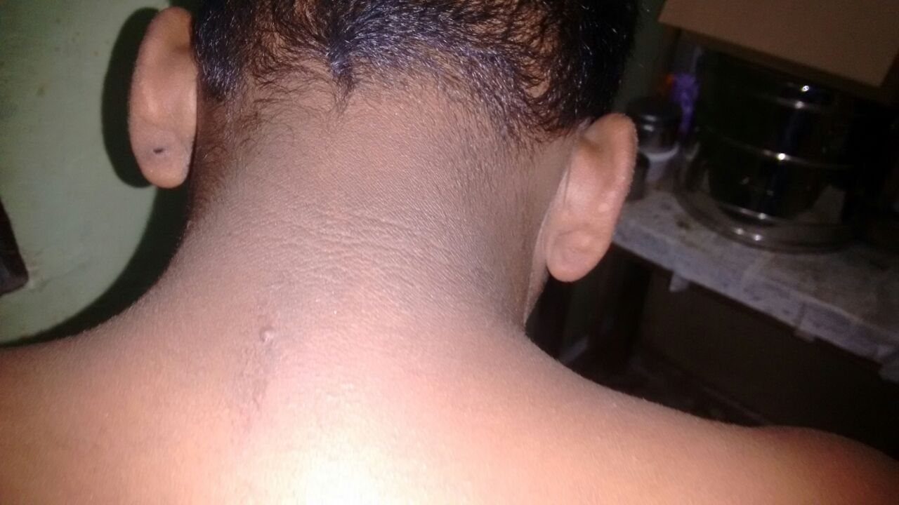
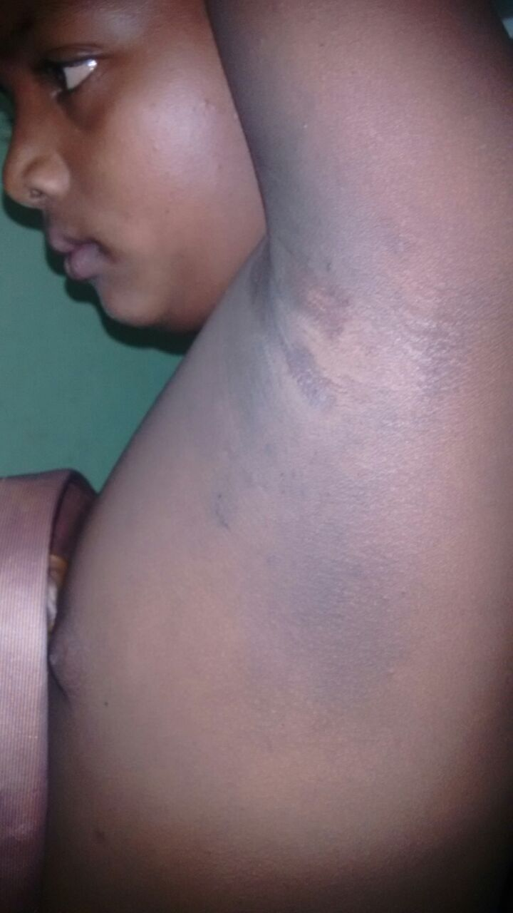
ACANTHOSIS NIGRICANS

Slide 13
ANTHROPOMETRY
BODY WEIGHT : 55 KG
HEIGHT : 146 CMS
BMI : 25.3
ONE MONTH LATER
BODY WEIGHT : 46 KG
HEIGHT :146 CMS
BMI : 21.5
Waist /hip ratio : 1.16

Slide 14
VITALS
PULSE – 82 per minute, regular, normal in volume , all peripheral pulses felt, no radio radial / radio-femoral delay
RESPIRATORY RATE – 16 per minute
BLOOD PRESSURE – 100/80 mm Hg in right upper limb in supine position, 100/80 mm Hg in standing
Spo2 – 96% in room air

Slide 15
SYSTEM EXAMINATION
CARDIOVASCULAR SYSTEM
JVP not elevated
Apical impulse in left 5th intercostal space half an inch medial to midclavicular line
Mitral, tricuspid, pulmonary , aortic area – s1s2 +
no murmur

Slide 16
RESPIRATORY SYSTEM
Trachea in midline
bilateral air entry equal
normal vesicular breath sounds +
ABDOMEN – soft, no organomegaly
CNS – NFND
pupil 3mm B/L RTL
FUNDUS : Normal

Slide 17
INVESTIGATIONS
COMPLETE HEMOGRAM
Hb – 13.6 gm/dl
TC – 10,500 cells/cu.mm
DC- neutrophils- 46%
lymphocytes 38%
monocytes 16%
Platelets – 3.45 lakhs/cu.mm
PCV – 39%
ESR – 13 mm/hr

Slide 18
Biochemistry
RBS | 589 mg/dl
S.Urea | 19mg/dl
S. Creatinine | 0.9 mg/dl
Serum electrolytes | Meq/l
sodium | 139.8
potassium | 4.5
chloride | 94.9

Slide 19
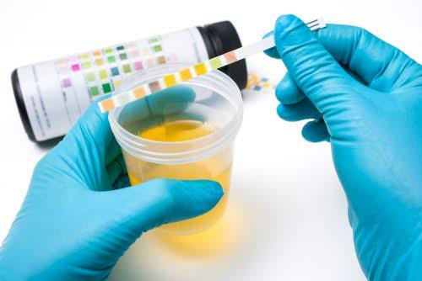
Urine analysis
Urine albumin nil
sugar ++++
deposits 2-4 pus cells
Urine acetone : negative

Slide 20
FASTING BLOOD SUGAR : 311 MGS %
POST PRANDIAL BLOOD SUGAR : 326 MGS%
HbA1C- 15.18%
FASTING LIPID PROFILE :
Serum cholesterol : 132 mgs%
HDL : 42 mgs%
VLDL: 40 mgs%
LDL : 52 mgs %
TGL : 202 mgs %
Serum amylase : 10 IU/L

Slide 21
USG Abdomen :
Mild hepatomegaly, Size 13.2cm
No evidence of free fluid/ effusion
Kidneys normal in size and shape ,CMD maintained
Spleen and pancreas : normal

Slide 22
ECG : Normal
Echocardiogram –
ejection fraction – 76%
no regional wall motion abnormality
other parameters normal

Slide 23
Provisional Diagnosis
YOUNG ONSET DIABETES MELLITUS FOR EVALUVATION WITH POSSIBLE INSULIN RESISTANCE.

Slide 24
TREATMENT
DIABETIC DIET
IV FLUIDS : Normal Saline 2 units
Ringer Lactate 1 unit
BCT 10D
BLOOD GLUCOSE MONITORING
INJ. HA | 15 | 15 | 15
INJ HM | 10 |  | 8

Slide 25
ENDOCRINOLOGIST OPINION
FAMILY HISTORY OF DIABETES +
No ketoacidotic features
USG : mild hepatomegaly
? TYPE 1 Diabetes
Suggested :
CT ABDOMEN WITH CONTRAST
FASTING C PEPTIDE LEVEL
GAD 65 ANTIBODY
THYROID PROFILE

Slide 26
OPTHALMOLOGIST OPINION OBTAINED
NO EVIDENCE OF DIABETIC RETINOPATHY AT PRESENT
STRICT GLYCEMIC CONTROL
ENT OPINION OBTAINED:
No hearing loss

Slide 27
CT ABDOMEN PLAIN AND CONTRAST : Normal study
PANCREAS : Normal
Thyroid profile : EUTHYROID
TOTAL T4 : 8.01 mg/dl
TSH : 4.75IU/ML
FASTING C PEPTIDE LEVEL:1.88ng/ml ( 0.48 to 3.30ng/ml)
GAD 65 ANTIBODY : 0.76U/ml (<1U/ml)

Slide 28
FOLLOW UP On follow up, Patient requires more than 100 units of insulin /day Sugar did not come under control .. Insulin resistance suspected
DAYS | DAY1 | DAY3 | DAY5 | DAY7 | DAY9
FBS | 311 | 342 | 232 | 250 | 186
PPBS | 326 | 290 | 321 | 277 | 320

Slide 29
Fasting insulin level :9.73 microIU/L( 2-25 microIU/L)
INSULIN RESISTANCE =(FASTING INSULIN LEVEL *FASTING BLOOD SUGAR)/405
VALUE FOUND TO BE 4.22
IMPLIES INSULIN RESISTANCE
We added T.ACARBOSE 50 MG TDS

Slide 30
DIABETOLOGIST OPINION
Family history positive
Symptomatic ,insidious onset
Abdominal obesity+
Acanthosis nigricans +
Sparse axillary and pubic hair
External genitalia normal
Insulin requirement more than 2 units /kg/ day
Diagnosis : 1. secondary diabetes due to insulin resistance
2. Type 2 DM in young
3. Type 1b diabetes
Suggested : to add T. Metformin 500 mg 1-0-1
Inj Human Mixtard 30 -0- 20 units

Slide 31
ENDOCRINOLOGY REVIEW
A CASE OF YOUTH ONSET DIABETES
T2 DM VS MODY
SUGGESTED
Genetic studies – MODY
Repeat C peptide
Glucagon stimulated C Peptide
May add metformin and pioglitazones
Reduce the dose of insulin

Slide 32
PLAN
To add T . METFORMIN 500mg 1- 0-1
T. Acarbose 50mg 1-1-1
And subsequently wean the dose of insulin
Regular follow up

Slide 33
AIM OF THE PRESENTATION
To highlight recent increase in incidence of Type 2 Diabetes mellitus in adolescence.
To look for stigmata for insulin resistance in young onset Diabetes Mellitus

Slide 34
THANK YOU ☺☺☺

