Slide 1
Thrombocytopenia In pregnancy
BY FIRST MEDICAL UNIT
CHIEF:PROF. DR.M.NATARAJAN M.D.,
ASST. PROFESSORS: DR.V.PALANIKUMARAN M.D.,D.DIAB
DR. VASANTHAKALYANI M.D.,DCP
DR. SURESHKUMAR M.D.,
PRESENTOR : DR.MANOJ PRABHU

Slide 2
Maternal thrombocytopenia
Defined as platelet count < 150K/uL.
2nd most common hematological problem in pregnancy after anemia.
Affects 10% of all pregnancies.
Bleeding symptoms are generally mild even in severe thrombocytopenia – due to procoagulant state of pregnancy.

Slide 3
Causes of thrombocytopenia during pregnancy
Acute fatty liver of pregnancy
Anti-phospholipid syndrome and SLE
Bone marrow disorders(eg., aplastic anemia, acute leukemia)
DIC
Drugs( mostly heparin and antibiotics)
Gestational thrombocytopenia (GT)
HELLP syndrome
Hypersplenism

Slide 4
Contd…
Immune thrombocytopenic purpura (ITP)
Nutritional deficiencies, including folate deficiency
Preeclampsia, eclampsia
Pseudothrombocytopenia
Thrombotic thrombocytopenic purpura- hemolytic uremic syndrome
Viral infections

Slide 6
Causes of thrombocytopenia by trimester

Slide 7
2nd Trimester

Slide 8
3rd Trimester

Slide 9
Management of maternal thrombocytopenia focuses on:
Accurate diagnosis of underlying etiology, with frequent reassessment based on trend/ clinical developments
Management of platelet count for labor and delivery
50K for C- section/ natural
70-80K for epidural

Slide 10
Gestational thrombocytopenia
Detected in 5-7% of otherwise healthy pregnant women, accounting for 64 – 80% of patients with thrombocytopenia at term.
Platelets > 70 – 80K.
A benign disorder
Not associated with increased risk of bleeding.
onset is later in gestation ( mid 2nd – 3rd trimester).
Decline in platelet count is greater than in normal pregnancies.

Slide 11
Features of GT:
No increased risk of newborn thrombocytopenia
No treatment needed
No contraindication to epidural anesthesia
Rapid and spontaneous resolution after delivery
Recurs in future pregnancies
Exaggerated increase in MPV( mean platelet volume) compared to normal pregnancies.

Slide 12
Pathogenesis of GT
Specific pathophysiology of GT is not known, but many theories exist, including:
? Dilution from expanded plasma volume.
? Insufficient TPO response
? Changes in VWF expression/ survival
- vWF Ag and FVIII significantly increase in pregnancy
- ( both increased production and prolongation of vWF half- life)
? Increased turnover
? Antiplatelet antibodies

Slide 13
Pathogenesis of GT
Some authors have also proposed platelet consumption by the placenta and hormonal depression of megakaryopoiesis as causes of GT, as suggested by the rapid return of platelet count to normal after delivery.

Slide 14
Platelet trends in GT: antepartum and postpartum
Tri – trimester
Day 0 = day of delivery
Rising MPV seen in all pregnancies, with a significantly higher elevation in MPV in GT (at all pregnancy stages) compared to normal pregnancy controls
Fogerty AE, Br J Haematol. 2021

Slide 15
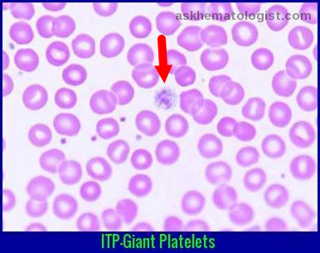
ITP in pregnancy:
Second most common cause of thrombocytopenia in pregnancy
Always exclude secondary causes.
1- 2/ 1000 pregnancies.
- most common cause of thrombocytopenia in 1st/ early 2nd trimesters.
Diagnosis of exclusion, no reliable ‘rule in’ test.
- consider: history, onset, trend over time, size of platelets.
TPO levels may be informative
- significant rise in pregnant women with ITP
compared to GT, normal pregnancies and
non- pregnant women with ITP.

Slide 16
Manifests in the first trimester
Platelet counts <50,000
Mucosal bleeding +
No indication for C-section unless there is an obstetric indication

Slide 17
Can result in fetal thrombocytopenia ( autoantibodies can readily cross the placenta)
- 8.7% - 14.7% fetal thrombocytopenia in neonates of ITP mothers.
- fetal intracranial hemorrhage: 1.5%
- avoidance of forceps/ Vacuum assisted delivery is advised.
Provan D. Blood. 2010

Slide 18
WHEN TO TRANSFUSE PLATELETS IN ITP ?
Risk of severe bleeding <20,000
With platelet count 20,000 -100000 risk of bleeding may occur with invasive procedures.
Vaginal delivery-transfuse to a platelet count of 30,000
Plt <20,000 &bleeding manifestations –transfuse immediately
Neuroaxial anesthesia – transfuse to a platelet count of >70,000
&
Dexamethasone 40mg OD ×4 days just before procedure
C-section –transfuse to a platelet count of 50,000

Slide 19
FREQUENCY OF PLATELET COUNT MONITORING
Gestational thrombocytopenia – once per month/once per trimester
Hospitalized due to maternal illness-Daily monitoring
Severely illness like HELLP -4 to 6 hrly monitoring

Slide 20
HOW AGENT TO BE SELECTED IN ITP IN PREGNANCY ?
Choice of glucocorticoid in pregnancy depends on whether the goal is to minimize fetal exposure or to treat both mother and fetus.
When delivery is not imminent(early pregnancy,preterm birth not expected) –PREDNISONE
1 mg/kg per day for two weeks followed by a gradual taper
Near term /to improve neonatal outcomes-
DEXAMETHASONE
40mg per day for 4 days

Slide 21
IV IG
MOA: Increase platelet count by interfering with macrophage uptake of auto-antibody coated platelets
IV IG
IV IG may used addition to or instead of glucocorticoid ,especially who require a more rapid increase in platelet count ,those who do not have an initial platelet count increase with glucocorticoids.
It will raise platelets within 12 to 24 hours.
If therapy is needed to raise platelet count prior to delivery ,it should be initiated approx. one week in advance for maximal efficacy
Raise in platelet count with IVIG is usually temporary persist for 2 to 6 weeks.
SIDE EFFECTS:
Headache
Hypertension Allergic reactions
VOMITING
ICH
Aseptic meningitis
Thrombosis
DOSE:0.4g/kg /day for 5 days

Slide 22
When steroids/ IVIg fail…
Platelet transfusion offers limited benefit due to enhanced clearance.
Anti- RhD ( limited published data)¹
- only works for D- positive mothers.
- risk for both maternal and fetal hemolysis.
Rituximab²
- limited efficacy data specific to ITP in pregnancy.
- risk neonatal lymphopenia and impaired response to vaccinations
- response often too slow.
1. Michel M. Br J Haematol. 2003.
2. Chakravarty EF. Blood. 2011.

Slide 23
When steroids/ IVIg fail…
Azathioprine ( reports of successful use, mostly from SLE)
Cyclosporine ( response often takes months)
Fogerty AE. Transfus Med Rev. 2018.

Slide 24
TPO mimetics in pregnancy?

Slide 25
Use of TPO mimetics in pregnancy
Late- term/ limited romiplostim exposure is not associated with an obvious risk signal.
- still insufficient data to consider for routine use.
- recommendation remains to discontinue TPO mimetics at the time of pregnancy confirmation.
Maternal response to TPO mimetic suggest similar efficacy as in non- pregnant cohorts.
Much more data needed to inform guidelines for use and safety
Provan D. Blood Adv. 2019.

Slide 26
Thrombotic microangiopathies in pregnancy:
Presenting in/ triggered by pregnancy:
lupus nephritis/ SLE
Vasculitis
Antiphospholipid antibody syndrome
Sepsis
Severe hemorrhage
TTP
Complement mediated - HUS

Slide 27
Pregnancy specific:
Hypertension of pregnancy
Pre- eclampsia
- hemolysis elevated liver enzymes low platelets (HELLP)
Acute fatty liver disease of pregnancy (AFLDP)
Placental abruption

Slide 28
Pre-eclampsia
3- 4% of all pregnancies.
Defined as: new onset HTN > 140/ 90 after 20 weeks with at least one of the following, (ACOG)
Proteinuria
Renal insufficiency
Thrombocytopenia
Impaired liver function
Pulmonary edema
New- onset headache or visual symptoms.
Characterized by endothelial damage and injury to multiple organ systems.

Slide 29
Angiogenic imbalance is the central driver
- excess secretion of placentally derived antiangiogenic factor: soluble fms- like tyrosine kinase- 1 (sFlt- 1)
- sFlt- 1 sequesters proangiogenic molecules – vascular endothelial growth factor (VEGF) and placental growth factor (PLGF).
- Increased sFlt- 1/PLGF ratios are seen both at diagnosis and weeks before clinical symptoms.

Slide 30
HELLP
Hemolysis with a microangiopathic blood smear, elevated liver enzymes, and low platelets.
Multiparity and age may contribute to increased risk.
A previous history of preeclampsia or HELLP syndrome can lead to recurrence in subsequent pregnancies.
HELLP syndrome has prevalence of 0.5% to 0.9%. About 70% of cases occur in third trimester of pregnancy, and the remainder occurs within 48 hours of delivery.

Slide 31
PATHOPHYSIOLOGY
An ischemic-reperfusion injury triggers the systemic inflammatory process in HELLP syndrome.
The spiral arteries which fail to remodel because of inadequate trophoblast invasion or defective endothelial apoptosis result in ischemia of the placenta.
This causes activation of endothelium, which is accompanied by increased release of antiangiogenic factors, which leads to multiorgan microvascular injury.
The coagulation cascade is activated by the adhesion of platelets on the activated and damaged endothelium.

Slide 32
Platelets release thromboxane A and serotonin, causing vasospasm, platelet aggregation, and further endothelial damage.
This causes the usage of platelets and hence, thrombocytopenia and the red blood cells break down while passing through the platelet-fibrin-rich capillaries, causing microangiopathic hemolytic anemia.
Multiorgan microvascular injury and hepatic necrosis lead to the development of HELLP syndrome.
The cascade terminates with the delivery of the fetus.

Slide 33
DIAGNOSIS
Tennessee classification is used to diagnose HELLP syndrome and requires the presence of all three criteria
1) Hemolysis confirmed with at least 2 of the findings:
-Peripheral smear with schistocytes.
-serum bilirubin >1.2mg/dl.
-Low serum haptoglobion(<25mg/dl) or LDH>two times the upper level of the normal.
-Severe anemia with hemoglobin <8 to 10 g/dl depending on the pregnancy stage, unrelated to blood loss.
2) Elevated liver enzymes: AST or ALT > 2 times the upper level of normal.
3) Low platelets: <100,000 cells/microL.

Slide 34
MANAGEMENT
Management is mainly supportive.
Consider patients red cell transfusion if hemoglobin is <7gm/dl or if the patient has ecchymosis, severe hematuria, or suspected placental abruption.
All actively bleeding patients with any degree of thrombocytopenia should be transfused with platelets.
Patients with coexisting DIC may need fresh frozen plasma and cryoprecipitate.
Patients with HELLP syndrome and coexisting TTP will benefit from therapeutic plasma exchange.

Slide 35
Acute fatty liver of pregnancy
This abnormality is very severe, but fortunately very rare condition.
Characterised by microvesicular fatty infiltration of liver, resulting in hepatic failure and encephalopathy.
The “ Swansea criteria”,
Six or more of these criteria should be present in a patient who has no obvious reason for hepatic failure.
Encephalopathy | Leukocytosis
Abdominal pain | Coagulopathy
Polydipsia and polyuria | Renal impairment
Elevated transaminases | Hypoglycemia
Elevated ammonia | Ascites or bright liver on USG
Elevated uric acid | Microvesicular steatosis on liver biopsy
Elevated bilirubin

Slide 36
 | Pre-eclampsia/HELLP | AFLDP | TTP | CM- HUS
Stage of pregnancy | Must be > 20 weeks Typically 3rd trimester Possibly early PP | Late in pregnancy or immediately PP | Any trimester or PP | Typically PP Antepartum: evenly distributed
Diagnostic features:
Thrombocytopenia | Mild/ moderate | Mild/ moderate | Severe ( < 20K) | Moderate
Transaminitis | Normal to severe | severe | Rare | Rare/ mild
Renal injury | Rare/ mild | Mild/ moderate | Mild or absent | severe
Coagulopathy | Rare/ mild | Often severe | Rare | Rare/ mild
Neurological Abnormalities | Headache common Rare seizures/ CVA | Encephalopathy common | Transient focal defects possible, progressive without treatment | Rare
Treatment | Fetal delivery | Fetal delivery | Plasma exchange (aTTP, antibody mediated) FFP – cTTP (congenital TTP, Upshaw- Schulman syndrome) | Eculizumab Renal replacement therapy may be required.

Slide 37
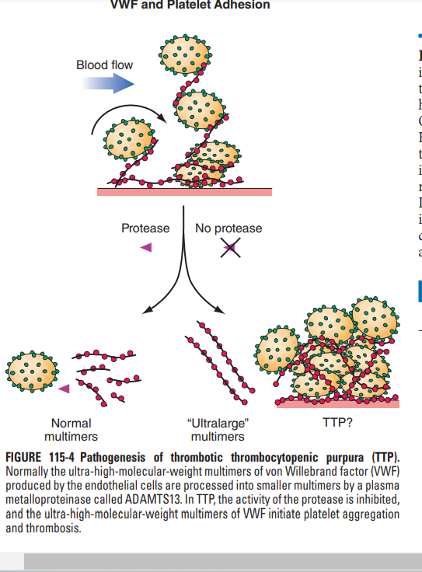
Only TTP has a readily available defining lab abnormality
- severe ADAMTS13 deficiency

Slide 38
Summary
Approach to thrombocytopenia in pregnancy:
Careful history
Review of the peripheral smear (?TMA, platelet size)
Timing of onset and severity of platelet count help focus the appropriate differential
Collect appropriate supporting data, which may include:
- comprehensive metabolic panel, PT/aPTT, vWD panel
- hemolysis evaluation (ADAMTS13)
- infections – HIV, HBV, HCV, H. Pylori
- Rheum – exam, ANA, RF, antiphospholipid antibodies
- consider heme malignanc/ possible need for bone marrow biopsy (rare in pregnancy)
Reassess diagnosis early if trajectory or response to early therapy is inappropriate.

