Slide 1
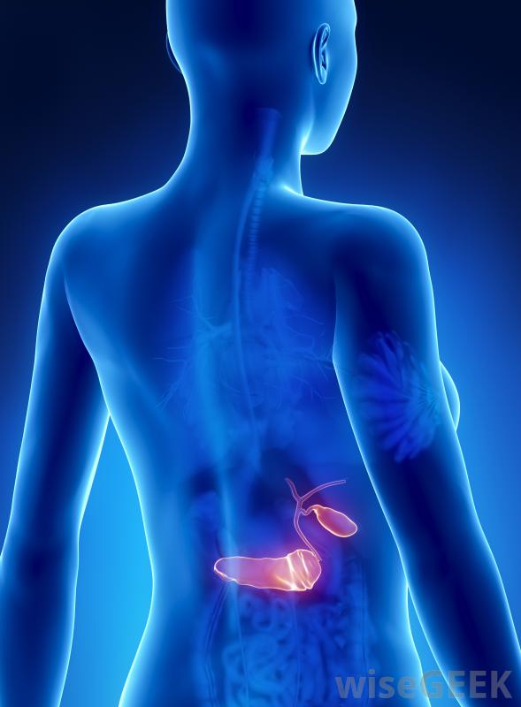
Fat fate Pancreas the darkness arises
III rd MEDICAL UNIT
CHIEF : DEAN PROF Dr.J.SANGUMANI M.D, D.Diab.,
Assistants : Dr.PALANIKUMARAN M.D, D.Diab.,
Dr.SUDHA.,M.D.,
Dr.SENTHIL .,M.D.,

Slide 2
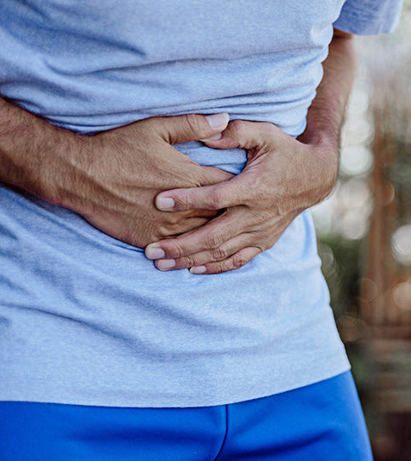
A 49 years old male who is a k/c/o T2DM for 15 years comes with
C/O Loose stools for 6 months

Slide 3
HOPI
H/O Loose stools - 6 months
For first four months – on/off
more after Non veg diet
2-3 episodes/day
For last 2 months – daily
after each meal/drink
4-5 episodes per day

Slide 4
STOOLS -
Yellowish in colour
Covered with greasy slimey layer
Large amount
Not blood stained
No bad odour
No worms in stools

Slide 5
Other histories
No h/o nausea / vomiting
No h/o abdominal pain / abdominal discomfort
No h/o fever
h/o loss of weight + (>15kg in last 6M)
h/o loss of appetite
h/o ulcer over both foot
h/o less ambulant for 2 months
No other significant positive history

Slide 6
Past history
K/C/O T2DM or 15 long years
Earlier he was on OAD-Switched to insulin for 2.5 yrs
(not on OAD)
Now on human premixed insulin(30/70) 12-0-10
Not k/c/o HTN/TB/BA/Thyroid illness/heart disease/ epilepsy/ CKD/CVA/jaundice
No past h/o surgery

Slide 7
Personal history
Takes mixed diet
Not a Alcoholic/ smoker/tobacco/ beetal nut chewer

Slide 8
O/E
Patient conscious
Oriented
Afebrile
Thin built & malnourished
Pallor +
Leuconychia +
B/L pitting PE
Not icteric/ cyanosis/ clubbing/ generalized lymphadenopathy
Vitals
BP- 100/70 mm Hg
PR – 88/Min
SPO2- 99%
Temp – 98.4F
RR – 14 / min
Patient’s weight before 1 year 63kg
Current weight – 45 kg
BMI – 14.07

Slide 9
S/E
CVS – S1 S2 + no murmur
RS – BAE+ , NVBS
NO added sounds
P/A – soft, BS+
scaphoid
Not distended,
not tender
no organomegaly
CNS – conscious , oriented
Moves all 4 limbs
B/L symmetrical sensorimotor polyneuropathy+
L/E : Pressure sores over both foot, above heel

Slide 10
1ST provisional Dx
T2DM
DIABETIC PERIPHERAL NEUROPATHY WITH NEUROPATHIC FOOT
CHRONIC DIARRHEA F/E

Slide 11
INVESTIGATIONS
CBC
TC | 8600
DC | 86/10/4
HB | 9.3
HCT | 26
PLT | 2.91
RED CELL INDICES
MCV | 78
MCH | 28
MCHC | 36
RDW-CV | 17
RBC | 5.6
RFT
Urea | 27 | 28
Creat | 0.9 | 0.9
Urine Routine
Albumin – Nil
Sugar - +
Dep- 0-2 cells

Slide 12
LFT
BIL(TOT) | 0.4 | 0.4
DIRECT | 0.2 | 0.2
INDIRECT | 0.2 | 0.2
SGOT | 20 | 22
SGPT | 18 | 14
ALP | 175 | 121
Total protein | 4.8
Albumin | 2.7
Globulin | 2.1
TFT
TSH | 1.25
Serum Electrolytes
Na | 126 | 133
K | 1.9 | 2.3

Slide 13
USG ABDOMEN AND PELVIS
Liver, spleen normal
Kidney normal size & echoes
Pancreas – normal
GB – distended
Bladder – Distended
e/o minimal free fluid in the abdomen and pelvis
SERUM
CHOLESTEROL - 74
TGL - 80
Serum Amylase – 112 U/L

Slide 14
BRITTLENESS TO BE NOTED
Patient’s blood sugar level fluctuated.
On second day morning, patient developed hypoglycemic symptoms & seizure.,
Treated with IV dextrose & recovered.
 | FBS | PPBS
DAY1 | 185 | 241
DAY 2 | 48 | 109
DAY 3 | 116 | 245
DAY 4 | 51 | 111
DAY 5 | 86 | 225
DAY 6 | 178 | 260
Because of labile blood sugar level C- peptide couldn’t be done

Slide 15
CHRONIC DIARRHEA
Stool examination
Macroscopic
Colour – greenish yellow
Transparency – semisolid, not formed
Blood – absent
Mucous – present
Microscopic
Pus cells – 01-02
RBCs- nil
Ova/cyst – nil
Culture - Negative
HISTORY
Weight loss
Fatty stools of large volume
Covered with slimy layer
More after taking food
Stigma of malasorption

Slide 16
CHRONIC DIARRHEA
DRUG INDUCED – METFORMIN – R/O
MALABSORPTION DIARRHEA
FECAL INCONTINENCE- R/O
DIABETIC AUTONOMIC NEUROPATHY- R/O

Slide 17
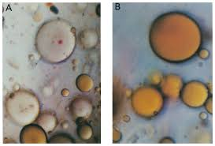
MALABSORPTION DIARRHEA
With the history and clinical examination and available investigation we suspect it as malabsorbtion diarrhea.
Among the quantitative & qualitative test.,
We have done qualitative SUDAN STAIN for steatorrhea which comes as positive.

Slide 18
FURTHER WORK UP
CECT ABDOMEN
PLANNED TO ASK FOR OGD SCOPY & DUODENAL BIOPSY

Slide 19
DARKNESS BEHIND THE DX

Slide 20
DARKNESS REVEALS
WE TOOK CECT FIRST..
IT REVEALS THE DARK TRUTH

Slide 21
THE DARK PANCREAS ARISES

Slide 22
CECT ABDOMEN

Slide 24
NORMAL VS DARK

Slide 25
CT REPORT

Slide 26
Journal & Patient

Slide 27
FINAL DX
DM / MALABSORPTION DIARRHEA – PANCREATIC EXOCRINE INSUFFICIENCY
TOTAL PANCREATIC LIPOMATOSIS – THE DARK PANCREAS

Slide 28
TREATMENT Given
Diabetic meal plan
Pancreatic enzyme replacement
Vitamins & iron supplementation
Iv Albumin
Supportive care

Slide 29
Aim Of The Presentation
Rarity of the presentation
Relation b/w diabetes and lipomatosis
A new insight about NAFPD and Lipotoxicity

Slide 30
THANK YOU

