Slide 1
Symposium
M6 medical unit
SEIZURE DISORDER
CHIEF
DR. M RAJKUMAR MD
ASSISTANT PROFESSORS
DR. T BALASELVI MD
DR. N P MADHAN VIGNESH MD
DR. HARIHARAN BP ( 1st Year Post graduate )

Slide 2
Synopsis
SEIZURE AND EPILEPSY
RESOLVED EPILEPSY
SEIZURE CLASSIFICATION AND SEMIOLOGY
INVESTIGATIONS
TREATMENT
Antiseizure medication
Surgical / DRE management

Slide 3
EPILEPTIC SEIZURE
Transient occurrence of signs and/or symptoms due to Abnormal excessive or synchronous neuronal activity in the brain.
EPILEPSY
Disorder of brain characterized by an enduring predisposition to generate epileptic Seizures, by neurological , cognitive , psychological , and social consequences of this condition.

Slide 4
What is an epilepsy ??
At least 2 unprovoked seizure or Reflex seizure occurring > 24hr apart
One unprovoked or Reflex seizure AND a probability of further seizure similar to the general recurrence risk ( at least 60% ) after two unprovoked Seizures, occurring over the next 10years.
Diagnosis of an epilepsy syndrome

Slide 5
UNPROVOKED SEIZURE
Absence of a temporary or reversible factor lowering the threshold and producing a seizure at that point in time.
PROVOKED SEIZURE
Occurs due to a transient , reversible cause affecting brain excitability. Hypoglycemia , Hyperglycemia , Hyponatremia , Fever , Alcohol withdrawal.
REFLEX SEIZURE
A Seizure that occurs in response to a specific , identifiable sensory or cognitive stimulus , reproducibly ( Visual / Auditory / Somatosensory / Cognitive ).
Hot water epilepsy ( significant in INDIA )

Slide 6
Epilepsy or not ?
CASE 1
6 yrs old boy ; 2 seizures 3days apart while playing a video game involving flashlights
H/o no other seizure
CASE 2
10yr old male
Facial twitching and drooling while falling asleep ( 1 episode till date )
EEG shows centrotemporal spikes with tangential dipole

Slide 7
RESOLVED EPILEPSY
Epilepsy is resolved for individuals :
Who had an age dependent epilepsy syndrome but are now past the applicable age
(OR)
Those who have remained seizure free for the last 10 years , with no seizure medications for the last 5 years

Slide 8
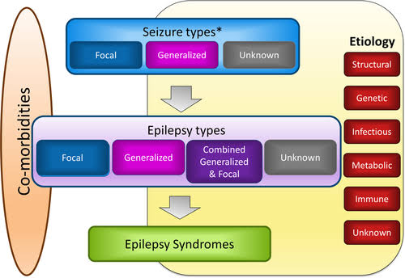
ILAE 2017

Slide 9
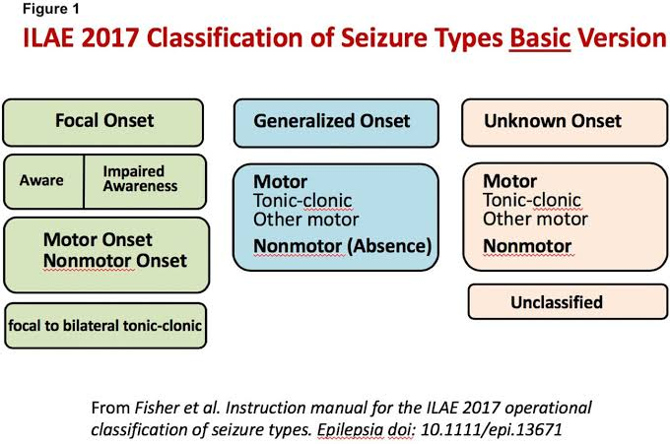
CLASSIFICATION OF SEIZURE TYPES

Slide 10
FOCAL ONSET SEIZURE
Arise from a neuronal network either discretely localized within one brain region or more broadly distributed but still within a cerebral hemisphere
Intact/Impaired awareness
Motor
Tonic / Clonic / Myoclonic
Non motor
Sensory / Autonomic / Emotional
FEATURES
Jacksonian March , Todd’s palsy , Epilepsy partialis continua , Aura

Slide 11
GENERALIZED Seizures
Arise in some point in the brain BUT immediately and rapidly engage neuronal networks in both cerebral hemispheres.

Slide 12
Typical absent seizure Vs ATYPICAL ABSENT SEIZURE
Sudden, brief lapses of consciousness without loss of postural control
Lasts for a few seconds
Rapid onset and offset / No post ictal confusion
Subtle B/L motor signs
Eyelid blinking
Chewing movements
Small amplitude , clonic movements of the hand.
Triggered by hyperventilation
EEG
Interictal : Normal background
Ictal : Generalized , Symmetric , 3Hz , spike and slow wave pattern
Longer duration of LOC
Less rapid onset and offset
More obvious motor signs
EEG
Interictal : +/- Abnormal background activity
Ictal : Generalized slow spike and slow wave pattern with a frequency of < 2.5 per second

Slide 13
GENERALIZED TONIC CLONIC SEIZURES
m/c seizure with metabolic derangement
TONIC PHASE
Tonic contraction of muscles throughout the body - Ictal cry – Cyanosis – Tongue bite
CLONIC PHASE
Superimposition of periods of muscle relaxation on the Tonic muscle contraction.
POST ICTAL PHASE
Unresposiveness , muscular flaccidity , stridorous breathing , incontinence , confusion
EEG
Tonic Phase: Generalized low voltage fast activity f/B generalized high amplitude , polyspike discharges
Clonic phase : Spike and slow wave pattern
Post ictal phase : Diffuse slowing

Slide 14
ATONIC SEIZURES
Sudden loss of postural muscle tone and LOC lasting 1-2 seconds
No post ictal confusion
Presents as
Head drops / nods
Drop attacks
Usually associated with LGS

Slide 15
MYOCLONIC SEIZURES
Sudden and brief muscle contractions that may involve one part of the body or the entire body
Causes
JME / Anoxic encephalopathy/ Metabolic encephalopathy / CJD / Hepatic encephalopathy (Negative)

Slide 16
EPILEPTIC SPASMS
Brief sustained flexion or extension of predominantly proximal muscles , including truncal muscles
Seen in Neonates : West syndrome
EEG
Hysarrhythmia , which consists of diffuse , giant slow waves
Chaotic background of irregular , multifocal spikes and sharp waves
Electrodecremental response ( corresponds with clinical spasm )
EMG : Rhomboid pattern
DOC : ACTH
Ketogenic diet
West syndrome + Tuberous sclerosis : Vigatrin

Slide 17
JUVENILE MYOCLONIC EPILEPSY
Janz epilepsy
Unknown cause : Possibly polygenic inheritance + Family history
SEIZURE TYPES
Myoclonic jerks ( early morning , provoked by sleep deprivation , alcohol )
Tonic clonic seizures
Typical absence seizure ( 1/3rd of patient )
EEG
3-6 Hz generalized Polyspike and wave discharge
Treatment : Levitiracetam / Sodium Valproate

Slide 18
LENNOX GASTAUT SYNDROME
TRIAD
Multiple seizure types ( Atypical absence / Atonic / GTCS )
EEG : slow <3Hz spike and wave discharges
Impaired cognitive functions
POOR PROGNOSIS
ETIOLOGY (Multifactorial)
De novo mutations
Developmental abnormalities
Perinatal hypoxia / ischemia , trauma , infection

Slide 19
Mesial TEMPORAL LOBE EPILEPSY
History of febrile seizure/ Family history of epilepsy/ early onset
Aura common / Complex automatism / unilateral posturing / Post ictal confusion amnesia or aphasia
U/L or B/L Anterior temporal spikes on EEG
MRI
Small hippocampus with increased signal on T2W and loss of trilaminar hippocampus internal architecture and compensatory increase in temporal horn of lateral ventricle
Small temporal lobe
Enlarged temporal horn
PATHOLOGIC FINDINGS
Highly selective loss of granule cell dispersion

Slide 20
DRUG INDUCED SEIZURES
Antimalarials
Meropenem
Fluoroquinolones
Acyclovir
Isoniazid
Tramadol
Cyclosporine ,Tacrolimus
Anti depressant : Bupropion
Anti psychotic: Clozapine
Lithium
Alcohol
Baclofen
Barbiturates/ Benzodiazepines
FLUMAZENIL

Slide 21
Investigations
RFT
ELECTROLYTES
LFT
TOXIN SCREENING
AUTOIMMUNE ANTIBODY SCREEING ( IF INDICATED )
CSF ANALYSIS ( INFECTIVE ETIOLOGY )
EEG ( CAE / JME / FOCAL EPILEPSY / LGS / WEST SYNDROME )
VIDEO EEG ( PRESURGICAL PLANNING / PNES )
MRI BRAIN ( MTLS / FOCAL CORTICAL DYSPLASIA / STRUCTURAL LESIONS – Tumors/AVN/ Cavernoma )
PET CT / SPECT
GENETIC TESTING

Slide 22
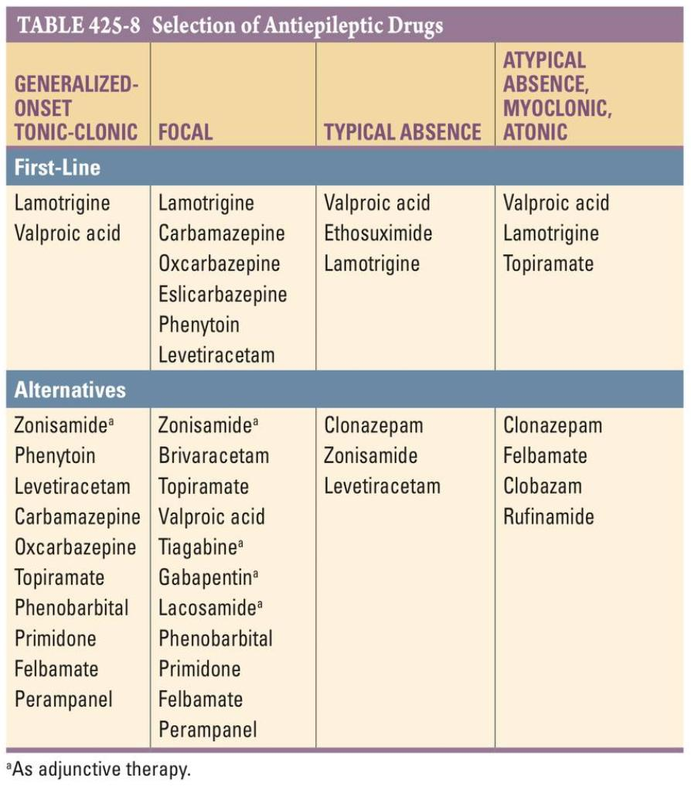
ANTI SEIZURE MEDICATION

Slide 23
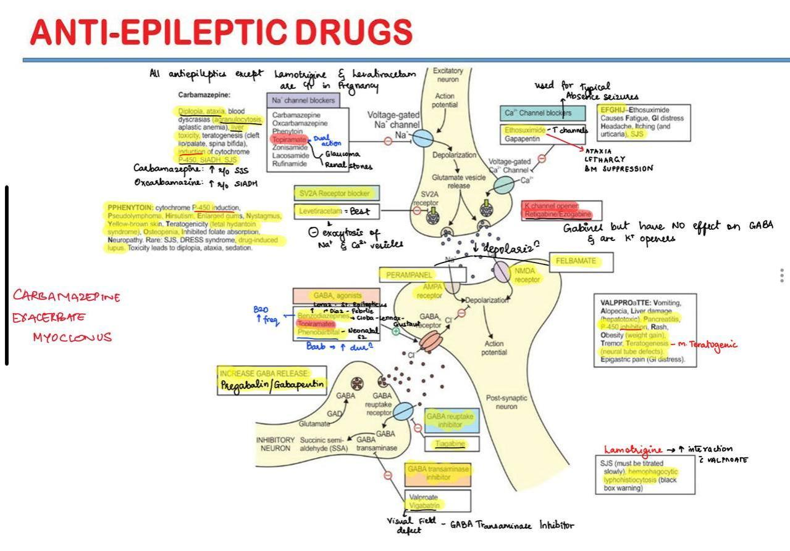

Slide 24
Drug resistant epilepsy
Failure of adequate trials of two tolerated and appropriately chosen and used ASD schedule ( whether as monotherapies or in combination ) to achieve sustained seizure freedom

Slide 25
EPILEPSY SURGICAL MANAGEMENT
Mesial temporal lobe epilepsy
Anterior temporal lobectomy with amygdalohippocampectomy
Extratemporal lobe epilepsy
Lesionectomy
Hemispherectomy
Rasmussen encephalitis
Hemimegalencephaly
Corpus callosotomy ( Tonic / atonic seizure/ Cognitively Impaired / LGS patients )
Vagas Nerve stimulation ( DRE / Cognitively normal patients )
Thalamic deep brain stimulation (DBS) – Anterior thalamic nuclei

Slide 26
References
Fischer RS , Cross JH , French JA et AL.
Operational classification of seizure types by the ILAE 2017 Epilepsia.
Harrison principles of Internal Medicine 21st edition.

Slide 27
THANKYOU

