Slide 1
SYMPOSIUM- Fifth Medical unit
MULTITASKERS OF MEDICINE
CHIEF - PROF DR. SYED BAHAVUDEEN HUSSAINI MD
ASST PROFESSORS :
DR.R.VINOTH KANNAN MD.
DR.V.P.PRIYA MD.
PRESENTOR : DR. S. PRADEEP SHANKAR
SECOND YEAR POST GRADUATE

Slide 2
1.METFORMIN
Mechanism of Action
Stimulates AMPK
Decreased gluconeogenesis
Decreased Lactic acid metabolism
Increased lipid oxidation – reduces LDL
Delays Gastric emptying
Modest weight loss
Decreased microvascular > Macrovascular complications

Slide 3
Pharmacokinetics
No Metabolism
Excreted unchanged by kidney
No plasma protein binding
USES
Drug of choice – Treatment and prophylaxis of Type 2 DM
PCOS
Metabolic syndrome
NAFLD
Antipsychotic induced weight gain.

Slide 4
SIDE EFFECTS | CONTRAINDICATIONS
Most common –GIT upset , Nausea , Vomiting , Diarrhoea , Anorexia. Lactic Acidosis Vitamin B12 Deficiency | Any condition that increase the risk of lactic acidosis Renal failure [ Creatinine > 1.5 mg/ dL ] Severe Lung disease Severe liver disease Congestive Heart failure Chronic alcoholic Elderly

Slide 5
2.OCTREOTIDE
Mechanism of Action
Stimulates SST-2 / 5 [Gi] receptors that decreases GH/TSH secretion
Decreased insulin and glucagon secretion.
Decreased gastrin and secretin secretion.

Slide 6
Commonly used as Drug of choice in
Acromegaly
Gigantism
Acute variceal bleeding
Decreased bleeding in pancreatic surgery
Secretory diarrhoea
Glucagonoma
VIPoma
Somatostatinoma
GRFoma

Slide 7
Other uses
Insulinoma
Thyrotrope adenoma
Carcinoid tumor
Radiolabelled octreotide is used for diagnosis of Carcinoid tumor and Pituitary Adenoma

Slide 8
Side effects
GIT upset most common
Gallstones
Hypothyroidism
CVS- Bradycardia , QT prolongation.
Dysglycemia.

Slide 9
3.ASPIRIN
MOA – Irreversible inhibitor of COX.
Effect
Analgesic and Antipyretic | 325 to 1000 mg every 4 – 6 hours
Anti inflammatory | High dose of 3 to 4 gram per day.
Anti aggregant | Low dose 75 mg to 325 mg per day

Slide 10
Uses
Antipyretic and analgesic
Limited use as anti inflammatory drug – Rheumatic and Rheumatoid arthritis.
Antiaggregant – Secondary prophylaxis of MI and stroke
Niacin induced flushing
Kawasaki disease

Slide 11
Side effects
Gastric ulcer.
Nephrotoxicity.
Bleeding.
Bronchoconstriction.
Reye syndrome in children.

Slide 12
Toxicity of Aspirin seen at doses > 10 gms
Respiratory alkalosis
Hyperthermia
Tinnitus
Seizure
Hyperglycemia
Pulmonary edema
Treatment – Urine alkalinisation and dialysis.

Slide 13
4.METHOTREXATE
Mechanism of Action
Mechanism of Resistance
Inhibits DHFR Thymidylate synthase Purine synthesis | Anticancer effect and immunosuppressive effect
Increases Adenosine | Anti inflammatory effect
Acute Resistance | DHFR enzyme Induction
Chronic Resistance | DHFR gene amplification and mutation

Slide 14
uses
NEOPLASTIC | NON-NEOPLASTIC
DOC – Choriocarcinoma Osteosarcoma – High doses Non Hodgkins Lymphoma Acute Lymphoblastic Leukemia | Rheumatoid arthritis- Anchor drug Psoriatic Arthritis – DOC Graft versus Host Disease Ectopic Pregnancy

Slide 15
Side effects
Bone marrow suppression – Leucovorin
Mucositis
Hepatotoxicity- Cirrhosis
Nephrotoxicity- Crystalluria
Glucarpidase can be used with methotrexate.

Slide 16
5.CYCLOSPORINE
Mechanism of Action
Cyclosporine binds to Cyclophilin blocks calcineurin and decreases Transcription of IL-2
Tacrolimus binds to FKBP.
Route – Oral preffered and if not possible Intravenous.
Tacrolimus >>>>>> Cyclosporine

Slide 17
Uses
GVHD – Cyclosporine used first , if no response then Tacrolimus is used.
SYSTEMIC USES | Steroid Resistant Nephrotic Syndrome Ulcerative colitis Rheumatoid arthritis Myasthenia gravis Bechets syndrome
TOPICAL USES | Atopic dermatitis Alopecia areta Lichen planus Psoriasis Pyoderma gangrenosum

Slide 18
Side effects
COMMON SIDE EFFECTS | CYCLOSPORINE
Nephrotoxicity Hepatotoxicity Neurotoxicity Hyperkalemia Hyperglycemia Hypertension Neoplasia – Kaposi sarcoma , Melanoma | Hirsutism Hyperplasia of gums Hyperlipidemia Hyperuricemia

Slide 19
6.GLUCOCORTICOIDS
Hydrocortisone | Least potent Shortest acting Both glucocorticoid and mineralocorticoid effect seen
Prednisone Prednisolone Methyl prednisolone | 4 – 5 times more potent that hydrocortisone. Both glucocorticoid and mineralocorticoid effect seen
Dexamethasone Betamethasone | 30 times more potent than Hydrocortisone. Longest acting. Only Glucocorticoid effect present.

Slide 20
Uses
Replacement in Adrenal insufficiency | Hydrocortisone preffered
Anti inflammatory | R.A , IBD , Asthma
Immunosuppresants | GVHD , Multiple sclerosis
Neoplasm | Leukemia , Lymphoma
Infections | Hemophilus influenza meningitis Bell’s palsy TB meningitis
Pregnancy | Fetal lung maturity

Slide 21
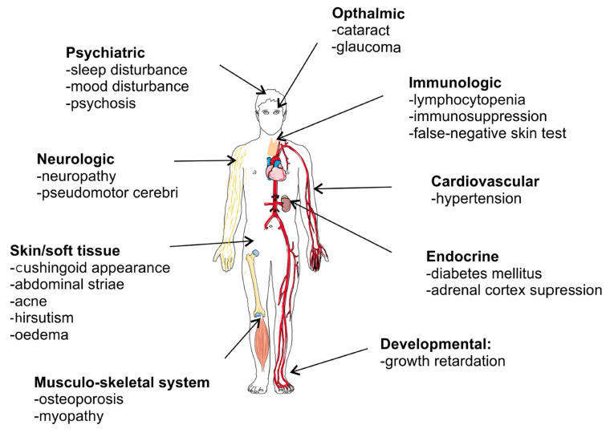
Side effects

Slide 22
7.Goserelin – GnRH Agonist
Mechanism of Action
It can be used in both intermittent and continuous dosing.
Intermittent Dosing | Continuous Dosing
Increased LH/FSH Increases Testosterone / Estrogen / Progesterone Increases Ovulation Increases Spermatogenesis | Transient increase followed by fall in LH/FSH Decreases Testosterone /estrogen/Progesterone. Decreases Ovulation Decreases spermatogensis

Slide 23
Intermittent dosing - USES | Continuous dosing - USES
Anovulation Oligospermia Delayed puberty Sexual infantilism | Endometriosis Uterine fibroids E.R . Positive breast cancer Prostate cancer Precocious puberty Acute intermittent porphyria Priapism
Intermittent dosing – Side effects | Continuous dosing – Side effects
Multiple Gestation Ovarian Hyperstimulation syndrome Gynaecomastia | Osteoporosis Impotence in males Hot flushes Vaginal atrophy

Slide 24
8.BISPHOSPHONATES
Mechanism of action
Blocks ruffled border formation in osteoclasts.
Induces the apotosis of Osteoclasts by
First generation – Abnormal ATP synthesis
Second and Third generation – Inhibiting Farnesyl pyrophosphate synthase.

Slide 25
GENERATION | DRUGS | POTENCY
First Generation | Etidronate Clodronate | Less potent
Second Generation | Alendronate Pamidronate | Moderate potent
Third Generation | Zolendronate Risendronate | Most potent

Slide 26
USES
Drug of choice in Osteoporosis – Alendronate , Risendronate , Zolendronate.
Paget’s Disease – Zolendronate.
Hypercalcemia of malignancy - Zolendronate

Slide 27
Side effects
Esophagitis – empty stomach with full glass of water and don’t lie down for 30 mins.
Osteonecrosis of Jaw – Mandible > Maxilla , Zolendronate
Bone fracture – Femoral chalk stick fracture , Alendronate.
Hypocalcemia / Seizures - Zolendronate.

Slide 28
9.HEPARIN
FUNCTIONS | UFH | LMWH | FONDAPARINUX
BREAK FACTOR | Xa = IIa | Xa> IIa | Only Xa
Subcutaneous availability | Low | High | High
Route | S/C –Prophylaxis I/V – Treatment. | S/C –Prophylaxis and treatment. | S/C – Prophylaxis and treatment.
Metabolism | Reticuloendothelial system. | Kidney | Kidney
Renal failure | Safe | Contraindicated | Contraindicated
Activity of Protamine Sulphate | Maximum | Moderate | Not active
HIT risk | Maximum | Moderate | Not active
aPTT | Required | Not required | Not required

Slide 29
USES | SIDE EFFECTS
For anticoagulation in all cases like MI / Stroke. LMWH / Fondaparinux is preferred. | Hyperkalemia , Hairloss Osteoporosis Thrombocytopenia

Slide 30
10.WARFARIN
Mechanism of Action
Inhibits VKOR – Decreases Activation of Vitamin K
Decreases coagulation factors 2, 7 ,9, 10.
Decreases anticoagulation Protein C and S.
VII > Protein C > II

Slide 31
USES
Prophylaxis of DVT and Pulmonary embolism.
For Acute management LMWH / Fondaparinaux started for 5 days and then warfarin is continued.
Prophylaxis of Thrombosis in Atrial fibrillation, Mechanical valves , Ventricular assist devices.
Prophylaxis in APLA

Slide 32
SIDE EFFECTS
Bleeding – most common
Skin necrosis – Due to rapid decline in Protein C and S – Most common site Breast in females.
Blue disclouration of feet.
Alopecia
Worsening of HIT.
Teratogenic – Nasal Hypoplasia , Stippled epiphyseal calcification.

Slide 33
Contraindications – Pregnancy , HIT
Monitoring – PT / INR – Target 2 to 3
Toxicity – INR < 10 – Asymptomatic – Stop and start once INR is normal.
INR > 10 - Asymptomatic – Vitamin K
Symptomatic – Bleeding – FFP and Vitamin K.
Drug interactions – Enzyme inducers and inhibitors can affect.
Antibiotics decreases Vitamin K and increase effect.

Slide 34
REFERENCES:
1.Goodman and Gilman’s the pharmacological basis of therapeutics, 13 th edition.
2.Essentials of Medical Pharmacology , K. D . Tripathi 9 th edition.

Slide 35
THANK YOU

