Slide 1
CASE SERIES ON EXTRACRANIAL INTERNAL CAROTID ARTERIOPATHY IN YOUNG ADULTS
CHIEF PROF: Dr.DAVID PRADEEP KUMAR M.D,MRCP
ASST PROF: Dr.RAGHAVAN M.D
ASST PROF: Dr.RAM KUMAR M.D
ASST PROF: Dr.NASEEMA BANU M.D
ASST PROF: Dr.NABIL FAYAZ M.D
PRESENTOR: Dr.HAMITH MUJAMMIL KHAN PG

Slide 2
CHIEF COMPLAINTS
A 33 years old male bought to our triage on 30/11/23, with
Right sided weakness and
altered sensorium
for 1 day

Slide 3
HISTORY OF PRESENTING ILLNESS:
Normal before one day, he developed
Difficulty in using right upper limb 18hrs before admission
H/O Weakness of right upper and lower limbs
-gradually progressed and finally patient became bedridden
H/O altered sensorium
incontinence of urine

Slide 4
HISTORY OF PRESENTING ILLNESS
H/O Fever one day before admission
high grade , continuous, no chills and rigor, relieved by antipyretics
No vomiting / headache/ seizure
No other relevant positive history

Slide 5
PAST HISTORY
Not a Systemic Hypertension, Diabetes mellitus, Coronary artery disease, Chronic kidney disease, Asthma, TB, Epilepsy
No Covid vaccination

Slide 6
PERSONAL HISTORY
Mixed diet
Normal bowel and bladder habits prior to illness
Not a Known alcoholic or smoker

Slide 7
GENERAL EXAMINATION
Moderately built and nourished
No pallor, icterus, cyanosis, clubbing
No pedal edema
No generalized lymphadenopathy
JVP not elevated

Slide 8
VITALS
BP- 130/ 80 mmHg
PR- 90/min, regular rhythm, normal volume, no delays
SpO2- 98% in room air
RR- 16/min
CBG- 99 mg/dl

Slide 9
CNS EXAMINATION
HIGHER MENTAL FUNCTIONS:
Drowsy
Orientation, Memory, Speech & language – could not be assessed
SENSORY AND CRANIAL NERVES
– could not be tested

Slide 10
Motor examination:
 |  | RIGHT | LEFT
BULK |  | Normal | Normal
TONE | UL | Hypertonia | Normal
 | LL | Hypertonia | Normal
POWER | UL | 2/5 | 5/5
 | LL | 2/5 | 5/5
DTR | UL | ++ | +
 | LL | ++ | +
PLANTAR |  | Extensor | Flexor
PUPIL |  | 3.5mm RTL | 3.5mm RTL

Slide 11
CEREBELLUM – no nystagmus
Gait – could not be assessed
EXTRAPYRAMIDAL- no involuntary movements
MENINGEAL SIGNS-
No neck stiffness
Kernig’s sign - Negative
Brudzinski’s sign - Negative

Slide 12
OTHER SYSTEM EXAMINATION
CVS- S1, S2 Heard
No murmur
RS- Bilateral Air entry
No added sounds
Abdomen- Soft, BS normal
No organomegaly

Slide 13
INVESTIGATIONS
 | 30/11 | 03/12 | 06/12
TC | 11600 | 17200 | 11800
Hb | 9.9 | 9.8 | 10.4
PCV | 34.7 | 34.3 | 35.5
PLT | 4,39,000 | 3,18,000 | 3,09,000
UREA | 19 | 27 | 14
CREATININE | 0.7 | 1.0 | 0.6
Na+ | 131 | 132 | 126
K+ | 3.5 | 4.2 | 5.1
Ca2+ |  | 10.8
ESR | 8 mm/hr | 22 mm/hr
CRP |  | Negative
ANA |  | Negative
APLA | Report awaited

Slide 14
TOT. BILIRUBIN | 0.5 | 0.6
DIR. BILIRUBIN | 0.2 | 0.3
IND. BILIRUBIN | 0.3 | 0.3
SGOT | 21 | 32
SGPT | 15 | 17
ALP | 62 | 96
PT | 15.5 | 14.6
INR | 1.3 | 1.05
APTT | 28.9 | 27.9
FBS | 107
RBS | 116
TOT. CHOLESTEROL | 139
TGL | 55
HDL | 40

Slide 15
HBsAg | NEGATIVE
HCV | NEGATIVE
HIV | NON REACTIVE
TPHA & RPR | NON REACTIVE
TSH | 1.2 IU/ml
Sr.Homocysteine | 15 umol/L (5.4 to 16.2)

Slide 16
CT BRAIN

Slide 18
MRI BRAIN

Slide 20
NEUROPHYSICIAN OPINION

Slide 21
CARDIOLOGY OPINION
OPHTHAL OPINION
NO RWMA
NORMAL BIVENTRICULAR FUNCTION
LVEF- 66%
NO MR/TR, All valves are normal
Normal fundus
USG ABDOMEN AND PELVIS-
Nil significant abnormality

Slide 22
CV DOPPLER

Slide 23
CT ANGIO REPORT

Slide 24
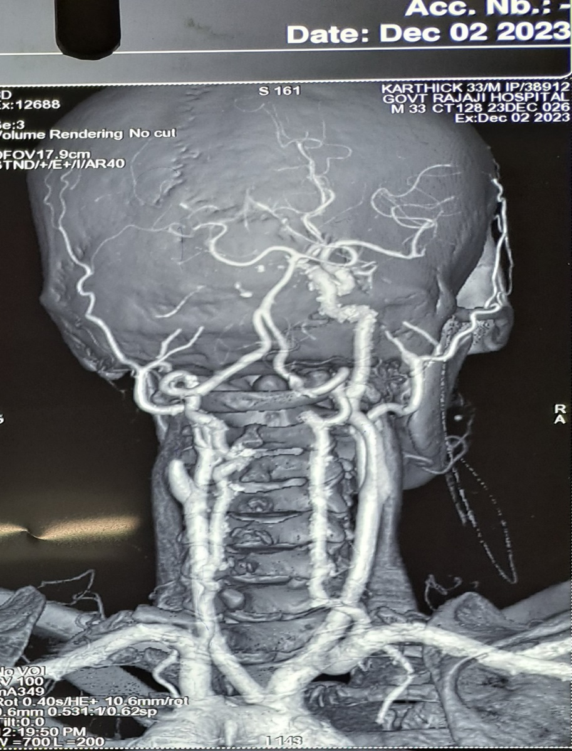
CT ANGIOGRAM

Slide 26
VASCULAR SURGEON OPINION

Slide 27
RHEUMATOLOGIST OPINION

Slide 28
NEUROPHYSICIAN REVIEW

Slide 29
TREATMENT GIVEN
INJ. MANNITOL 100ml TDS for 3 days
INJ. CEFTRIAXONE 1G iv bd for 3 days
INJ.RANITIDINE 50mg iv bd
T. ASPIRIN 150mg 0- 1/2- 0
T. CLOPIDOGREL 75mg 0-1-0
T.ATORVOSTATIN 10mg 0-0-4
PHYSIOTHERAPY

Slide 30
CASE 2:
A 45 year old male bought to our triage on 30/11/23, with chief complaints of involuntary movements involving both upper limb and lower limb
- a/w uprolling of eyeballs, tongue biting, frothing
- lasted for 1 day (controlled by continInj Midazolam infusion)
No H/O fever
No H/O vomiting/ headache
No H/O head injury
No other relevant positive history
No comorbidities present
Chronic Alcoholic and Smoker for past 20 yrs

Slide 31
GENERAL EXAMINATION
drowsy
Responding to painful stimuli
No pallor / icterus/ cyanosis
No pedal edema
No generalized lymphadenopathy
VITALS:
BP-120/80 mmHg
PR- 86/min
SpO2- 98% in ra
CBG- 120 mg/dl

Slide 32
CNS EXAMINATION
HIGHER MENTAL FUNCTIONS:
Drowsy
Responds only to painful stimuli
(sensorium gradually improved - Pt Aphasic)
Orientation, Memory – could not be assessed

Slide 33
MOTOR EXAMINATION:
 |  | RIGHT | LEFT
BULK |  | Normal | Normal
TONE | UL | Hypertonia | Normal
 | LL | Hypertonia | Normal
POWER |  | Couldnt be assesed | Couldnt be assesed
DTR | UL | ++ | +
 | LL | ++ | +
PLANTAR |  | Extensor | Flexor
PUPIL |  | 3.5mm RTL | 3.5mm RTL

Slide 34
SENSORY AND CRANIAL NERVES – could not be tested
CEREBELLUM – no nystagmus
Gait – could not be assessed
MENINGEAL SIGNS-
No neck stiffness
Kernig’s sign - Negative
Brudzinski’s sign - Negative

Slide 35
INVESTIGATIONS
TOT.BILIRUBIN | 0.8
DIR.BILIRUBIN | 0.4
IND.BILIRUBIN | 0.4
SGOT | 33
SGPT | 12
ALP | 86
FBS | 76
PPBS | 101
CHOLESTROL | 106
TGL | 186
HDL | 17
LDL | 54
PERIPHERAL SMEAR TC- 12400 DC-N 77/ L21/ E-/ M-2 HB- 17.3 HCT- 47.9 PLT- 2.57 | RBCs- Normochromic normocytic WBCs- count increased, no atypical cells Plt- normal IMP: LEUCOCYTOSIS
 | 30/11
TC | 11500
Hb | 17
PCV | 50
PLT | 2,94,000
UREA | 11
CREATININE | 0.6
Na+ | 131
K+ | 3.5
RBS | 71
ESR | 2 mm/hr
CRP | Positive
Viral markers | Negative
HIV | Non reactive

Slide 36
CT BRAIN

Slide 38
MRI BRAIN

Slide 40
CV DOPPLER

Slide 42
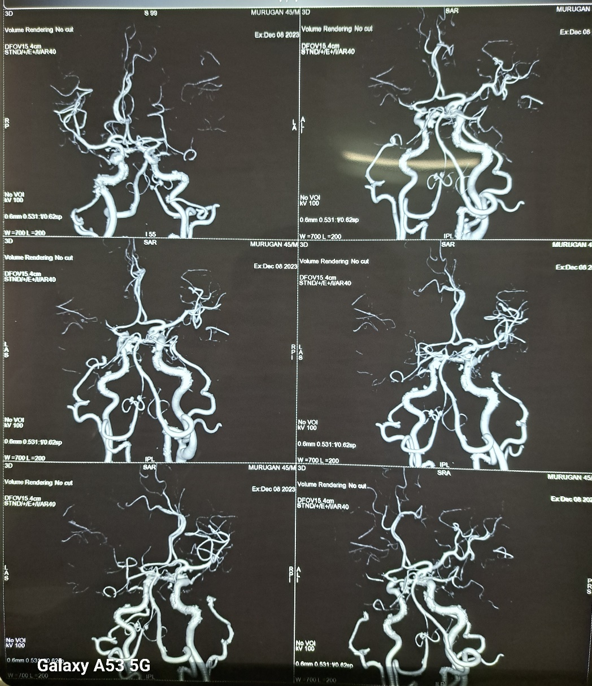
CT ANGIOGRAM

Slide 43
TREATMENT GIVEN
INJ. MANNITOL 100ml iv TDS for 5 days
INJ. CEFTRIAXONE 1G iv BD for 5 days
INJ.THIAMINE 300mg in 100ml iv OD
INJ.LEVETRIACETAM 500mg iv BD
f/b
T.LEVETRIACETAM 500mg 1 - 0 -1
T. ASPIRIN 150mg 0 - ½ - 0
T. ATORVOSTATIN 10mg 0 - 0 - 2

Slide 44
Diagnosis
Case 1
Case 2
33 Y M - A case of Acute ischemic stroke in the young – Right Hemiparesis – left Extra cranial ICA Thrombus (Total occlusion)
Possible etiologies..?
45 y M – A case of Acute ischemic stroke – Right Hemiparesis – Left extracranial ICA Thrombus (Near total occlusion) – New onset Seizure
Possible etiologies..?

Slide 45
Thank you

Slide 47
Discussion - ICA occlusion
Bouthillier classification (Radiological)
Cervical segment
Petrous segment
Lacerum segment
Cavernous segment
Choroid segment
Ophthalmic segment
Communicating (terminal) segment
ICA Anatomy
Cervical segment
Petrous segment
Cavernous segment
Cerebral segment

Slide 48
Prevalence
ICA occlusion – independent predictor of neurological worsening in stroke
Difficult to ascertain ( as most as asymptomatic)
TIA – sometimes will not seek medical attention
STROKE – routinely not undergo CV doppler study
Incidence of symp CAD – 6 / 1,00,000 (majority- U/L – 99 %)
Precipitating factors of ischemic symptoms in ICA occlusion
Orthostatic Hypotension, postprandial hypotension, exercise (cerebral claudication), cardiac failure, Fluid / blood loss

Slide 49
Risk factors – Modifiable / Non modifiable
Modifiable RF
(Medical – hypertension, AF… Lifestyle factors – Smoking, Dietary habits, Physical inactivity)

Slide 50
Localization
Proximal MCA
Contralateral hemiplegia
Hemi anesthesia
Homonymous hemianopia
Dominant Hemi – Aphasia , Non dominant Hemi – anasognosia, Constructional Apraxia, neglect
ICA occlusion
Findings of proximal MCA + Transient Monoocular blindness (Amaurosis fugax)
CCA occlusion
Symptoms of prox MCA+ ICA + jaw claudication (d/t low flow)

Slide 51
Etiologies
Cardio embolic phenomena – ruled out (echo – N)
Large vessel vasculitis – Symptoms of headache, claudication, loss of peripheral pulses, visual disturbacnce)
Early atherosclerosis
Hypercoagulable states (Protein C, S, AT III defi, Fac v leidin)
APS (obstetric APS, Thrombotic APS, Catastrophic APS)
Moya Moya disease – congenital – presentation – adulthood – stenosis of distal ICA / vessels of circle of willis) – Puff of smoke appearance in angiography
Fibro muscular dysplasia – involvement of SMA, IMA, RA & carotid artery ( CT – string of beads appearance)

Slide 52
Ultimately, without a definitive underlying etiology, the patient was treated for atherosclerotic disease
Management
Medical management alone - Dual Antiplatelets + statin therapy
Surgical- to Establish revascularisation-
Carotid endarterectomy
Carotid artery stenting, Baloon Angioplasty
If pt presents within 6 hrs – IV tPA →if cli → Endovascular mechancal thrombectomy ( Our patient – ouside the window period)
(if the vessel is opened within 1 hr → 80% good outcome , if 6 hrs elapsed – only 1/3 rd good outcome)

