Slide 1
An interesting ecg FROM iii mu
CHIEF PROFESSOR:
Dr. B. Palani kumar M.D.,
ASSISTANT PROFESSORS:
Dr. S. Ponsenthil kumar M.D.,
Dr. M. Ilamaran M.D.,

Slide 2
Chief complaints:
26/M came to GRH
C/o inability to use right upper limb and lower limb for 10 days
c/o slurring of speech
Acute in onset, non progressive in nature.
No h/o fever
No h/o difficulty in breathing
No h/o chest pain/ palpitation/ giddiness/ sweating
No h/o reduced urine output.
Pt is a k/c/o RHD with severe MS, s/p balloon valvotomy at 2017 on irregular treatment.

Slide 3
VITALS:
BP- 100/60 mmhg
PR- 96/ min
Spo2 – 98% at room air
Temp - normal
O/E
Awake
Responds to oral commands
Not dyspneic
Not tachypneic
No pallor/icterus/ cyanosis/ clubbing/
Pedal edema

Slide 4
Systemic examination:
CVS:
Apical impulse:
at 6th intercostal space lateral to mid clavicular line
Tapping in nature
Grade 3 parasternal heave present
Palpable P2 present
Auscultation:
Mitral area:
Loud S1 present
Opening snap present
MDM murmur grade 2/4 present
Pulmonary area:
Loud P2 present

Slide 5
RS – BAE present, NVBS
PA - soft, bowel sound present
CNS- Awake, oriented
hypotonia in right upper and lower limbs.
Power 3/5 in right upper and lower limbs.
Deep tendon reflexes present.
b/l plantar withdrawl
No carotid bruit
b/l pupil 3mm rRTL

Slide 6
Investigations
CBC:
LFT:
WBC | 7.3 k
Hb | 15.2 gm/dl
Plt | 3.4 lakhs
T.BIL | 1.3mg/dl
D.BIL | 0.4mg/dl
I. BIL | 0.9 mg/dl
OT | 90 U/L
PT | 88 U/L
ALP | 53 U/L

Slide 7
RFT:
Sr.electrolytes
Coagulation profile:
RBS | 93
Urea | 39
creatinine | 0.8
PT | 21.7
INR | 1.7
APTT | 30.1
sodium | 128
potassium | 4.1

Slide 8
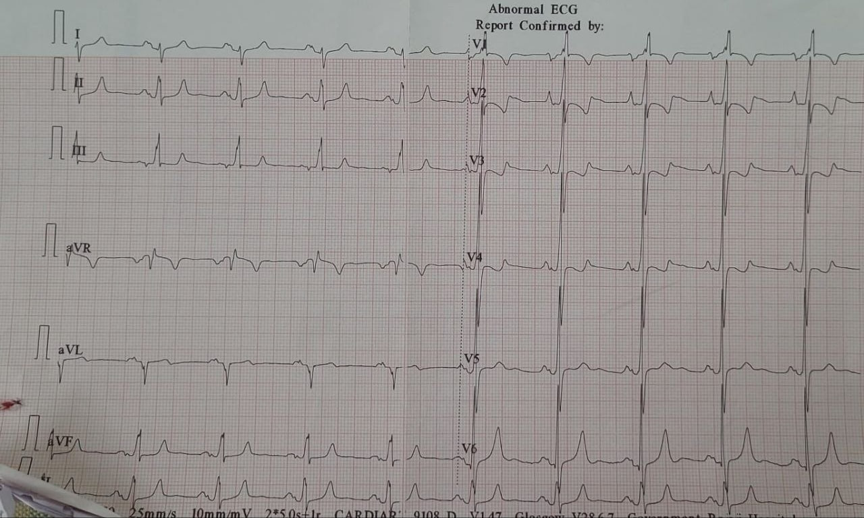

Slide 9
LET’S DISCUSS…

Slide 10
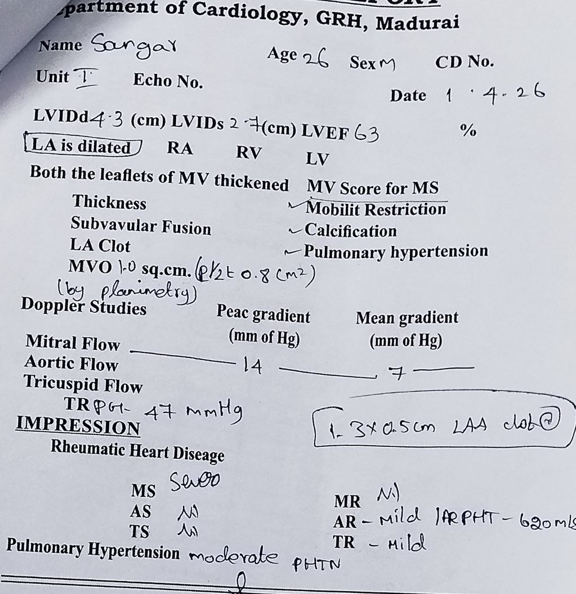
Echo:
LA is dilated
EF – 63%
1.3 * 0.5 cm LAA clot
IMPRESSION:
Sev MS
Mild TR
Mild AR
Mod PHTN

