Slide 1
THE REACH OF THE HIDDEN MONARCH
By IMCU I
CHIEF : PROF DR.P.V.BALAMURUGAN MD
ASST PROFESSOR : DR.PALANIKUMARAN M.D
PRESENTER : DR.M.KRUTHIKA

Slide 2
CHIEF COMPLAINTS
A 43 year old male patient was brought to GRH with chief complaints of FEVER for past 1 week and altered sensorium for the past 1 day.

Slide 3
HISTORY OF PRESENTING ILLNESS
THE PATIENT WAS APPARENTLY NORMAL BEFORE 1 WEEK AFTER WHICH THE PATIENT DEVELOPED
Fever - low grade, intermittent in nature, not associated with chills and rigor.
H/o Altered sensorium for past 1 day.
H/o one episode of seizure - GTCS - Involving all 4 limbs, lasting for 2 mins.
No H/O Headache
No H/O Projectile Vomiting
No H/O Deviation of angle of mouth
No H/O Difficulty in swallowing
No H/O Speech disturbances
No H/O Tremors

Slide 4
No H/O Bowel-Bladder disturbances
No H/O Sensory disturbances
No H/O Cough with expectoration
No H/O Breathlessness
No H/O Chest Pain/Palpitation
No H/O LOA/LOW
No H/O Burning micturition
No H/O Abdominal Pain
No H/O Loose Stools
No H/O Rashes over body
No H/O Ear Discharge
No H/O Trauma
No H/O recent Vaccination

Slide 5
PAST HISTORY
Recently Diagnosed T2DM on Tab.Metformin 500mg 1-0-1 for the past month.
Not a k/c/o SHTN/Tuberculosis/Bronchial Asthma/Epilepsy/CAD/Thyroid Disorder.

Slide 6
PERSONAL HISTORY
Mixed diet
Bowel and bladder habits - normal
Sleep pattern - normal
Known smoker and alcoholic for the past 15 years - last alcohol intake 1 month ago.
No H/O IV drug Abuse

Slide 7
GENERAL EXAMINATION
Pt drowsy
Partly obeys oral commands
Afebrile
Pallor +
No Clubbing
No Icterus
No cyanosis
No pedal edema
No generalized lymphadenopathy
No External markers for HIV/Tuberculosis
No External Neurocutaneous markers

Slide 8
SYSTEMIC EXAMINATION
CVS - S1 S2 +
Late systolic Murmur + over mitral area
RS - BAE +
No added sounds
P/A - soft BS+
No organomegaly

Slide 9
SYSTEMIC EXAMINATION
CNS – Drowsy
Partly obeys oral commands
Pupils 3mm equally reacting to light
MENINGEAL SIGNS
Neck stiffness present
Kernig sign negative
Brudzinski sign negative
 |  | RIGHT | LEFT
TONE | UPPER LIMB | N | N
 | LOWER LIMB | N | N
POWER | Power couldn't be elicited
DEEP TENDON REFLEX | UPPER LIMB | + | +
 | LOWER LIMB | + | +
PLANTAR |  | MUTE | MUTE

Slide 10
VITALS
BP - 120/70 mmHg
PR - 82/min
SPO2 - 99% in room air
CBG - 260 mg/dl

Slide 11
INVESTIGATIONS
Date/ Investigations | 27.07.25 | 01.08.25 | 02.08.25
Hb | 11.5 | 11.6 | 11.3
TC | 13900 | 14000 | 11700
PLT | 3.2 L | 2.5 L | 2.4 L
RBS | 285 | 202 | 156
U/Cr | 94/1.6 | 63/0.7 | 46/0.8
TB/DB/IB | 1.2/0.7/0.5 | 0.4/0.2/0.2 | 0.5/0.3/0.2
OT/PT/ALP | 21/47/116 | 27/40/113 | 35/40/126

Slide 12
INVESTIGATIONS
Date/Investigations
qCRP | 64.3
ESR | 56
Na+ | 137
K+ | 3.5
Serum procalcitonin ( 29/ 7/ 25) | 0.033

Slide 13
INVESTIGATIONS
URINE ALBUMIN - Nil
URINE SUGAR - ++
URINE DEPOSITS - 1-2 pus cells
URINE ACETONE- NEGATIVE
VCTC - NON REACTIVE
VIRAL MARKERS - NEGATIVE

Slide 14
CSF ANALYSIS
CELLS - 1-2 Lymphocytes/10 HPF
Few Scattered RBC seen.
SUGAR - 119 mg/dl
PROTEIN - 55 mg/dl
LDH - 83 U/L
CBG - 299 at the time of CSF Analysis

Slide 15
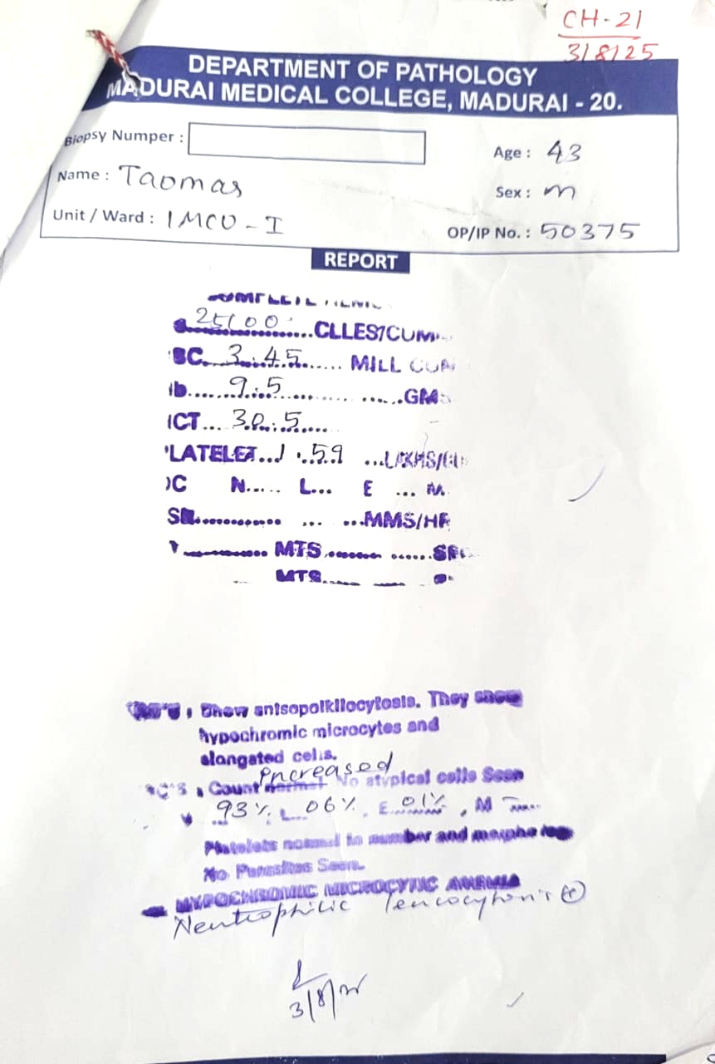
PERIPHERAL SMEAR
IMPRESSION
Neutrophilic Leukocytosis

Slide 16
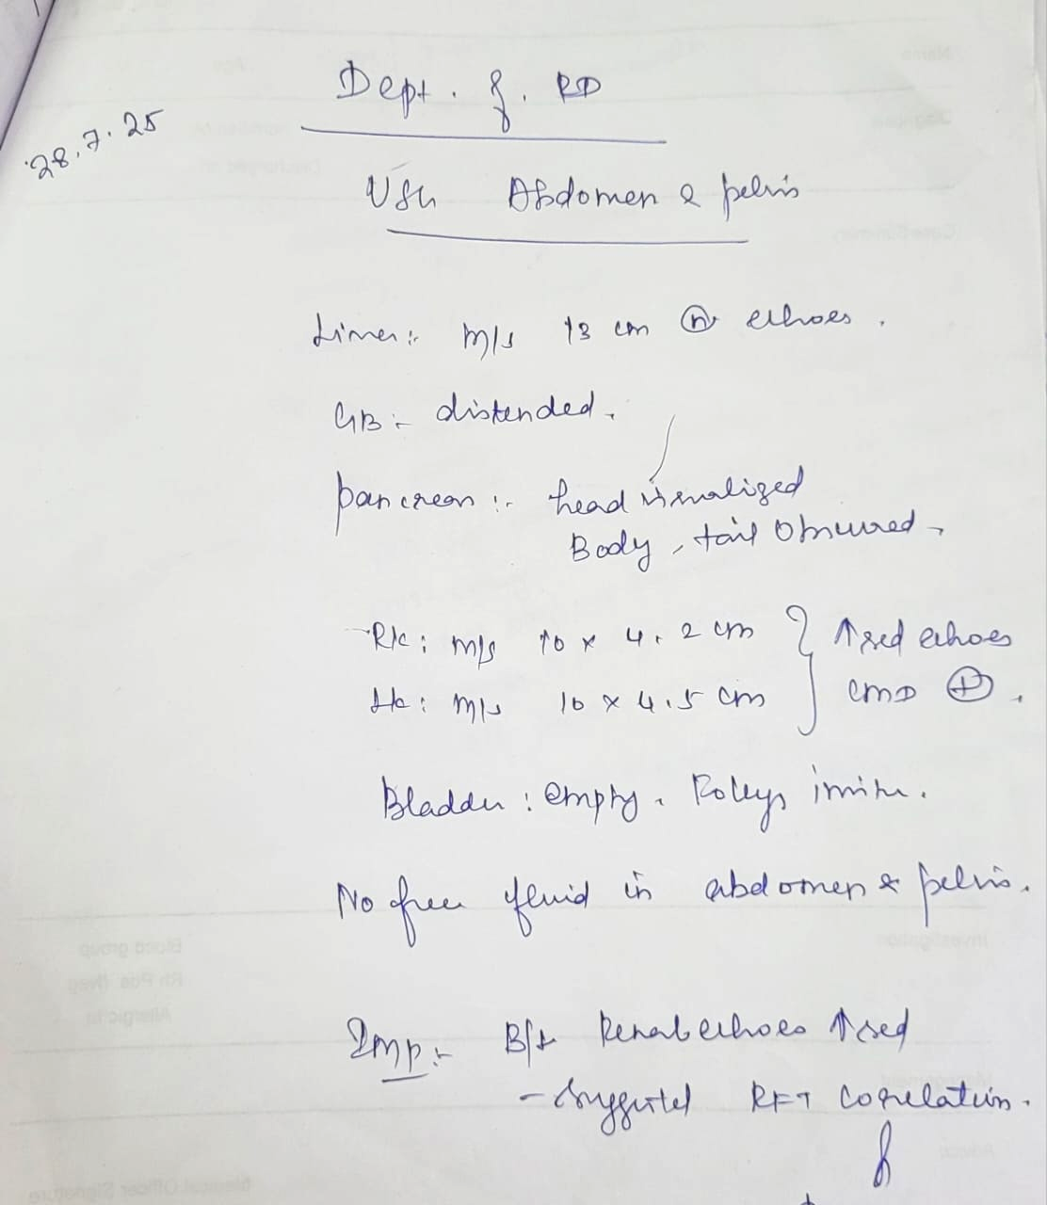
USG ABDOMEN
AND
PELVIS

Slide 17
ECHO
No RWMA
EF - 60%
MILD MR
No evidence of vegetations

Slide 18
OPHTHALMOLOGY OPINION
Right eye - No view due to mature cataract
Left eye – Macular exudates with hemorrhages seen inferior to fovea
?Retinitis/ ? Vitrtis

Slide 19
NEURO MEDICINE OPINION
IMPRESSION - Type 2 DM / Acute meningoencephalitis
CT Brain Normal
Suggested MRI Brain with MRA and MRV

Slide 20
TREATMENT GIVEN
Diabetic diet
IVF 3NS @ 75ml / hr
Inj ceftriaxone 2g iv bd
Inj Ampicillin 2g iv qid
Inj Acyclovir 500mg iv tds
Inj dexamethasone 8mg iv bd
Inj levetiracetam 500mg iv tds
T.paracetamol 500mg tds
Inj insulin according to CBG
TPR/ I/O Chart

Slide 21
On the 3rd day of admission the patient developed erythematous skin lesions over the palms and 2 days later developed nodules on the pulp of the fingers.
Also developed blackish discoloration of the fingertips.

Slide 22
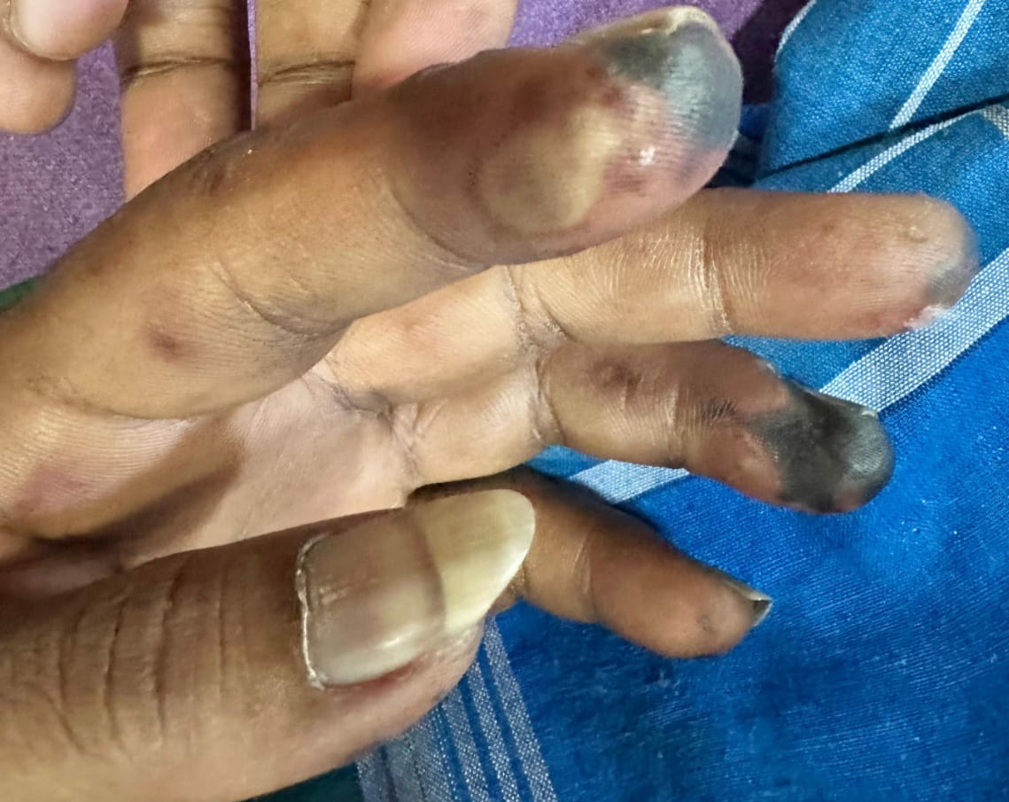

Slide 23
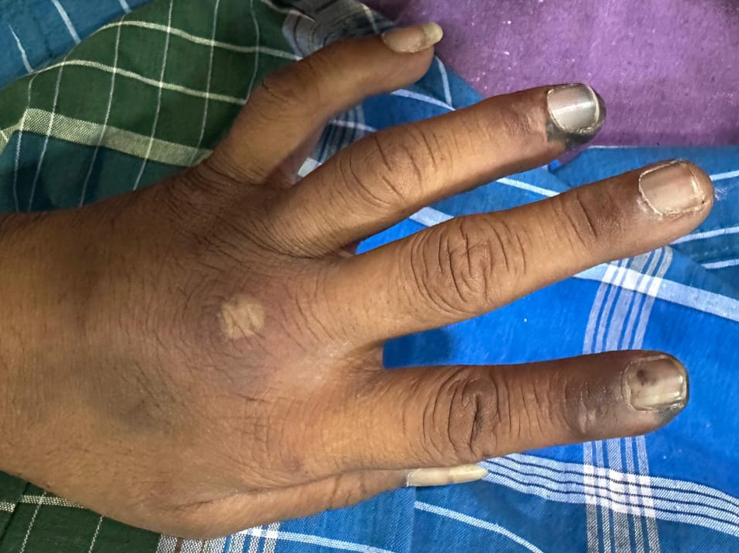

Slide 24
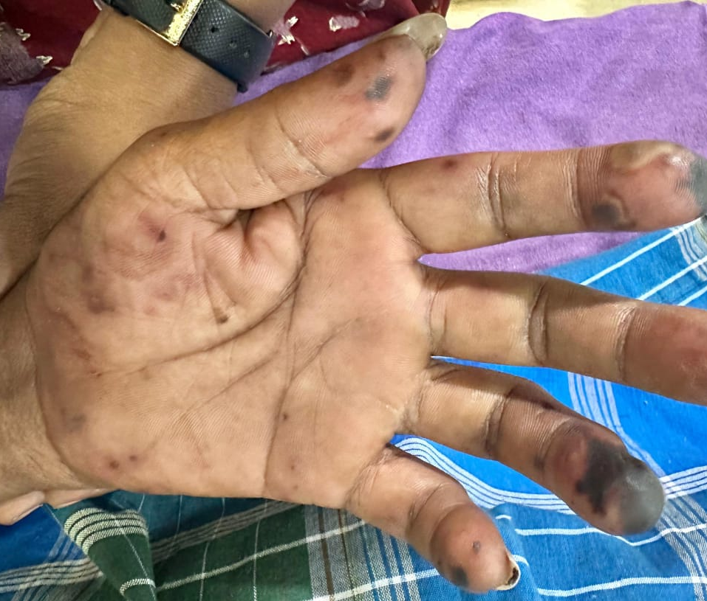

Slide 25
Rheumatology opinion obtained
Impression - ? vasculitis
Advised ANA ,anti-beta2 glycoprotein IgM, IgG
Dermatology opinion obtained
impression- sepsis induced gangrene.

Slide 26
ANA- negative
Urine culture- negative
CSF-C/S No growth
Igm scrub-negative
Igm lepto- negative

Slide 27
WHAT’s NEXT ?

