Slide 1
FAHR’S DISEASE
VI medical unit
PROF.DR.C DHARMARAJ MD.DCH
DR M RAJKUMAR MD
DR SENTHUR RAJA PANDIAN MD.DM
DR ARUN GOVIND PG

Slide 2
42 year old male patient
Presented with H/o
abnormal involuntary movements of Lt UL - 1yr
Weakness of Rt UL and LL - 5 days

Slide 3
Patient has been having abnormal movements of the Lt upper limb - 1yr
Not evaluated or treated
Slow involuntary movements limited to the distal aspect
Slowly progressive
Disappears during sleep

Slide 4
10 days ago he had H/o early morning giddiness
For which taken to a nearby hospital –treated symptomatically and recovered
5 days ago he again developed giddiness
Taken to GSVMCH
Found to have elevated blood sugar- corrected
And weakness involving Rt UL and LL
Referred to GRH for evaluation of Rt hemiparesis and involuntary movements of Lt UL

Slide 5
No H/o LOC, headache, seizures, vomiting, altered sensorium
H/o difficulty in buttoning & unbuttoning shirt
No H/o difficulty in combing hair
H/o slipping of chappels on Rt foot while walking
No H/o difficulty in rolling over in bed
No H/o spasms
h/o numbness over both hands and feet

Slide 6
Past medical history
K/c/o Type 2 DM/HT for past 7 yrs on irregular treatment
Not a K/c/o CAD, CKD, TB, Epilepsy
Not a K/c/o Parkinsonism
No H/o Psychiatric illness or cognitive defect
No H/o drug abuse/toxin exposure

Slide 7
Personal history
H/o Alcoholism for past 10 yrs
Not a smoker
Married - having 2 children
Sleep & appetite normal
Mixed diet

Slide 8
Family history
No H/o movement disorders or psychiatric illness in the family
Mother died at 36 yrs during child birth

Slide 9
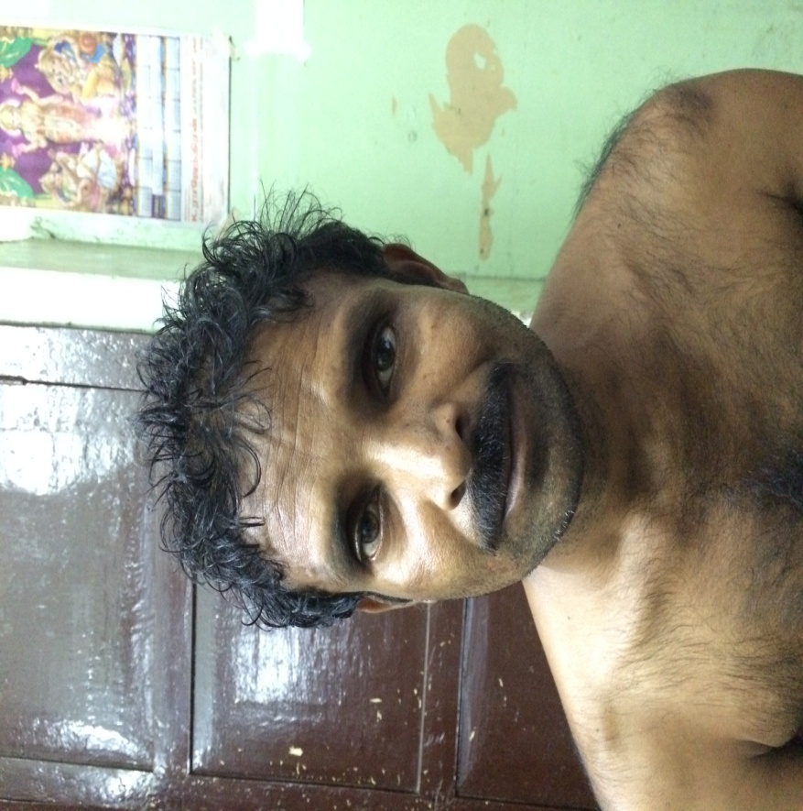
General examination
Conscious
Oriented
No pallor
No icterus
No KF ring
No cyanosis
No clubbing
No goitre
Chvostek sign - negative
Trousseau sign - negative

Slide 10
VITALS
BP : 140/100 mm Hg in Rt upper limb
PR : 84/min, regular
SpO2 : 98% in room air
Carotid pulse & all other peripheral pulses felt equally

Slide 11
HMF
Rt handed person
Conscious, oriented
Speech, memory - intact
Normal intelligence
Sleep - normal

Slide 12
CRANIAL NERVES
 | RIGHT | LEFT
OLFACTORY | N | N
OPTIC | N | N
3,4,6 | N | N
TRIGEMINAL | N | N
FACIAL | UMN facial palsy | N
VESTIBULO COCHLEAR | Mixed hearing loss | Mixed hearing loss
9,10,11,12 | N | N

Slide 13
MOTOR SYSTEM
 | RIGHT | LEFT
BULK | No obvious wasting | nil
TONE | Clasp knife spasticity on Rt UL & LL | N
POWER | 4/5 over Rt UL & LL | 5/5
SUPERFICIAL REFLEXES | RIGHT | LEFT
CORNEAL | + | +
CONJUNCTIVAL | + | +
PALATAL | + | +
PHARYNGEAL | + | +
ABDOMINAL | -- | +
CREMASTRIC | - | +
PLANTAR |  | withdrawal

Slide 14
DEEP TENDON REFLEXES | RIGHT | LEFT
BICEPS | Depressed | Depressed
SUPINATOR | Depressed | Depressed
TRICEPS | Depressed | Depressed
KNEE | Depressed | Depressed
ANKLE | absent | absent

Slide 15
EXTRAPYRAMIDAL SYSTEM
Slow writhing involuntary movements noted over distal aspect of Lt UL-athetosis
No mask like facies
Blink rate normal
No bradykinesia,
No cogwheel/leadpipe rigidity noted

Slide 17
SENSORY SYSTEM
glove & stocking type peripheral neuropathy
CEREBELLAR SYSTEM
normal
No meningeal signs
Cirumduction gait
Spine and cranium normal

Slide 18
INVESTIGATIONS
Hb : 10.5g/dl
TC : 7500
DC : P67/L32/M1
ESR : 26
Plt : 3.77 lakh
PCV : 29%

Slide 19
RBS : 230 mg/dl
Bl.Urea : 29 mg/dl
S.Cr : 1.1mg/dl
Urine : alb - nil
sug - nil
dep - 0-2 pc/hpf
Lipid Profile : N

Slide 20
S.Calcium : 9.2 mg/dl(corrected-9.84)
S.Phosphorus : 4.1 mg/dl
T Proteins : 5.5 g/dl
alb : 3.2 g/dl
glob : 2.3 g/dl
S. PTH : 27.40 pg/ml (14-72)
S.CPK : 71
Total T4 : 10.09 mcg/dl (5.2-12.7)
TSH : 2.28 HIU/ml (0.3-5.5)
S.CERULOPLASMIN:29mg/dl
S.Osmolality: 298 mosm/kg
ANA :NEGATIVE

Slide 21
ABG
ph : 7.38 (7.35-7.45)
pCO2 : 34.7 mmhg (32-48)
pO2 : 107 (92-108)
Na : 140 (135-145)
K : 4.24 (3.5-4.5)
Ca : 1.16 (1.15-1.29)
Cl : 107 (98-106)
Hb : 10g/dl
HCO3 : 18.4

Slide 22
HIV 1&2 : negative
VDRL : negative
CHG/PS : normal and no acanthocytes
CSF:
Protein : 40mg/dl
Sugar : 74mg/dl
Cells : 0-2 lymphocytes
chloride : negative
globulin : negative

Slide 23
ECG : LVH+
ECHO : Concentric LVH
Gr 1 diastolic dysfunction
LVEF - 60%
USG Abdomen: normal and no pancreatic pathology
CV Doppler : normal flow and wave pattern
NCS: axonal form of peripheral neuropathy

Slide 24
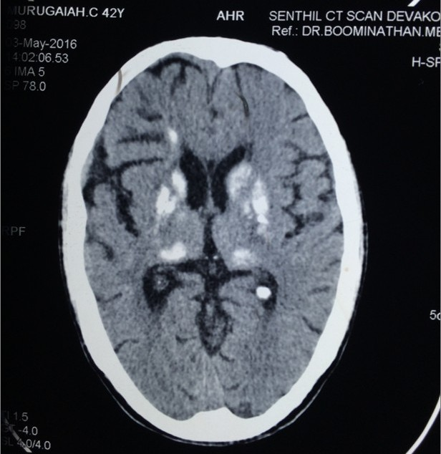
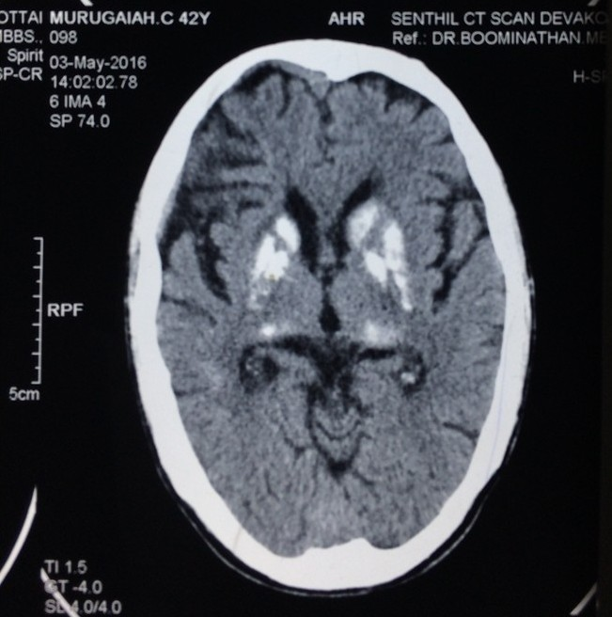
CT Brain:
Symmetric Calcification in bilateral basal ganglia, thalamus and centrum semiovale

Slide 25
MRI Brain:
1) Ischaemic infarct with haemorrhagic transformation in left corona radiata
2) Fahrs disease
To R/o Hypoparathyroidism, pseudohypoparathyroidsm

Slide 26
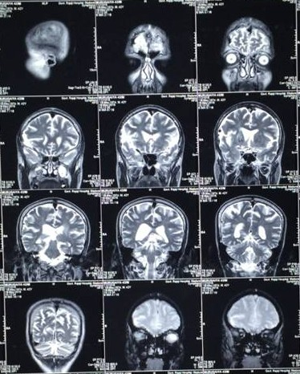
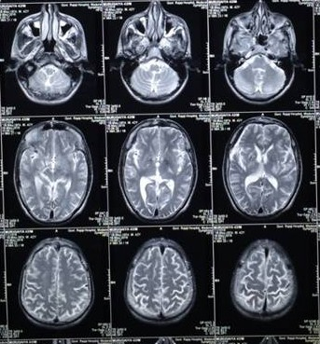

Slide 27
Treatment given
Diabetic diet
HA 10-0-5
HM 10-0-5
T Enalapril 2.5mg 1 BD
T Atorvastatin 10mg 2HS
T Haloperidol 0.5mg ½ BD
Physiotherapy

Slide 28
Neurologist opinion
Young Stroke - Rt Hemiparesis
DM
Diabetic Peripheral Neuropathy
Fahr’s disease
Adv
Carotid , Vertebral Artery Doppler - N
Nerve Conduction Study - Peripheral neuropathy
Atorvastatin
Haloperidol
Adequate control of blood sugar
Physiotherapy

Slide 29
Endocrinologist opinion
To R/o Hypoparathyroidism
Adv
S. Calcium
S. Phosphorus
PTH
Thyroid function - N
Ruled out Hypoparathyroidism

Slide 30
Ophthalmologist opinion
Lens - clear
BE - no e/o KF ring
RE - grade III hypertensive retinopathy
with macular venous occlusion - resolving
LE - grade II hypertensive retinopathy
No e/o Diabetic Retinopathy

Slide 31
ENT opinion
Audiogram-
mild,mixed hearing loss b/l
 | R | L
RINNES | + | +
WEBER
ABC | SAME AS EXAMINER | SAME

Slide 32
PSYCHIATRIST OPINION
Detailed Clinical and Psychiatric evaluation done
patient doesn’t have features of any primary Psychiatric illness at present

Slide 33
DIAGNOSIS
T2DM
Systemic HTN
Young stroke - Rt Hemiparesis
Mixed Hearing loss
Peripheral Neuropathy
FAHR’S DISEASE

Slide 34
Aim of presentation
Rarity
Discussion of Movement disorder

Slide 35
THANK YOU

