Slide 1
AN INTERESTING AUTOMATED HEMOGRAM FOR DISCUSSION
CHIEF – PROF.DR. M. NATARAJAN MD
ASST PROF – DR. P S. ARUL RAJA MURUGAN MD.,DM
DR.B.PALANIKUMAR MD
DR PREMKUMAR MD.,DM
PRESENTED BY DR. THIRUNAVUKKARASU (PG)

Slide 2
47 year old male
k/c/o type 2 diabetes mellitus on oral hypoglycemic agents for past 5 years
No significant comorbities / past history / family history
During a master health checkup found to have the following laboratory values….

Slide 3
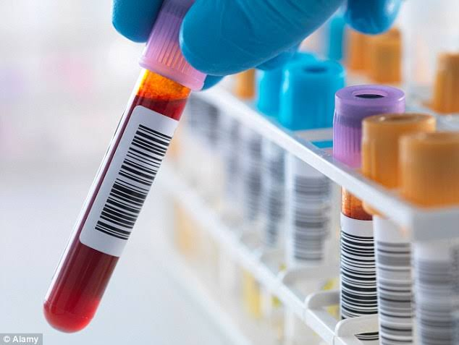
HbA1c | 8.02%
Blood Urea | 18 mg/dl
Serum Creatinine | 0.79 mg/dl
Urine Albumin | Nil
Glucose | Nil
Urine deposits | no pus cells, RBC casts and crystals

Slide 4
Fasting lipid profile | mg/dl
Total cholestrol | 144
Direct HDL | 38
DIRECT LDL | 78
VLDL | 25
TRIGLYCERIDES | 123

Slide 5
COMPLETE BLOOD COUNT
TOTAL WBC COUNT | 8,500 cells/cu.mm
DIFFERENTIAL WBC COUNT | N 58.9% L 34.7% E 2.3% M 3.6% B 0.5%
HEMOGLOBIN | 11.7 g/dl
TOTAL RBC COUNT | 5.75 million/cu.mm
PACKED CELL VOLUME | 39.4%
MCV | 68.4 fL
MCH | 20.3 pg
MCHC | 29.7%
PLATELET COUNT | 2,78,000 cells/cu.mm
RDW | 16.4%
ABSOLUTE EOSINOPHIL COUNT | 200 cells/cu.mm
RETICULOCYTE COUNT | 1.05%

Slide 6
???

Slide 7
CLASSIFICATION OF NORMOCYTIC ANEMIAS ON BASIS OF RDW
MCV normal and RDW normal (normocytic homogenous) | MCV normal and RDW high (normocytic heterogenous)
Normal Chronic liver disease Hb S and C trait Transfusion Acute bleeding Hereditary spherocytosis without spleen Chemotheerapy CLL, CML | Early iron deficiency Microangiopathic hemolytic anemia Hereditary spherocytosis with spleen Myelofibrosis Hb SS disease Hb SC disease Anemia of cancer- acute leukemia, solid tumors

Slide 8
CLASSIFICATION OF MICROCYTIC ANEMIAS ON BASIS OF RDW
MCV low and RDW normal (microcytic homogenous) | MCV low and RDW high (microcytic heterogenous)
Alpha thalassemia minor Beta thalassemia minor Hb E trait | Iron deficiency HbS – beta thalassemia Homozygous Hb E Anemia of chronic disease Severe thalassemia – HbH disease HbE / beta thalassemia, homozygous beta thalassemia Red cell fragmentation

Slide 9
CLASSIFICATION OF MACROCYTIC ANEMIAS ON BASIS OF RDW
MCV high and RDW normal (macrocytic homogenous) | MCV high and RDW high (macrocytic heterogenous)
Aplastic anemia Preleukemia | Normal newborn infants Folate deficiency Vitamin B12 deficiency Immune haemolytic anemia Hemolytic disease of newborn Aplastic anemia in remission Cold agglutinins Acute leukemia (on treatment)

Slide 10
Serum Ferritin – 6 ng/ml

Slide 11
Hemoglobin electrophoresis
Hb A0 71.8%
Hb F 0
Hb S 0
Hb A2 3.5%
Hb D 0
Hb E 24.7%
Hb H 0
Hb Q 0
P3 0
Hb Lepore 0

Slide 12
Hemoglobin Electrophoresis
Hb A - 71.8%
Hb E - 24.7%
Hb A2 - 3.5%

Slide 13
☺☺☺☺
Thank u

