Slide 1
REFRACTORY HYPERTENSION
BY FIRST MEDICAL UNIT
CHIEF:PROF. DR.M.NATARAJAN M.D.,
ASST. PROFESSORS: DR.V.PALANIKUMARAN M.D.,D.DIAB
DR. VASANTHAKALYANI M.D.,DCP
DR. SURESHKUMAR M.D.,
PRESENTOR : DR.MANOJ PRABHU

Slide 2
A 63 year old female came to grh Madurai with
-chief complaints of giddiness for 2 days
H/O vomiting of 2-3 episodes/day, non projectile, contains food particles, not blood stained
No h/o chest pain, palpitation
No h/o abdominal pain
no h/o headache
No h/o decreased urine output
no h/o facial puffiness
no h/o swelling of legs
no h/o altered sensorium
No h/o breathlessness

Slide 3
PAST HISTORY:
k/c/o t2dm/htn for 4 years and on regular treatment(on t.amlodipine 5mg 1od, t.metoprolol 25mg bd, t.metformin 500mg tds)
Not a known case of BA/TB/THYROID DISORDER/CAD/CKD
h/o recurrent similar episodes in the past and got treated
PERSONAL HISTORY:
Mixed diet
Normal bowel bladder habits
Sleep pattern normal
NO ADVERSE SOCIAL HABITS

Slide 4
MENSTRUALAL HISTORY
ATTAINED MENARCHE AT 14 YEARS
Attained menopause 18 years back
OBSTETRIC HISTORY
P2L2A1
STERILISATION NOT DONE
FAMILY HISTORY
NO SIGNIFICANT FAMILY HISTORY

Slide 5
On examination,
Pt conscious
oriented
afebrile
no pallor, cyanosis, clubbing, icterus, pedal edema
no generalized lymphadenopathy
Vitals
BP:210/100mmhg(supine)
190/100mmhg(sitting) BMI-24.7KG/m2
190/100mmhg(standing) ABPI-1.09(1.0-1.4)
r ul- 210/100mmhg PR:80/min
l ul- 210/100mmhg spo2:99%RA
r ll- 230/110mmhg cbg:319mg/dl
l ll- 230/110mmhg urine acetone- negative

Slide 6
Systemic examination
CVS :S1S2 +, no murmur
RS: BAE+, nvbs+
P/A: soft, bs+
no organomegaly
no guarding, rigidity
no scars, sinuses
no renal artery bruit
cns: conscious
oriented
moves all 4 limbs
b/l plantar flexor
ALL PERIPHERAL PULSES EQUALLY FELT

Slide 7
INVESTIGATIONS
DATE | 08/07 | 10/07 | 11/07 | 12/07 | 13/07 | 15/07
WBC | 18600 |  |  |  | 10600
HB | 15.8 |  |  |  | 15.1
RBC | 6.17mil |  |  |  | 6.01mil
HCT | 48.5 |  |  |  | 47.5
PLT | 344000 |  |  |  | 298000
RBS | 227
UREA | 30 |  |  | 33 | 34 | 32
CREATININE | 1.2 |  |  | 1.4 | 1.1 | 1.1
Sr.Na+ | <120 | 111 | 114 | 122 | 126 | 132
Sr.K+ | LOW | 2.4 | 3.5 | 3.7 | 3.3 | 4.0

Slide 8
Sr.MAGNESIUM- 1.94MG/dL(1.7-2.2MG/dL)
Sr.CK - 706 U/L(30-135U/L)
HBA1C - 8.1(4-5.6)
TSH - 2.25(0.5-5 mIU/L)
Sr.URIC ACID - 6.1MG/Dl(2.7-7.3MG/dl)
T.PROTEIN - 4.6GM/dL(6-8GMG/dL)
ALBUMIN - 2.9GM/dL(3.5-5GM/dL)
GLOBULIN - 1.7GM/dL(2-3.5gm/dL)
ESR - 56mm/hr
CRP - NEGATIVE
VCTC - NR
VIRAL MARKERS- NEGATIVE

Slide 9
URINE ROUTINE
ALBUMIN- LOADED
SUGAR - ++
DEPOSITS- 8-10 PUS CELLS
URINE ELECTROLYTES
Na+- 100Meq/L
K+ - 84.5Meq/L
URINE SPOT PCR- 51.8
24 HOUR URINARY
PROTEIN- 11.84GM/DAY(< 150 MG/DAY)
K+ - 40.4mmol/L(30-99mmol/L)

Slide 10
LIPID PROFILE
DATE | 09/07 | 12/07 | 13/07 (OUTSIDE)
S. CHOLESTEROL | 833 | 686 | 566
S. TGL | 313 | 317 | 286
S. HDL | 61 | 54 | 83
S. LDL |  |  | 366
S. VLDL |  |  | 53

Slide 11
ECG

Slide 12
ECHO

Slide 13
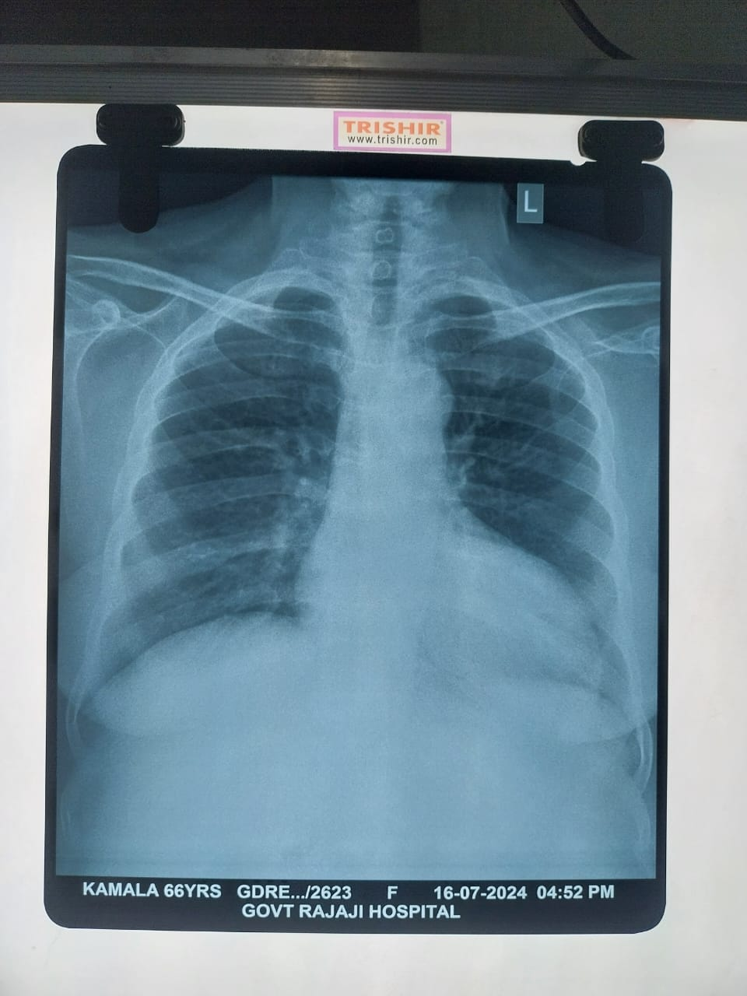
CHEST XRAY- PA VIEW

Slide 14
FUNDUS EXAMINATION
(BE) GRADE 1 HTR AT PRESENT
(BE) MODERATE NPDR AT PRESENT

Slide 15
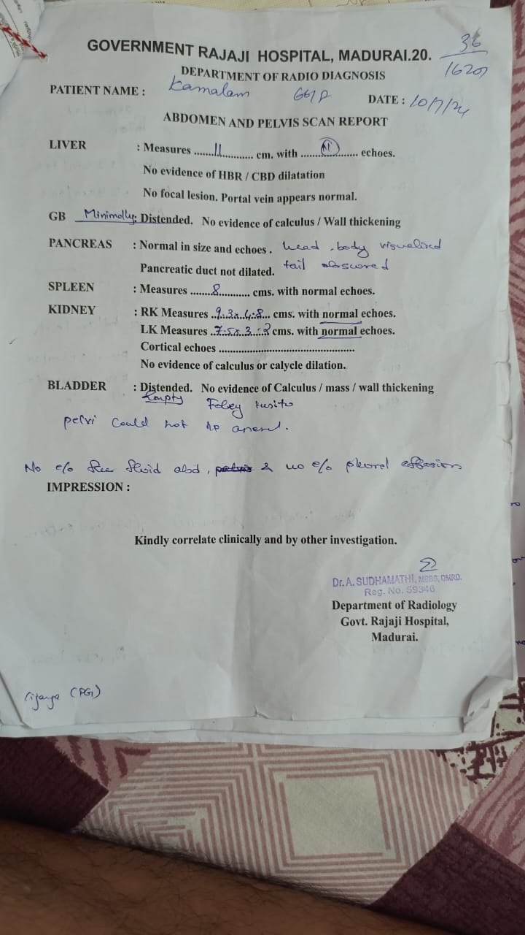

Slide 16
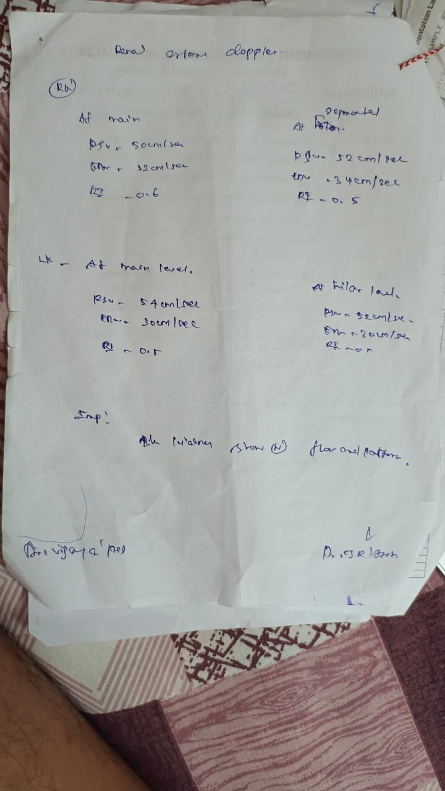

Slide 17
BP CHART
DAY | DAY 1 | DAY 2 | DAY 4 | DAY 6 | DAY 7 | DAY 8
BP | 230/100mm/hg | 220/110mm/hg | 220/110mm/hg | 210/110mm/hg | 200/100mm/hg | 190/100mm/hg
DRUGS | T.AMLODIPINE 5MG 1OD T.METOPROLOL 50 MG 1BD | T.NIFEDIPINE 10MG 2 QID T.METOPROLOL 50 MG 1BD T.ENALAPRIL 2.5MG 4 BD | T.NIFEDIPINE 10MG 2 QID T.METOPROLOL 50 MG 1BD T.ENALAPRIL 2.5MG 4 BD T.SPIRONOLACTONE 25MG 2OD | T.NIFEDIPINE 10MG 2 QID T.METOPROLOL 50 MG 1BD T.TELMISARTAN 40MG 1OD T.SPIRONOLACTONE 25MG 2OD | T.NIFEDIPINE 10MG 2 QID T.METOPROLOL 50 MG 1BD T.TELMISARTAN 40MG 1OD T.SPIRONOLACTONE 25MG 2OD T.PRAZOSIN 2MG 2TDS | T.NIFEDIPINE 10MG 2 QID T.METOPROLOL 50 MG 1BD T.TELMISARTAN 40MG 1OD T.SPIRONOLACTONE 25MG 2OD T.PRAZOSIN 2MG 2TDS

