Slide 1
A RARE CASE OF HYPOKALEMIC PARALYSIS
Prof G Bagialakshmi MD
Asst prof:
Dr P. Saravanan MD
Dr Krishnasami Prasad

Slide 2
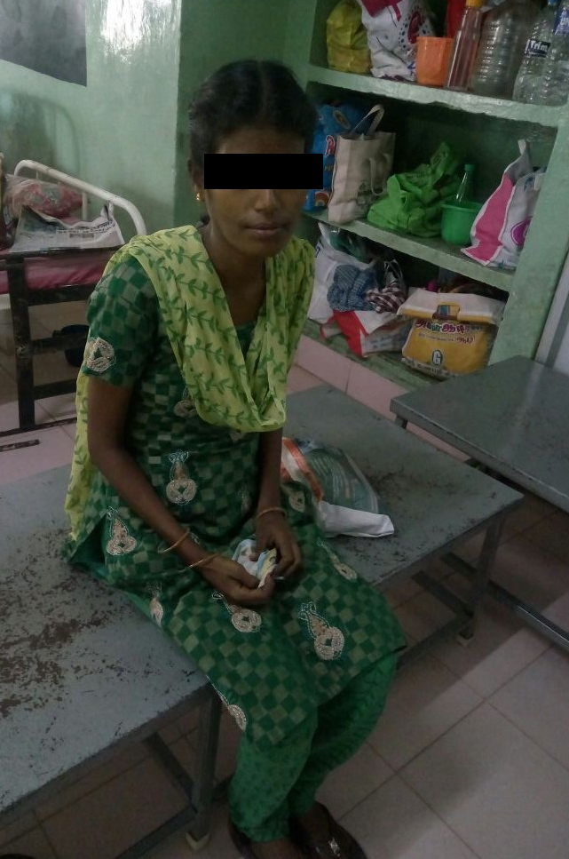
Complaints
35 Yr old Female presented with C/o difficulty to
walk since past 3 day.
Both upper limb weakness since the same evening

Slide 3
Presenting Complaints
H/o upper and lower limb weakness since 1 day
Acute , ascending, flaccid
No bowel bladder disturbance
Absent sensory,autonomic symptom
H/o vomiting
H/o fever on/off since 1 week
h/o joint pains + - large joints, migratory – 2 months
No H/o bleeding manifestations
No H/o seizures
No diurnal variation
No H/o altered sensorium
No history of breathing difficulty

Slide 4
No H/o chest pain, palpitations/ syncope
No history of any abnormal swellings anywhere in the body
No history rash, ulcers, hairfall , joint pain
No history of any visual disturbance or dysphagia or change in voice or diificulty in articulation
No H/o Abdominal pain, loose stools ,URI/LRI symptoms

Slide 5
Past History
H/o previous similar episodes were present ,3 episodes in last 4 yrs, treated with full recovery
Not a K/c/o Diabetes Mellitus/ Systemic Hypertension/ Coronary artery disease/ chronic kidney disease/ chronic liver disease/ bronchial asthma/seizure disorder/ hypothyroidism
No h/o animal bite or trauma

Slide 6
PERSONAL HISTORY
Married for 18 yrs , P2L2, RMP
Mixed diet
No drug allergies
Normal bowel / bladder habits

Slide 7
On Examination
Patient conscious
Oriented
PALLOR +
Not icteric, clubbing , edema, cyanosis, lymphadenopathy
Breast n thyroid normal

Slide 8
BP
100/60 mmhg
SpO2 96%
RR : 26/min
PULSE
98/min
TEMP
97.5F

Slide 9
CNS
Conscious
Oriented
Higher Mental Function : normal
Cranial nerves : normal

Slide 10
SPINOMOTOR SYSTEM
BULK B/L NORMAL
TONE : HYPOTONIA IN ALL FOUR LIMBS
POWER : 3/5 3/5
3/5 3/5
no neck muscle weakness
Deep tendon reflexes
biceps + +
tricep + +
supinator + +
knee + +
ankle + +
jaw jerk – absent

Slide 11
Abdominal Reflex
Plantar

Slide 12
SENSORY
POSTERIOR COLUMN
SPINOTHALAMIC TRACT
CORTICAL SENSATION
NORMAL

Slide 13
CEREBELLUM
AUTONOMIC SYSTEM
No signs of meningeal irritation
No involuntary movements
Fundus b/l normal
NORMAL

Slide 14
Other systems
CVS :
Jvp (-)
S1S2+
No murmur, No gallop
RS :
Trachea midline
b/l NVBS
P/A
Soft
No organomegaly/ free fliud

Slide 15
Provisional Diagnosis
ACUTE FLACCID PARALYSIS
?HYPOKALEMIC PARALYSIS
? AIDP

Slide 16
Investigations
Blood sugar : 67 mg/dl
Blood urea : 18 mg/dl
Serum Creatinine : 0.9 mg/dl
Liver Function tests
Total Bilirubin : 1.2 mg/dl
SGOT : 36 U/L
SGPT : 22 U/L
CBC
Hb : 9.5 g%
Total Count : 2400 cells /microL
Differential Count : P71L15Mx14
Platelets : 69000
PCV : 35.4%
ESR : 114mm/hr

Slide 17
Ecg
90/min
Normal axis
NSR
PR- 200msec
QTc-523msec

Slide 18
Investigations (contd.)
Serum Electrolytes :
Sodium : 141 mEq/L
Potassium : 2.1 mEq/L
Chloride :115mEq/L
Bicarbonate :16.4 mEq/L
Calcium : 8.3mg%
Viral Markers
HIV
HCV Negative
HBsAg

Slide 19
Sr.protein 8.0 gm%
ALBUMIN 4.5gm%
GLOBULIN- 3.5 gm%
THYROID FUNCTION TEST
TSH – 2.45mIU/L
T4 - 8.5 Microgm%
EUTHYROID STATUS

Slide 20
Peripheral Smear :
Hypochromic Microcytic Anemia with few activated lymphocytes.
Wbc – counts reduced, no blasts/atypical cells
Platelet –decreased in number
Reticount : 0.8%

Slide 21
USG Abdomen & Pelvis :
Liver
Spleen
Kidney
Impression : Left Minimal Pleural Effusion
CT Brain P&C : Normal Study
CT Chest P&C : Normal Study
Normal sze and echotexture
DONE OUTSIDE

Slide 22
URINE ANALYSIS
24 hr urine volume – 2.6L
Urine pH : 6.5
Urine Osmolality : 204
Albumin : nil
Sugar : nil
Deposits : 0 to 2 pus cells, 2-3
epithelial cells
Urine sodium :24.5mmol/L (80-280mEq/;day)
Urine Potassium : 47.5 mmol/L (3-100mEq/d)
Urine chloride : 52.0 mmol/L(110-250 mEq/d)
Urine Bicarbonate : 15.1 mmol/L
Urine creatinine :524mg/L(500-2000/d)

Slide 23
ABG
pH : 7.35 (7.35-7.43)
pCo2 : 25.8 mm Hg(35-45) Na : 145 mmol/L
HCo3 : 16.4 mEq/L(22-26) K : 2.13 mmol/L
Anion Gap : 14.1(8-12) Ca : 0.99 mmol/L

Slide 24
OPINIONS
NEUROLOGY :
PANCYTOPENIA
ACUTE FLACCID QUADRIPARESIS
HYPOKALEMIC PARALYSIS
TO DO
Work up for hypokalemia
TO GIVE IV KCL with ECG monitoring
Correct metabolic parametres

Slide 25
Further work up ???

