Slide 1
CLINICOPATHOLOGICAL CONFERENCE
By 7th medical unit
CHIEF: Dr.Alagavenkatesan MD.,
ASSISTANT PROFESSORS : Dr.Arul Prakash MD.,
Dr.Vinoth kannan MD.,
Dr.Nabil Fayaz MD. Presentor : Dr.F.Fetancylin

Slide 2
Chief complaints
A 13 year old boy was brought with complaints of altered sensorium for 2 days

Slide 3
HISTORY OF PRESENTING ILLNESS
Pt was apparently normal three months ago after which he went to a nearyby clinic for the complaints of
Abdominal pain on JULY 15 for 10 days
Rt sided , dull aching type
intermittent
gradual in onset , progressive in nature
not radiating , not associated with food intake
not relieved by medications
H/O easy fatiguability+
H/O loss of appetite+

Slide 4
no h/o vomiting
no h/o breathlessness
no h/o fever
no h/o cough
no h/o passage of loose stools
no h/o headache
no h/o malena
no h/o joint pain
No h/o skin rashes
No h/o sore throat,ear pain
No h/o any swelling over the neck
No h/o swelling over the legs
N/o h/o hoarseness of voice

Slide 8
Pt was initiated ATT on 13.08.2024 and got discharged from Tvmch.
Pt discontinued ATT due to vomiting after 2 days of discharge.
Then he developed one episode of involuntary movements involving right upper and lower limb lasting for about 3 mins associated with uprolling of eyeballs and post ictal confusion on 25.8.24.
He was then taken to a private hospital where MRI Brain with contrast imaging was done

Slide 11
Pt also had 2 episodes of seizure during hospital stay and got discharged after 10 days and advised to continue ATT.
Then pt attenders found himself in a a state of altered sensorium on Sep 7 for which he was taken to a private hospital where liver function tests were derranged and referred to a private hospital in madurai .
There he was advised PLEX and then Pt attenders then took him here on 8.9.24.
Pt was admitted on 8.9.24 and initially he was in IMCU and got treated with antibiotics , N acetyl cysteine ,antiepileptics and other supportive measures.

Slide 12
In our hospital, he was admitted with
H/O altered sensorium for 2 days
H/O Yellowish discoloration of sclera and urine + for 2days
H/O weight loss+

Slide 13
Past history:
Not a known case of DM,SHTN,TB,Bronchial asthma,Epilepsy
no prior history of blood transfusion or surgery
no history of contact with TB patients

Slide 14
Personal history:
Mixed diet
studies 8 th standard went to school 3 months ago
normal bowel and bladder habits
no h/o native treatment
no addictive habits
H/o owning pets+ (dog, goat, cat)

Slide 15
On examination
pt drowsy
irritable
not obeys oral commands
reacting to painful stimuli
no pallor
icterus+
no clubbing
no palpable lymph nodes
no pedal edema

Slide 16
vitals
BP-110/70 mmHg
PR-112/min
SPO2-96 at RA
Admission Wt-56Kg

Slide 17
Systemic examination:
CVS: S1,S2+
No murmur
RS : BAE+
No added sounds
P/A : soft,BS+
CNS: Pt drowsy
not obeys oral commands
reacting to painful stimuli
hypotonia + in all 4 limbs
DTR present in all 4 limbs
B/L plantar withdrawal
no neck stiffness

Slide 18
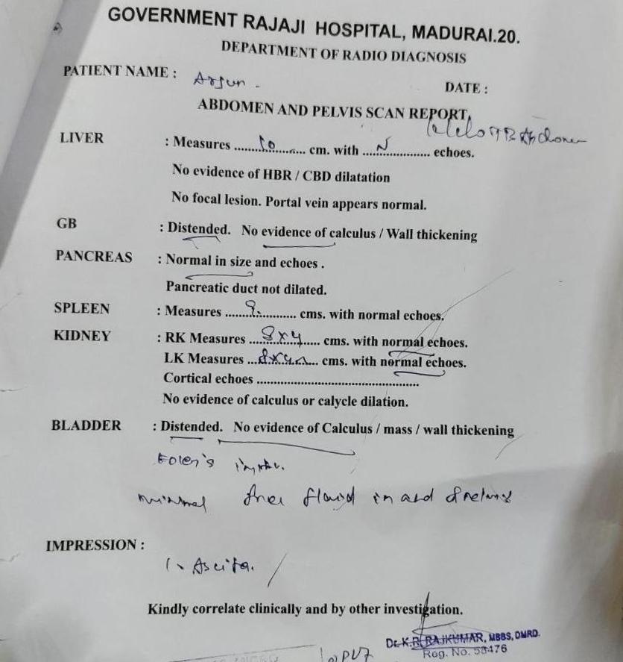
USG abd and pelvis(9.9.24)

Slide 19
RESPIRATORY MED (8/9/24) :
WITHHOLD ATT (in view of DILI) & continue other lines of management
NEUROMED (8.9.24)
Abdominal TB/DILI/Acute encephalopathy(hepatic)
CSF analysis after normalization of coagulation profile
can be taken up for PLEX under moderate risk
OPHTHAL(13.9.24)
BE normal fundus
no KF ring

Slide 20
MGE OPINION (8/9/24):
Abdominal TB/?DILI/acute encephalopathy ? infectious
Sugg:
serial LFT,PT-INR monitoring
T.UDCA 300mg 1-0-1
Syp.Lactulose 15ml tds
PLEX can be planned as a high risk procedure

Slide 21
After 1 week of IMCU stay pt’s general condition improved and got transferred to ward.
Repeat CECT abd and pelvis was taken on 14.9.24.
Multiple enlarged necrotic nodes noted with peripheral enhancement seen in periportal , peripancreatic , B/L upper and lower para aortic and B/L perihilar region seen.
largest node measuring 4.8*4.2 cm in peripancreatic and peripheral region causing compression of EHBR displaces SMA and SMV anteriorly.
IVC displaced anteriorly by aortocaval node
Lower paraaortic node completely encasses aorta.

Slide 24
On 18.9.24 pt again developed one episode of involuntary movements involving Right upper and lower limb over 3mins associated with uprolling of eyeballs and post ictal confusion.
So, pt got shifted to IMCU.
MRI Brain with contrast was taken on 20.9.24

Slide 25
MRI BRAIN WITH CONTRAST (20.9.24)
T2/FLAIR hyperintensities with diffusion restriction noted involving left thalamus,cortical and subcortical region of temporo occipital lobe
Post contrast shows leptomeningeal and pachymeningeal enhancement
-Possibility of TB meningitis with TB induced vasculitis
EEG-Normal record

Slide 28
Neuromed opinion(18.9.24)
Inj.levetriacetam 500 mg i.v bd
MGE Opinion (20.9.24)
Hepatosafe ATT can be started
Repeat USG guided biopsy from lymph nodes

Slide 30
INVESTIGATIONS
DATE | TC | HB | PLATELET | DC-N/M/L
8/9/24 | 37,100 | 13.5 | 4,84,000 | 73/11/15
13/9 | 13,600 | 9.0 | 1,86,000
18/9 | 24,000 | 10.6 | 1,29,000 | 83/6/12
22/9 | 10,900 | 10.3 | 2,13,000
25/9 | 14,900 | 10.0 | 2,33,000
26/9 | 12,300 | 9.3 | 1,84,000 | 77/9/12

Slide 31
DATE | T.BIL | DIR.BIL | Indir bil | SGOT | SGPT | ALP | TOTAL PROTEIN
8/9/24 | 22.3 | 14.5 | 7.8 | 505 | 83 | 121
9/9/24 | 18.2 | 11.2 | 7.0 | 318 | 1057 | 127 | 5.0
10/9/24 | 17.2 | 11.9 | 5.3 | 277 | 256
12/9/24 | 11.7 | 8.3 | 3.4 | 205 | 393
16/9/24 | 15.8 | 9.2 | 6.6 | 65 | 190
18/9/24 | 13.4 | 9.1 | 4.3 | 65 | 87 | 112
22/9 | 5.7 | 3.4 | 2.3 | 119 | 63
26/9 | 5.1 | 3.0 | 2.1 | 123 | 70
30/9 | 3.0 | 1.8 | 1.2 | 96 | 91
5/10 | 2.8 | 1.8 | 1.0 | 69 | 55
14/10 | 1.1 | 0.5 | 0.5 |  | 53 |  | 4.1/2.3/1.8

Slide 32
DATE | PT | INR | APTT
8/9/24 | 39.0 | 3.42 | 44.9
9/9/24 | 19.8 | 1.64 | 35.6
10/9 | 16.9 | 1.3
18/9 | 18.3 | 1.3 | 19.0

Slide 33
DATE | RBS | UREA | CREATININE | NA | K | Sr.Ca
8/9/24 | 72 | 28 | 0.6 |  |  | 8.7
12/9/24 |  | 12 | 0.4 | 130 | 3.1
16/9 | 116 | 10 | 0.4 | 127 | 2.7
18/9 | 63 | 21 | 0.4 | 128 | 3.4 | 7.9
27/9 |  | 22 | 0.9 | 129 | 3.5
30/9 |  | 17 | 0.7 | 134 | 3.2

Slide 34
CSF analysis (18.9.24):
TC-3Cells /10 hpf
poly-1
lymph-2
Protein-56 mg%
sugar-52 mg%
LDH-91 U/L
ADA-1 U/L
CSF CBNAAT-MTB not detected
CSF TB PCR-Negative
CSF Culture and sensitivity-no growth

Slide 35
Normal sinus rhythm
Sinus tachycardia+
Normal axis
No significant T-T changes
ECHO
no RWMA at rest, Ef-68%
normal LV systoic function

Slide 36
CT CHEST(30.9.24)
B/L lung fields normal
no significant lymphadenopathy
lytic/sclerotic lesion noted in D8
vertebral body.

Slide 37
Fasting lipid profile
Sr.Cholesterol-269mg%
Sr.TGL-239 mg%
Urine alb-nil
sugar-nil
deposits: 3-4 pus cells
Blood culture and sensitivity- no growth
HbsAg,HCV – negative
VCTC - non reactive

Slide 38
CHG WITH PERIPHERAL SMEAR(9.9.24)
TC-16,400
Hb-9.6
Hct-32.3%
plt – 2,85,000
N-76%,L-6%,E-6%,M-2%
Toxic granules+
Absolute eosinophil count-652 ells/cumm
IMP: Hypochromic microcytic anaemia with neutrophilia

Slide 39
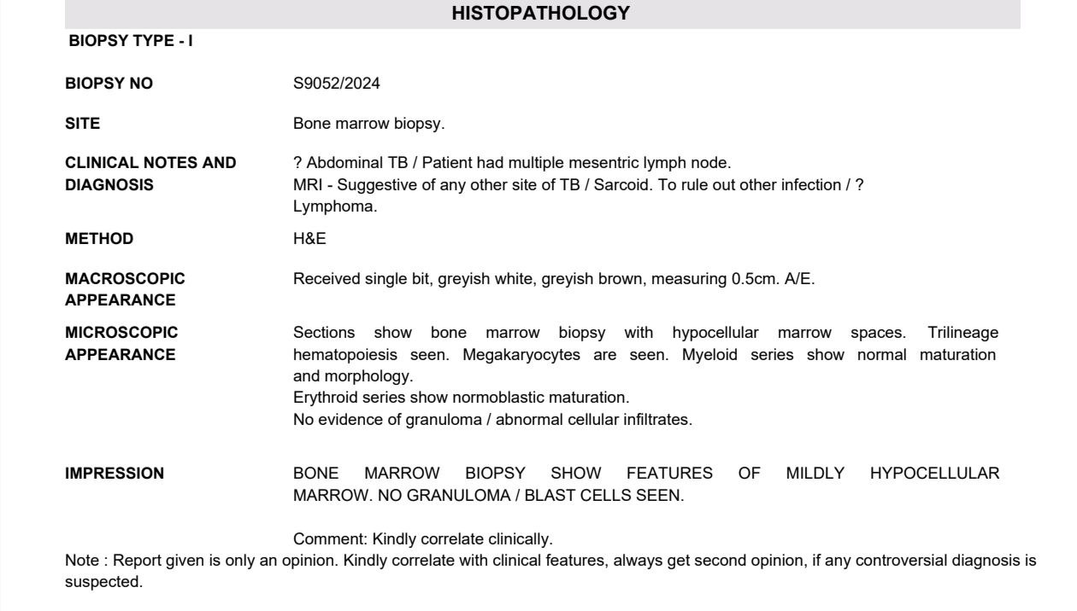
BONE MARROW ASPIRATION (27.9.24)
Normococellular marrow
myeloid:erythroid ratio=4:1
leucopoeisis show normal pattern of maturation with blasts less than3%

Slide 40
ACE : 63.38 U/L ( Reference range: 12-68)
ANA by IF method-Negative
Toxoplasma-IgM and IgG-non reactive
CMV IgG –Reactive(410.80)
CMV IgM –Non reactive(0.17)
HSV 1 and 2 IgG Antibody-positive(>200)
HSV 1 and 2 IgM Antibody-equivocal(0.83)

Slide 41
Treatment given:
IVF NS,DNS at 75 ml/hr
Inj.Piperacillin tazobactam 4.5 g i.v tds
Inj.levetriacetam 500 mg i.v. Bd
Inj.Dexamethasone 8 mg i.v bd
Hepatosafe ATT-SLE regimen
Inj.NAC 1gm i.v tds
Inj.Ondansetron 8 mg iv (sos)
T.UDCA 300mg bd
Syp.Lactulose 15 ml tds

Slide 42
After few days of treatment
Pt conscious
oriented
Icterus ( )
B/L pitting pedal edema+
no palpable lymph nodes
BP-90/60 mmHg.
PR-66/min
SPO2-98%
Wt-46Kg

Slide 43
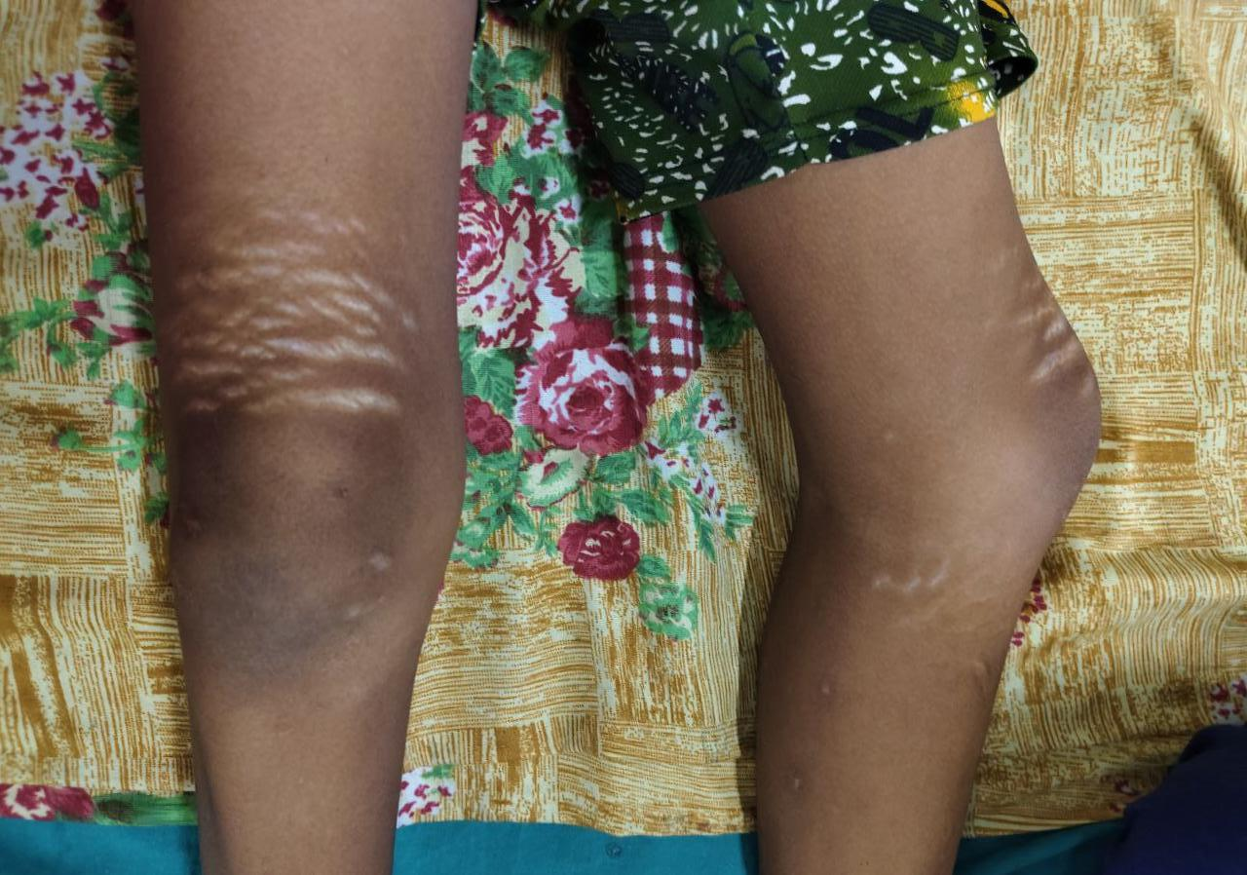
Striae marks with hypopigmented patch present above knee

Slide 44
LET’S DISCUSS..

