Slide 1
JOURNAL PRESENTATION 2nd MEDICAL UNIT
CHIEF – PROF. DR. BHAKIYALAKSHMI M.D.,
ASST. PROF. DR. VALLIDEVI M.D.,
DR. PONSENTHIL KUMAR M.D.,
DR. ILAMARAN M.D.,
PRESENTOR – DR. ram babu

Slide 2
Ferric Carboxymaltose in Patients with Heart Failure and Iron Deficiency

Slide 3
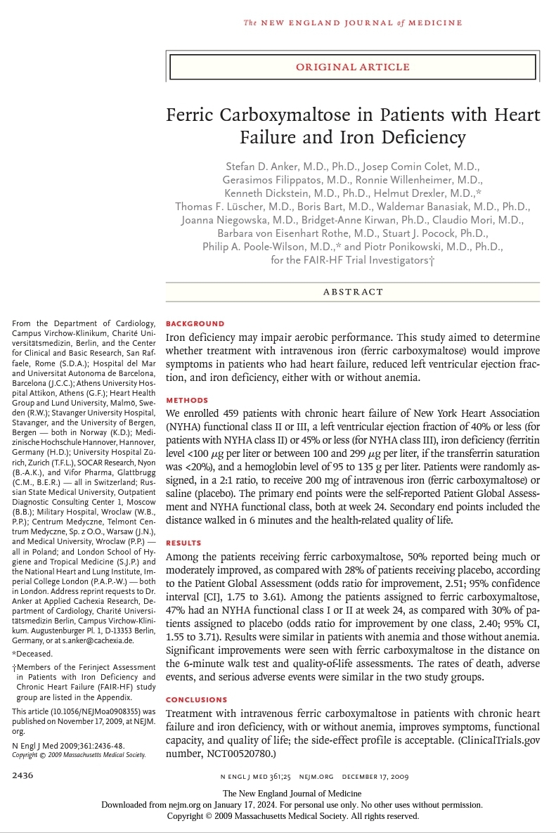

Slide 4
BACKGROUND
Iron deficiency may impair aerobic performance.
This study aimed to determine whether treatment with intravenous iron (ferric carboxymaltose) would improve symptoms in patients who had heart failure, reduced left ventricular ejection fraction, and iron deficiency, either with or without anaemia.

Slide 5
METHODS
459 patients with chronic heart failure of NYHA functional class II or III
Double blinded , treatment trial
The primary end points were the self-reported Patient Global Assessment and NYHA functional class, both at week 24. Secondary end points included the distance walked in 6 minutes and the health-related quality of life.

Slide 6
INCLUSION CRITERIA
Ambulatory patients
Chronic heart failure of NYHA class II or III,
LVEF of 40% or less (for patients in NYHA class II) or 45% or less (for patients in NYHA class III),
Hemoglobin level at the screening visit between 9.5 and 13.5 g/dl, and iron deficiency
Iron deficiency (serum ferritin level <100 μg/l or between 100 and 299 μg/ l when the transferrin saturation was less than 20%)

Slide 7
EXCLUSION CRITERIA
Uncontrolled hypertension,
Other clinically significant heart disease,
Inflammation, or
clinically significantly impaired liver or renal function.

Slide 8
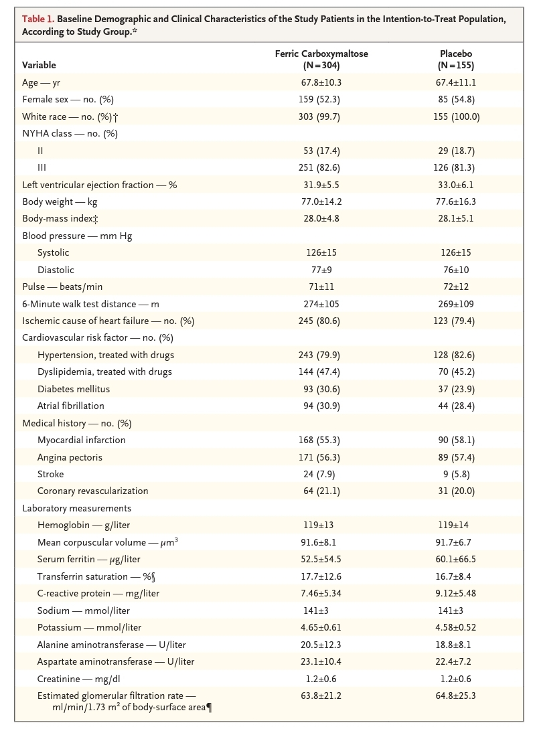

Slide 9
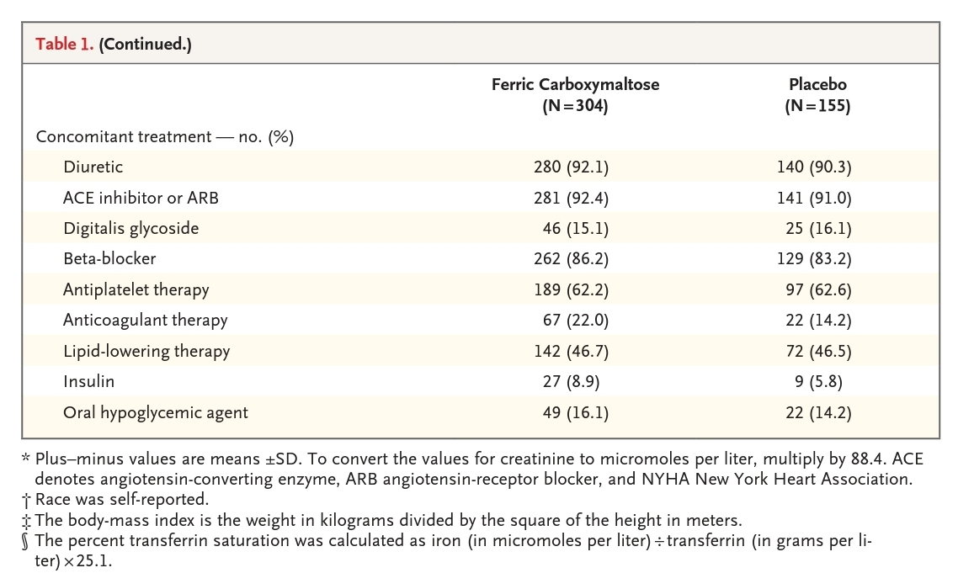

Slide 10
RANDOMIZATION
A clinical history, physical examination, 6-minute walk test results, and 12-lead electrocardiogram were obtained for each patient.
We also performed assessments of the health-related quality of life in all patients.
Using a central interactive voice-response system, we randomly assigned eligible patients, in a 2:1 ratio, to receive either ferric carboxymaltose (provided by Vifor Pharma) or placebo (normal saline)
Double blinded, Randomised control trial

Slide 11
STUDY THERAPY
The ferric carboxymaltose or saline was administered as an intravenous bolus injection of 4 ml (which is the amount of ferric carboxymaltose in a water solution for injection that is equivalent to 200 mg of iron).
The dosing frequency was weekly until iron repletion was achieved (the correction phase) and then every 4 weeks during the maintenance phase, which started at week 8 or week 12, depending on the required iron-repletion dose
In addition to the dosing visits, at weeks 4, 12, 24, and 26, patients were assessed for efficacy and safety

Slide 12
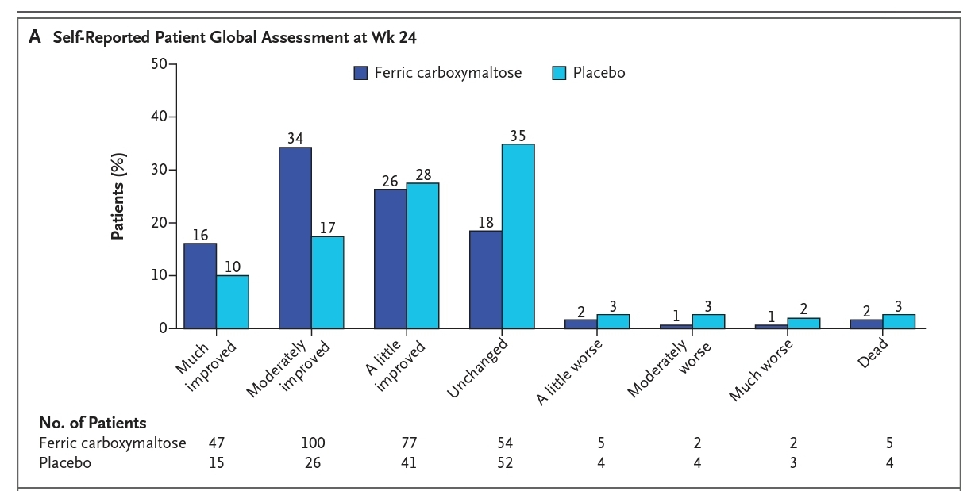
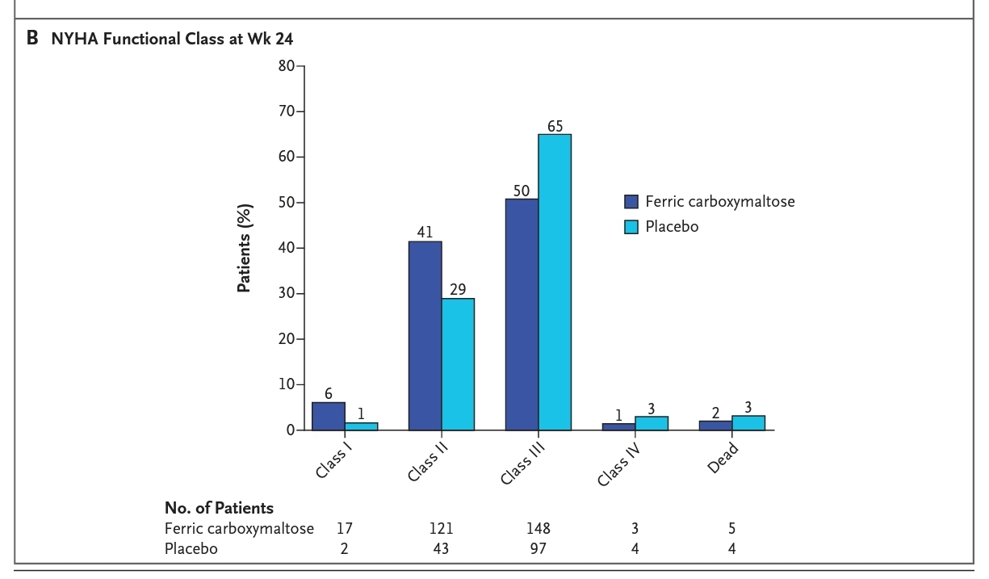
PRIMARY END POINTS
The self-reported Patient Global Assessment and NYHA functional class (adjusted for the class at baseline) at week 24.

Slide 13
SECONDARY END POINTS
Secondary end points included the self-reported Patient Global Assessment and NYHA functional class at week 4 and week 12, as well as the distance on the 6-minute walk test and the overall score on the Kansas City Cardiomyopathy questionnaire22 and the European Quality of Life–5 Dimensions (EQ-5D) Visual Analog Scale23 at weeks 4, 12, and 24.
Safety end points were serious and nonserious adverse events, hospitalization, and death, as assessed up to week 26

Slide 14
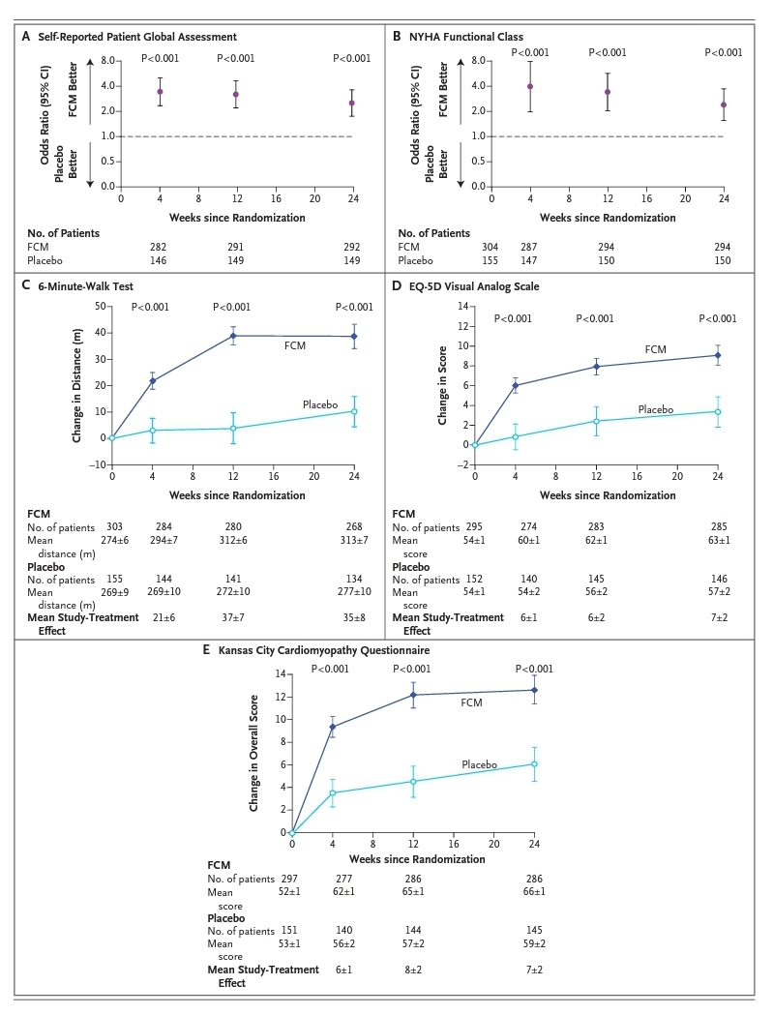

Slide 15
FOLLOW UP
Of the 304 patients assigned to receive ferric carboxymaltose, 26 (8.6%) did not complete the 24 weeks of follow-up; of these 26, 5 had died and 21 had withdrawn
Of the 155 patients assigned to receive placebo, 20 (12.9%) did not complete the 24 weeks of follow-up; of these 20, 4 had died and 16 had withdrawn.

Slide 16
RESULTS – PRIMARY END POINTS
The self-reported Patient Global Assessment at week 24 was improved in the ferric carboxymaltose group, with 50% of patients reporting that they were much or moderately improved, as compared with 28% of patients in the placebo group (odds ratio for being in a better rank, 2.51; 95% confidence interval [CI], 1.75 to 3.61; P<0.001)
Similarly, the NYHA functional class at week 24, after adjustment for the baseline value was improved in the ferric carboxymaltose group, with 47% having an NYHA functional class I or II, as compared with 30% in the placebo group (odds ratio for improvement by one class, 2.40; 95% CI, 1.55 to 3.71; P<0.001)

Slide 17
SECONDARY END POINTS
The use of ferric carboxymaltose, as compared with placebo, significantly improved the self-reported Patient Global Assessment and NYHA class at weeks 4 and 12 (P<0.001 for all comparisons)
Significant improvements were also seen in the distance on the 6-minute walk test and in the quality of life, as evaluated by the EQ-5D visual assessment score and the overall Kansas City Cardiomyopathy score, at weeks 4, 12, and 24 (P<0.001 for all comparisons)

Slide 18
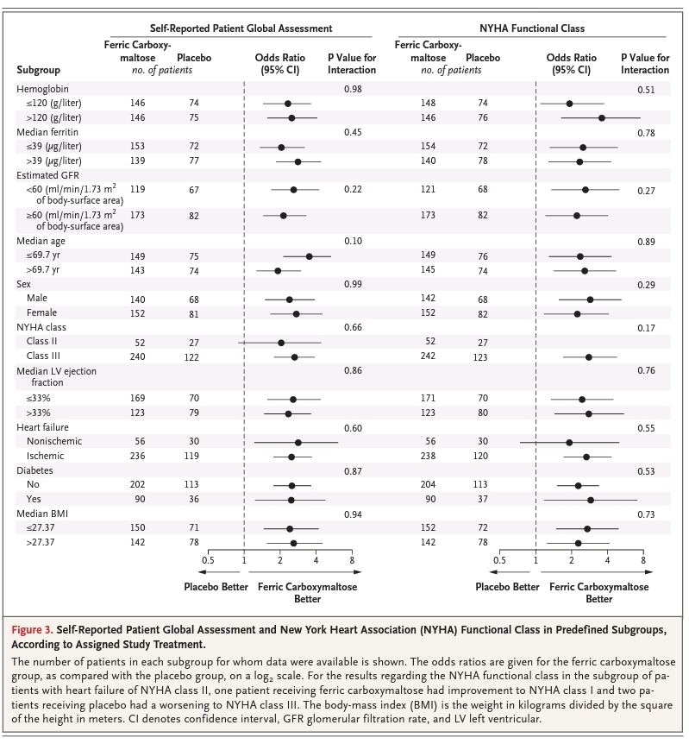

Slide 19
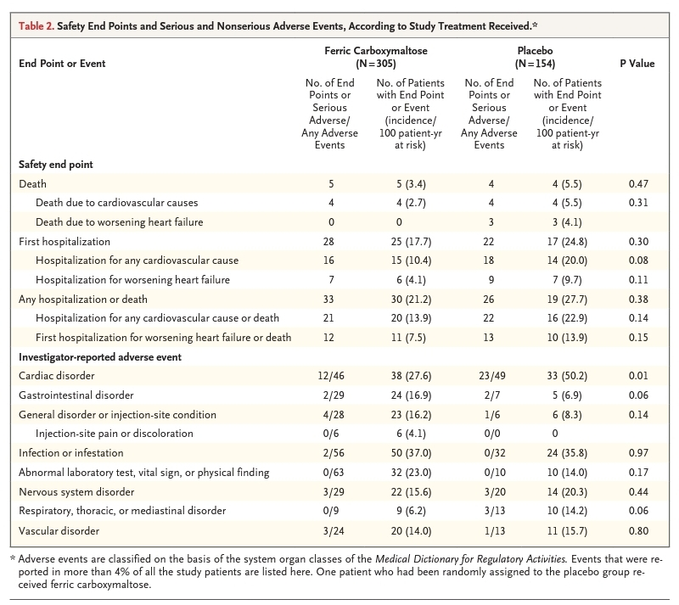

Slide 20
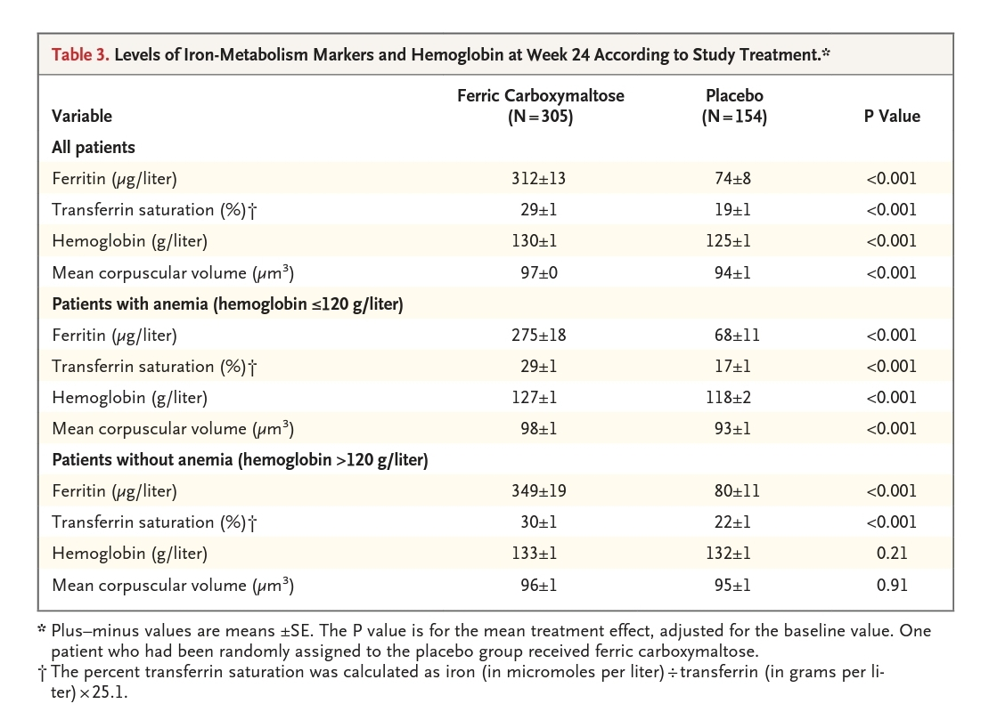

Slide 21
CONCLUSION
In stable, symptomatic, ambulatory patients with chronic heart failure, an impaired left ventricular ejection fraction, and iron deficiency, treatment with ferric carboxymaltose over a 24-week period improves symptoms, physical performance, and the quality of life and has acceptable side-effect and adverse-event profiles
The benefit was seen in patients with anaemia and in those without anaemia.

Slide 22
THANK YOU

