Slide 1
ORAL HYPOGLYCEMIC AGENTS
CHIEF - Prof.Dr.SYED BAHAVUDEEN HUSSAINI M.D.
ASSISTANT PROFESSOR - Dr.VINOTH KANNAN M.D.
Dr.PRIYA M.D.
PRESENTOR - Dr.HEMALATHA

Slide 2
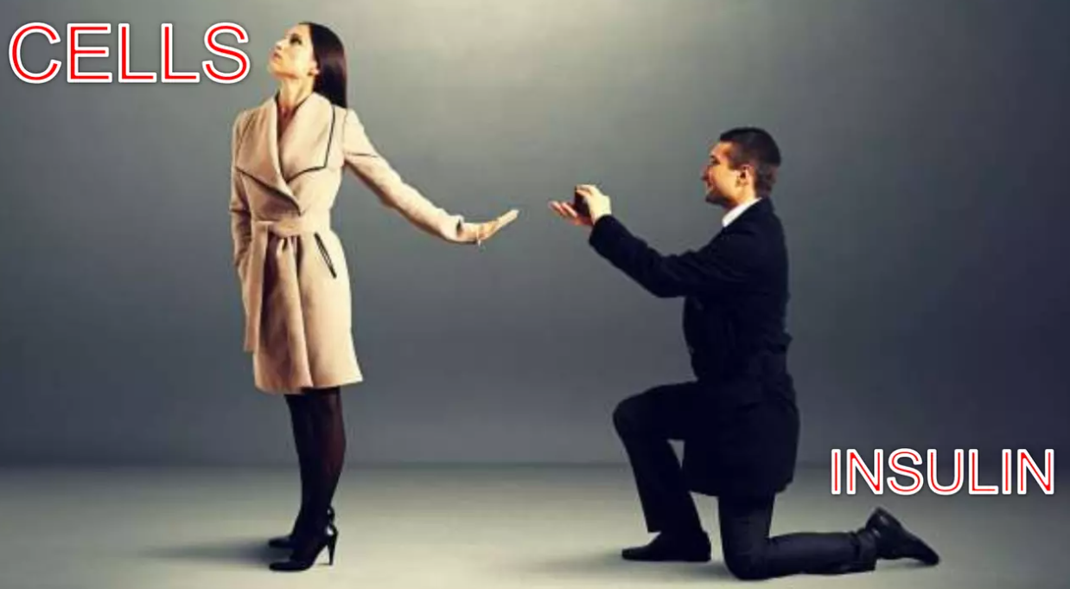
DIABETES MELLITUS:
Refers to a group of metabolic disorders characterised by hyperglycemia results from defects in insulin secretion,action or both

Slide 3
TYPES OF DIABETES (BASED ON ETIOLOGY):
TYPE1DM:
Immune mediated beta cell destruction leads to absolute insulin deficiency
TYPE2DM:
Impaired insulin resistance with relative insulin secretion, excessive hepatic glucose production, abnormal fat metabolism & systemic low-grade inflammation
MODY:
Genetic defect in insulin secretion or action;Young onset<25yrs; AD;monogenic diabetes.

Slide 4
GDM:
Insulin resistance is related to the metabolic and hormonal changes of pregnancy, during which the increased insulin demands and insulin resistance may lead to IGT or diabetes.
TYPE5DM:
Malnutrition related diabetes
TYPE 1.5 (LADA):
>30 yrs; Autoimmune(GAD); doesn't require insulin at the time of diagnosis
TYPE 3C / PANCREATOGENIC DIABETES

Slide 5



SIGNS & SYMPTOMS :
Polyphagia
Polyuria
Polydipsia
Peripheral neuropathy
Slow wound healing
Unexplained weight loss

Slide 6

WHEN TO DIAGNOSE?
 | NORMAL GLUCOSE TOLERANCE | PREDIABETES | DM
HbA1c FPG 2hr PG | <5.6% <100 <140 | 5.7-6.4% 100 - 125 140-199 | >6.5% >126 mg/dl >200mg/dl

Slide 7

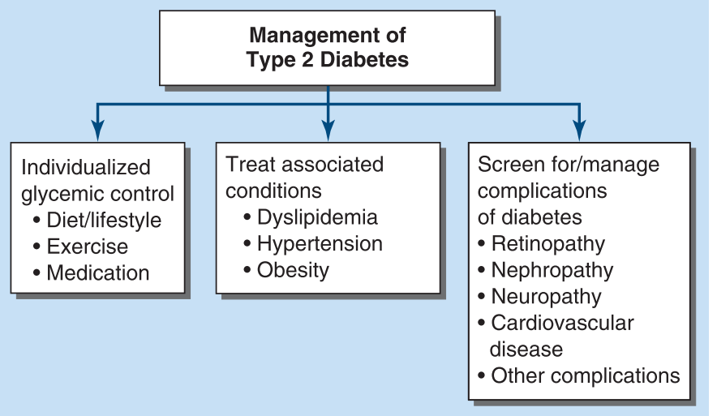
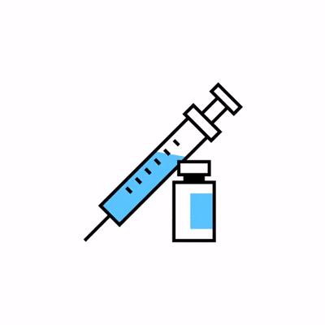

ORAL HYPOGLYCEMIC AGENTS:
Non insulin medications taken orally to reduce bood sugar levels predominantly used in patients with type 2 DM

Slide 8
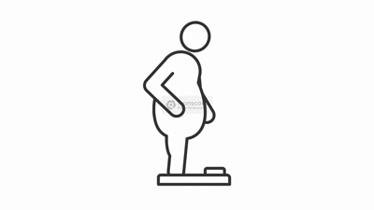
ORAL HYPOGLYCEMIC AGENTS:
AGENTS | MOA | BENEFITS | ADVERSE EFFECTS | CONSIDERATION
INSULIN SECRETAGOGUES: 1)SULFONYLUREAS: Glimipride Glipizide Glyburide 2)MEGLITINIDES: Repaglinide Nateglinide | Increases insulin secretion by inhibiting B cell K+ ATP CHANNELS→ increased calcium influx→insulin release | Rapid & short acting Lowers postprandial glucose; taken before each meal | HYPOGLYCEMIA Weight Gain | Renal / Liver Insufficiency (Except repaglinide-renosafe)

Slide 9
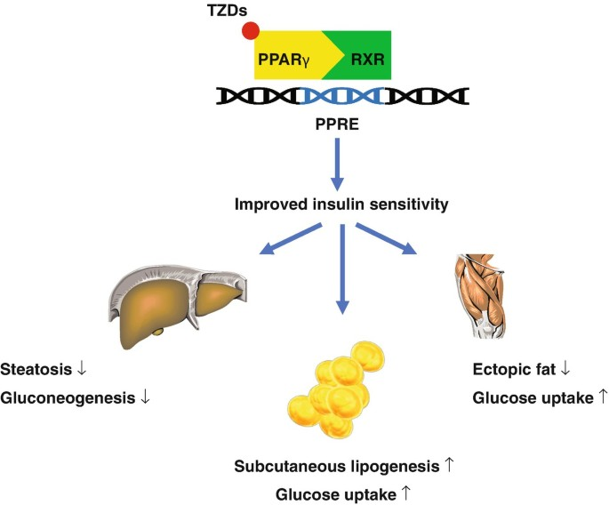
INSULIN SENSITIZERS: 1)BIGUANIDES: METFORMIN 2)THIAZOLIDINEDIONES: PIOGLITAZONE ROSIGLITAZONE | # Stimulate AMP Kinase pathway→ Decreased hepatic gluconeogenesis → _{# Peripheral glucose uptake →} # Decreased intestinal glucose absorption → All leads to Decreased INSULIN RESISTANCE /increased SENSITIVITY Activates transcription regulator PPAR G | Max.reduction in HbA1c Modest decrease in CV events Inexpensive; Wt. Neutral Lowers insulin requirements as it increases the insulin sensitivity | Lactic acidosis Vit B12 deficiency Diarrhoea Peripheral edema CHF Weight gain Fracture Macular edema risk of bladder Ca- pioglitazone; MI - Rosiglitazone | Renal Insufficiency (stop if eGFR <30 mL/min/1.73 m2) CHF Hypoxemic conditions Liver insufficiency also

Slide 10
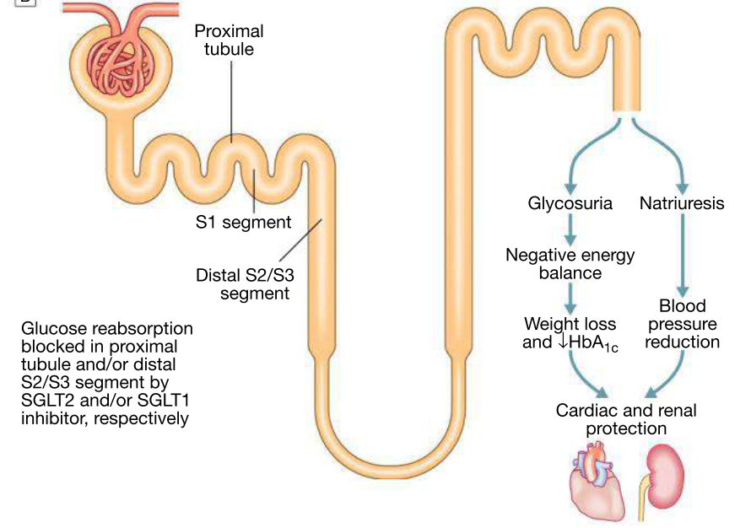
AGENTS | MOA | BENEFITS | SIDE EFFECTS | CONSIDERATION
SGLT2 INHIBITORS: Canagliflozin Dapagliflozin Empagliflozin Ertugliflozin Bexagliflozin Sotagliflozin(1&2) | ↑ Renal glucose excretion | Renal protective ↓ CV events, ↓ heart failure, Do not cause hypoglycemia Modest ↓ weight and blood pressure | UTI & necrotizing fasciitis of perineum polyuria(osmotic diuresis); dehydration Euglycemic DKA exacerbate tendency to hyperkalemia | Moderate renal insufficiency Discontinue 3–4 days before surgery, during serious illness.

Slide 11
AGENTS | MOA | BENEFITS | SIDE EFFECTS | CONSIDERATION
INCRETINS: GLP-1 RA:(sc) Dulaglutide exenatide liraglutide lixisenatide semaglutide(oral +) Tirzepatide(GIP+) | ↑ glucose dependent Insulin secretion ↓ glucagon secretion slow gastric emptying, satiety | Reduce CV risk mortality;wt.loss Renal protection | Pancreatitis Possibly worsens retinopathy Medullary thyroid ca. Nausea/GI intolerance | Renal disease(C/I in severe/ESRD; caution with mod. renal impairment) MTC Pancreatic disease Agents also slow GI motility; Previous ileus
DPP-4 INHIBITORS: Linagliptin Saxagliptin Sitagliptin Vildagliptin(not indicated if >3 ×LFT) | Prolong endogenous GLP-1 action ↑ insulin ↓ glucagon | Weight neutral | Nasopharyngitis Angioedema Anaphylaxis | Reduce dose with renal insufficiency(if eGFR<50ml/min/m2) Except linagliptin

Slide 12
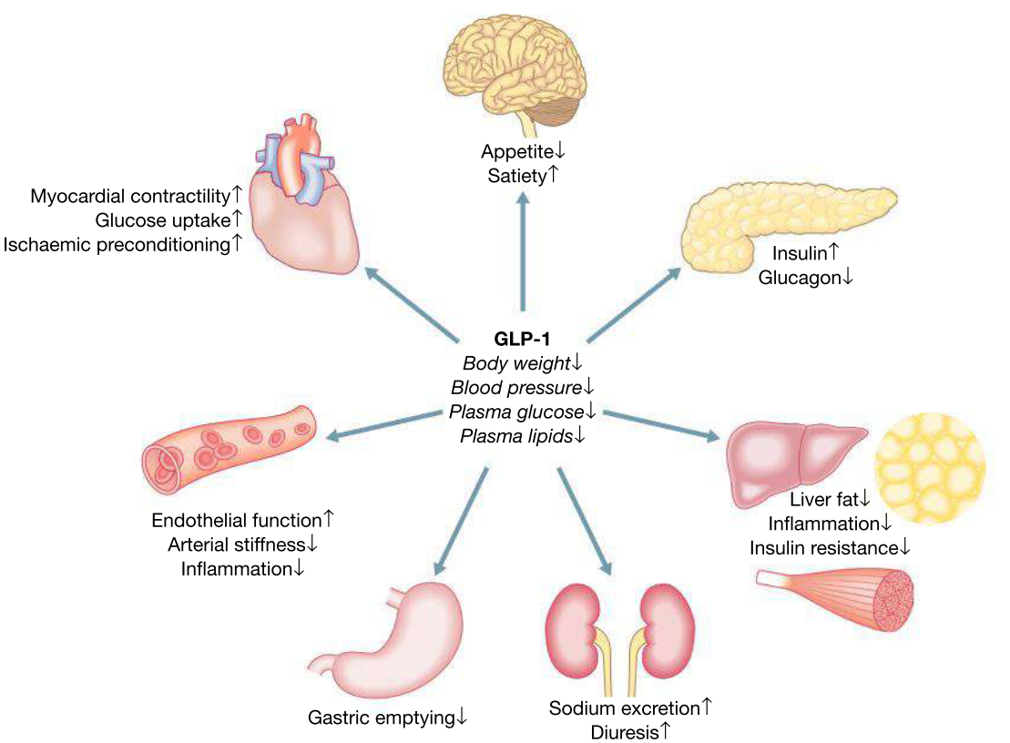

MOUNJARO(TZP) & OZEMPIC(SEMAGLUTIDE)
Weekly once sc injection
INDICATIONS:
T2DM with poor glycemic control
OBESITY BMI>30 or >27 with comorbidities
Diabetes with high cv risk
Fatty liver disease with obesity(MASLD)
PCOS
Metabolic syndrome
Obesity related secondary hypogonadism

Slide 13
AGENTS | MOA | BENEFITS | SIDE EFFECTS | CONSIDERATION
α-GLUCOSIDASE INHIBITORS: Acarbose Miglitol | ↓ G.Intestinal glucose(disaccharide) absorption | Reduce Post prandial glycemia | Diarrhoea/Flatulence | IBD Renal/liver insufficiency Avoid if S.Cr >2.0mg/dl
AMYLIN AGONIST: Pramlintide | Delays gastric emptying ↓ glucagon secretion | Reduce postprandial glucose Wt. Loss Both type 1 & 2 | ↑ risk of hypoglycemia with insulin | Agents that also slow GI motility

Slide 14

OTHER MISCELLANEOUS DRUGS:
BROMOCRIPTINE (D2 AGONIST) -
BILE ACID BINDING RESINS (COLESEVALAM)
Both used for type 2DM.
Role is not yet defined
It is contraindicated in bowel obstruction or GI motility disorders can be used in renal and hepatic disease; take on an empty stomach

Slide 15
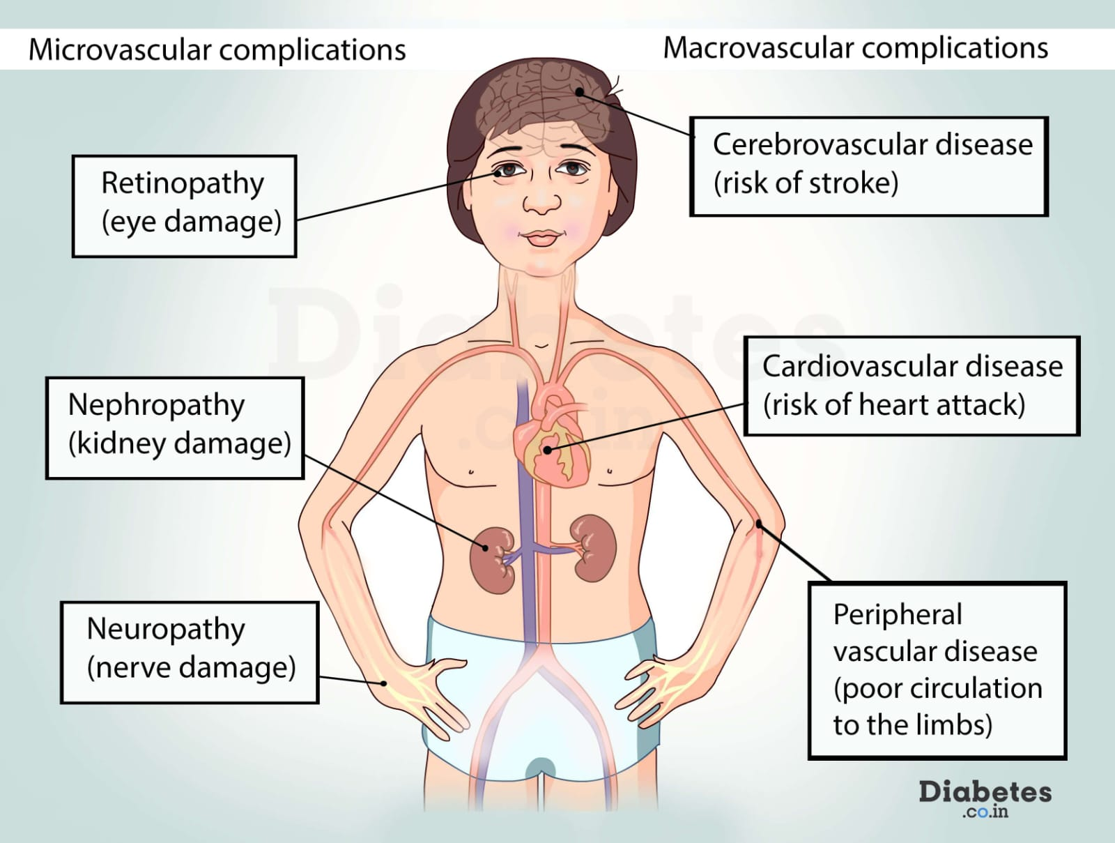
COMPLICATIONS OF DM:
Preventing complications matters more than chasing HbA1c alone
Pts with T2DM don't just die from high glucose.Major risk factors include CV disease; Heart failure; kidney disease
Evidence showed some drugs reduce
#CV Events
#HF Hospitalisations
#CKD Progression

Slide 16
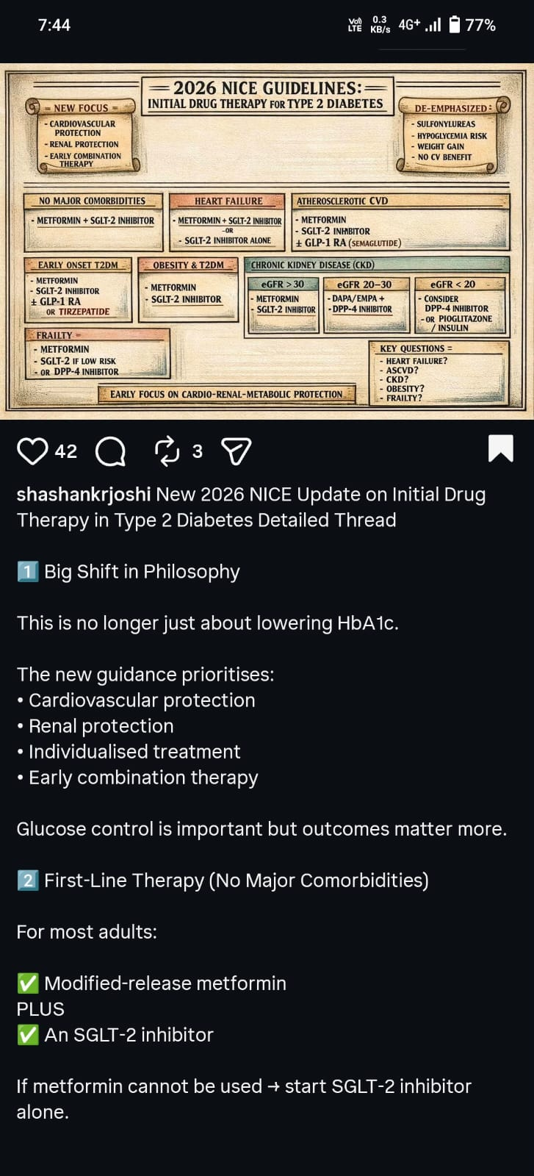

Slide 17
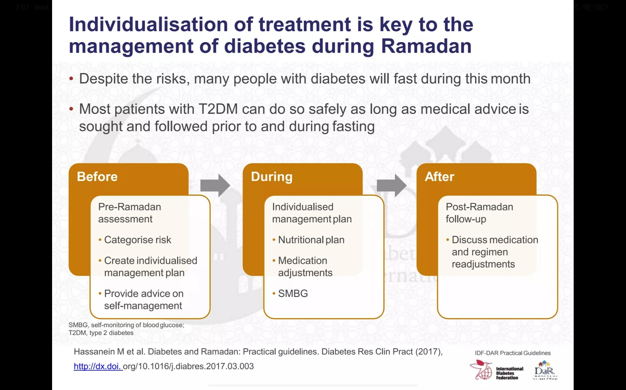
IDF DAR 2026 GUIDELINES:
Risk Stratification (Essential): Patients must undergo a risk assessment before Ramadan to determine if they are low, moderate, or high-risk for personalized assessment, medication adjustments (specifically insulin and OHA), and strict monitoring to prevent hypo or hyperglycemic events .
When to Break the Fast: Immediate cessation is required if blood sugar drops< 70mg/dl or>300 mg/dlor if symptoms of hypoglycemia, dehydration, or acute illness occur.
Nutrition and Hydration: focus on complex carbohydrates and slow-release foods Break the fast with water and dates; avoid excessive fatty, fried, or high-sugar foods. Adequate fluid intake inbetween meals
Monitoring: Regular daily self-monitoring of blood glucose (SMBG) is advised and does not mean break the fast.

Slide 18

