Slide 1
INTERESTING X RAY
MVII

Slide 2
VII MEDICAL UNIT
CHIEF: PROF.DR.K.SENTHIL.MD
ASSOCIATE PROF: DR.K.MURALIDHARAN MD
ASST PROF:DR V.MANIKANDAN MD
DR C. RAMANAN MD
DR.SARAVANA MADAV MD,DTCD
PRESENTOR- DR E GOPINATHAN

Slide 3
18yr old female admitted with
c/o bloody sputum- 1 year
c/o cough – 1 year
c/o Breathlessness – 1 month
c/o fever – 10 days

Slide 4
HISTORY OF PRESENTING ILLNESS
Patients was apparently normal 1 year before after that patient noticed heaviness in the right side chest followed by
H/O hemoptysis for 1 year, occasional; mild in quantity
H/O cough – 1 year
initially dry cough,
later becomes Productive cough for past 10 days
Sputum – mucoid (approx 10-15ml/day)
not foul smelling
H/O difficulty in breathing – 1 month
gradual onset ,progressive
MMRC grade II

Slide 5
H/O Fever – 10 days
High grade
Intermittent,
not a/w chills/rigor
no rashes / no joint pain
no diurnal variation

Slide 6
No h/o palpitations
No h/o abdominal pain/distension
No h/o vomiting
No h/o loose stools
No h/o LOW/LOA
No h/o Jaundice
No h/o sneezing/nasal obstruction
No h/o Seizures

Slide 7
PAST HISTORY
Not a k/c/o T2DM/HTN/TB/BA/THYROID disorders/Congenital heart disease /seizure disorders
No H/O previous hospital admissions
PERSONAL H/O:
Mixed diet
Normal bowel and Bladder habits
No h/o contact with TB
Menstrual cycles – regular 5/30 days cycle
history of contact with dog in her home since her childhood

Slide 8
GENERAL EXAMINATION
Pt conscious
Oriented
Febrile on admission
Tachypneic at rest
No pallor
No icterus
No cyanosis
No clubbing
No Pedal edema
VITALS:
BP-100/60mm hg
PR- 120/Min
SPO2 – 98% RA
RR-24/min

Slide 9
SYSTEMIC EXAMINATION
RS: BAE + , NVBS ,
RT Infrascapular/Infraxillary fine crepts+
CVS- S1,S2+, No murmurs
P/A – soft, No organomegaly
CNS- Pt conscious, oriented, NFND

Slide 10
INVESTIGATIONS
DATE | 3/10/21 | 4/10/21 | 9/10/21
TOTAL COUNT | 14900 | 15200 | 8400
DIFF COUNT | 68/19/13 | 80/12/7 | 58/22/20
HB | 10.1 | 10.4 | 10.1
PCV | 32 | 30.8 | 33%
PLATELETS | 3.20 L | 2.99 L | 3.81 L
UREA | 20 |  | 13
Cr | 1.0 |  | 0.8

Slide 11
DATE | 3/10/21 | 9/10/21
TOT. BIL | 1.1 | 0.5
D.BIL | 0.4 | 0.2
I.BIL | 0.7 | 0.3
SGOT | 13 | 16
SGPT | 7 | 15
ALP | 41 | 47
CRP | 146.9 | 33
ABSOLUTE EOSINOPHIL COUNT | 856 Cells/mm3 | VCTC – NON REACTIVE
SPUTUM AFB & GENE XPERT | Negative | ESR-55 mm/hr

Slide 12
ECHO:
NORMAL STUDY
LVEF – 75%
LVIDD – 3.9
LVIDS – 2.0
USG ABDOMEN:
LIVER – Normal size and echoes, No focal lesion
PANCREAS – Normal size and echoes
SPLEEN – Normal
KIDNEYS – Normal size, normal echoes, CMD maintained

Slide 13
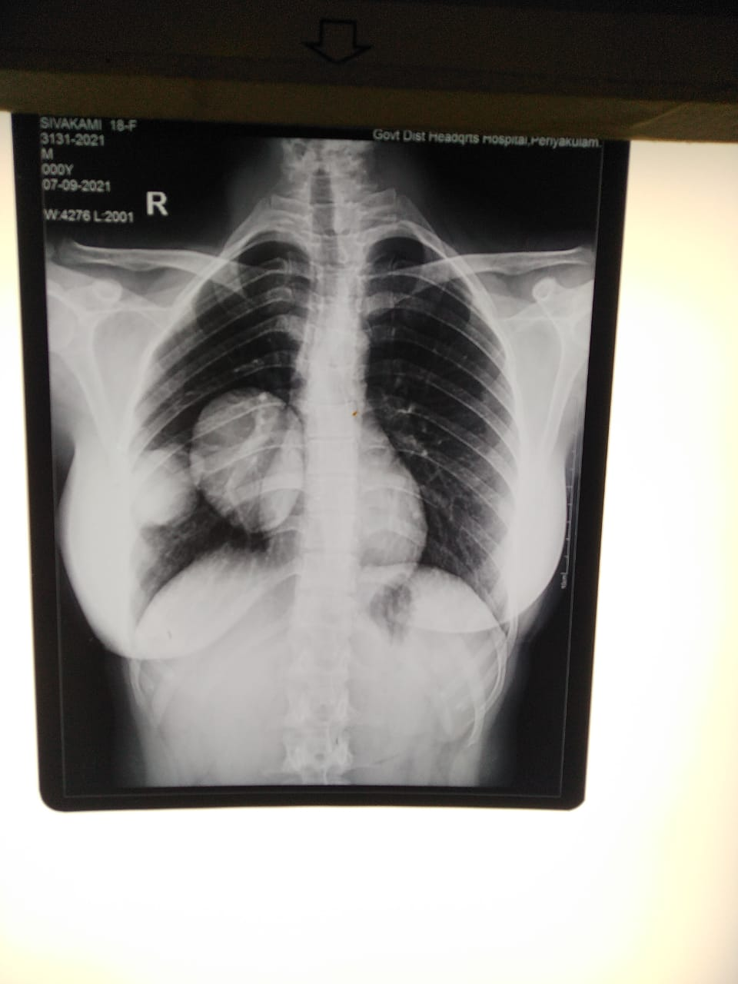
CHEST XAY – 07.09.21

Slide 14
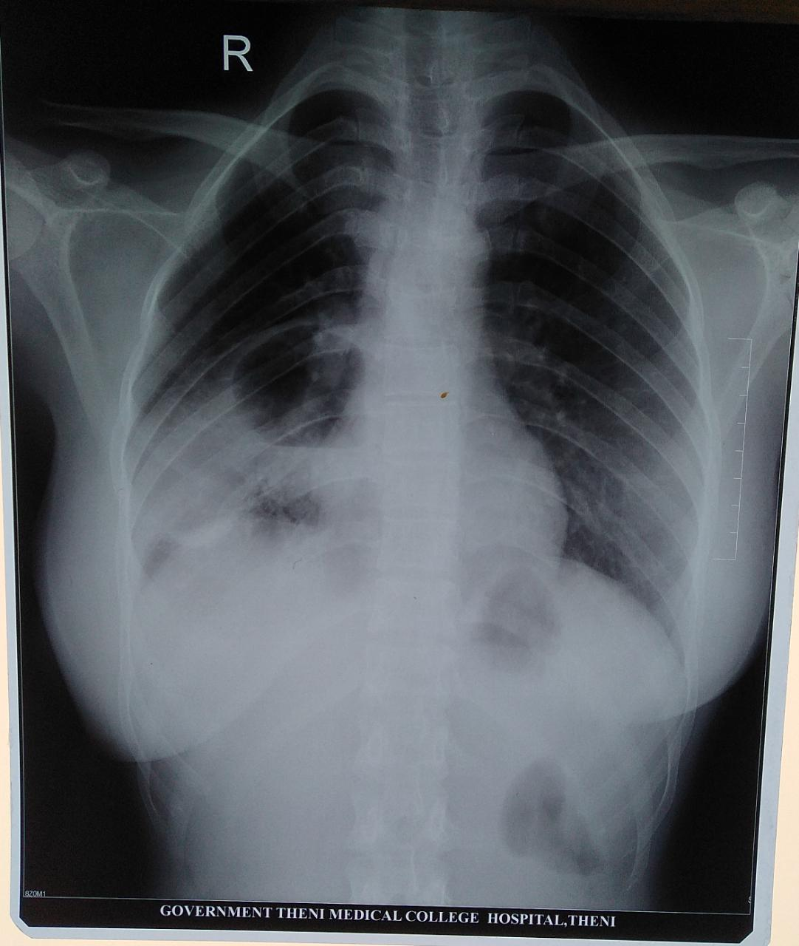
CHEST XRAY – 30.09.2021

Slide 15
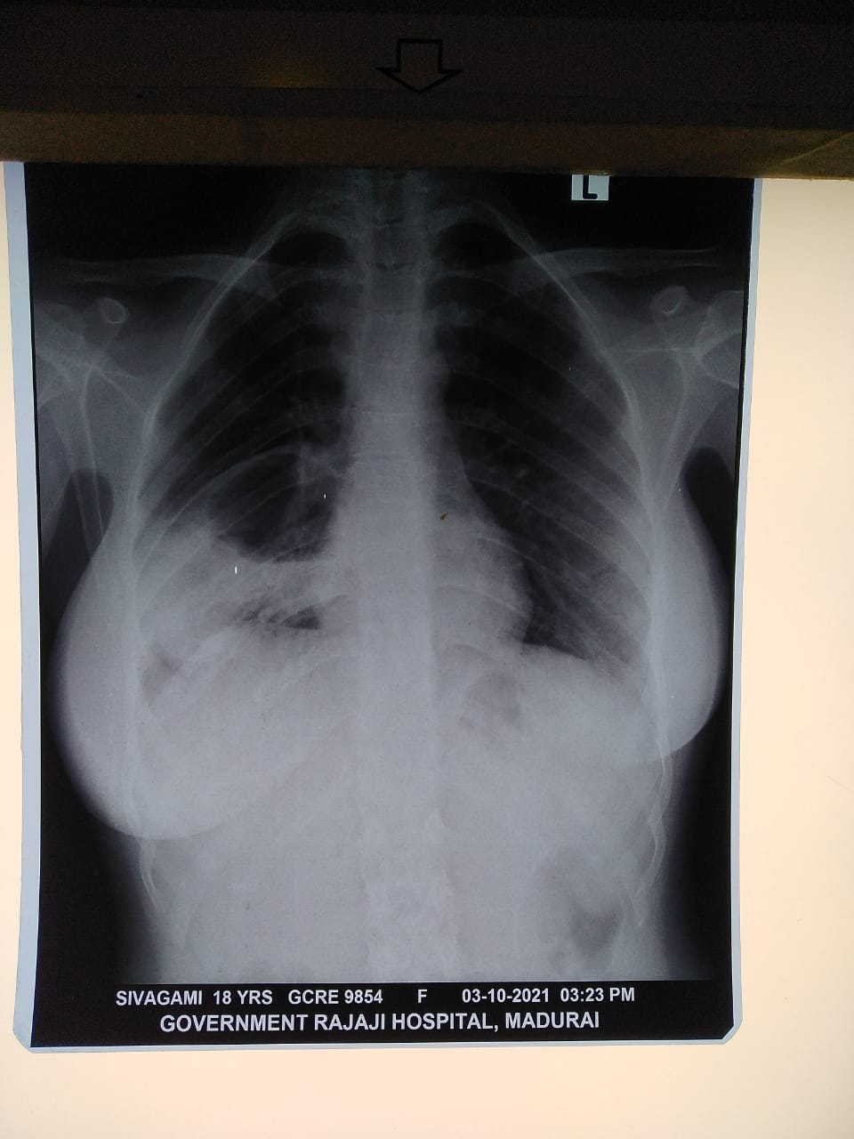
CHEST X RAY – 3.10.2021

Slide 16
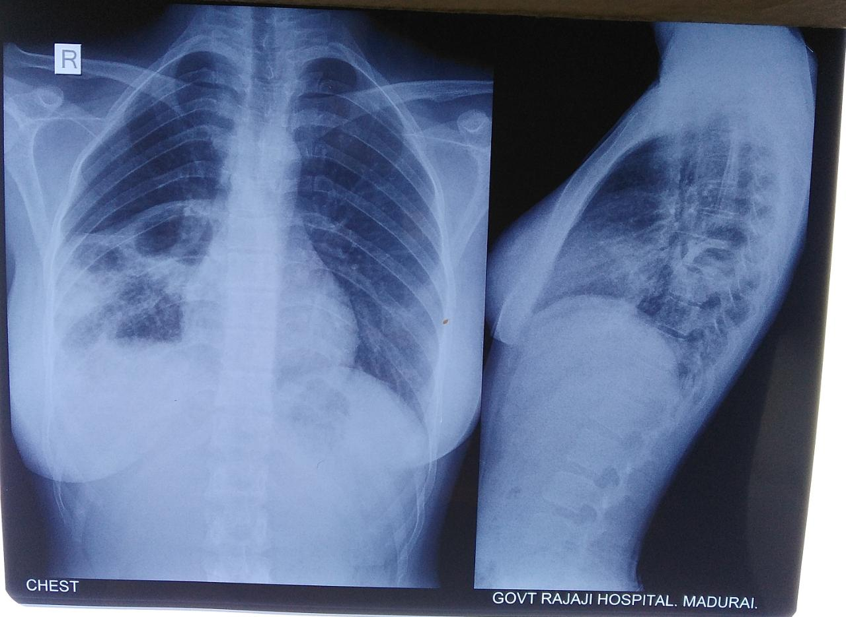
CHEST X RAY - 12.11.2021

Slide 17
WHAT NEXT?

