Slide 1

SPOT DIAGNOSIS WITH DANCING EYES
SECOND Medical unit.,
Professor & Chief:Dr.R.Balajinathan.,M.D
Assistant Profs:Dr.V.N.Alagavenkatesan.,M.D
Dr.P.V.Balamurugan.,M.D

Slide 2

A 30 year old female hailing from Dindigul, was admitted with chief complaints of.,
Hearing loss in left ear – 3 Months
Headache and Unsteadiness of Gait – 1 Month
On Examination,She had the following ocular finding……………..

Slide 3
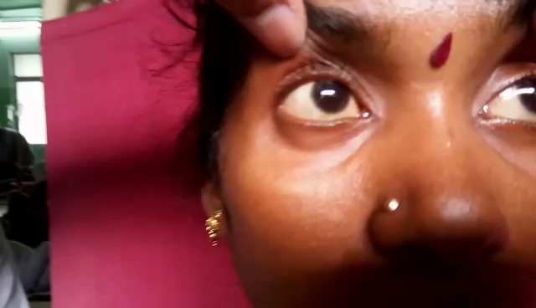

Slide 4




