Slide 1
AN INTERESTING ECG FROM IIIrd MEDICAL UNIT
CHIEF PROFFESSOR: DR.B.PALANI KUMAR MD
ASST PROFESSORS:
DR S.PONSENTHIL KUMAR MD
DR M.ILAMARAN MD

Slide 2
Chief complaints
62 years old male patient presented to GRH with complains of palpitation and giddiness for past 2 hours

Slide 3
HISTORY OF PRESENTING ILLNESS
Patient was apparently normal until 2 hours back patient presented with
H/o Palpitation
H/o giddiness
No H/O chest pain
No H/o Breathlessness
No H/O fever
PAST HISTORY:
H/O Similar complaints two weeks back treated at Theni Govt Medical College

Slide 4
ON EXAMINATION:
Conscious oriented
Afebrile
BP- Right UL 120/80 mmHg left UL- 130/80 mmHg
Right LL 120/80 mmHg left LL – 120/80 mmHg
SPO2 – 98 % RA SYSTEMIC EXAMINATION
CVS- S1 S2 + No murmur
RS- B/L AE+ No added Sounds
P/A - NAD
CNS- NAD

Slide 5
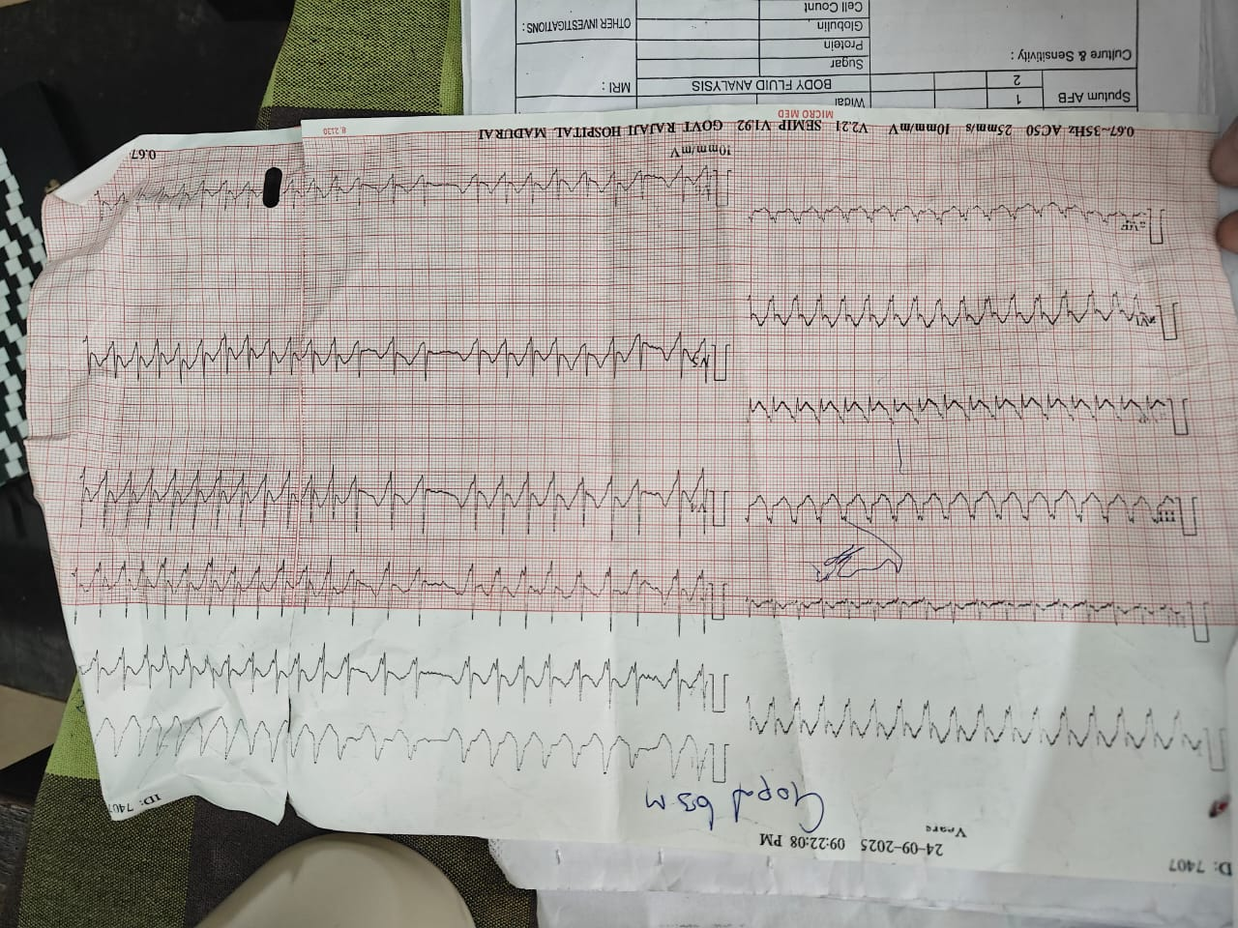

Slide 6
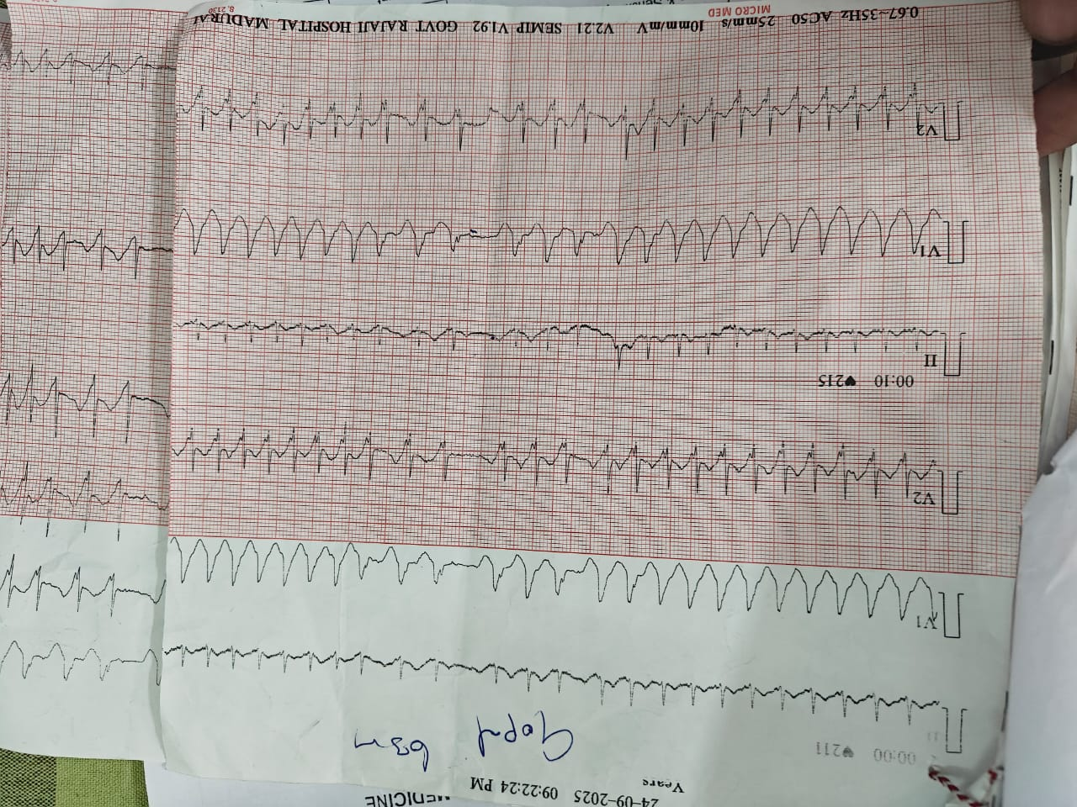

Slide 7
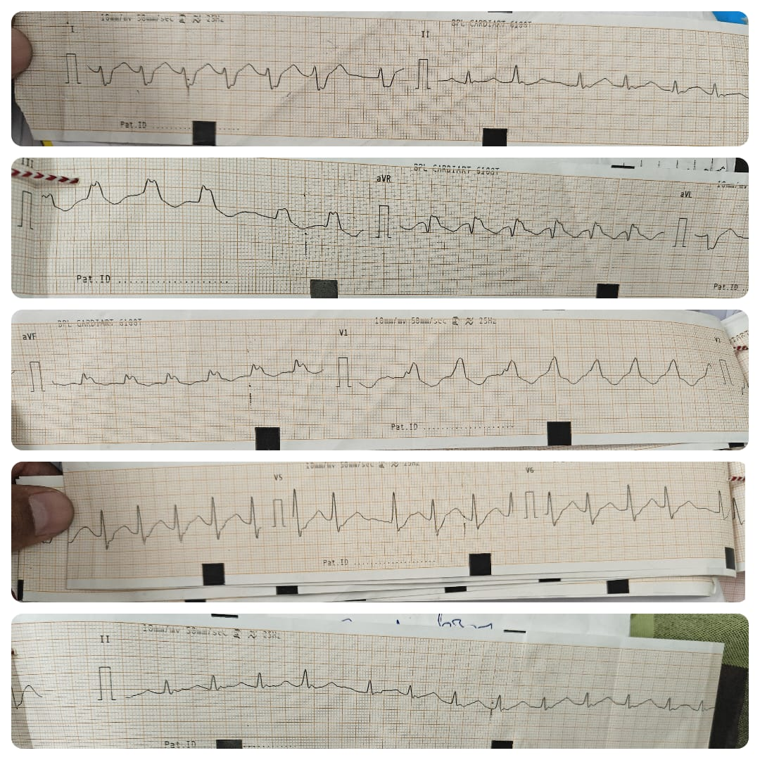
50 mm ecg

Slide 8
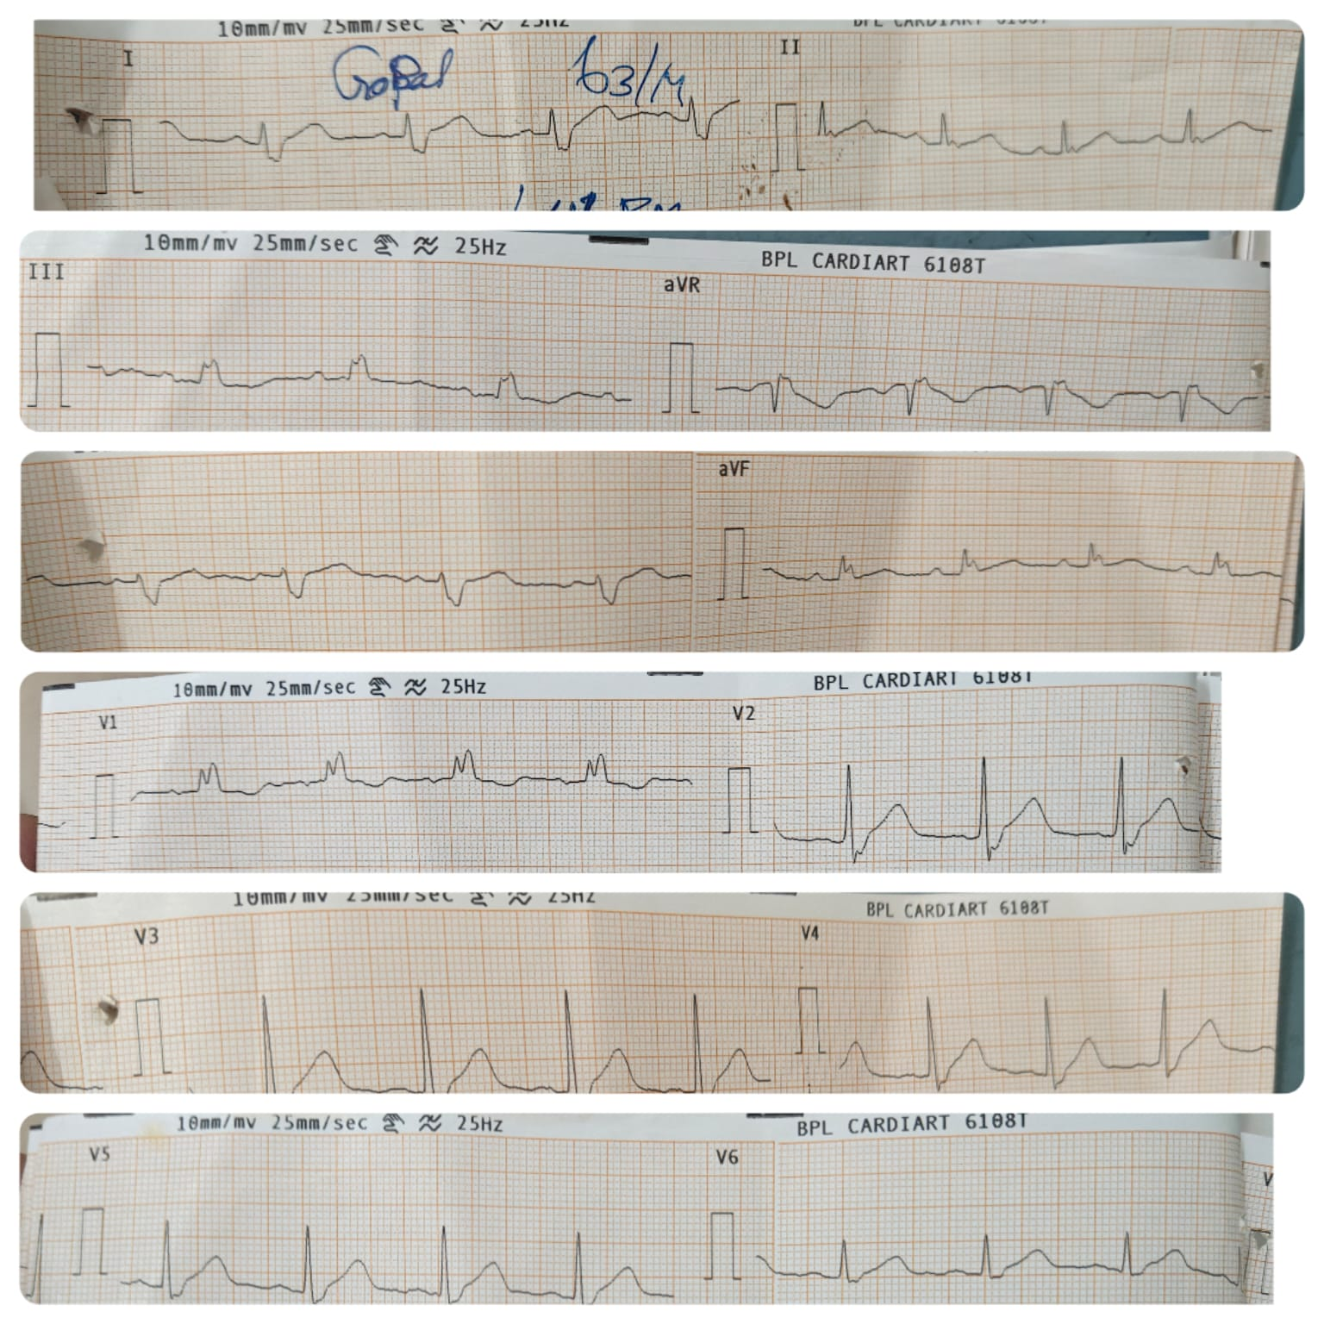

Slide 9
Let’s discuss

