Slide 1
INTERESTING CASE OF PANCYTOPENIA
DR.N.ILAVARASI
POST GRADUATE
MADURAI MEDICAL COLLEGE

Slide 2
HISTORY
26 yrs old female admitted with
Loss of appetite
Easy fatiguability 1 year
Bleeding PV &
Lower abdominal pain 10 days.

Slide 3
HISTORY
PAST HISTORY;
Repeated blood transfusions- GRH past 2 yrs
Not a k/c/o T2DM/SHT/BA/Seizures/Jaundice
No h/o previous surgeries
MENSTRUAL HISTORY
Menarche -13 yrs of age, regular cycle 5/28

Slide 4
history
PERSONAL HISTORY
Unmarried. Studied up to 12 th std.
Developmental mile stones normal
Sleep & appetite normal
Bladder & bowel habits normal
FAMILY HISTORY

Slide 5
GENERAL EXAMINATION
Short statured
Conscious
Oriented
Moderately built
Severe pallor +
No cyanosis
No clubbing
No significant lymphadenopathy
Not icteric
Not dyspneic
No markers of TB or HIV
NO NEURO CUTANEOUS MARKERS

Slide 6
GENERAL EXAMINATION
Diffuse Hyper keratosis
Hyper pigmentation over knuckles & tongue were present
Hypoplastic Right Thumb +

Slide 7
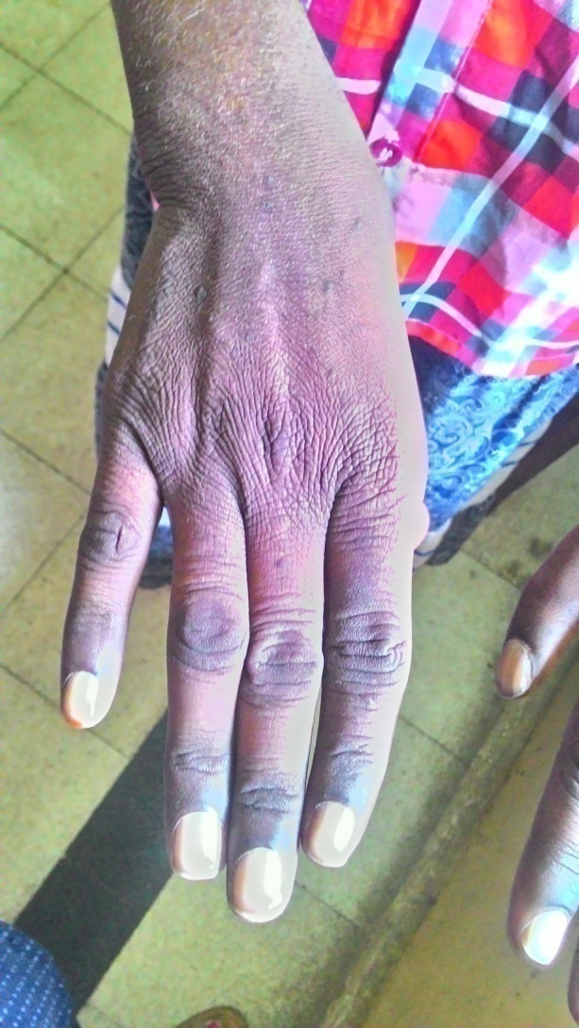

Slide 8
HYPO PLASTIC RIGHT THUMB

Slide 9
ANTHROPOMETRY
Height : 139 cm
Wt : 34 kg
Height ;neck ratio : normal
VITALS
BP : 100/60 mmhg
PR : 86/min
RR : 14/min
Temperature : 98.2 F
Fundus : PALE

Slide 10
SYSTEMIC EXAMINATION
CVS:
S1S2 +
Soft systolic haemic murmur +
RS : NVBS heard
P/A : Soft, no organomegaly
CNS : NFND

Slide 11
PROVISIONAL DIAGNOSIS
1. SHORT STATURE WITH SKELETAL
ABNORMALITIES
2. ANEMIA FOR EVALUATION

Slide 12
INVESTIGATIONS
RBS : 109
RFT : U-18,Cr-0.8
ELECTROLYTES : NORMAL
LFT : NORMAL
Urine routine : Normal
Blood grouping : O +ve
ECG : Normal
Lipid profile : Normal
USG ABDOMEN&
PELVIS : NORMAL STUDY
CXR :Normal study

Slide 13
INVESTIGATIONS
COMPLETE HEMOGRAM
Hb :5.9gms
TC :1600
Platelet :3000
ESR :95mm/hr.
PCV :18.8%
BT&CT :NORMAL
Reticulocyte count :0.5%
C.reti count :0.25%
ANC :976

Slide 14
INVESTIGATIONS
PERIPHERAL SMEAR
RBC; Anisopoikilocytosis,they show hypo chromic micro cytosis ,some of them show normo cytic normo chromic , few elongated cells seen.
WBC; Count slightly diminished.
Neutrophil -61%
Lymphocytes -38%
Monocyte - 1%
Platelets -3000
IMPRESSION:
PANCYTOPENIA

Slide 15
INVESTIGATIONS
Repeat values showed
Hb;6.8 gms, TC ;2300,platelet-17,000
REPEAT peripheral SMEAR showed:
Marked hypo chromic micro cytic anemia with thrombocytopenia.
WBC count ;normal.
BONE MARROW ASPIRATION
Markedly diluted with peripheral blood .
Marrow particles not seen.
IMPRESSION:
ANEMIA WITH THROMBOCYTOPENIA.

Slide 16
X RAY – BOTH HANDS

Slide 17
X RAY REPORT
Right:
Thumb hypo plastic
Bone, joints normal
Left:
Thumb appears normal
Hand with joint & soft tissue normal

Slide 18
EVALUATION
2D echo :Normal
OGD :Normal
Fundus :Pale
TFT :Hypo thyroid
Audiogram :Normal
Screening x rays :Normal
ANA :Negative
VIRAL MARKERS:
1.HIV :Negative
2.HBsAg :Negative
3.HCV :Negative

Slide 19
EXPERT OPINION
?APLASTIC ANEMIA
BMA: Inconclusive
SUGGESTED
1.Repeat BMA
2.Bone marrow biopsy
3.Cytogenetic studies

Slide 20
FATTY MARROW
WITH MYELOID AND ERYTHROID SERIES

Slide 21
BONE MARROW BIOPSY

Slide 22
CYTOGENETIC STUDIES
CHROMOSOMAL BREAKAGE ANALYSIS
done at
CHRISTIAN MEDICAL COLLEGE. VELLORE

Slide 23
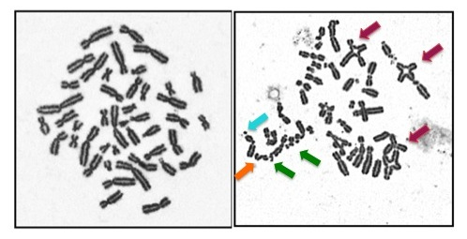
CHROMOSOMAL BREAKAGE

Slide 24
OUR PATIENT ‘S Chromosome Breakage Analysis

Slide 25
OUR PATIENT ‘S Chromosome Breakage Analysis

Slide 26
Analysis report

Slide 27
DISCHARGE ADVICE
Case of FANCONI`S ANEMIA.
ADVISED:
1.C.DANAZOL.200 mg 1-0-1
2.T. FOLIC ACID 1-0-1
3.T. BC 1-0-1
4.T. FS 1-0-1
Genetic counselling given

Slide 28
DIAGNOSIS
1.Short stature
2.Hypo plastic thumb
3.Hyper pigmented lesions
4.Pancytopenia/Aplastic anemia
5.Chromosomes sensitive to MITOMYCIN C
FINAL DIAGNOSIS
1. FANCONI’S ANEMIA
2. HYPOTHYROIDISM

Slide 29
AIM OF PRESENTATION
Rare case.
Rare in ADULTS
Incidence 1 in 3,60,000 individuals
Treatment is different
FUTURE PLAN:
Bone marrow transplantation at JIPMER.
Family screening.

Slide 30
REFERENCE ARTICLE
The concept and practice of Fanconi Anemia: from the clinical bedside to the laboratory bench:
From Western Sydney Genomics, Western Sydney Genetic Program, The Children’s Hospital at Westmead, NSW, Australia
Correspondence to: Dr Zhan-He Wu. Western Sydney Genomics, Western Genetic Program, NSW, 2145, Australia. Email: zhan.wu@health.nsw.gov.au.

Slide 31
Carry home message
1.Short stature
2.Hypo plastic thumb
3.Hyper pigmentation
4.Pancytopenia/Aplastic anemia
Think of FANCONI`S ANEMIA

Slide 32
discussion
Defective DNA repair
AR disorder; except FANCB- XR
15 genes responsible.FANCA most common
Cause of death – Bone marrow failure
Male : Female ; 1:1
Squmous cell CA commonest malignancy
Diagnosis : Physical , marrow failure, MDS or AML in an atypical age
Chromosomal fragility in T-lymphocytes is gold standard
HSCT treatment of choice.ATG or cyclosporine

