Slide 1
ECG in Amitriptyline poisoning
Vth medical unit
Prof Dr.J.Sangumani
Asst prof Dr.R.Sundaram
Asst Prof Dr.S.Murugesan

Slide 2
History
A 32years old female patient admitted with alleged history of ingestion of 16 tablets of Amitriptyline 25mg.
Not a known psychiatric patient.

Slide 3
Clinical examination
Conscious
Moderately built
Pulse: 108 / min
BP : 100 / 70 mm Hg
RR : 14 / min
SpO₂ : 99% on room air
Review of systems : Clinically normal.

Slide 4
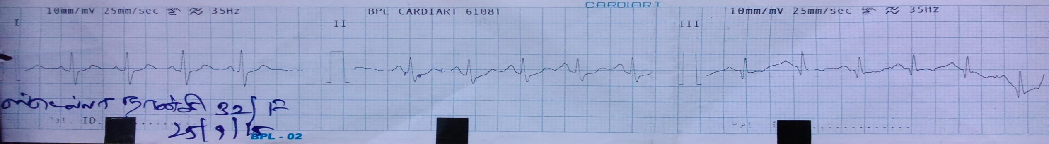
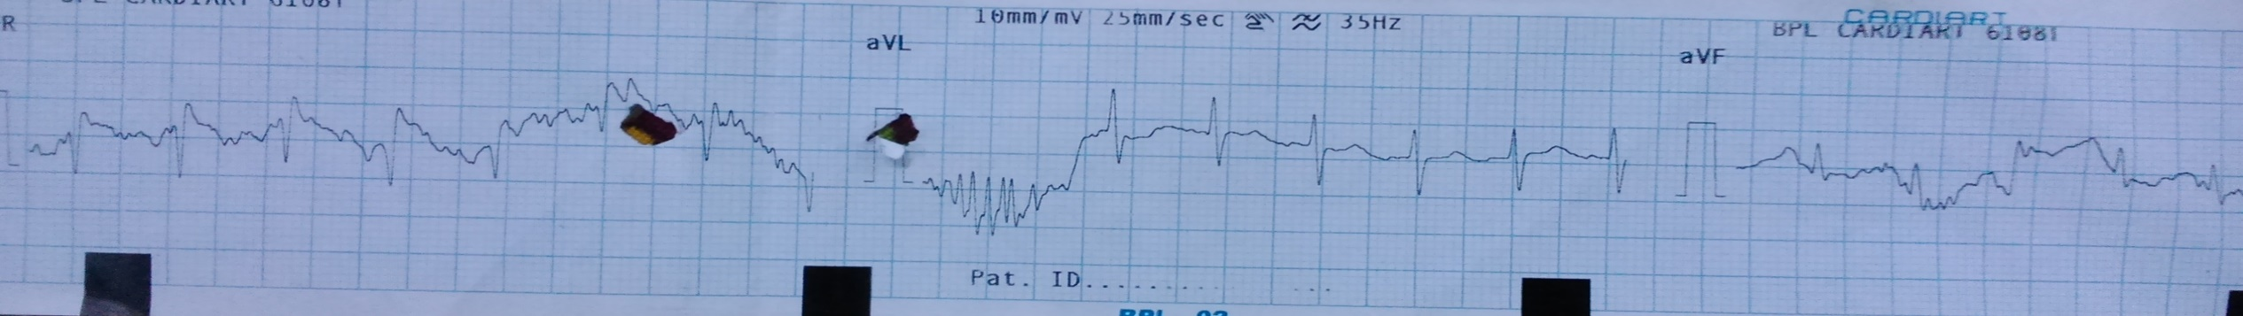
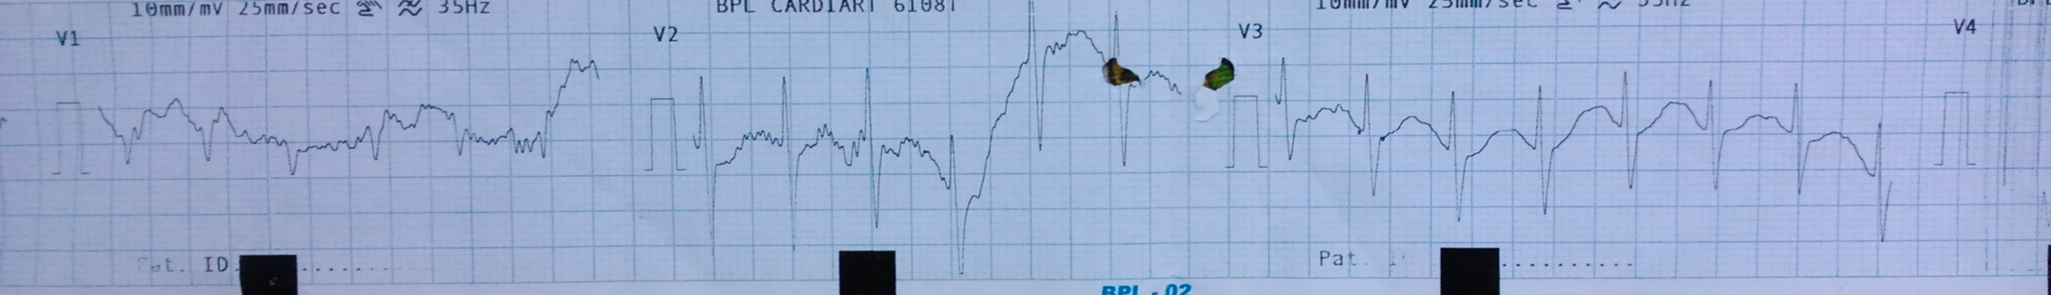
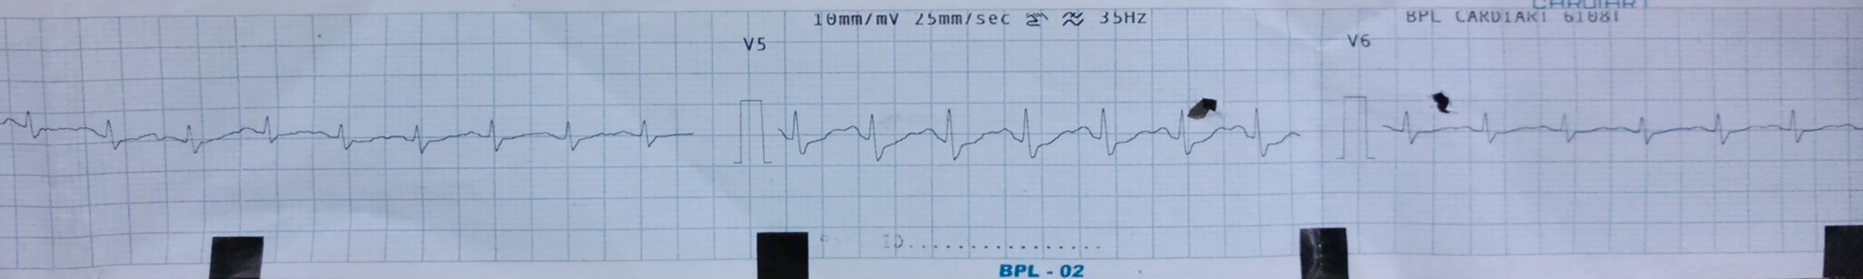

Slide 5
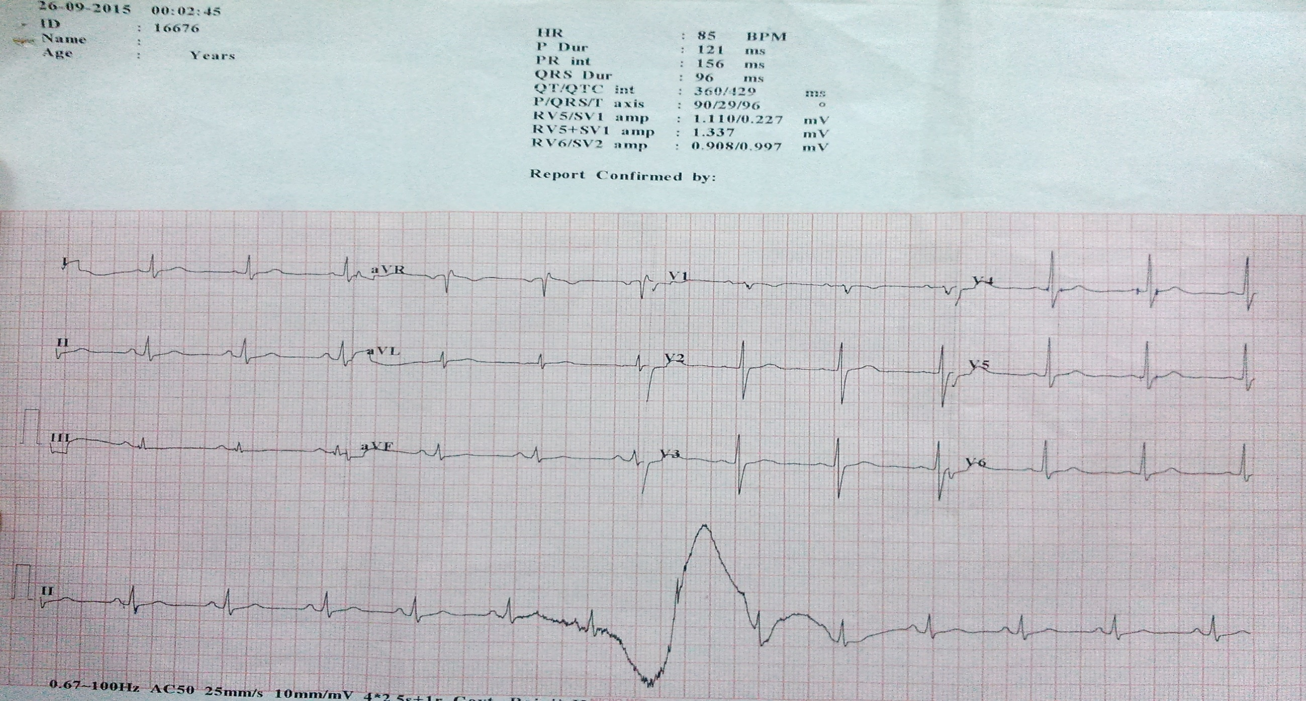

Slide 6
THANK YOU

