Slide 1
An interesting case of splenomegaly
IV th MU
Chief - Dr. R.Sundaram, M.D.,
Asst. Professors - Dr.S.Sugadev, M.D.,
Dr.P.Krishnarajan, M.D.,
Presenter - Dr.G.Preethi
(2nd year Post graduate)

Slide 2
A 35 year old male Mr Selvam presented with complaints of breathlessness for past 3 months
H/O presenting illness:
H/O breathlessness for past 3 months - insidious onset, gradually progressive in nature, initially during exertion then progressed to even at rest (from MMRC grade 1 to 4)
H/O abdominal pain for past 2 month - left sided dragging type of pain, dull aching, non radiating pain, associated with abdominal distension.
No H/O vomiting/loose stools/chest pain/palpitations.
No H/O fever/cough with expectoration.
No H/O swelling of legs/reduced urine output.
No H/O yellowish discoloration of eyes and urine
Past H/o :
Not a k/c/o DM / HTN / CAD / thyroid / seizure disorder / PTB or similar illness in past.

Slide 3
Personal H/o :
Mixed diet
Occasional smoker and alcoholic
General examination:
Conscious,oriented
Pallor(+), tachypneic
No Clubbing,not icteric
No pedal edema
left supraclavicular node of size 0.5 * 0.5 cm and left axillary node of size 2*2 cm present (non tender & hard in consistency )

Slide 4
Systemic examination:
RS – Trachea shifted to right side,
left supraclavicular fullness present
chest movement reduced in left hemithorax
Stony dullness present over left hemithorax starting from 2nd intercostal space
Air entry , VF, VR reduced in left hemithorax
P/A - soft,
spleen - palpable 8 cm below left costal margin, crosses umbilibcus.
hard in consistency.
Liver palpable 3 cm below right costal margin, firm in consistency
CVS – S1,S2+, no murmur
CNS - NFND

Slide 5
Investigations:
Differential count
CBC
WBC count | 10600 cells/cu.mm
Hemoglobin | 10.6 g/dl
ESR | 56mm/hr
HCT | 36.9%
Platelets | 9,51,000cells/cu.mm
PDW | 9.7 fL
MPV | 8.3 fL
MCV | 78.7 fL
MCH | 24.7 pg
MCHC | 30.1 gm/dl
Neutrophils | 84%
Lymphocytes | 10%
Eosinophils | 2%
Mixed | 4%
Peripheral smear :-
RBC shows anisopoikilocytosis, with microcytic hypochromic and elongated cells. WBC count increased,no atypical cells.
RFT & LFT : Normal

Slide 6
Pleural fluid analysis
VCTC, viral markers | Non reactive
Smear for MP, MF | Negative
Serum LDH | 3240 u/l
Serum uric acid | 7.3 mg/dl
RA Factor | Negative
TSH | 3 mIU /L
Appearance | hemorrhagic
Sugar | 25 mg%
LDH | 6357 mg%
Protein | 5693 mg%
Cell count | 3000 cells/cumm
DC | LYM;70% PMN:30%
ADA | 101 IU/L
CBNAAT | Negative

Slide 7
TREATMENT GIVEN :-
Supportive care and empirical ATT started
Left ICD insertion

Slide 8
USG NECK & THYROID :-
THYROID
10x7mm well defined hyperechoic lesion with internal cystic areas without any calcification noted in right lobe of thyroid
Possibility of TIRADS II lesion in Right lobe of thyroid
NECK
Multiple enlarged nodes noted in left level IV Supraclavicular and Left axilla with internal fatty hilum. No evidence of necrosis or calcification noted. Largest measuring 2.7x1.5 cm in left SCL area and in axilla(3.3x1.4cm). All nodes appear discrete.

Slide 9
CT ABDOMEN PLAIN AND CONTRAST
IMPRESSION:
Spleen appears grossly enlarged with multiple ill defined hypodense areas noted within spleen . Multiple enlarged paraaortic, aortocaval and bilateral common iliac nodes noted.
Cortical erosion with partial collapse of L5 vertebra noted
CT CHEST
IMPRESSION:
Left gross pleural effusion causing passive collapse of lung fields
Trachea shifted to right side

Slide 10
Bone marrow biopsy:
Microscopy - section studied shows bony trabeculae and islands of haematopoietic elements. Normocellular for age. Erythropoiesis show micronormoblastic and normoblastic maturation. Leukopoiesis show normal pattern of maturation. Megakaryopoiesis active.
IMPRESSION - REACTIVE MARROW
PLEURAL FLUID CELL BLOCK & CYTOLOGY :-
Smear studied shows mature squamous cells, ciliated columnar epithelial cells, macrophages & degenerated inflammatory cells & Eosinophilic material seen.
no evidence of granuloma/malignancy seen.

Slide 11
LEFT AXILLARY LYMPH NODE – FNAC
Occasional clusters of degenerated cells in hemorrhagic background.
LEFT AXILLARY LYMPH NODE – EXCISION BIOPSY :-
Microscopy shows structure of lymph node with diffuse sheets of small lymphocytes with few thin walled blood vessels. No granuloma made out.
IMPRESSION - REACTIVE LYMPHADENITIS

Slide 12
PET CT
Metabolically active massive splenomegaly with necrotic areas and FDG avid lesion noted in segment 2 of liver measuring 111x45mm.
Metabolically active lesion in pancreas and omental and peritoneal thickening.
Metabolically active multiple lymphadenopathy and multiple skeletal marrow lesions present.

Slide 13
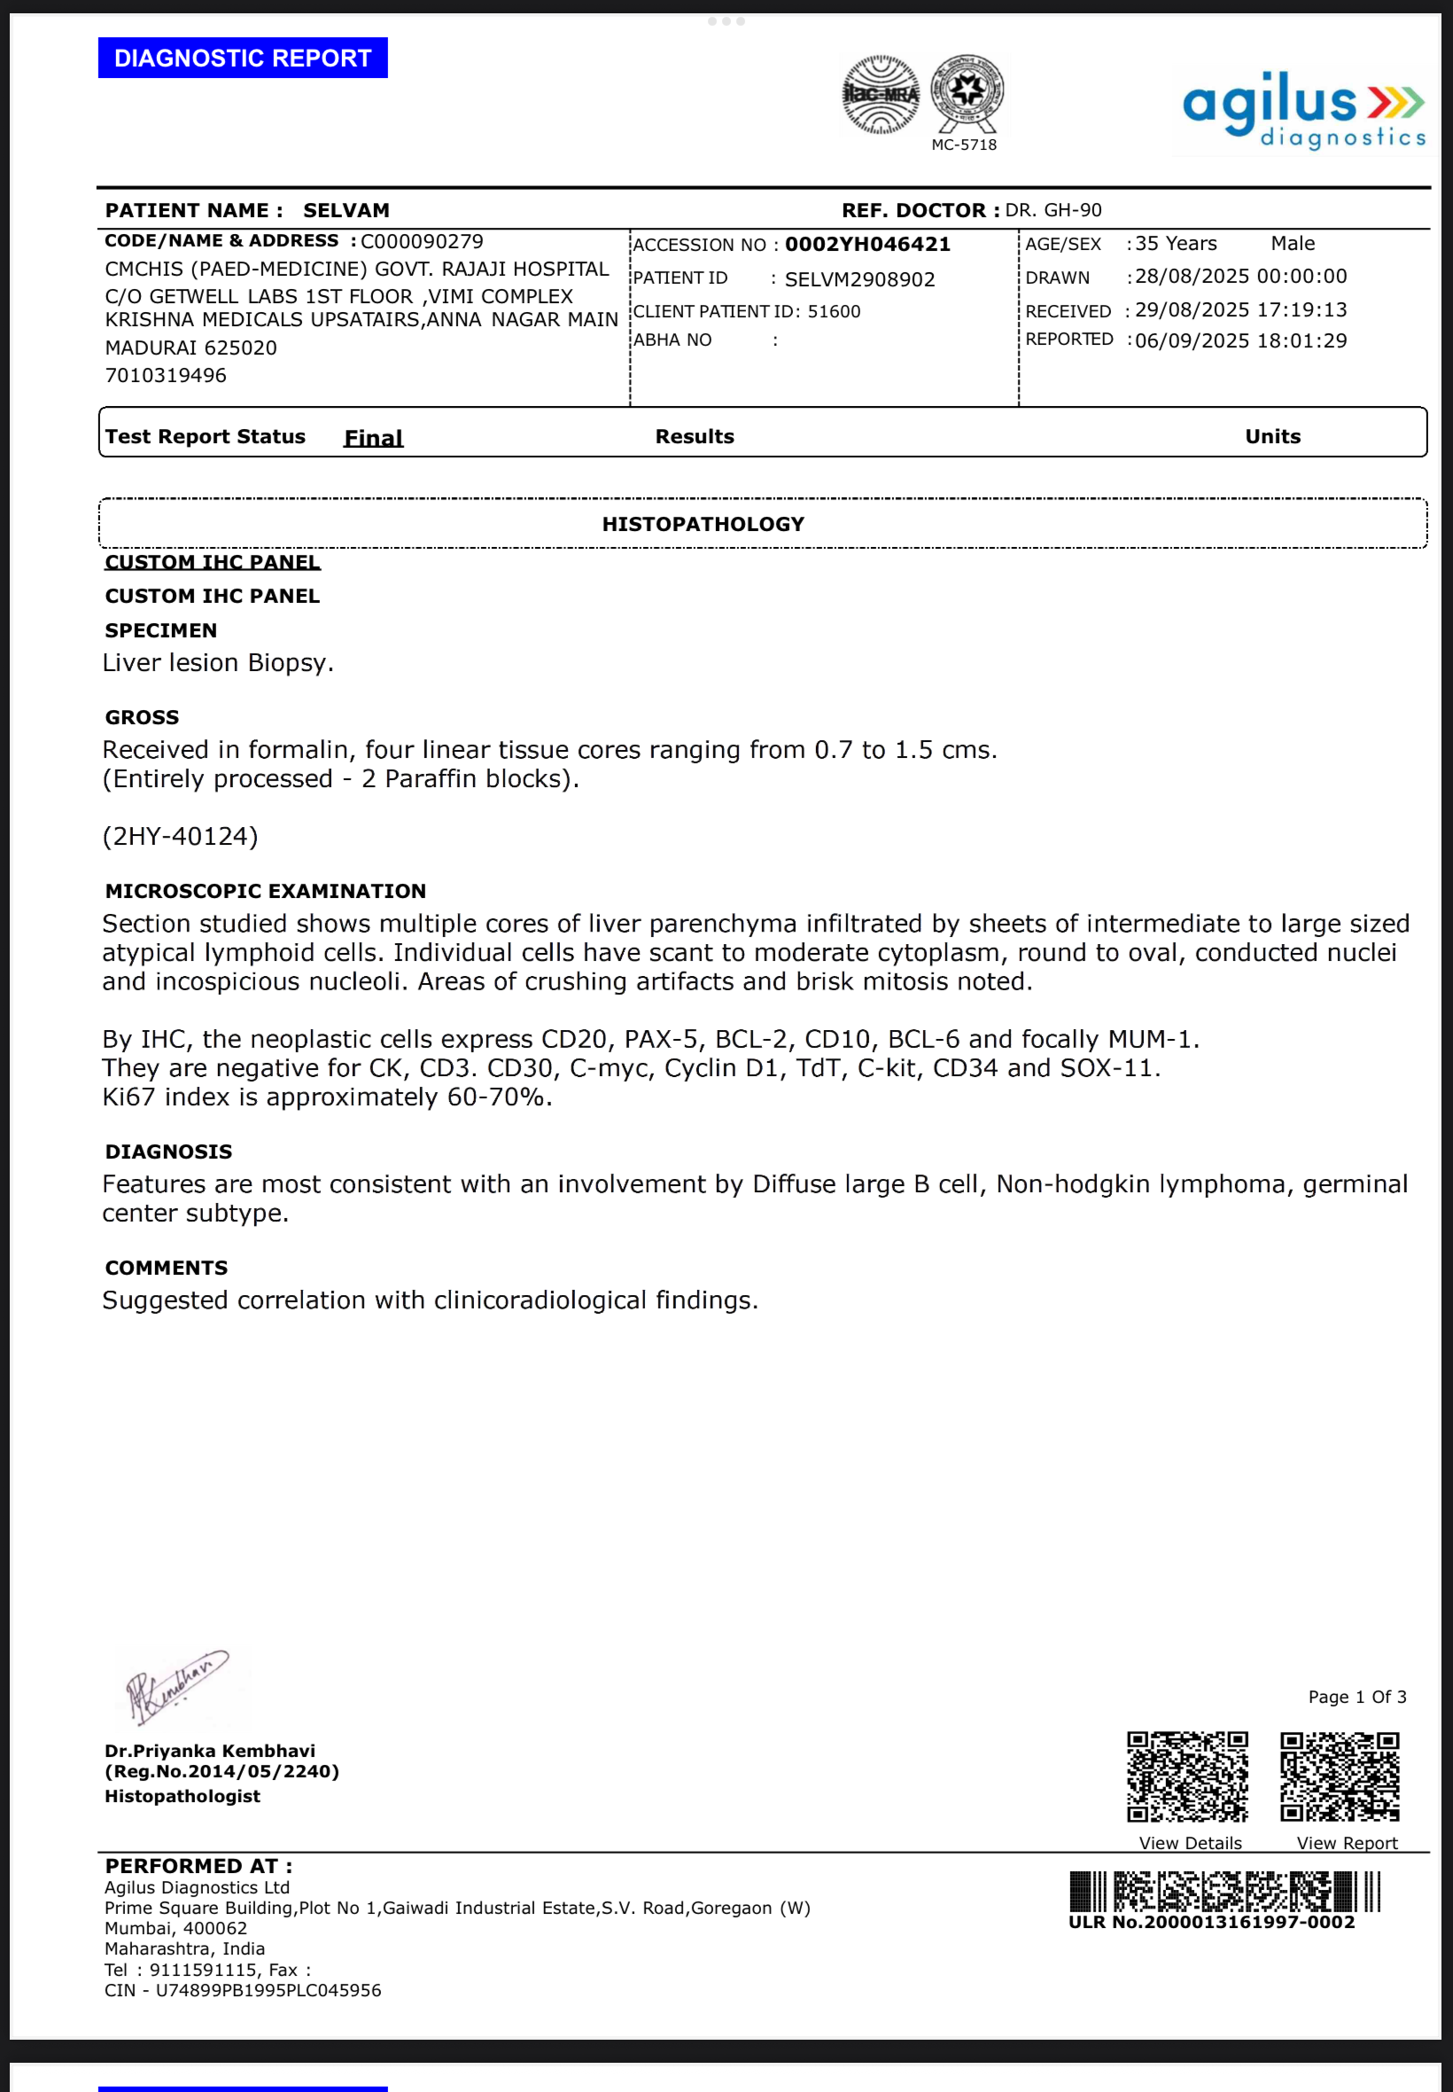
LIVER BIOPSY

Slide 14
DIAGNOSIS :-
Diffuse large B cell Non Hodgkin Lymphoma ,
Germinal centre – Subtype
IHC – CD20, PAX-5, BCL-2,CD10,BCL-6 & focally MUM-1.

Slide 15
THANK YOU

