Slide 1
AN INTERESTING CASE FOR DISCUSSION
II MEDICAL UNIT
CHIEF: DR. DAVID PRADEEP KUMAR
ASSISTANT PROF: DR. PRABHU
DR. NASEEMA BANU
DR. RAMKUMAR
PRESENTOR: DR. VIKRAM KRUSHNAA

Slide 2
33-year-old female home maker c/o difficulty in breathing for 2 months PRESENTING ILLNESS: Patient c/o difficulty in breathing, gradually progressive (NYHA Grade II – Grade IV) h/o cough with expectoration 2 months, mucoid, not blood stained. h/o fever, low grade, intermittent. No h/o Abdominal pain No h/o decreased urine output No h/o chest pain No h/o leg swelling or pain

Slide 3
PAST HISTORY:
Patient treated in private and diagnosed as ?organizing pneumonia ? Malignancy/
moderate pulmonary hypertension for 1 month.
Personal history:
Normal
Vitals : BP:110/70 mm Hg
PR:110/min. Regular, normal volume
SpO2:80% in RA
94% in 8L O2

Slide 4
O/E: Pt conscious, afebrile
JVP elevated
No pallor, pedal edema, icterus, cyanosis, clubbing, generalised lymphadenopathy
S/E:
CVS: S1S2, loud S2
RS: BAE, B/L fine crepitations
P/A: soft, BS
CNS: NFND

Slide 5
 | 24/12/24 | 25/12/24 | 26/12/24 | 03/01/25 | 5/01/25 | 8/1/25 | 10/1/25 | 12/1/25
TC | 18,700 | 14,100 | 11,200 | 8000 | 17,300 | 15,000 | 14,000 | 12000
RBC | 4.69 | 4.85 | 4.69 | 4.17 | 4.55 | 4.65 | 4.75 | 4.72
Hb | 8.4 | 9.7 | 8.4 | 8.2 | 8.7 | 8.0 | 8.5 | 9
Hct | 29.3 | 33.6 | 29.3 | 28.4 | 31.1 | 28 | 30 | 35
Plt | 2.59 L | 2.68 L | 2.59 L | 3.16 L | 1.52 L | 1.44L | 2.25L | 2.75L

Slide 6
 | 24/12 | 25/12 | 27/12 | 30/12 | 3/1 | 6/1
RBS | 90 | 97 | 100 | 95 | 100 | 90
UREA | 18 | 31 | 32 | 25 | 28 | 30
CREAT | 1.0 | 1.0 | 0.8 | 1.1 | 0.9 | 1.0
Na/K | 134/3.5 | 133/3.8 | 136/3.6 | 130/3.5 | 135/3.8 | 138/3.8
TOTAL BILIRUBIN | 0.6 | 0.9 | 0.8 | 0.7 | 0.6 | 0.8
DIRECT BILIRUBIN | 0.4 | 0.5 | 0.7 | 0.6 | 0.8 | 0.5
INDIRECT BILIRUBIN | 0.2 | 0.4 | 0.4 | 0.3 | 0.5 | 0.4
OT/PT | 13/18 | 16/10 | 20/15 | 20/18 | 15/22 | 18/20
ALP | 107 | 93 | 100 | 98 | 100 | 105

Slide 7
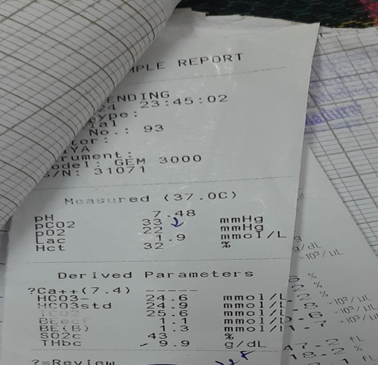
 | 25/12/24 | 29/12/24 | 3/1/25 | 9/1/25
CRP | 20.1 | 73.5 | 136 | 83
ESR | 48 | 60 | 38 | 33
VCTC and VM – Negative
Peripheral smear : Microcytic hypochromic anaemia
Rheumatoid factor: Negative ANA (IF method): Negative ANCA: Negative Sputum CBNAAT: MTB not detected

Slide 8
USG Abd and pelvis – normal ECHO- RA, RV dilated severe PHTN EF-70 % ? Cor pulmonale

Slide 10
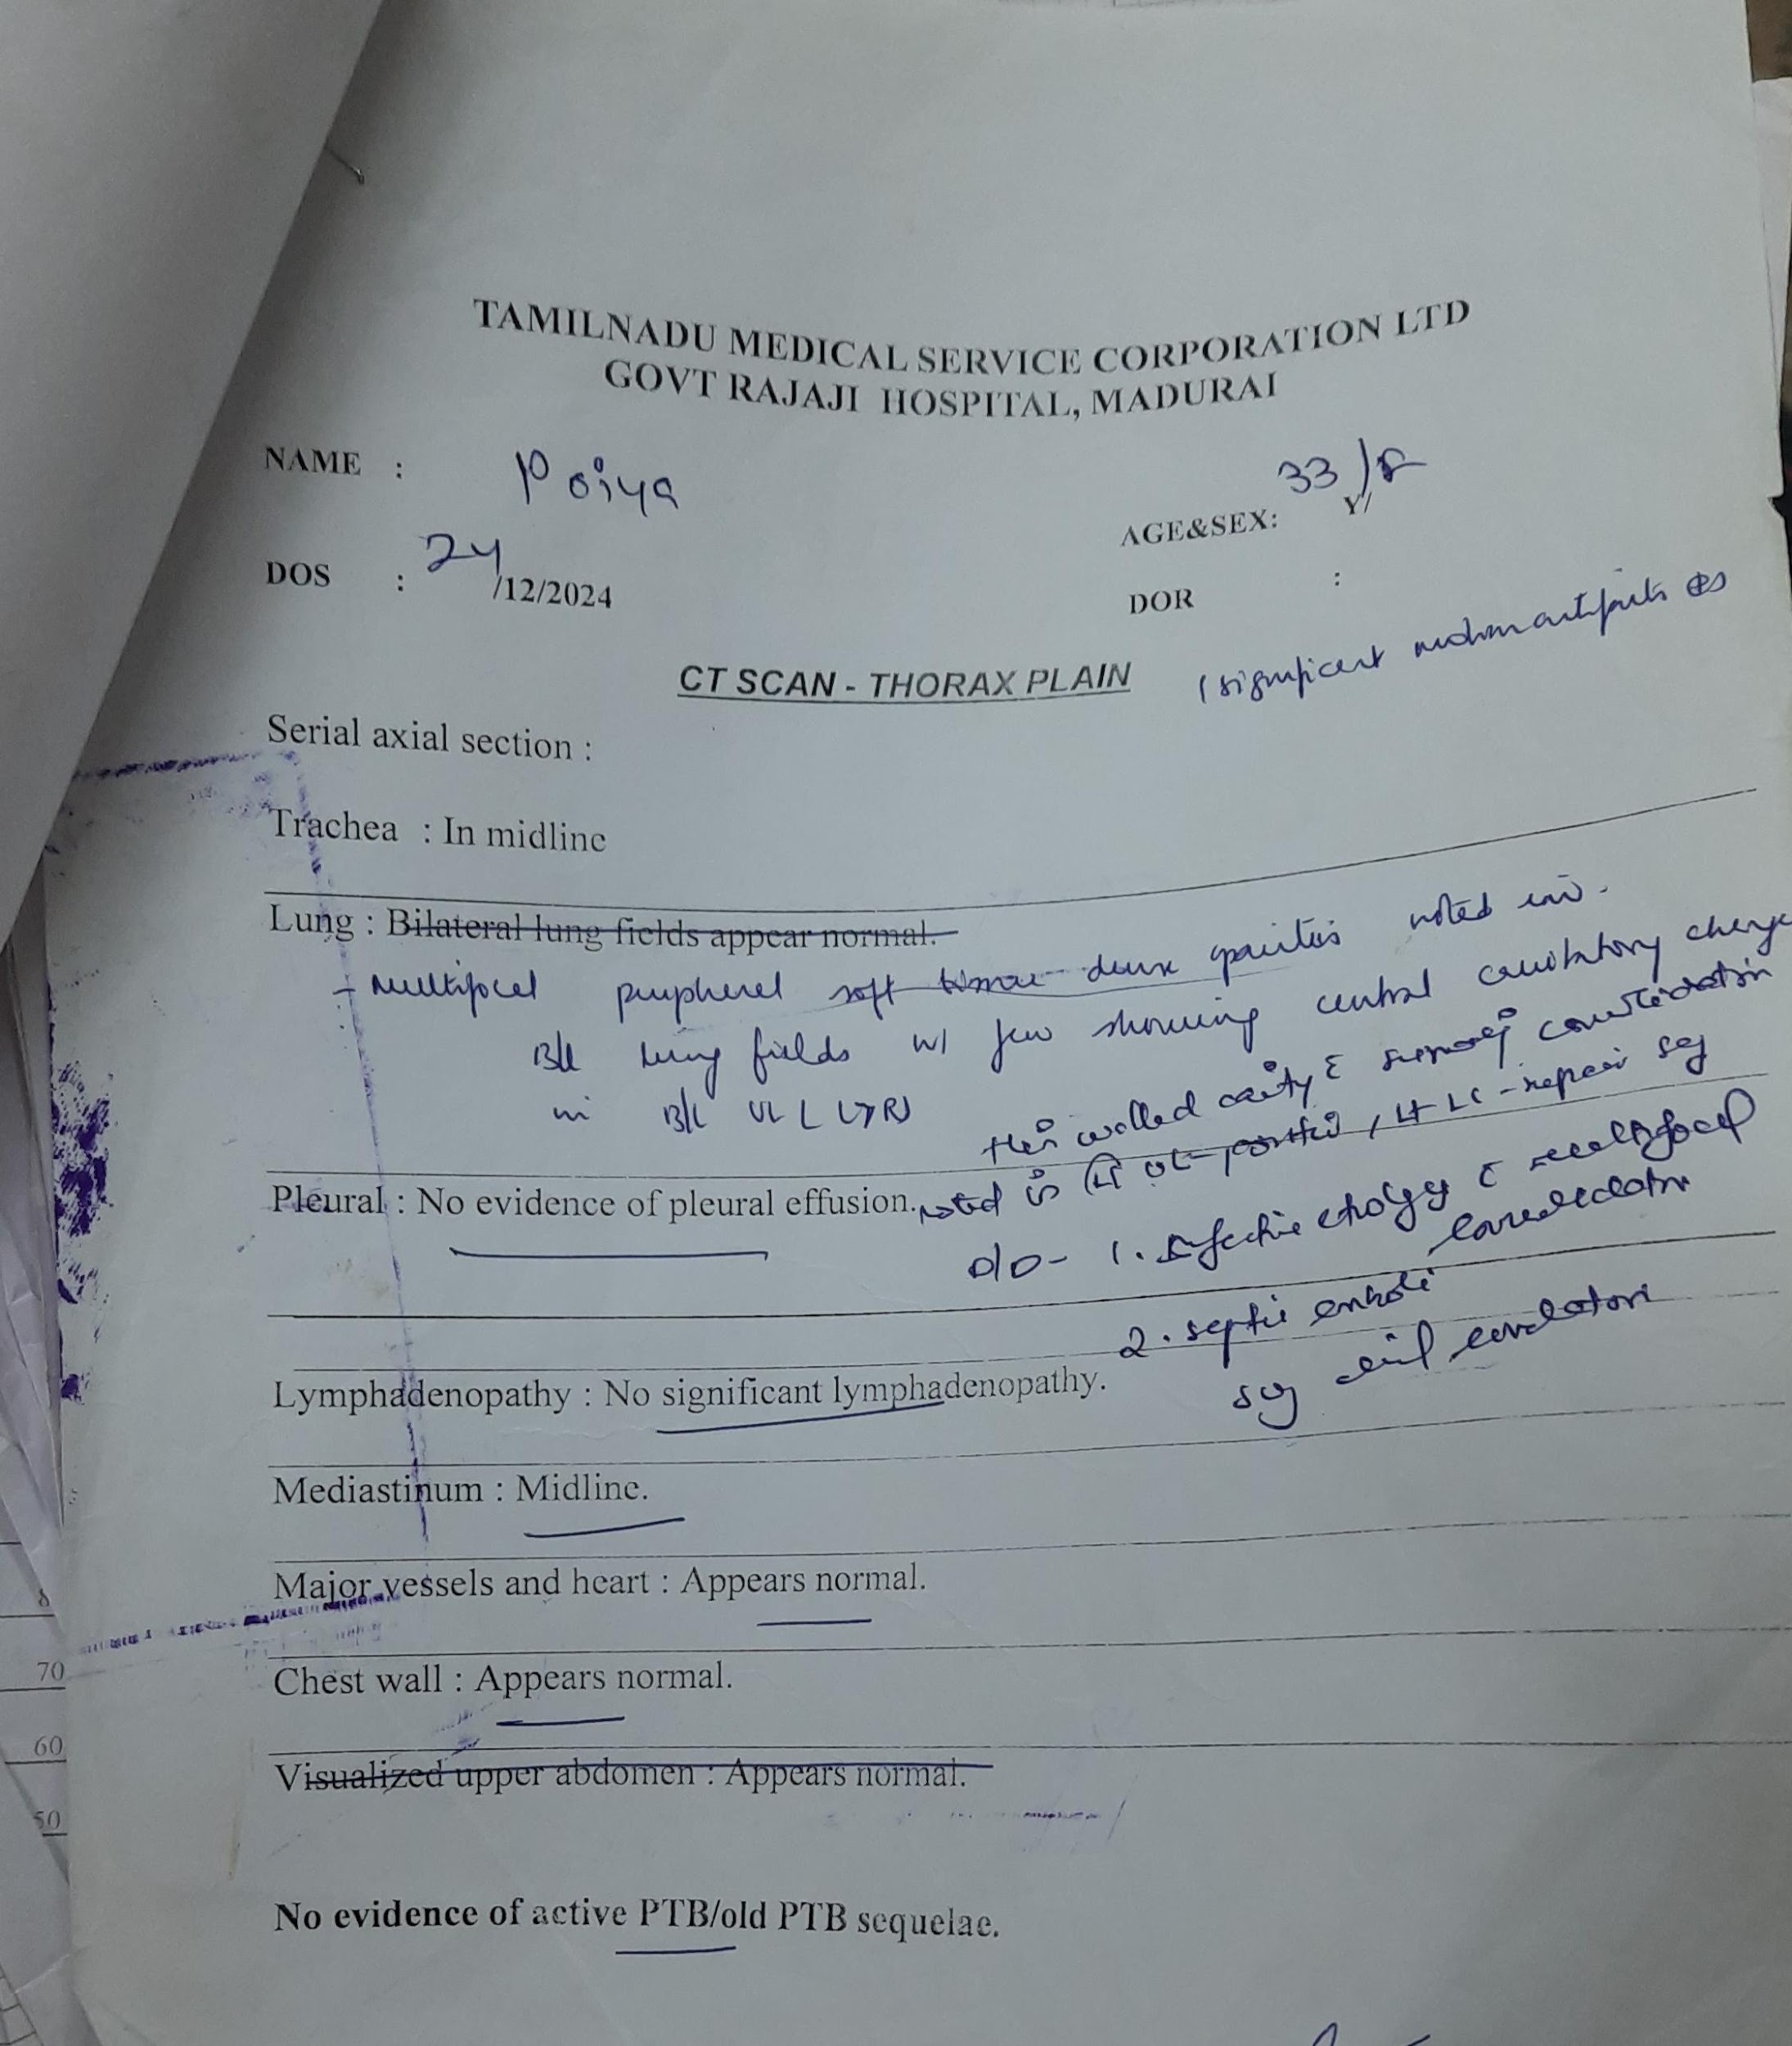

Slide 11
Urine C/S – CANDIDA PARAPSILOSIS growth
High vaginal swab – CANDIDA tropicalis growth
Blood c/s – non fermentative GNB
Sputum c/s- CANDIDA PARAPSILOSIS growth

Slide 12
Thoracic physician opinion: (25/12/24)
Imp: Moderate pulmonary hypertension / ?organizing pneumonia
?PTB ?Viral pneumonia ?septic emboli
Advice:
Sputum CBNAAT and C&S
Blood C&S / ABG
Rheumatoid factor
CRP
ANA
Continue nasal o2
Continue antibiotics

Slide 13
OG opinion: (30/12/24)
Urine C&S - profuse Candida parapsilosis
Advice:
T. Fluconazole 150 mg stat
Repeat urine C&S
High vaginal swab
USG Abdomen and pelvis
Perineal hygiene

Slide 14
Thoracic physician opinion: (5/1/25)
Imp: bilateral cavitating pneumonia ? Fungal
Advice:
To continue Amphotericin B
D-Dimer
Repeat chest X-ray after 7 days
To continue nebulization

Slide 15
TREATMENT GIVEN:
Nasal O2
Inj Imipenam 1gm IV tds cap Oseltamivir 75 mg 1-0-1 tab Azithromycin 500 mg 1-0-0
Inj Amphotericin B 40 mg IV OD
Inj Methyl prednisolone 150 mg IV OD T. Spironolactone 25 mg 1-0-0
Nebulisation and supportive care

