Slide 1
ECG FOR DISCUSSION
BY 3rd medical unit chief: DR. DAVID PRADEEP KUMAR MD MRCp
ASST PROF: DR. RAMKUMAR MD
DR. NASEEMA BANU MD
DR. NABIL FAYAZ MD
PRESENTOR: DR. Sneha srinivasan

Slide 2
A 53 year old male patient came with chief complaints of breathlessness for past 2 days
HISTORY OF PRESENTING ILLNESS
Patient was apparently normal before 2 days. Then presented with chief complaints of breathlessness of NYHA class 3 aggravated on exertion and relieved on taking rest
No H/O chest pain, palpitation
No H/O cough with expectoration
No H/O pedal edema, abdominal distension
No H/O syncope, oliguria

Slide 3
PAST HISTORY
K/c/o CAD/ Old IWMI / HFrEF 32 % on regular medication
Not a K/C/O Type 2 DM, SHTN, CVA, Bronchial asthma, TB
No other surgical history in past
PERSONAL HISTORY
Mixed diet
Normal bowel and bladder habits
Normal sleep pattern
Occasional alcoholic and smoker

Slide 4
GENERAL EXAMINATION
Conscious , oriented, afebrile , no pallor, no pedal edema ,not icteric, no cyanosis , no clubbing and no generalized lymphadenopathy
VITALS
BP: 140/90 mm/Hg – left upper arm in supine posture
PR : 112/min
SPo2- 98 % in room air

Slide 5
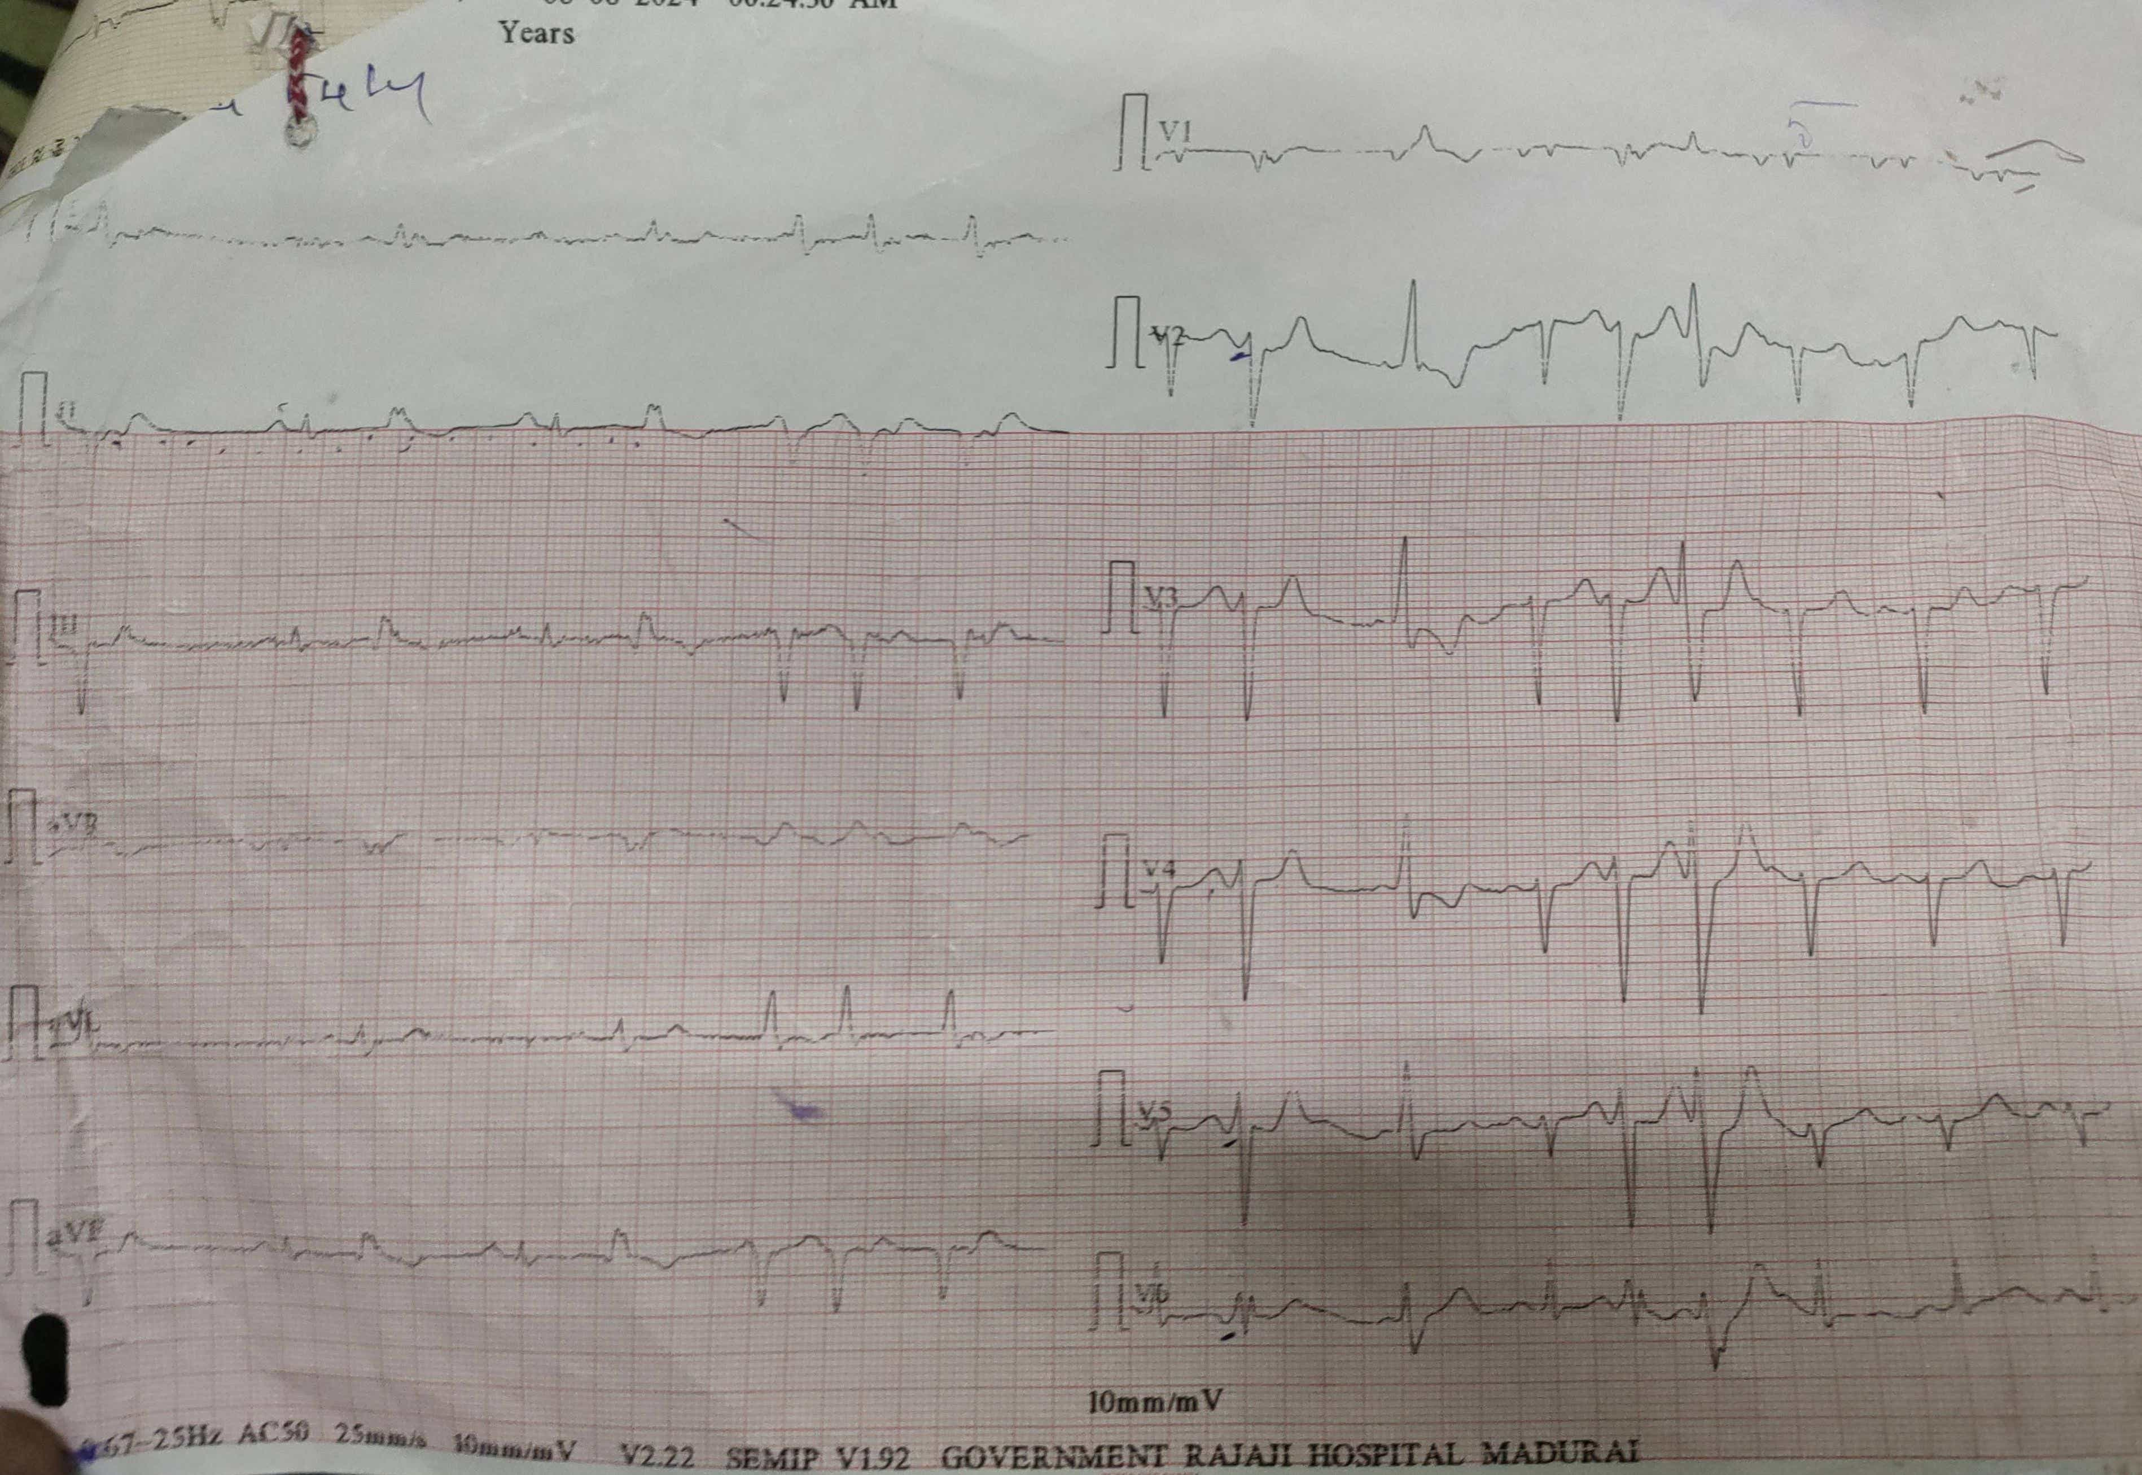

Slide 6
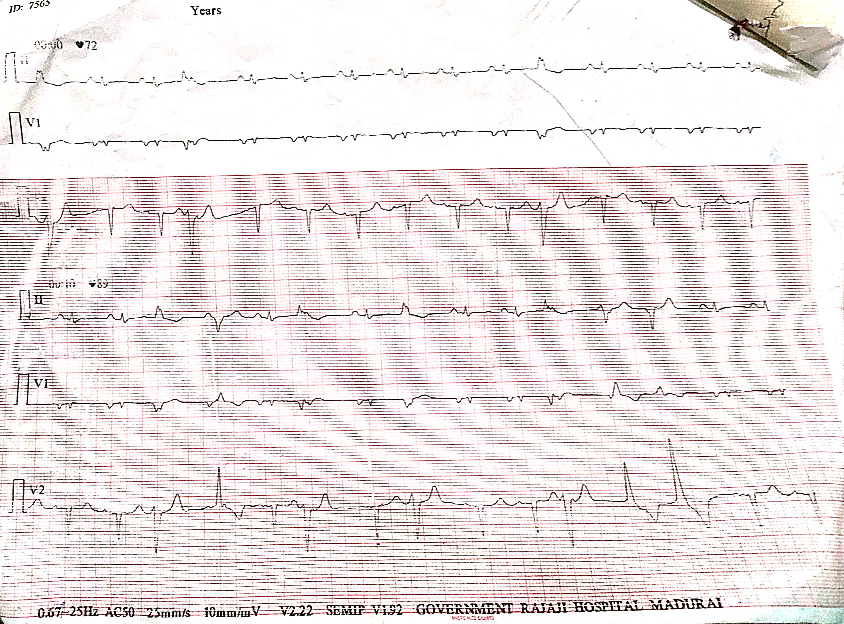

Slide 7
THANK YOU

