Slide 1
DENGUE VACCINE-BUTANTAN
BY 6TH MEDICAL UNIT
CHIEF:PROF DR S.PEER MOHAMED M.D
ASST PROF:DR.M.SATHEESH KUMAR M.D
DR.C.VIGNESH M.D
DR.V.PRIYA M.D
PRESENTER-HARSHON ROY

Slide 2
PUBLISHED ON JAN 31,2024

Slide 3
PREVIOUS DENGUE VACCINES

Slide 4
INTRODUCTION
FOUR SEROTYPES OF DENGUE VIRUS CIRCULATE WORLDWIDE,CAUSING AN ESTIMATED 390 MILLION INFECTIONS ANNUALLY
THE LARGEST BURDEN OF DENGUE DISEASE OCCURS IN SOUTHEAST ASIA,CENTRAL AND SOUTH AMERICA
ALTHOUGH MOST PRIMARY DENGUE INFECTIONS ARE ASYMPTOMATIC,DENV CAN RESULT IN SEVERE DISEASE PARTICULARLY WITH SECONDARY HETEROTYPIC INFECTION
THE GOAL OF DENGUE VACCINE IS TO OFFER PROTECTION AGAINST ALL SEROTYPES

Slide 5
BACKGROUND OF STUDY
TWO TETRAVALENT LIVE ATTENUATED DENGUE VIRUS VACCINES ARE CURRENTLY LICENSED,HOWEVER A SINGLE DOSE VACCINE THAT IS INDICATED FOR A BROAD AGE RANGE AND PROTECT AGAINST ALL FOUR DENGUE SEROTYPES IS NEEDED
BUTANTAN-DENGUE VACCINE(Butantan-DV) IS SINGLE DOSE LIVE ATTENUATED TETRAVALENT VACCINE AGAINST DENGUE DISEASE

Slide 6
INCLUSION CRITERIA
CHILDREN OVER 2 YEARS OF AGE
ADOLESCENTS AND ADULTS UP TO 60 YEARS
AGREE TO PERIODIC CONTACT BY TELEPHONE,ELECTRONIC MEANS AND HOME VISITS

Slide 7
EXCLUSION CRITERIA
PREGNANCY
BREAST FEEDING MOTHERS
IMMUNOCOMPROMISED INDUIDUALS
SUSPECTED OR CONFIRMED FEVER WITHIN 72 HOURS PRIOR TO VACCINATION
H/O PREVIOUS LIVE VACCINE ADMINISTRATION IN LAST 28 DAYS
H/O BLOOD TRANSFUSIONS IN LAST 3 MONTHS
IMMUNOSUPPRESANT THERAPIES

Slide 8
STUDY DESIGN
RANDOMISED,MULTICENTER,DOUBLE BLIND,PLACEBO CONTROLLED ONGOING PHASE 3 TRAIL CONDUCTED IN BRAZIL PLANNED FOLLOWUP FOR 5 YEARS
16,235 HEALTHY VOLUNTEERS FROM AGE 2 TO 59 YEARS
DIVIDED IN TO 3 AGE GROUPS
1) 2 TO 6 YEARS
2)7 TO 17 YEARS
3)18 TO 59 YEARS
TO RECEIVE EITHER ONE DOSE OF BUTANTAN DV OR PLACEBO in 2;1 ratio

Slide 9
PRIMARY END POINTS
PRIMARY EFFICACY END POINT IS THE GENERAL INCIDENCE DENSITY OF SYMPTOMATIC DENGUE CASES CONFIRMED VIROLOGICALLY AFTER 28 DAYS OF VACCINATION REGARDLESS OF PREVIOUS EXPOSURE TO DENGUE
PRIMARY SAFETY END POINT IS THE FREQUENCY OF SOLICITED AND UNSOLICITED LOCAL AND SYSTEMIC ADVERSE REACTIONS IN THE 3 AGE GROUP (2 TO 6,7 TO 17, 18 TO 59) DURING 21ST DAY OF VACCINATION

Slide 10
SECONDARY END POINTS
SECONDARY EFFICACY END POINTS ARE
a)incidence density of dengue cases confirmed virologically after 28 days of vaccination regarding previous exposure to dengue virus.
b)incidence density of severe dengue with alarming signs ,hospitalised or not after 28 days of vaccination.
SECONDARY SAFETY END POINT
the frequency of solicited and unsolicited local and systemic adverse reactions regarding previous exposure to dengue virus

Slide 11
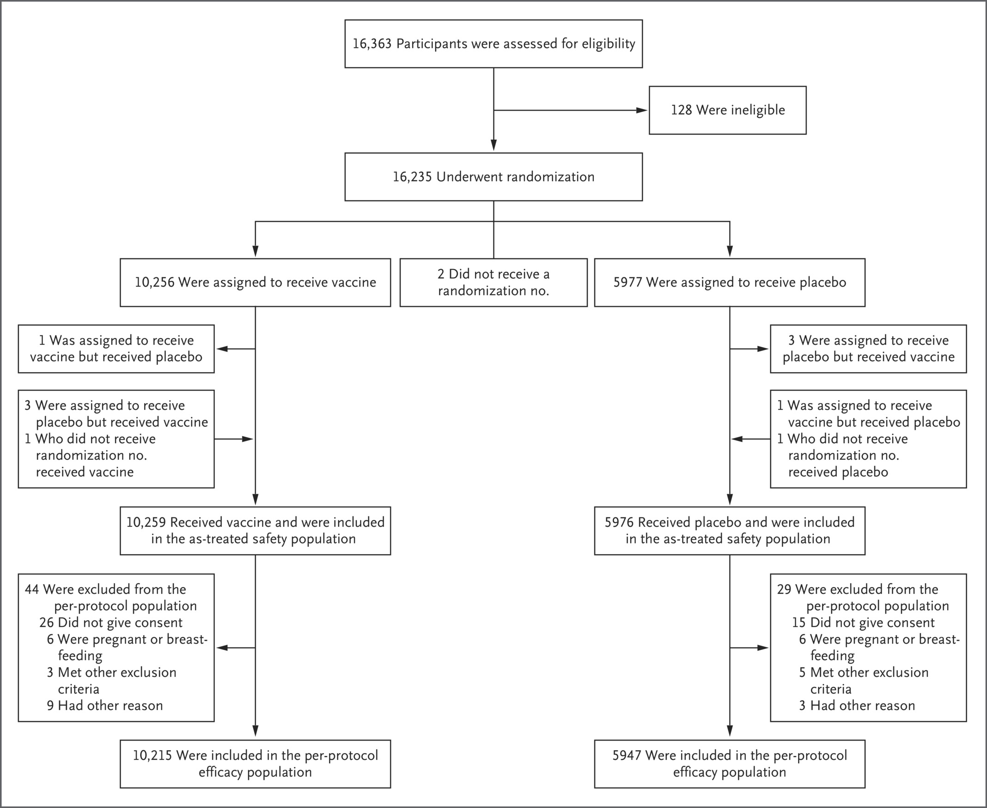

Slide 12
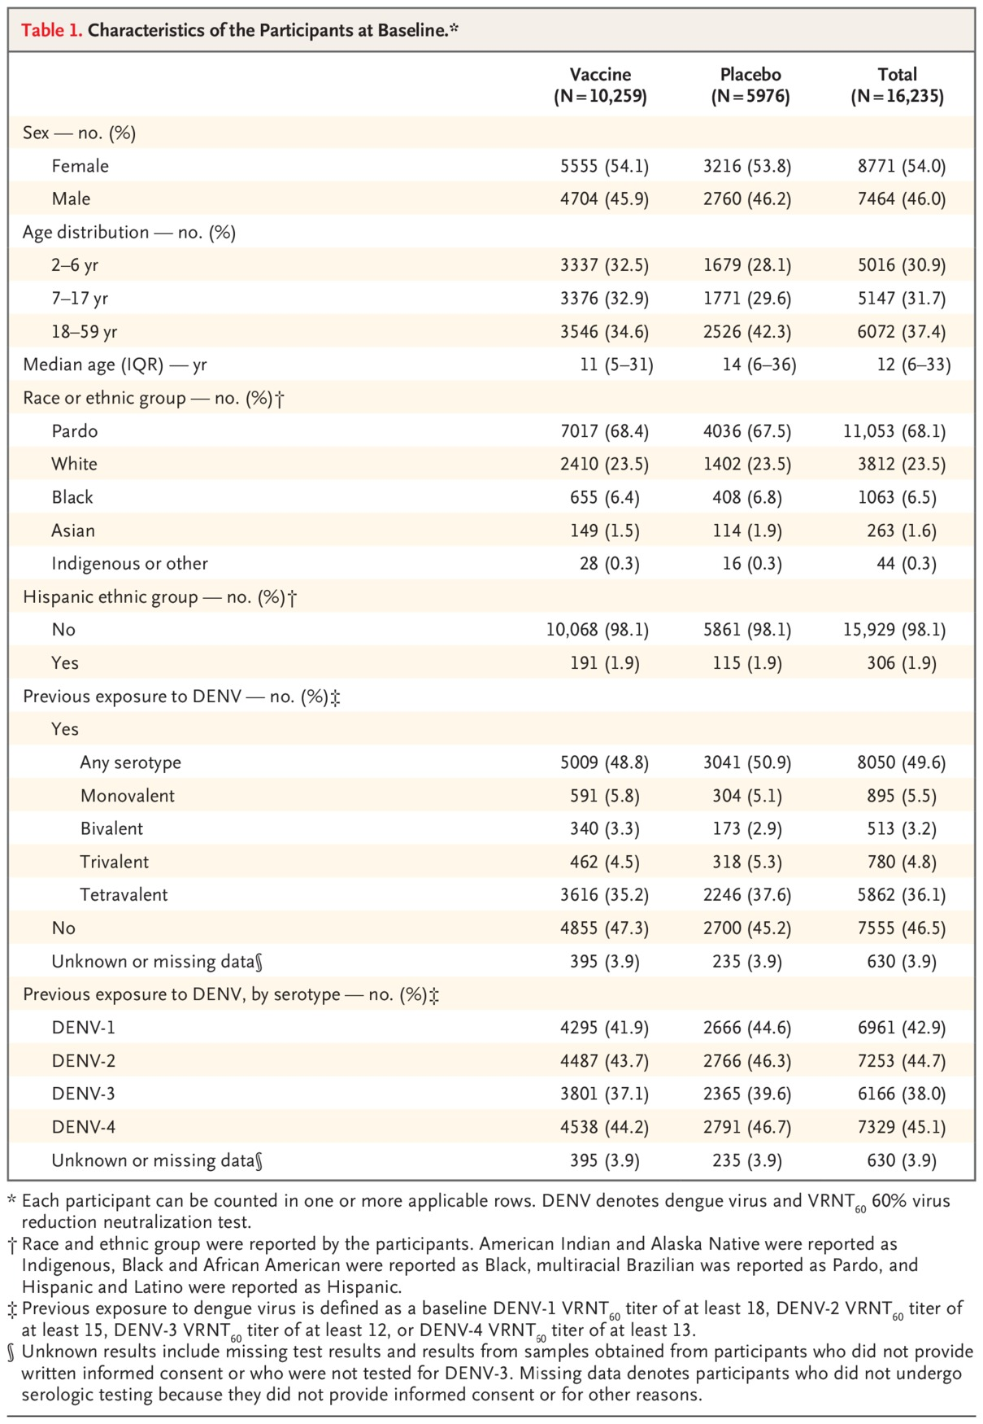
Characteristics of the Participants at Baseline.
Kallás EG et al. N Engl J Med2024;390:397-408
Notes:
Table 1 Characteristics of the Participants at Baseline.

Slide 13
CUMULATIVE INCIDENCE OF DENGUE THROUGH 2 YEARS OF FOLLOW UP

Slide 14
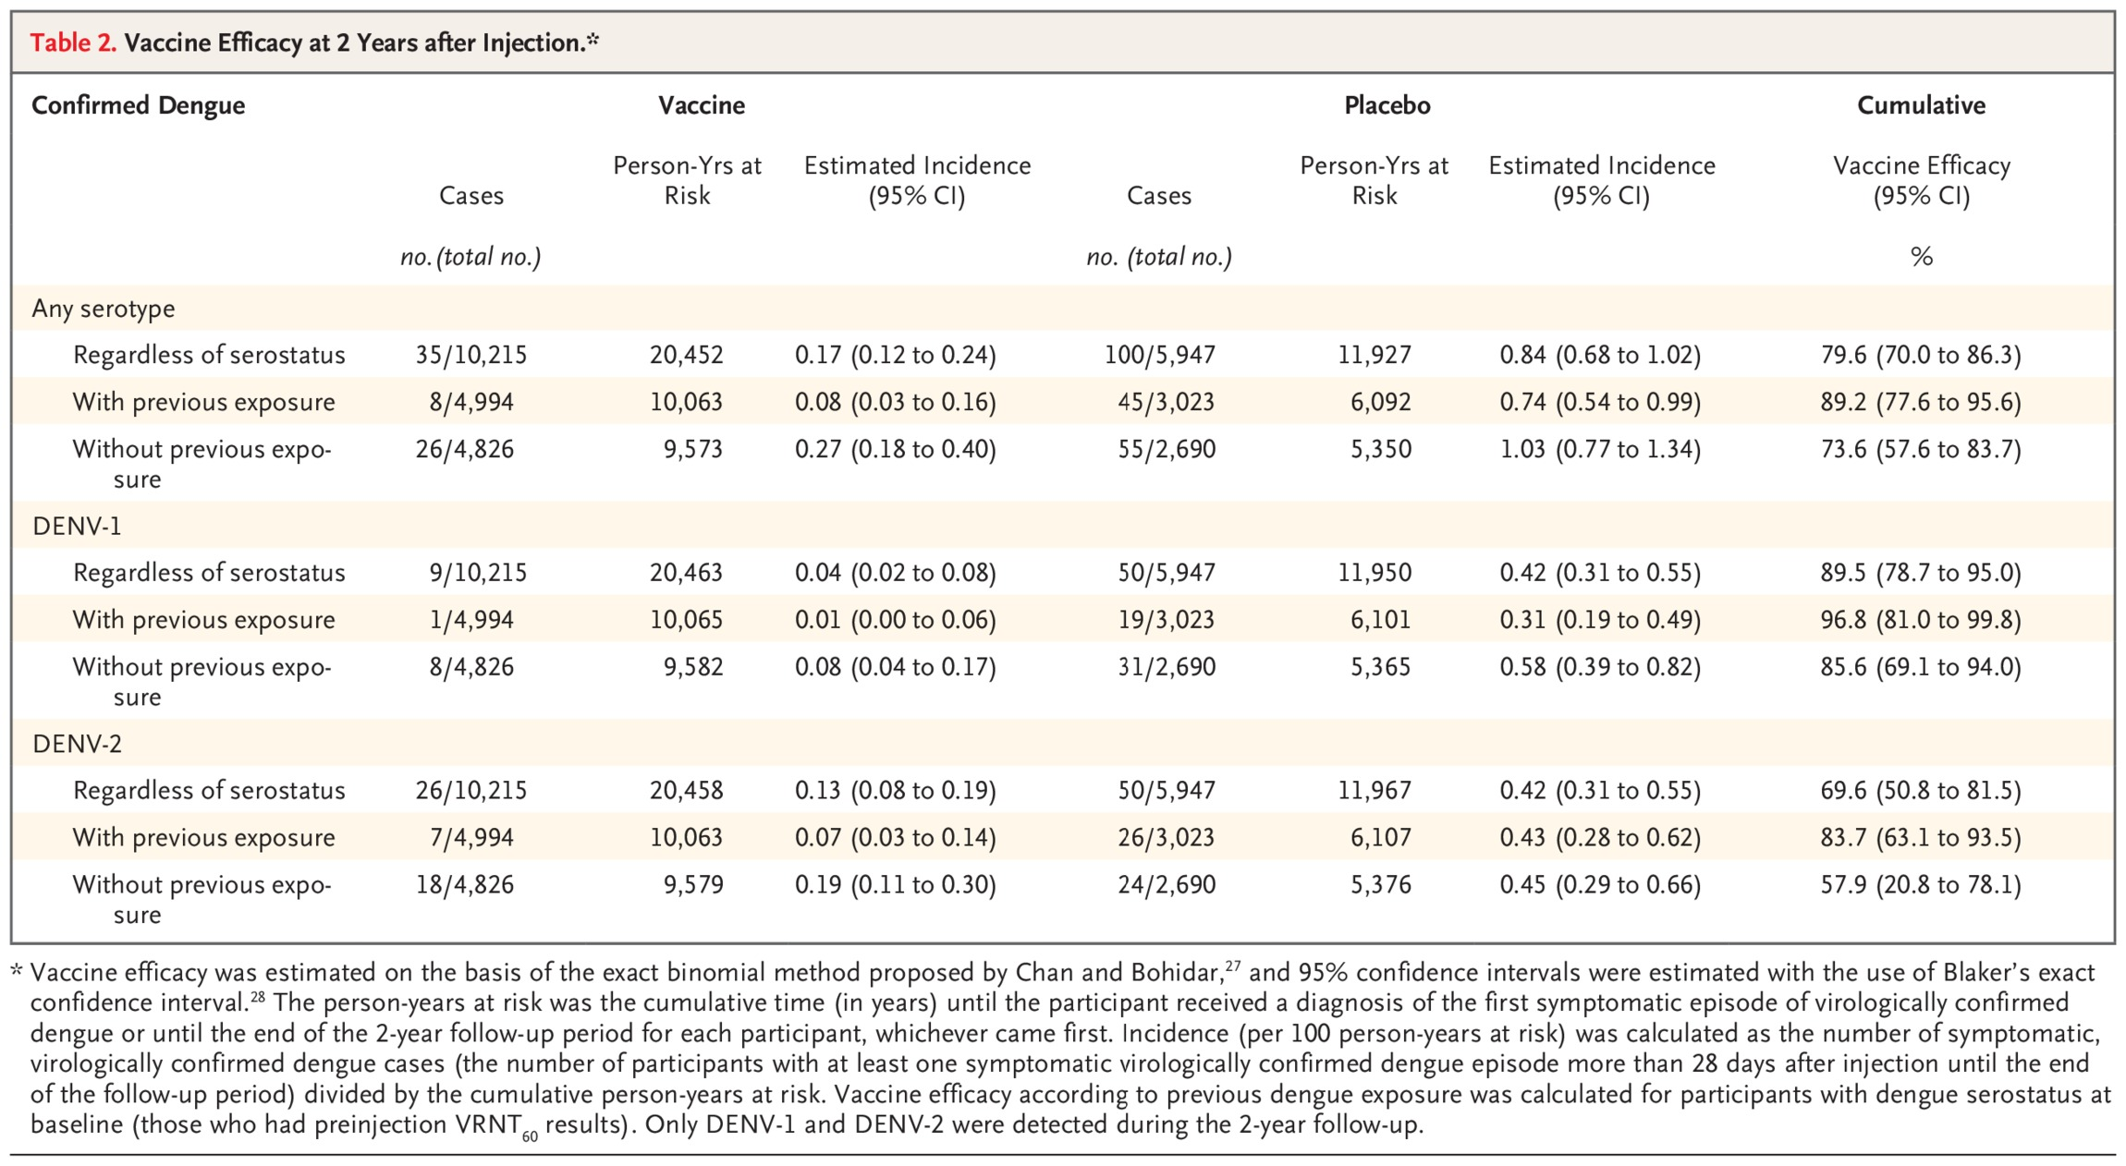
VACCINE EFFICACY AFTER 2 YEARS
Kallás EG et al. N Engl J Med2024;390:397-408
Notes:
Table 2 Vaccine Efficacy at 2 Years after Injection.

Slide 15
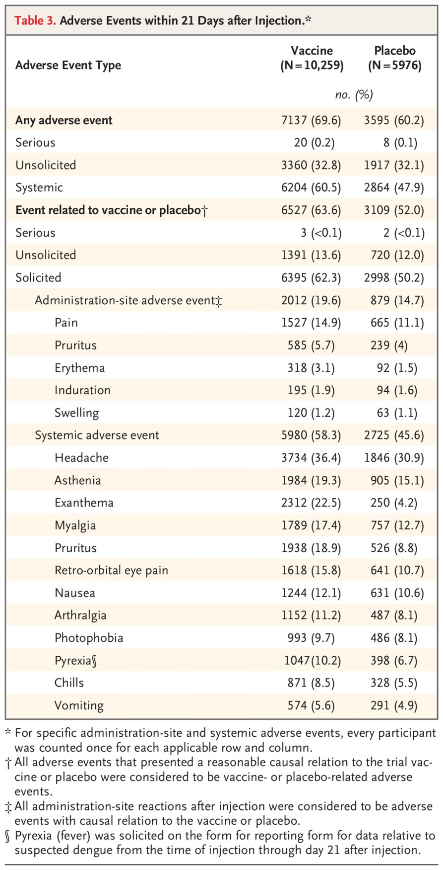
ADVERSE EFFECTS
Kallás EG et al. N Engl J Med2024;390:397-408
Notes:
Table 3 Adverse Events within 21 Days after Injection.

Slide 16
LIMITATIONS
NO DENV-3 OR DENV-4 CASES OCCURRED,WHICH PRECLUDED ASSESMENT OF VACCINE EFFICACY AGAINST THESE SEROTYPES
NO SAFETY CONCERNS WERE IDENTIFIED,CAREFUL FOLLOWUP FOR 5 YEARS WILL BE IMPORTANT TO CONFIRM THIS FINDING
THE EFFECT OF PRE EXISTING IMMUNITY FROM OTHER FLAVIVIRUS(ZIKA VIRUS OR YELLOW FEVER) ON SUBSEQUENT DENV INFECTION OR BUTANTAN DV VACCINATION REQUIRES EXPLORATION

Slide 17
CONCLUSION
A single dose of Butantan-DV prevented symptomatic DENV-1 and DENV-2, regardless of dengue serostatus at baseline, through 2 years of follow-up.

