Slide 1
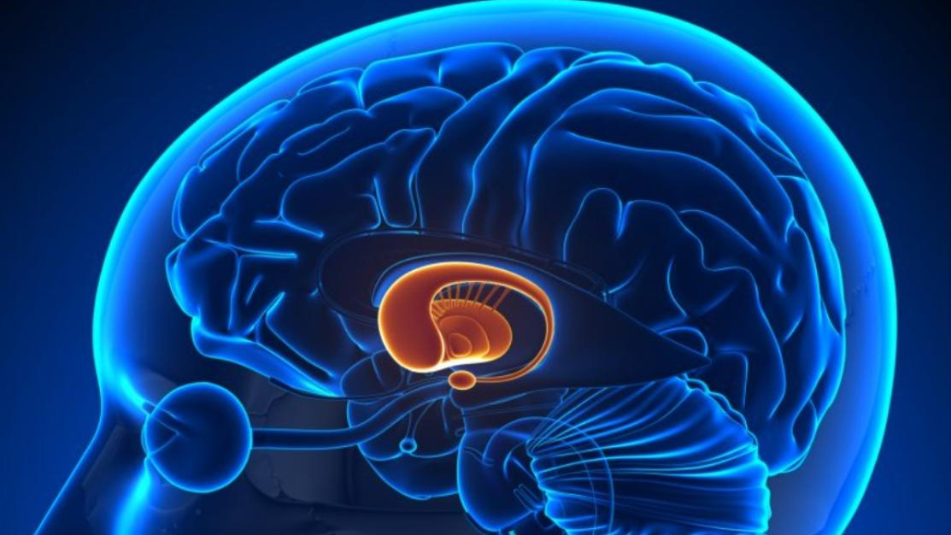
Parkinson’s Disease
By ||| MEDICAL UNIT
Chief : DR PALANIKUMAR MD
DR PONSENTHIL KUMAR MD
DR ILAMARAN MD
PRESENTOR: DR APEKSHA B

Slide 2
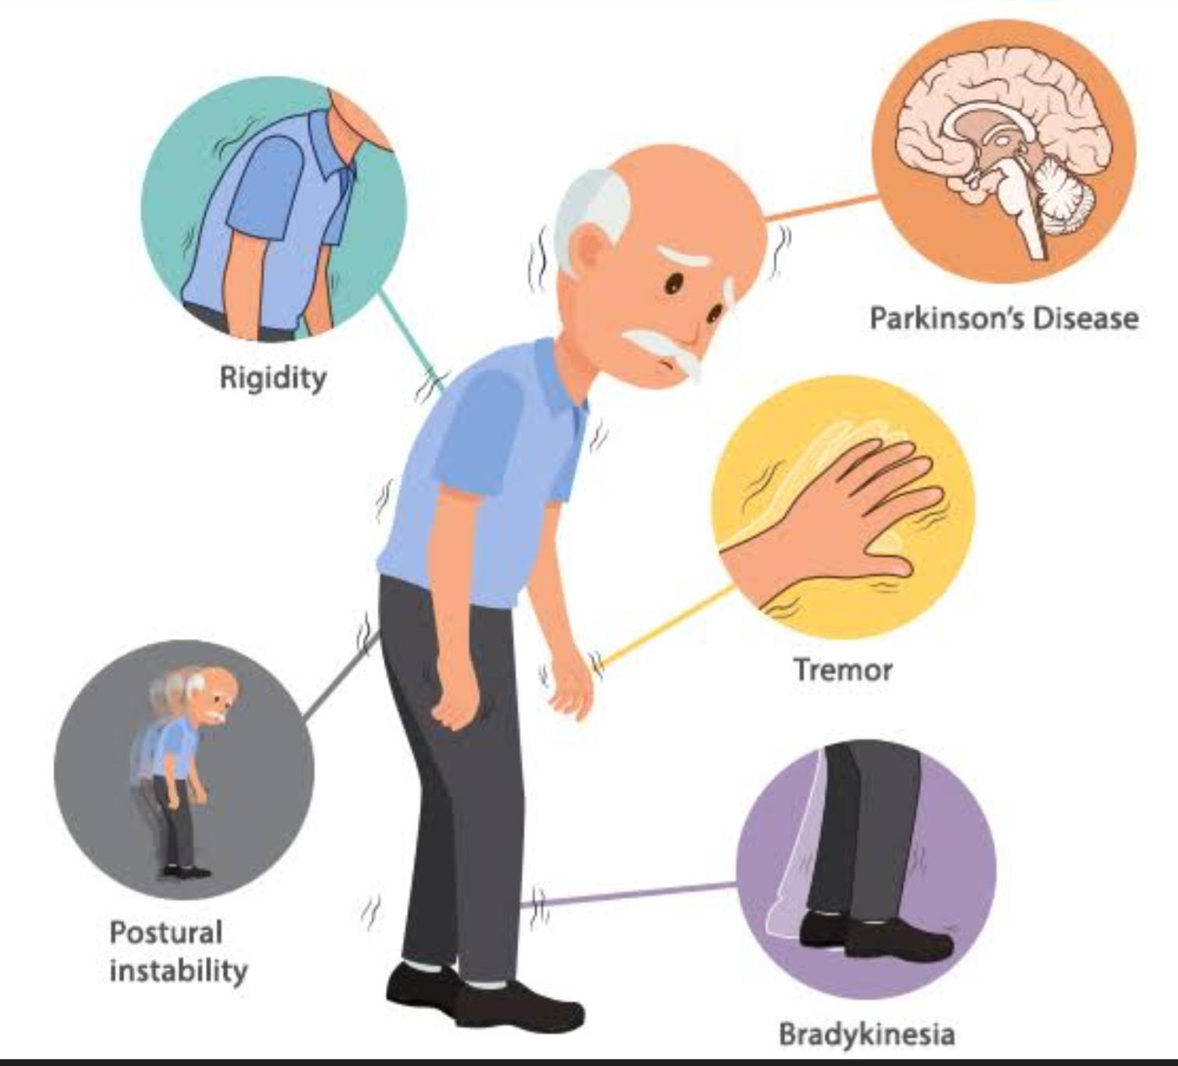
It is the second commonest neurodegenerative disease
Predominantly affects motor system
Due to loss of dopaminergic neurons in substantia nigra pars compacta

Slide 3
Epidemiology
Worldwide is 10.8 million
Incidence increases with age, with mean age of onset being 60 yrs
Male : Female ≈ 1.5 : 1
Also seen in younger population in their 20s when associated with a pathological gene mutation

Slide 4
Etiopathogenesis – Overview
Most PD cases occur sporadically and are of unknown cause .
Gene mutations are the only known cause of pd and can be seen even in sporadic cases.

Slide 5
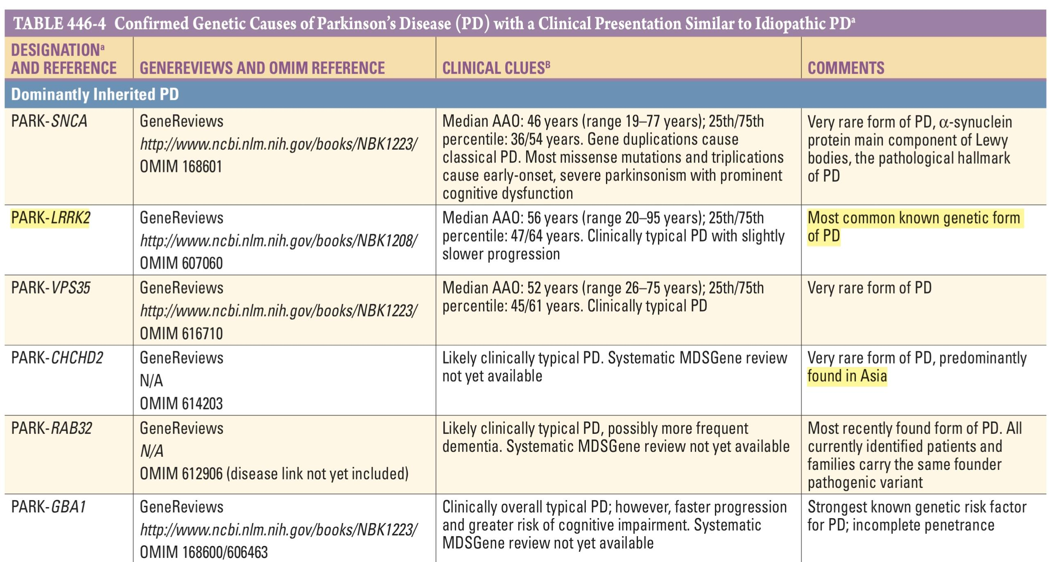

Slide 6
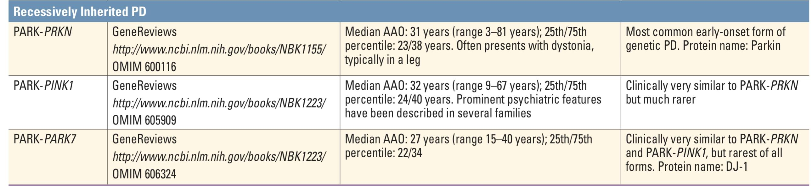

Slide 7
Environmental factors:MPTP , by-product of heroin like drug , exposure to pesticides,rural living,solvents,farming , drinking well water
Protective factors : caffeine,smoking,nsaids,ccbs

Slide 8
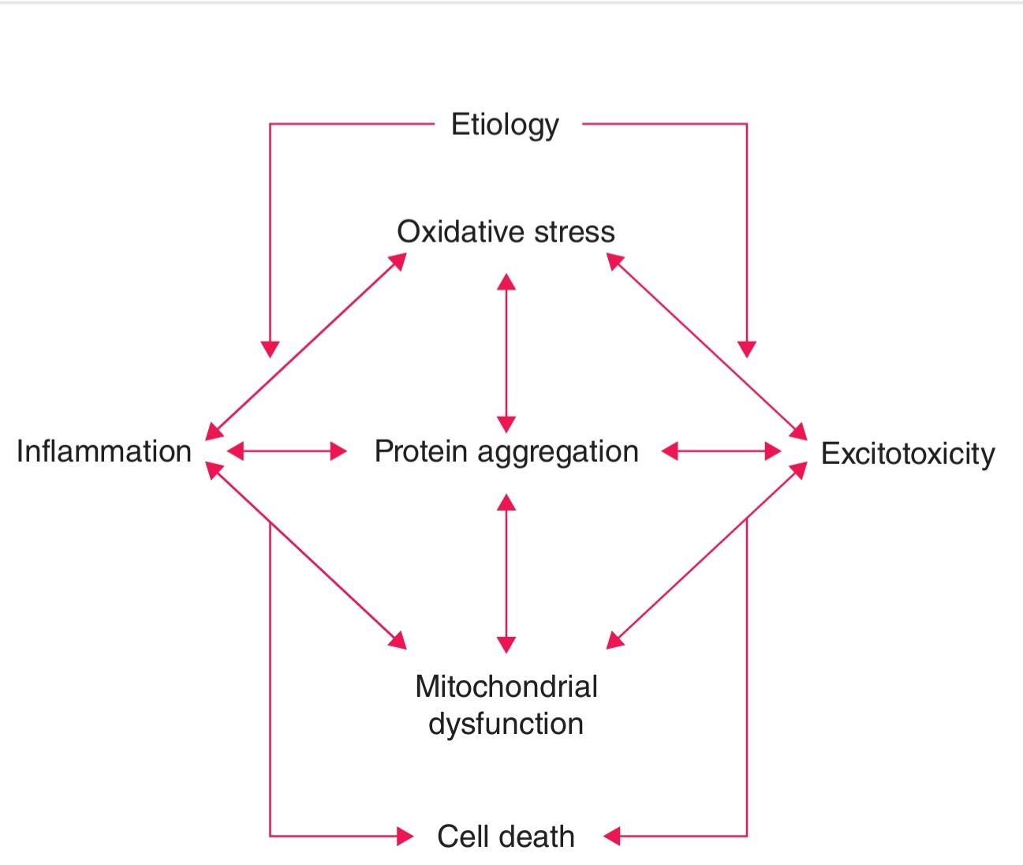

Slide 9
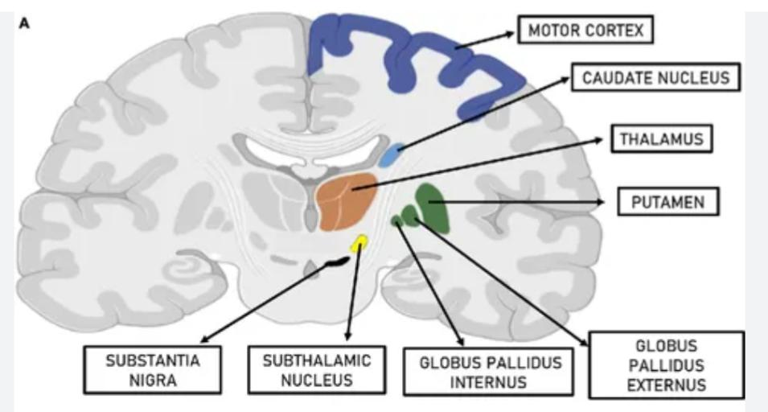
Pathogenesis

Slide 10
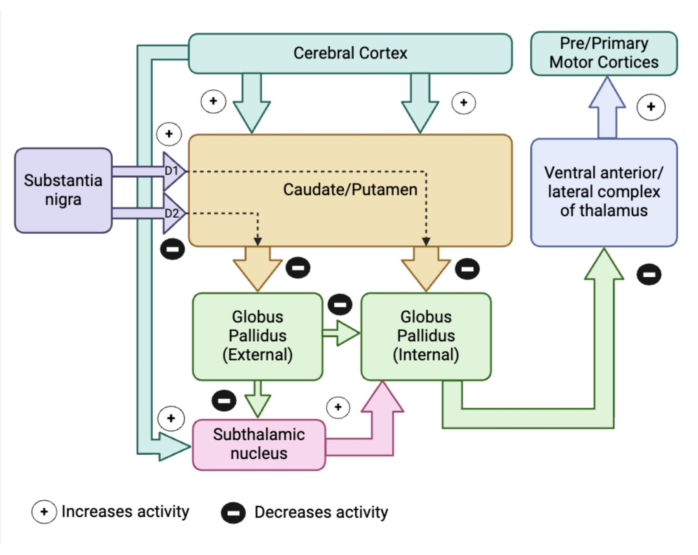

Slide 11
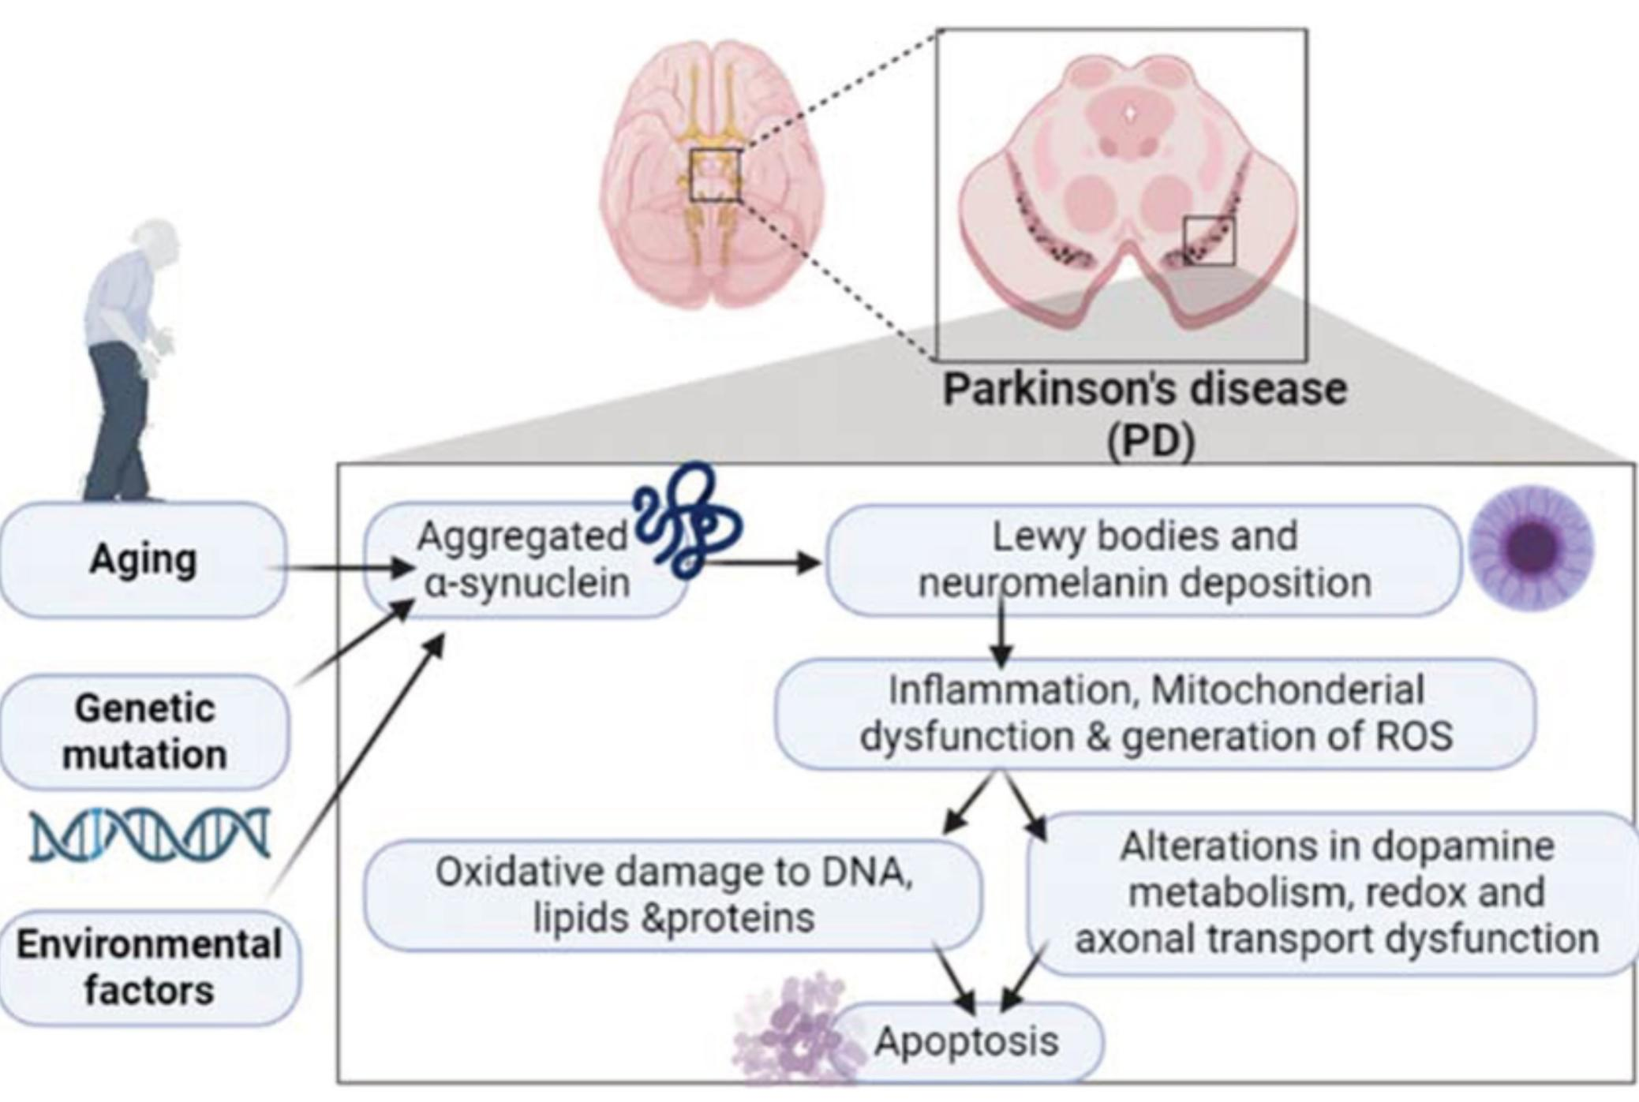

Slide 12
In PD there is dopamine denervation with loss of dopaminergic tone leading to increased firing of neurons in the STN and Gpi,
Excessive inhibition of thalamua
Reduced activity of cortical motor system

Slide 13
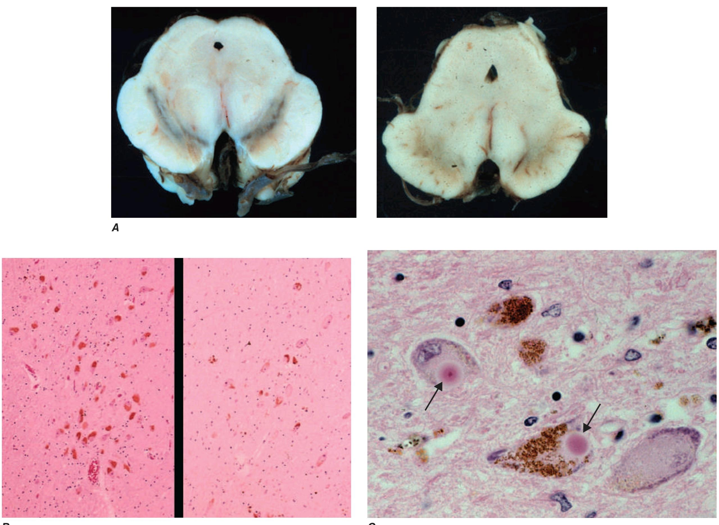
Lewy Bodies
Pathologically the hallmark features of PD are the degeneration of dopaminergic neurons in SNc, reduced striatal dopamine ,d intraneuronal proteinaceous inclusions in cell body and axons that stain for a-synuclein : LEWY BODIES
LEWY PATHOLOGY
Non- dopaminergic pathology: LEWY pathology can affect cholinergic neurons of nucleus basalis of Mrynert , norepinephric neurons of locus ceruleus , serotonin neurons of raphae nuclie and olfactory system

Slide 14
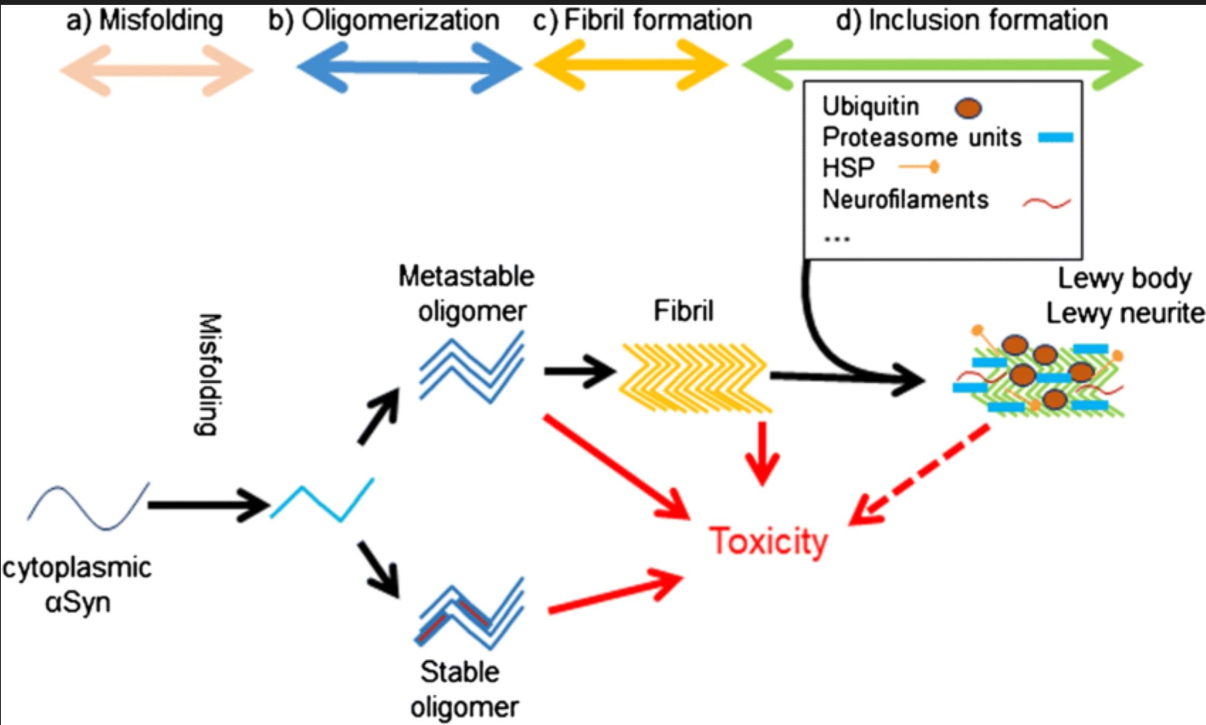

Slide 15
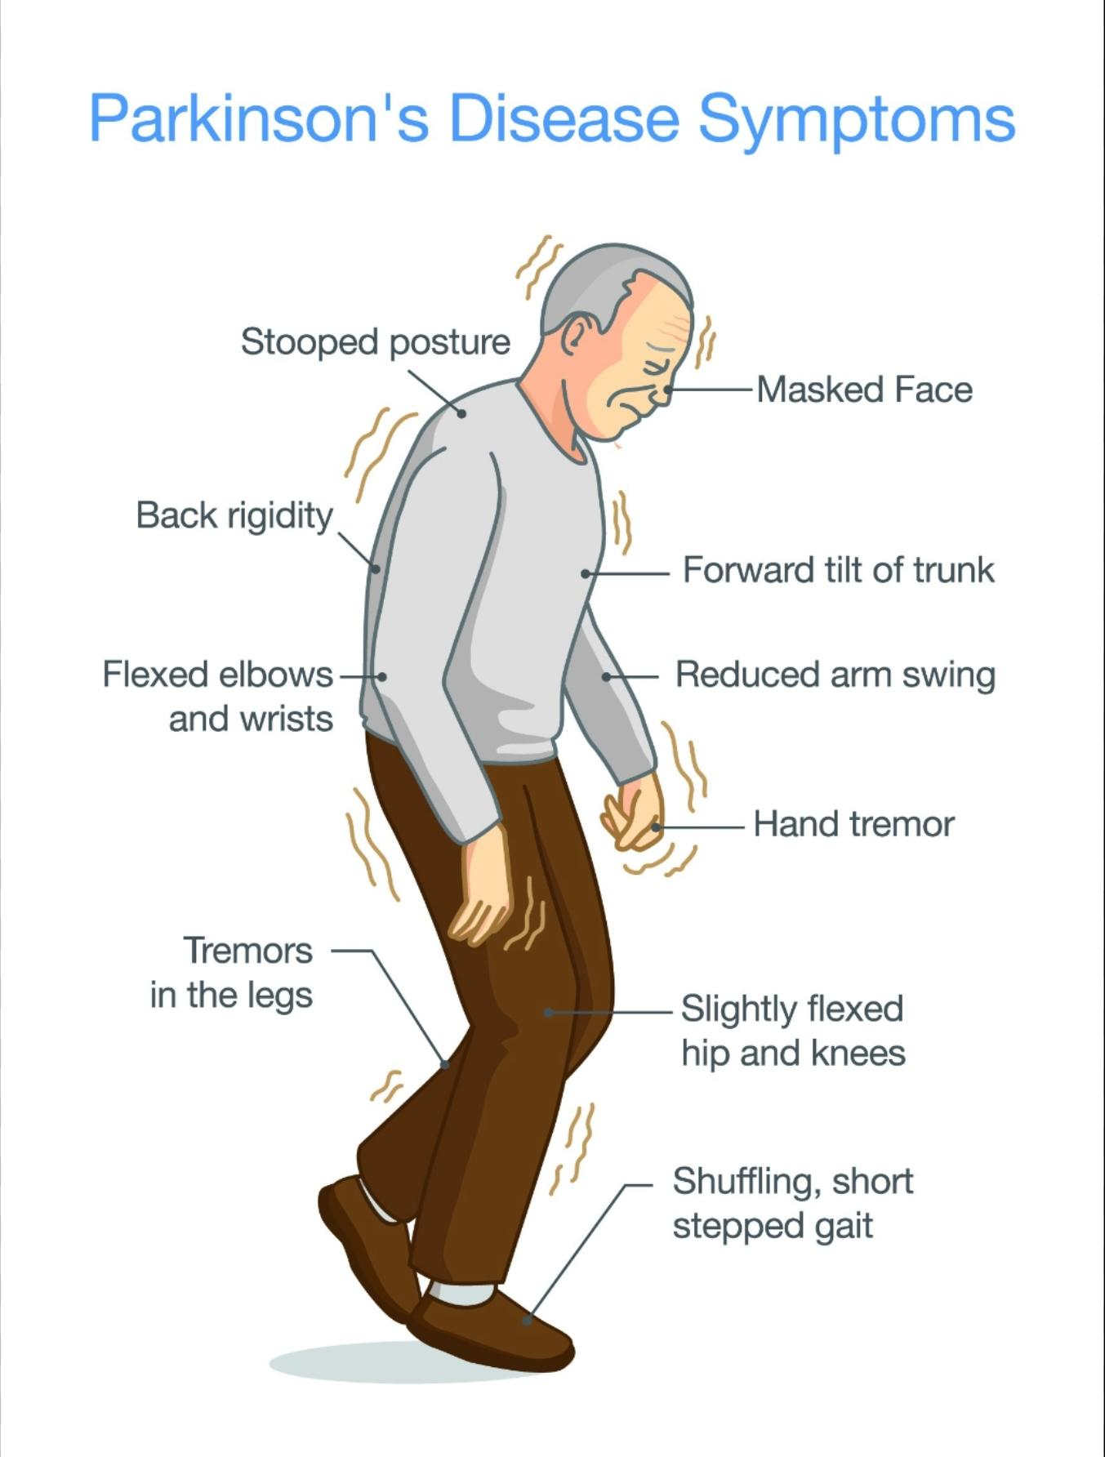
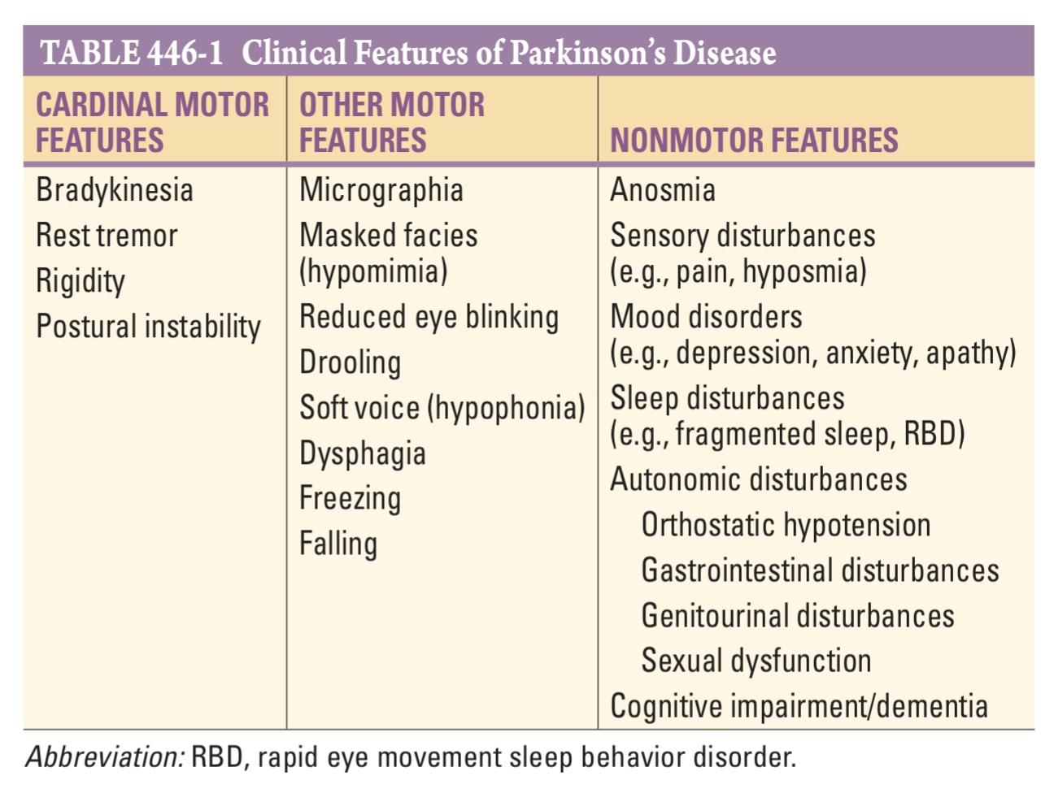
Clinical features

Slide 16
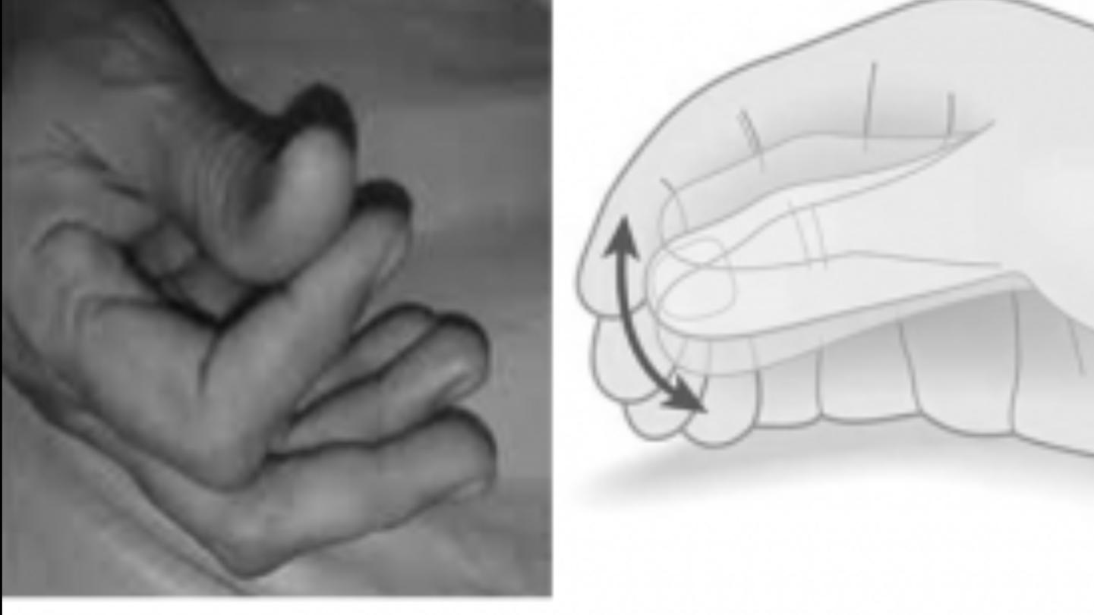
Tremors
Often involves the hand
Pill rolling tremors are characteristic, involving thumb and fingers
Resting tremors
Voluntary movements dampens the tremors

Slide 17
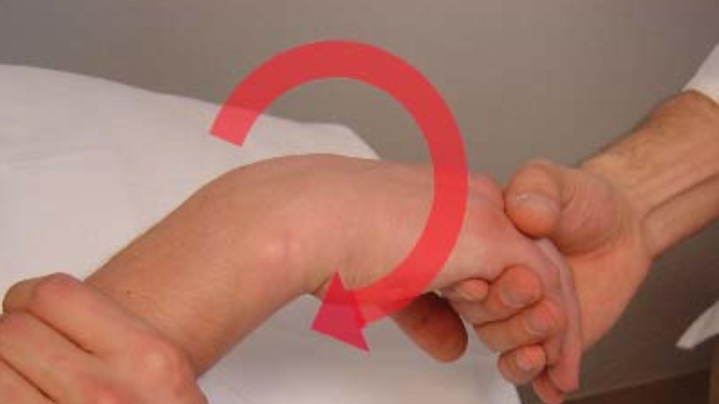
Rigidity
Muscles are continuously or intermittently firm and tense
Unlike spasticity it lacks the initial “free interval” on passive flexion thus having the quality of bending lead pipe.
It involves both flexors and extensors but predominantly flexors.
Small muscles of face, tongue,larynx are also affected.
COGWHEEL PHENOMENON: rigidity with superimposed tremor .
Normal tendon reflexs

Slide 18
Hypokinesia and bradykinesia
The frequent autonomic habitual movements are reduced or absent
Infrequent blinking and face lacks expressive mobility
Reduced arm swing
Micrographia
Bradykinesia refers to reduced velocity of the movement , increased reaction time.
Myersons sign: inability to inhibit blinking in response to tap over the bridge of nose or glabella.

Slide 19
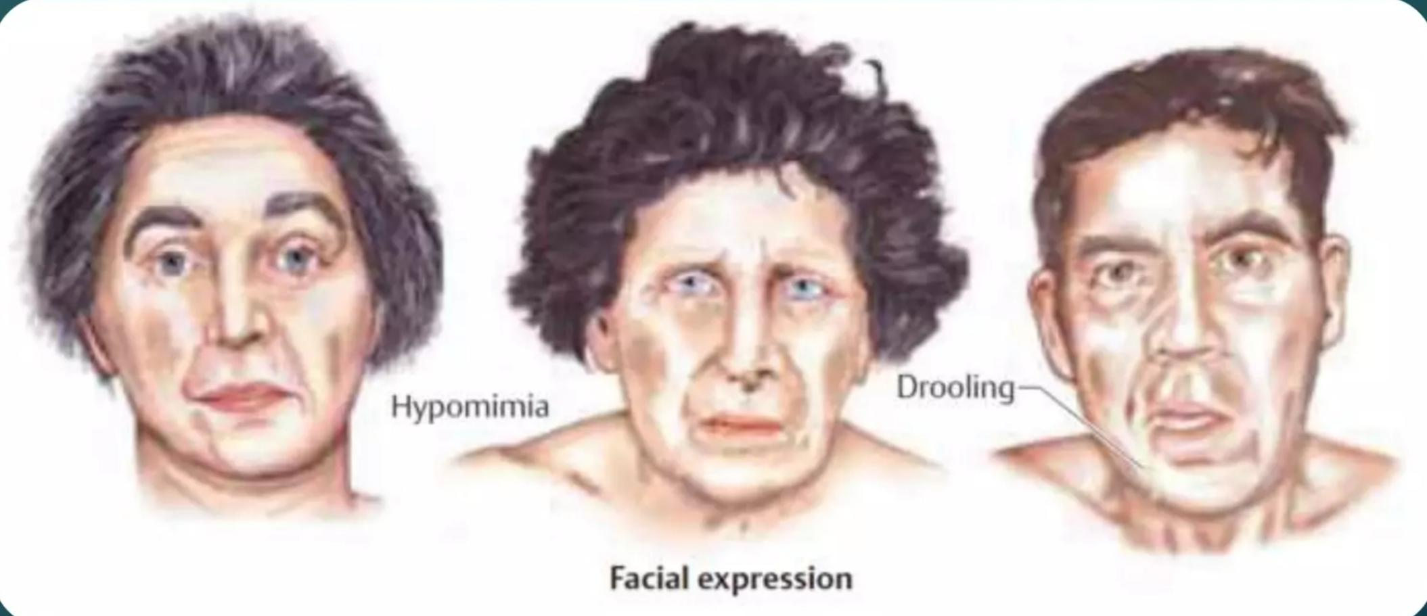
Hypomimia
Masked facies , infrequent blinking,soft voice with rapid, monotonous speech

Slide 20
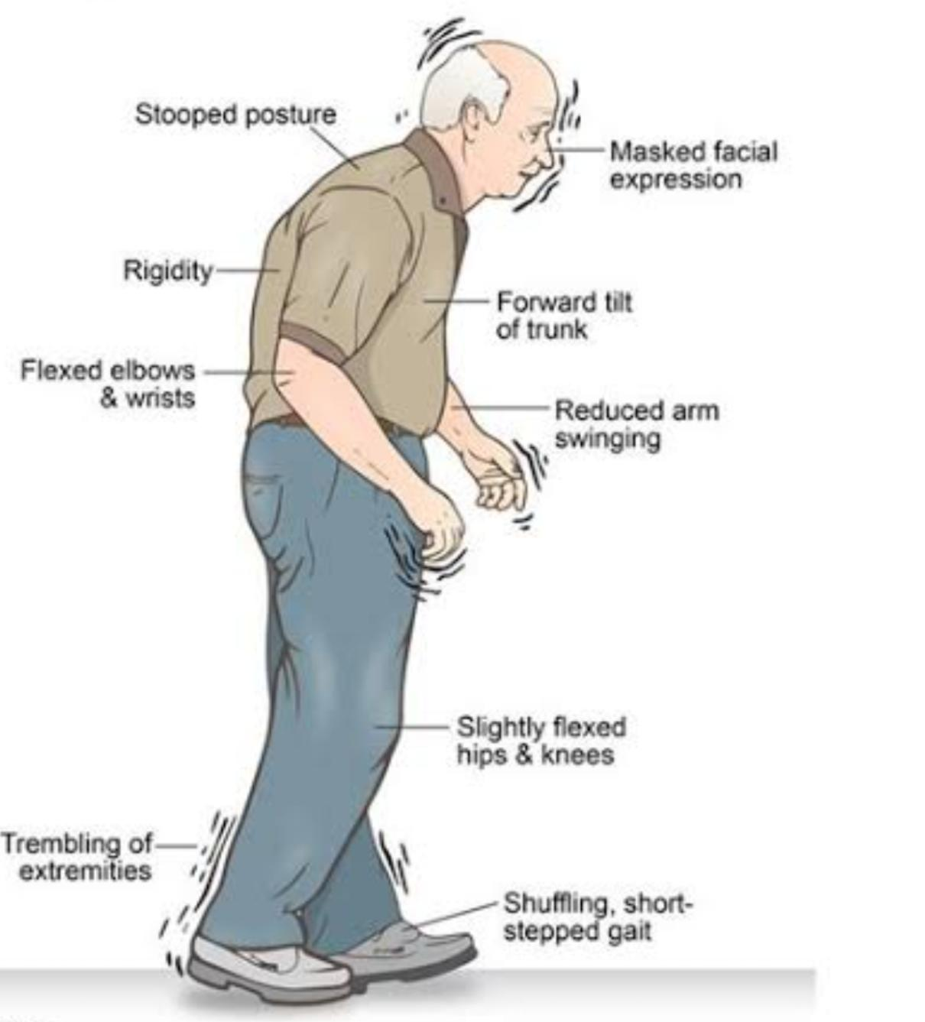
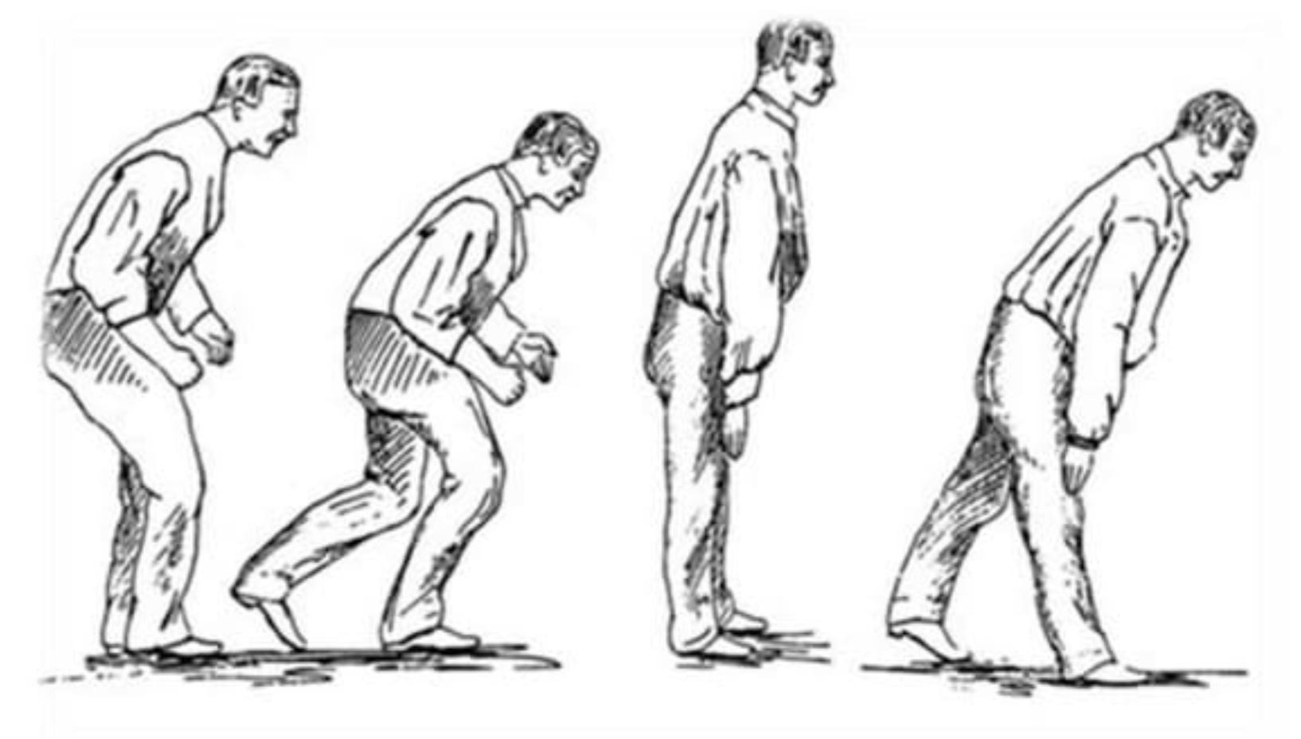
Parkinsonian gait
Involuntary flexion of the trunk limbs and the neck.
Hesitation in starting to walk
Short steps and the feet barely clears the ground as pt shuffles along
Festination: trying catch up to his centre of gravity

Slide 21
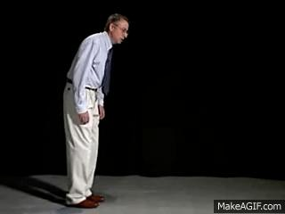

Slide 22
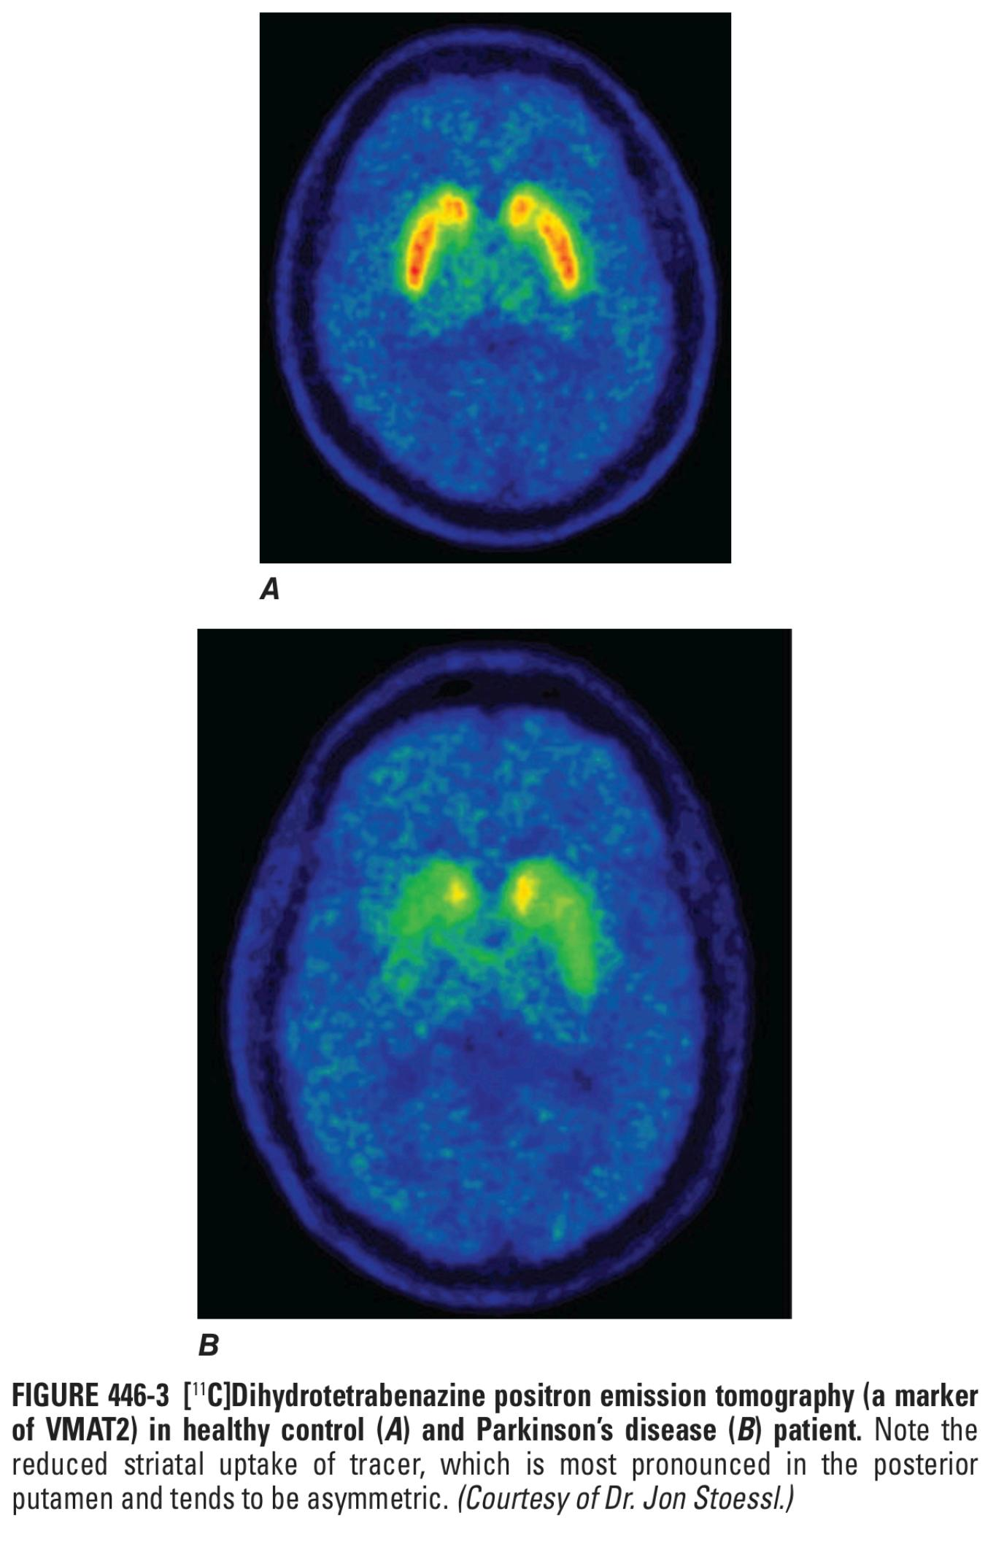
Investigations
Only useful for research purpose
Diagnosis is only based on clinical features
Genetic testing may be useful in identifying at risk individuals in research setting .

Slide 23
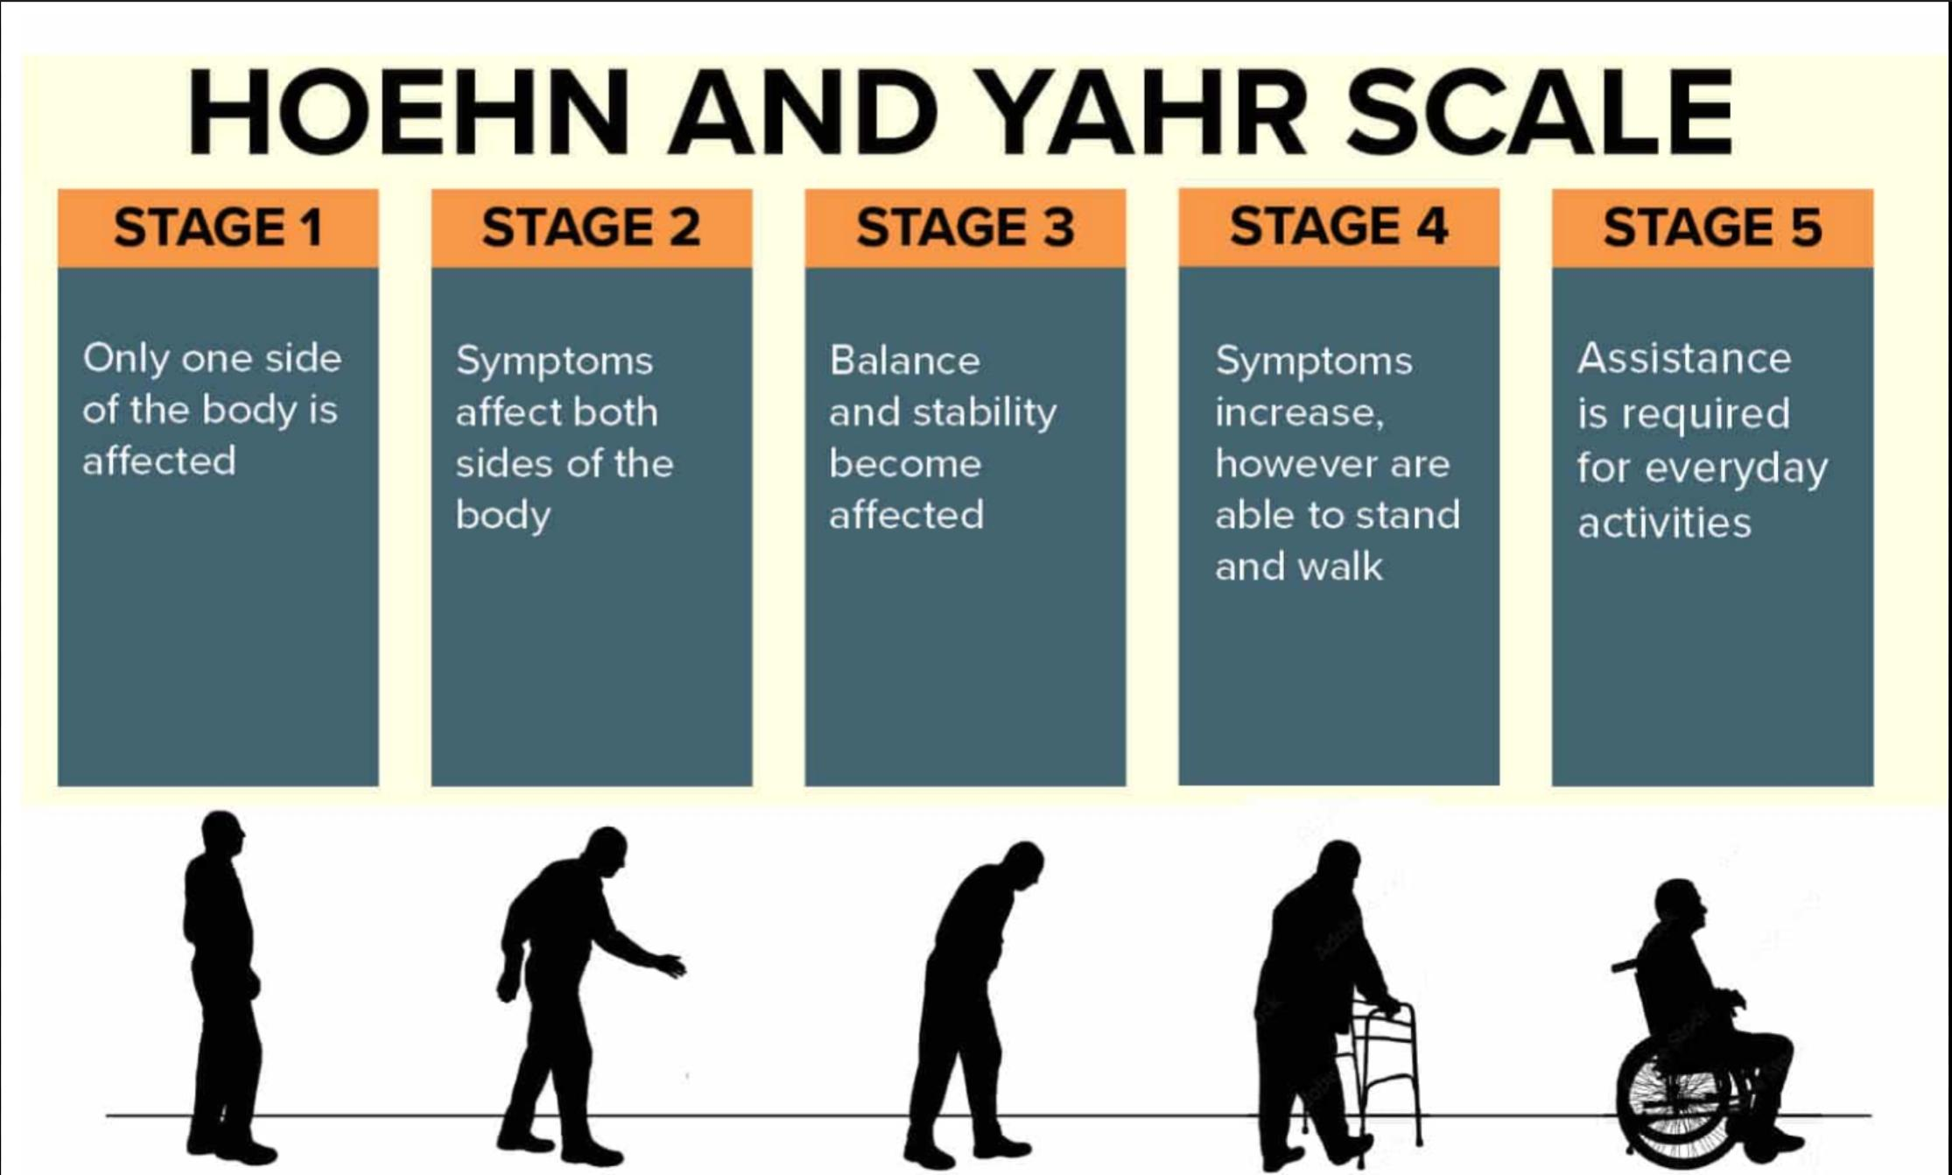

Slide 24
Treatment
Pharmacotherapy
Surgery
Physiotherapy

Slide 25
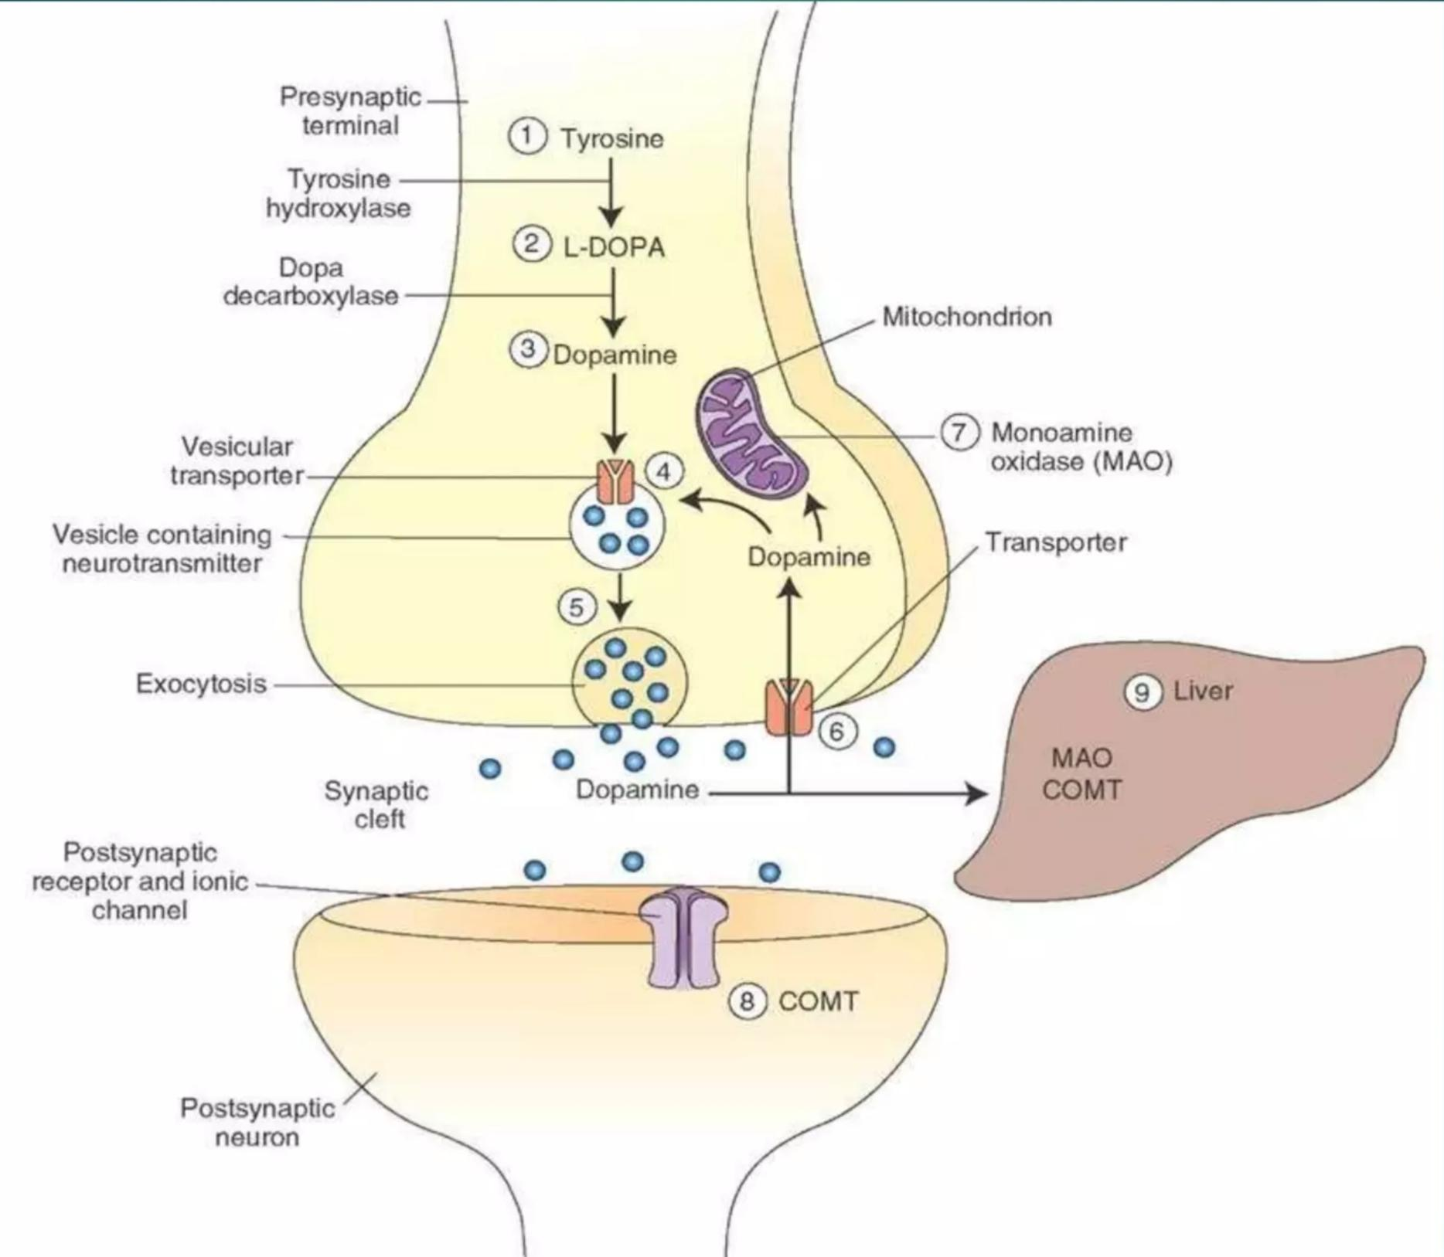
Dopamine synthesis

Slide 26
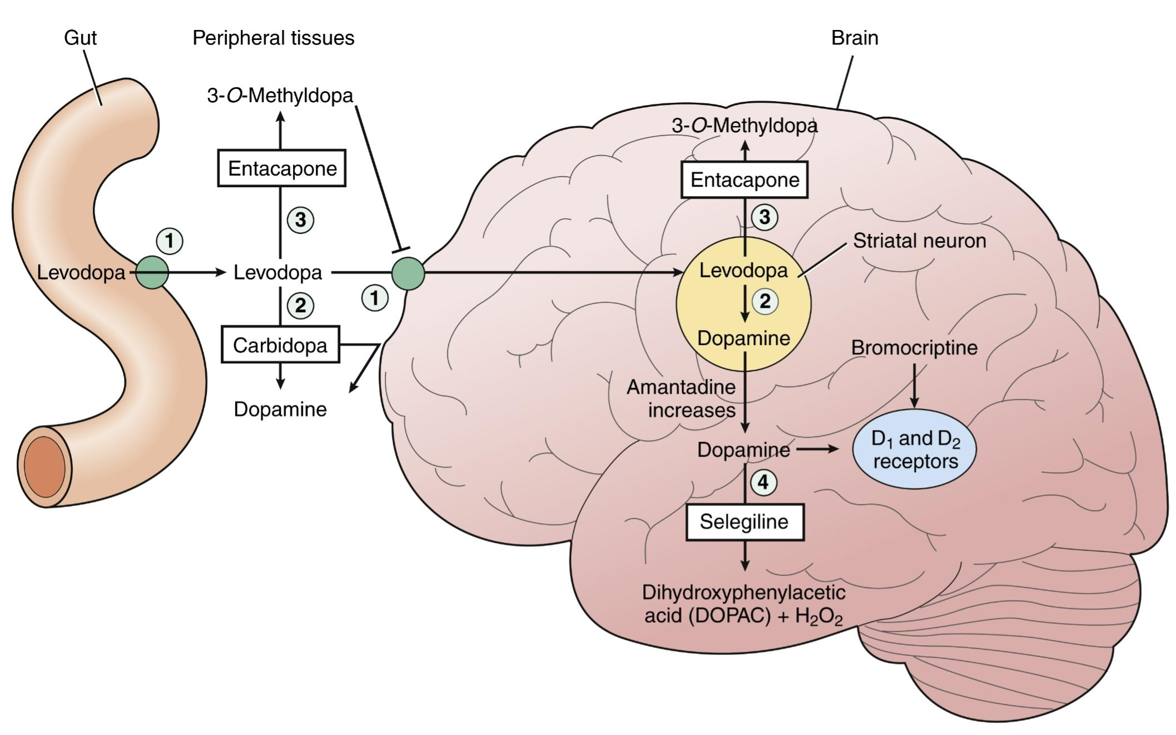

Slide 27
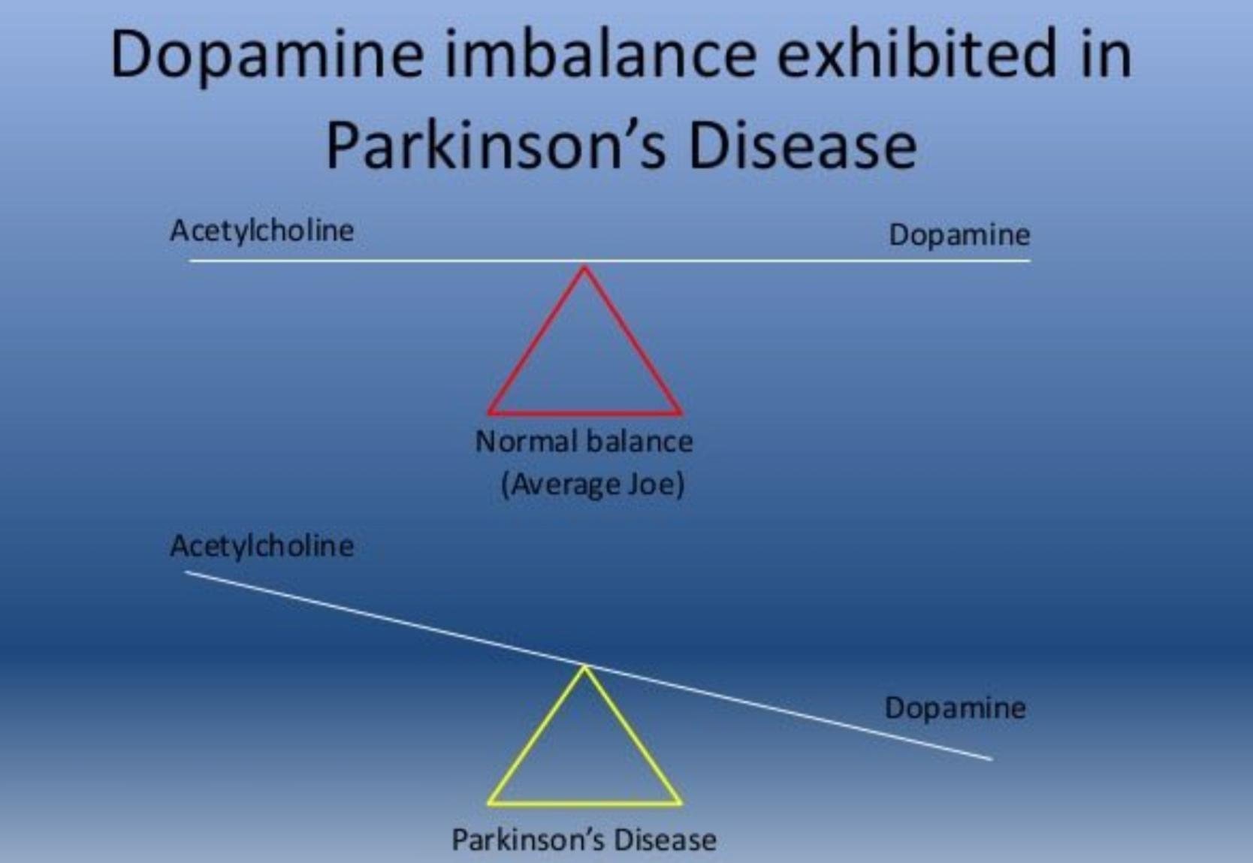

Slide 28
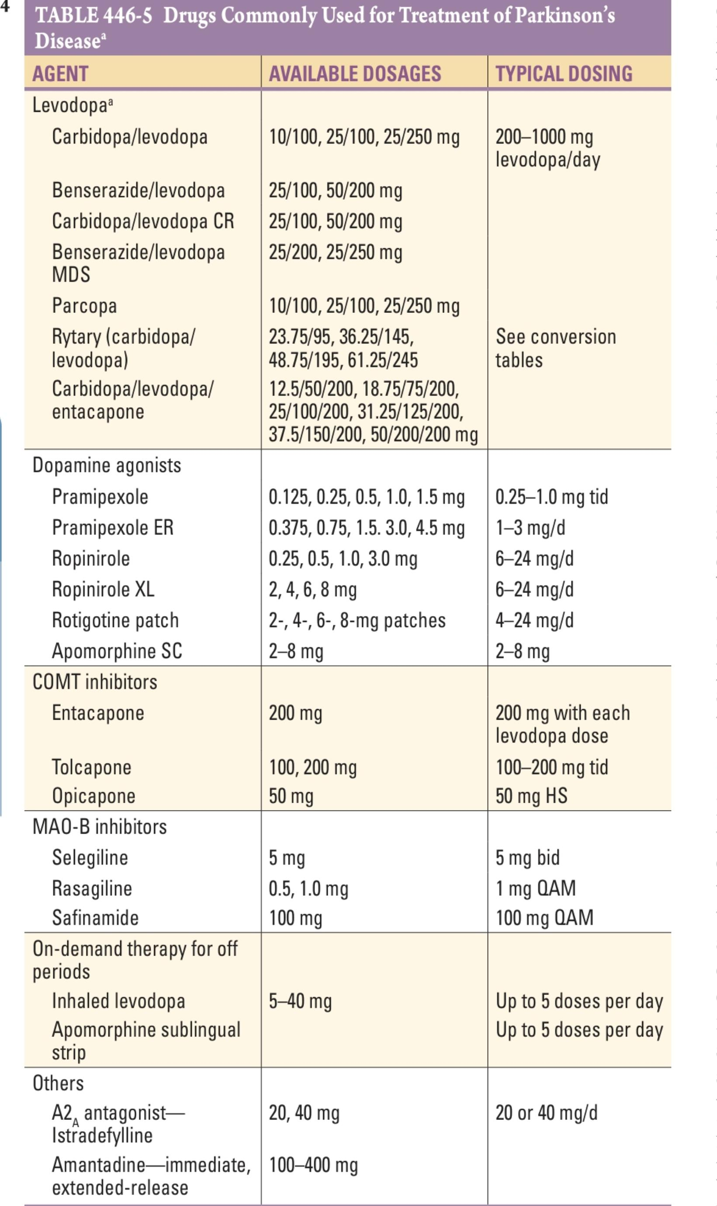

Slide 29
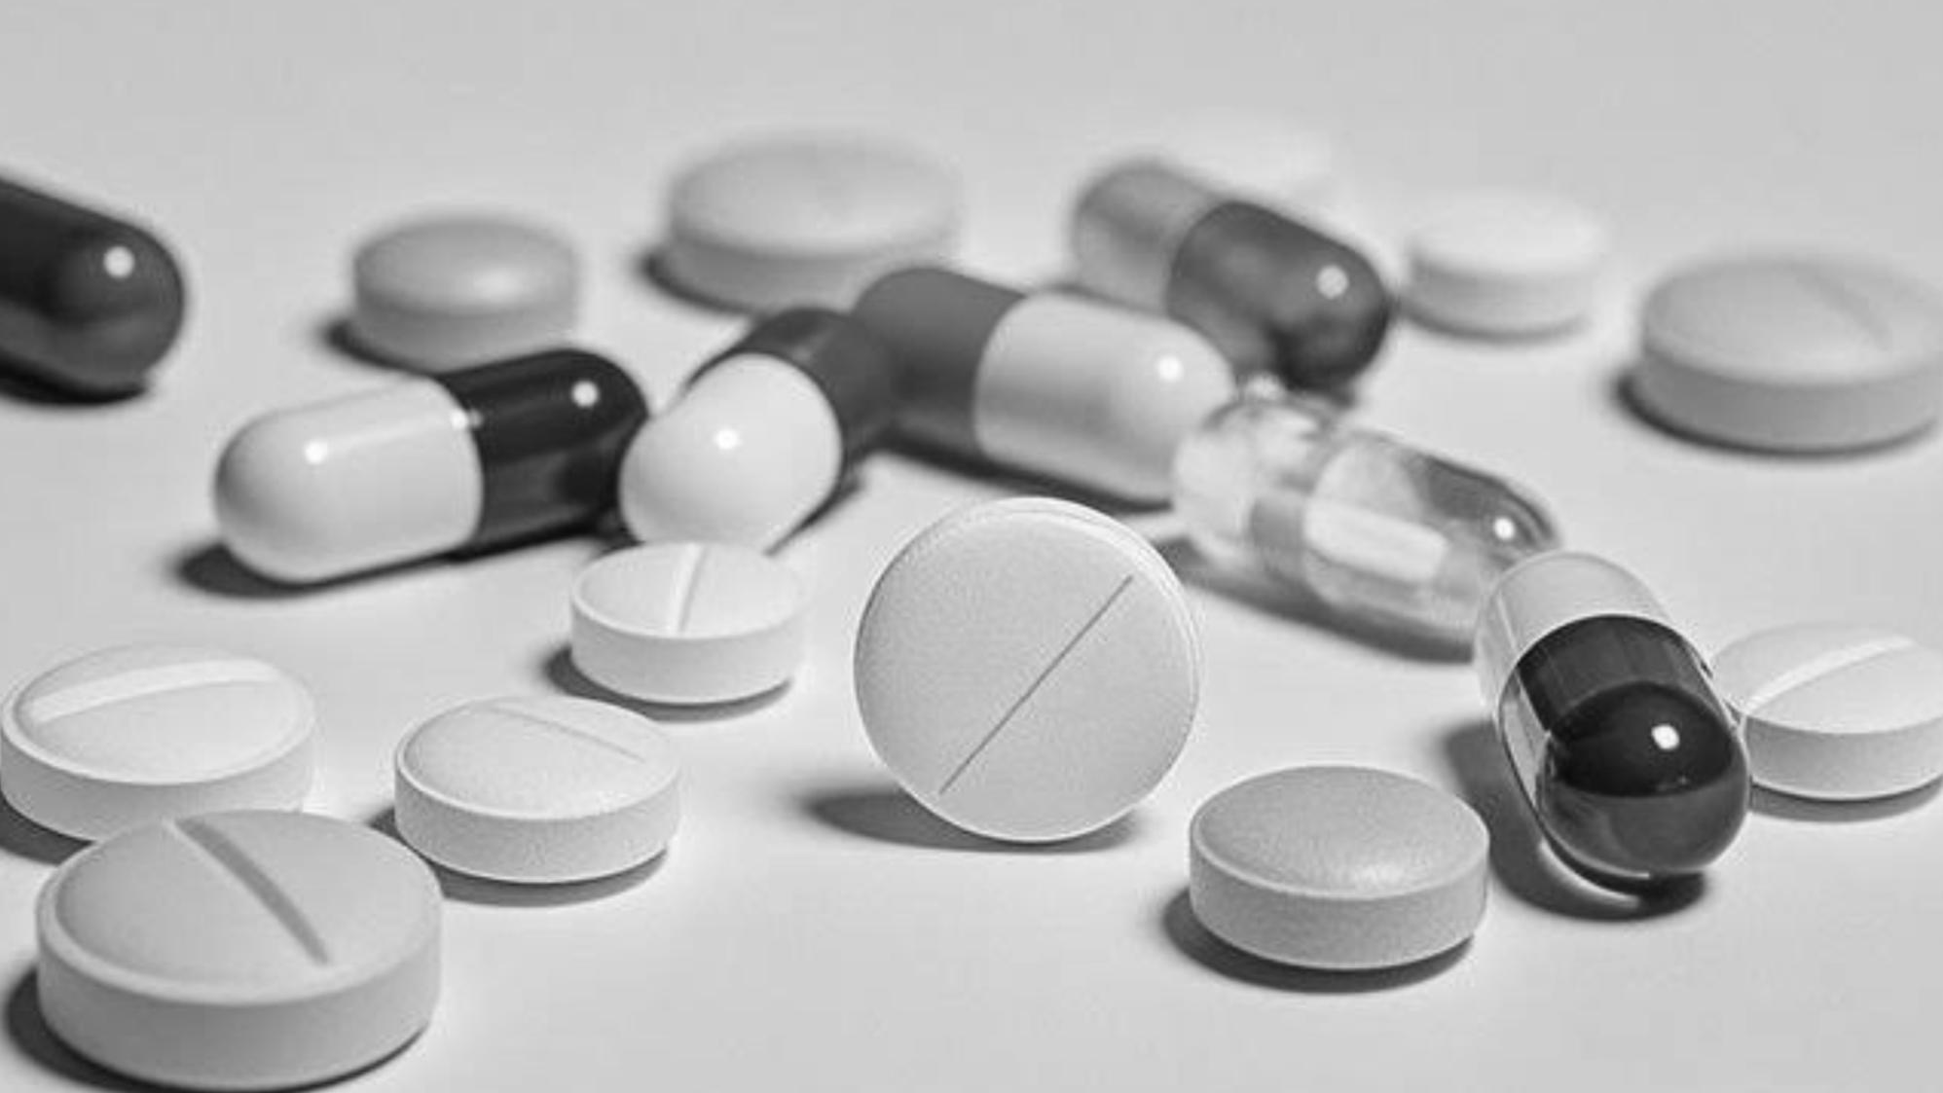
Levodopa
Dopamine does not cross the blood-brain barrier (BBB), so clinical trials were initiated with levodopa, the precursor of dopamine.
Levodopa is routinely administered in combination with a peripheral decarboxylase inhibitor to prevent its peripheral metabolism to dopamine and the development of nausea, vomiting, and orthostatic hypotension due to activation of dopamine receptors in the area postrema that are not protected by the BBB.
Levodopa plus a decarboxylase inhibitor is also available in a methylated formulation, a controlled-release formulation (Sinemet CR or Madopar HP), and in combination with a catechol-O-methyltransferase (COMT) inhibitor (Stalevo).

Slide 30
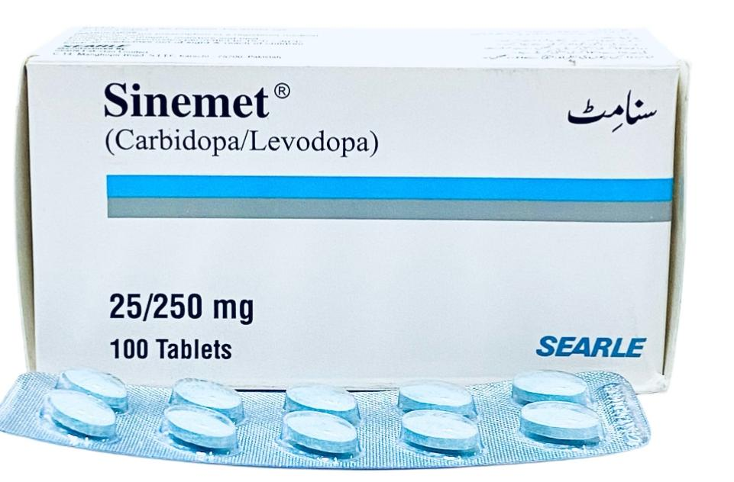
Levodopa benefits the classic motor features of PD, prolongs independence and employability, improves quality of life, and increases life span. levodopa also benefits some “nondopaminergic” features such as anxiety, depression, and sweating
Levodopa remains the most effective symptomatic treatment for PD and the gold standard against which new therapies are compared

Slide 31
Limitations of LD
Acute dopaminergic side effects include nausea, vomiting, and orthostatic hypotension.
Can be avoided by starting with low doses and gradual up-titration.
As the disease continues to progress, features such as falling, freezing, autonomic dysfunction, sleep disorders, and dementia may emerge that are not adequately controlled by levodopa.

Slide 32
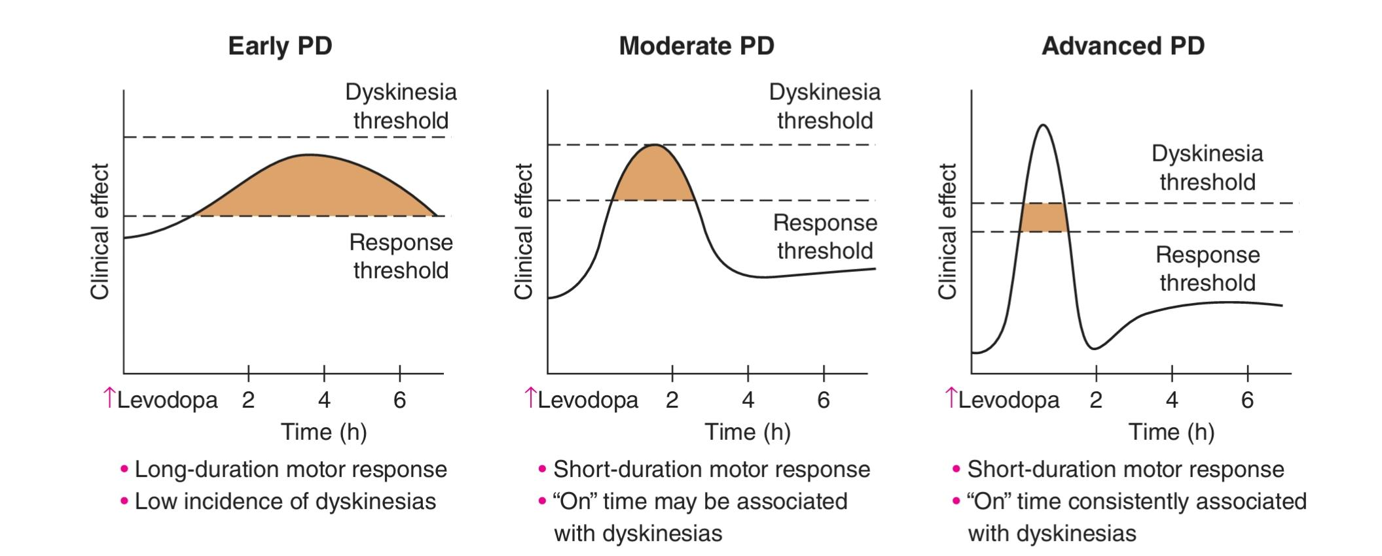
On and off phenomenon
Motor complications consist of fluctuations in motor response (“on” episodes when the drug is working and “off” episodes when Parkinsonian features return as the drug wears off) and involuntary movements known as dyskinesias, which typically complicate “on” periods .
When patients initially take levodopa, benefits are long-lasting (many hours and to some degree even weeks—the “long-duration” response) even though the drug has a relatively short half-life (60–90 min). With continued treatment, the duration of benefit following an individual dose becomes progressively shorter until benefits approach the half-life of the drug. This loss of benefit is known as the wearing-off effect.
Some patients may also experience a rapid and unpredictable switch from the on to the off state known as the on-off phenomenon

Slide 33
Behavioural complications can also be associated with levodopa treatment
. A dopamine dysregulation syndrome has been described where patients have a craving for levodopa and take frequent and unnecessary doses of the drug in an addictive manner.
PD patients taking high doses of levodopa can also develop purposeless, stereotyped behaviors such as the assembly and disassembly or collection and sorting of objects. This is known as punding,
Hypersexuality and other impulse-control disorders .

Slide 34
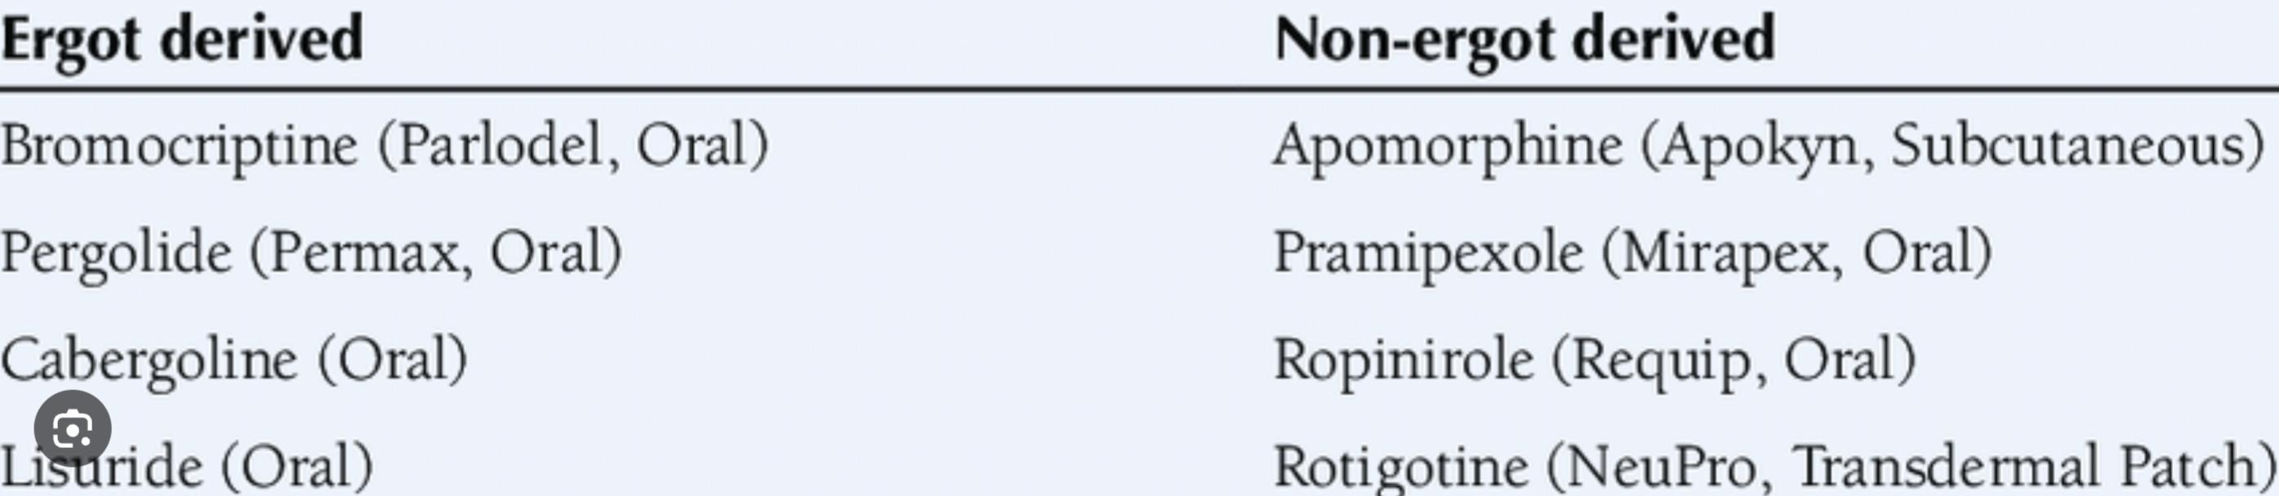
Dopamine agonists
Initial dopamine agonists were ergot derivatives (e.g., bromocriptine, pergolide) and were associated with potentially serious ergot-related side effects such as cardiac valvular damage and pulmonary fibrosis.
They have largely been replaced by a second generation of non-ergot dopamine agonists (e.g., pramipexole, ropinirole, rotigotine).
dopamine agonists do not have comparable efficacy to levodopa. They were initially introduced as adjuncts to levodopa to enhance motor function and reduce “off” time in fluctuating patients.
dopamine agonists are less prone than levodopa to induce dyskinesia, as they are long acting in comparison to levodopa.

Slide 35
Both ropinirole and pramipexole are available as orally administered immediate (three times a day) and extended-release (once a day) formulations
. Rotigotine is administered as a once-daily transdermal patch and may be useful in managing surgical patients who are not able to be treated with an oral therapy.
Apomorphine must be administered parenterally as it is rapidly and extensively metabolized if taken orally. It has a short half-life and duration of activity (45 min). It can be administered by subcutaneous injection as a rescue agent for the treatment of severe “off” episodes but can also be administered by continuous subcutaneous infusion where it has been shown to reduce both “off” time and dyskinesia in advanced patients.

Slide 36
Side effects
Side effects associated with chronic use include hallucinations, cognitive impairment, and leg edema
Sedation with sudden unintended episodes of falling asleep that can occur in dangerous situations, such as while driving a motor vehicle, have been reported. Patients should be informed about this potential problem and should not drive when tired.
Dopamine agonists can also be associated with impulse-control disorders, including pathologic gambling, hypersexuality, and compulsive eating and shopping.
Injections of apomorphine can be complicated by skin lesions at sites of administration, which can be minimized by proper cleaning and alternating the injection sites.
The sublingual bilayer formulation of apomorphine can be associated with oropharyngeal side effects

Slide 37
Mao-b inhibitors
Inhibitors of monoamine oxidase type B (MAO-B) block central dopamine MAO-B-oxidative metabolism and thereby increase synaptic concentrations of the neurotransmitter.
Selegiline and rasagiline are relatively selective suicide inhibitors of the MAO-B isoform of the enzyme. Clinically, these agents provide antiparkinsonian benefits when used as monotherapy in early disease stages and reduced “off” time when used as an adjunct to levodopa in patients with motor fluctuations.
MAO-B inhibitors are generally safe and well tolerated.

Slide 38
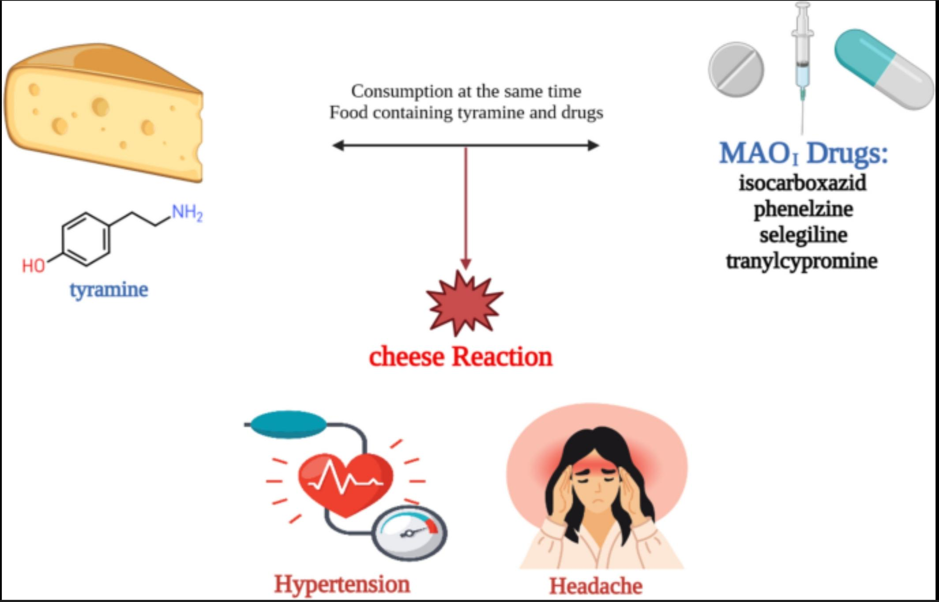
Inhibition of the MAO-A isoform prevents metabolism of tyramine in the gut, leading to a potentially fatal hypertensive reaction known as a “cheese effect” because it can be precipitated by foods rich in tyramine such as some cheeses, aged meats, and red wine.
Safinamide is a reversible and selective MAO-B inhibitor that has been approved as an adjunct to levodopa for treating advanced PD patients with motor fluctuations.

Slide 39
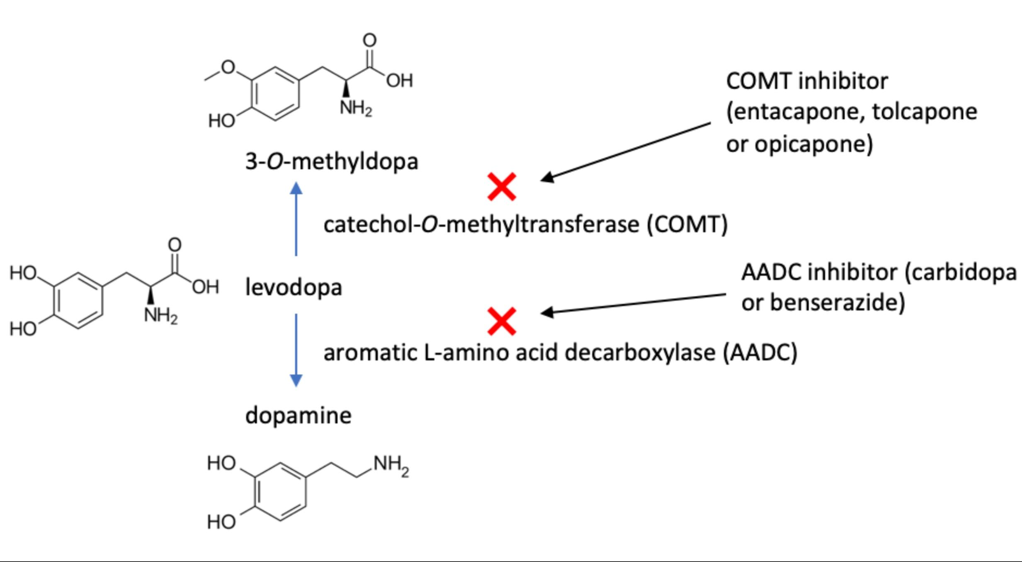
Comt inhibitors
Combining levodopa with a COMT inhibitor reduces “off” time and prolongs “on” time in fluctuating patients while enhancing motor scores.
tolcapone is administered three times daily, while entacapone is administered in combination with each dose of levodopa
. Opicapone, a long-acting COMT inhibitor that only requires once-daily administration, has more recently been approved
. A combination tablet of levodopa, carbidopa, and entacapone (Stalevo) is also available

Slide 40
Neuroprotection
A neuroprotective or disease-modifying therapy that slows or stops disease progression remains the major unmet therapeutic need. Some trials have shown positive results (e.g., selegiline, rasagiline, pramipexole, ropinirole) consistent with a disease-modifying effect.
These agents block the oxidative conversion of MPTP to the pyridinium ion MPP+ that is taken up by and selectively damages dopamine neurons.
MAO-B inhibitors also have the potential to block the oxidative metabolism of dopamine and prevent oxidative stress..

Slide 41
Neuroprotective therapies that prevent the formation or accumulation of toxic α-synuclein species, inhibit LRRK2, or enhance GCase are currently being studied.
GLP-1 agonists, developed for use in diabetes, have also shown some promise based on antiinflammatory and pro-mitochondrial actions

Slide 42
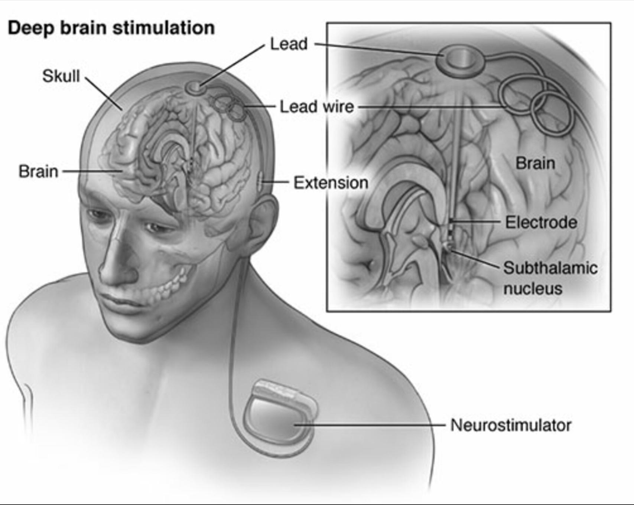
Surgical treatment
Deep brain stimulation (DBS). Here, an electrode is placed into the target area and connected to a stimulator inserted subcutaneously over the chest wall.
DBS simulates the effects of a lesion without needing to make a brain lesion.
Act by disrupting the abnormal neurophysiological signals that are associated with PD and motor complications.
The stimulation variables can be adjusted with respect to electrode configuration, voltage, frequency, and pulse duration in order to maximize benefit and minimize adverse side effects. The procedure does not require making a lesion in the brain and is thus suitable for performing bilateral procedures with relative safety.

Slide 43
DBS for PD is primarily used to target the STN or the Gpi. It provides antiparkinsonian benefits, particularly with respect to tremor, and reduces both “off” time and dyskinesias but does not provide antiparkinsonian benefits that are superior to levodopa
Side effects can result from the surgical procedure (hemorrhage, infarction, infection), the DBS system (infection, lead break, lead displacement, skin ulceration), or the stimulation itself (ocular and speech abnormalities, muscle twitches, paresthesias, depression, and rarely suicide). Results of DBS of the STN and Gpi are comparable, but Gpi stimulation may be associated with a reduced frequency of depression.

Slide 44
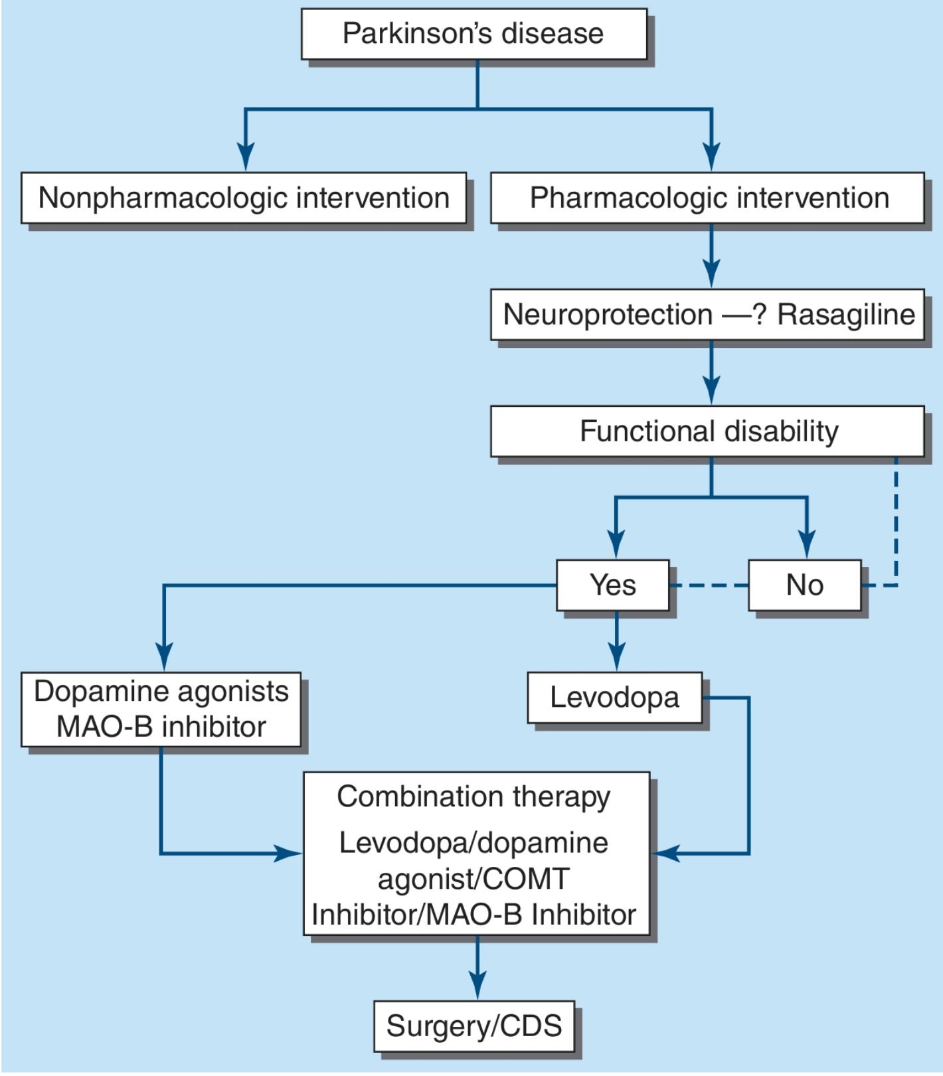

Slide 45
Management of nonmotor symptoms
Depression ;ssris
Anxiety : shorts acting bzd
Psychosis: low doses neuroleptics,clozapine
Orthostatic hypertension: added salt in diet

Slide 46
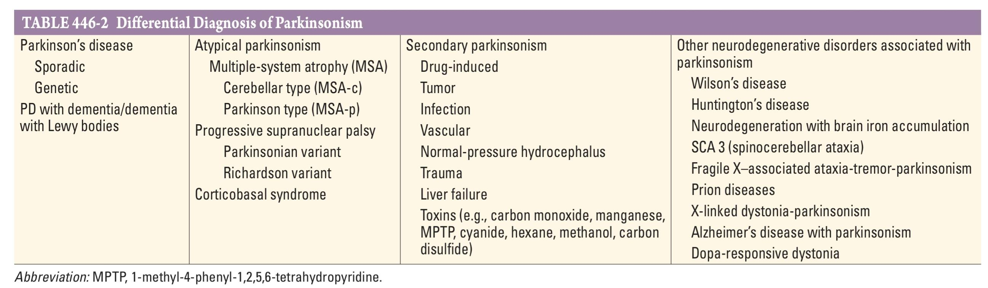
Differential diagnosis

Slide 47
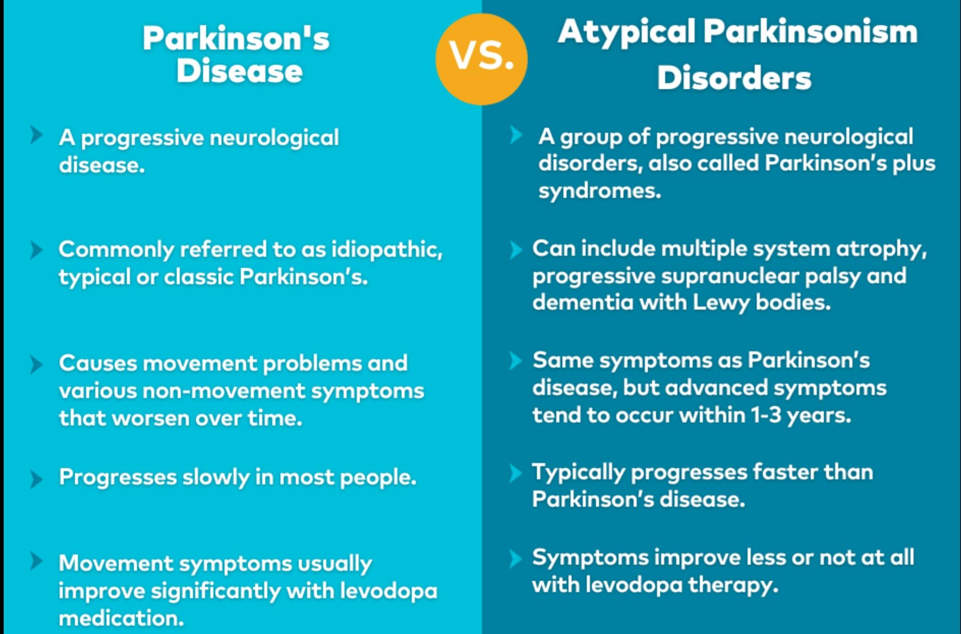

Slide 48
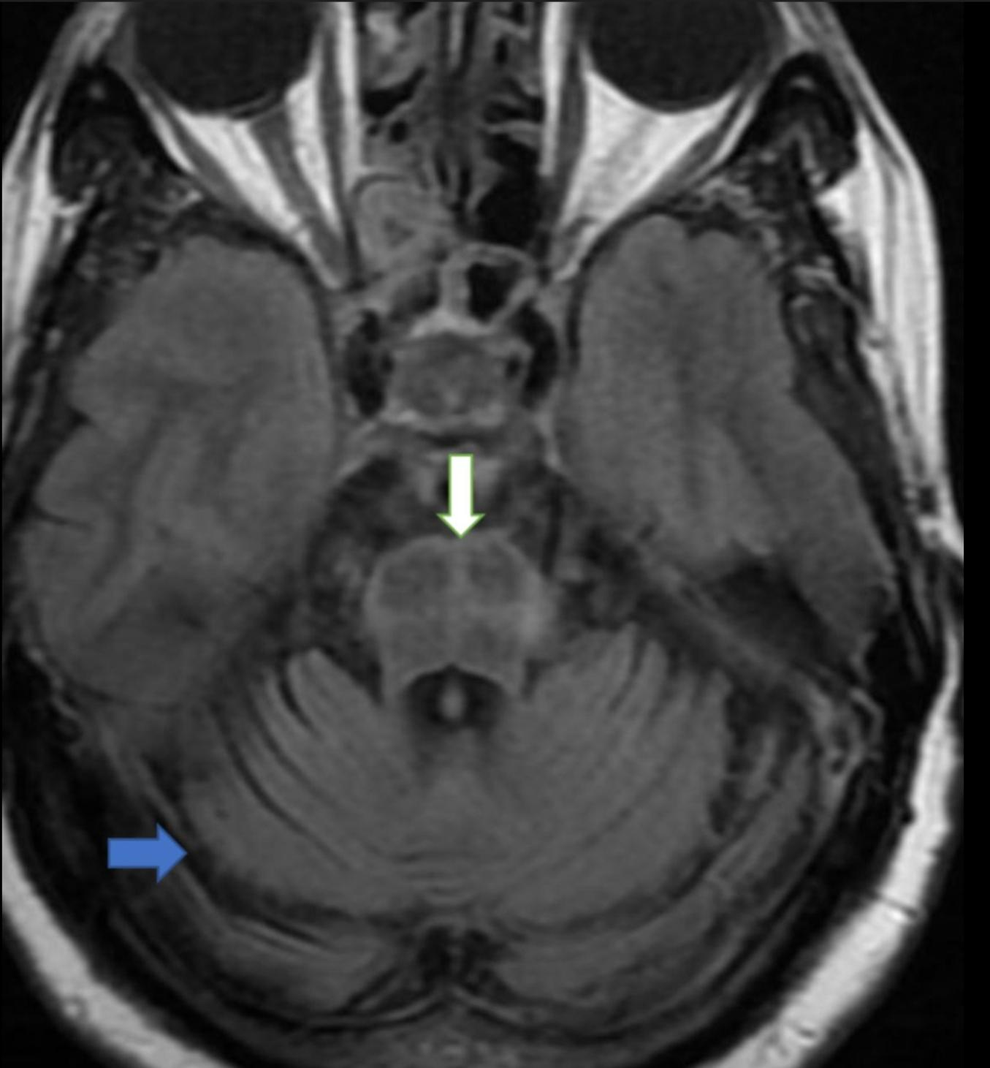
Multiple system atrophy
Characterized by parkinsonism, autonomic failure and cerebellar features ; MSA-P or MSA –C
Early falls,postural instability, and lack of response to Ld are the clues for diagnosis
The pathological hallmark is the a-synuclein glial cytoplasmic inclusions found in basal ganglia, cerebellum,and motorcirtex
Poor prognosis, early disability.
Cognition is preserved
“HOT- CROSS BUN”

Slide 49
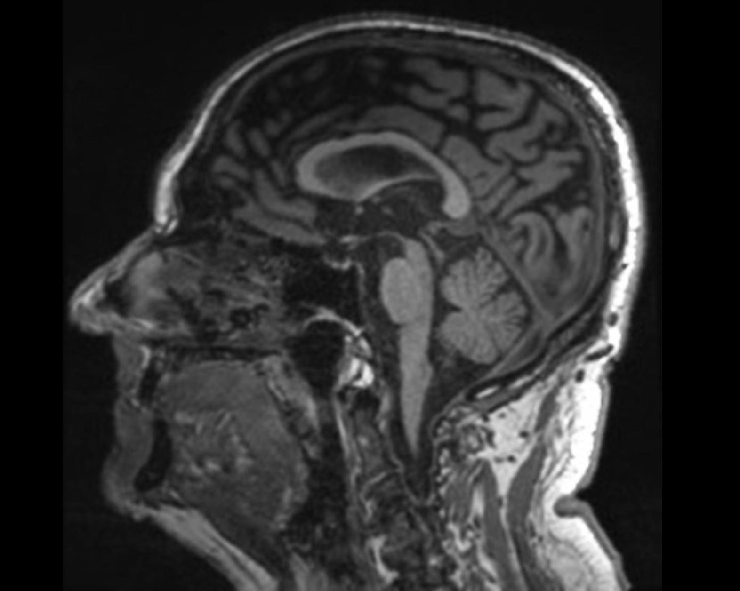
Progressive supranuclear palsy( psp)
Presents with symmetrical parkinsonism, cognitive impairment,early falls and bulbar symptoms
The characteristic eye movement disorder: slowed vertical saccades leading to impairment of up and down gaze
Pathology: Abnormal accumulation of tau proteins and degeneration of the substantia nigra , subthalamic nucleus and mid brain.
There is no treatment,and parkinsonism usually doesn’t respond to LD

Slide 50
Cortical basal ganglionic degeneration
Less common than MSA psp
Variable clinical features with dystonia , myoclonus with ‘alien limb’ phenomenon, wherein a limb moves about or interfers with the other limb without apparent conscious control
Cortical symptoms, especially apraxia,are common
It is also a tauopathy .

Slide 51
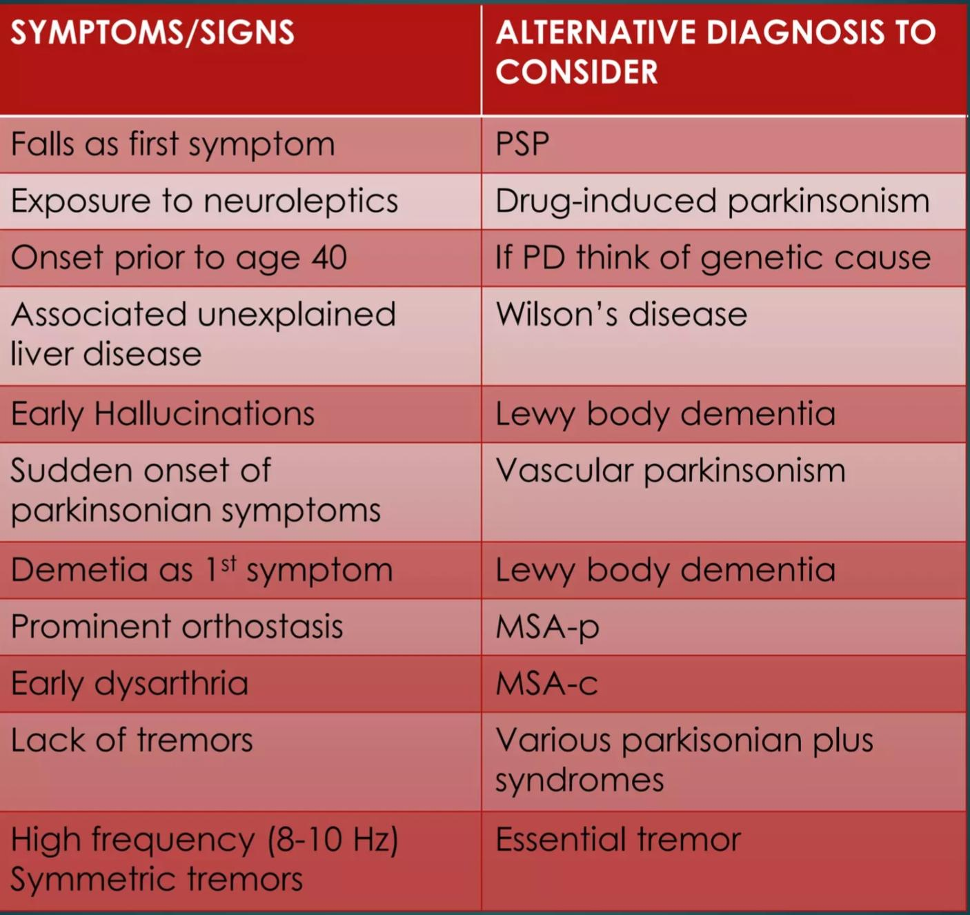

Slide 52


