Slide 1
ASCITES
Chief: Prof. Dr. R.SUNDARAM, M.D
Assistant Professors: Dr. S.SUGADEV, M.D,
Dr. P.KRISHNARAJAN,M.D.
Presenter: Dr. PRITHVIRAJ T

Slide 2
ASCITES
Ascites is the accumulation of fluid within the peritoneal cavity.

Slide 3
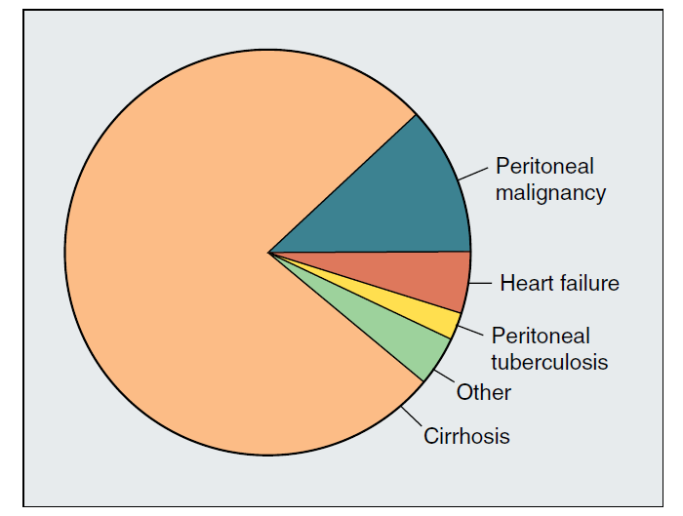
Causes of Ascites
Conditions directly involving the peritoneum | Conditions remote from the peritoneum
Infection Tuberculosis Malignancy | Liver disease Heart failure (Cardiac ascites) Hypoproteinemia
Most common cause of Ascites: Portal Hypertension in Cirrhosis Liver

Slide 4
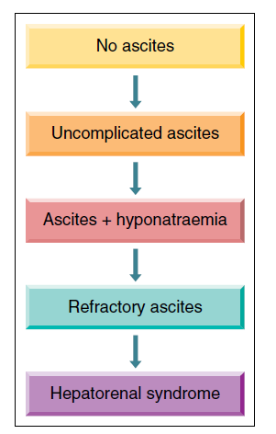
Ascites in Cirrhosis
Natural Course of Ascites
In patients with cirrhosis, the development of ascites marks the transition from compensated to decompensated cirrhosis.
Ascites is the most frequent first decompensating event.

Slide 5
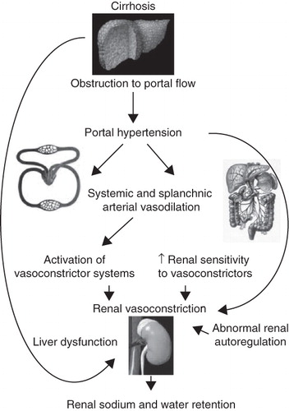
Pathogenesis
Mechanisms of Ascites Formation
The mechanisms of ascites formation in cirrhosis are complex.
Sinusoidal hypertension
Sodium and water retention
  (Vasodilation theory)

Slide 6
Mechanisms of Ascites Formation
Sinusoidal Hypertension
Cirrhosis Liver
In cirrhosis, the source of ascites is mainly the hepatic sinusoids.
Portal hypertension is the initial mechanism that determines leakage of ascites into the peritoneal space.
Regenerative nodules and fibrosis
Hepatic venous outflow block
Threshold Hepatic Venous Pressure Gradient (HVPG) ≥ 10 mmHg → Defined as ‘Clinically significant Portal Hypertension’
→ Predicts the development of complications of cirrhosis
Sinusoidal Hypertension

Slide 7
Mechanisms of Ascites Formation
Sodium and water retention
In patients with cirrhosis and ascites → Normal regulation of sodium balance is lost
Avid/ Inappropriate retention of sodium
Urinary sodium excretion <5 mmol/day
Vasodilation theory – Explains Sodium retention

Slide 8
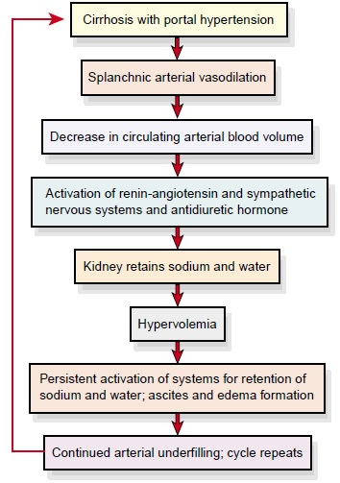
Mechanisms of Ascites Formation
Vasodilation Theory
Portal Hypertension
Release of VEGF, Angiotensin, shear stress, inflammatory cytokines
Activation of Nitric Oxide (NO) synthesis
Arterial Vasodilation
Notes:
The other vasodilators implicated in the vasodilation of cirrhosis include carbon monoxide, endocannabinoids, prostacyclin, neuropeptides, and glucagon.
RAAS – Renin-Angiotensin-Aldosterone system
SNS- Sympathetic Nervous System (through carotid sinus baroreceptors).
There is a constant leaking of retained fluid out of the intravascular compartment into the peritoneal cavity → Vascular filling not achieved → Process continues
Hypoalbuminemia → Reduced plasma oncotic pressure → Loss of fluid from the vascular compartment into the peritoneal cavity (Contributing factor)

Slide 9
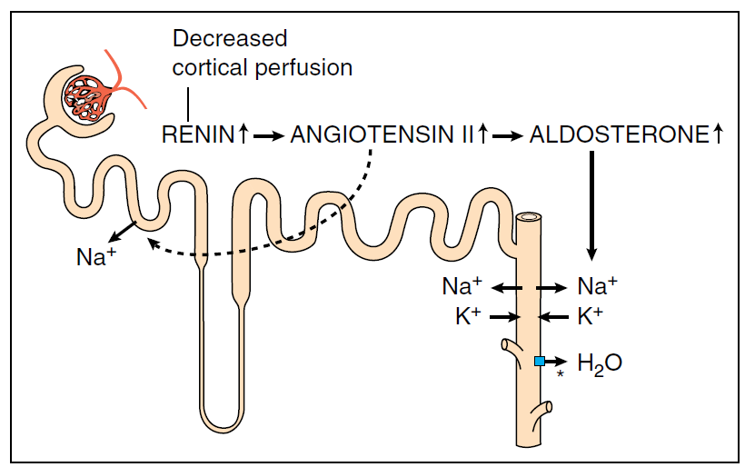
Pathogenesis
Renin ↑
Angiotensin II ↑
Aldosterone ↑
Non-osmotic release of ADH ↑
Potent vasoconstrictor
(Venules and arterioles)
Potent activator of the adrenergic system
Sodium and water retention
Hyponatremia
Renal Vasoconstriction & Hypoperfusion
Hepatorenal syndrome (HRS)

Slide 10
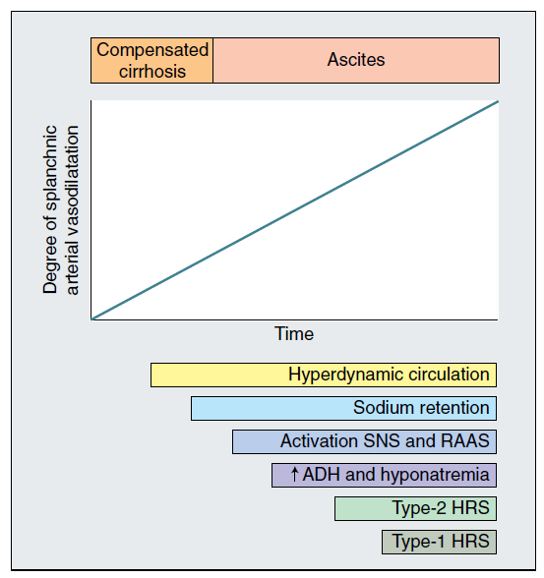
Pathogenesis
Time Course of Circulatory, Neurohormonal, and Renal function Abnormalities in Cirrhosis

Slide 11
Ascites - Clinical Features
Insidious in onset
Increase in abdominal girth (notices tightness of the belt or garments around the waist)
Recent weight gain
Development of peripheral edema
Dyspnea (Compromised respiratory function due to elevation of diaphragm)
Feeling of satiety
Generalized abdominal pain
Muscle wasting
Excessive fatigue
Weakness
Hepatic hydrothorax

Slide 12
Ascites - Clinical Features
Grading |  | Characteristic
Grade 1 | Mild Ascites | Detectable only by ultrasound examination
Grade 2 | Moderate Ascites | Moderate symmetrical distension of the abdomen
Grade 3 | Large or Gross Ascites | Marked abdominal distension
Grade 2 and 3 ascites are clinically evident and symptomatic; Require therapy

Slide 13
Ascites – Physical Examination
Stigmata of cirrhosis – Jaundice, spider angiomata, palmar erythema, muscle wasting
Signs of portal hypertension – splenomegaly, abdominal wall collaterals
Bulging flanks, Flank dullness
Shifting dullness – most sensitive sign
Fluid wave/ thrill – more specific, less sensitive
Presence of a ballotable liver/ spleen – “bounced” back and forth by a flicking motion of fingers

Slide 14
Ascites – Associated Conditions
Umbilical Hernia
Hepatic Hydrothorax
Peripheral edema

Slide 15
Umbilical Hernia
Increased intra‐abdominal pressure favours the development of diastasis recti or hernias in the umbilical, femoral, or inguinal regions or through old abdominal incisions.
Hernias develop in about 20% of patients with cirrhosis and ascites.
Hernias may increase to 70% in patients with long‐standing, recurrent, tense ascites.
Risks: Rupture and incarceration

Slide 16
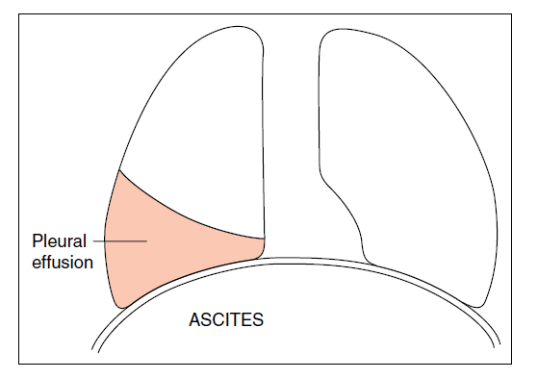
Hepatic Hydrothorax
Develops in about 5-10% of patients with cirrhosis.
More common on the right side (85%), left-sided in 13% and bilateral in 2% of the cases.
Implicates a rent in the diaphragm with free flow of ascitic fluid into the pleural cavity.
Clinical features: Severe shortness of breath and hypoxaemia

Slide 17
Peripheral edema
Hypoproteinaemia
Functional inferior vena caval block due to pressure of the abdominal fluid
The presence of oedema without ascites should lead to investigations of causes of fluid retention other than ascites.
Causative factors:

Slide 18
Diagnosis
Physical Examination
Abdominal Imaging
  Subtle amounts of ascites can be detected by ultrasound or CT scanning
Diagnostic paracentesis - Performed in patients with
    New-onset grade 2 or 3 ascites
    Those hospitalized for worsening ascites or any complication of cirrhosis
    Suspected Spontaneous Bacterial Peritonitis (SBP)

Slide 19
Diagnostic Paracentesis
To characterize the fluid
  Fluid appearance: Clear/ green/ straw-coloured/ bile-stained/ blood-stained
To determine
  Total protein
  Albumin content
  Serum ascites-to-albumin gradient (SAAG)
  Blood cell counts with differential
  Bacteriological cultures
  Amylase and cytology (when appropriate)

Slide 20
Diagnostic Paracentesis
Ascites Total Protein
High Ascites Total Protein (>2.5 g/dL) | Low Ascites Total Protein (<2.5 g/dL)
Occurs with Peritoneal Involvement Malignancy Tuberculosis | Cirrhosis (Deposition of fibrous tissue in the sinusoids → Sinusoids less leaky to macromolecules)
Occurs in Post-sinusoidal or Post-hepatic Sinusoidal hypertension Budd-Chiari syndrome Heart failure | When Ascitic fluid protein is very low <1.5 g/dL → Increased risk for developing SBP

Slide 21
Diagnostic Paracentesis
Serum ascites-to-albumin gradient (SAAG)
  = Serum albumin level – Ascites fluid albumin level
  Correlates with the hepatic sinusoidal pressure
  SAAG >1.1 g/dL → Indicates Portal hypertension → Cirrhosis, Heart failure, Budd-Chiari syndrome
  SAAG <1.1 g/dL → Consider infectious or malignant causes of ascites

Slide 22
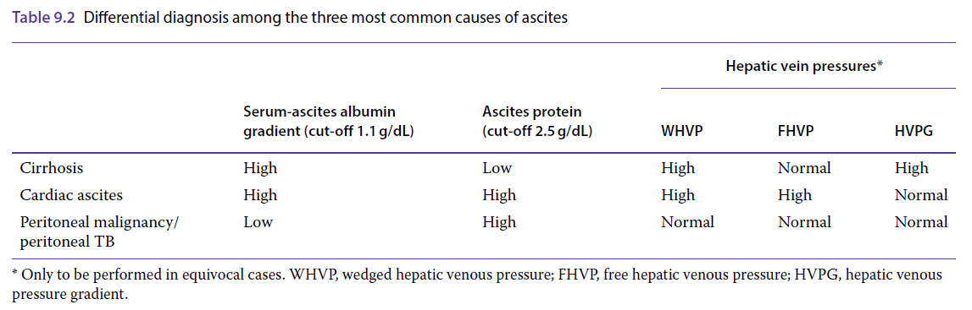
Diagnostic Paracentesis

Slide 23
Diagnostic Paracentesis
Blood cell counts with Differential
  Sterile ascites → Ascitic fluid WBC count <100/mm³; mononuclear cell predominance
  ↑ PMN cell count → Peritoneal infection, intra-abdominal inflammatory conditions (diverticulitis, cholecystitis)
  SBP → PMN cell count >250/mm³
  High level of RBCs in ascitic fluid → Traumatic tap, HCC, ruptured omental varix, recent invasive procedures (liver biopsy)

Slide 24
Diagnostic Paracentesis
Ascites Bacteriological culture
  Negative in approximately 50% of patients
  Both aerobic and anaerobic cultures to be performed
  Recommended method: Inoculation of ascitic fluid directly into blood culture bottles at the bedside

Slide 25
Differential Diagnosis
Cardiac ascites
Malignant ascites
Tuberculous ascites
Mixed aetiology ascites
Chylous ascites
Budd-Chiari syndrome

Slide 26
Differential Diagnosis | Clinical Features | Diagnosis
Cardiac ascites | Secondary to heart failure/ constrictive pericarditis C/F: Jugular venous distension, Elevated serum BNP, Echocardiographic findings , Paradoxical pulse, and Radiological demonstration of a calcified pericardium | Ascites protein >2.5 g/dL SAAG >1.1 mg/dL Right and left heart catheterization and transjugular liver biopsy with measurements of hepatic venous pressure gradient – to differentiate between cardiac and cirrhotic ascites.
Malignant ascites | Symptoms and localizing signs due to the primary tumour Liver enlarged and nodular on examination after paracentesis | Resemble the characteristics of cirrhotic ascites Fluid cytological exam should be performed

Slide 27
Differential Diagnosis | Clinical Features | Diagnosis
Tuberculous ascites | Suspected particularly in patients in endemic areas C/F: Abdominal pain, weight loss, and pyrexia Lumps of matted omentum may be palpated after paracentesis. | Ascitic fluid analysis: Contains many lymphocytes. Send for Acid fast-bacilli staining Send for M. tuberculosis PCR analysis and cultures.
Mixed etiology ascites | In patients with mixed ascites (e.g. Cirrhosis with superimposed peritoneal malignancy or tuberculosis) | Findings of ascites due to cirrhosis predominate. SAAG is high and the ascites protein is low

Slide 28
Differential Diagnosis | Clinical Features | Diagnosis
Chylous ascites | Results from accumulation of fat, predominantly chylomicrons, in the ascitic fluid Most common cause: Post‐surgical disruption of lymphatics Most common cause of non‐surgical chylous ascites: Cirrhosis | Milky in appearance Ascitic fluid Triglyceride content >200 mg/dL
Budd-Chiari syndrome | Hepatic venous obstruction | Considered especially if there is High Ascitic fluid protein content and High SAAG
Pancreatic Ascites | Ascites is rarely gross in pancreatic ascites Complication of acute pancreatitis With pseudocyst rupture, or From pancreatic duct disruption | Ascitic fluid Amylase content: Very high

Slide 29
Treatment of Cirrhotic Ascites
Ascites Grade | Treatment
Small ascites (Subclinical Ascites) | Dietary sodium restriction (1.5-2 g sodium/day)
Moderate ascites (Symptomatic Ascites) | Dietary sodium restriction + Diuretic therapy Spironolactone - start at 100 mg/day, maximum of 400 mg/day ± Furosemide – start at 40 mg/day, maximum of 160 mg/day
Large ascites | Paracentesis
Tense ascites | Urgent Paracentesis (Risk of eversion and rupture of umbilical hernia, shock, renal failure, sepsis, high mortality)
Refractory ascites | Repeated Large Volume Paracentesis (LVP) TIPS (Transjugular Intrahepatic Portosystemic Shunting) Peritoneovenous (LeVeen) shunt

Slide 30
Sodium restriction/ Diet
Sodium excretion in patients with cirrhosis and ascites:
  Urine: ̴ 0.2 g/day
  Extrarenal loss: ̴ 0.5 g/day
Sodium taken in excess of 0.75 g will result in ascites, with every gram retaining 200 mL of fluid
Current recommendation: ‘No added salt’ diet ± Diuretics
‘No added salt’ diet: 1.5-2.0 g/day (70-90 mmol/day)

Slide 31
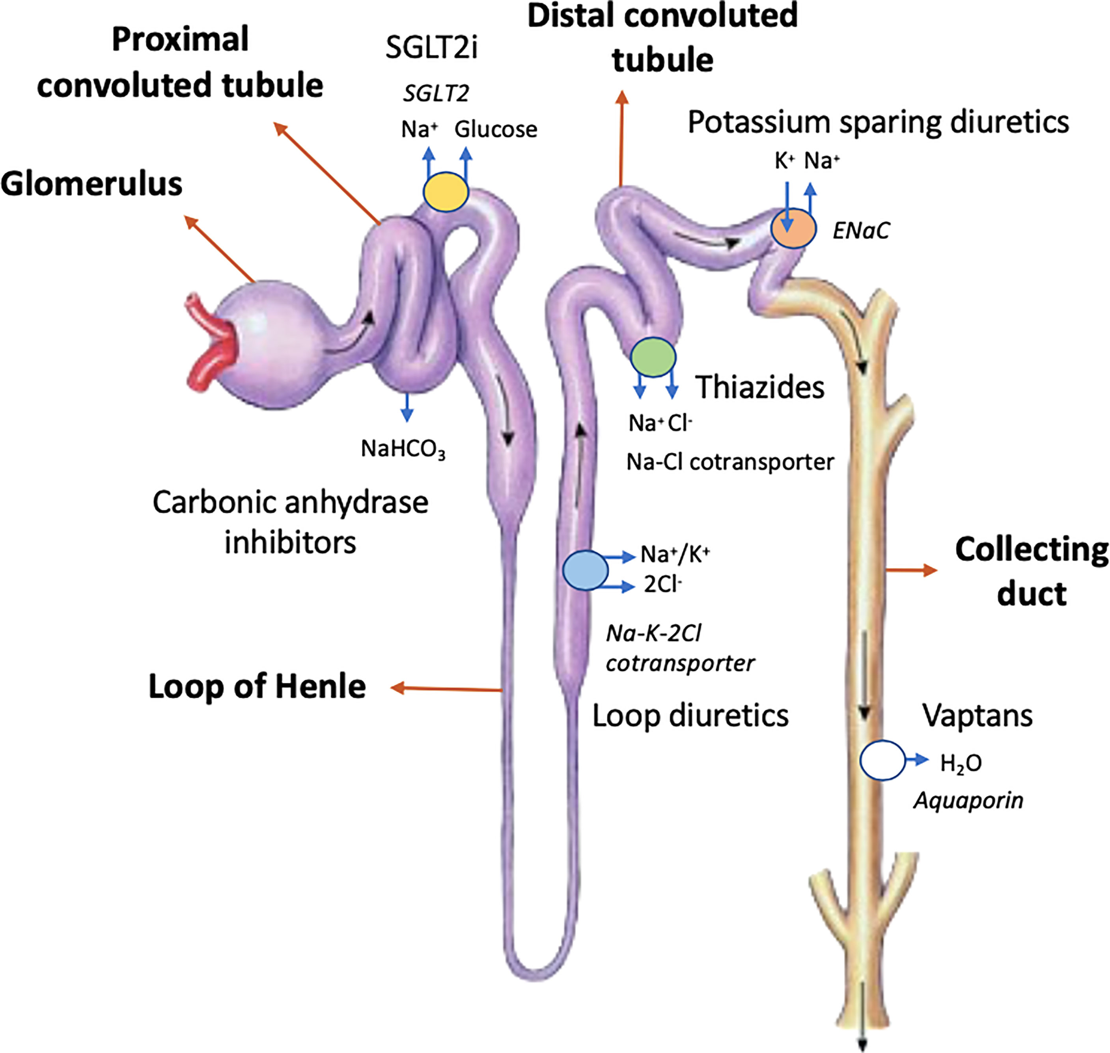
Diuretics
↑RAAS activity → Hyperaldosteronism →
Avid reabsorption of sodium from distal tubule and collecting duct → Sodium retention in Cirrhosis
Diuretics – 2 main groups:
Na+-K+-2Cl- (NKCC2) cotransporter inhibitors (Ascending limb of Loop of Henle)
    Furosemide, Bumetanide
    Not appropriate to use alone (sodium can be reabsorbed in the distal tubule and collecting duct d/t hyperaldosteronism)
Aldosterone antagonists (Distal tubule and collecting duct)
    Spironolactone, amiloride, triamterene
    First drug of choice
    Conserve potassium, may result in hyperkalemia
Notes:
Thiazides inhibit reabsorption in the distal convoluted tubule, have a longer half-life, may cause hypotension, and should not be used in the treatment of ascites.

Slide 32
Diuretics
Two therapeutic approaches
1) Spironolactone alone
  Starting dose: 50-100 mg/day
  If Insufficient clinical response (weight loss <300g/day) after 3-4 days →
  Increase the dose by 100 mg/day every 4 days to a maximum of 400 mg/day, unless hyperkalemia develops
  If Insufficient response on Spironolactone alone or Associated Hyperkalemia → Add a Loop diuretic (Furosemide 20-40 mg/day)
2) Combination of Spironolactone + Furosemide
Start with a combination of Spironolactone 100 mg + Furosemide 40 mg daily
Maximum dose: Spironolactone 400 mg/day; Furosemide 160 mg/day
Monitor daily weight – Maximum daily weight loss – 0.5 kg/day, with a maximum of 1.0 kg/day in those with edema to avoid the risk of renal dysfunction
Notes:
Intravascular volume expansion with IV albumin increases natriuresis in response to diuretics – but expensive, not cost-effective.
Long-term spironolactone causes painful gynaecomastia in males.
Amiloride – less natriuretic effect than spironolactone
Eplerenone – ameliorates painful gynecomastia while maintaining efficacy; but is more expensive

Slide 33
Failed Diuretic Therapy
Non-compliance with sodium restriction should be Ruled Out.
Non-compliance is suspected when
  24-hour urine sodium excretion is >78 mmol/L (OR)
  Spot urine sodium concentration > potassium concentration
Rule out concomitant use of NSAIDs and vasodilators such as ACEIs and ARBs

Slide 34
Complications of Diuretic Therapy
Complication
Acute Kidney Injury
Encephalopathy
Hyperkalemia
Hypovolemic hyponatremia
Painful gynaecomastia
Muscle cramps

Slide 35
Therapeutic (Large-Volume) Paracentesis
Local therapy by which ascites is removed through a needle
Complications:
  Paracentesis Induced Circulatory Dysfunction(PICD)
    Leads to faster reaccumulation of ascites, hyponatremia, renal impairment, and shorter survival
    After LVP of ≥ 5L, IV 25% albumin at a dose of ̴ 6-8 g/L of removed ascites should be given to prevent circulatory dysfunction
  Bleeding (low platelet count <50000, Child-Pugh class C)
  Leakage of ascitic fluid
  Development of sudden scrotal edema
Notes:
Clotting abnormalities are not a contraindication to LVP
Leakage treated by completing the LVP preferablt in a site remote from the leaking puncture site
Scrotal elevation for scrotal edema

Slide 36
Prognosis
Poor prognosis in cirrhotic patients with ascites
<50% of the patients survive 2 years after the onset of ascites
Consider liver transplantation in patients with ascites

Slide 37
Complications of Ascites
Spontaneous Bacterial Peritonitis (SBP)
Hyponatremia
Hepatorenal syndrome (HRS)
Umbilical hernia rupture
Encephalopathy (If TIPS)

Slide 38
Spontaneous Bacterial Peritonitis
Common and severe complication of ascites
Spontaneous infection of the ascitic fluid without an intraabdominal source
Occurs in up to 30% of the hospitalized patients with cirrhosis and ascites
Diagnosis requires a high degree of suspicion

Slide 39
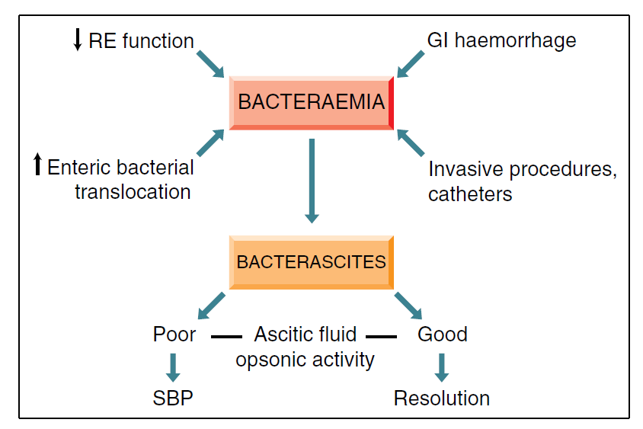
Spontaneous Bacterial Peritonitis
Pathogenesis:
  Presumed mechanism: Bacterial translocation with gut flora traversing the intestine into the mesenteric lymph nodes, leading to bacteremia, and seeding of the ascitic fluid.
  An overactive sympathetic nervous system slows gut motility and facilitates bacterial stasis and overgrowth, facilitating bacterial translocation.

Slide 40
Spontaneous Bacterial Peritonitis
Suspect SBP when a cirrhotic patient deteriorates, with encephalopathy, acute kidney injury and/or jaundice, with variceal bleeding, previous SBP.
Clinical Features: Fever, altered mental status, local abdominal pain and tenderness, elevated WBC count
Diagnosis: Absolute neutrophil count in ascitic fluid >250/µL
SBP – Typically a monobacterial infection
Causative organisms:
  Escherichia coli, Klebsiella and other gut bacteria – most common
  Streptococcus viridans, Staphylococcus aureus, Enterococcus spp.,
Nosocomial and heathcare-associated SBP → Gram-positive and multidrug resistant organisms
If >2 organisms are identified → consider secondary bacterial peritonitis due to perforated viscus or secondary peritonitis

Slide 41
Spontaneous Bacterial Peritonitis - Treatment
Start empirical antibiotics in all patients with ascites showing >250/µL PMN cells
  IV Third-generation Cephalosporin
    Cefotaxime 2 gm Q12H for 5-7 days
  Extended spectrum antibiotics in nosocomial or healthcare associated SBP
    Carbapenams, imipenem/cilastatin, piperacillin/tazobactam with or without glycopeptides
IV Albumin (1.5 g/kg body weight on day 1 and 1.0 g/kg on day 3)
  Reduces the risk of renal failure and improves survival rates
  Especially in those with renal dysfunction at baseline (Sr. Creatinine >1.0 mg/dL and/or BUN>30 mg/dL) and serum bilirubin >4 mg/dL.

Slide 42
Spontaneous Bacterial Peritonitis - Prophylaxis
In patients with a Previous episode of SBP:
  Oral Norfloxacin 400 mg/day
  Second-line drugs: Ciprofloxacin (500 mg/day), Trimethoprim/sulfamethoxazole (160/800 mg/day)
  Evaluate for Liver transplantation
In patients with Upper GI hemorrhage:
  Oral Norfloxacin 400 mg Q12H for at least 7 days
  IV Third-generation cephalosporins (decompensated cirrhosis, a recent infection due to a quinolone‐resistant organism or in those receiving quinolone prophylaxis)
In patients with advanced liver failure (Child-Pugh score>9, Sr. Bilirubin >3 mg/dL) or impaired renal function (Sr. Creatinine>1.2 mg/dL, BUN>25 mg/dL, Sr. Sodium <130 mEq/L):
  Oral Norfloxacin prophylaxis
Prophylaxis is not necessary if Ascitic fluid protein >1 g/dL without a past history of SBP

Slide 43
Hyponatremia
Serum sodium concentration < 130 mEq/L
Develops in 20-30% of cirrhotic patients with ascites
Usually Hypervolemic/ Dilutional
Mechanism: Water retention due to excess vasopressin as a result of baroreceptor stimulation (d/t reduced effective circulating volume)
C/F: Asymptomatic, anorexia, nausea, vomiting, lethargy, seizures
Treatment:
  Fluid restriction 1-1.5 L/day
  Vaptans (V2-receptor antagonists) – Tolvaptan – Transient effect
Poor prognostic marker – Risk factor for encephalopathy and HRS

Slide 44
Refractory Ascites
Ascites that cannot be mobilized or prevented from recurring by medical therapy
Diuretic-resistant: Ascites not mobilized despite maximal diuretic dosage
Diuretic-intractable: Development of diuretic-induced complications that preclude the use of an effective diuretic dosage
Review dietary history, use of NSAIDs, ACEIs, ARBs, and patient compliance with the treatment regimen before confirming the diagnosis
Treatment: Large volume paracentesis, TIPS, peritoneovenous shunting, liver transplantation

Slide 45
Treatment of Refractory Ascites
Treatment Options |  | Comments
First-line | Serial LVP + Albumin | Recurrence is the rule Avoid removal of >2L fluid at a time if there is renal dysfunction
Second-line | TIPS | When paracenteses >1-2/month MELD <15 More effective than LVP in preventing recurrence of ascites ?Survival benefit May precipitate hepatic encephalopathy and/or liver failure
Third-line | Peritoneo-venous (LeVeen) shunt | Non-LVP, non-TIPS candidates Complications: Frequent blockage, DIC, pulmonary edema, variceal hemorrhage, high perioperative mortality. May hinder TIPS placement, may complicate liver transplant surgery due to peritoneal adhesions

Slide 46
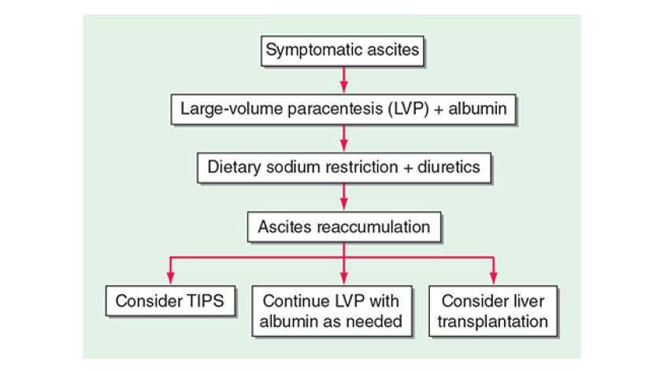
Treatment of Refractory Ascites

Slide 47
Hepatorenal syndrome
Severe complication of cirrhosis
Development of renal failure in the absence of any identifiable renal pathology
Functional rather than structural disturbance in the renal function
Pathogenesis: Intense splanchnic and peripheral vasodilatation with consequent renal vasoconstriction
Diagnosed by excluding other forms of renal failure such as prerenal azotaemia, acute tubular necrosis, or other structural kidney injury

Slide 48
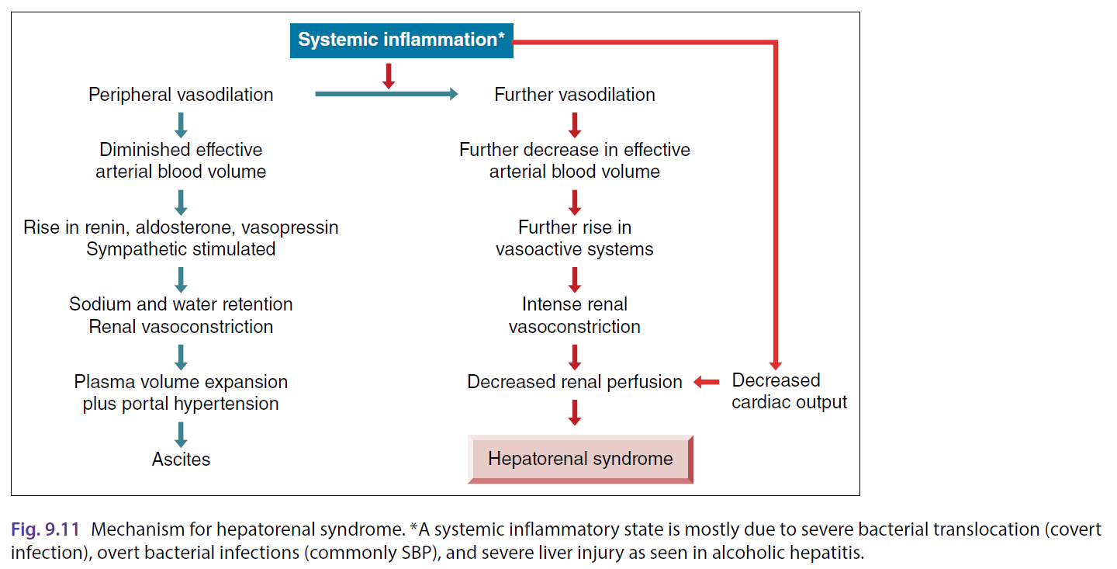
Hepatorenal syndrome – Pathogenesis
Most common precipitant of HRS:
Bacterial infection

Slide 49
Hepatorenal syndrome – Clinical types
Type I HRS (HRS-AKI)
Rapidly progressive reduction of renal function
Poor prognosis
Type II HRS (HRS-NAKI)
Progressive but slower deterioration in renal function
Better prognosis

Slide 50
Hepatorenal syndrome – Diagnostic criteria
1) Cirrhosis with ascites
2) Diagnosis of AKI according to ICA-AKI criteria (based on KDIGO): Increase in serum creatinine by ≥0.3 mg/dL (≥26.5 μmol/L) within 48 hours; OR a percentage increase in SCr ≥50% from baseline, which is known or presumed to have occurred within the prior 7 days
3) No response after at least 48 hours of diuretic withdrawal and volume expansion with albumin (1 g/kg of body weight per day up to a maximum of 100 g/day)
4) Absence of shock
5) No current or recent use of nephrotoxic drugs (e.g. NSAIDs, aminoglycosides, iodinated contrast, etc.) or drugs that have reduced mean arterial pressure (e.g. vasodilators)
6) Absence of evidence of structural kidney injury as indicated by: Proteinuria > 500 mg/day, Microhaematuria > 50 RBCs per high power field, and/or Abnormal renal ultrasonography

Slide 51
Hepatorenal syndrome – Clinical Features
Advanced liver disease (Child-Pugh class C)
Ascites (Mostly refractory)
Low serum sodium
Low mean arterial pressure
Very low fractional excretion of sodium (FeNa)
FeNa <0.1% is highly suggestive of HRS

Slide 52
Hepatorenal syndrome – Treatment
Stop Diuretics
Intravascular volume expansion with IV albumin at a dose of 1g/kg body weight up to a maximum of 100 g
The dose can be repeated in 12 hours if serum creatinine has not improved and if the patient is not anuric
Stop potentially nephrotoxic drugs, vasodilators, and non-selective beta blockers
Search for any source of sepsis; start broad-spectrum antibiotics if infection is strongly suspected
Renal replacement therapy – if severe volume overload, acidosis, or hyperkalemia
Vasoconstrictors (terlipressin, norepinephrine, octreotide+midodrine) as a bridge to liver transplantation
Liver transplantation – Only definitive therapy for HRS
Other options: TIPS, Extracorporeal albumin dialysis (MARS)
Notes:
TIPS – Transjugular intrahepatic portosystemic shunt
MARS – Molecular Absorbent Recirculating System

Slide 53
Take Home Points
Ascites is most commonly caused by portal hypertension due to cirrhosis, but always consider other causes like malignancy, TB, and heart failure
RAAS and sympathetic nervous system activation in cirrhosis contribute to sodium retention and fluid accumulation
Diagnostic paracentesis is mandatory in all new-onset ascites and in any cirrhotic patient with clinical deterioration (Rule out SBP)
First-line management includes: Salt restriction, Diuretics (spironolactone ± furosemide), Therapeutic paracentesis if tense ascites
Refractory ascites may require: Repeated large-volume paracentesis with albumin, TIPS, Liver transplantation

Slide 54
References
Harrison’s Principles of Internal Medicine, 21st edition
Sherlock’s Diseases of the Liver and Biliary system, 13th edition

Slide 55
Thank You

