Slide 1
FROM TOXICOLOGY CHIEF-DR.MURALIDHARAN M.D ASST PROF DR.SARVANAMADHAV M.D
AN INTERESTING CASE OF SNAKE BITE

Slide 2
A 41 year old male patient presented to udumalpet GH with alleged h/o snake bite over left lowerlimb for which he was given 10 vials of asv and pt developed cellulitis f/b compartment syndrome treated by fasciotomy and was referred to grh for AKI management
During course of hospital stay in GRH On day 4 pt developed h/o low back ache f/b pt developed b/l lower limb weakness

Slide 3
HOPI: H/O back ache-sudden onset
dull aching pain
H/O B/L lower limb weakness-
sudden onset
rapidly progressive
involving both proximal and distal
muscles
H/O loss of any form of sensation of both the lower limbs
H/O not able to feel cloth sensation
H/O not able to feel pain or touch sensation
H/O Bowel incontinence
H/O urinary retention
NO H/O trauma
No h/o previous chronic medical illness

Slide 4
No h/o altered sensorium
No h/o involuntary movements
No h/o fever
NO h/o breathlessness
No h/o visual disturbance
No h/o recent vaccination
NO h/o recent UTI or respiratory tract infections
No h/o prior radiations

Slide 5
Past history: no comorbities
No h/o recent vaccination
No h/o chronic medical illness in past
Personal history:consumes mixed diet
non alocholic or smoker
previously normal bowel and
bladder habits
normal sleep pattern
Treatment history:
Treated for snake bite with 10 vials of asv
Fasciotomy for cellulitis and compression syndrome
1 hd cycle

Slide 6
General examination:
pt conscious
Oriented
Comfortable at rest and cooperative
Moderately built
afebrile
No pallor
No icterus
No cyanosis
No clubbing
No lymphadenopathy
No pedal edema
No neuro cutaneous markers

Slide 7
Vitals:
BP:110/70mmhg left upper arm in supine position
PR:85/MIN regular rhythm, normal voulme ,no specific character , felt equally in all peripheral vessels, no radio radial and radio femoral delay
SPO2:99%RA
RR:18 /min

Slide 8
CNS:
Higher mental functions: normal
Cranial nerves examination:normal
Cerebellum: normal

Slide 9
sign
 | TEST
1 | TONE UL LL | NORMAL FLACCID | NORMAL FLACCID
2 | POWER NO NECK MUSCLE WEAKNESS UL LL: HIP FLEXION-EXTENSION ABDUCTION –ADDUCTION KNEE FLEXION-EXTESNION ANKLE DORSI-PLANTAR FLEXION INVERSION EVERSION TRUNK MUSCLE BEEVORS SIGN MOTOR LEVEL LOCALISING TO L1 | 5/5 0/5 0/5 0/5 0/5 GOOD ABSENT | 5/5 0/5 0/5 0/5 0/5 GOOD ABSENT
MOTOR system:

Slide 10
Trunk muscle power normal
Abdominal reflex –present
Beevors sign -absent

Slide 11
 | TEST
4. | REFLEXES
 | SUPERFICIAL: Abdominal reflex Cremasteric perianal | present Absent absent | present Absent absent
 | DEEP TENDON REFLEX: Biceps jerk Triceps jerk Supinator jerk Knee jerk Ankle jerk | + + + - - | + + + - -
 | PLANTAR | MUTE | MUTE

Slide 12
All sensations below L1 dermatome level are absent
 | test | RIGHT | LEFT
1. |  | UL | UL
 |  | normal | normal
 |  | LL | LL
 | Spinothalamic Crude touch Pain temperature | Absent Absent absent | Absent Absent absent
 | Posterior column Fine touch Vibration Position sense | Absent Absent absent | Absent Absent absent

Slide 13
Autonomic nervous system:
Bladder: urinary retention
Bladder catheterised drained around 1200ml of urine
Loss of bowel control,constipation
No sweating disturbances and palpitation
NO MENINGEAL SIGNS

Slide 14
Systemic examination:
CVS: S1 S2+
NO MURMUR
RS: B/LAE+
NVBS
PA: SOFT BS+
non tender

Slide 15
ECG:

Slide 16
INVESTIGATIONS:
CBC
TC | 14400 | 12700 | 12100
HB | 14 | 12.0 | 12.5
PLATELET | 137000 | 213000 | 272000
RFT
UREA | 62 | 80 | 100 | 88
CREATININE | 2.9 | 4.0 | 5.6 | 6.6

Slide 17
LFT-
T.BILIRUBIN-0.6
DIRECT-0.3
INDIRECT -0.3
SGOT-27
SGPT-32
ALT-59
PT-17.2
INR-1.2
APTT-31.7

Slide 18
VCTC-NEGATIVE
VIRALMARKERS-NEGATIVE
Sr electrolytes
Na+ | 130 | 127 | 131 | 131
K+ | 3.7 | 3.5 | 3.5 | 3.8

Slide 19
CSF analysis:
SUGAR:139 mg(cbg-262mg/dl)
PROTEIN:485 mg
CELLS:
Total cell count:2 cells
POLYMORPH-1 CELL
LYMPHOCYTE:1CELL

Slide 20
Mri brain:

Slide 21
MRI SPINE:

Slide 23
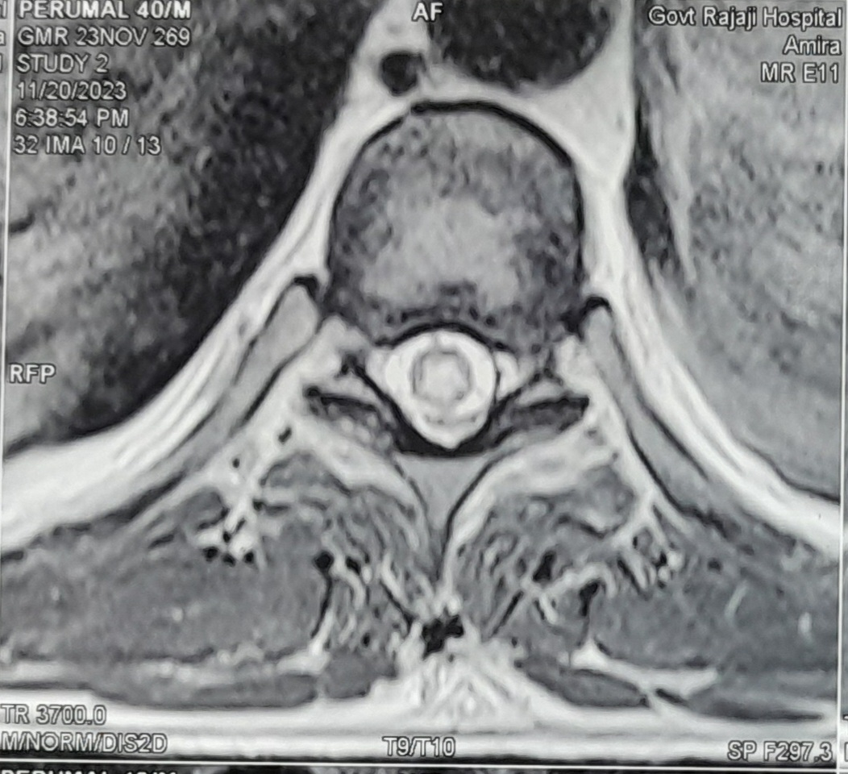

Slide 24
NEUROMEDICINEOPINION
OPINION:
post snake bite/transverse myelitis
To start on inj.methyprednisolone 500mg iv for 5 days
f/b tab.prednisolone 5mg 6-0-0

Slide 25
TREATMENT
PATIENT WAS TREATED WITH
INJ.METHYL PREDNISOLONE 500MG IV OD for 5 days
F/B
T.PREDNIOSOLONE 5MG 6-0-0
And patient had 6 cycles hemodialysis for AKI
And 3 cycles of plasmapharesis was done

