Slide 1
AN INTERESTING CASE OF DERMATOMYOSITIS
CHIEF -PROF.DR.M.NATARAJAN MD
ASST PROF -DR. P S ARUL RAJAMURUGAN MD.,DM
DR . B . PALANIKUMAR MD
Dr.Premkumar md.,dm
PRESENTer : Dr.P. THIRUNAVUKKARASU

Slide 2
55 year old male
Weakness of both upper & lower limbs – 3 months
Difficulty in swallowing - 3 months

Slide 3
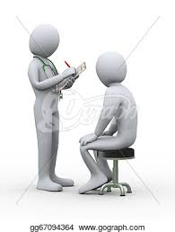
History of Present illness
Difficulty in lifting both upper limbs above shoulder and difficulty in getting up from squatting position for the past 3 month
Insiduous onset,progressive
No h/o difficulty in buttoning shirts
No h/o difficulty in holding slippers
No h/o difficulty in rolling over
h/o difficulty in lifting head from bed +

Slide 4
History of Present illness
h/o skin rash involving the face, upper trunk, back ,scalp for 3 months
accentuated on sun exposure,Pruritic
h/o voice change +
h/o regurgitation of food +
h/o difficulty in swallowing
No h/o any sensory disturbances

Slide 5
History of Present illness
No h/o fever
No h/o arthralgia
No h/o weight loss
No h/o chest pain, palpitations , syncope
No h/o cough
No h/o breathlessness

Slide 6
PAST HISTORY
Not a k/c/o SHTN / Type 2 diabetes mellitus
Not a k/c/o tuberculosis/ seizure disorder/ bronchial asthma / liver diseases/ thyroid illness
No h/o steroid abuse
No h/o any other drug intake
No h/o S/O any infections in the recent past
No h/o similar episodes in the past

Slide 7
PERSONAL HISTORY
Consumes mixed diet
Ex smoker and not an alcoholic
No h/o extra marital contact
Bowel and bladder habits normal
Sleep pattern normal

Slide 8
Family history
no h/o similar illness in other family members

Slide 9
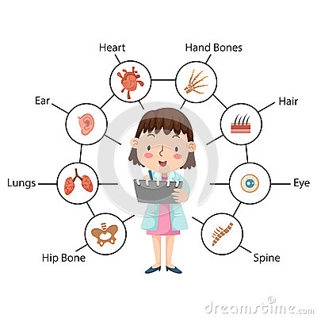
GENERAL EXAMINATION
Conscious
Oriented
Afebrile
Not tachypneic at rest
No pallor/ icterus/ cyanosis/ clubbing/ pedal edema
No generalised lymphadenopathy
Skin rashes over chest,scalp & back

Slide 10
VITALS
PULSE – 98 per minute, regular, normal in volume and rhythm, all peripheral pulses felt, no radioradial / radiofemoral delay
RESPIRATORY RATE – 18 per minute
BLOOD PRESSURE – 110/70 mm Hg in right upper limb in supine position
Spo2 – 98% in room air

Slide 11
SYSTEM EXAMINATION
CARDIOVASCULAR SYSTEM
First and second heart sounds heard normally
No murmur & no added sounds

Slide 12
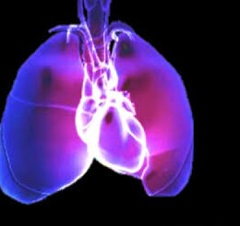
Respiratory system
Bilateral air entry equal
normal vesicular breath sounds present
No added sounds

Slide 13
ABDOMEN
soft
umbilicus in midline
no distension
no organomegaly

Slide 14
CENTRAL NERVOUS SYSTEM
Higher mental functions – normal
Cranial nerves – Normal
Fundus – normal
Reflexes – normal
Plantar – flexor on both sides

Slide 15
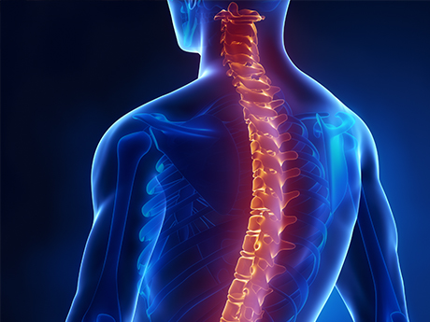
MUSCULOSKELETAL SYSTEM
Bulk - normal
Tone – normal
Power - 2/5 - Proximal muscles in both UL & LL
5/5 – Distal muscles in both UL & LL
Neck muscle weakness +
No muscle tenderness
Range of movements in all joints - normal

Slide 16
Central Nervous System
Sensory system - normal
Cerebellum - normal
Spine and cranium normal

Slide 17
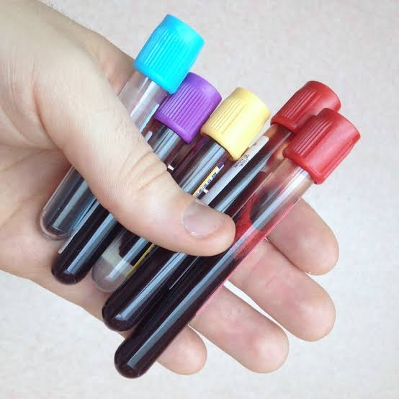
INVESTIGATIONS
COMPLETE HEMOGRAM
Hb – 12.6 gm/dl
TC – 10000 cells/cu.mm
DC- neutrophils- 85%
lymphocytes 5%
monocytes 10%
Platelets – 1.91 lakhs/cu.mm
PCV – 38%
ESR – 12 mm/hr

Slide 18
Biochemistry
RBS | 68 mg/dl
S.Urea | 16 mg/dl
S. Creatinine | 1 mg/dl
Serum electrolytes | Meq/l
sodium | 137
potassium | 3.8
chloride | 111

Slide 19
Biochemistry
Total bilirubin | 1.2 mg/dl
Direct bilirubin | 0.4mg/dl
Indirect bilirubin | 0.8mg/dl
SGOT | 36 U/L
SGPT | 20 U/L
ALP | 64 U/L
Total proteins | 4.9g/dl
Albumin | 2.7 g/dl
globulin | 2.2 g/dl

Slide 20
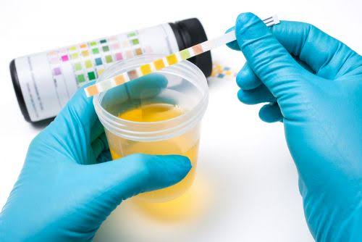
Urine - investigations
Urine : albumin - nil
sugar - nil
deposits 2-4 pus cells

Slide 21
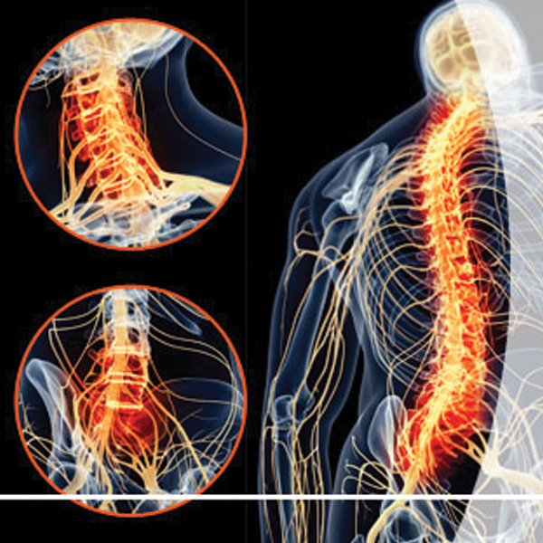
Neuro Physician opinion
Proximal muscle weakness for evaluation –?Myopathies
Suggested - NCS
EMG
Serum CPK
Serum electrolytes
thyroid profile

Slide 22
Dermatologist opinion
Poikilo dermatous skin changes in neck, upper chest , arm and back
Scaling & erythema + in extensor aspect of arm, elbow and dorsum of hand
b/l periorbital rash +
Scaling present all over the scalp
Nail – ragged cuticles +
Palms and soles – keratoderma +

Slide 23
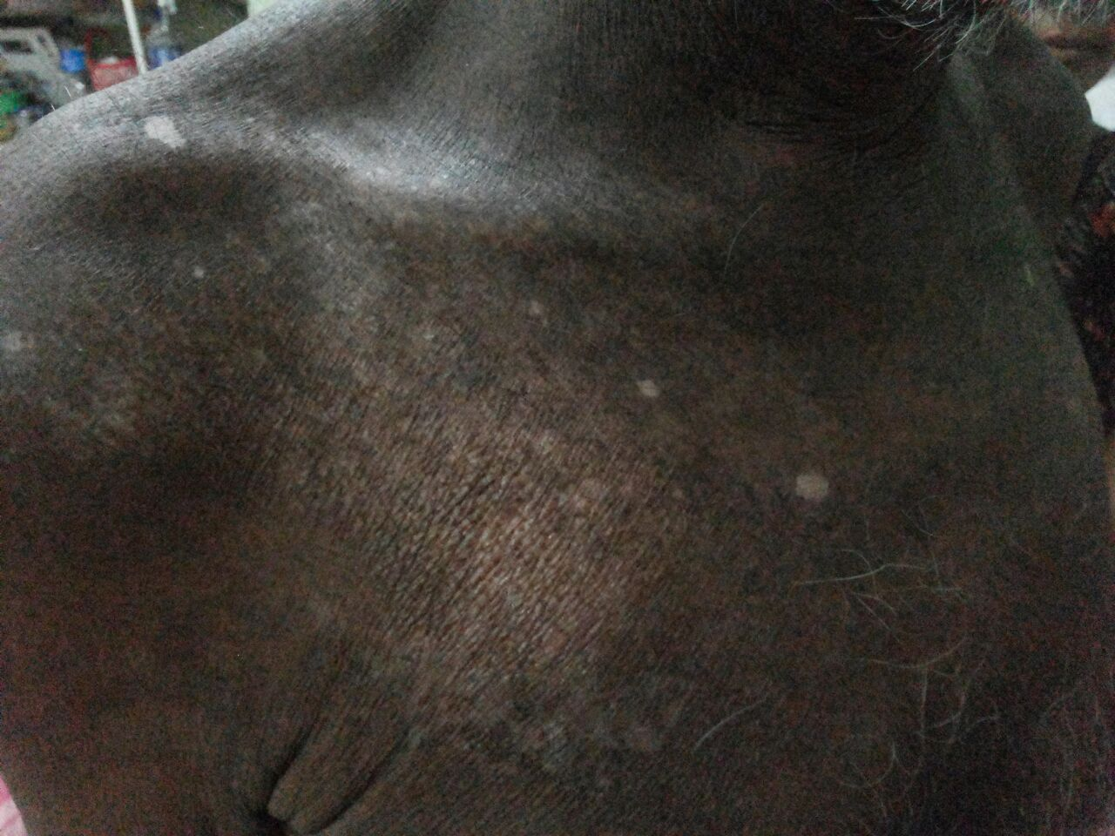
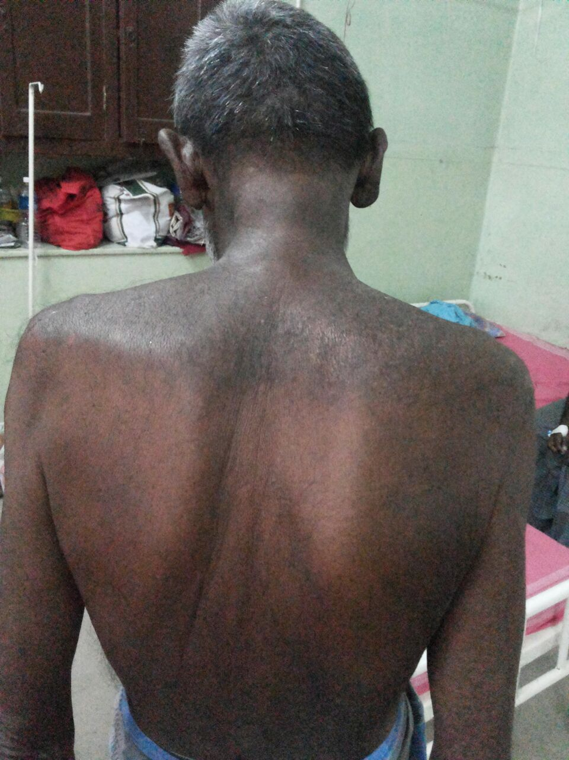

Slide 24
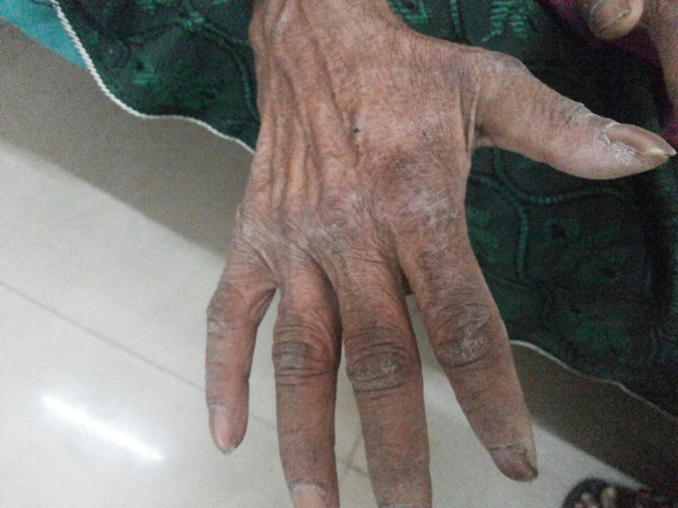
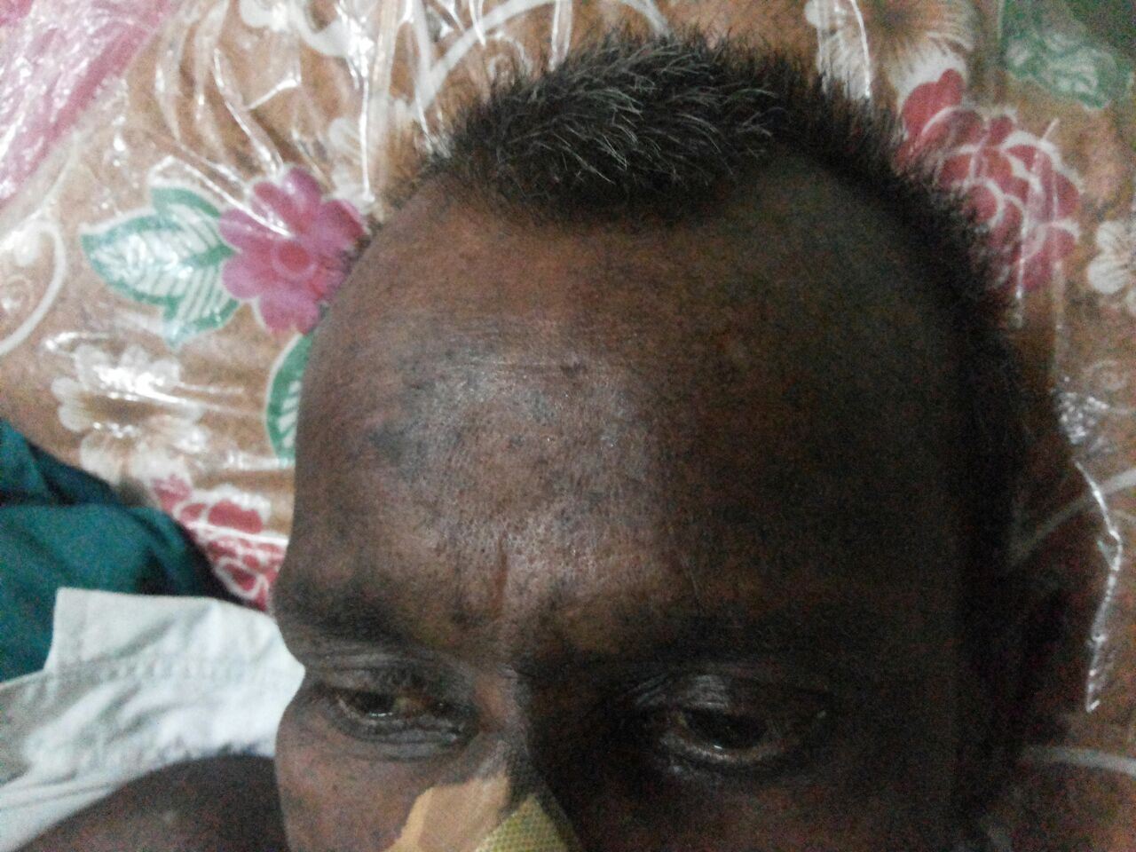

Slide 25
Dermatologist opinion
Skin lesions S/O DERMATOMYOSITIS
- To rule out internal malignancy
- ZINC cream for topical application

Slide 26
CREATINE PHOSPHOKINASE – 1179 U/L
HIV – NON REACTIVE
THYROID FUNCTION TESTS – NORMAL
Echo – normal study
ANA - negative

Slide 27
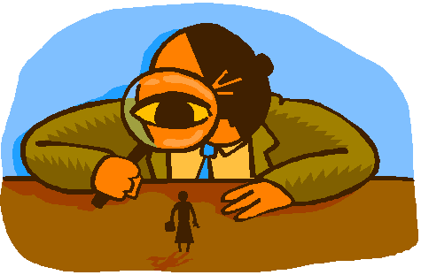
Screening for Occult Malignancy
USG abdomen and pelvis – Normal study
ENT examination – normal
Chest x ray - normal
OGD – normal study
CT abdomen & Pelvis – Normal
Per Rectal – No Prostatomegaly

Slide 28
NERVE CONDUCTION STUDY - B/l peroneal nerves not stimulated
F waves normal
SNAPs normal
ELECTROMYOGRAPHY – NORMAL STUDY

Slide 29
MUSCLE BIOPSY
Skeletal muscle biopsy shows skeletal muscle fibres with well maintained cross striations and uniform size and shape of muscle fibres along with occasional atrophic fibres. Occasional foci of muscle necrosis with focal infiltration of macrophages. Many muscle fibres shows internal migration of sarcolemmal nuclei. In one focal area, infiltration of mixture of polymorphs and lymphocytes around a small blood vessel. There is no fatty replacement of hypertrophied rounded muscle bundles as seen in congenital myopathy
Suggestive of inflammatory myopathy most probably dermatomyositis

Slide 30
CLUES to Diagnosis
Myopathic Muscle weakness
Muscle Enzymes elevated
Muscle biopsy – Perivascular infiltration
RASH

Slide 31
DIAGNOSIS
DERMATOMYOSITIS

Slide 32
TREATMENT
T.Prednisolone 5mg 12 OD
T.Calcium 300mg 1-1-1
T.Hydroxychloroquine 200 mg OD
Zinc cream for E/A
PHYSIOTHERAPY

Slide 33
After treatment
Weakness improved muscle power 3/5
Neck muscle weakness improves
Skin rash resolving

Slide 34
AIM OF PRESENTATION
Presented for its Rarity
To look for occult Malignancy in any Patients with
inflammatory Myopathy

Slide 35
THANK YOU ☺☺☺

