Slide 1
CEFEPIME–TANIBORBACTUM IN COMPLICATED URINARY TRACT INFECTION

Slide 2
III MEDICAL UNIT
CHIEF PROF: Dr. DAVID PRADEEP KUMAR M.D, MRCP
ASST PROFESSORS: Dr.NASEEMA BANU M.D
Dr.RAM KUMAR M.D
Dr.NABIL FAYAS M.D

Slide 4
INTRODUCTION
Widespread and emerging resistance to beta-lactam antibiotics complicates the management of serious infections including complicated UTI
CEFEPIME [broad spectrum,4th generation cephalosporin] & TANIBORBACTUM [B-Lactamase inhibitor] combination is active both invitro and invivo against Cefepime resistant & Carbapenamase resistant enterobacterales and MDR Pseudomonas aeuroginosa

Slide 5
BACKGROUND OF STUDY
To Demonstrate non-inferiority of CEFEPIME-TANIBORBACTUM to MEROPENAM in the treatment of Complicated UTI including Acute pyelonephritis
A randomised double blind multicentric study to establish efficacy and safety of CEFEPIME-TANIBORBACTUM compared to MEROPENAM in the treatment of Complicated UTI including Acute pyelonephritis

Slide 6
STUDY DESIGN
Multicenter
Double blind
Randomized ,active controlled trial at 68 sites in 15 countries
August 2019 to December 2021
CERTAIN-1 Phase 3 trial comparing CEFEPIME-TANIBORBACTUM with MEROPENAM in patients with Complicated UTI

Slide 7
INCLUSION CRITERIA
Adult male and female >18yrs of age
Had pyuria ,one of following criteria
Urine dipstick + for leukocyte esterase
WBC >10cells/mcL in unspun urine
WBC>10cells/high power field in urinary sediments

Slide 8
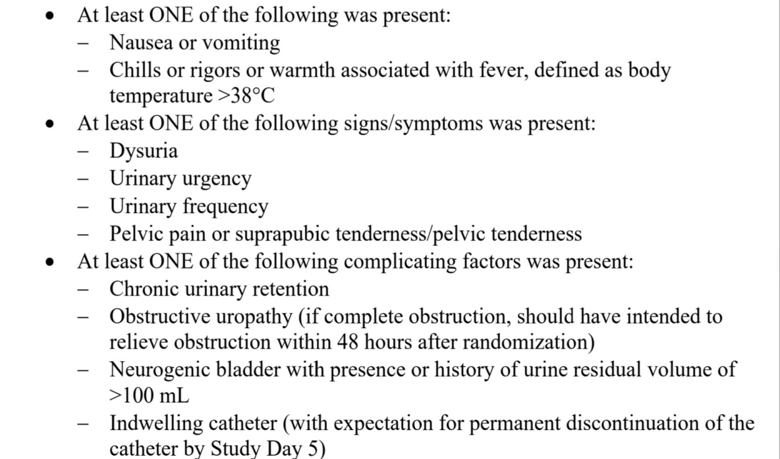
INCLUSION CRITERIA
COMPLICATED UTI
ACUTE PYELONEPHRITIS
(OR)

Slide 9
EXCLUSION CRITERIA
Received effective antibacterial drug therapy for duration >24hrs during previous 72hrs prior to randomization
Infection with Meropenam resistant pathogen
eGFR<30ml/min/1.73m²
Renal transpantation
Prostatitis, Perinephric/renal abscess
Severe hepatic impairment
Hypersentivity to β-lactam antibiotics

Slide 10
METHOD OF STUDY

Slide 12
OVERALL OUTCOME
Microbiologic success is defined as reduction in all gram negative pathogens found at baseline <10³ CFU per ml.
Clinical success was defined as symptomatic resolution or return to preinfection baseline of all core signs and symptoms,with no use of additional antibacterial agents for complicated UTI.
Primary outcome is both microbiological and clinical success in microITT population at the test of cure on trial days 19 to 23.
Secondary outcome both microbiological and clinical success in microITT population at the end of treatment (< 24 hours after the last dose of trial drug) and at late follow-up (trial days 28 to 35)

Slide 13
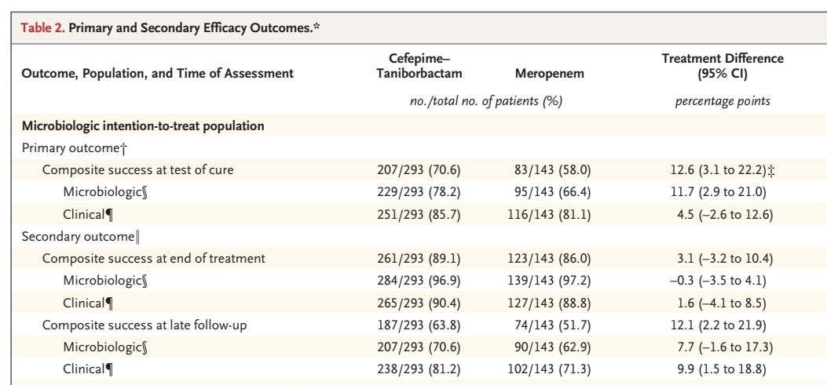
EFFICACY OUTCOMES

Slide 14
SAFETY
Adverse events occurred during treatment in 35.5% of patient in the cefepime-taniborbactam group and in 29.0% of those in the meropenem group
Premature discontinuation of a trial drug occurred in 3.0% of patient in the cefepime-taniborbactam group and in 0.9% of those in the meropenem group

Slide 16
RESULTS
Total of 436 patients were included in microITT population
207/293 patients (70.6%)in the cefepime-taniborbactam group and in 83/143 patients(58.0%) in the meropenem group had overall treatment success.

Slide 17
CONCLUSION
In patients with complicated UTI (including acute pyelonephritis), cefepime–taniborbactam was superior to meropenem regarding composite success at test of cure
The frequencies of both composite success and clinical success were higher in the cefepime–taniborbactam group than in the meropenem group at late follow-up
Cefepime–taniborbactam and meropenem had similar safety profiles
Thus, cefepime–taniborbactam was shown to be a potential treatment option for patients with complicated UTI and acute pyelonephritis caused by Enterobacterales species and P. aeruginosa, including antimicrobialresistant strain

Slide 18
THANK YOU

