Slide 1
DERMATOLOGICAL MANIFESTATION OF SYSTEMIC DISEASES
BY DR.S.S.CHAKRAVARTHI
III MEDICINE UNIT
CHIEF PROF.DR.BAGIALAKSHMI
ASST PROF.DR.RAJ KUMAR
DR.SARAVANAN
DR.PON SENTHIL KUMAR

Slide 2
DERMATOLOGICAL MANIFESTATION OF IMMUNE AND AUTOIMMUE DISEASE

Slide 3
SYSTEMIC LUPUS ERYTHEMATOSUS
It is multisystem autoimmune disease charecterised by involvement of connective tissue and blood vessels
More common in females F:M ratio 1 : 9

Slide 5
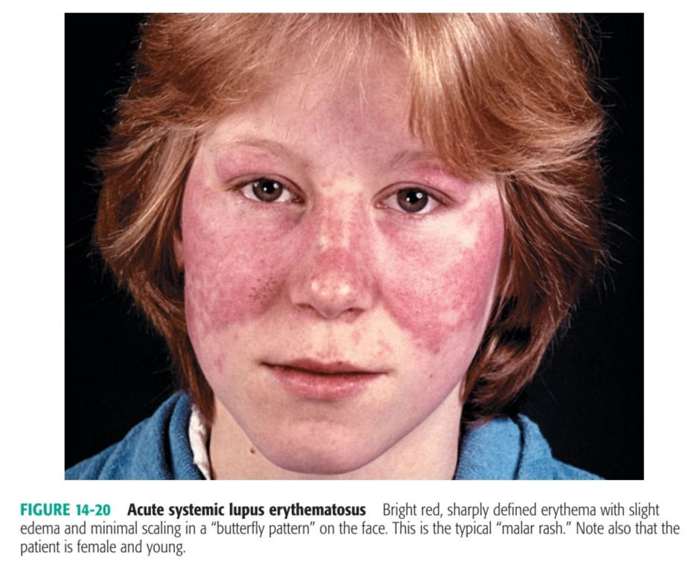
ACUTE CUTANEOUS LE

Slide 6
SUBACUTE CUTANEOUS LE

Slide 7
CHRONIC CUTANEOUS LE

Slide 8
LUPUS PANNICULITIS

Slide 9
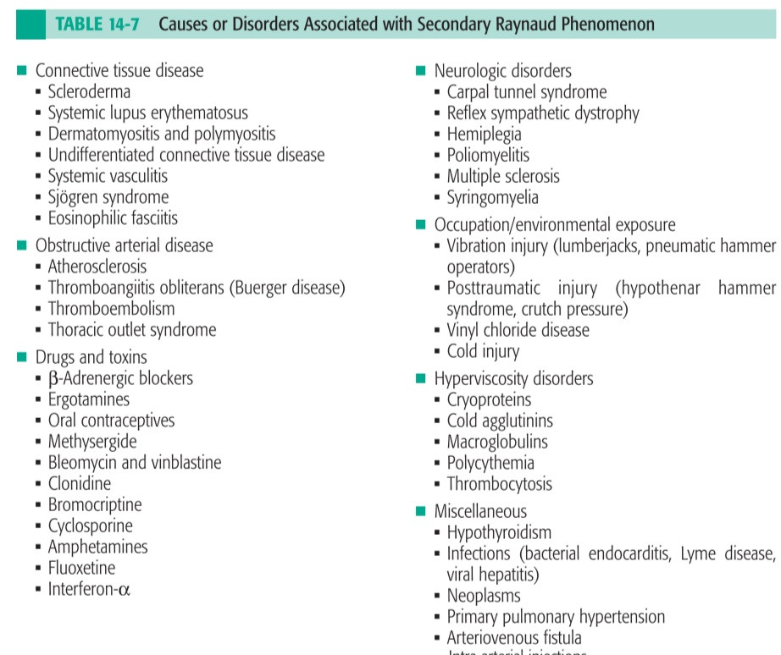
RAYNAUD PHENOMENON
Raynaud phenomenon is digital ischemia that occurs on exposure to cold or as a result of emotional stress
CAUSES

Slide 10
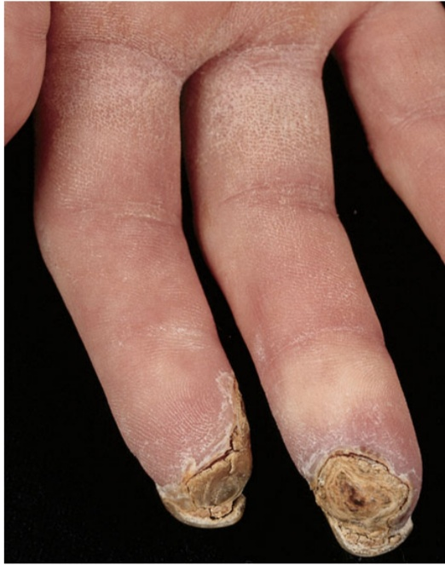
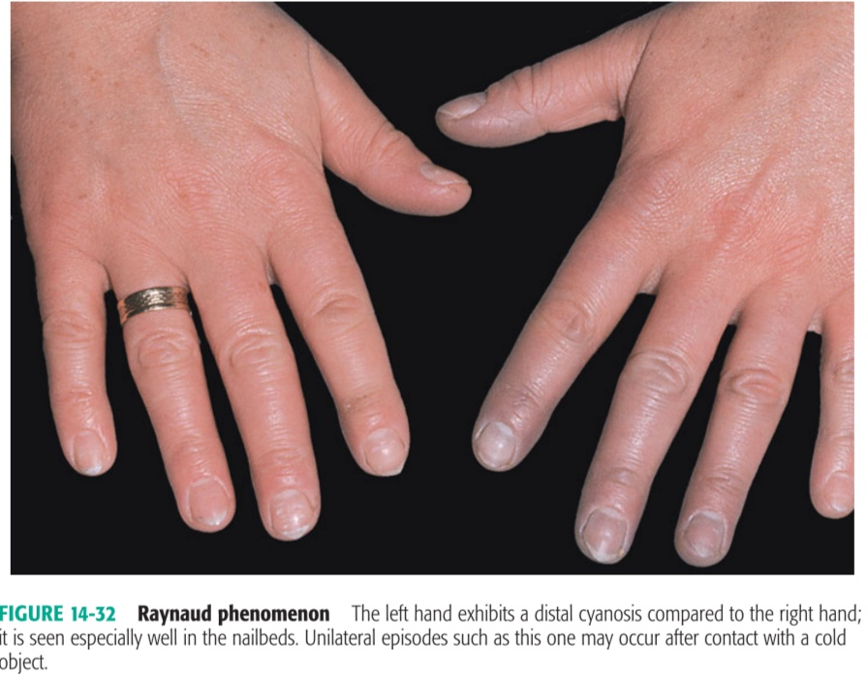
MANAGEMENT – Heath education
Drugs like CCBs, intravenous PGI2 can be useful

Slide 11
BEHCET DISEASE
It is multisystem vasculitic disease with multiorgan involvement
Symptoms include
SKIN - recurrent oral aphthous ulcer, gential ulcer, erythema nodosum, superficial thrombophlebitis, skin pustules
EYE – Iridocyclitis, posterior uveitis, retinal vasculitis, secondary cataract
SYSTEMIC – arthritis, ileocecal ulceration, vascular and CNS lesions
INVESTIGATION
PATHERGY TEST – Positive pathergy test read at 24 or 48hrs after skin puncture
HLA TYPING – significant association with HLA-B5, HLA-B51

Slide 13
MANAGEMENT
Aphthous ulcers : intralesional triamcinolone, thalidomide 50-100mg OD, Colchicine 0.6mg TDS can be given
Systemic involvement : Steroids with or without immunosuppressants

Slide 14
DERMATOMYOSITIS
Dermatomyositis belongs to idiopathic inflammatory myopathies, is genitically determined autoimmune diseases targeting skin and/or skeletal muscles
CLINICAL SPECTRUM
Juvenile DM – Classic type, associated with vasculitis and calcinosis
Adut-onset DM – associated with internal malignancy
Amyopathic DM – only cutaneous inflammation
Polymyositis – only muscle inflammation

Slide 15
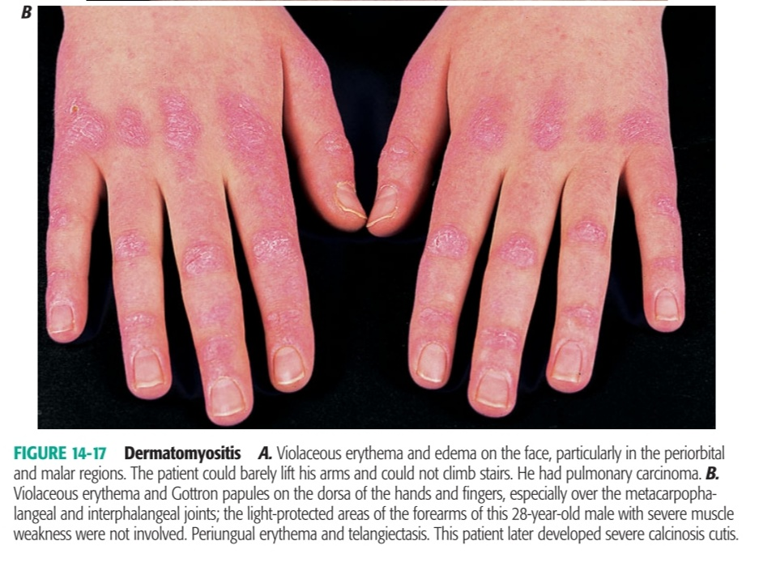

Slide 17
INVESTIGATION
Blood – Elevated CPK, LDH
Autoantibodies – anti-Jo (highly specific), ANA
URINE – Elevated 24-h creatine excretion (>200mg/day)
Electromyopathy – increased irritability on insertion of electrodes, spontaneous fibrillations, pseudomyotonic dicharges excludes neuromyopathy
HISTOLOGY – Segmental necrosis within muscle fibers with loss of cross striations, coagulative type of eosinophilic staining, with inflammatory cells

Slide 18
MANAGEMENT
STEROIDS : Prednisone 0.5 to 1mg/kg/day taper when muscle enzyme levels approach normal. Best if combined with Azathioprime 2-3mg/kg/day
Steroid myopathy may occur after 4-6 wks of therapy
Alternatives : Methotrexate, Cyclophosphamide, Cycloserine
IV IG ( 2g/kg/day given over 2days ) at monthly intervals spares steroid doses to maintain remission

Slide 19
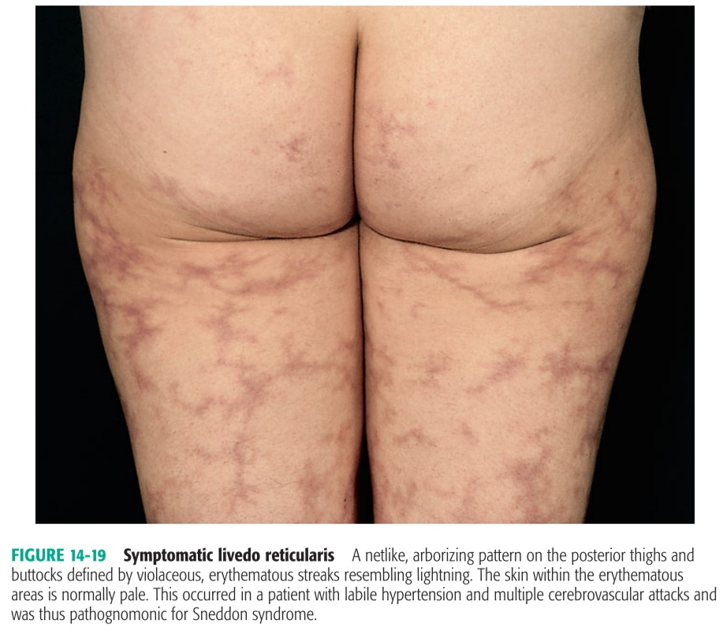
LIVEDO RETICULARIS
Livedo reticularis is mottled bluish discoloration of the skin that occurs in a net like pattern. It occurs a result of reaction

Slide 21
HYPERSENSITIVITY VASCULITIS
It encompasses a heterogenous group of vasculitides associated with hypersensitivity to antigens from infectious agents, drugs, etc
It is charecterised pathologically by deposition of immune complexes in postcapillary venules leading to inflammation and fibrinoid necrosis (necrotising vasculitis)
SKIN LESIONS :Hallmark is PALPABLE PURPURA
DD : Thrombocytopenic purpura, DIC, Septic vasculitis (rickettsial spotted fevers), septic emboli(infective endocarditis), Meningococcemia

Slide 22
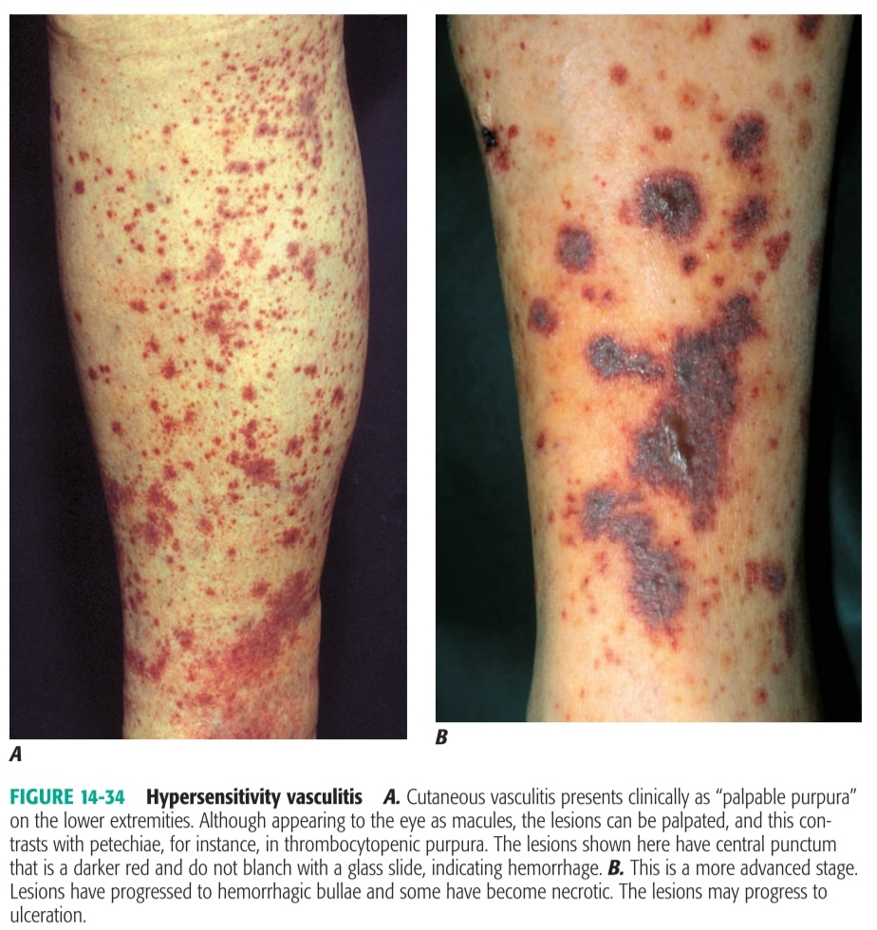
MANAGEMENT
Antibiotics cover
Prednisone – for moderate to severe disease
Henoch-Schonlein purpura – consists of palpable purpura, bowel angina, bowel ischaemia includes bloody diarrhoea, kidney involvement (hematuria, red cell casts) and arthritis

Slide 23
POLYARTHRITIS NODOSA
It is multisystem, necrotizing vasculitis of small and medium sized muscular arteries with involvement of the renal and visceral arteries
30 % of cases are associated with hepatitis B and C antigenemia ( Immune-complex formation)
SKIN MANIFESTATIONS – Palpable purpura, Nodules and ulcers
Constitutional symptoms are fever, asthama, myalgia etc
INVESTIGATION
Histology – Neutrophilic infiltrates of all layers of muscular vessel wall and perivascular areas, Fibrinoid necrosis of vessel wall occluding lumen leading to infarction of tissues
Blood – Elevated ER, Eosinophilia, p-ANCA positivity
CT Arteriography – bead on end appearance of small and medium sized arteries

Slide 24
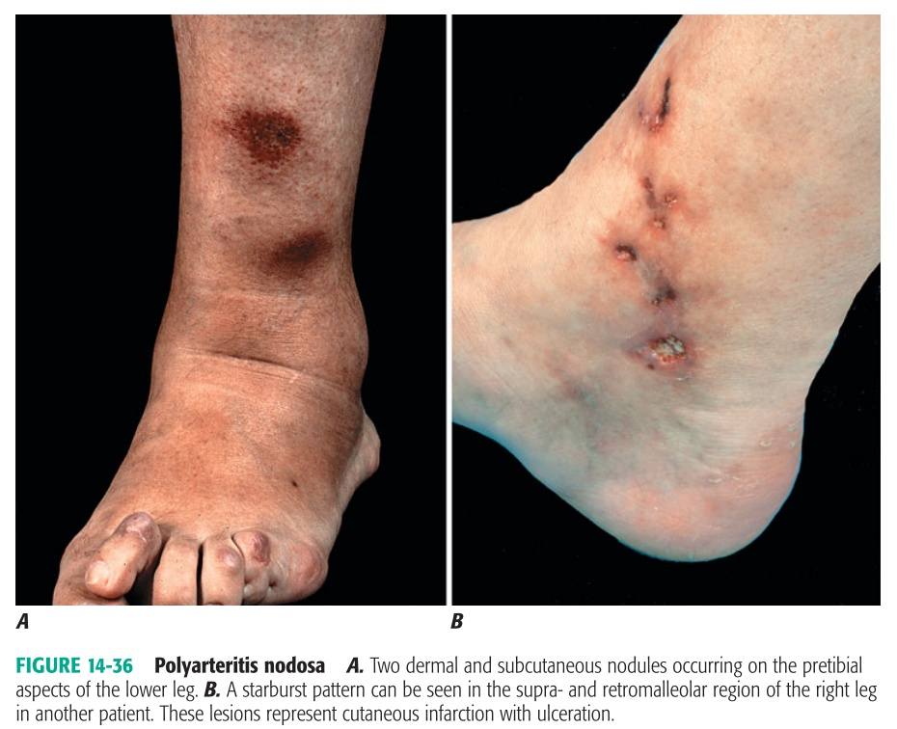
MANAGEMENT
Systemic PAN – Prednisone 1mg/kg/day + Cyclophosphamide 2mg/kg/day
Cutaneous PAN – NSAIDS, Steroids

Slide 25
WEGNER GRANULOMATOSIS
It is systemic vasculitis charecterised by clinical triad of involvement of upper airways, lung and kidneys
Pathology- possibly an aberrant hypersensitivity response to exogenous or endogenous antigen that enters through upper airway
SKIN LESIONS : Ulcers with jagged, undermined borders resembles pyoderma gangrenosum
Papules, vesicles, palpable purpura as in hypersensitivity vasculitis
Noduloulcerative lesions as in PAN
Mucous membranes- oral ulcerations, nasal septal perforation, saddle-nose derformity

Slide 26
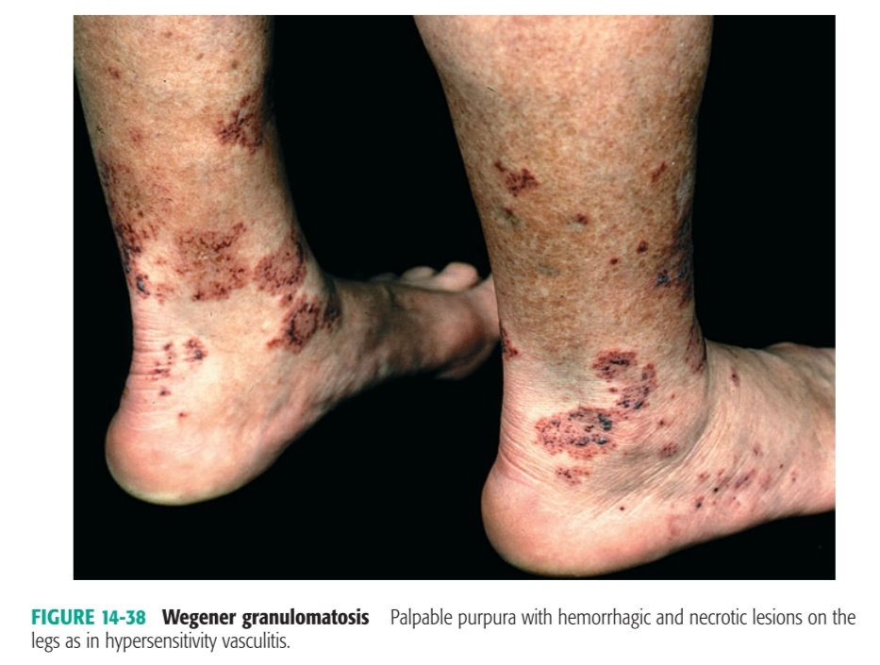

Slide 27
INVESTIGATION
Blood : Mild anaemia, leucocytosis, Raised ESR, Raised RFT
Urine : Proteinuria, hematuria, RBC casts
Serology : c-ANCA specific for WG
Histology : Necrotizing vasculitis of small arteries/veins with intra or extravascular granuloma formation
Kidney – Focal/segmental glomerulonephritis
TREATMENT : Cyclophosphamide + Prednisone
Cyclophosphamide – 2mg/kg/day continued for 1yr after complete remission, then tapered and discontinued
Prednisone : 1mg/kg/day for 1 month and then changed to alternate day doses which are tapered and then discontinued after 6 months of therapy

Slide 28
GIANT CELL ARTERITIS
It is systemic granulomatous vasculitis of medium and large sized arteries, most commonly the temporal artery and other branches of carotid artery in elderly patient
It is charecterised by headache, fatigue, claudication jaw / tongue while talking
Eye involvement : transient blindness, ischemic optic neuritis
Systrmic vasculitis : claudication of extremities, stroke, MI, visceral organ infarction
Skin manifestation : Superficial temporal arteries are swollen, prominent, tortuous initially pulsatile later become occluded
Necrosis and ulceration of scalp

Slide 29
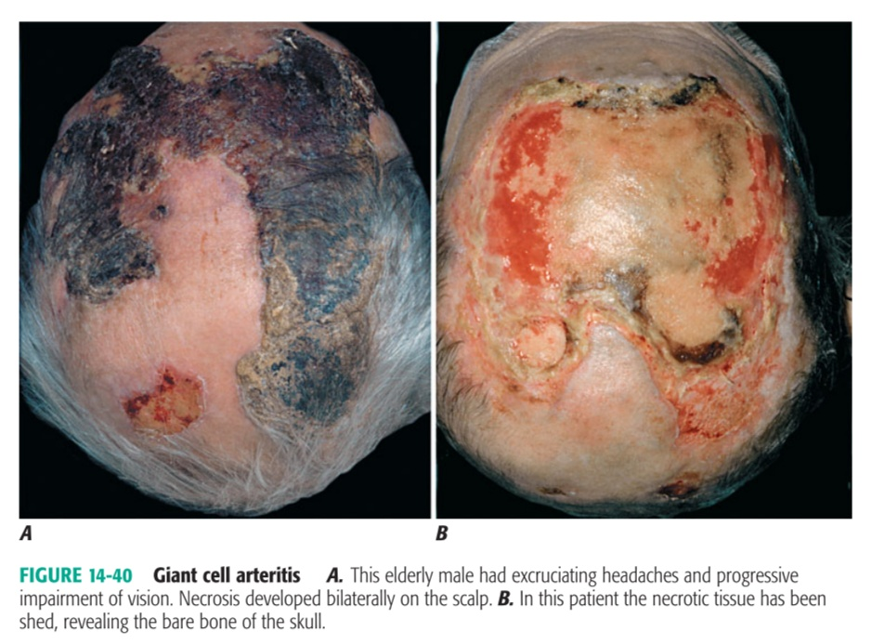
MANAGEMENT
Prednisone : Initially 40-60mg/day taper when symptoms ablate
continue 7.5 to 10mg/day for 1-2 yrs
Methotrexate : Low dose 15 to 20mg mtx once a week has considerable glucocorticoid sparing effect

Slide 30
REACTIVE ARTHRITIS (REITER SYNDROME)
It is defined by an episode of peripheral arthritis of >1 month duration occurring in association with urethritis and/or cervicitis
TRIAD – Arthritis,Urethritis,Conjuctivitis
PATHOGENESIS
Genetic factor HLA-B27
Enteric pathogens ( Salmonella, Yersinia, Campylobacter, Shigella ) or genitourinary pathogens (Chlamydia, Ureaplasma )
TWO PATTERNS – Epidemic form follows STI
Postdysenteric form follows GI infection

Slide 31
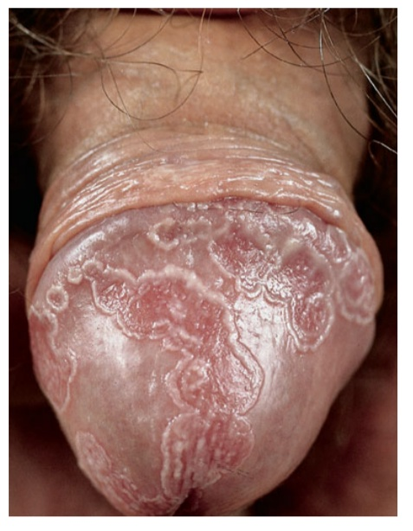

Slide 32
MANAGEMENT
Prior infection : antibiotic therapy no role in altering course of postvenereal RA
Cutaneous manifestation
Balanitis : Low potency glucocorticoids
Palmar/Plantar : potent glucocorticoid preparations
refractory disease – systemic retinoids, phototherapy, PUVA
Prevention of articular inflammation : rest, NSAIDS, anti-inflammatory agents

Slide 33
SARCOIDOSIS
A systemic Granulomatous disease of unknown cause
It primarily affects Lungs ( Bilateral lymphadenopathy, pulmonary infiltration)
SKIN LESIONS
Erythema nodosum – most common nonspecific lesion, suggest good prognosis
Lupus Perino
Swelling of individual digits (Osteitis Cystica- cystic lesions in phalangeal bones )

Slide 34
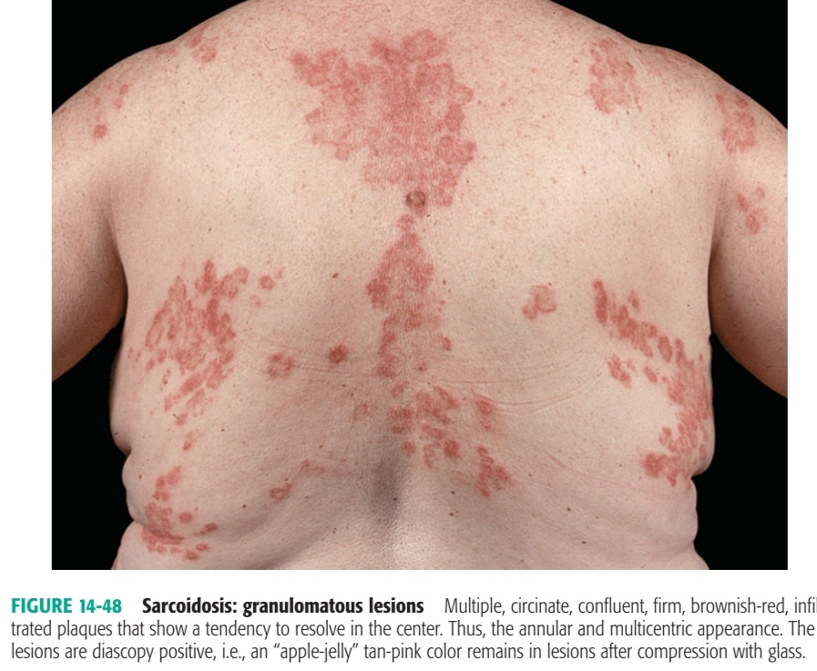

Slide 36
INVESTIGATION
HPE of Lesional biopsy: Non caseating granulomas
Asteroid bodies in large histiocytes
GALLIUM scan
Blood Inv : Increased serum ACE levels
Hypergammaglobulinemia
Hypercalcemia
MANAGEMENT
Systemic – Oral Glucocorticoids
Cutaneous : Local- intralesional triamcinolone 3mg/ml
Systemic- Glucocorticoids for widespread or disfiguring involvement
Refractory – HCQ 100mg BD can be tried
Methotrexate can be tried

Slide 37
DERMATOLOGICAL MANIFEXTATION OF ENDOCRINE DISORDERS

Slide 38
CUSHING SYNDROME AND HYPERCORTICISM

Slide 39
Altered subcutaneous fat distribution ( Moon facies, Buffalo hump, truncal obesity)
Generalised hypertrichiosis
Increased collagen breakdown
Skin fragility leading to abdominal striae
Vascularity fragility resulting in purpura and impaired wound healing
Acne

Slide 40
GRAVES DISEASE AND HYPERTHYROIDISM

Slide 41
Pretibial myxedema
Bilateral, asymmetric, nonpitting nodules and plaques that are pink, skin colored
Rx : low dose oral glucocorticoids or intralesional Triamcinolone is useful
Thyroid Acropachy
it is charecterised diaphyseal proliferation of the periosteum and clubbing
Ophthalmopathy
Spastic component (stare, lid lag, lid retraction)
Mechanical ( proptosis, ophthalmoplegia, congestive occulopathy, chemosis, complications of corneal ulceration )
Rx : Mild cases – symptomatic
Severe cases – prednisone with gradual tapering
Orbital radiation, Orbital decompression

Slide 42
HYPOTHYROIDISM AND MYXEDEMA

Slide 43
ADDISON’S DISEASE
Insufficient adrenal cortisol production is mostly consequence of autoimmune adrenalitis or infections ( TB, Systemic fungal infections) or suppression of ACTH secretion following long term glucocorticoid therapy
Hypermelanosis is due to compensatory oversecretion of ACTH and its enzymatic cleavage product alpha-MSH
If addisonian hyperpigmentation present in association with vitiligo or alopecia areata it is essential to rule out autoimmune adrenalitis

Slide 44
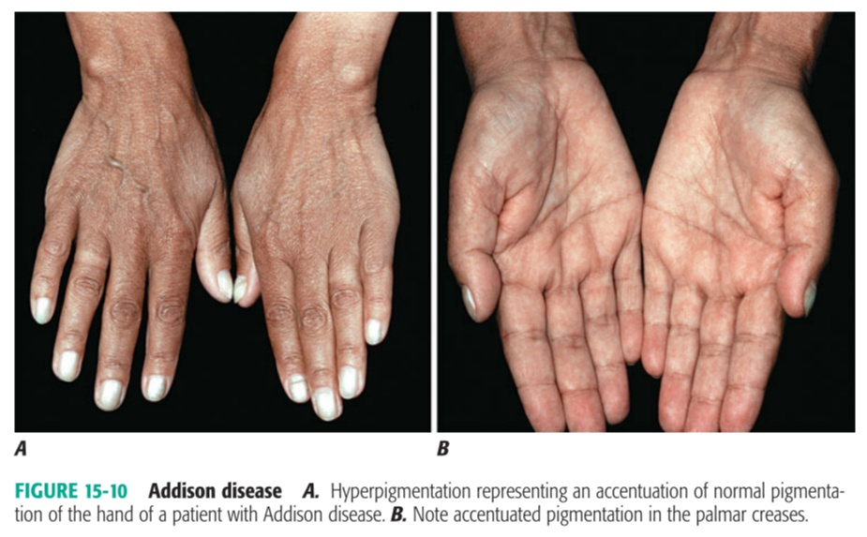
DD
Vit B12 Deficiency
Hemochromatosis
Porphyrea cutanea tarda
Liver cirrhosis
Chronic renal failure
Chromophobe adenomas that secreate ACTH
Chemotherapy (5-FU, Bleomycin, Doxorubicin)

Slide 45
NUTRITIONAL DEFICIENCIES
SCURVY
Dietary deficiency of ascorbic acid
Symptoms of depletion occur when pool size < 0.5 g
Precipitating factors – Pregnancy, Lactation, Thyrotoxicosis, Alcoholism
CLINICAL FEATURES
Petechiae
Follicular hyperkeratosis with perifollicular haemorrhage
Generalised Ecchymoses
Gingiva – swollen, spongy and bleed easily
Bones – Haemarthrosis, Scorbutic rosary

Slide 46
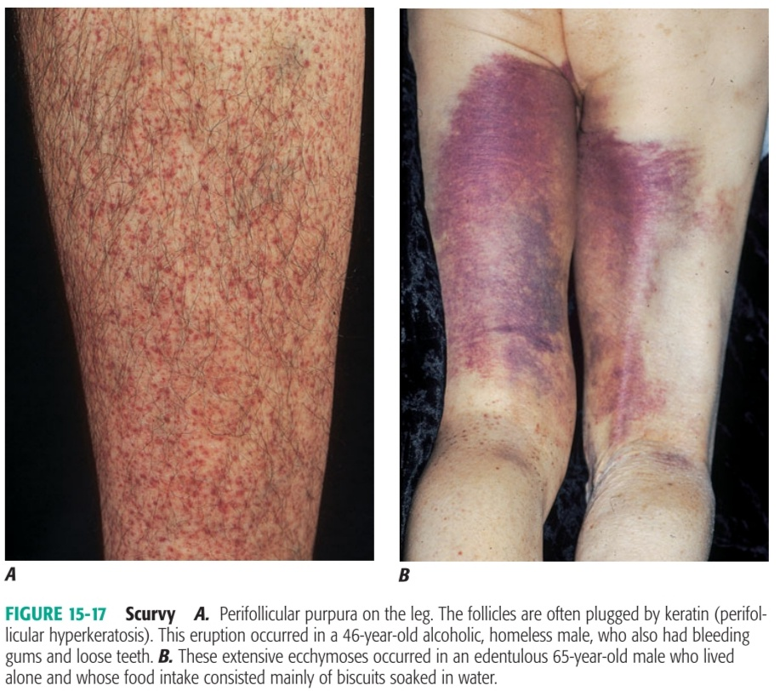
INVESTIGATION : Platelet ascorbic acid < 25%
Rx : Ascorbic acid 100mg 3-5 times daily until 4g is given then 100mg/day is curative in days to weeks

Slide 47
ACRODERMATITIS ENTEROPATHICA
It is genetic disorder of Zinc absorption presents in infancy charecterised by triad of
Acral Dermatitis (face, hand, feet, anogenital area )
Alopecia
Diarrhoea
SKIN LESION : Patches and plaques of dry, scaly, sharply marginated and bright red, eczematous dermatitis evolving into vesiculobullous, pustular, erosive and crusted lesions involving perioral and anogenital areas
Hair – Diffuse alopecia, greying of hair
Nails – paronychia, nail ridging, loss of nails

Slide 48
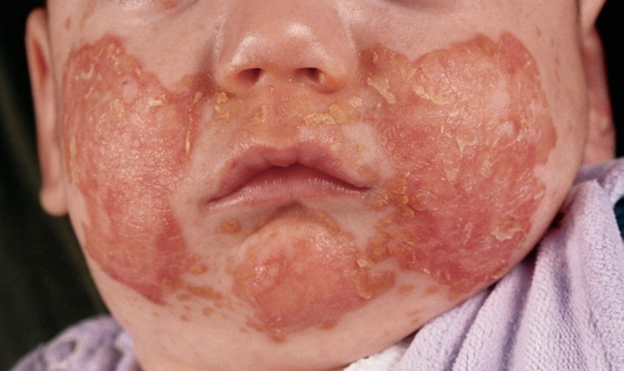
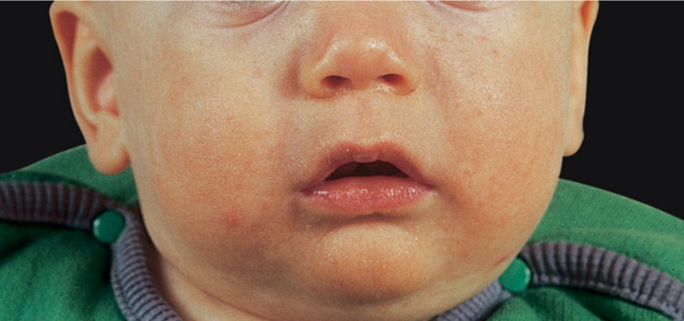
MANAGEMENT : Zinc salt supplementation 2 to 3 times the required daily amount restores normal zinc status in days to weeks

Slide 49
PELLEGRA
It is due to NIACIN deficiency
Niacinamide is important constituent of coenzyme I (NAD) and coenzyme II (NADP) which function in oxidation-reduction reaction
3 D’s : DERMATITIS, DIARRHEA, DEMENTIA
Skin lesion : Symmetric itching and erythema on dorsum of hand, neck and face. Vesicles and bullae may erupt and break so crusting occurs
these skin lesions become indurated, lichenified,covered by scales and crusts with fissures

Slide 50
GAUNTLET OF PELLEGRA
CASAL NECKLACE

Slide 51
GENETIC DISEASES
TUBEROUS SCLEROSIS
It is autosomal dominant disorder caused by mutation in tumour suppressor gene
It leads to genetically programmed hyperplasia of ectodermal and mesodermal cells and manifested by variety of lesions in the skin, CNS (hamartomas), heart, kidney and other organs
It is charecterised by triad of Seizures, Mental retardation and Congential white spots
Facial angiofibromata are pathognomonic but do not appear until 3rd or 4th year
MANAGEMENT : Counseling and Laser surgery for angiofibromas

Slide 52
HYPOMELANOTIC MACULES

Slide 53
ANGIOFIBROMAS ( ADENOMA SEBACEUM )

Slide 54
PERIUNGUAL FIBROMA (KOENEN TUMOR )

Slide 55
NEUROFIBROMATOSIS
It is an autosomal dominant trait manifested by changes in the skin, nervous system, bones and endocrine glands
TYPES : Classic Von Recklinghasen NF (NF 1)
Acoustic NF (NF 2)
DIAGNOSTIC CRITERIA FOR NF (2 of following must)
Multiple CAL macules – more than 6 lesions with a diameter of 1.5cm in adults
and more than 5 lesions with a diameter of 0.5cm or more in children < 5yrs
Multiple Freckles in the axillary and inguinal region
Two or moreneurofibromas of any type or one plexiform neurofibroma
Sphenoid wing Dysplasia or thinning of long bone cortex, with or without pseudoarthrosis

Slide 56
Bilateral Optic nerve Gliomas
Two or more Lisch nodules on slit lamp examination
First degree relative with NF1 by the preceding criteria
MANAGEMENT
Orthopedic consultation – kyphoscoliosis and tibial bowing
Plastic surgery – reconstructive surgery on the facial asymmetry
Close follow-up annually to detect sarcomas that may arise within plexiform neuromas

Slide 59
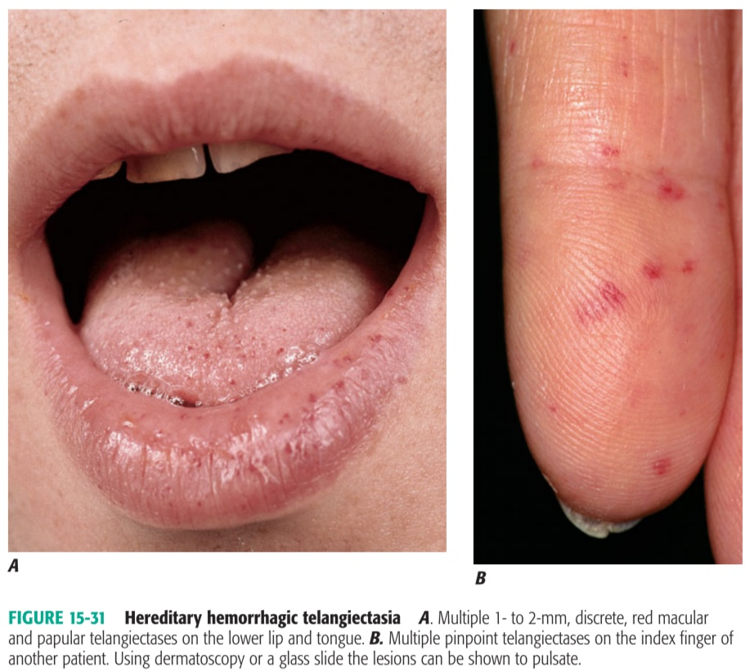
HERIDITARY HEMORRHAGIC TELANGIECTASIA (OSLER-WEBER-RENDU SYNDROME )
It is autosomal dominant condition affecting blood vessels especially in the mucous membranes of mouth and GI tract
It is charecterised by frequent epistaxis that appears often in childhood
Chronic blood loss results in anema
MANAGEMENT
Electrocautery and pulse dye laser
Estrogen- to treat recalcitrant bleed

Slide 60
DERMATOLOGICAL MANIFESTATIONS IN HIV
The spectrum of skin disorders depends on
Immunological stage, as reflected by CD4 count
Concurrent use of HAART
Pattern of Endemic infections

Slide 64
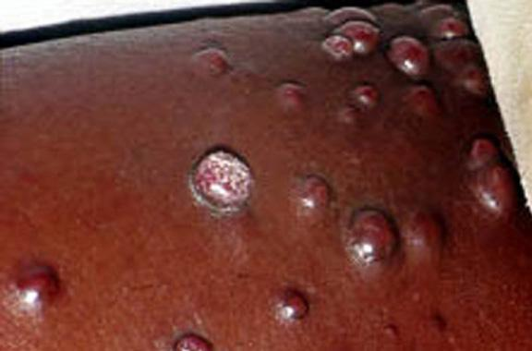
KAPOSI SARCOMA
It is an abnormally vascularised tumour like lesion affecting skin, Lymphnodes and Viscera
It is due to proliferation of endothelial cells induced by Human Herpes Virus type 8
It Manifests as Purplish Macules and Plaques which later become Nodular
TREATMENT : Local therapy with Liquid Nitrogen
Surgery or Systemic chemotherapy with single agent using ( Vinblastine, Vincristine, Bleomycin, Doxorubicin, Etoposide )

Slide 65
ORAL HAIRY LEUKOPLAKIA
Epstein-Barr virus is important cause
It is charecterised by Filiform White papules localised on side of tongue
White plaques should be differentiated from oral candidiasis, Lichen planus and geographic tongue

Slide 66
BACILLARY ANGIOMATOSIS
Causative organism : B.Quintana, B.henselae
It is charecterised by angiomatous lesion ( red-purple nodules ) involving eyelids, mucosa, liver or spleen
It is seen in patient with CD4 count <100 and history of at scratch or bite
DOC : Erythromycin

Slide 67
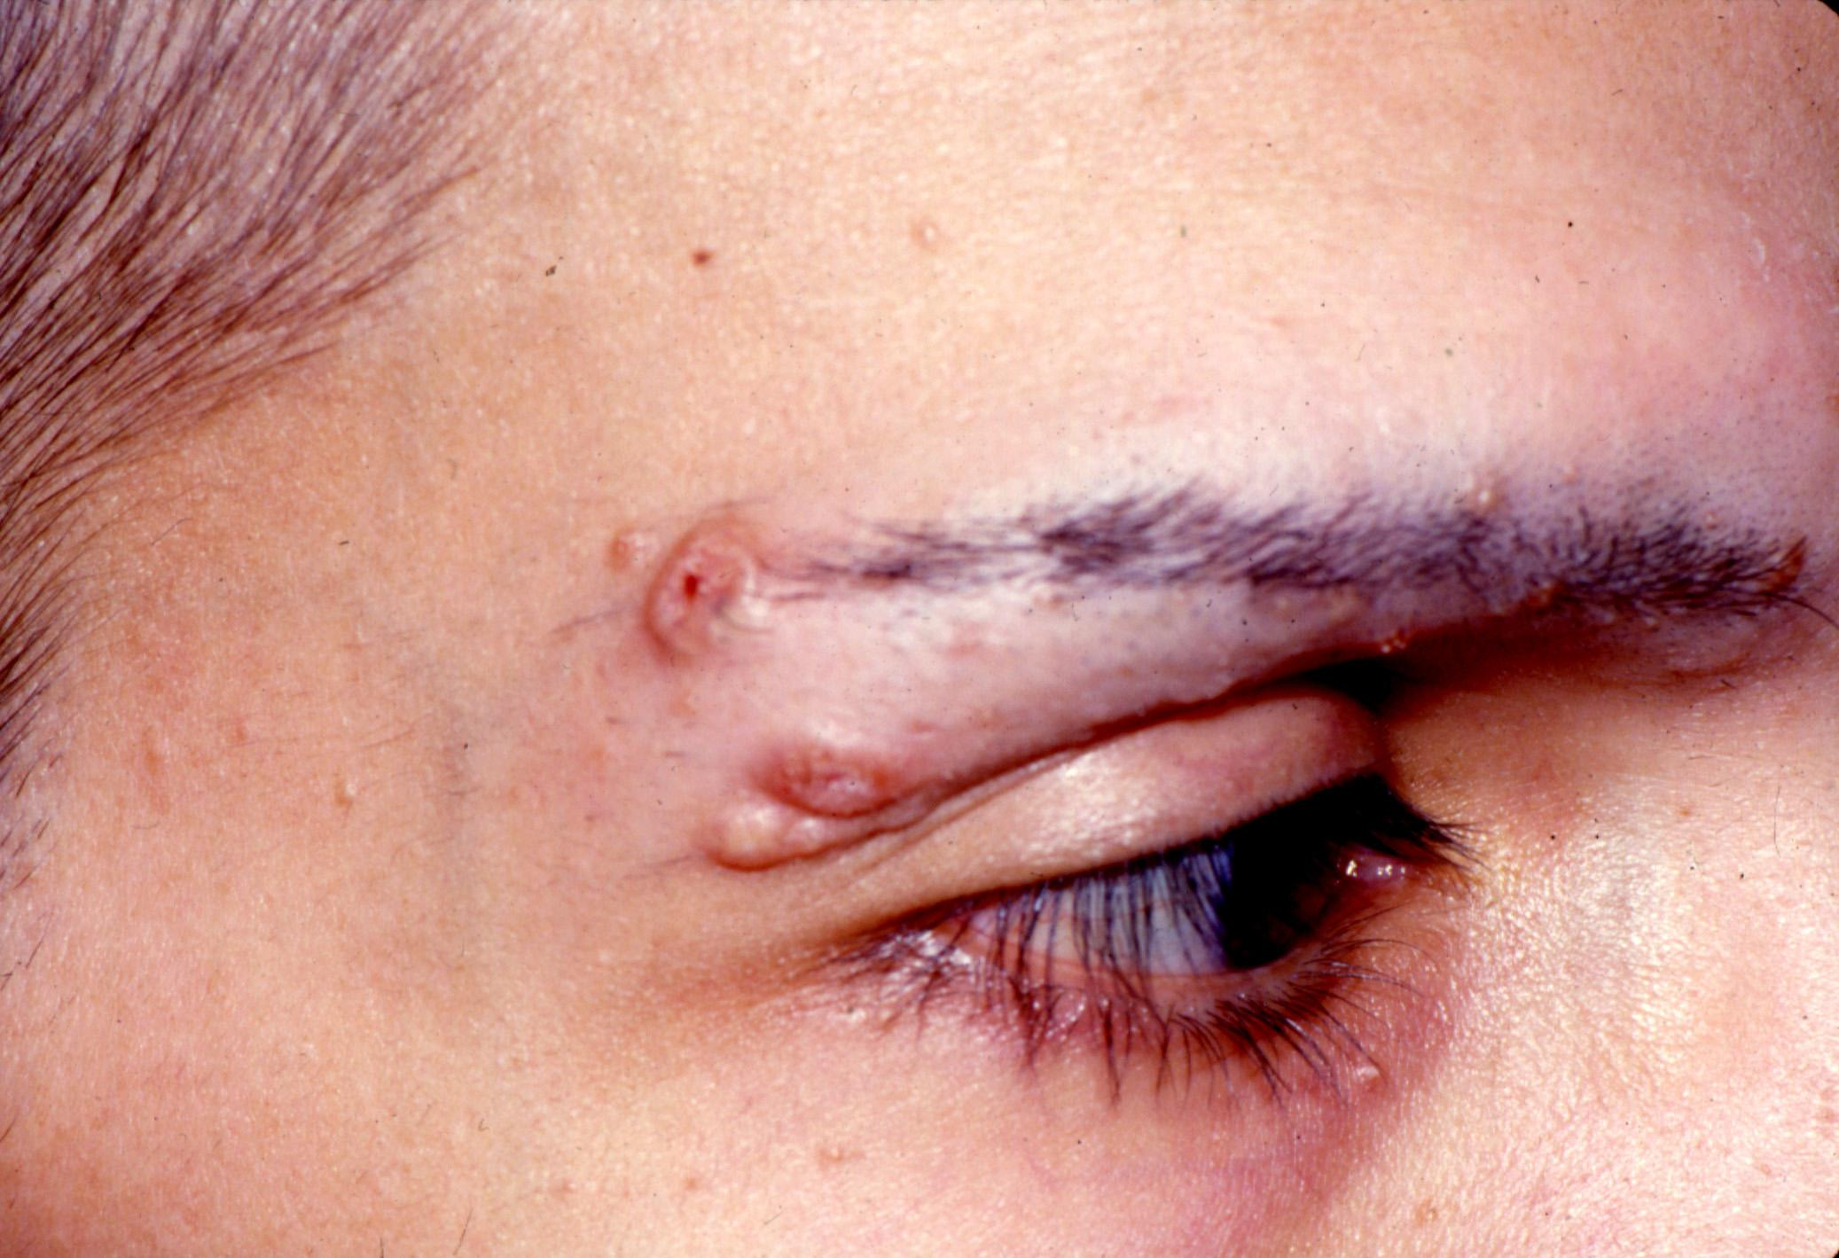
MOLLUSCUM CONTAGIOSUM
Causative organism : Pox virus
Lesions are usually multiple and have a predilection for the Face and Genitalia
In HIV, atypical lesions such as giant mollusca may be present
DOC : Imiquimod
Resolution also occurs on starting Zidovudine therapy

Slide 68
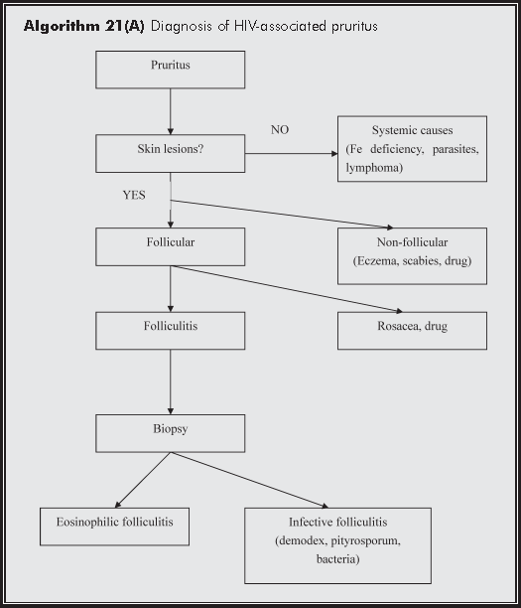
HIV ASSOCIATED PRURITIS

Slide 69
DERMATOLOGICAL MANIFESTATION OF RENAL DISEASES

Slide 70
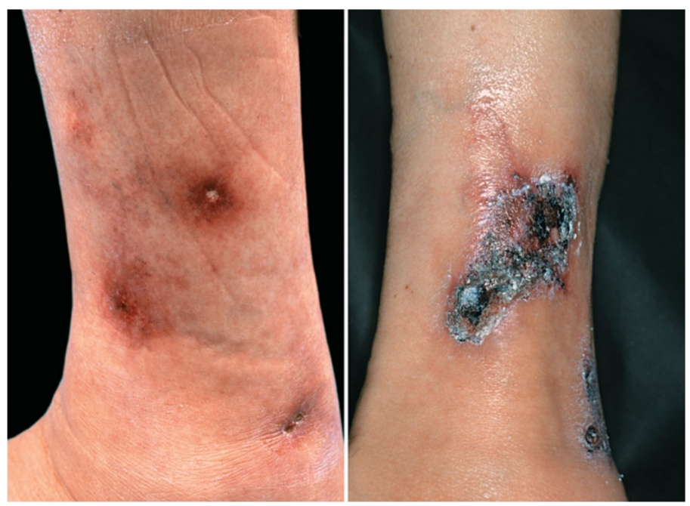
CALCIPHYLAXIS
It is charectersied by progressive cutaneous necrosis associated with small and medium vessel calcification
It is usually associated with ESRD, Diabetes
and Hyperparathyroidism
It is extremely painful and may extend to
fascia and beyond
It commonly involve Lower extremities,
abdomen, buttocks and penis
TREATMENT : Early diagnosis and treatment of renal failure
Partial Parathyroidectomy if needed
Debridement of Necrotic tissue

Slide 71
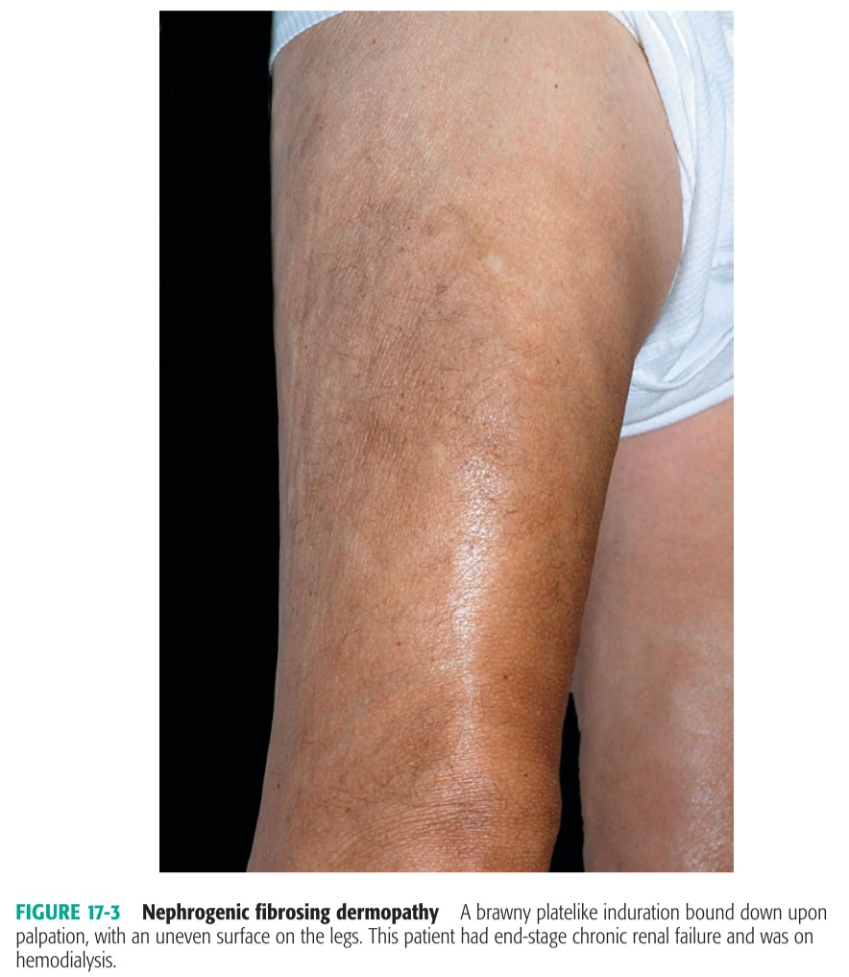
NEPHROGENIC FIBROSING DERMOPATHY
NFD is a fibrosing disorder commonly seen in patient on Hemodialysis
Exact etiology Unknown but exposure to Gadodiamid containing contrast media for MRA has strong association
DD : Pretibial Myxedema, Lipodermatosclerosis
Panniculitis
Rx : Imatinib may be useful

Slide 72
ACQUIRED PERFORATING DERMATOSIS

Slide 73
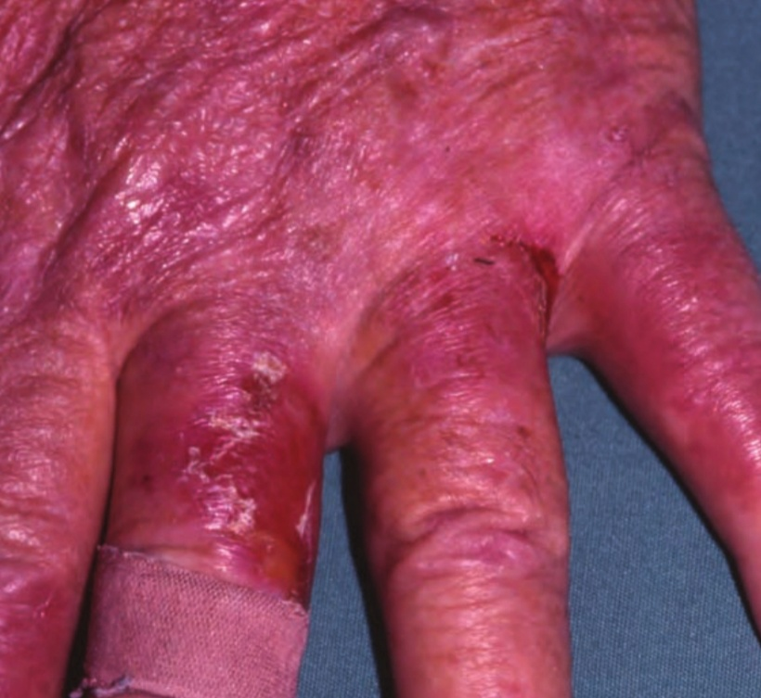
BULLOUS DISEASES
PSEUDOPORPHYRIA
It is bullous eruption mimicking porphyria cutanea tarda has been reported in patient with ESRD
No evidence of elevated Porphyrins
It is triggered by several drugs like Furosemide,
Oestrogen and NSAIDS
N-Acetylcysteine, an antioxidant may be useful

Slide 74
ACQUIRED PARTIAL LIPODYSTROPHY
BARRAQUER – SIMONS SYNDROME
It is charecterised by lipoatophy of upper part of body with lipohypertrophy of thigh
It is seen in Membranoproliferative Glomerulonephritis
Complement C3 levels will be low
Renal failure at early age is common

Slide 75
XEROSIS
Hypervitaminosis A
Uraemia induced alteration in corneocyte maturation
HYPERPIGMENTATION
Increase in Melanin production because of an increase in poor dialyzable Beta Melanocyte Stimulating hormone
URAEMIC FROST
It is seen when BUN levels > 250-300 mg/dl
Deposition of urea crystals on the skin involving face, neck and trunk

Slide 76
PRURITIS
Xerosis
Decreased transepidermal elimination of pruritogenic factor
Hyperparathyroidism
Hypercalcaemia
Hyperphosphatemia
Elevated Histamine levels
Increased Dermal mast cell proliferation
Uremic sensory neuropathy
Middle molecule theory

Slide 77
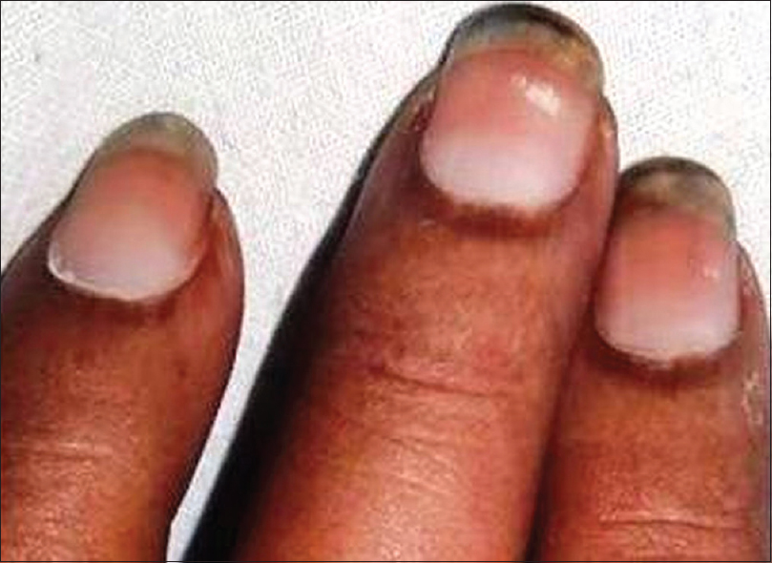
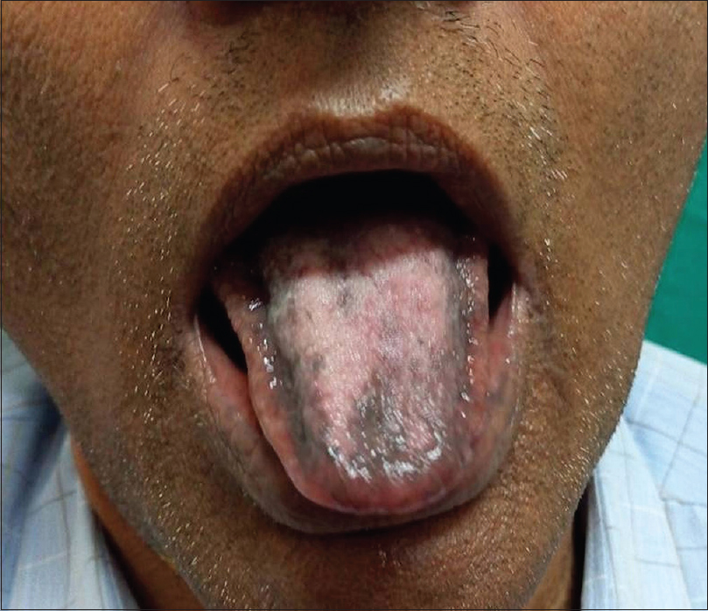
NAIL CHANGES
TONGUE CHANGES
Pallor
Absent Lunula
Half and half nail
TONGUE SIGN OF URAEMIA
White coated tongue
Macroglossia
Prominent teeth marking

Slide 78
DERMATOLOGICAL MANIFESTATION OF CARDIAC DISEASES

Slide 79
SKIN SIGNS OF CARDIAC DISEASE
CYANOSIS – Cyanotic heart disase
ERYTHEMA – Secondary polycythemia
FINGER CLUBBING – CCHD
QUINCKE SIGN – Visible Nail bed pulsation
Sign of Aortic Regurgitation due to wide pulse pressure

Slide 80
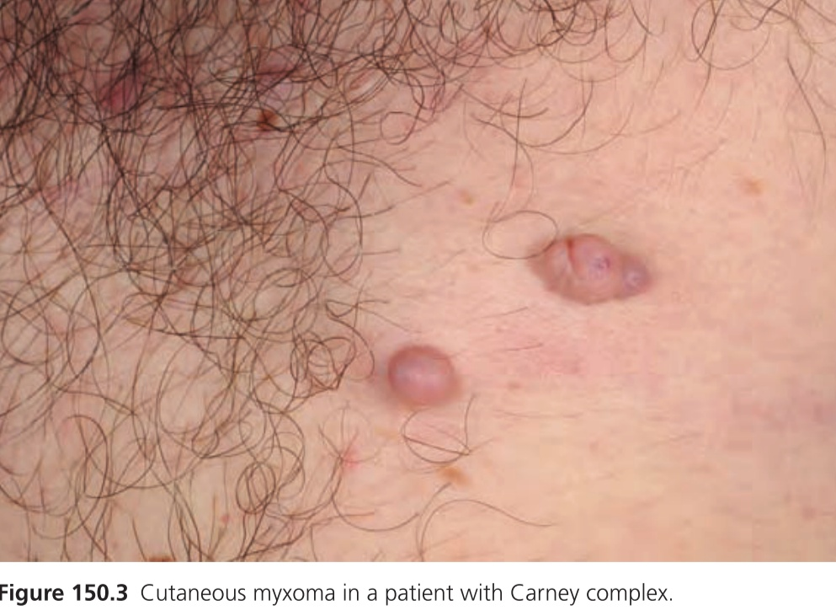
CARNEY COMPLEX
It is Autosomal Dominent disorder due to mutation in PRKAR1A gene
LAMB Syndrome
Lentigines
Atrial myxoma
Mucocutaneous myxoma
Blue naevi

Slide 81
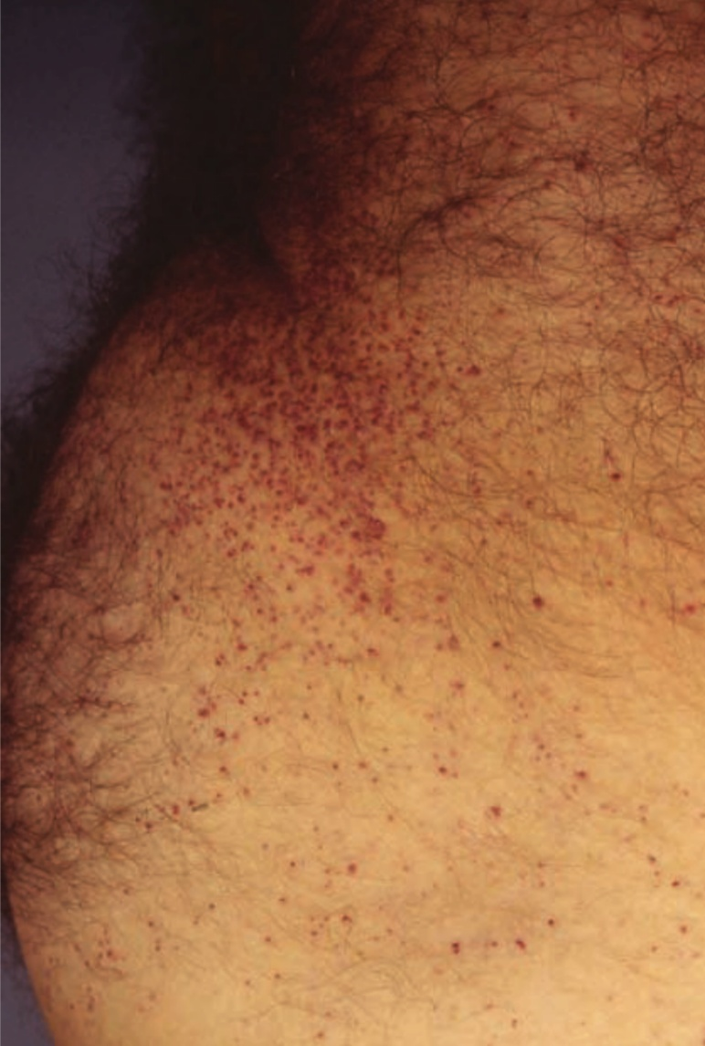
FABRY DISEASE
It is rare inherited Sphingolipidosis
Cutaneous Manifestation – Angiokeratoma corporis diffusum, anhidros
Cardiac Manifestations
arrhythmias
hypertrophic cardiomyopathy
valve abnormalities
coronary artery disease

Slide 82
KAWASAKI DISEASE
MUCOCUTANEOUS LYMPHNODE SYNDROME
It is an acute febrile disease of infant and children and is due to immune mediated medium vessel vasculitis that affect coronary arteries
It is charecterised by
Fever
Cutaneous and mucosal erythema with subsequent desquamation
Cervical Lymphadenitis
Bilateral bulbar non exudative conjunctivitis
Strawberry tongue

Slide 83
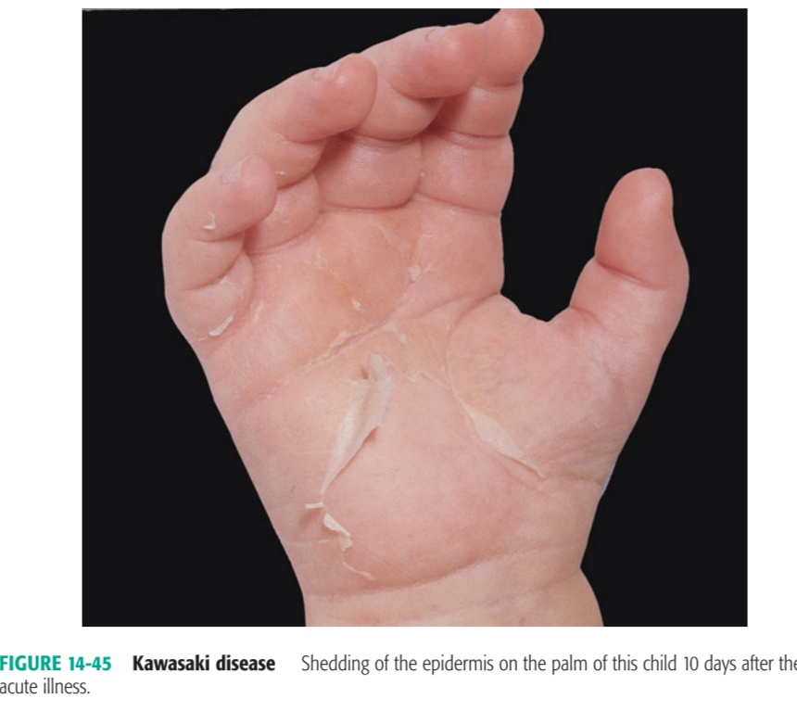
COMPLICATIONS
Coronary abnormalities – Aneurysm (30%), Myocarditis
Arthritis
Urethritis
Aseptic Meningitis

Slide 84
TREATMENT
Intravenous Immunoglobin 2g/kg – single infusion over 10hrs
+
Aspirin 100mg/kg/day till 14days
Aspirin 5 to 10mg/kg/day till ESR and Platelet count returns to normal
STEROIDS – Contraindicated because associated with increased incidence of coronary aneurysm

Slide 85
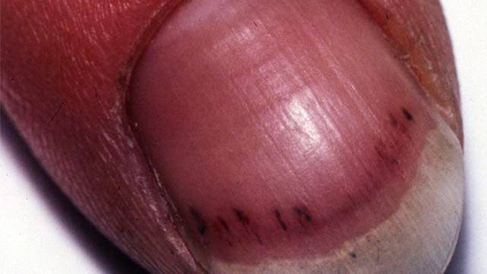
INFECTIVE ENDOCARDITIS
Cutaneous lesion may represent either septic emboli or immune complex disease due to circulating bacterial antigens
SPLINTER HAEMORRHAGE

Slide 86
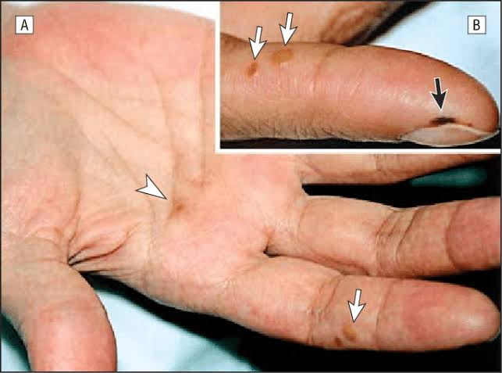
OSLER’S NODE
JANAWAY LESION

Slide 87
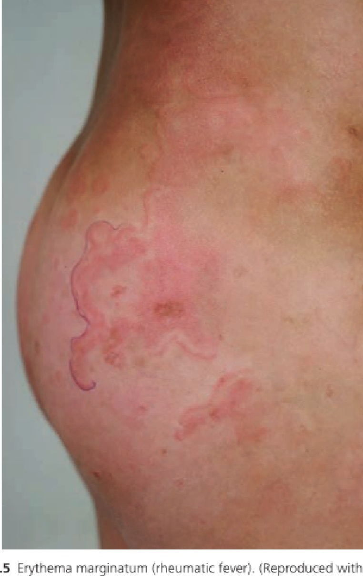
RHEUMATIC FEVER
SUBCUTANEOUS NODULES – Extensor surface of extremities
ERYTHEMA MARGINATUM – transitory gyrate erythema located mainly on trunk and proximal extremities

